Slide 1

The Role of the Junior Vice Commandant in the Marine Corps League
Presenter:
Dan Tolson
Jr. Vice Commandant
Department of Indiana
Marine Corps League
October 4, 2025

Slide 2
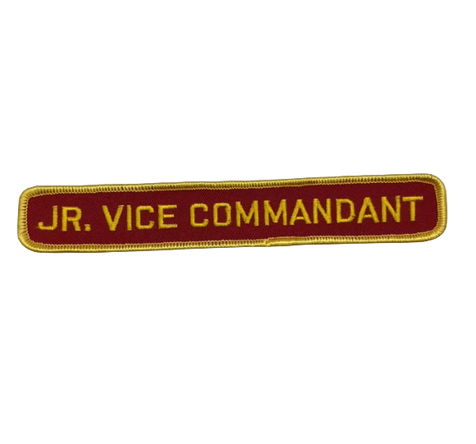
Leading the Way: Roles, Responsibilities, and Improvement Strategies for the Junior Vice Commandant

Slide 3
Overview of the Marine Corps League (MCL) Structure
National HQ
Department
Detachment
Division
Commandant
Sr. Vice Commandant
Jr. Vice Commandant

Slide 4
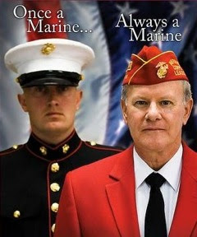
What’s My Role As Jr. Vice Commandant?
Primary Responsibility::
Recruiting and Retention of Members

Slide 5
Core Responsibilities of the Junior Vice Commandant – Membership Focus
Primary Duty (All Levels): Drive recruiting and retention to ensure continuous growth.
  Develop and lead membership incentives, programs, and campaigns (e.g., personal outreach, renewal reminders, welcome events).
  Chair the Membership Committee; maintain current rosters with contact info (quarterly updates with Adjutant).
  Identify prospective members (e.g., via Marine units, veteran groups, events like birthday balls) and promote the MCL's value.
At Detachment Level: Focus on local recruitment; host social events (picnics, celebrations) to build camaraderie.

Slide 6
Operational and Programmatic Responsibilities
Prepare and promote engaging programs/activities to boost participation.
  Arrange monthly meeting agendas with speakers (contact military/civilian bureaus for topics on Marine history, leadership, or community issues).
  Ensure new members are welcome: Introduce them, involve them in the meeting.
  Promote special events (e.g., Marine Corps Birthday, Toys for Tots drives) to attract and retain members.
Develop budgets, goals, and reports on membership status for Board of Trustees and general meetings.
Boring meetings kill attendance!

Slide 7
Leadership and Succession Responsibilities
Assume duties of Senior Vice Commandant (SVC) in their absence; step up to Commandant if both are unavailable.
  Stay familiar with SVC-led projects (e.g., internal operations, youth programs).
Serve on committees as assigned (e.g., events, awards, budget).

Slide 8
Key Traits and Challenges for Success
Essential Traits:
  Enthusiasm and salesmanship for "selling" the MCL.
  Innovation in marketing (e.g., brochures, social media).
  Strong communication (verbal/written); problem-solving skills.
  Commitment to member needs; ability to evaluate feedback.
Common Challenges:
  Low turnout, retention drops, resource limits.
Overcoming Them:
  Form sub-committees for shared workload; collaborate with other veteran orgs; track metrics quarterly.

Slide 9
Differences Between Department and
Detachment JVC Roles
Aspect | Detachment JVC | Department JVC
Scope | Local unit (e.g., one city/county) | State/regional oversight of multiple Detachments
Membership Focus | Hands-on recruiting; local events | Strategic programs; fund-raising coordination
Budget/Finance | Assist with local dues/events | Chair Budget Committee; supervise state-wide raises
Succession | Fill local leadership gaps | Advise/support Detachments; report to National
Reporting | To Detachment Board | To Department Commandant and National BOT

Slide 10
Ways a Detachment JVC Can Improve Their Detachment – Strategy 1: Boost Engagement
Enhance Community Involvement:
Partner with local charities (e.g., Toys for Tots, scholarships for high schoolers); host joint events with other veteran groups to increase visibility and attract members.
Leverage Social Media:
Create a vibrant Facebook page for events, stories, and recruitment—post regularly to engage younger Marines and families.
Personal Touch:
Assign sponsors to new members; conduct quarterly check-ins to address needs and foster bonds.

Slide 11
Ways a Detachment JVC Can Improve Their Detachment – Strategy 2: Training and Operations
Provide Training/Education:
Offer workshops on MCL bylaws, leadership, and VA benefits; invite National/Department speakers for skill-building sessions.
Strengthen Communication:
Hold regular Board meetings; use tools like email lists or apps for updates; encourage feedback surveys post-events.
Promote New Initiatives:
Start mentorship programs for transitioning Marines; develop marketing materials (flyers, videos) for local fairs/malls.

Slide 12
Ways a Detachment JVC Can Improve Their Detachment – Strategy 3: Sustainability and Growth
Track and Report Metrics:
Monitor membership trends; set goals (e.g., 10% growth quarterly) and report to leadership for support.
Collaborate Upward:
Work with Department JVC for resources/funding; form alliances with nearby Detachments for joint events.
Innovate for Retention:
Host family-inclusive activities; recognize member milestones (e.g., awards ceremonies) to build loyalty.
Measure Success:
Aim for higher attendance, positive feedback, and stable finances—celebrate wins to motivate.

Slide 13
Conclusion and Call to Action
Key Takeaway:
The JVC role is pivotal for growth, leadership, and fellowship—embrace it with Marine tenacity.
Next Steps:
Review your Detachment's bylaws; form a Membership Committee today; contact your Department JVC for guidance.
Contact:
DLTOLSON@GMAIL.COM – (219)916-3550
Semper Fi—Let's Build Stronger Detachments!

Slide 14
QUESTIONS?

