Slide 1

Recruiting Challenges and Mitigation Strategies
Presenter:
Dan Tolson
Jr. Vice Commandant
Department of Indiana
Marine Corps League
March 14, 2026

Slide 2
Key Recruiting Challenges
What are your recruiting challenges?
Why do you think that is?

Slide 3
Key Recruiting Challenges Identified in News and Publications
Veteran service organizations, including Marine Corps League detachments, face declining membership due to an aging member base and deaths outpacing new recruitment.
News reporting shows younger and post‑9/11 veterans often perceive traditional veteran's organizations as outdated or primarily social clubs, reducing interest in joining.

Slide 4

Publications highlight that many younger veterans balance careers, families, and education, leaving limited time for regular meetings and volunteer commitments.
Research notes a general lack of awareness among eligible Marines about the Marine Corps League’s mission, benefits, and eligibility requirements.

Slide 5
Studies on VSOs identify a shrinking overall veteran population as a structural challenge affecting all legacy organizations.
Media coverage indicates negative stereotypes—such as ‘drinking halls or nostalgia‑focused environments—discourage modern veterans from participation.

Slide 6
Academic research shows that organizations slow to modernize communication and programming struggle to remain relevant to newer generations of veterans.

Slide 7
Ways Junior Vice Commandants Can Combat These Challenges
How would you combat these challenges?

Slide 8
Ways Junior Vice Commandants Can Combat These Challenges
Emphasize the Marine Corps League’s mission‑driven service (honor guards, Toys for Tots, community support) rather than social aspects when recruiting.
Promote flexible participation by highlighting that members can engage at different levels without attending every meeting.

Slide 9
Ways Junior Vice Commandants Can Combat These Challenges
Modernize outreach using social media, detachment websites, and digital communication to reach post‑9/11 Marines.
Conduct personal, Marine‑to‑Marine outreach, which research and local reporting show remains the most effective recruiting method.

Slide 10
Ways Junior Vice Commandants Can Combat These Challenges
Offer hands‑on, short‑duration service projects that appeal to younger veterans seeking purpose without long‑term commitments.
Improve new‑member onboarding with mentorship and early involvement to reduce first‑year attrition.

Slide 11
Ways Junior Vice Commandants Can Combat These Challenges
Publicly communicate tangible benefits of membership, including camaraderie, continued service, leadership opportunities, and support to Marines and families.
Refresh meeting formats and programs to ensure meetings are engaging, relevant, and respectful of members’ time.

Slide 12
Ways Junior Vice Commandants Can Combat These Challenges
Partner with other veteran and community organizations to increase visibility and credibility among potential members.

Slide 13
Lastly
Use technology
  AI (ChatGPT, Google Gemini, Grok AI)
  Social Media (Facebook, Instagram, TikTok)
  Apps & Websites (Canva, Adobe, Base 44)
Be active in what you do
Ensure you have the right person for the role (not just a body)
Seek help from others, reach out to other detachments / Jr. Vices

Slide 14
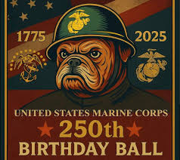
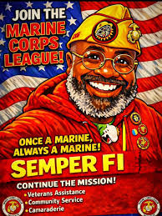
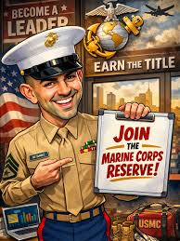

Slide 15
QUESTIONS?

