Slide 1
Unlocking AI: How Online AI Programs Actually Work
Your guide to using artificial intelligence smartly and safely.
Presented by Dan Tolson

Slide 2
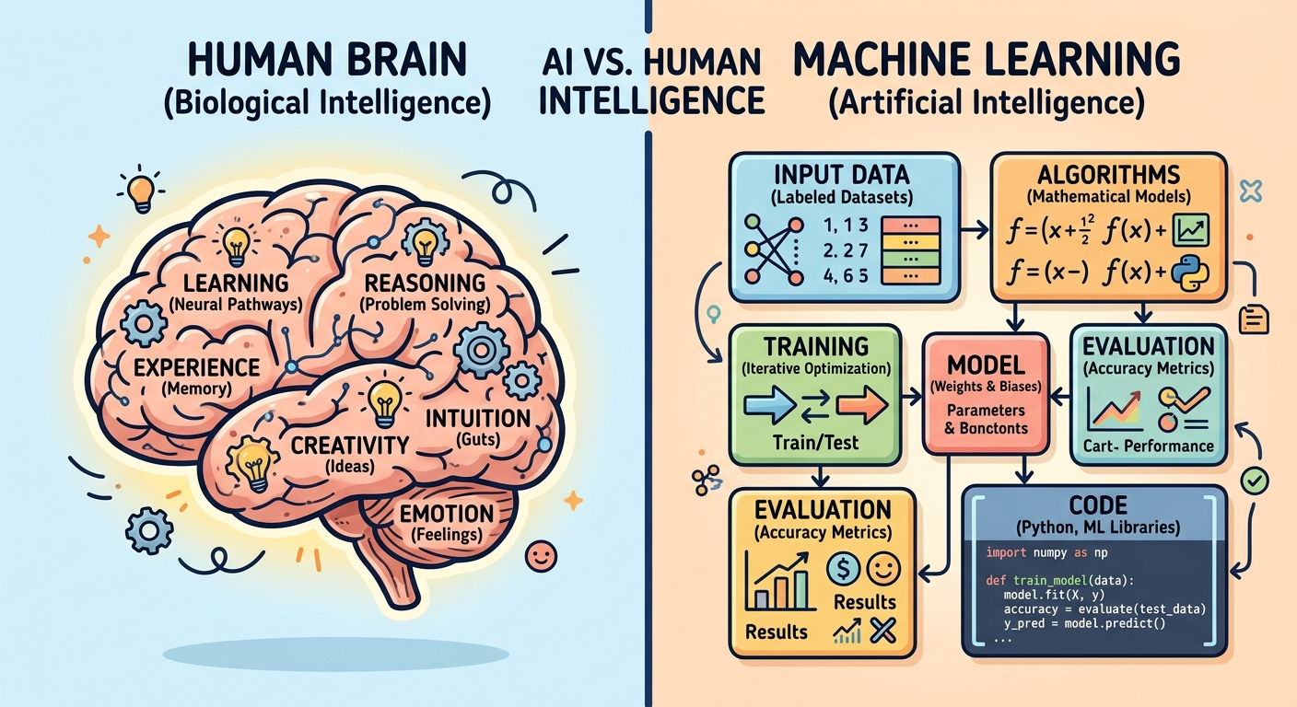
What is AI?
The Simple Idea: Artificial Intelligence (AI) isn't a human brain—it's super-advanced software that learns patterns from massive amounts of data.
How it thinks: Instead of "thinking" like you do, AI uses statistics to guess the most likely answer, image, or next word.
Real-world examples: Spotify recommendations, TikTok algorithms, and autocorrect are all everyday forms of AI you already use.

Slide 3
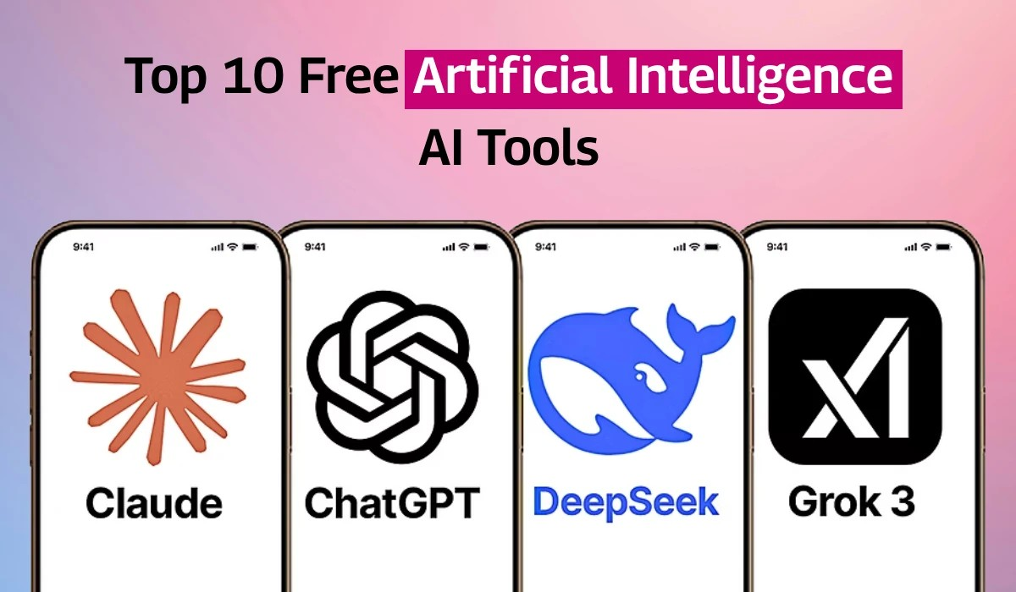
ChatGPT
Perplexity
Claude
Gemini
Grok
Jasper
Midjourney
Synthesia
Fathom
Notion AI

Slide 4
Types of AI Programs You Can Use Online – Cont.
Large Language Models (LLMs):
AI that processes text. (Examples: ChatGPT, Claude, Gemini). Good for summarizing, writing code, or brainstorming.
AI that turns text prompts into visual art.(Examples: Midjourney, DALL-E, Stable Diffusion).
Image Generators:
Audio & Video Generators:
Tools that synthesize voices, compose music, or create digital avatars. (Examples: Suno, ElevenLabs).
AI built into search engines, photo editors, and grammar checkers.
Specialized Tools:

Slide 5
Types of AI Programs You Can Use Online – Cont.
Narrow AI (ANI)
Generative AI
Specialized in a single specific task.
Creates novel text, code, audio, and images.
Examples: Spam filters, facial recognition
Examples: ChatGPT, Midjourney, Gemini

Slide 6
Mastering Prompts: The PTFC Framework
Person/Role:
P-
Tell the AI who it should act like
"Act as a high school biology teacher..."

Slide 7
Mastering Prompts: The PTFC Framework – Cont.
T-
Task:
Clearly state what you need
"...explain photosynthesis..."

Slide 8
Mastering Prompts: The PTFC Framework – Cont.
F-
Format:
Specify how you want the output
"...in a bulleted list with simple analogies..."

Slide 9
Mastering Prompts: The PTFC Framework – Cont.
C-
Context:
Give essential background info
"...for a 9th-grade student studying for a quiz tomorrow."

Slide 10
Mastering Prompts: The PTFC Framework – Cont.
"Act as a high school biology teacher. Explain photosynthesis in a bulleted list with simple analogies for a 9th-grade student studying for a quiz tomorrow."

Slide 11
Mastering Prompts: The PTFC Framework – Cont.
Pretend you are a Unit Commander with the Young Marines. You have a recruit graduation and promotion ceremony where you have to give 2 short speeches. Research the Young Marines Program. Write a 250-word speech that details the importance of the graduating recruit training in the Young Marines Program. Also write a 250-word speech about being promoted in the Young Marines Program. Include how their accomplishments in the program will benefit their lives.

Slide 12
Mastering Prompts: The PTFC Framework – Cont.
Pretend you are an expert speechwriter. Research the Young Marines program. Write a graduation speech that highlights the impact of the Young Marine program on the youth today. Emphasize how the Young Marines core values and the Marine Corps core values help the youth in life and in society. Use my personal experience as a Marine Corps veteran, graduating high school in 1989, joining the Marine Corps, and standing on the yellow footprints on October 5, 1989. Joining the 2nd Tank Battalion, 2nd Marine Division, and deployed to Desert Storm in January 1991. Incorporate the experiences of every Marine who wears the Eagle, Globe, and Anchor.

Slide 13
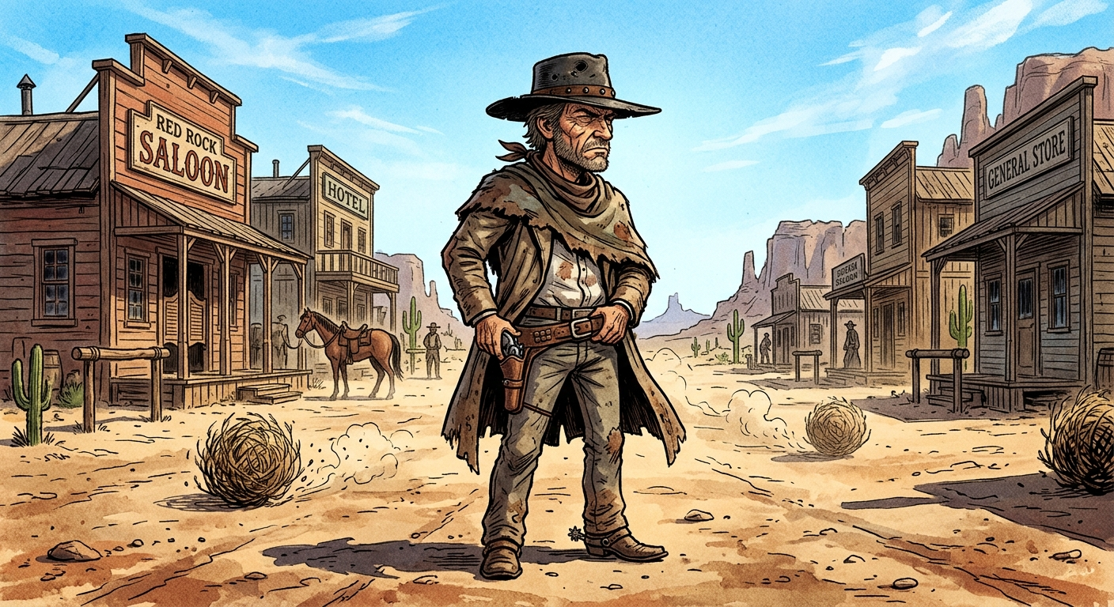

Text-to-image Test
Make an original cartoon: a squinting, weathered gunslinger in a wide-brimmed hat, standing in a dusty desert town at high noon with tumbleweeds rolling by, in a classic spaghetti-western mood.
Gemini
Grok AI

Slide 14
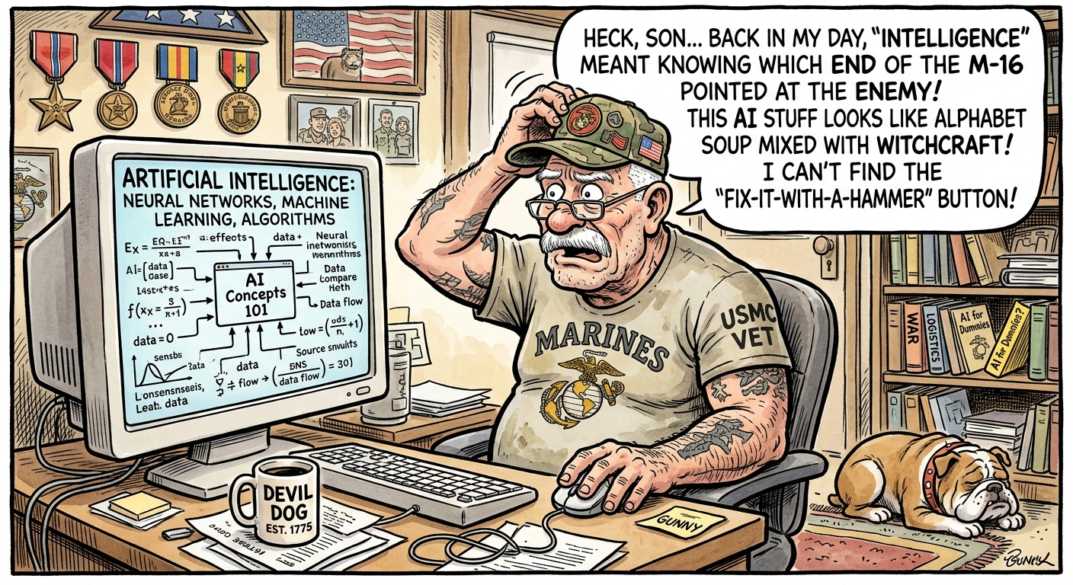
Text-to-image Test
Pretend you are a cartoonist. You have an old Marine Corps veteran trying to understand Artificial Intelligence. Create a funny, self-deprecating 1-panel comic about the old Marine Corps veteran struggling to understand Artificial Intelligence.
Gemini

Slide 15
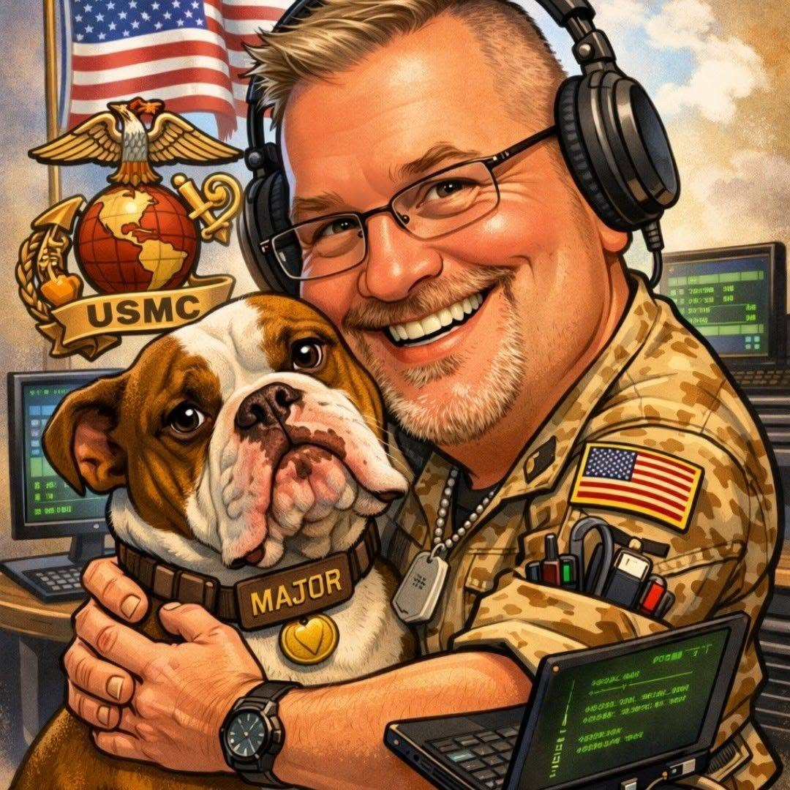
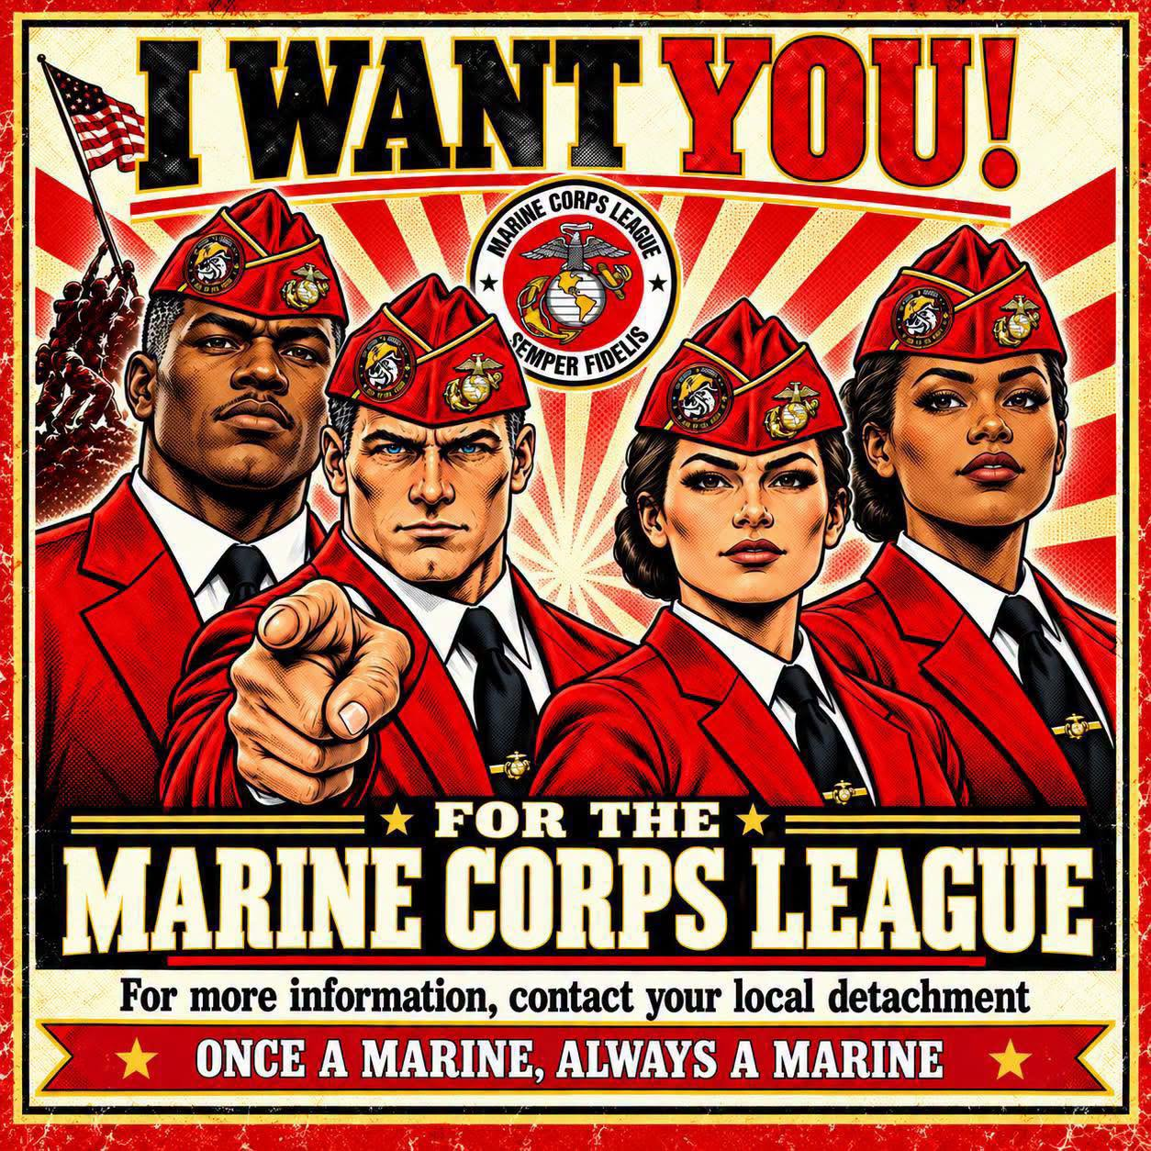

MCL Examples

Slide 16
How to Get Better Results from AI
Iterate Continuously:
Treat the first answer as a draft. Ask follow-up questions to refine.
Provide Good Examples:
Feed sample text or templates to guide tone and structure.
Set Negative Constraints:
Explicitly state what to avoid (e.g., "No buzzwords, keep under 200 words").

Slide 17
Truths and Fallacies of AI
Fallacy (Common Myths)
Truth (Technical Fact)
AI is a pattern-matching machine; it has no consciousness, feelings, or true understanding.
AI is conscious and actually knows what it is talking about.
Always double-check facts. AI outputs should be treated as a rough draft, not absolute truth.
Everything AI tells you is factually accurate.
AI is a tool. It relies on human direction, curation, and original ideas to produce anything meaningful.
AI will replace human creativity completely.

Slide 18

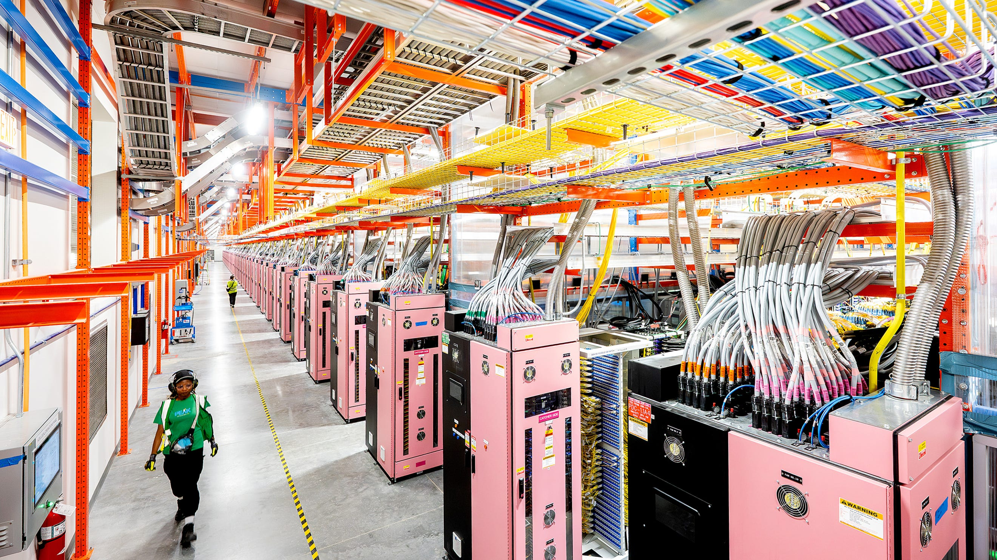
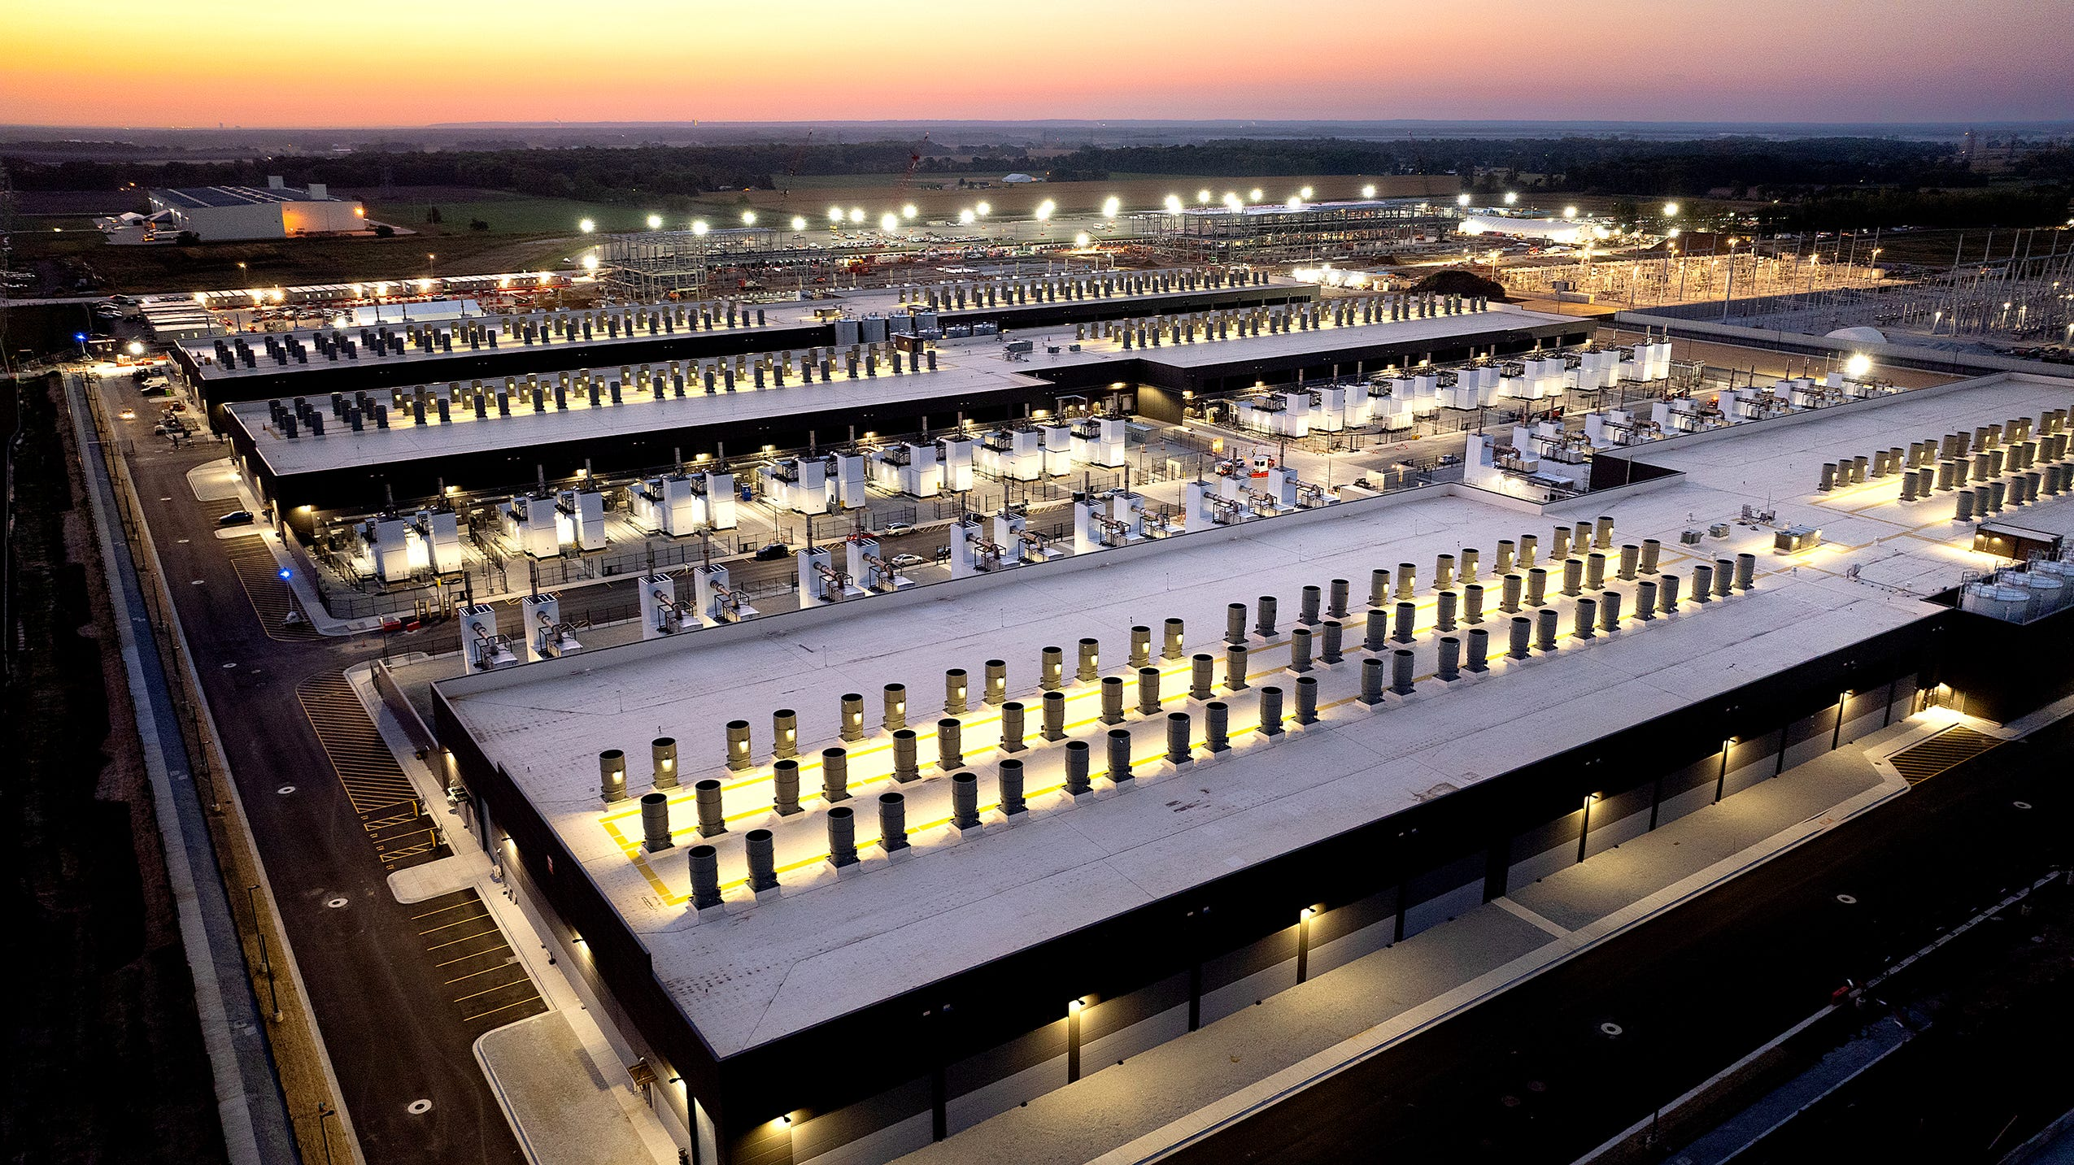
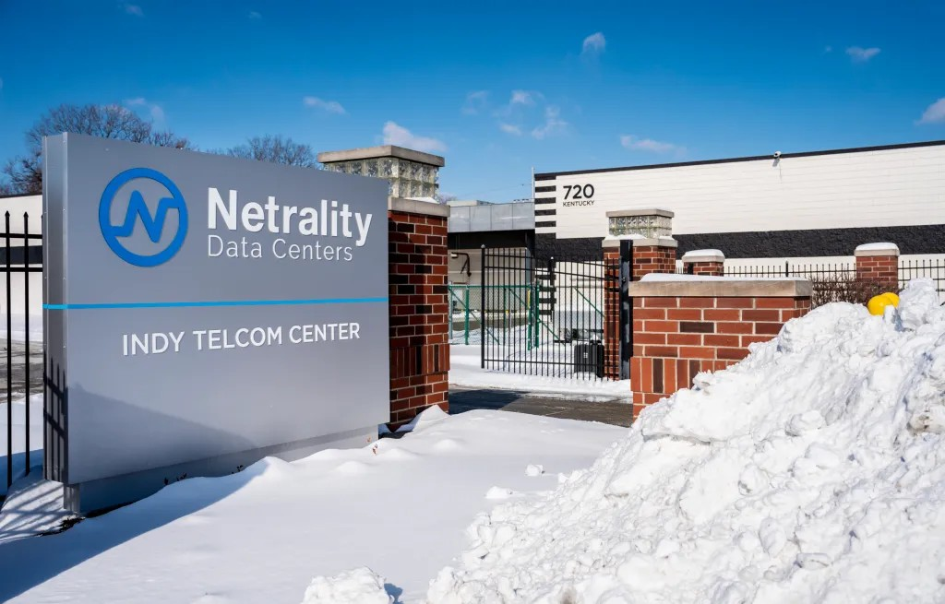
Data Centers

Slide 19
What are Data Centers?
Supercomputer Warehouses
Houses thousands of specialized AI processing chips (GPUs) networked together.
Cloud Compute Engine
Processes user prompts remotely and streams generated responses in real time.
24/7 Global Connectivity
Maintains reliable uptime, backup power, and ultra-fast fiber optic routing.

Slide 20
What are Data Centers? – Cont.
It doesn't live in "the cloud"—it lives in massive physical buildings called Data Centers.
Where does AI live?
Thousands of high-performance computer servers (GPUs and CPUs) wired together to process information at incredible speeds.
What's inside?
Whenever you send a prompt to an AI online, your request travels through undersea cables to a data center, processes the math, and sends the answer back to your phone in seconds.
Why they matter:

Slide 21
Data Centers: Myths vs. Facts
Myth
Fact
"Data centers operate without any physical resource needs.”
Running millions of servers generates extreme heat. Data centers require significant electricity to power the processors and water or advanced cooling systems to keep them from overheating.

Slide 22
Data Centers: Myths vs. Facts
Myth
Fact
"AI processing happens instantaneously without infrastructure limits."
Server capacity is finite. That is why online AI tools sometimes slowdown or crash during high-traffic hours.

Slide 23
Data Centers: Myths vs. Facts
Myth
Fact
"All Data Centers Are Massive Environmental Disasters for Water"
Water impact varies wildly depending on cooling architecture and geography. Modern facilities increasingly use closed-loop liquid cooling, dry-chillers, or direct-to-chip air cooling systems that consume minimal or zero water on-site. While older or budget evaporative cooling systems consume significant water locally, many new designs rely strictly on-air heat exchangers or recycled non-potable water systems to avoid drawing from local drinking supplies.

Slide 24
The Golden Rule of Prompting
80/20
AI generates 80% of the initial draft in seconds. Human oversight provides the vital final 20% polish and truth.

Slide 25
Summary & Best Practices
AI is a Tool, Not a Replacement: Use it to enhance your productivity and creativity, not to skip learning.
Verify Everything: After copy-paste AI responses check for accuracy and make adjustments.
Master the Prompt: Use the PTFC method to get precise, high-quality results.
Stay Curious: The tech changes fast—experimenting with new tools is the best way to learn!

Slide 26
Questions?

