Slide 1


Start Strong
INDIANA DEPARTMENT OF REVENUE
Indiana Business Taxes for New and Small Business
Nancy Tyree, Agency Initiatives Manager

Slide 2
Disclaimer: Every attempt is made by DOR to provide information that is consistent, with the appropriate statutes, rules and court decisions at the time of presentation. Any information provided by DOR in this presentation that is not consistent with the law, regulations or court decisions is not binding on either the taxpayer or DOR. Therefore, the information provided herein should serve only as a foundation for further investigation and study of the current law and procedures related to the subject matter covered herein.

Slide 3
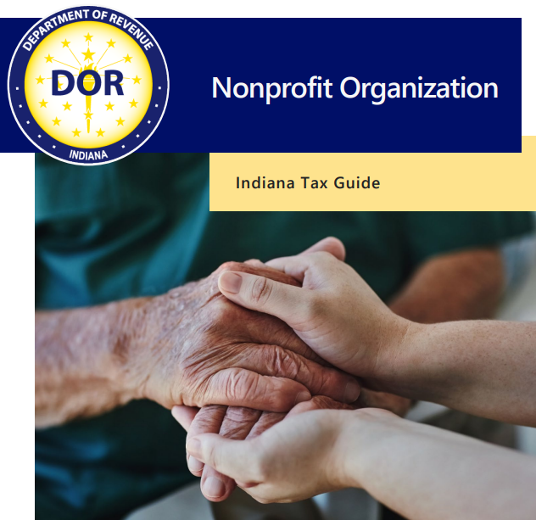
Overview
Filing Requirements
Tax Exempt Status
Exempt Purchases
Exempt Sales
Other Tax Concerns
Using INTIME
Business Resources
in.gov/dor/files/nonprofit-tax-guide.pdf

Slide 4
Filing Requirements

Slide 5
Form-20A
Nonprofits typically must register with the IRS and Indiana Secretary of State before registering with DOR.
Form NP-20A, Nonprofit Application for Sales Tax Exemption must then be completed.
After DOR accepts this application, a nonprofit can obtain exemption certificates from DOR.

Slide 6
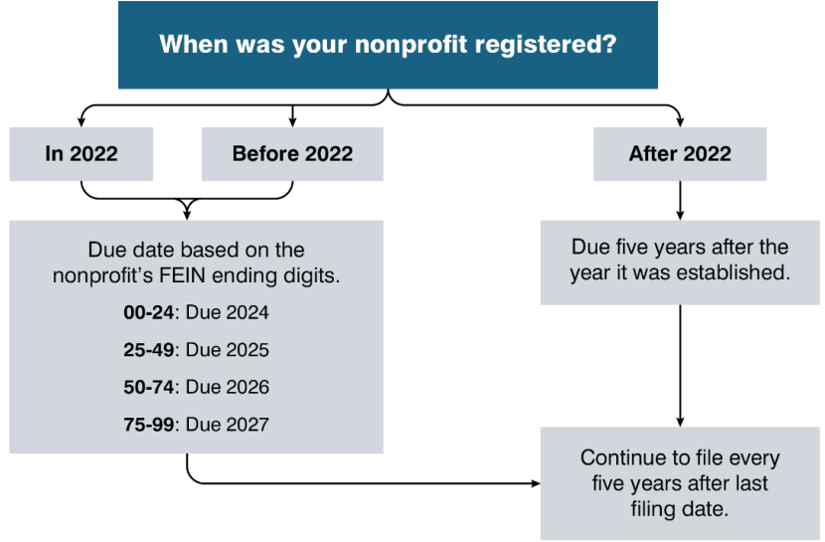
Form NP-20R
Form NP-20R, Indiana’s Nonprofit Organization's Report, must be filed every 5 years.
Due date based on when nonprofit was created OR FEIN.

Slide 7
Other Filing Requirements
Form IT-20NP, Unrelated Business Income Tax Return must be filed annually if a nonprofit earns income from activities not directly related to its mission.
Form IT-6, Indiana Corporation Estimated Quarterly Income Tax Return, is also required for some nonprofits with consisted taxable, unrelated business income.

Slide 8
Tax Exempt Status

Slide 9
Social Organizations
If more than 50% of a nonprofit’s expenditure is related to social activities, it will not be exempt from Indiana sales tax on purchases or sales.
Common social activity expenditures include:
  food and beverage services
  golf courses or swimming pools
  dances, parties, and other similar social activities

Slide 10
Exempt Purchases

Slide 11
Purchases for Nonprofits’ Exempt Purpose
Qualified nonprofits may be exempt from sales tax when purchasing tangible property IF they use these purchases for the nonprofit’s exempt purpose.
Purchases made by nonprofits and used for other purposes are subject to sales tax, including:
  Purchases for the private benefit of nonprofit members
  Meals and lodgings

Slide 12
Exemption Certificates
Form NP-1, Nonprofit Sales Tax Exemption Certificate required for tax-exempt purchases.
Nonprofits must request an NP-1 for each individual vendor they make tax-exempt purchases from.
  Can use for individual purchases or blanket exemptions
  Can bulk upload multiple NP-1 requests on INTIME
  NP-1 expires after five years

Slide 13
Exempt Sales

Slide 14
Exempt Sales
Sales are exempt if intended primarily to further the organization’s purpose and not used to carry out a private or proprietary business.
If sales reach $100,000 or more in the current or previous calendar year, you must collect sales tax.
  Exempt sales as listed above still count towards threshold.
  Stop if collecting less than $100,000 for two consecutive years.
  Threshold not applicable to social organizations.

Slide 15
Collecting and Remitting Sales Tax
If collecting sales tax, you must register for a Registered Retail Merchant Certificate (RRMC).
  Register on INBiz at inbiz.in.gov.
  One-time $25 application fee.
  Automatically renewed every two years if in good standing.
Must file sales tax returns on INTIME each period, even if no you did not collect any during that period.

Slide 16
Other Tax Concerns

Slide 17
Sales Tax and Food Items
All previous nonprofit sale exemption rules apply.
Taxable Food Items: sold by a restaurant (prepared food), candy, soft drinks, & dietary supplements.
Exempt Food Items: “Grocery” food sold unheated by weight or volume as single items, not including utensils.
For more information visit in.gov/dor/files/sib29.pdf.

Slide 18
Food and Beverage Tax (FAB)
All previous nonprofit sale exemption rules apply.
FAB is specific to certain counties and municipalities. Taxable transactions include:
  Food sold and served by catering
  Food sold at deli counter that is cooked on premises
  Food sold and seller provides eating utensils
See in.gov/dor/files/dor-fab-business-guide.pdf.

Slide 19
Using INTIME

Slide 20
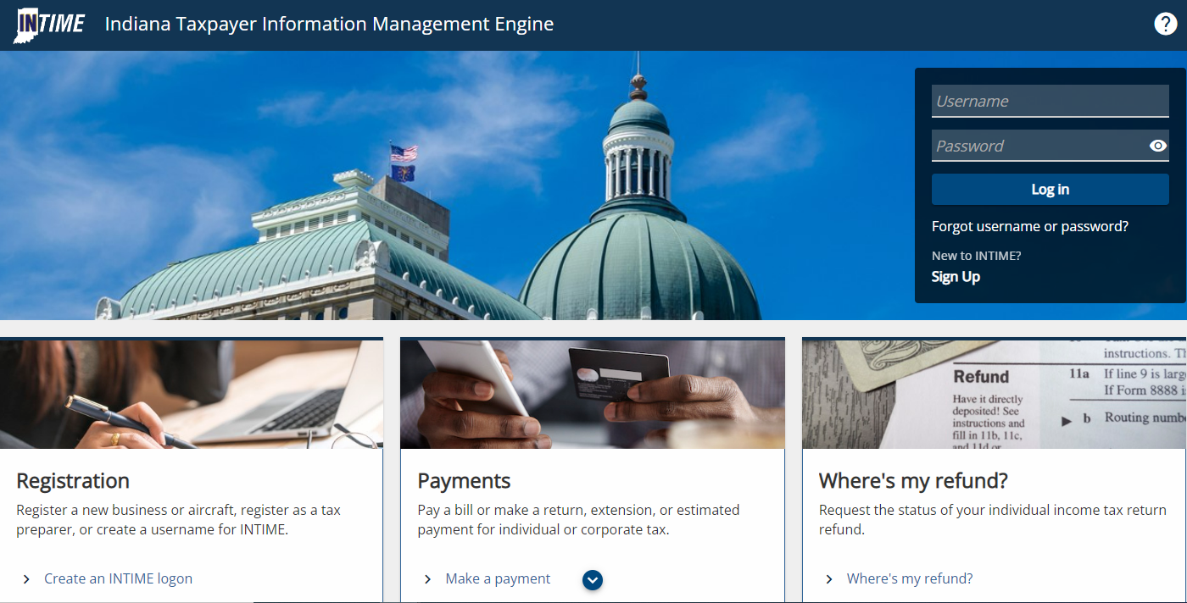
INTIME
Guide: in.gov/dor/files/intime-business-guide.pdf

Slide 21
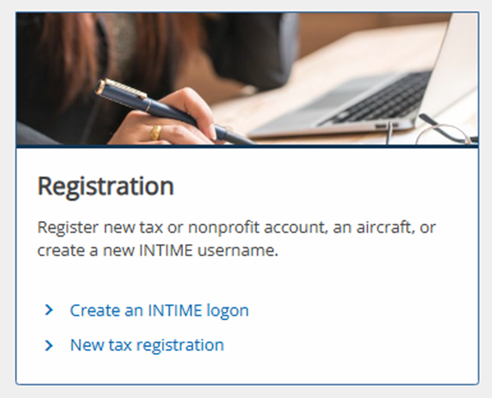
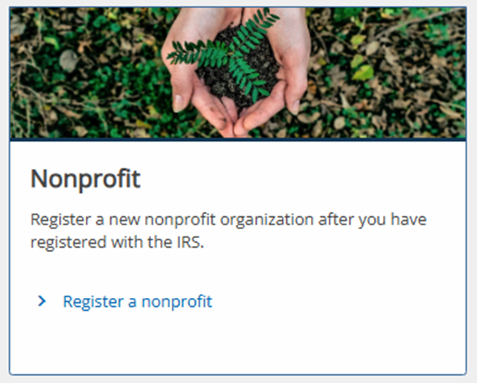
Getting Started with INTIME
Will be asked to provide:
  Nonprofit FEIN
  Date of incorporation
  Legal name & address
  Mailing address
  Filing information
  Organization type
  Federal determination letter

Slide 22
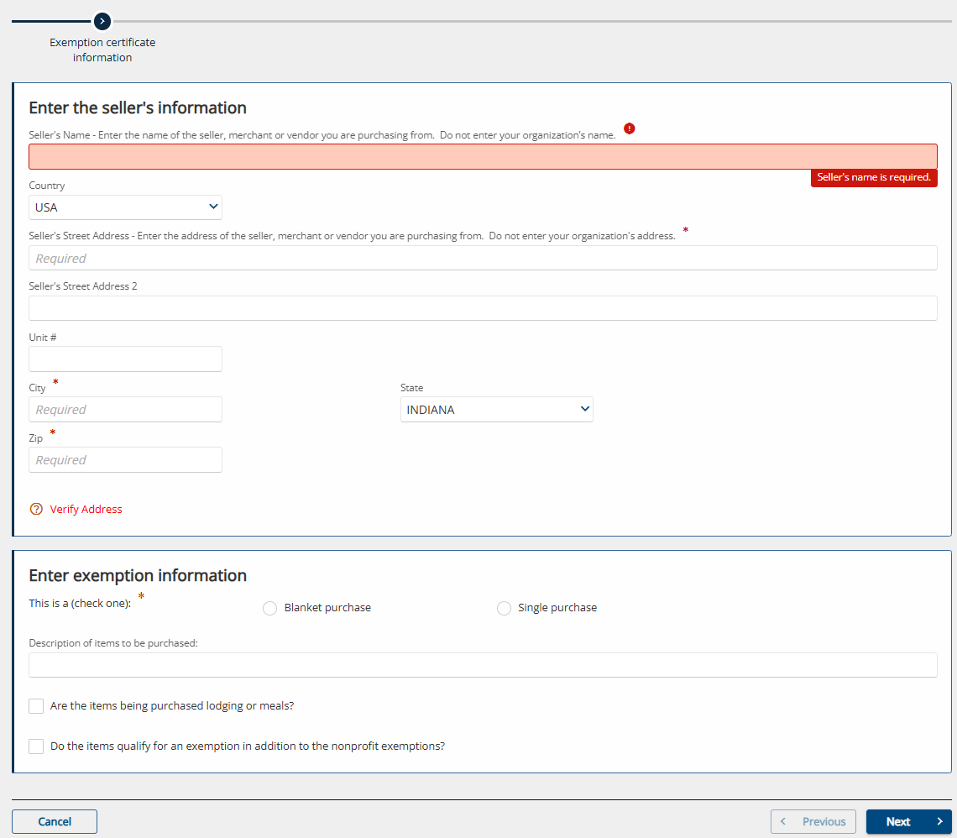
Requesting NP-1
You can request:
  Single NP-1, available immediately.
  Multiple NP-1s, available in 1-2 business days.
  View certificates under “All Actions” and “View Letters.”
You cannot request a blank certificate.

Slide 23
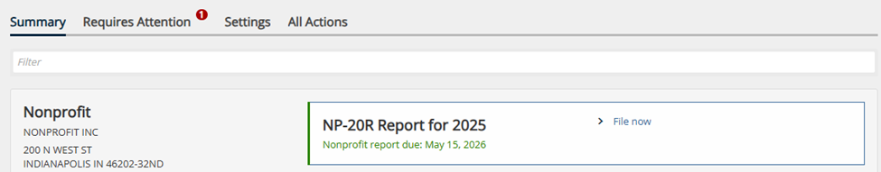
Using INTIME – Filing NP-20R
Once logged in, the summary tab will alert you when your NP-20R is due.
Select “File now,” then enter the information requested and attach federal returns, if applicable.

Slide 24
Business Resources

Slide 25
DOR Resources
Nonprofit Information in.gov/dor/tax-forms/nonprofit.
Tax Library in.gov/dor/resources/tax-library.
  Sales Tax Bulletin #10 – application of sales tax to nonprofits
  Income Tax Bulletin #17 – taxation and filing requirements for nonprofits
Nonprofit Organization Indiana Tax Guide in.gov/dor/files/nonprofit-tax-guide.pdf.

Slide 26

DOR Updates and Information
Subscribe to our Tax Bulletin monthly newsletter and email updates.
Sign up for emails at in.gov/dor/about/contact-us by clicking this box on the page.

Slide 27
Contact Us
Call our nonprofit customer service support team at 317-232-3424.
Securely message us on INTIME at intime.dor.in.gov.
In-Person: in.gov/dor/about/contact-us/appointments.

Slide 28
Thank You

