Slide 1

2025 NATIONAL ADMINISTRATIVE PROCEDURES ENCLOSURE(3)
UNIFORM CODE MARINE CORPS LEAGUE
Class Instructed by
National Uniform Committee Member
Matt Careins
Marine Corps League
Department of Indiana
2026 Summer Convention

Slide 2
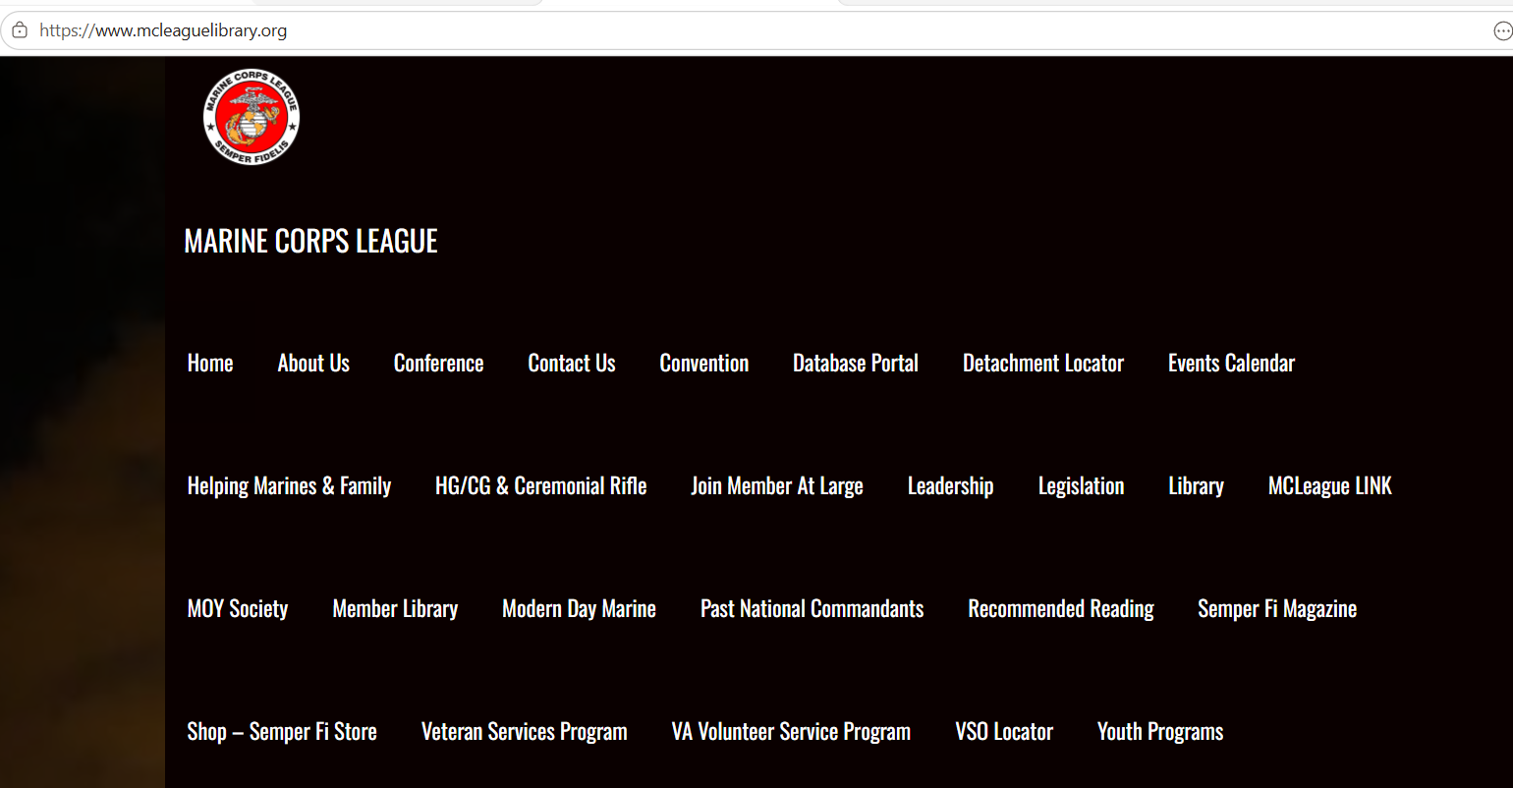
Where can we find Enclosure 3 of the National Administrative Procedures?
mcleaguelibrary.org

Slide 3
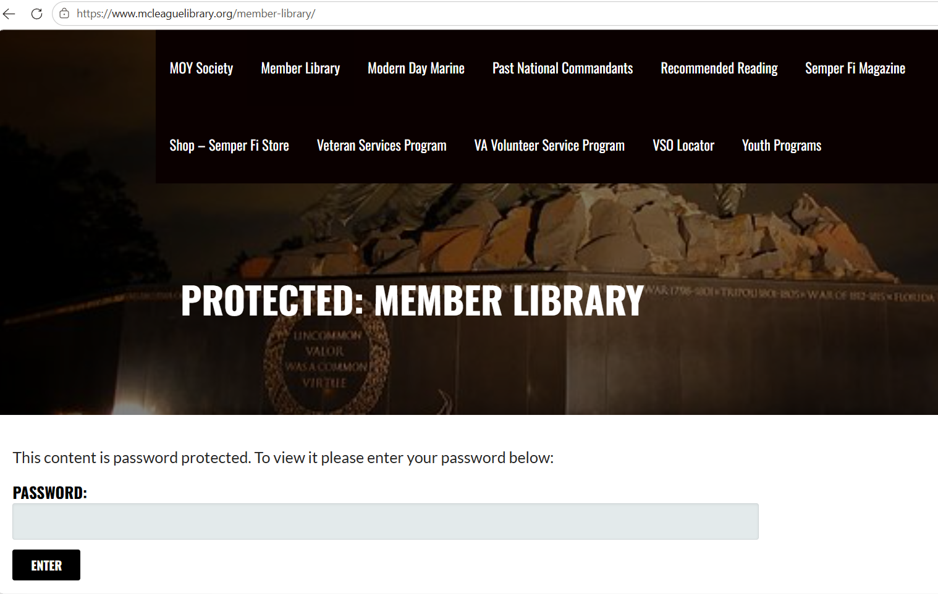

Slide 4
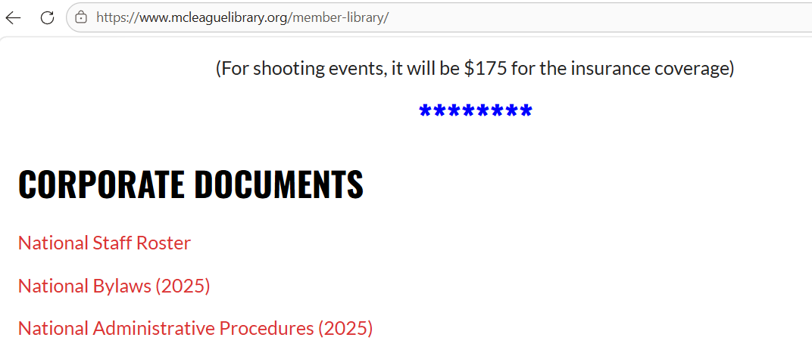
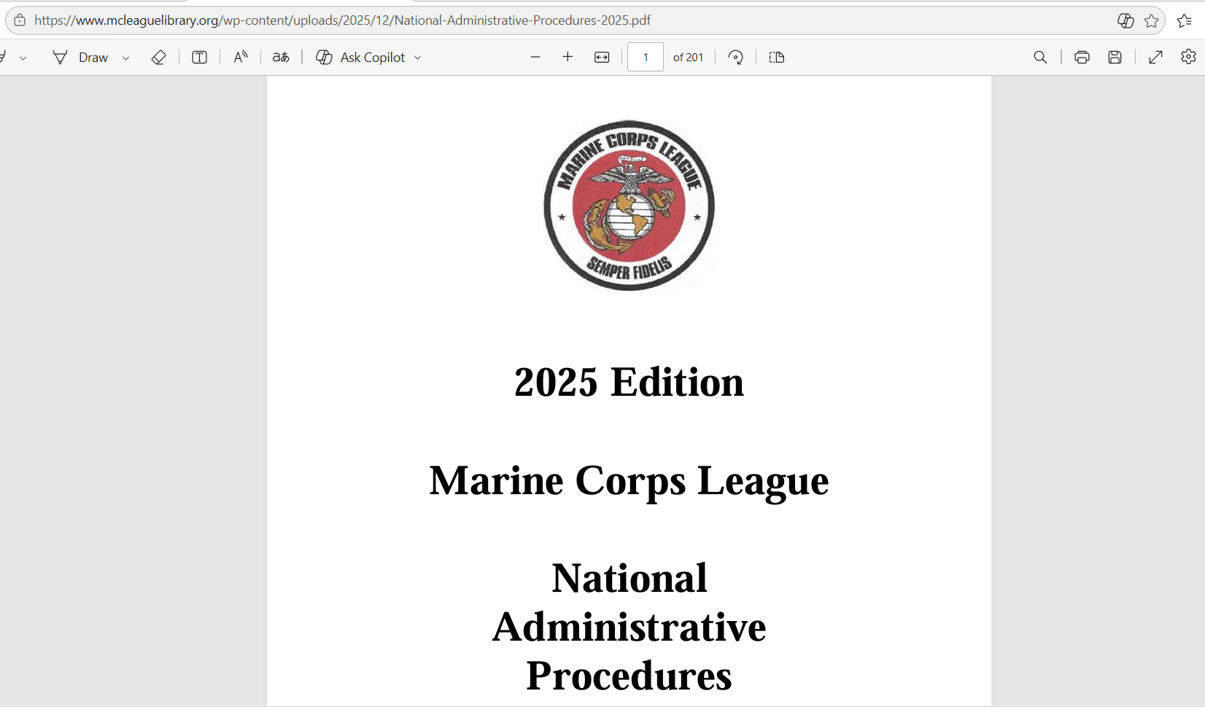

Slide 5
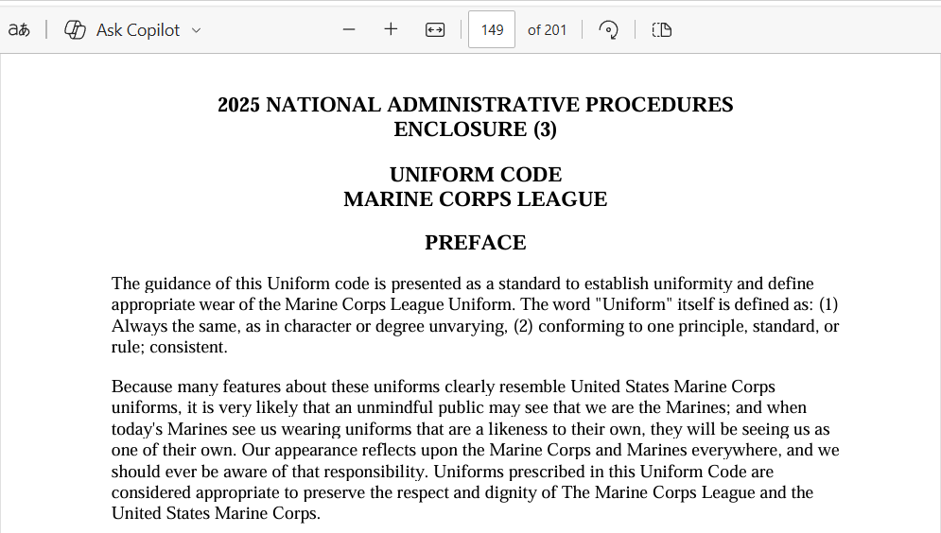

Slide 6
No member of the Marine Corps League is ever made to wear any uniform.
(cover is required for National meetings!)
If you show up without the recommended uniform to a meeting, you will not be kicked out!
If you CHOOSE to wear a Marine Corps League uniform, it is required to be worn correctly and in accordance with Enclosure 3.
Certain details require a Marine Corps League uniform to be worn when performing them. Those requirements may be different than Enclosure 3.
  Honor Guards
  Color Guards
Red polo shirts, t-shirts, ball caps, US MARINES silk jacket, and any other “USMC” or “MCL” apparel are not MCL uniforms.
The guidance in Enclosure 3 is not optional, and it is expected of all members to familiarize themselves with the requirements of each uniform prior to wearing them.
If there are ever any questions about uniforms, reach out to any member of the National Uniform Committee for clarification.

Slide 7
VI. SPECIAL UNIFORM AUTHORIZATION
The standard MCL cover is the minimum uniform item worn by members to be considered “IN UNIFORM”.
Members who are participating in memorial services and who are in MCL uniform may (given authority) wear “WHITE GLOVES”.
ONLY those uniforms that are outlined under “UNIFORM – MALE” “UNIFORM – FEMALE”; and “ASSOCIATE MEMBERS UNIFORM” are approved uniforms of the MCL.
NO variation(s) of the prescribed uniforms are authorized.
In case of inclement weather (rain, snow, sleet, or cold) the local Detachment or Department Commandant may authorize appropriate outer wear to be worn over the Marine Corps League uniform (ALL UNIFORMS AND CLOTHING "MUST" BE THE SAME).
Proposed changes to the uniform code must be submitted through the Bylaws and Administrative Procedures amendment process.

Slide 8
Section V. Marine Corps League Cover
a. The basic uniform of the MCL is the unique cover that identifies the members of the MCL. Because all other parts of the uniform that are designated in this enclosure are optional, the cover remains as the only consistent identifier for MCL members, which is why the cover is worn indoors at appropriate MCL functions. When MCL members are wearing the appropriate cover, as listed below, they are considered in uniform.
NO OTHER TYPE OF COVER MAY BE WORN AT A MARINE CORPS LEAGUE FUNCTION OR MEETING.
b. All members of the Marine Corps League are authorized to wear the RED COVER.
Members elected or appointed at the department level are authorized to wear the RED COVER with a GOLD CROWN.
Members elected to a national office or appointed to a national staff/committee are authorized to wear GOLD COVERS.
The Chief Devil Dog will wear a BLACK COVER.
The National Commandant will wear a WHITE COVER.

Slide 9
Section V. Marine Corps League Cover
c. The Past National Commandants and Honorary Past National Commandants are authorized to wear a GOLD COVER with WHITE CROWN.
The Past Chief Devil Dogs and Honorary Chief Devil Dogs are authorized to wear a GOLD COVER with a BLACK CROWN.
Past National Vice Commandants of Divisions, Past Division Vice Chief Devil Dogs, Past National Executive Directors, and Past National Directors of Young Marines are authorized to wear a GOLD COVER with a GOLD CROWN.
Past Department Commandants and Past Pack Leaders are authorized to wear a RED COVER with a GOLD CROWN.
Past Detachment Commandants and Past Pound Keepers are authorized to wear a RED COVER with a RED CROWN.
All past officers listed above may identify their past office with a title strip or embroidery and may display the years that they held that office.
Only the officers listed in this paragraph are authorized to retain the cover for their previous office after they leave that office. All other members will revert back to the appropriate cover for the elected or appointed office currently held, and if any, removing the officer identification STRIP(S) for prior offices no longer held.

Slide 10
Section V. Marine Corps League Cover
d. The only insignia authorized for wear on the MCL covers is the 1-1/2" X 1-1/2" anodized solid gold color or polished brass Marine Corps emblem (Enlisted Style Only) on the left side.
The Devil Dog patch, if authorized, will be worn up front on the right side of the cover.
The identification strips, i.e., department or detachment strip, or embroidering, will be centered on the right side.
If the "LIFE" strip is worn, it will be to the rear of the right side. The "LIFE MEMBER" strip will be worn the same as the identification strips are worn and should be worn above other strips.
NO DIVISION PINS OR OTHER PINS/ORNAMENTS ARE AUTHORIZED ON MARINE CORPS LEAGUE COVERS.
Page 165 of the National Administrative Procedures - print out and give to the embroiderer.

Slide 11
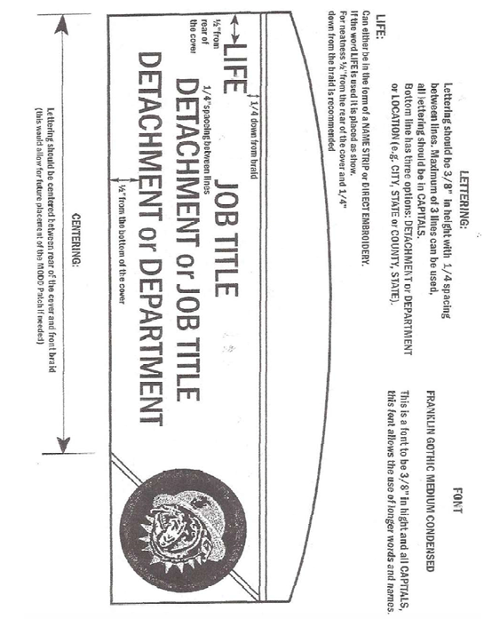

Slide 12
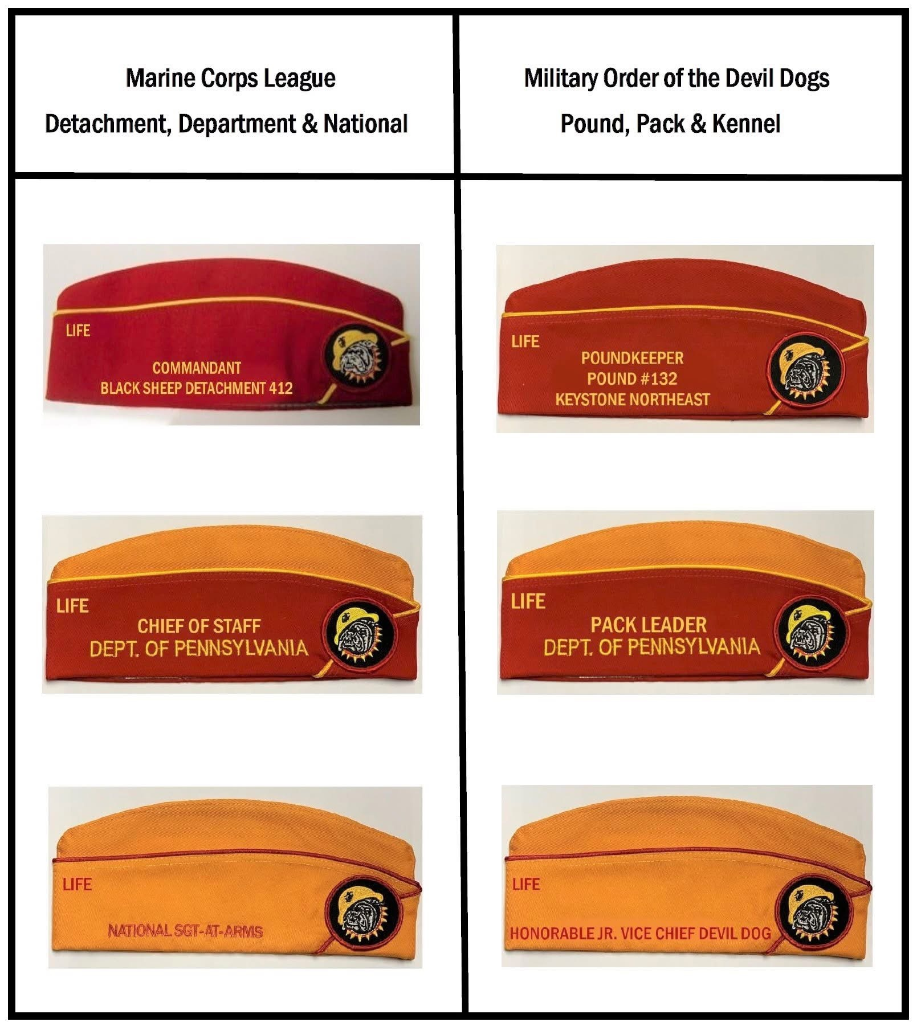

Slide 13
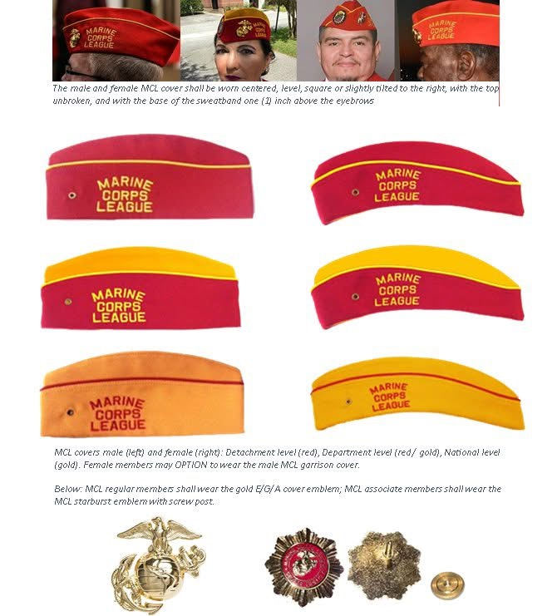
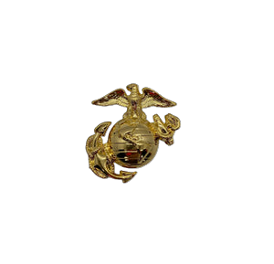
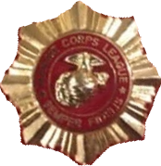
MCL covers male (left) and female (right): Detachment level (red), Department level (red/gold), National level (gold). *Female members have the OPTION to wear the male MCL cover.
Below: MCL regular members shall wear the gold Eagle Globe and Anchor cover emblem; MCL associate members shall wear the MCL starburst emblem with screw post.

Slide 14
UNIFORM MALE – UNDRESS LONG SLEEVE
Standard cover
Name tag (optional) - (There is no regulation for name tags)
White shirt, with military creases (to be airline pilot style with two (2) pockets with button down flaps and shoulder epaulets).
MCL Sunburst insignias on collar, centered 1/2" inside the collar tip, with the wings of the emblem parallel to the deck.
Shoulder patches as authorized.
Earrings (optional) will be worn in a professional manner. When worn, earrings will fit tight against the ear and will not extend below the earlobe.
MCL ribbons or DOD authorized ribbons, wings, badges, (MCL AND DOD RIBBONS CANNOT BE WORN TOGETHER: (NO MEDALS TO BE WORN ON THIS UNIFORM).
The Marine of the Year Medallion and Ribbon (national, division, department or detachment); the Chapel of Four Chaplains Medallion (Legion of Honor, Humanitarian Award, and Bronze Medallion Award); (PINS NOT WORN ON THESE) or the Military Order of Devil Dogs collar, if authorized, may be worn with the undress long sleeve uniform. Only one of these devices, medallions, or collars, may be worn at a time at the option of the wearer.
NOTE MEDALLIONS MAY NOT BE WORN WITH ANY OTHER STYLE SHIRT
(I.E., POLO, T-SHIRT, OR CIVILIAN DRESS SHIRTS.)

Slide 15
UNIFORM MALE – UNDRESS LONG SLEEVE
MCL ribbons should be centered over the left breast pocket, 1/8" above the pocket flap. DOD awards and decorations should be worn as authorized to the individual.
TIE. PLAIN BLACK with Marine Corps or MCL gold tie bar ENLISTED STYLE ONLY (no open collar).
Trousers, dress blue (with NCO "RED" stripe) with belt, Marine Corps khaki web, with web belt brass buckle.
Shoes, black, plain toe (military style, highly glossed).
Socks, Black.
OPTIONAL: Trousers, black, dress, with the black leather belt with square gold buckle with Marine Corps emblem (EGA); a ratcheting black leather belt with a gold Marine Corps emblem buckle (EGA); or a ratcheting black leather belt with a gold buckle with MCL logo may be worn instead of the dress blue trousers and khaki web belt.

Slide 16
UNIFORM FEMALE – UNDRESS LONG SLEEVE
Same as the Male uniform with the following differences:
Standard cover, male or female style
White shirt, (to be airline pilot style with two (2) pockets with button down flaps and shoulder epaulets or women's white USMC shirt or Army white ASU.)
TIE. PLAIN BLACK with USMC gold or MCL gold tie bar or women's USMC black neck tab (no open collar.)
Skirt, black, straight (length should be 1" to 2" below the knees) or trousers, black, dress, with the black leather belt and square gold buckle with EGA, or female dress blue trousers to match male uniform regulations, dress blue trousers with NCO red stripe with Marine Corps khaki web belt with web belt dress buckle.

Slide 17
UNIFORM FEMALE – UNDRESS LONG SLEEVE
NOTE: Women's dress blue trousers do not have belt loops and cannot be altered to have belt loops. When wearing the female dress blue trousers, you must wear the women's white USMC shirt (shirt is worn outside of the trousers.)
When wearing the male dress blue trouser you must wear the men's white shirt as authorized under the male undress long sleeve regulations.
Shoes, black oxford patent leather with trousers. Patent leather flats or pumps with skirt. Heels for pumps will measure up to 2" in height.
Hose, nylon, black or flesh tone (with pumps) or socks, black, (with trousers.)
Earrings (optional) will be worn in a professional manner. When worn, earrings will fit tight against the ear and will not extend below the earlobe.
UNIFORM ASSOCIATE – UNDRESS LONG SLEEVE
The 1/2" x 1/2" gold “MCL” insignia will be worn on the shirt collars.
The MCL Associate shoulder patch will be worn in lieu of the standard MCL shoulder patch.
Marine Corps dress blue trousers may be worn, but without the NCO red stripe.
MCL tie claps, not USMC tie claps.

Slide 18
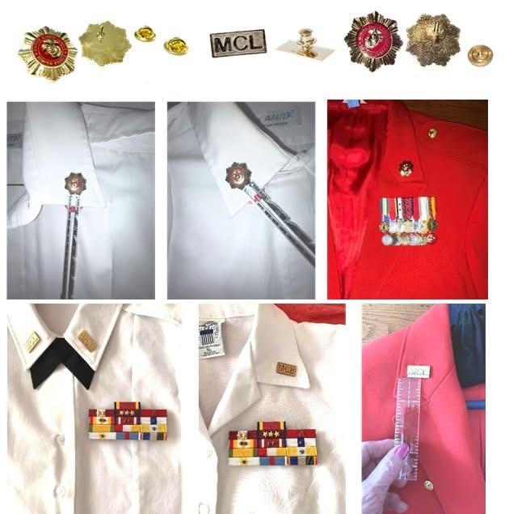
UNIFORM - UNDRESS
REGULAR MEMBER MCL COLLAR STARBURTS, ½ INCH INSIDE COLLOR TIP WINGS PARALLEL TO THE DECK
ASSOCIATE MEMBER “MCL” BAR, ½ INCH ABOVE AND PARALLEL TO SEAM OF COLLAR

Slide 19
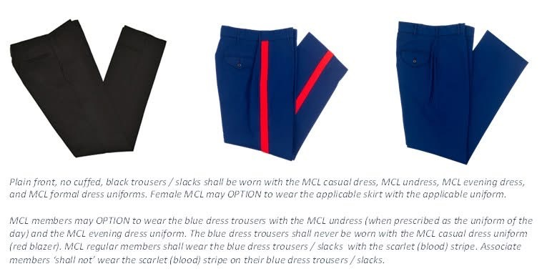
UNIFORM - UNDRESS
All Members
Regular Members
Associate Members

Slide 20
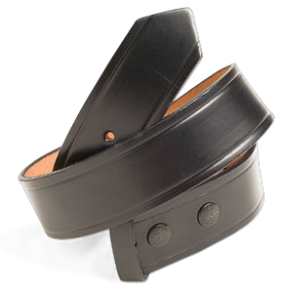
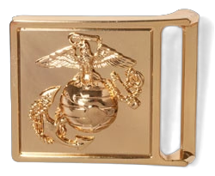
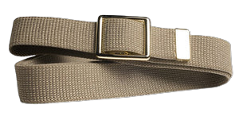
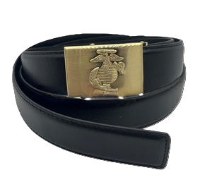
UNIFORM - UNDRESS
Belt for Dress Blue Trousers ONLY
Belts for Black Trousers ONLY

Slide 21
UNIFORM – UNDRESS
XI. WHITE DUTY BELTS
a. White duty belts may (given authority) be worn by a member while performing the duty as Sergeant at Arms (SAA) or as a member of a Color Guard or Honor Guard,
and only with the undress uniform short sleeve white or long sleeve white shirt.
b. The white duty belt will be the Standard Plain White Cotton Web Belt (2-1/2") with brass Marine Corps waist plate (3-1/2" x 2-1/2") (DRILL INSTRUCTOR STYLE) or Standard Plain White Cotton Web Belt (2-1/2") with gold (in color) Marine Corps Buckle (3-1/2" x 2-1/2"), either highly shined brass or Hamilton gold plated anodized brass with the EGA.
AN ASSOCIATE MEMBER MAY WEAR THIS BUCKLE WHILE PREFORMING THE DUTIES OF SERGEANT AT ARMS OR DURING AN HONOR GUARD DETAIL CEREMONY ONLY. THE ASSOCIATE MEMBER MAY NOT WEAR THIS BUCKLE AT ANY OTHER TIME.
c. The MCL White Duty Belt is for use while under arms (Honor Guard), standing post (SAA) or marching in a parade performing the duties of a Color Guard.
It is NOT the same belt as the 1¾” dress blue uniform white belt. This belt is never worn with any MCL uniform.

Slide 22
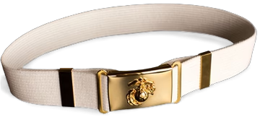
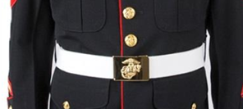
UNIFORM – UNDRESS
ONLY wear MCL Duty belts.
Order on THE SEMPER FI STORE.
Make sure to order both buckle and belt.
(they are sold separately) Links below.
Belt Buckle Uniform for white Honor Guard Belt (ONLY BUCKLE) – The Semper Fi Store
Belt Uniform Honor Guard White BUCKLE NOT INCLUDED – The Semper Fi Store
NEVER wear Dress Blue uniform belt with ANY MCL uniform.

Slide 23
UNIFORM - UNDRESS
IV. SHOULDERPATCHES .
Shoulder patches are worn on the undress uniform white aviator shirt, short sleeve or long sleeve, and the female white USMC style shirt ONLY.
a. The Marine Corps League shoulder patch will be worn on the LEFT sleeve, centered on the sleeve and 1-1/2" below the shoulder seam.
b. The United States Flag patch (2" x 3") will be worn on the RIGHT Sleeve, centered on the sleeve and 1-1/2" below the shoulder seem. The United States Flag patch will have a WHITE border and will have a field of BLUE to the right (to the wearer's front.)
c. AT THE WEARER’S CHOICE if a member is also a member of the Military Order of Devil Dogs, the MODD patch may be worn in place of the United States Flag patch, centered on the sleeve and 1-1/2" below the shoulder seam. Only one patch can be worn on each sleeve.
d. NO service or unit patches are to be worn on the MCL Uniform.

Slide 24
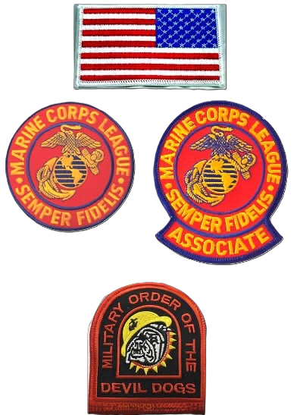
UNIFORM – UNDRESS PATCHES

Slide 25
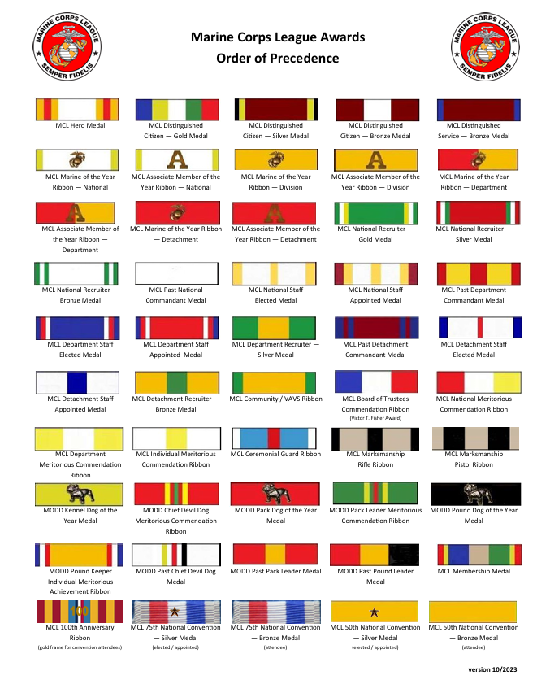
UNIFORM - UNDRESS RIBBONS
https://www.mcleaguelibrary.org/wp-content/uploads/2023/12/Ribbon-Precedence-Chart_Rev-2023.pdf

Slide 26
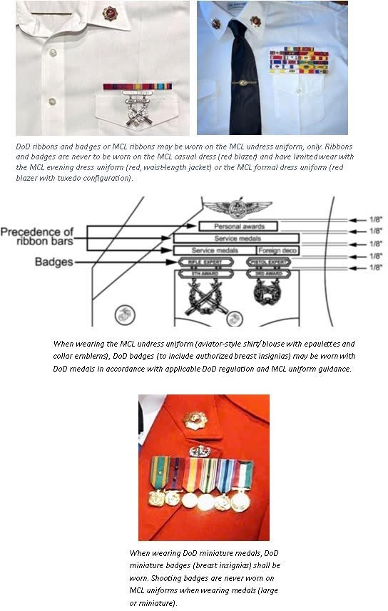
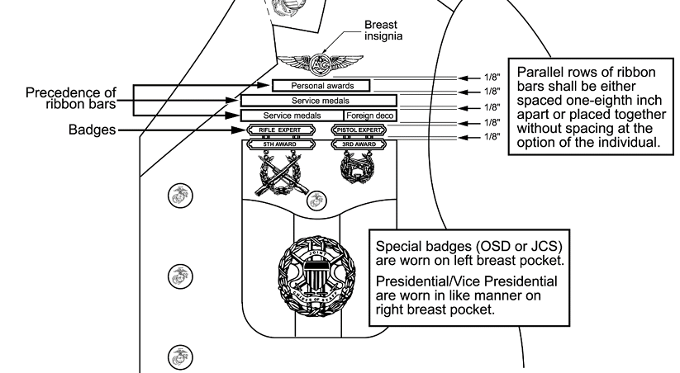
UNIFORM - UNDRESS RIBBONS, MEDALS, AND BADGES
DOD ribbon and badges or MCL ribbons may be worn on the MCL undress uniform. DOD badges (to include authorized breast insignias) may be worn with the DOD medals in accordance with applicable DOD regulations and MCL uniform regulations.

Slide 27
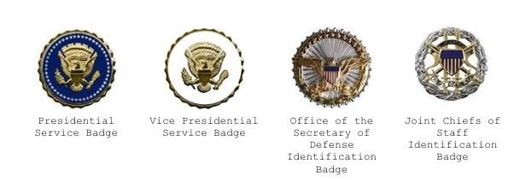
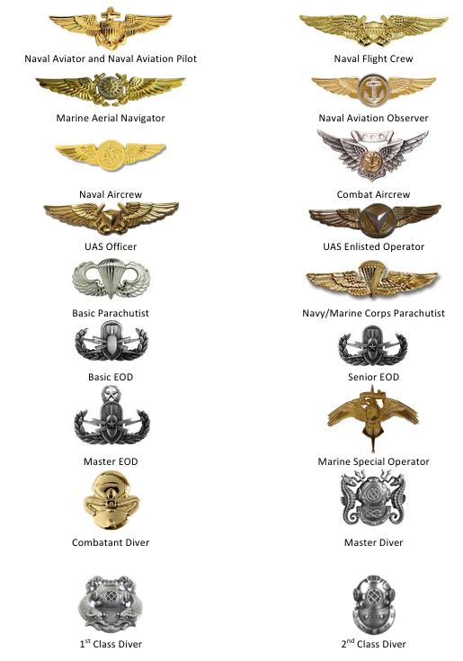
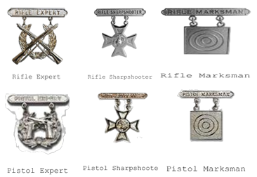
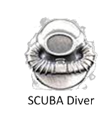
UNIFORM - UNDRESS AUTHORIZED DOD SERVICE BADGES
MARKSMANSHIP COMPETITION BADGES
ARE ALSO AUTHORIZED
REF. MCO 1020.34H 5500 1 THRU 24
OTHER BRANCH’S BADGES ARE AUTHORIZED

Slide 28
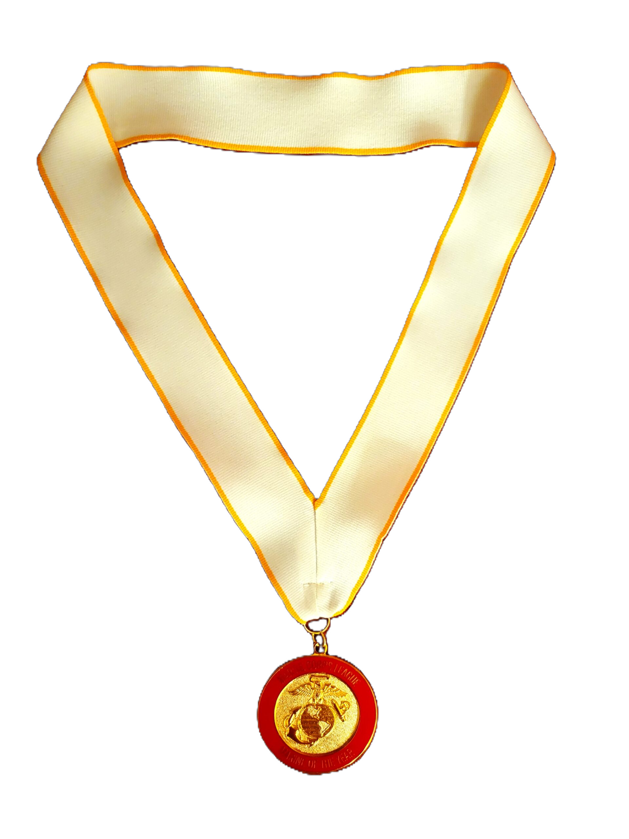
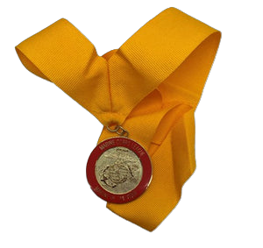
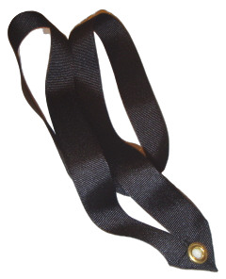
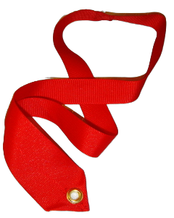
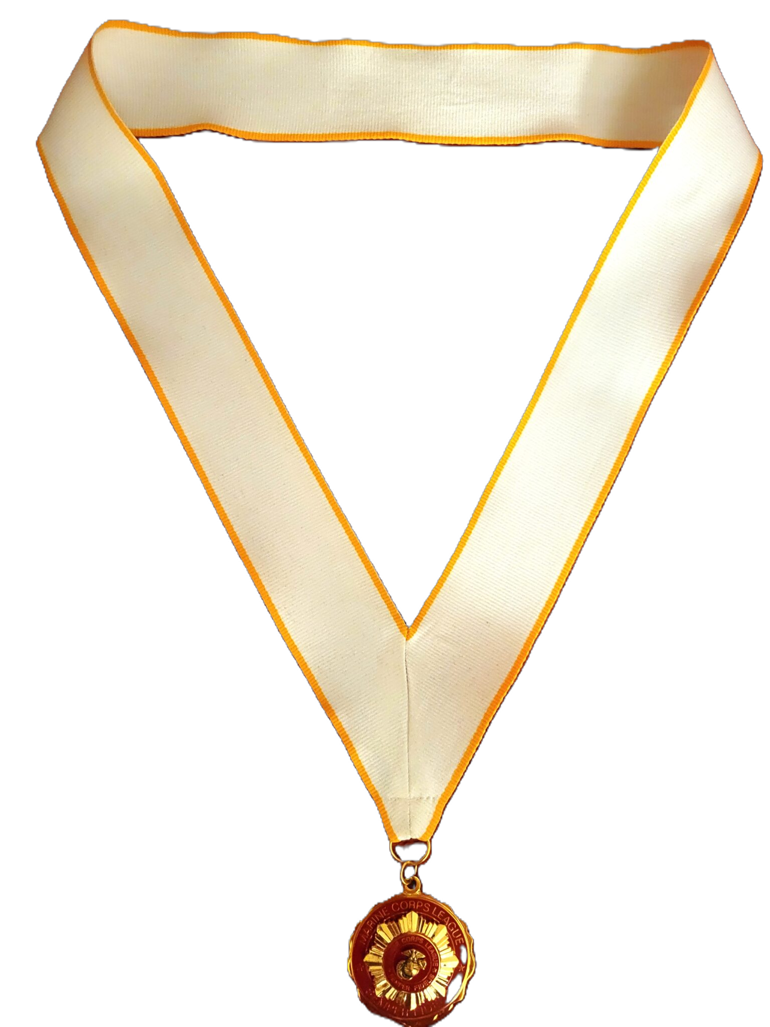
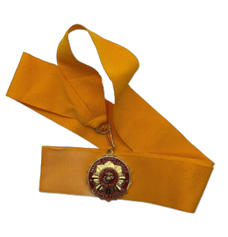
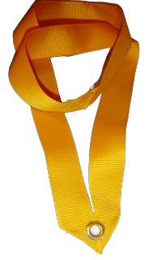
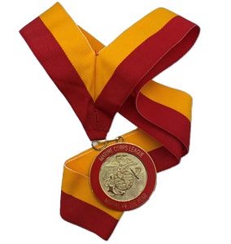
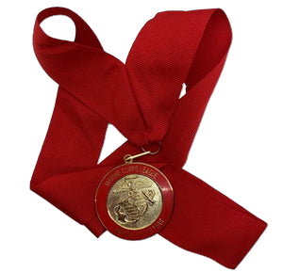
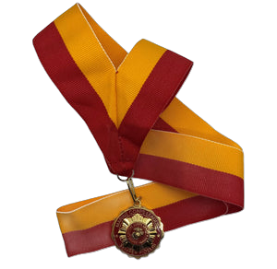
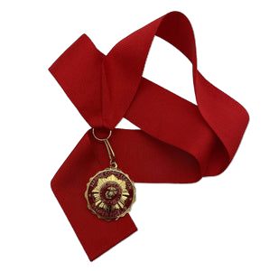
UNIFORM - MEDALLION AND RIBBONS
National Marine
of the Year
Division Marine
of the Year
MODD Pup
Collar
MODD Devil Dog Collar
National Associate of the Year
Division Associate of the Year
Department Marine
of the Year
Detachment Marine
of the Year
Department Associate
of the Year
Detachment Associate
of the Year
MODD
Pedigree Devil Dog
Collar

Slide 29
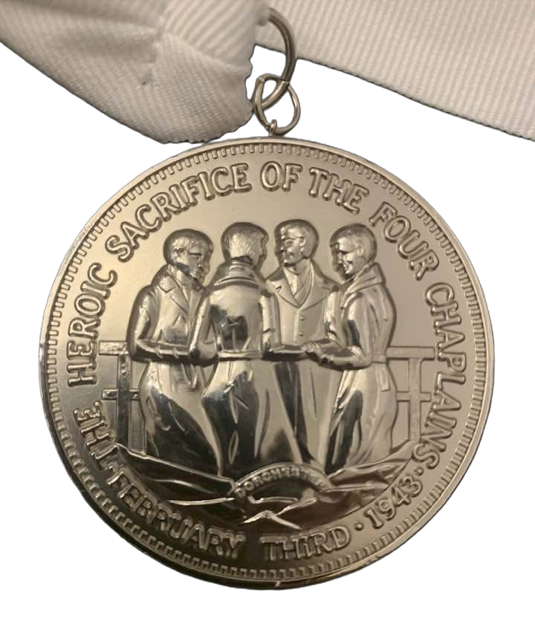
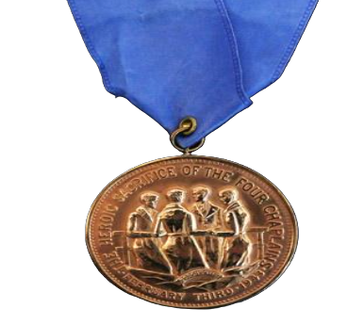
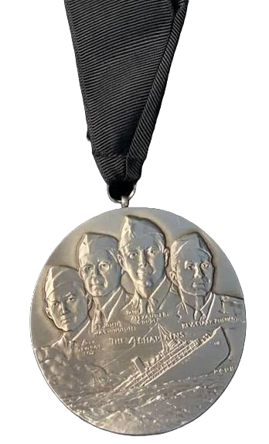
UNIFORM - MEDALLION AND RIBBONS
CHAPEL OF THE FOUR CHAPLAINS AWARDS
HUMANITARIAN MEDALLION
BRONZE MEDALLION
LEGION OF HONOR AWARD

Slide 30
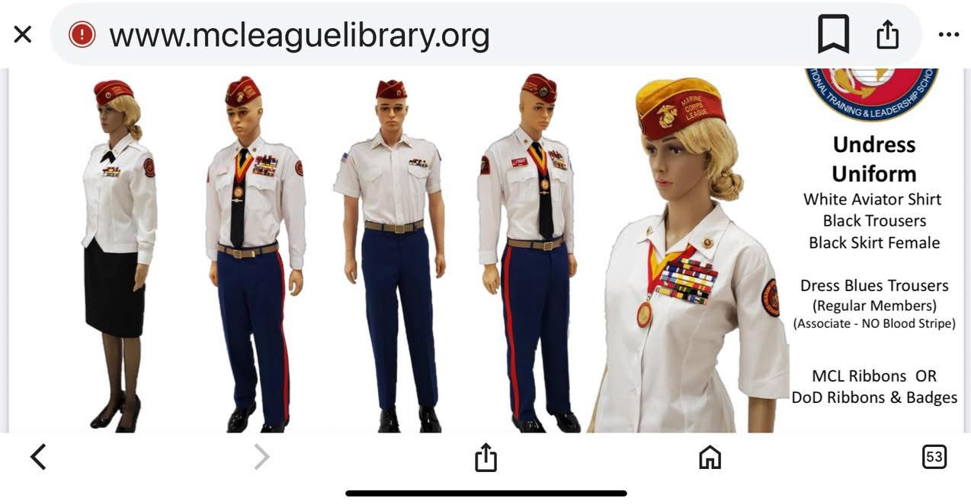
UNIFORM – UNDRESS LONG SLEEVE
FEMALES CAN WEAR
SKIRT, BLACK PANTS, DRESS BLUE FEMALE PANTS (SHIRT UNTUCKED), DRESS BLUE MALE PANTS (SHIRT TUCKED IN).
REFER TO SLIDE 15.
MALES CAN WEAR BLACK PANTS OR
DRESS BLUE PANTS

Slide 31
UNIFORM – UNDRESS SHORT SLEEVE
The short sleeve UNDRESS uniform is the same in every way to the long sleeve UNDRESS uniform with the following exceptions:
The shirt shall be the same airline pilot style, but short sleeves instead of long.
The shirt shall be worn with an open collar and NO TIE OR TIE BAR IS WORN WITH THE UNDRESS SHORT SLEEVE SHIRT.

Slide 32
UNIFORM – CASUAL – RED BLAZER - MALE
Standard cover.
Earrings (optional) will be worn in a professional manner. When worn, earrings will fit tight against the ear and will not extend below the earlobe.
The Marine of the Year Medallion and Ribbon (national, division, department or detachment); the Chapel of Four Chaplains Medallion (Legion of Honor, Humanitarian Award, and Bronze Medallion Award); (PINS NOT WORN ON THESE) or the Military Order of Devil Dogs collar, if authorized, may be worn with the casual– red blazer uniform. Only one of these devices, medallions, or collars, may be worn at a time at the option of the wearer.
White shirt, plain collar (no button-down collars, NO SUNBURST INSIGNIAS on the collar).
TIE. PLAIN BLACK with MCL or USMC (ENLISTED STYLE) gold tie bar.
Blazer, red with two (2) MCL buttons on front and three (3) or four (4) MCL buttons on each sleeve cuff.
Marine Corps League Crest
Lapel Pin(s) (optional)
Trousers, black, dress.
Belt, black leather, with Marine Corps emblem (EGA) on square gold buckle.
Shoes, black plain toe (military style, highly glossed).
Socks, black.

Slide 33
UNIFORM – CASUAL – RED BLAZER - MALE
OPTIONAL: A black leather dress belt maybe worn as a substitute to the black leather belt with Marine Corps emblem (EGA) on square gold buckle. Also optional is a ratcheting black leather belt with a gold Marine Corps emblem buckle (EGA) or a ratcheting black leather belt with a gold buckle with MCL logo.
Sunburst insignias are NOT worn on the shirt collar.
Marine Corps Dress Blue trousers are NOT WORN with the CASUAL RED BLAZER UNIFORM.
Name tags are NOT WORN with the Red Blazer.

Slide 34
UNIFORM – CASUAL – RED BLAZER - FEMALE
Standard cover, Male or Female style.
The Marine of the Year Medallion and Ribbon (national, division, department, or detachment); the Chapel of Four Chaplains Medallion (Legion of Merit, Humanitarian Award, and Bronze Medallion Award); (PINS NOT WORN ON THESE) or the Military Order of Devil Dogs collar, if authorized, may be worn with the casual– red blazer uniform.
White blouse, long or short sleeve plain collar.
TIE. PLAIN BLACK with USMC Gold (Enlisted)or MCL gold tie bar or women's USMC black neck tab.
Red Blazer, {Male or Female Style} with two (2) MCL buttons on the front and three (3) or four (4) MCL buttons on each sleeve cuff.
Marine Corps League Crest (optional).
Lapel Pin(s) (optional).
Skirt, black, straight (length should be 1" to 2" below the knees) or trousers, black, dress, with black leather belt and square gold buckle with Marine Corps emblem (EGA) or a black dress belt. The ratcheting black leather belt with a gold Marine Corps emblem buckle (EGA) or a ratcheting black leather belt with a gold buckle with MCL logo are approved optional dress belts.)

Slide 35
UNIFORM – CASUAL – RED BLAZER - FEMALE
Shoes, black oxford patent leather with trousers. Patent leather flats or pumps with skirt; heels for pumps will measure up to 2” in height.
Hose, nylon, black (with Pumps) or socks, black (with trousers).
Earrings (optional) will be worn in a professional manner. When worn, earrings will fit tight against the ear and will not extend below the earlobe.
Sunburst insignias are NOT WORN on the shirt collar.
Marine Corps Dress Blue Trousers are NOT WORN WITH THE CASUAL UNIFORM.
Name tags are NOT WORN with the Red Blazer.
UNIFORM – CASUAL –RED BLAZER - ASSOCIATE
The uniform code for both male and female applies to all ASSOCIATE MEMBERS with the following exceptions:
No Blazer Crest seal will be worn.
OPTIONAL FOR ALL CASUAL RED BLAZER UNIFORMS:
NOTHING IS REQUIRED TO BE WORN ON THE BLAZER, WEARER’S CHOICE.

Slide 36
UNIFORM – CASUAL – RED BLAZER - MEDALS
MEDALS and RIBBONS
Ribbons are NEVER worn on the Casual –Red Blazer
Only LARGE MCL or DOD medals are worn on the Causal – Red Blazer uniform.
NEVER wear miniature medals on the Causal – Red Blazer uniform. (Big Tie = Big Medals)
MCL and DOD medals should NEVER be mixed on any uniform. The wearer has only the choice of wearing authorized medals of EITHER, but NEVER BOTH TOGETHER.
Enclosure Four (4) should be referenced for proper precedence of MCL medals.
Members are expected to know their individual authority to wear DOD medals, badges, devices, and awards and the proper way to wear those decorations. Appropriate military uniform directives should be referenced for proper precedence of USMC or other DOD medals.

Slide 37
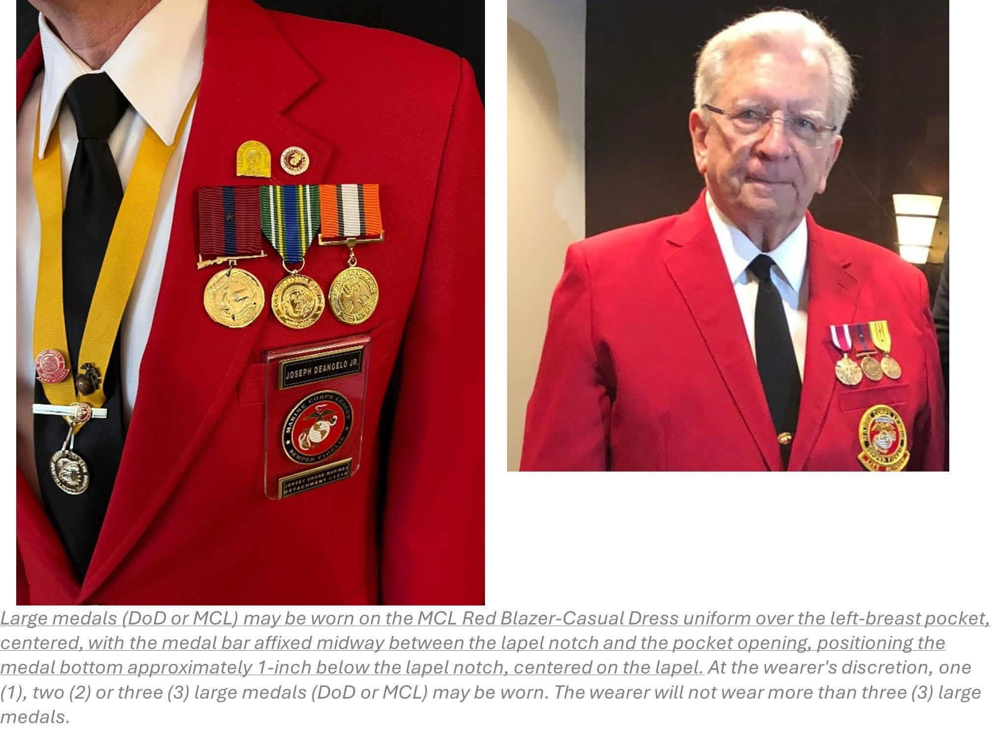
UNIFORM – CASUAL –RED BLAZER - MEDALS
Large medals (DOD or MCL may be worn on the MCL Red Blazer Casual Dress uniform over the left breast pocket, centered, with the medal bar affixed midway between the lapel notch and the pocket opening, positioning the medal bottom approximately 1-inch below the lapel notch, centered on the lapel. At the wearer’s discretion, one, two, or three large medals. The wearer will not wear more than three large medals.

Slide 38
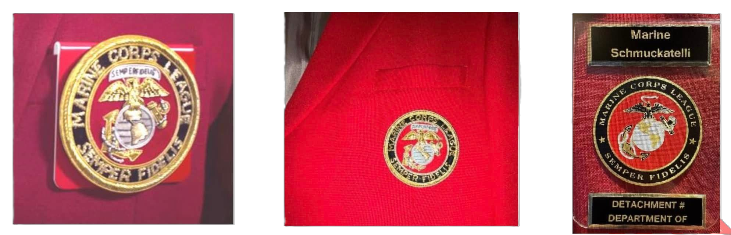
UNIFORM – CASUAL – RED BLAZER - CRESTS
The metallic embroidered Marine Corps League Crest has clutch pins on the reverse and pins directly to the red blazer pocket, or may be worn on a plastic pocket sleeve, either glued or pinned to the plastic sleeve.
The commercially sold pocket crest, with Marine Corps emblem, MCL Seal permanently set into the plastic sleeve or embroidered MCL crest that is permanently embroidered on the pocket of the red blazer itself, may also be worn as optional wear.
Name Tags are NEVER authorized to be worn on the Casual – Red Blazer uniform.

Slide 39
UNIFORM – CASUAL – RED BLAZER – LAPEL PINS
VIII.LAPEL PINS
The following lapel pins may be worn only on the Red Blazer.
The Past National Commandant Pin may be worn inboard with the National Marine of the Year outboard.
National Marine of the Year may be worn inboard with a Past Department or Detachment Commandant Pin. (ONLY ONE PAST COMMANDANT PIN MAYBE WORN AT A TIME, WEARER'SCHOICE.)
Kennel Devil Dog of the Year Pin may be worn outboard of the National Marine of the Year. The Chapel of Four Chaplains, MCL membership, or retired Marine or retired Navy lapel pins may also be worn. Although there are several types of MCL membership pins (i.e., National Associate Member of the Year, Past Commandant, Life Member, Five Year Membership, Ten Year Membership, etc...), only "ONE" MCL membership pin should be worn.
Ordained ministers or chaplains may wear a symbol of their religion of the size approved by DOD.
Whatever pins are approved for wear; ONLY TWO (2) PINS MAY BE WORN AT ANYTIME, WEARER’S CHOICE. Only ONE (1) miniature ribbon of the individual’s choice may be worn above the lapel pins on the red blazer.

Slide 40
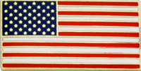
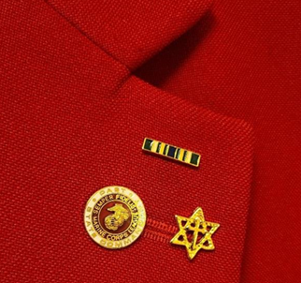
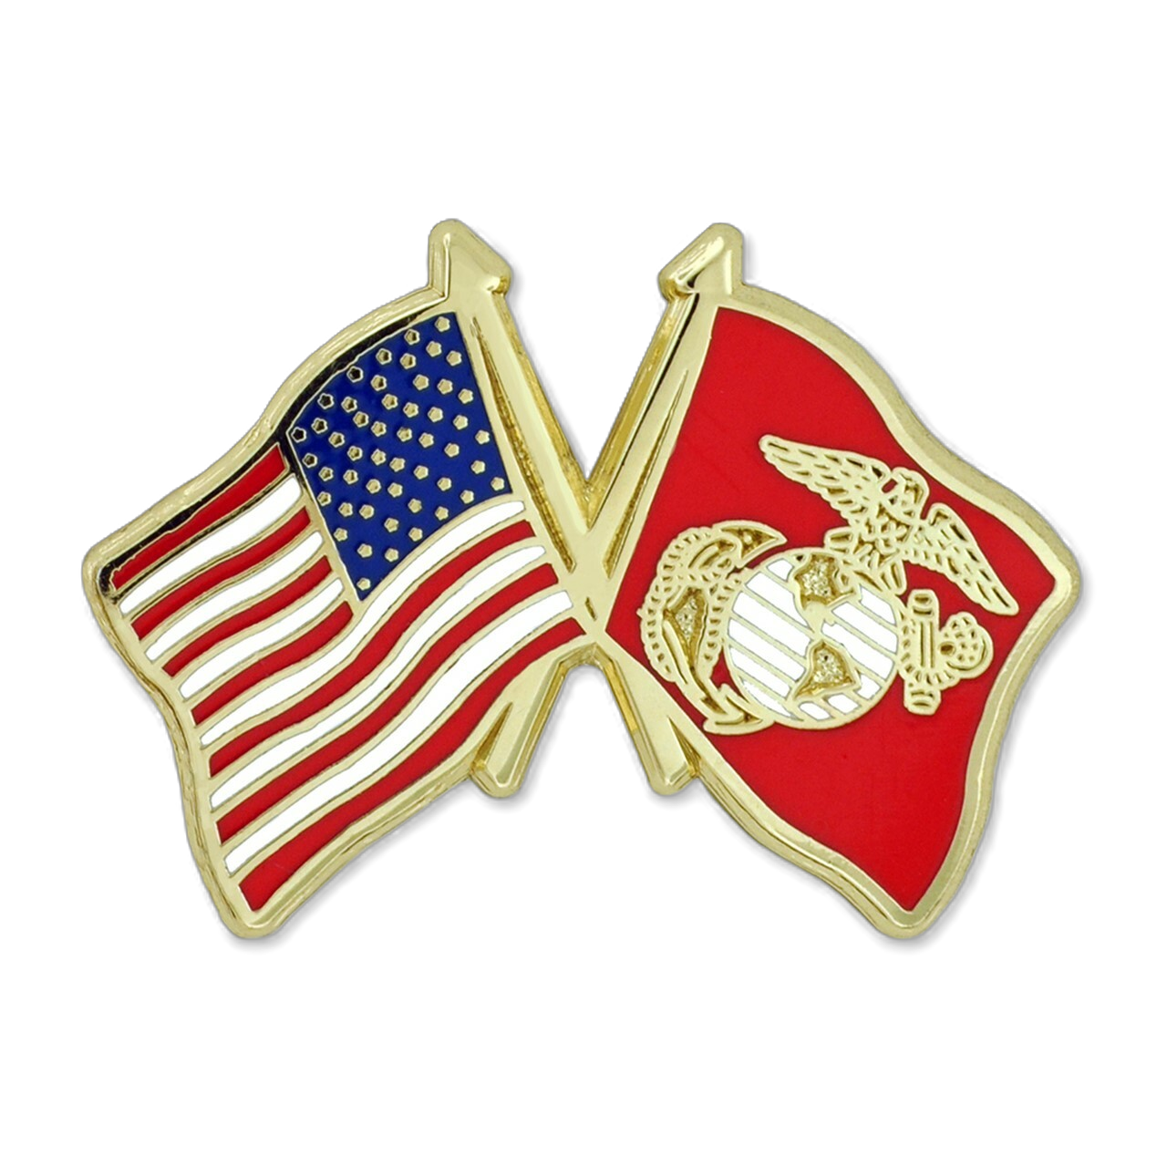
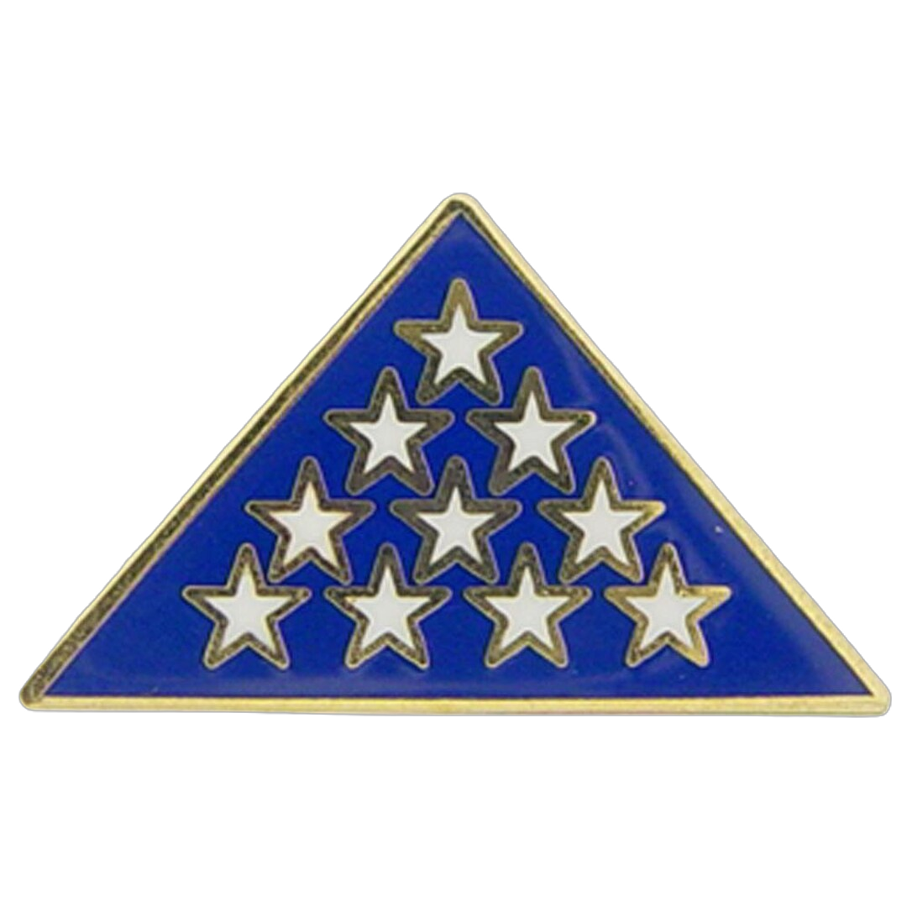
UNIFORM – CASUAL – RED BLAZER – LAPEL PINS
APPROVED LAPEL PINS – If it is not on the list, don’t wear it.
1. Past National Commandant Pin
2. National Marine of the Year Pin
3. Kennel Devil Dog of the Year Pin
4. National Associate Member of the Year Pin
5. Past Department or Past Detachment Commandant Pin
6. Chapel of Four Chaplains Pin
7. MCL Membership Pin
8. Retired Marine or Retired Navy Pin
9. Life Member Pin
10. Ordained Ministers or Chaplains Symbol Pin
11. United States Flag Pin (3/8” X 3/4” in size)
12. Vietnam War 50th Commemorative Pin
13. Gold Star Pin
14. Next of Kin Deceased Personnel Pin
15. Presidential Volunteer Service Award Pin (Life, Gold, Silver, Bronze)
NOTE: There are many styles of most pins but only ONE (1) type may be worn at a time.
Pins are NEVER worn on the right collar of the Casual Red Blazer uniform.
#11 ONLY type of Approved US Flag Pin
Proper wear of pins. Side by side, not one above the other.
May wear two plus ribbon bar.
The Crossed Flag Pin (US & USMC)
is NOT ALLOWED ON ANY MCL UNIFORM
The Folded Flag Pin is NOT ALLOWED ON ANY MCL UNIFORM

Slide 41
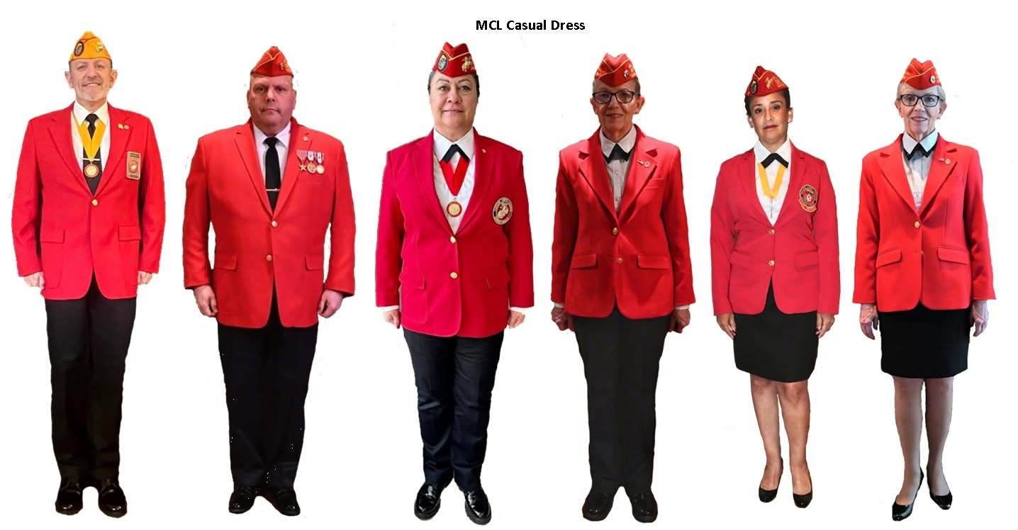
UNIFORM – CASUAL –RED BLAZER

Slide 42
UNIFORM – FORMAL – RED EVENING DRESS JACKET / BLAZER MALE
Standard Cover (Paragraph V) NOT WORN AT INDOOR FORMAL EVENTS/ CEREMONIES.
Earrings (optional) will be worn in a professional manner. When worn, earrings will fit tight against the ear and will not extend below the earlobe.
The Marine of the Year Medallion and Ribbon (national, division, department or detachment); the Chapel of Four Chaplains Medallion (Legion of Honor, Humanitarian Award, and Bronze Medallion Award); or the Military Order of Devil Dogs collar, if authorized, may be worn with the formal dress uniform. Only one of these devices, medallions, or collars, may be worn at a time at the option of the wearer.
Military bow tie, black.
White shirt, formal (standard collar), PLEATED FRONT- NO RUFFLES.
Gold cuff links with EGA and gold studs.
Cummerbund, gold- OR- gold vest front (only approved design.) T
Trousers, black, with black dress belt (a ratcheting black leather belt with a gold Marine Corps emblem buckle (EGA) or a ratcheting black leather belt with a gold buckle with MCL logo are an approved optional dress belt.)

Slide 43
UNIFORM – FORMAL – RED EVENING DRESS JACKET / BLAZER MALE
MCL red evening dress jacket, medium weight gabardine material with MCL buttons, gold waist chain, and sunburst insignias at locating holes in jacket collar.
Lapel pin(s) (optional)
Shoes, black plain toe (military style, highly glossed.)
Socks, black.
Miniature medals, wings, badges (optional) (Little tie = little medals)
OPTIONAL:
The red blazer may be worn as an option to the red evening dress jacket with the FORMAL DRESS UNIFORM. If the red blazer option is chosen, the following applies. The Marine Corps League Crest is optional if miniature medals are worn. Medals may be worn per Enclosure 3.
OPTIONAL:
In addition to the black tuxedo trousers worn with the evening dress jacket, the wearer may opt to wear the Marine Corps dress blue trousers with NCO red stripe in place of the black tuxedo trousers.
NOTE: THE MARINE CORPS DRESS BLUE TROUSERS WILL NOT BE WORN WITH THE RED BLAZER AT ANY TIME.

Slide 44
UNIFORM – FORMAL – RED EVENING DRESS JACKET / BLAZER FEMALE
Standard Cover (Paragraph V) NOT WORN AT INDOOR FORMALEVENTS/ CEREMONIES
The Marine of the Year Medallion and Ribbon (national, division, department, or detachment); the Chapel of Four Chaplains Medallion (Legion of Merit, Humanitarian Award, and Bronze Medallion Award); or the Military Order of Devil Dogs collar, if authorized, may be worn with the formal dress uniform. Only one of these devices, medallions, or collars, may be worn at a time at the option of the wearer.
White shirt, formal (standard collar) pleated front. NO RUFFLES. Gold cuff links with EGA and gold studs.
Tie, Women's USMC black neck tab.
Cummerbund, gold or gold vest front (only approved design).
Skirt, long women's USMC evening dress uniform skirt of women's tuxedo skirt, black straight ankle length with slit on left side, no higher than bottom of knee cap.
Skirt- short black straight (Length should be 1" to 2" below the knees) When wearing this skirt, it is to be worn with the red blazer, white shirt, tie, plain black with Marine Corps Gold (Enlisted) or MCL gold tie bar or women's USMC black neck tab.

Slide 45
UNIFORM – FORMAL – RED EVENING DRESS JACKET / BLAZER FEMALE
MCL red evening dress jacket, with MCL Buttons, gold waist chain and sunburst collar devices at locating holes in the jacket collar. The red blazer may be worn as an option to the red evening dress jacket with the formal dress uniform.
Lapel Pin(s) (optional)
Shoes, black oxford patient leather with trousers. Patient leather flats or pumps with skirt. Heels for pumps will measure up to 2" in height.
Hose, nylon, black with pumps or socks, black with trousers.
Earrings (optional) will be worn in a professional manner. When worn, earrings will fit tight against the ear and will not extend below the earlobe.
Miniature medals, WINGS, BADGES (optional)
OPTIONAL:
If the red blazer is worn as an option to the red dress evening jacket, the following applies: The Marine Corps League Crest is optional.
Miniature medals may be worn per Enclosure 3.

Slide 46
UNIFORM – FORMAL – RED EVENING DRESS JACKET / BLAZER FEMALE
MCL red evening dress jacket, with MCL Buttons, gold waist chain and sunburst collar devices at locating holes in the jacket collar. The red blazer may be worn as an option to the red evening dress jacket with the formal dress uniform.
Lapel Pin(s) (optional)
Shoes, black oxford patient leather with trousers. Patient leather flats or pumps with skirt. Heels for pumps will measure up to 2" in height.
Hose, nylon, black with pumps or socks, black with trousers.
Earrings (optional) will be worn in a professional manner. When worn, earrings will fit tight against the ear and will not extend below the earlobe.
Miniature medals, WINGS, BADGES (optional)
OPTIONAL: If the red blazer is worn as an option to the red dress evening jacket, the following applies: The Marine Corps League Crest is optional.
Miniature medals may be worn per Enclosure 3.
OPTIONAL: In addition to the long black evening skirt, the black dress trousers may be worn with the evening dress jacket. The wearer may opt to wear Marine Corps dress blue trousers with NCO red stripe. The wearer must wear military black bow tie in place of the female USMC black neck tab. (Men's Formal Dress)

Slide 47
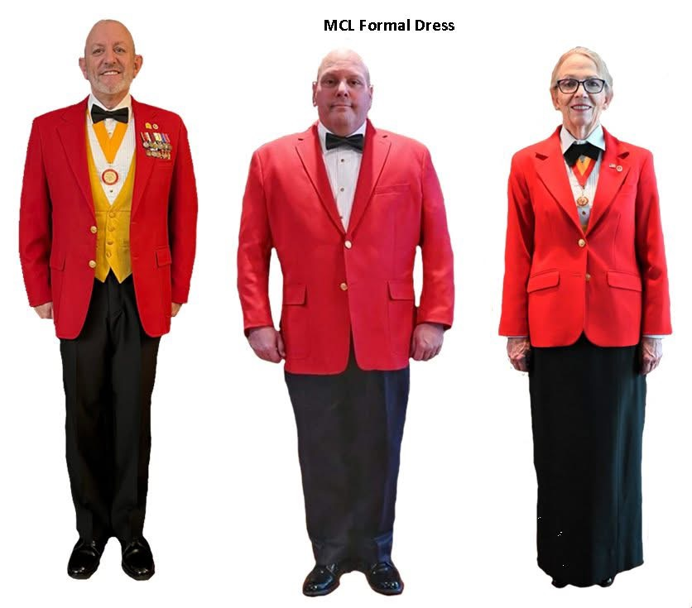
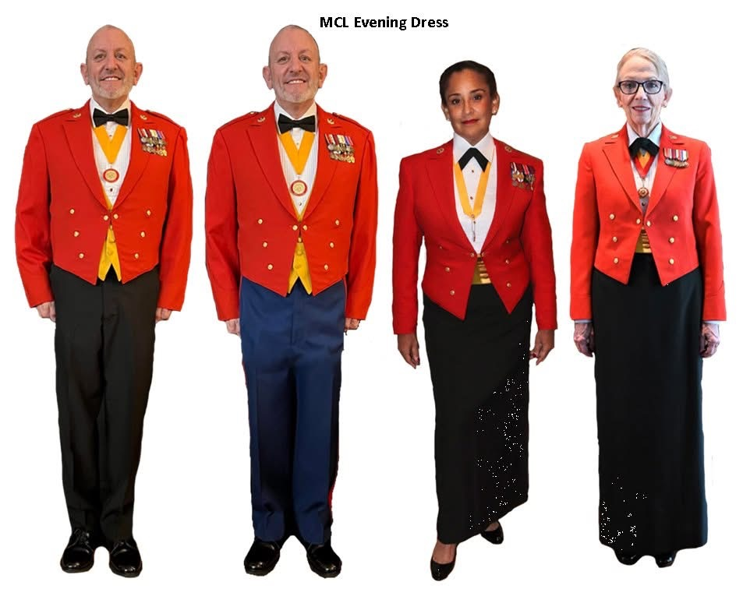
UNIFORM – FORMAL – RED EVENING DRESS JACKET / BLAZER ASSOCIATE
The uniform code for both male and female applies to all ASSOCIATE MEMBERS with the following exceptions:
No pocket crest if wearing the Red Blazer as Formal Dress.
MCL Bars on the collar.

Slide 48
UNIFORM – FORMAL – RED EVENING DRESS JACKET / BLAZER MEDALS
MOUNTING OF MINIATURE MEDALS
a. When more than one (1) medal is worn they should be suspended from a holding bar of sufficient stiffness to support the weight of the medals.
b. When eleven (11) medals are worn, there will be five (5) medals on the top row, and six (6) medals on the bottom row. When there is an uneven number of medals, the rows cannot be even top to bottom.
c. The maximum length of the holding bar for miniature medals should be four (4) inches, (3 RIBBON BAR) although a holding bar of maximum length has room for a maximum of five (5) medals side by side; it can however accommodate ten (10) medals if overlapped. Overlapping shall be equal (not more than 50%) and the right or inboard medal shall be shown in full.

Slide 49
UNIFORM – FORMAL – RED EVENING DRESS JACKET / BLAZER MEDALS
d. Mounting of the Miniature medals by rows:
One to ten (10) medals, one (10) row only
Two medals, mounted side by side on a 1-5/16" (1 ribbon bar)
Three medals mounted on a 1-5/16" bar (1 ribbon bar) overlapped
Four medals, mounted side by side on a 2-5/8" bar (2 ribbon bar)
Five medals, mounted on a 2-5/8" bar (2 ribbon bar) overlapped
Six to ten medals, mounted on a 4" bar (3 ribbon Bar) overlapped
Eleven medals, 2 rows-first row (5) second row (6)
Twelve or more medals should be tiered on rows as above.
e. In the case of MCL issued medals only; in lieu of the above prescribed overlapping mini-medals mounting, the commercially available mini-medal mounting bars, which display the mini-medals in rows of (4) or (5), when five (5), ten (10), fifteen (15) or twenty (20) are worn, or partial additional rows of one (1), two (2), or three (3) mini-medals, without overlapping, may be worn.

Slide 50


UNIFORM – FORMAL – RED EVENING DRESS JACKET / BLAZER MEDALS
Miniature medals DOD or MCL may be worn on the MCL Red Blazer-Formal Dress and MCL Evening Dress uniforms. Follow slides above and Encloser 3 for proper wear. Wen wearing DOD miniature medals, DOD miniature badges will be worn. Shooting badges are NEVER worn. Miniature medals will be placed one inch below the notch of the left of the lapel, centered on the lapel. They may extend beyond the lapel, if needed.
Miniature medals are worn with a distinct pattern that is different from other veteran service organizations and other branches or service. When getting your miniature medals mounted (or doing yourself, ensure they are mounted the Marine Corps way.

Slide 51
UNIFORM - MISCELLANEOUS UNAUTHORIZED ITEMS
WHEN WEARING THE MCL UNDRESS, CASUAL, FORMAL, EVENING DRESS UNIFORM
NO KHAKI USMC SHIRTS
NO USMC COVERS OF ANY KIND
NO HONOR GUARD ROCKERS, PATCHES, OR PINS
NO FOURRAGERE (SHOULDER) CORDS
NO MOURNING BANDS
NO HELMETS OF ANY KIND
NO GUN HOLSTERS
NO POLICE BADGES
NO COMMEMRATIVE MEDALS OR RIBBONS
NO KILTS
NO SHORTS
NO RANK ON COVER, SHIRT, BLAZER OR DRESS JACKET
NO OTHER TIE CLAPS OR PINS THAN USMC ENLISTED OR MCL
NO TURTLENECK SHIRTS
NO WEARING RED BLAZER WITH CREST OTHER THAN IN FULL MCL UNIFORM
NO BALL CAPS IN UNIFORM
NO MIXING UNFORMS WITH OTHER ORGANIZATION’S UNIFORMS

