Slide 1
General Cybersecurity Awareness

Slide 2
What is Cybersecurity?
Cyber security is the practice of defending computers, servers, mobile devices, electronic systems, networks, and data from malicious attacks.

Slide 3
Personal Cybersecurity Tips /
Best Practices
Use Strong Passwords
Use a VPN When Necessary
Think Before You Click
Update Your Home Router
Update Your Devices
Use Two-Factor Authentication

Slide 4
Threats and Practices
Malware
Spear Phishing
Malicious Links
Passwords
Browsing in Public
Data Compromise

Slide 5
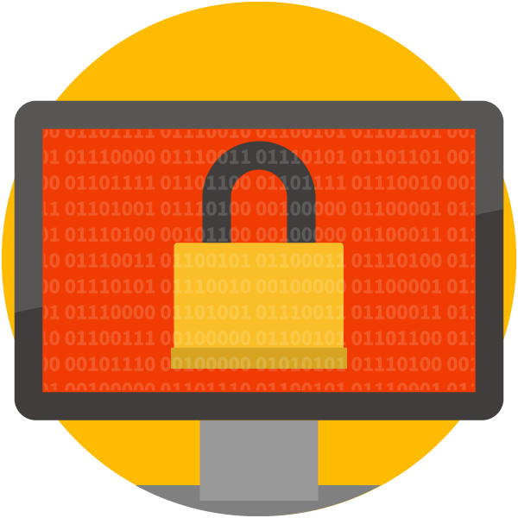
Threat: Malware
Software designed to compromise a device/network
Examples:
  Worm/virus
  Botnet
  Banking Trojan
  Ransomware

Slide 6
Who is Targeted?
Ransomware
It is estimated that ransomware damages will cost more than $20 billion globally in 2020
Encrypts/locks files
Holds files for ransom
Typically obtained via:
  Spam & phishing emails
  Unpatched security vulnerabilities

Slide 7
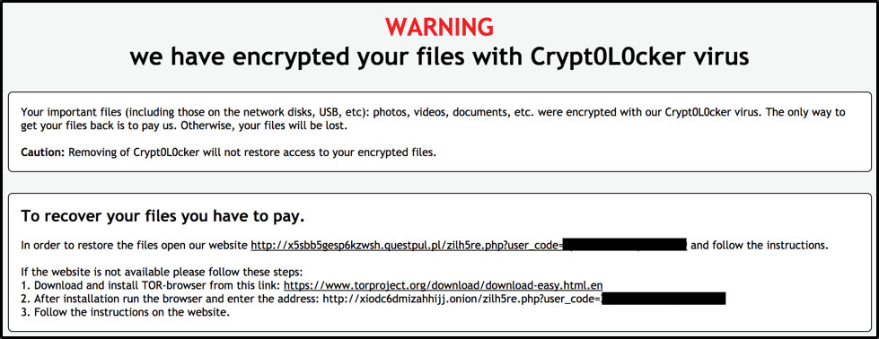
Threat: Malware
Ransomware
1
2

Slide 8
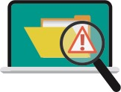
Best Practices: Malware
Learn to identify phishing emails
Exercise caution with links
Do not download or click suspicious links or files
Keep software up-to-date
Back files up regularly

Slide 9

Threat: Spear Phishing
Spear-phishing is a targeted attempt to steal sensitive information such as account credentials or financial information from a specific victim, often for malicious reasons.
Common cause of data breaches
Targeted emails
Sent to small groups or individuals
Use social engineering tactics
93 percent of incidents/breaches

Slide 10
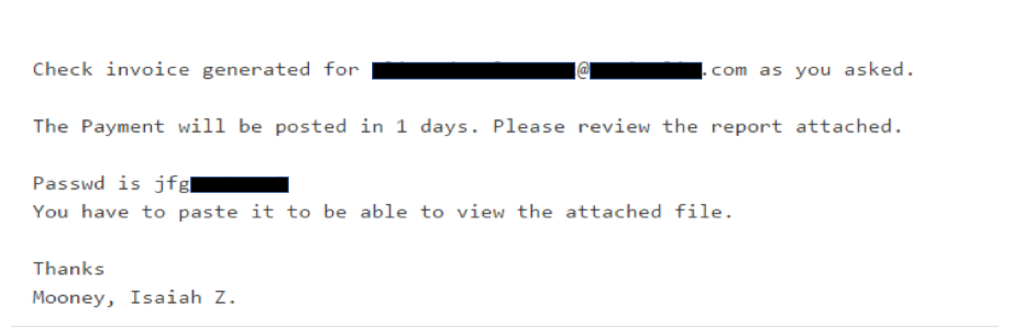
Example of a Spear Phishing Email
1
2
3
4
5

Slide 11
Threat: Business Email Compromise
Solicits wire transfer
Impersonates executive, vendor, or supplier
Resembles spear phishing
Targets financial officers

Slide 12
Best Practices: Spear Phishing
Check the sender
Look out for warning signs
Think before you click or take action
Never hand over sensitive info

Slide 13
Threat: Malicious Links
Anchor may hide true destination
Hacked landing pages
Copycat domains (exampel.com)
Shortened links

Slide 14
Best Practices: Malicious Links
Always check the destination
Desktop: hover over anchor
Mobile: hold for several seconds
See It In Action!
https://www.example.com/totally-legit.html
(http://www.example.com.some-other-site.co.uk/downloads/file.php)

Slide 15
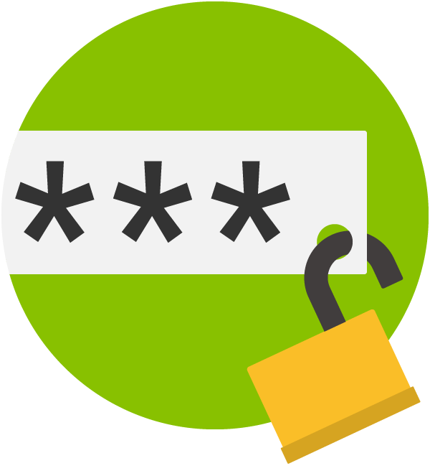
Threat: Password Security
Susceptible to:
  Brute force
  Hacking
  Malware
  Phishing
  Data breach

Slide 16
Best Practices: Password Security
Effective passwords are:
  Long
  Complex
  Unique
  Rotating
Enable MFA where possible
Yes
No
9@kj*YbM25nGnl
p@ssw0rd12

Slide 17

Threat: Browsing in Public
Unsecured networks
  “Man in the Middle”
Visual hacking
44% of stolen devices were left in a public place [3]

Slide 18
Best Practices: Browsing in Public
Avoid public wireless networks
Use reputable VPN
Be mindful of surroundings
Precautionary apps
  “Find my phone”
  “Remote wipe”

Slide 19
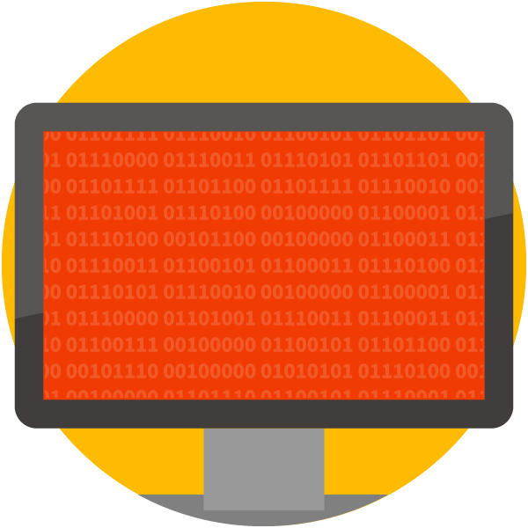
Threat: Data Compromise
May result from:
  Spear phishing
  Hacking or malware
  Simple negligence
Average cost: $3.86 MM [4]

Slide 20
Best Practices: Data Compromise
Storing sensitive information:
  Yes to encrypted devices
  No to removable media (flash drives)
Sharing:
  Who is authorized?
  Check email CC’s
  Secured network?
Destruction:
  Recycle bin is not enough!

Slide 21
Cybersecurity Basics Checklist
Keep all your software up-to-date
Install a reliable antivirus solution
Enhance your security with a product that can block attacks antivirus can’t detect
Use strong passwords and change them often
Activate and use two step verification where available
Avoid oversharing information on social media
Back up your data. Do it often. Back up in several places

Slide 22
Cybersecurity Basics Checklist
Never open emails from unknown senders
Never download or open attachments sent by unknown senders
Keep your financial information safe and don’t share it with anyone
Avoid untrusted websites and don’t click on suspicious banners or links
Adjust the privacy and security settings in your browser and apps

Slide 23

Let’s Recap

Slide 24
Sources for Cybersecurity News
Forbes Cybersecurity offers daily cybersecurity-focused pieces from staff writers and contributors.
WIRED SECURITY publishes content on cyberwarfare, dark web and global cybersecurity news.
The New York Times Computer Security News shares breaking cybersecurity news/stories.
U.S. News Cybersecurity covers the latest news items on cybersecurity and cybercrime.
CNBC Tech | Cybersecurity shares relevant news on cybersecurity and privacy issues.
Technopedia offers a comprehensive glossary of cybersecurity terms and concepts.

Slide 25
QUESTIONS?

