Slide 1
Filing The 990-N Updated 3/1/2021
USE THIS IF:
Your Gross Revenue is less than $50,000
You must file by the 15th day of the 5th month past the end of your fiscal year. All detachments now end their fiscal year on June 30th. Due Date is Nov 15th. You can file as early as 1 July

Slide 2
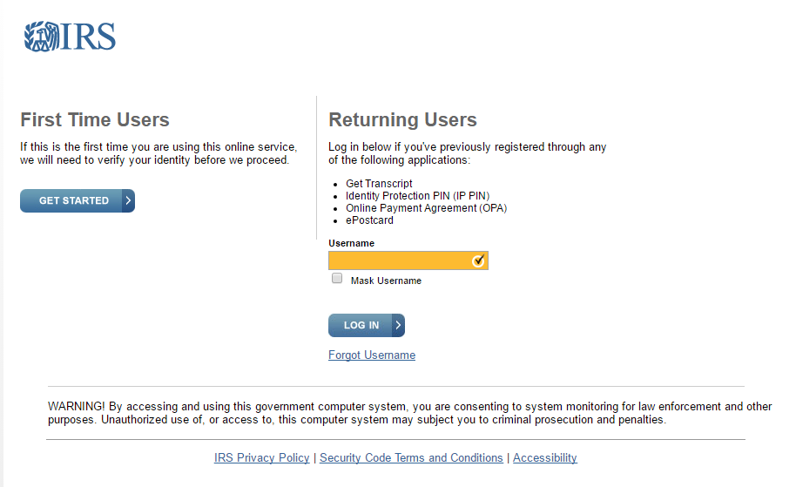
Navigate to the IRS Website
Form 990-N Electronic Filing System (e-Postcard).
Click this to open the IRS website, or go to IRS.gov and enter “file 990-N” in the search box.
You must create a user account under the new system if you have not already done so.
Click “Get Started”
If you already have an account, logon to the returning users and go to “Filing the 990”

Slide 3
Adding an account
Follow the instructions and create an account. Use your Name. An active email address is required to continue.
A code will be emailed to you to continue the setup process.

Slide 4
Creating/managing a profile
After you create an account, you’ll need to login. You’ll be taken to this page.
Your first step is to create a profile. Click
The “manage E-Postcard Profile”

Slide 5
Adding your EIN
Type in your EIN and click “Add EIN”
One advantage of the new system is that you can manage more than one EIN.
After adding your EIN, you can file your 990-N by selecting “Create New Filing”

Slide 6
Filing the 990
Select the EIN you want to file for from the drop down list.
(click on the down arrow)
and hit continue
If you logged on as an existing customer, click on the “manage 990 form submissions” after logging on. That will bring you to this page.

Slide 7
Filing the 990
Follow the prompts and update any information necessary from last filing. Most important is “Principle Officer” information.
After you press submit you will see a manage form dialog. After a few minutes you will be able to click on the “Action block” and it will update your status from “submitted” to “accepted”. Click on the “Submission ID” to get your confirmation message.”
Important! After you submit your filing you will be given an opportunity to print the actual E-Postcard. This is the only chance you have to print it.

Slide 8
Filing the 990
This is your confirmation. You will not receive an email confirmation as in the past. Print or save as a PDF and submit to the Department Paymaster.
This completes the process.

