Slide 1
Indiana Department of Veterans Affairs
Our Mission:
To support, Serve & Advocate for the Indiana Veteran Community
Our Vision:
Indiana is the choice for Veterans to Live, Work & Thrive.

Slide 2
Indiana Department of Veterans Affairs
2022
State of Indiana Veteran Benefits & Services

Slide 3
Indiana Department of Veterans Affairs
IDVA Agency Divisions – Main Office – 777 N. Meridian Street Indianapolis
Executive Team:
IDVA Director, Operations Director, Outreach Director, General Counsel
Training & Service Team:
Veteran Service Director, Training Coordinator, State Veteran Service Officer, 6 District Service Officers
Military Relief Fund Team:
MFRF Director, Assistant Director, Case Managers
Outreach Team:
Communications Manager, Women Veteran Coordinator, Media Coordinator, Health & Wellness Coordinator, Social Media Coordinator
Work Force Development Team:
Disabled Veteran Outreach Program Specialist
State Approving Agency:
SAA Director, Admin Assistant, 5 Program Managers

Slide 4
Indiana Department of Veterans Affairs
IDVA Agency Facilities
Indiana Veterans Memorial Cemetery
Located in Madison, Indiana, the IVMC is dedicated to Veterans and their families as a lasting memorial, and final resting place, in appreciation and gratitude for their service and sacrifice to our nation.
Services at the IVMC include casket burial, in ground cremation, Columbarium, scatter garden and use of the beautiful chapel. Services are available to Indiana resident veterans and their spouses at no cost. The IVMC hosts annual events for memorial Day, Veterans Day, and Wreaths Across America.

Slide 5
Indiana Department of Veterans Affairs
IDVA Agency Facilities
The Indiana Veterans' Home
Located in West Lafayette, Indiana, the home was originally created to care for veterans of the Civil War, the Indiana Veterans’ Home welcomed its first resident in 1896. Located on 250+ acres in West Lafayette, IVH is a full-service care facility offering a complete array of services for residents.
The Indiana Veterans' Home Mission
“To honor Indiana's veterans and their spouses by providing the highest level of care in a therapeutic home-like environment, enhancing health and yielding optimal quality of life. To do this and meet the unique needs of these heroes and their families, we deliver compassionate and comprehensive skilled care while integrating arts and cultural programming and preserving the rich history of the Home."

Slide 6
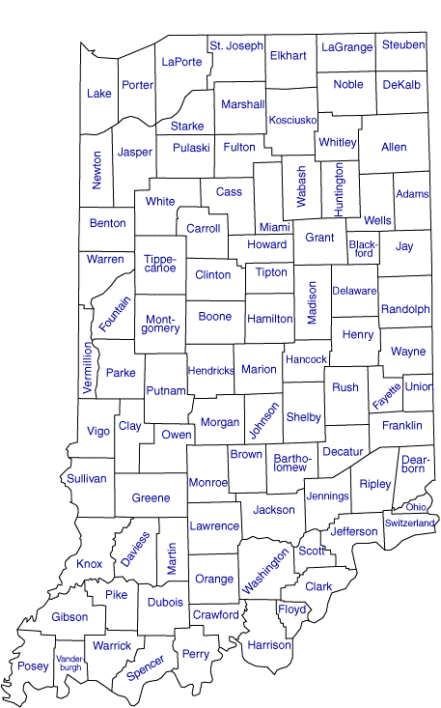
Indiana Department of Veterans Affairs
(92) County Veteran Service Offices
The Majority of Indiana's County Veteran Service Officers (CVSOs) are:
Accredited Service Officers with the Federal VA
Utilize a standard claims management system

Slide 7
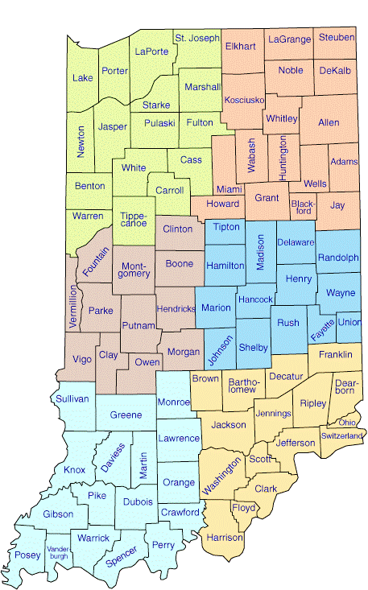
Indiana Department of Veterans Affairs
(6) IDVA District Service Officers
Each DSO assists the CVSOs with:
On-site training
Individualized service
Assisting/Advising County Officials with the hiring of CVSOs as needed
Assisting the IDVA Outreach team support and organize events to reach to veteran community

Slide 8
Indiana Department of Veterans Affairs
Northwest
Northeast
Central West
Central East
Southwest
Southeast

Slide 9
Indiana Department of Veterans Affairs
State Veteran Benefits:
Tuition and Fee Exemption *
Reduced fee Hunting and Fishing License *
Property Tax Deduction *
Income Tax Reduction
Disabled Hoosier Veteran License Plate *
Military Family Relief Fund *
Discounted Golden Hoosier Passport
Free Peddlers, Vendors and Hawkers License
* benefits application & eligibility verification available from CVSO/IDVA

Slide 10
Indiana Department of Veterans Affairs
State Veteran Benefits:
Tuition and Fee Exemption
Who is Eligible:
VETERAN
CHILDREN OF A VETERAN
FORMER STUDENTS of MORTON MEMORIAL H.S.

Slide 11
Indiana Department of Veterans Affairs
State Veteran Benefits:
Tuition and Fee Exemption
VETERAN:
have been awarded the Purple Heart Medal
have received discharge that is not dishonorable
qualify for Indiana in-state tuition
have entered the Armed Forces from an Indiana HOR

Slide 12
Indiana Department of Veterans Affairs
State Veteran Benefits:
Tuition and Fee Exemption
CHILDREN OF VETERAN:
Veteran Criteria:
Served in the Armed Forces during recognized war time dates or received a service or campaign medal for equally hazardous duty.
Have a VA disability rating 0%-100%
Student Requirements:
Be a Biological child of the veteran.
Be a legally Adopted child of the veteran prior to age 18 years.
Qualify for Indiana in-state tuition.
Maintain satisfactory academic progress.
Marital status of the student does not affect benefit.

Slide 13
Indiana Department of Veterans Affairs
State Veteran Benefits:
Tuition and Fee Exemption
CHILDREN OF VETERAN:
Veteran initially entered military on or before
June 30, 2011
ADOPTED CHILD of VETERAN:
Must have been adopted prior to reaching age 18
Cannot be older than 32 years
PROGRAM PAYS FOR:
124 semester hours of tuition and regularly assessed fees paid at 100%
VETERAN RESIDENCY REQUIREMENTS:
Must have designated Indiana as HOR at the time of entry into the military OR
Been a resident of Indiana at least 5 years prior to first application of benefit as of July 1, 2019.
Veteran initially entered military on or after July 1, 2011
ADOPTED CHILD of VETERAN:
Must have been adopted prior to age 18
Cannot be older than 32 years
PROGRAM PAYS FOR:
124 Semester hours of tuition and regularly assessed fees paid up to 100%. This is based on the veteran’s disability percentage (Combined VA Rating) + 20%
VETERAN RESIDENCY REQUIRMENTS:
Must have designated Indiana as HOR at the time of entry into the military OR
Been a resident of Indiana at least 5 years prior to first application of benefit.

Slide 14
Indiana Department of Veterans Affairs
State Veteran Benefits:
Tuition and Fee Exemption
ELIGIBLE SCHOOLS:
Indiana University
Purdue University
Indiana State University
Ball State University
U of Southern Indiana
Vincennes University
Ivy Tech (all locations)
Western Governor’s Univ. (INDIANA ONLY)

Slide 15
Indiana Department of Veterans Affairs
State Veteran Benefits:
Tuition and Fee Exemption
CHILDREN OF VETERAN:
All application are done on Scholar Track
https://scholartrack.che.in.gov
New students need to request a user profile in
“Scholar Track”
Documents Required
Birth Certificate
Proof of veteran’s wartime service (DD 214, NGB 22)
Proof of VA Disability Award
Proof of 5 years residency if entry Home of Record was not
an Indiana address. (noted on DD214)

Slide 16
Indiana Department of Veterans Affairs
State Veteran Benefits:
Reduced Hunting & Fishing License
$2.75 per year
$27.50 for 10 years
Qualification:
Resident of Indiana
Served in the Armed Forces
Been awarded a service-connected disability by the U.S. Department of Veterans Affairs OR Disability retirement benefits from DOD

Slide 17
Indiana Department of Veterans Affairs
State Veteran Benefits:
Property Tax Deduction
Certain Hoosier Veterans and their Surviving Spouses qualify for a property tax deduction of:
$24,960
or
$14,000
or
A Combination of Both - $38,960
Surviving Spouses can carry over the benefit upon the veteran's death on the existing address or transfer to another home address in Indiana.
Surviving Spouse can be a first-time applicant if the veteran has
all the qualifications at time of death.
Surviving Spouses are eligible for the $14,000 deduction if the veteran died while serving on active duty or active duty for training.

Slide 18
Indiana Department of Veterans Affairs
State Veteran Benefits:
Property Tax Deduction
Property Tax Deduction
Section 13- $24,960
WARTIME SERVICE is REQUIRED
To Qualify:
Served in the Armed Forces during a recognized WARTIME period
AND
Service Connected by VA with a combined rating of at least 10%

Slide 19
Indiana Department of Veterans Affairs
State Veteran Benefits:
Property Tax Deduction
Property Tax Deduction Section 14 - $14,000
WARTIME SERVICE not REQUIRED
To Qualify:
Must have served honorably in the Armed Forces for at least 90 days
AND
Be totally disabled
(100% VA rating)
Or:
Served in the Armed Forces for at least 90 days
AND
Over age 62
AND
Service-connected VA rating of at least 10%.
*The assessed property value limit is ($200K)

Slide 20
Indiana Department of Veterans Affairs
State Veteran Benefits:
Property Tax Deduction
Property Tax Deduction Combination - (13&14) - $38,960
WARTIME SERVICE is REQUIRED
Served in the Armed Forces during a
recognized WARTIME period
AND
Have a total disability
(100% VA disability)
OR
Over age 62
AND
Rated at least 10 % service-connected disabled.
*The assessed property value limit is ($200K)

Slide 21
Indiana Department of Veterans Affairs
State Veteran Benefits:
Property Tax Deduction
Option if person does not own property
If a veteran, or surviving spouse, does not own any real property then the lesser of the following can be applied: The amount owed for vehicle excise tax or $70 can be applied per vehicle. Maximum of 2 vehicles.
Eligibility is the same as if property is owned
Situation: Veteran does not own any property and lives in an apartment but is eligible for the property tax deduction.
Example 2: Veteran owns this vehicle and excise tax owed is more than $70. Veteran would get a $70 credit and pays the remaining excise.
Example 1: Veteran owns this vehicle and the excise tax owed is under $70. Excise tax is waived.

Slide 22
Indiana Department of Veterans Affairs
State Veteran Benefits:
Property Tax Deduction
Disabled Veteran with homestead conveyed without consideration
(donated to the Veteran by a nonprofit organization)
Deductions are as follows:
Veteran is totally disabled, deduct 100% of assessed value
Veteran is 90% disabled, deduct 90% of assessed property value
Veteran is 80% disabled, deduct 80% of assessed property value
Veteran is 70% disabled, deduct 70% of assessed property value
Veteran is 60% disabled, deduct 60% of assessed property value
Veteran is 50% disabled, deduct 50% of assessed property value
NOTE: the veteran cannot claim a deduction under sections 13-14 AND Section 14.5
But can claim sections 13 and 14 together if eligible.

Slide 23
Indiana Department of Veterans Affairs
State Veteran Benefits:
Income Tax Reduction Retired Military
Deduction for retired military pay:
Military retirement, and Survivor benefits received during the taxable year from service in the active Armed Forces of the United States Including Reserve and Indiana National Guard components
The amount of the deduction is the lesser of: (A) the benefits in the adjusted gross income of the individual or the individual’s surviving spouse; or (B) six thousand two hundred fifty dollars ($6,250) plus the following:
For taxable years beginning in 2019, twenty five percent (25%) of the amount of the benefits in excess of $6,250
For taxable years beginning in 2020 fifty percent (50%) of the amount of the benefits in excess of $6250
For taxable years beginning in 2021, seventy-five percent (75%) of the amount of the benefits in excess of $6,250
For taxable years beginning after 2021, one hundred percent (100%) of the amount of the benefits in excess of $6,250

Slide 24
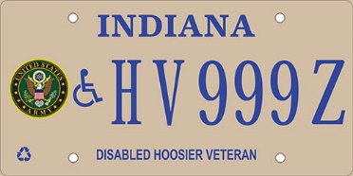
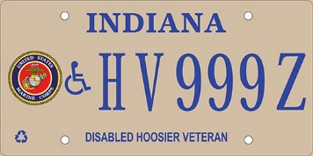
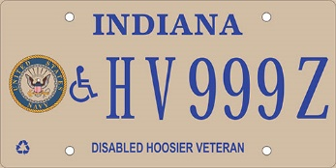
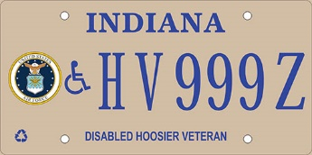
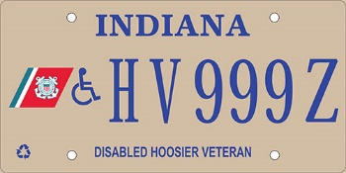
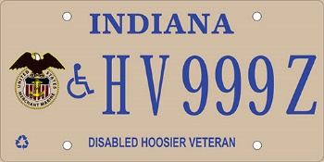
Indiana Department of Veterans Affairs
State Veteran Benefits:
Disabled Hoosier Veteran License Plate & Placard
Eligibility IC 9-18.5-5
Lost sight in both eyes or suffered permanent impairment of vision in both eyes with S/C compensation
Suffered loss of one or both hands or feet or permanent loss of use of one or both hands or feet
A United States Department of Veterans Affairs (USDVA) disability rating for a physical condition that precludes the individual from walking without pain or difficulty OR been rated by the USDVA as being at least 50% disabled and receiving compensation. At least 60% of the 50% rating must be attributed to a mobility disability
Eligibility for this plate also entitles the veteran for a reduced fee Golden Hoosier Passport for use at State Parks, museums, and DNR facilities
In any metered space in the state of Indiana

Slide 25
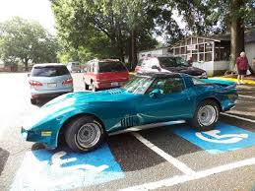
Indiana Department of Veterans Affairs
State Veteran Benefits:
Disabled Hoosier Veteran License Plate & Placard
Don’t be this person
In any metered space in the state of Indiana
Serves as a handicapped plate
Allows for parking in legal metered spaces in Indiana at no charge and allows for parking longer than the allotted time normally permitted
No other individual is authorized parking privileges (the eligible veteran must be present when parking privilege is used)
This plate & placard are not authorized for commercial vehicles
IC 9-18.5-5

Slide 26
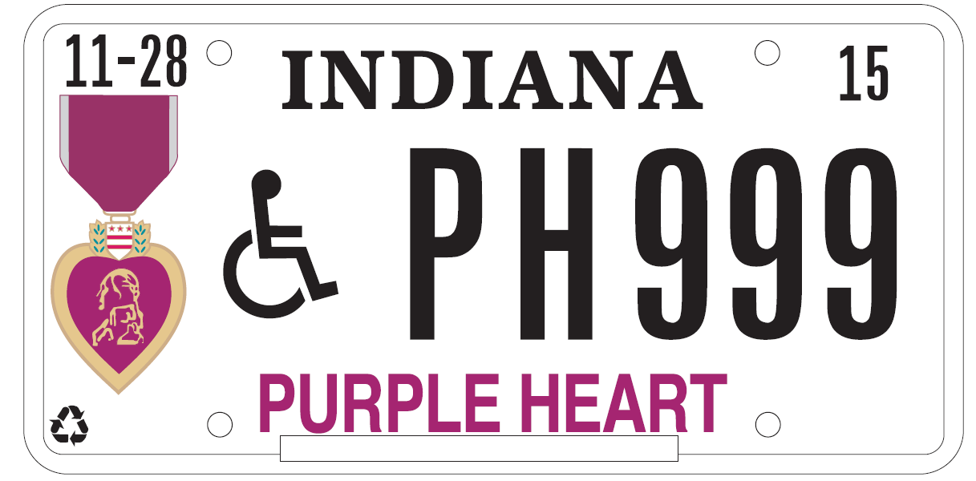
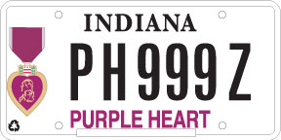
Indiana Department of Veterans Affairs
State Veteran Benefits:
Purple Heart License Plates
Purple Heart Disabled Veteran License Plate
Purple Heart License Plate
A Purple Heart Plate with the universal handicap symbol is also now available. Use the same form as for the Disabled Hoosier Veteran, POW/ MIA, Purple Heart Recipient Plate.
The applicant must be eligible for either a Disabled Hoosier Veteran plate OR be authorized a handicapped placard in Indiana
Request must be accompanied by DD 214 or orders showing Purple Heart award
The Purple Heart license plate allows free parking in legal metered spaces and for longer than the allotted time permitted
PH plates available for passenger vehicle, truck (less than 11,000 lbs), RV, and motorcycle and are available for 1 OR more vehicles
In any metered space in the state of Indiana

Slide 27
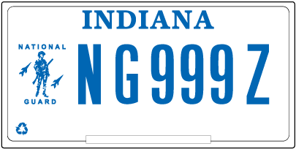
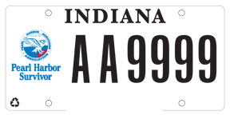
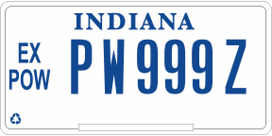
Indiana Department of Veterans Affairs
State Veteran Benefits:
Military & Veteran License Plates
In any metered space in the state of Indiana

Slide 28
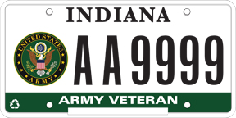
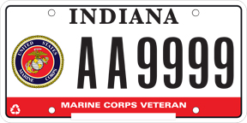
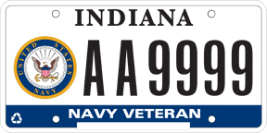
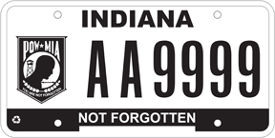
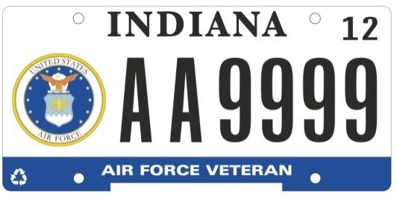
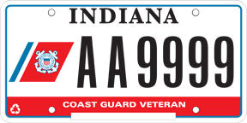
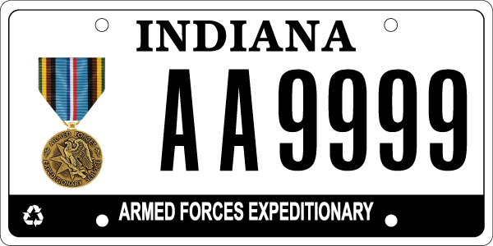
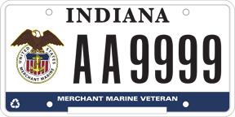
Indiana Department of Veterans Affairs
MILITARY SERVICE LICENSE PLATES
Veterans simply take their DD214 to the licenses branch to purchase these plates.
All proceeds from these (8) plates go to the Military Family Relief Fund.

Slide 29
Indiana Department of Veterans Affairs
State Veteran Benefits:
Military Family Relief Fund (MFRF)
Purpose:
To assist Veterans/families who are having financial difficulties.
Example of what the fund can be used for are:
Utility bills, needed auto repairs, mortgage/rent payments, current medical bills, and groceries etc.
Eligibility:
Grants may be awarded to Indiana residents who is serving or has served in the Armed Forces of the United States or the National Guard on active duty.
More information and application can be viewed/downloaded
on the IDVA web page at www.in.gov/dva.

Slide 30
Indiana Department of Veterans Affairs
IDVAs Women’s Program (WINVet) is dedicated to empower women
veterans to attain the utmost quality of life.
WINVet provides reliable resources, delivers quality statewide outreach and cultivates a vast networking collective for all Women of Indiana who are Veterans.

Slide 31
Indiana Department of Veterans Affairs
State Veteran Benefits:
Discounted Golden Hoosier Passport
Half cost to veterans qualifying for
disabled Hoosier veteran license plate.
Delayed High School Diploma Program
For WWII, Korea and Vietnam veterans.
Free Peddlers, Vendors & Hawkers License
Issued by Indiana county or city.

Slide 32
Indiana Department of Veterans Affairs
www.in.gov/dva
317-232-3190 - Toll Free: 800-400-4520

Slide 33
Indiana Department of Veterans Affairs
IDVA Main Office Phone 317-232-3910
Web page www.in.gov/dva
Facebook
https://www.facebook.com/indiana.veterans/
https://www.facebook.com/INVetMemCemetery/
https://www.facebook.com/Women.Vets.IN/
Twitter
https://twitter.com/InVetAffairs
Instagram
https://www.instagram.com/in_dva/
LinkedIn
Indiana Department of Veterans Affairs
YouTube
Indiana Department of Veterans Affairs

Slide 34
Indiana Department of Veterans Affairs
IDVA Main Office Phone 317-232-3910
Web page www.in.gov/dva
Questions?

