Slide 1

Marine Corps League
Professional Development
Uniforms
Presented by: Dan Tolson
Summer Convention 2021

Slide 2
The Standard Marine Corps League Cover
The basic uniform of the Marine Corps League is the unique cover that identifies the members of the Marine Corps League.
All other parts of the uniform that are designated in this presentation are optional, the cover remains as the only consistent identifier for Marine Corps League members, which is why the cover is worn indoors at appropriate Marine Corps League functions.
When Marine Corps League Members are wearing the appropriate cover, as listed below, they are considered to be in uniform.
NO OTHER TYPE OF COVER MAY BE WORN AT A MARINE CORPS LEAGUE FUNCTION OR MEETING.

Slide 3
The Standard Marine Corps League Cover
All members of the Marine Corps League are authorized to wear the RED COVER.
  Members Elected or Appointed at the Department Level are authorized to wear the RED COVER with a GOLD CROWN.
  Members Elected to a National Office or Appointed to a National Staff/Committee are authorized to wear GOLD COVERS.
  The National Commandant will wear a WHITE COVER.
  Past National Commandants are authorized to wear a GOLD COVER with WHITE CROWN.
  Past Chief Devil Dogs are authorized to wear a GOLD COVER with a BLACK CROWN.
  Past National Vice Commandants of Divisions, Past National Directors, and Past Department Cover National Directors of Young Marines are authorized to wear a GOLD COVER with a GOLD CROWN.
  Past Department Commandants and Past Pack Leaders are authorized to wear a RED COVER with a GOLD CROWN.
  Past Detachment Commandants and Past Pound Keepers are authorized to wear a RED COVER with a RED CROWN.

Slide 4
The Standard Marine Corps League Cover
All Past Officers, listed above, will identify their Past Office with a title strip or embroidery, and will display the years that they held that office.
With the exception of Past National Commandants and Past Chief Devil Dogs, they all will also display the organization where they held that office. (i.e. Southeast Division, Department of Ohio, Chattanooga Detachment, etc.).
Only the officers listed in this paragraph are authorized to retain the Cover for their previous office after they leave that office.
All other members will revert back to the appropriate cover for the elected or appointed office currently held, and if any, removing the officer identification STRIP(S) for prior offices no longer held.

Slide 5
The Standard Marine Corps League Cover
The only insignia authorized for wear on the Marine Corps League Covers is the 1-1/2" X 1-1/2" Anodized Solid Gold Color or Polished Brass Marine Corps Emblem (Enlisted Style Only) on the Left Side.
The Devil Dog patch, if authorized, will be worn up front on the right side of the cover.
The identification strips, i.e., Department or Detachment strip, or embroidering, will be centered on the right side.
If the "LIFE“ strip is worn, it will be to the rear of the right side.
The "LIFE MEMBER" strip will be worn the same as the identification strips are worn, and should be worn above other strips.
NO DIVISION PINS OR OTHER PINS/ORNAMENTS ARE AUTHORIZED ON MARINE CORPS LEAGUE COVERS.

Slide 6
Male Covers
Male Detachment Cover
Male Department Cover
Associate Cover
Male National Cover

Slide 7
Female Covers
Female Detachment Cover

Slide 8
NO PINS ON COVERS
PINS, ORNAMENTS, OR RIBBONS ARE NOT AUTHORIZED FOR WEAR ON THE MCL COVER.
Nothing goes on the Basic Cover, except the Marine Corps Emblem on the left side and approved identification strips or embroidering on the right side.
The Marine Corps emblem should be the anodized solid gold color or polished brass MC emblem, not a Marine officer's gold and silver emblem.
Identification strips should be worn to indicate “current” offices only, except as authorized by the Uniform Code for “Past Commandants".
“Past Commandant” may be embroidered, as this is a lifetime title. It must be small enough, as to be covered by a strip denoting any current office held.

Slide 9
Life Member Strips
The Uniform Code says that the detachment name should be placed on the right side, 1/2" up from the bottom of the cover, centered left to right and abbreviated, if need be.
The recommended font is Franklin Gothic Medium Condensed.
Contact your Detachment about having the detachment’s name embroidered on your cover.

Slide 10
Placement

Slide 11
Uniform Types
Casual
Undress
Women’s Undress
Women’s Casual
Formal Uniform

Slide 12
Nomenclature of MCL Uniforms
Casual – Red Blazer
Plain Black Socks
Highly Shined Smooth Toe Black Lace-up Oxford Shoes
Plain Black tie
Marine Corps or Marine Corps League gold tie bar
Black Standard or Pleated Trousers
Black belt and square gold buckle with the Marine Corps Emblem
White T-Shirt
White Shirt, standard collar
Gold tie bar
Red Blazer
Marine Corps League Cover
White Crew (Round Collar) T-Shirt should be worn under all MCL Uniform Shirts. Members participating in Memorial Services and who are in MCL Uniform may wear white gloves, at the discretion of the Senior Officer in charge of the detail. (Gloves shall be of the same type as worn by the Uniformed Services).

Slide 13
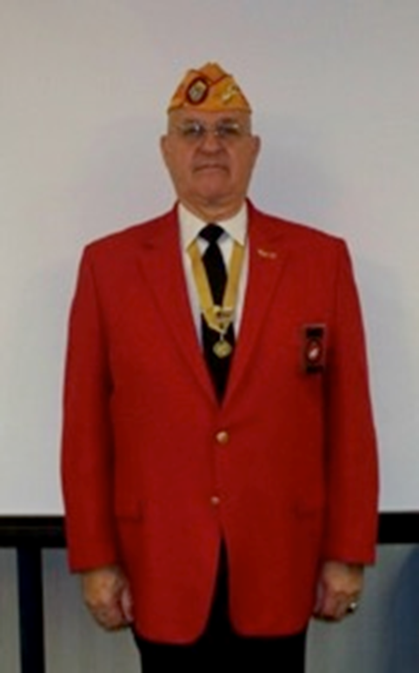
Nomenclature of MCL Uniforms
Casual – Red Blazer

Slide 14
Uniform Types – Cont.
Casual – Red Blazer
The red blazer is available at clothiers outside the Marine Corps League; see your Detachment Paymaster about ordering this item.
All attached items are ordered through the Marine Corps League, see your Detachment Paymaster on how to order these items.
The buttons it comes with must be removed and in their place Marine Corps League buttons sewn. There will be two.

Slide 15
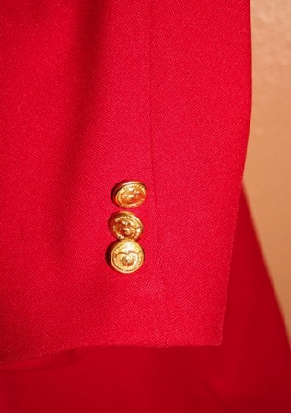
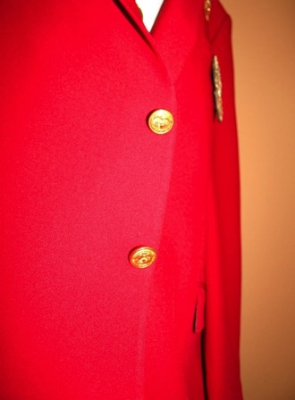
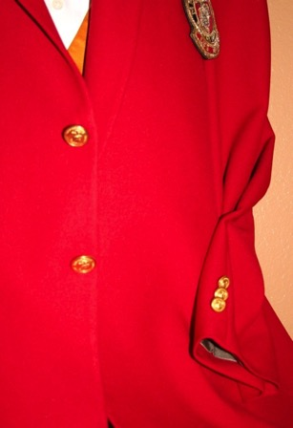
Nomenclature of MCL Uniforms
Casual – Red Blazer

Slide 16
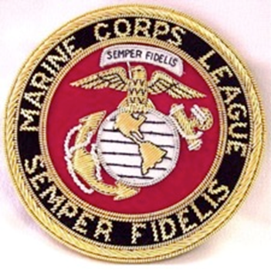
THE MCL CREST
The Marine Corps League Crest is worn on the left breast pocket, about 1/4" below the lower half of the pocket cuff and centered on the pocket.
The Marine Corps League Crest pocket insert may be worn in place of the standard crest, and the commercially sold plastic sleeve insert with permanently set Marine Corps Seal may also be worn.

Slide 17
RED BLAZER OR EVENING DRESS JACKET LAPEL PINS
The MCL Member, MCL Life Member, 5 Year, 10 Year, etc., pins are worn in the left lapel buttonhole. Other pins are also authorized, but never more than two (2) at a time, on the left lapel.
  Past National Commandant Pin
  National Marine of the Year Pin
  Past Department Commandant Pin
  Past Detachment Commandant Pin
  Kennel Dog of the Year Pin
  Chapel of Four Chaplains
  MCL Membership Pin
  Retire Marine / Navy Pin
The Past National Commandant pin may be worn inboard with the National Marine of the Year outboard.
National Marine of the Year pin may be worn inboard, with a Past Department or Detachment Commandant, or other Member pin outboard.

Slide 18
Casual – Red Blazer
Name Tags
The name tag is not worn with this uniform.
Sunburst insignia are never to be worn with the red blazer.
Miniature medals, ribbons, and badges are not to be worn on the red blazer, except when the blazer is worn as an optional jacket of the Formal Uniform, and then miniature medals may be worn or a maximum of three large Medals.

Slide 19
Casual – White Shirt
The shirt can be either long sleeve or short sleeve but must be plain white in color.
This shirt can be purchased at any clothing store.
The shirt should have a plain collar. It will not be the “aviator” style shirt worn with the Undress Uniform.
Sunburst insignias are not worn with the “Casual” uniform. Ribbons and badges are not to be worn with the Casual Uniform.
Patches are not worn with the "Casual" uniform.
No devices, pins, badges or patches of any kind are to be worn with the "Casual“ uniform. Just the shirt, field scarf, and prescribed tie bar.
Nothing more!
* Note: The Marine of the Year Neck Ribbon may be worn.

Slide 20
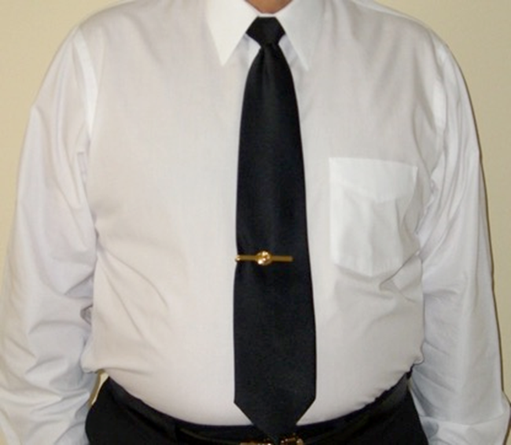
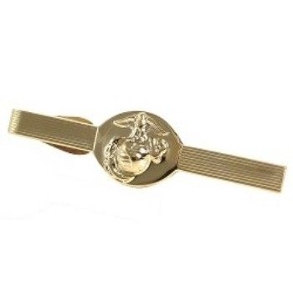
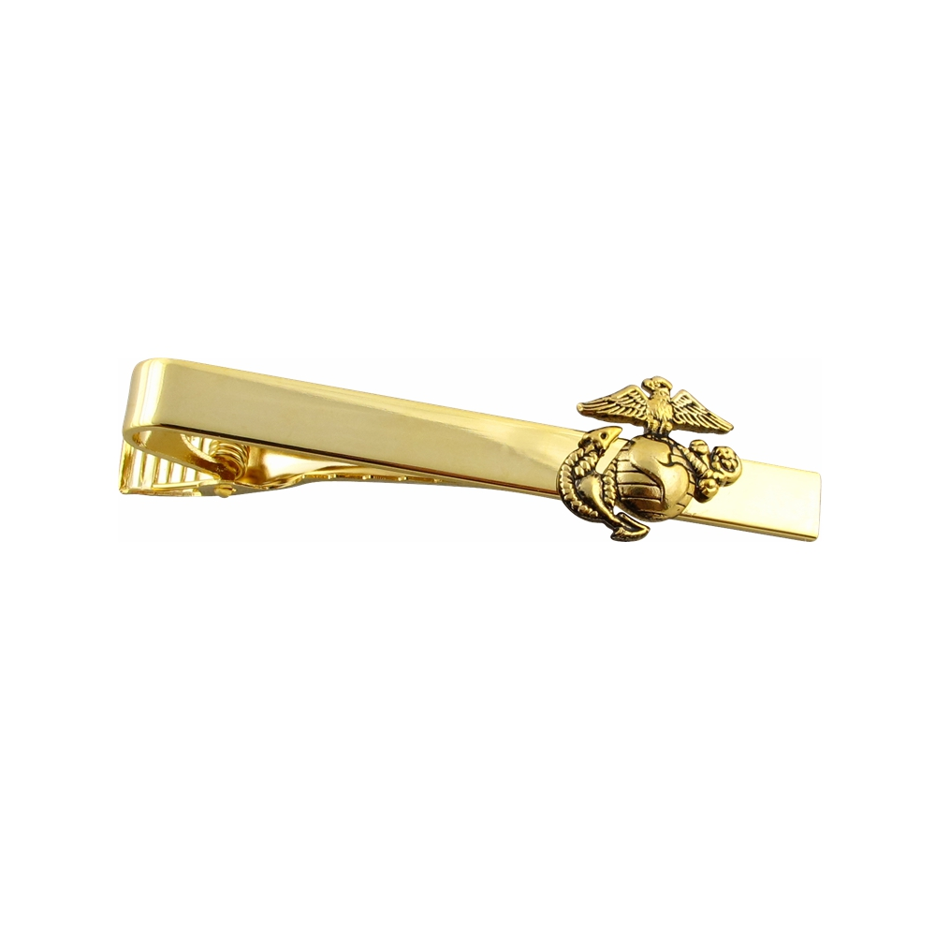
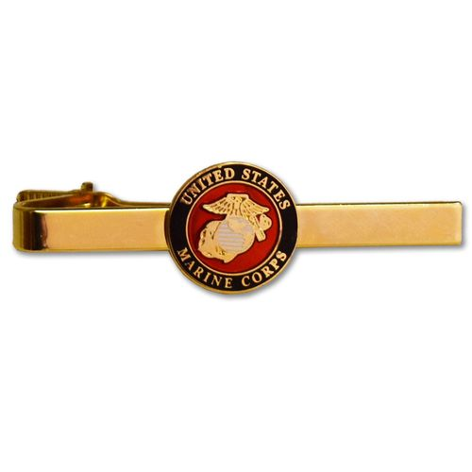
Casual – White Shirt

Slide 21
Casual – Black Trousers
Black trousers with a black belt and square gold buckle with the Marine Corps Emblem are to be worn with the Casual Uniform.
The belt can be either the wide leather belt or the narrow dress belt.
The wide leather belt is worn with the large square buckle with the Marine Corps Emblem on it.
Both are available through National.
The narrow dress belt with the smaller buckle, also having the Marine Corps Emblem, satisfies the black dress belt option.
See your Detachment Paymaster about how to order these items.
The trousers are purchased at any clothing store.
The bottom of the cuff, should just reach the top of the heel sole of the shoes.
Dress blue trousers with red stripe are not authorized with the Casual Uniform.
Sans a belt trousers are not authorized with the Casual Uniform.

Slide 22
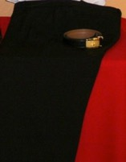
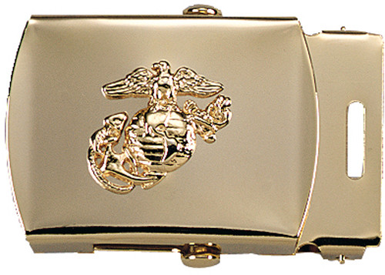
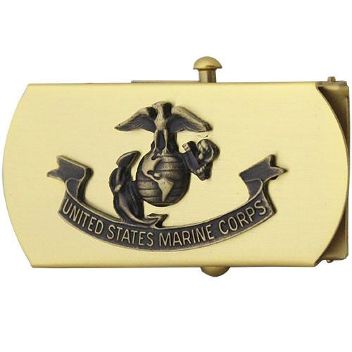
Casual – Black Trousers

Slide 23
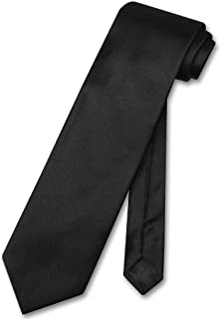
Casual – Field Scarf (Tie)
The field scarf should be a plain flat black tie with a Marine Corps League or Marine Corps gold tie bar.
The field scarf is available at any clothing store, but the tie bar is purchased through the Marine Corps League, or you may wear the Marine Corps issued gold tie bar.
No other tie bar is authorized.
No tie tacks, no field scarf colors other than black, and no embroidered or other designs on the field scarf are authorized. Just a simple, plain, black, field scarf .
A clip-on field scarf may be worn, or if using a regular field scarf , a four in hand knot is recommended.

Slide 24
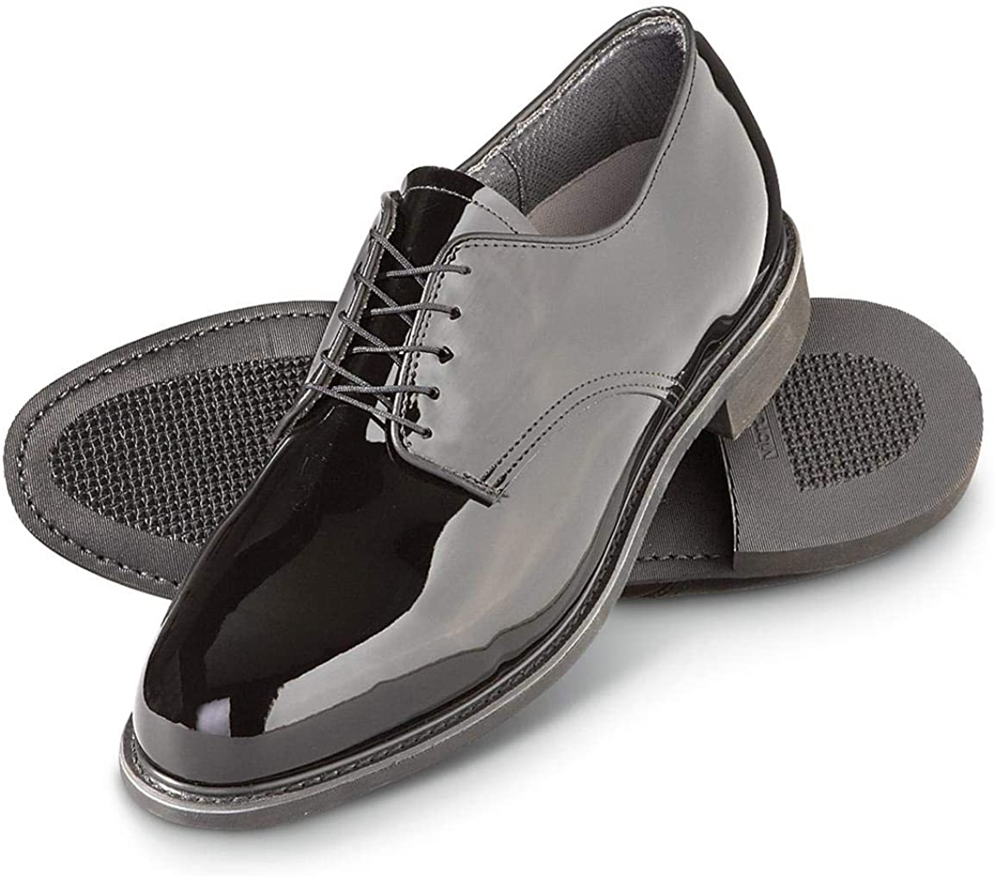
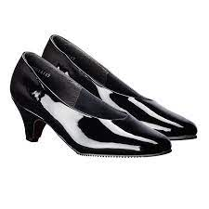
Casual – Shoes
MALE
The shoes should be black leather oxfords, either Corfam© type, or highly shined.
The uppers on the toes should be flat leather, with no seams.
Rubber or leather soles may be worn.
Black socks, shall be worn.
Shoes, black oxford patent leather with trousers.
The same shoes and socks are worn with the Undress Uniform, as with the Casual Uniform.
FEMALE
Patent leather flats or pumps with skirt.
Heels for pumps will measure up to 2" in height.
Hose, nylon, black (with pumps) or socks, black, (with trousers)

Slide 25
Nomenclature of MCL Uniforms
Undress Uniform
Plain Black Socks
Highly Shined Smooth Toe Black Lace-up Oxford Shoes
Plain Black tie
Marine Corps or Marine Corps League gold tie bar
Black Standard or Pleated Trousers
Black belt and square gold buckle with the Marine Corps Emblem
Marine Corps web belt and brass buckle
White T-Shirt
Marine Corps League Cover
Blue Trousers with NCO Stripe
White Shirt w/epilates, 2 Breast Pockets w/button Flaps, Long Sleeve (2)
White Shirt w/epilates, 2 Breast Pockets w/button Flaps, Short Sleeve

Slide 26
Undress Uniform
There's more to the Undress Uniform than just taking off your red blazer.
The Dress Blue trousers with the red NCO stripe are worn with the Undress Uniform, along with the Marine Corps web belt and brass buckle.
Dress Blue trousers have the red NCO stripe, not the wider Officers stripe.
The Black Trousers may be worn as an option with both Undress Uniforms, having the same belt and buckle options as with the Casual Uniform.
The same shoes and socks are worn with the Undress Uniform, as with the Casual Uniform.
Sunburst insignia and ribbons are worn the same as the long sleeve shirt.
The optional name tag is worn the same way as with the long sleeve shirt.

Slide 27
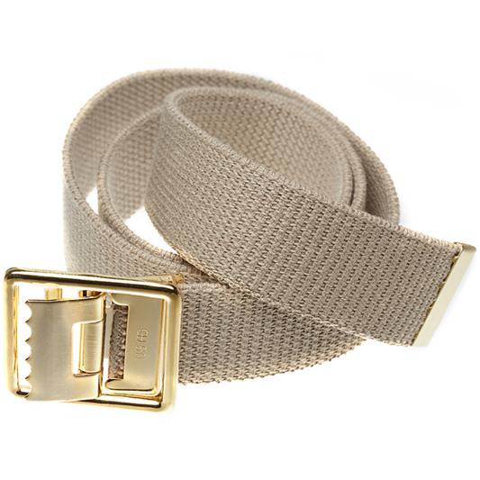
Undress Uniform

Slide 28
Long Sleeve Shirt
The Long Sleeve Undress Uniform shirt will be an aviator style shirt, with two (2) button down breast pockets and shoulder epaulets.
It will have a military crease running top to bottom, centered on each pocket and three creases on the back.
The Marine Corps League Shoulder Patch is worn on the left shoulder, centered on the crease, 1-1/2" down from the shoulder seam.
The Field Forward American Flag or Devil Dog patch will be worn on the right shoulder, centered on the crease, 1-1/2" down from the shoulder seam.

Slide 29
Short Sleeve Shirt
The Short Sleeve Undress Uniform is same as long sleeve except in sleeve length.
It has the same pockets, shoulder epaulets, creases and patches.
The top most button is left open and a tie is never worn with the short sleeve Undress Uniform shirt.
The dress blue trousers with red NCO stripe are to be worn with this uniform, the black trousers are an option.
The same belts and belt options are worn with the short sleeve Undress Uniform as with the long sleeve Undress Uniform.

Slide 30
Undress Uniform

Slide 31
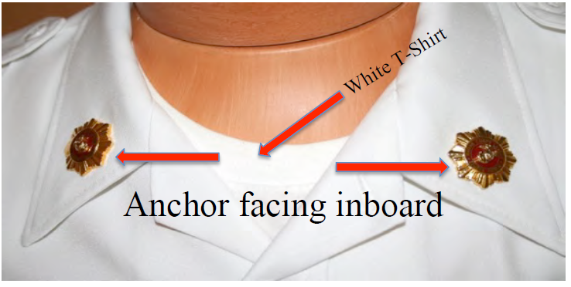
Sunburst Insignia
The Sunburst Insignias are worn on each collar, centered, 1/2" from both edges, with the eagles wings parallel to the deck, with anchors facing inboard.
The nametag may be worn above the right breast pocket, centered and 1/8“ above the top of the flap.
Either Marine Corps League ribbons or Department of Defense ribbons and badges may be worn above the left breast pocket, centered, 1/8" above the top of the flap.
Marine Corps League and Department of Defense ribbons cannot be mixed.
Ribbons are to be worn in rows not exceeding four ribbons per row. If the top row has fewer ribbons than the lower rows, they are to be centered on the lower rows.

Slide 32
Nomenclature of MCL Uniforms
Women’s Uniform
Plain Black Socks
Highly Shined Smooth Toe Black Lace-up Oxford Shoes
Black Standard or Pleated Trousers
Black Nylons
Black Pumps
Women's white blouse that is worn with the USMC Dress Blues
Black cross over (Marine Corps Style) tie
White T-Shirt
Red Blazer
Marine Corps League Cover
Plain black "A" line skirt
Black belt and square gold buckle with the Marine Corps Emblem

Slide 33
Women’s Undress Uniform
Dress blue trousers with red NCO stripe may be worn, with Marine Corps web belt and brass buckle, when in Color Guard.
Black nylon hosiery and a black, plain toe, closed pump are worn with this uniform.
When wearing trousers, plain, black oxfords may be worn.

Slide 34
Women’s Shirts
A long sleeve or short sleeve white shirt, with shoulder epaulets, military creases and two button down flap pockets, similar to the men's shirt, is worn.
An option is the women's white blouse that is worn with the USMC Dress Blues. Either Marine Corps League ribbons or Department of Defense ribbons and badges may be worn, but not mixed.
With the long sleeve version of this uniform, either the black cross over (Marine Corps Style) tie -OR- black field scarf with MC or MCL gold tie bar will be worn.
The Sunburst insignias, shoulder patches and name tag are all worn the same as is prescribed with the men's uniform.
A plain black "A" line skirt or black slacks are worn the same as with the casual uniform.
When the trousers are worn, the same belts that are authorized with the Casual Uniform may be worn.

Slide 35
Women’s Undress Uniform

Slide 36
Earrings
Although earrings aren't mentioned in the Women's Casual Uniform section of the National Bylaws, Enclosure (3), it is written in the section on the Women's Undress Uniform and is believed to apply to all uniforms.
Earrings may be worn with this uniform.
They must either be small, round, white pearl (or pearl like), or gold earrings, not to exceed 9mm in size.
When worn, they will fit tight against the lobe of the ear and not extend below the earlobe.

Slide 37
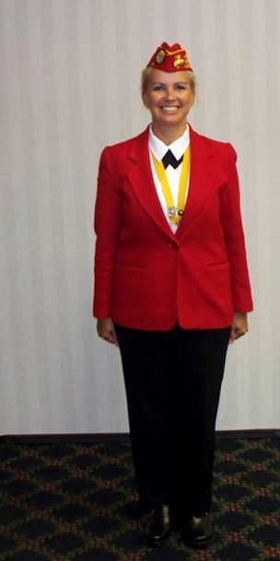
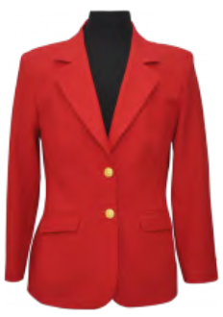
Women’s Casual Uniform
The Women's Casual Uniform will consist of the red blazer, with the buttons arranged as is on the Men's Casual Uniform or the Women’s Red Blazer which is fitted differently, and the front buttons are on the opposite side, from the men's red blazer worn.
Like the Men's Casual Uniform, black dress pants are worn.
Both are available through an outside clothier.

Slide 38
Associate Member’s Uniform
The Associate Member is not to wear the Marine Corps Emblem. This Emblem is highly honored by all Marines and only those who earn it, may wear it.
The regulations for Associate Member Uniforms are the same as Regular Member Uniforms, except as follows:
    The Marine Corps Emblem on the Basic Cover is replaced with a Starburst Emblem with Forward Facing Anchor.

Slide 39
Associate Member’s
Crest, Sunburst, American Flag and MCL Patch
On the Casual Uniform, the Crest or Bullion Seal is not worn.
The Sunburst Insignias on the Undress Uniform is replaced with 1/2" x 1/2“ gold MCL insignias.
The field forward American flag patch is worn on the right shoulder and the Marine Corps League patch with an Associate Rocker attached at the bottom will be worn on the left shoulder.
They are to be worn in the same way as prescribed on the Regular Member Undress uniforms.
Dress blue trousers may be worn, but without the red NCO stripe.

Slide 40
Nomenclature of MCL Uniforms
Formal Uniform
Plain Black Socks
Highly Shined Smooth Toe Black Lace-up Oxford Shoes
Black Standard or Pleated Trousers
Blue Trousers w/ NCO Stripe
Black Tuxedo Trousers
Formal pleated shirt with a standard collar and no ruffles
Military Bow Tie - Black
White T-Shirt
Marine Corps League Cover
Marine Corps black field scarf and Marine Corps or Marine Corps League Gold cuff links and gold studs
Red Mess Jacket

Slide 41
Formal Uniform
The Formal Uniform will consist of the Basic Cover, as with all other uniforms.
The shirt will be a formal pleated shirt with a standard collar and no ruffles.
The tie will be a black, military bow tie.
The shirt will have gold cuff links and gold studs.
The Chapel of Four Chaplains medal may be worn with this uniform as an option and the Marine Corps League Blazer Crest or Bullion is optional when miniature medals are worn.

Slide 42
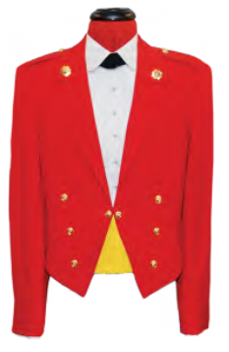
Formal Uniform – Cont.
The red mess jacket is worn with this uniform, but the red blazer may be worn as an option, due to the high cost of the red mess jacket, which is ordered through an outside clothier.
If the red mess jacket is worn, it will be a medium weight gabardine material with Marine Corps League buttons, a gold waist chain and the Sunburst Insignia in locating holes in the jacket collar.
The buttons are sewn on, three to a sleeve and three on either side of the waist, as illustrated.

Slide 43
Formal Uniform – Cont.
A gold cummerbund or gold vest front can be worn with either Jacket.
They are both sold through National.
Blue trousers with NCO Stripe or Black tuxedo trousers are worn with the Evening Dress jacket, but black trousers are an accepted option.
The belt and buckle can be either of the belts worn with the Casual Uniform.
When wearing the Red Evening Dress jacket, large medals may not be worn.
When wearing the red blazer, miniature medals are authorized as described below, or up to three large medals may be worn.
Shoes and socks are the same as the Casual Uniform.

Slide 44
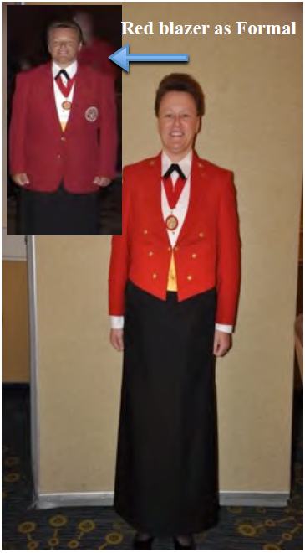
Formal Uniform – Cont.

Slide 45
Mounting of Medals
When more than one medal is worn, they shall be suspended from a holding bar of metal or other material of sufficient stiffness to support the weight of the medals.
When eleven (11) medals are worn, there will be five (5) medals on the first row, and six (6) medals on the second row (medallions cannot be even top to bottom).
One to ten medals can be mounted on one (1) row.
In the case of Marine Corps League issued medals only, in lieu of overlapping mini-medal mounting, the commercially available mini-medal mounting bars, which display the mini-medals in rows of four (or rows of five, when five, ten, fifteen or twenty are worn), or partial additional rows of one, two or three mini-medals, without overlapping, may be worn.
When eight or more medals are worn, the lower row will contain the same number as, or one more than, the upper row and overlap evenly, up to seven medals.

Slide 46
Mounting of Medals – Cont.
The upper row will be side by side up to four medals, then overlapping if the second row is more than Four medals and less than seven.
The upper row, should never be more than one medal greater in number than the lower row.
If more than fourteen medals are worn, they are to be placed on three rows, with the lower and middle rows containing the same number of medals and the top row, either the same number or one less than the middle row.
At no time are there to be more than seven medals to a row.
Any time there are more than four medals to a row, they are to be overlapped evenly (no more than 50%) and the upper rows will have no more than one more medal than the next lower row.

Slide 47
Wearing of Miniature Medals
Formal Dress Only
Miniature Marine Corps League or Miniature Department of Defense Medals may be worn only with the FORMAL DRESS UNIFORM, either on the Evening Dress Jacket, or on the MCL Red Blazer when worn as the optional jacket for the FORMAL DRESS UNIFORM.
They shall be worn centered on the left lapel of the Formal Jacket with the medals placed evenly between the left lapel notch and the top edge of the breast pocket and one inch out from the edge of the inside of the left lapel.
Additional holding bars on the Red Blazer shall be placed under the top row in such a manner that the medallions of the upper row are in line immediately above the medallions of the succeeding row, unless medal count is uneven.

Slide 48
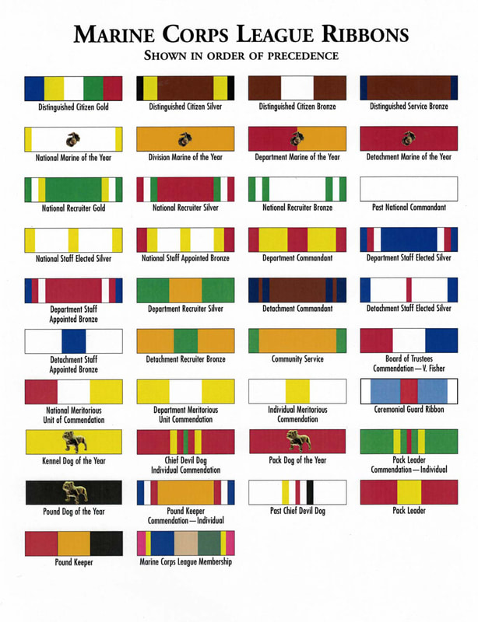

Slide 49
Military Order of the Devil Dogs
Uniform Regulations
The cover patch of the Military Order of the Devil Dogs, Inc. is to be sewn on the right-hand side of the Marine Corps League Cover centered over the piping, (gold piping on the Detachment member and Department Officer cover, red piping on the National Officer cover) so that one half of the patch extends from either side of the piping.
The eyes of the Bulldog on the Patch should be level to the deck and the Gold Trench Helmet will be canted to the left side of the Bulldog’s head.
The bottom line of the helmet touching the Bulldog’s head on either side should be parallel to the piping on the cover.
The Patch shall not touch the piping on the top of the cover, or the bottom edge of the cover, nor shall it touch any lettering on the cover.
No pins, stars, medals, or any other devices shall be worn on the cover.
Kennel officers may wear gold covers but must revert to the cover they are authorized after their term of office.
Past Chief Devil Dogs are authorized to wear a Gold with black crown.

Slide 50
Military Order of the Devil Dogs
Uniform Regulations – Cont.
An embroidered official insignia may be worn on the right sleeve of the shirt with the top of the insignia 1-1/2 inches below the shoulder seam.
The official identification disc of the Military Order of the Devil Dogs, Inc. shall be a metal one, which can be gold or silver plat.
The disc shall be 1-1/4 inches in diameter on the face of which is the official insignia surrounded by the lettering of the official title of the order and below the insignia the words "Pound No." allowing space for the number of the member's Pound.
On the top of the reverse side shall appear the words "Presented to" below which shall be a space for the name and state of the member, at the bottom the words "License No." which is for the member's license number.

Slide 51
Military Order of the Devil Dogs
Uniform Regulations – Cont.
The disc is to be perforated and suspended by a 1inch ribbon of approximately 36 inches in length to permit the disc to be worn pendant about the neck in colors herein described:
    All active PEDIGREED DEVIL DOGS shall wear a gold ribbon.
    All active DEVIL DOGS shall wear a red ribbon.
    All active PUPS shall wear a black ribbon.
    Gold plated discs shall be worn by all Past Kennel Officers and bear the name of the highest office held and the fiscal year of tenure.
    Silver plated discs shall be worn by all Past Pack and Pound Officers and shall be similarly inscribed as to the highest Pack or Pound office held and fiscal year of tenure.
    All other members of the order shall wear the plain metal disc.
These Devil Dog Items are those that affect the Marine Corps League authorized Uniforms; for complete information contact your Pound Keeper.

Slide 52
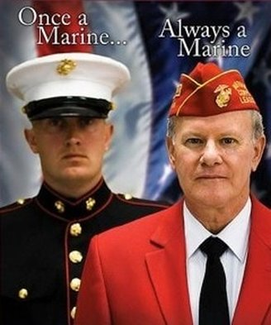
END OF LESSON
ENJOY THE CONVENTION

