Slide 1

Poll-a-palooza
Brian Colker
September 28, 2024

Slide 2
“Absent an extraordinary upending event, Kamala Harris will win the national popular vote on November 5th. I’m confident of that not because she is ahead in the polling averages... I say it because in the MAGA Era the best predictor of how – and whether – someone will vote in the future is how – and whether – they have voted in the past
Michael PodHorzer (September 26, 2024)
https://substack.com/@michaelpodhorzer/p-149428413

Slide 3
Burning Questions
What are the polls telling us?
What’s going on with independents, Latinos, and young voters?
How is the Senate looking?
Where should we put our time and money?

Slide 4

Current National Polling:
Harris has reached Biden’s 2020 numbers
She is hitting 50% in numerous polls – a key polling milestone
Data is showing the Anti-MAGA coalition is coming back into focus
Poll | Harris | Trump
ABC News | 51 | 46
Morning Consult | 50 | 45
CBS News | 52 | 48

Slide 5

Blue Wall Polling:
Biden / Harris ground game in PA paying off – key early investments in Hispanic voters; Harris holds 13 pt lead among independents
In WI, local teamsters endorsed Harris; Baldwin’s coattails might also help; 57% oppose repeal of Roe v. Wade
UAW backing Harris will matter in MI, where union membership is 13% of the vote
State | Most recent Poll | RCP Average
Wisconsin | Harris +2 | Harris +2.2
Michigan | Harris +3 | Harris +2.4
Pennsylvania | Harris +5 | Harris +1.4

Slide 6

Other Swing States
State | Most Recent Poll | RCP Average
Arizona | Harris +3 | Trump +1.2
Florida | Trump +3 | Trump +4.1
Georgia | EVEN | Trump +0.8
Nevada | Harris +7 (!) | Harris +1.0
North Carolina | Harris +2 | Trump +0.4
If Harris wins the blue wall, she needs to win ZERO of these states.

Slide 7

Harris with Key Voters: 9/19 Times/Siena
  +25 white college
  +24 non-white, non-college
  +21 with 18-29 year olds
  +17 suburban
  +12 with Hispanic
  +12 with women
  +4 with 30-44 year olds
  -3% with independents
  -36 rural
  -36 white, non-college

Slide 8

Case for Optimism
Harris maintains huge cash advantage
Republican ground game is non-existent
Fewest # of undecided voters ever, possibly
Harris steadily recovering anti-MAGA coalition
Democratic enthusiasm skyrocketed from July
Republican down-ballot candidates horrible
RFK quickly becoming non-factor
Democrats continue to hold the policy positions large majorities favor
Trump is a worse candidate now than in ‘20, and much worse than ’16
Little evidence of “red wave” in data; post-Dobbs polling undercounts dems

Slide 9

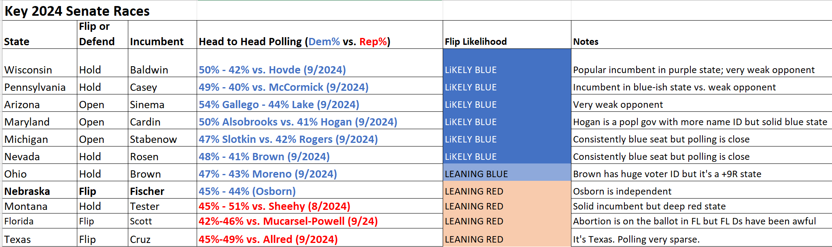
Senate Map: Nailbiter
We can only afford to lose ONE seat

Slide 10
Last Minute $$$
DNC – they are pushing money down ballot!
California House races: pick your favorite
Senate races: FL, MT, NE

Slide 11
Where I’m investing time
CA House races: OC, Central Valley, CA27
Maricopa County

Slide 12
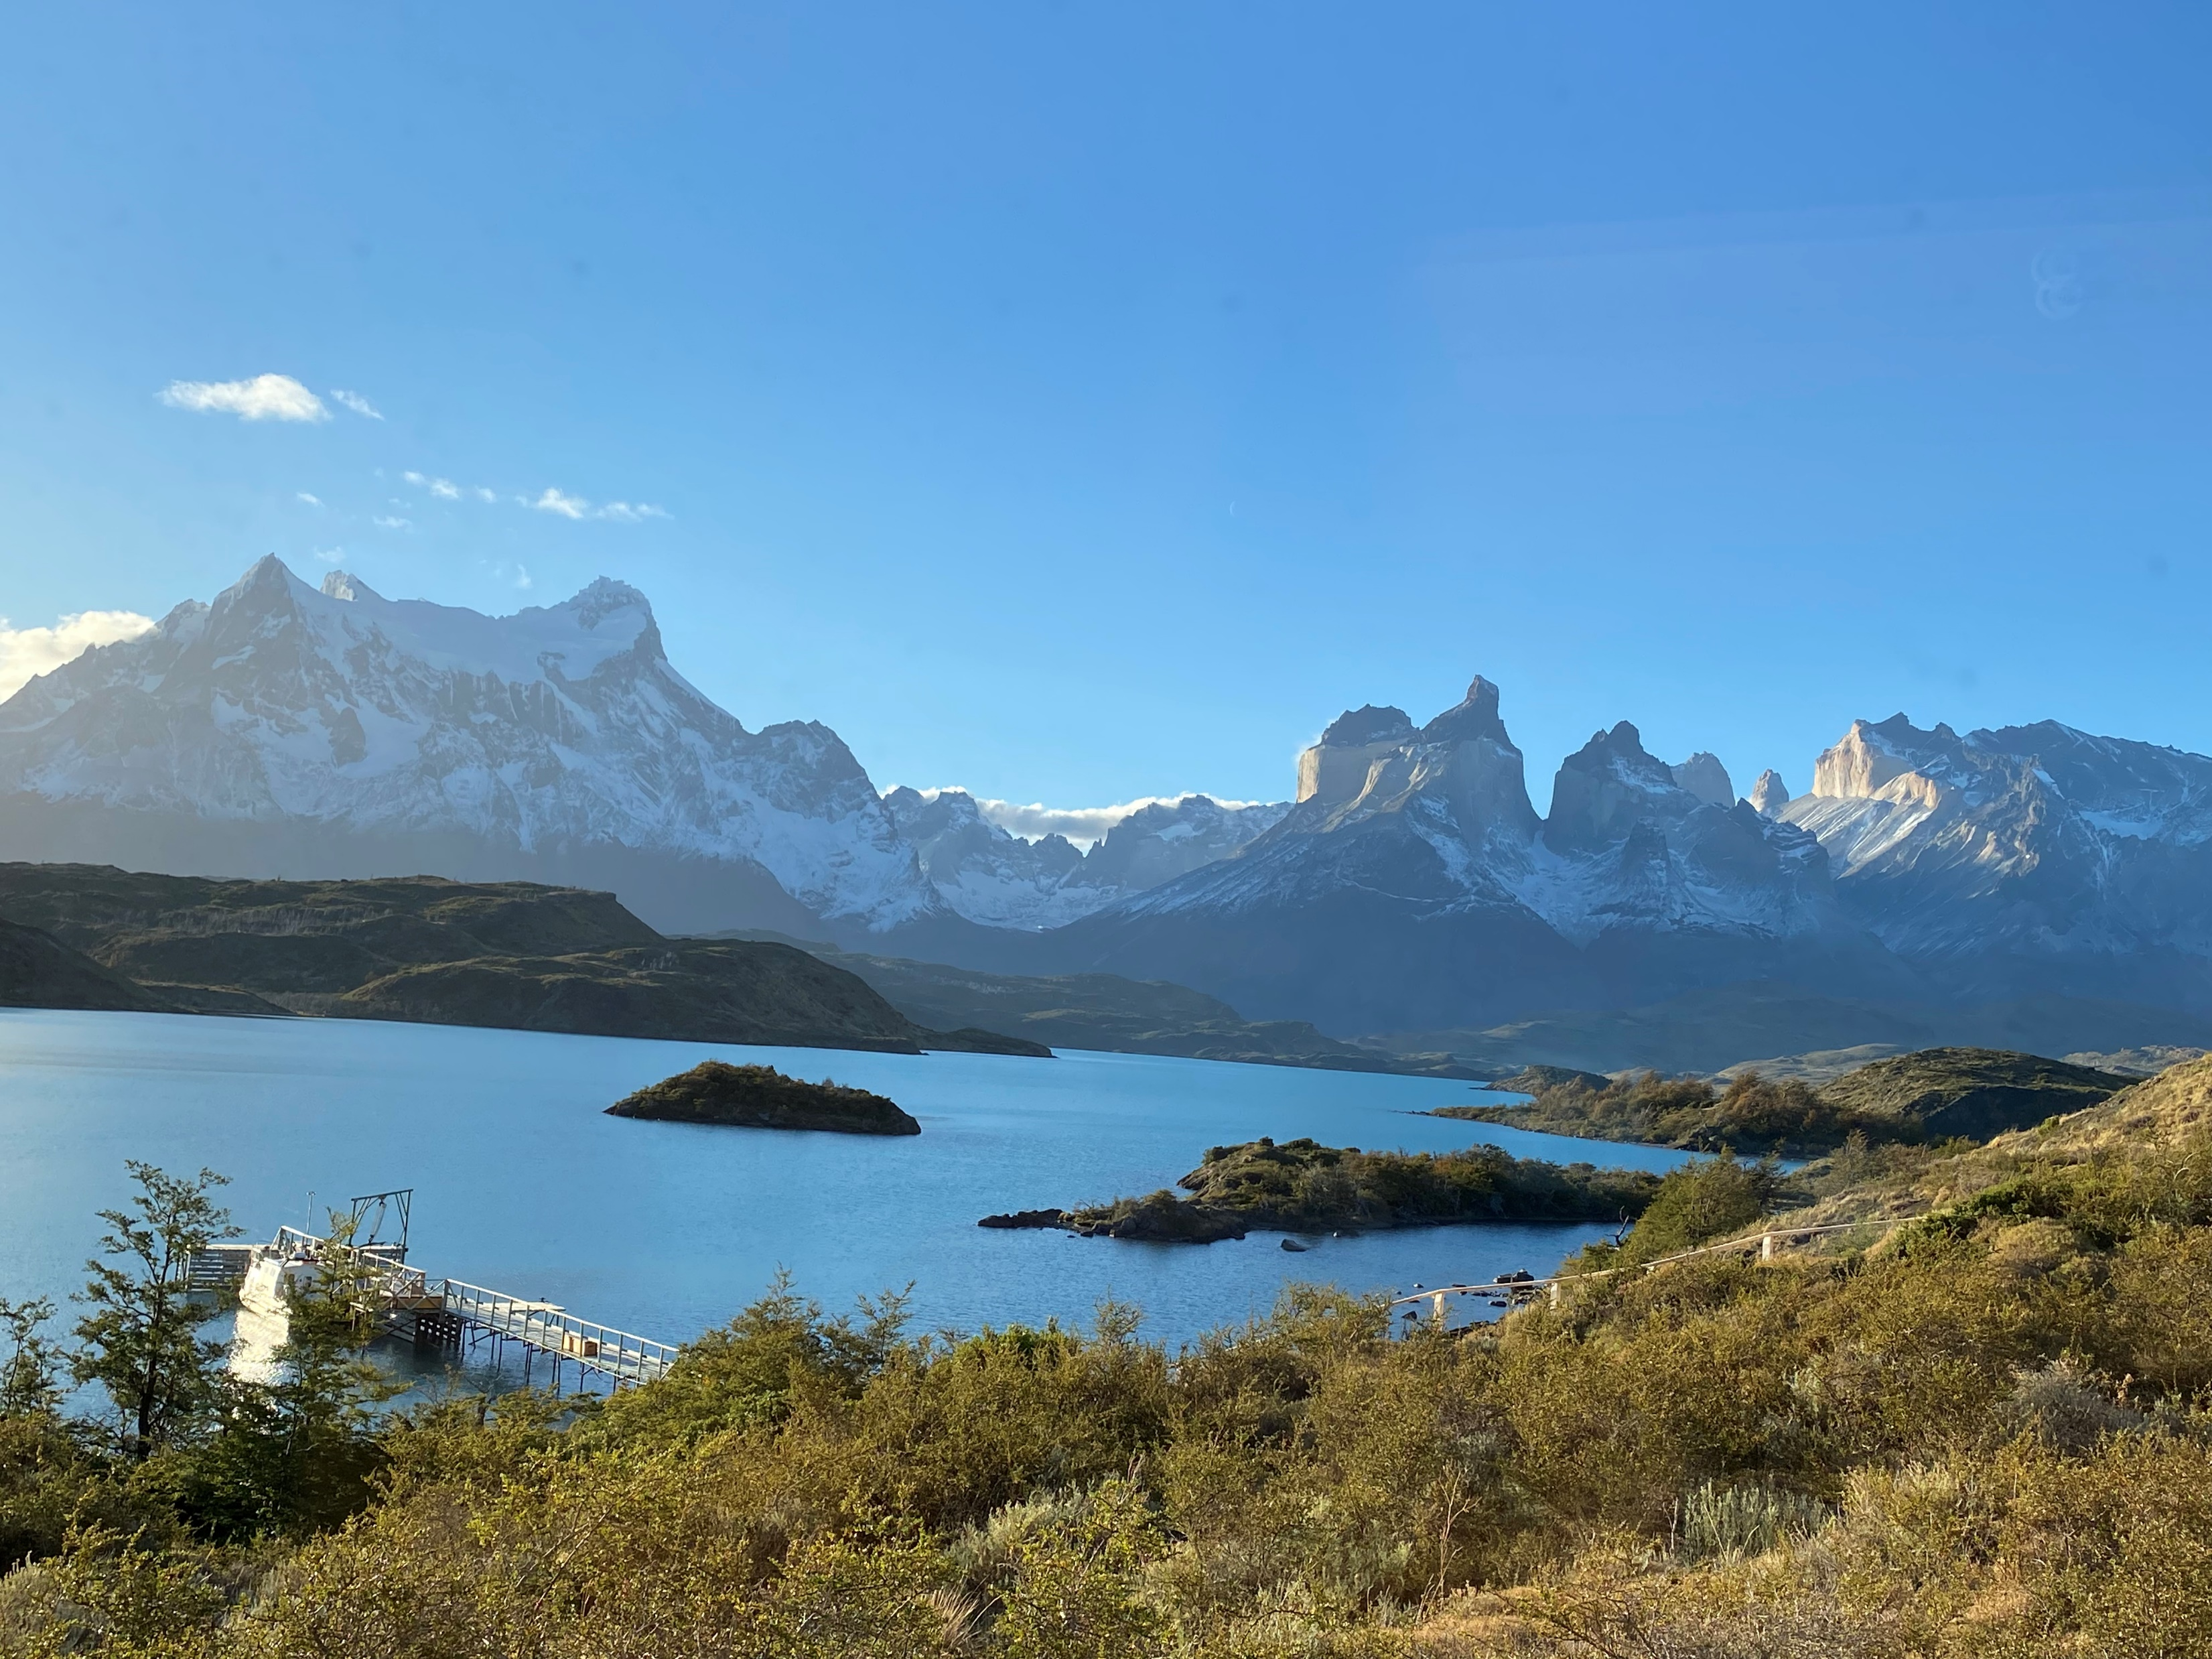
(It’s a big, beautiful world)

