Slide 1

Sure wish we could have a do-over
Brian Colker
October 26, 2025

Slide 2
“The American people need a Democratic Party that stands strong and pushes back against the Trump Administration. The president and his rich friends care more about giving tax breaks to the wealthy than making the costs of the things we buy go down or helping American workers. Democrats need to be the ones to unite the American people regardless of race, class, or zip code against this hostile government takeover and demand representation for all of us, not just the top 1%.”
--Message 83% of 2024 Non-voters found somewhat or very persuasive (Lake Street Partners, April 2025)

Slide 3
Burning Questions
What happened last year? Where did the Anti-MAGA coalition go?
Do any voters and non-voters regret their decisions from 2024?
What does this tell us about the way forward for 2026 and beyond?

Slide 4
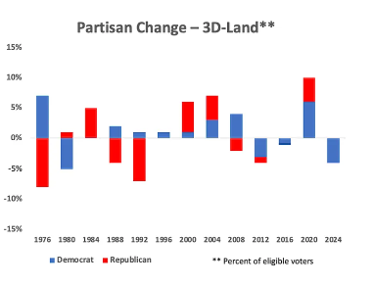
Anti-MAGA coalition underperformed
Harris lost because Democratic turnout was lower in ‘24 that ’20
19 million 2020 Biden voters didn’t vote in ‘24
Voter intensity against Trump was significantly lower: 15 million fewer “anti-Trump” votes in ’24
Trump was not more popular in ’24 than in ’20; his support was stable (on the balance)
Michael Podhorzer https://www.weekendreading.net/p/how-trump-won

Slide 5
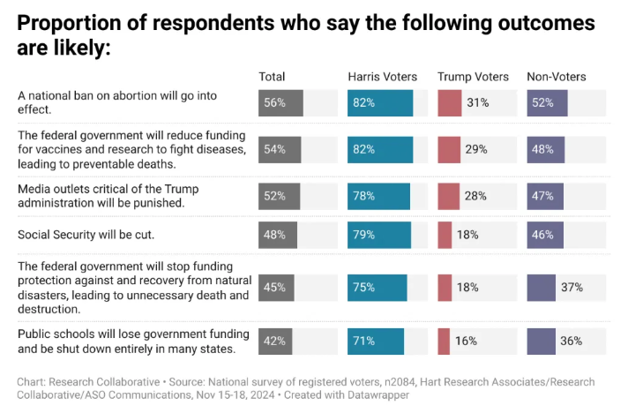
He won’t really do that, will he?
Credulity Chasm*: many voters did not know what Trump planned to do
It was more a question of not knowing, not hearing about it and then rejecting it
Trump voters knew the least about his actual pans.
Anat Shenker-Osorio

Slide 6
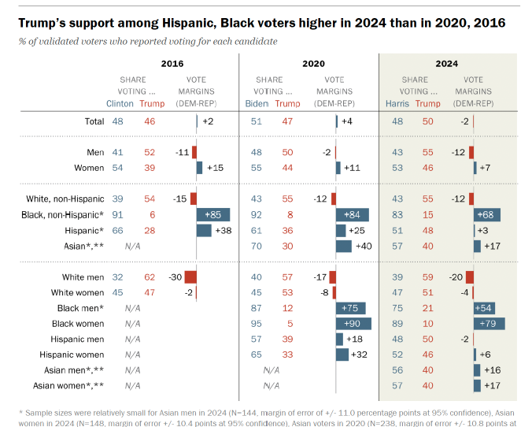
Hispanic Voters – Disaffected or Red-Pilled?
Hispanic voters either moved steadily to the right or were more likely to sit out election (both were true in ‘24)
Black voters showed similar behavior, but not as pronounced
Big gender gap persists but all arrows moving in same direction

Slide 7
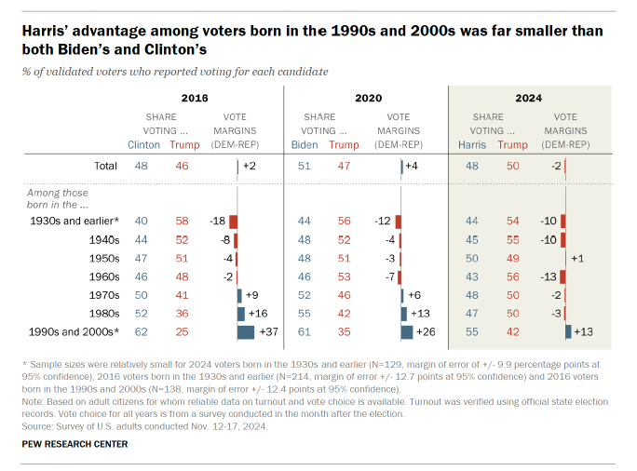
Youth vote blues
Younger voters likely voted significantly less in ’24 than in ‘20 or ’16, vs. shifted to the right

Slide 8
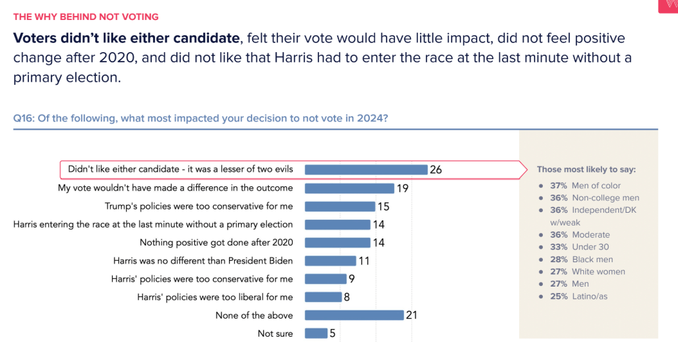
Non-Voters: WHY???
Why did 19 million Biden voters stay at home?
Not convinced by these answers – voting is not rational for most people
Study by Lake Street Partners / Way to Win: Polling done April-June among 822 non-voters

Slide 9
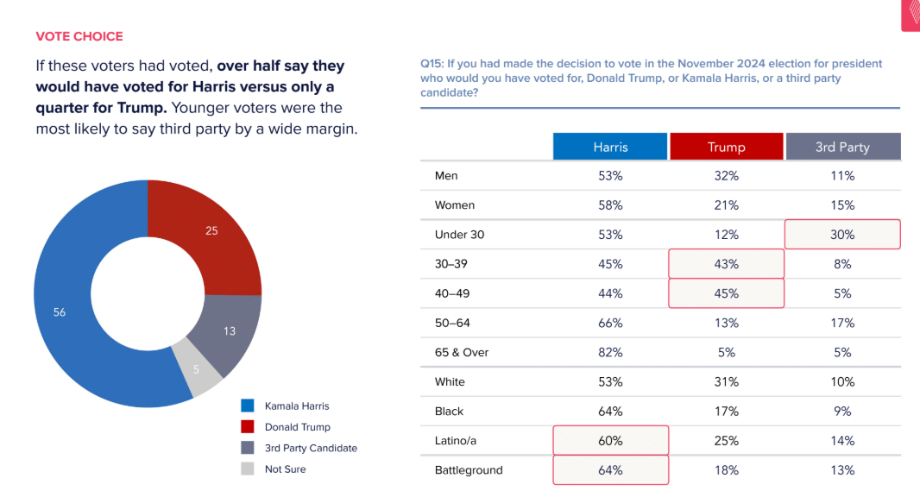
They swung the election to Trump
Pretty clear from the data that higher turnout would have meant a Harris win
Confirms Podhorzer’s theory

Slide 10
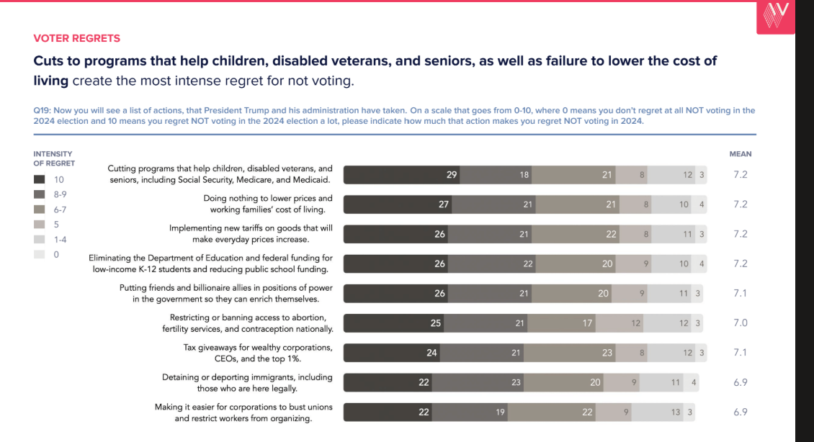
Buyer’s Remorse
Yeah, they feel bad
The intensity of regret is pretty high as well

Slide 11
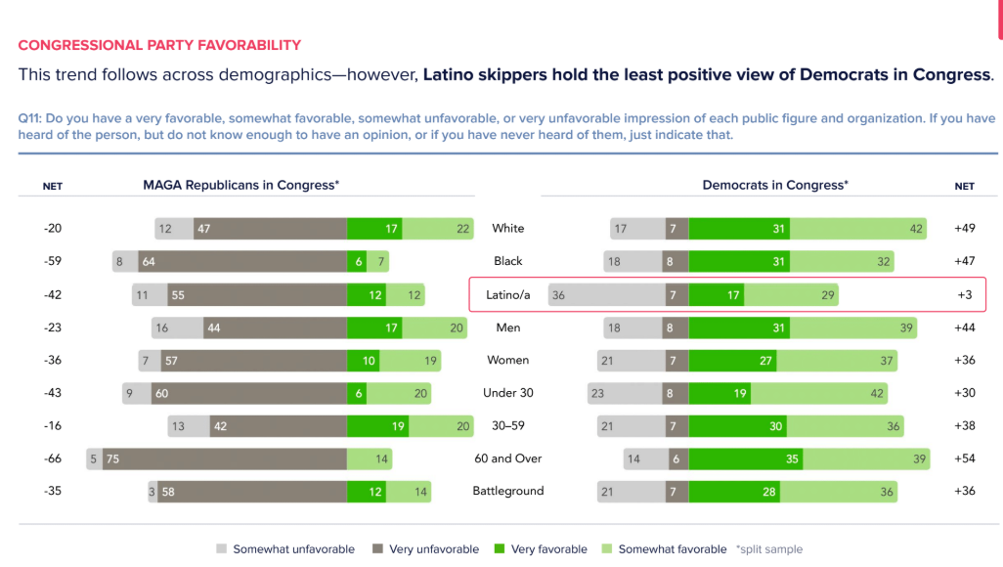
Latino Non-Voters: Neutral on Dems
Non-Voters generally are Democratic-friendly voters
Hispanic are the least supportive (but still +3 net)
Confirms that Democratic “brand” problem is not decisive

Slide 12
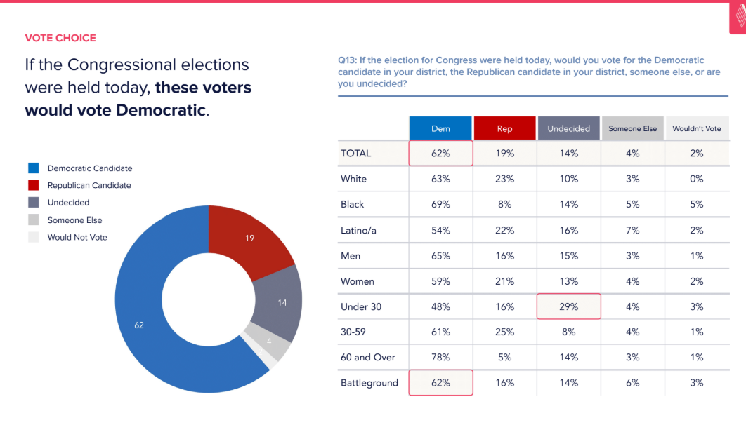
Looking good for mid-terms
Non-Voters are poised to support Democrats in ‘26
Likely to be an anti-incumbent vote
Under 30s are the most undecided

Slide 13
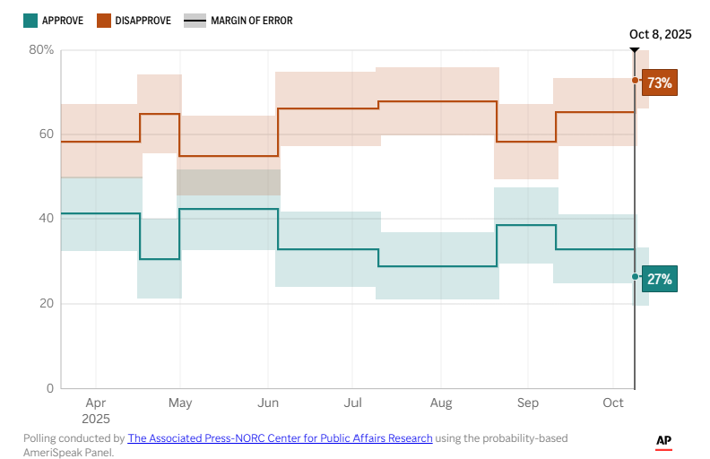
Regrets, I have a few
19% drop in Hispanic approval in 9 months
73% of Hispanic voters think country in going in wrong direction
Hispanic Republican approval – 83%->66%

Slide 14
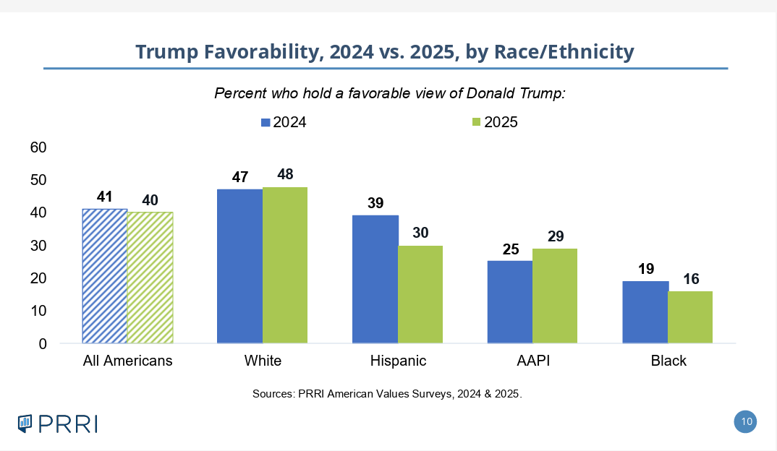
Hispanic Voter Regrets
Note Hispanic drop the largest of any group

Slide 15
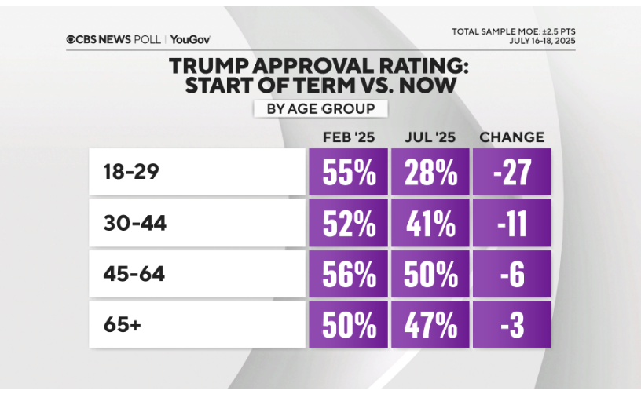
Regrets, I have a few
17% of Trump voters say they know a person who regrets their vote (double Harris)
10% of Trump voters say they regret their own vote
Young voters the most changed in opinion

Slide 16
What does this mean?
MAGA is as unpopular as always.
A significant number of voters and non-voters did not know what Trump planned to do.
A lot of people (in the millions) regret their decision to not vote or to vote for MAGA.
These people are open to voting for the Democratic party.
They are attracted to someone willing to fight.
Fighting against billionaires and a rigged system is the most popular framework to move non-voters.
Most voters don’t want lists of policies and they don’t care about non-partisanship; they are moved by emotional commitment to a shared value

Slide 17

(It’s a big, beautiful world)
(especially far away from here)

