Slide 1
The New Anti-MAGA Midterm Voter
Brian Colker
February 26, 2023

Slide 2
“Where voters understood the stakes, they voted as they had in 2018 and 2020; where they did not, they met the pundits’ expectations about a Red Wave.”
MICHAEL PodhoRzer, January 13th, 2023
https://michaelpodhorzer.substack.com/p/red-wave-blue-undertow?utm_source=twitter&utm_campaign=auto_share&r=103bk

Slide 3
When Comparing 2018 to 2022…
In 15 states, Democrats netted 4 House Seats and 4 Senate seats. and turnout stayed historically high (53.3%)
In 35 states, Democrats lost 25 House seats and netted no Senate seats, and turnout declined 5%
What explains the difference? A new block of Anti-MAGA midterm voters.

Slide 4
House: 2 Different Elections
This chart compares 150 House races to the Democratic Presidential turnout vote
The left graphic is all 50 states; the right separates the 15 states with MAGA statewide candidates

Slide 5
5 Key States: PA, GA, WI, AZ, MI
Combined # of Democratic: | 2016 | 2022
Governors | 1 | 4*
Majorities in State Legislature | 0 | 3
Senators | 4 | 9
*These 4 Governors ran 1.3% ahead of the 2018 midterms; in 31 other states, Dem Gov’s were -4%

Slide 6
Who are regular voters?
Regular voters are the 87.1 million people who have voted in the last four elections. They favor Rs by 2.4%.
 | Gen Z | Millenial | Gen X | Boomer | Silent
Regular Voters | 3% | 15% | 23% | 41% | 17%
New Midterm | 3% | 30% | 30% | 30% | 6%
Total Electorate | 7% | 25% | 25% | 32% | 11%
 | AAPI | Black | Latino | White
Regular Voters | 3% | 11% | 6% | 80%
Total Electorate | 7% | 13% | 13% | 68%
They tend to be older and (slightly) whiter than the general electorate. Most notably lack Asian, Latino and younger voters.

Slide 7
Anti-MAGA voters
Among those who voted in 2016, Biden got the same vote share as Hilary Clinton (+2 nationally)
But Joe Biden won the 40 million Americans who did not vote in 2016 by 12 points
These overlap with the 39.6m new midterm voters (didn’t vote in 2014, did vote in 2018 and 2020): they favor Ds by 12.7%

Slide 8
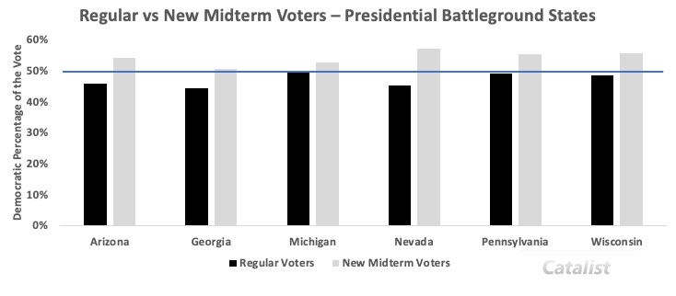
Regular vs. New Midterm Voters
Blue bar is 50% Democratic vote share
New Midterm voters are the difference makers.
There is no evidence they are swing voters – vast majority of voters vote single party
Note the reliance on new midterm voters in AZ, GA, NV…
Numerous analyses have shown the importance of the youth, Latino, and Asian vote in these states…

Slide 9
How important is the anti-MAGA midterm voter to Democrats?

Slide 10
CA-27 and CA-45 Turnout (PDI)
 | CA27 | CA45
Democrats | 44% (of 184K) | 50.8% (of 165K)
Republicans | 57.3% (of 129K) | 61.73% (of 141K)
Latino | 39.7% | 38.53%
Black | 44.8% | 60.98%
Asian | 45.64% | 47.26%
White | 51.86% | 59.01%
Age 18-34 | 26.16% | 30.5%
35-54 | 41.6% | 45.7%
55+ | 62.4% | 67.23%
The regular voter demographic dominated in these two districts… Where were the Anti-MAGA midterm voters???
How do we get them out in 2024?

Slide 11
Implications #1
Voters are very motivated by extremist MAGA candidates when they are directly impacted by them
Split-ticket voting is not a thing, or is so rare as to be insignificant
Even in blue states, Democratic turnout was not terrible; it just wasn’t as good as 2018
This was a national problem – hard to blame individual candidates in California
Key for 2024: keep the anti-MAGA voting coalition in the voting booth

Slide 12
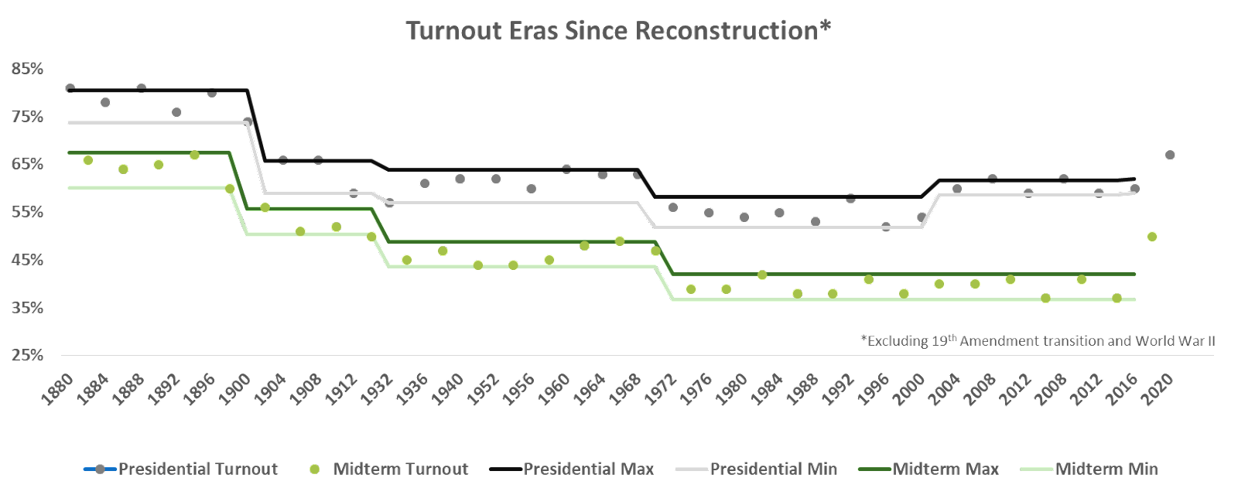
Implications #2
There is reason to believe the surge in turnout is not a two-election anomaly:

Slide 13
The case for optimism…
The Republican party shows no sign of moderating. The ‘24 presidential candidate is almost certainly going to be a MAGA candidate.
The anti-MAGA voting block is highly likely to elect/re-elect the Democrat in ’24 if the other choice is a MAGA republican
Trump may have unwittingly created the first significantly broad-based leftward swing in the electorate since 1968*
*I realize we could argue for the next several months regarding the Clinton / Obama presidencies. I still think the electorate as a whole has had a center-right tilt for decades.

Slide 14
(It’s a big, beautiful world)

