Slide 1
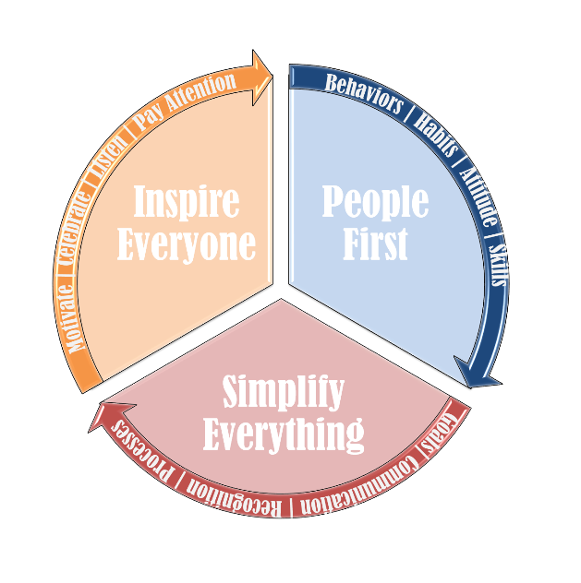
READ THIS FIRST: This PowerPoint Template can be used to craft your leadership philosophy. Please replace the text with your own unless I call out where you can use mine.
Mikeal R. Morgan
Leadership Philosophy
Use this area to set the context of the document explaining what it is and how it should be used. You can use mine if you prefer.
SETTING CONTEXT
The purpose of sharing this document, is to give you insight and information on how I think, feel and will act as a leader. It outlines the attributes that my team and I will strive to achieve, what we expect from one another, as well as what things to avoid in order to best align our personalities and resources so that we achieve excellence every day.
Insert your own logo that represents your brand here or use mine.
ATTRIBUTES I ASPIRE TO ROLE MODEL
LEADERSHIP STRATEGY
Faith: I am and will always be a believer first and foremost.
Integrity: I am a principles-based leader, and will always say what I mean, and mean what I say. Doing things right will never be as important as doing the right thing.
Humility: God has given mankind many gifts, and I do not consider myself as one of them.
Work Ethic: I do not believe that things just happen. I believe that if we want something that we must be prepared to out-think, out-plan, out-work and out everything our competitors in order to get it.
Professionalism: Everything from punctuality to the shine on my shoes is scrutinized by someone. Each day, I must strive to be my personal best at everything I engage in. It is in this that I will differentiate myself from the amateurs. No exceptions. Everything matters.
Passion: Enthusiastically greeting each day with a sincere love for what I do, who I am and where I am going.
Attitude: I am the master of my destiny and will use my positive attitude to overcome even the toughest obstacles. I know that “whether I believe I can or I believe I can’t, I’m right.”
Accountability: I am responsible and accountable for my actions and words. I do not pass blame. I am accountable for how I make others feel, regardless of intent. I apologize when I am wrong and will recognize you when you are right.
Servant: I selflessly serve others. I will recognize others for their contributions and achievements; rewarding positive behaviors and results.
Dedication: I will plan my work and work my plan diligently until I succeed. “I will persist until I succeed.”
Intelligent Utilization of Resources: Utilizing every support mechanism, system, department and tool available in order to deliver the most optimized performance possible.
Attitude: We are what we believe we are.
Aptitude: I encourage everyone to aspire to be the best version of themselves each and every day. Be true to who you are and play to your strengths. Equally, be self aware of your opportunities for personal growth and development. Learn, grow and develop daily.
Accountability: Own your actions and words. Be professional and responsible.
Action: Dedication to winning and exceeding expectations with urgency. A bias for action, and sets the standard for all others to be measured against.
People First
Simplify Everything
Inspire Everyone
Describe your leadership strategy here in its simplest terms.
LEADERSHIP PHILOSOPHY
Leadership is my passion, my privilege and my life’s work. My team and I will strive to stay results oriented but change focused. This means that we must remain focused on changing and improving our behaviors, habits, attitude, and skills in order to achieve excellence. We will establish and communicate clear goals that stretch us beyond our comfort zones so that we realize what we are truly capable of. We will out-think, out-plan, out-execute and out everything our competition and our personal best with integrity. Everything matters, especially the small stuff.
You are adding the traits that you aspire to role model and a brief description here. There should be more expected out of you, the leader than from the team.
Here is where your actual leadership philosophy will go.
TRIGGERS
These are the expectations you have from your team. You should only list a few so make them count.
Poor attitude
Excuses
Arrogance
Laziness
Not controlling the controllable
List the few things that are absolutely frowned upon while working with you.
THE 4 A’S | TEAM EXPECTATIONS
This is where you write a brief commitment statement that ties you personally to this document.
MY COMMITMENT
You can add a quote here if you choose. Choose something that speaks to you and embodies how you think and feel.
To be a dedicated leader committed to my team, company and clients. To work hard; intelligently and enthusiastically leading the team, executing on a well-designed program that clearly outlines our vision, goals and plan.
“I NEVER LOSE, I EITHER WIN OR I LEARN”
- Nelson Mandela

