Slide 1
SIMPLE SOLUTIONS FOR LOW BACK PAIN
Lisa Sitek, BSEE, MSPT, CHC
ALL ABOUT YOU PHYSICAL THERAPY, LLC

Slide 2
INTRODUCTION OF SPEAKER
BSEE, successful career in aerospace
Fitness fanatic
History of personal injury
MSPT from UCF 2006
Private practice

Slide 3
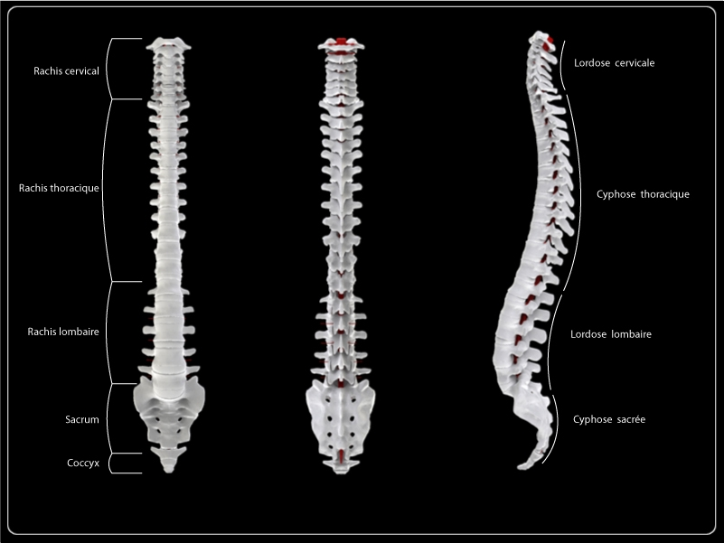
ANATOMY OF THE SPINE

Slide 4
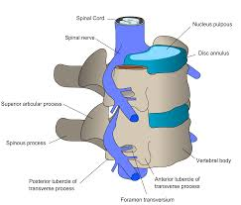
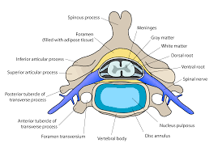
DETAILED SPINAL ANATOMY

Slide 5
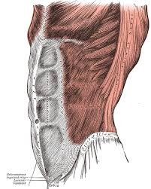
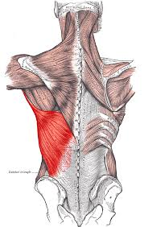
MUSCLES OF THE LOW BACK
en.wikepedia.org

Slide 6
LOW BACK PAIN (LBP) BASICS^{1, 2}
Approximately 80% of adults experience low back pain at some point in their life
About 25% of Americans report having LBP within the last 3 months
It is the most common job-related complaint leading to disability
Majority of LBP is mechanical in nature
LBP categorized as either acute (< 4 weeks), subacute (4-12 weeks), chronic, or recurrent
In most cases, LBP usually resolves on its own
HOWEVER , If LBP is accompanied by these symptoms, seek medical care immediately:
Loss of bowel or bladder control
Numbness in groin or inner thigh region

Slide 7
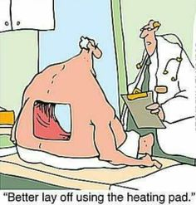
BASIC PRINCIPLES FOR MANAGING LOW BACK PAIN
Relative rest: slow down but don’t stop moving!
Studies show that bed rest for > 1-2 days can actually slow your recovery!
HOT or COLD???
Over-the-counter pain medications
Specific strengthening/stretching exercises when tolerable
www.pintrest.com

Slide 8
PREVENTION OF LOW BACK INJURIES
Use good body mechanics when lifting, get help with heavy loads!
Use good body positioning during work, home and leisure activities
Keep legs and “core” strong with regular exercise
Begin exercise with warm up and/or gentle stretching
Maintain a healthy body weight

Slide 9
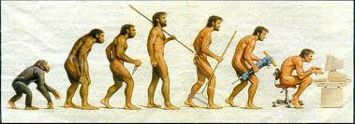
CAUSES OF LBP
Sprains/strains – usually due to lifting/twisting with poor body mechanics
Disc herniations – obesity, frequent driving, sedentary lifestyle and repetitive work activities increase risk
Sciatica - pain that radiates down the back of the leg due to compression of sciatic nerve
Degeneration of spinal structures – “normal” aging
Arthritis/spondylosis
Degenerative disc disease (DDD)
Stenosis

Slide 10
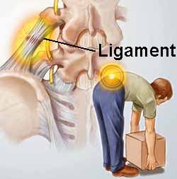
LUMBAR SPRAIN/STRAIN
http://www.spineuniverse.com/conditions/sprains-strains/lumbar-back-sprains-strains
Lumbar sprain/strain is the most common cause of low back pain
Defined as a stretching injury to the muscles, tendons or ligaments of the low back
Causes: Overuse, poor body mechanics or trauma
Lumbar spine most susceptible to muscle strain

Slide 11
TREATMENT FOR LUMBAR SPRAIN/STRAIN
Avoid aggravating activities and stretching for first few days
Basic Principles, especially cold pack first few days, then heat
Gentle massage to improve blood flow
Resume normal activities gradually
Gentle stretching exercises when tolerable to improve flexibility
Double knee to chest
Hamstring stretch

Slide 12
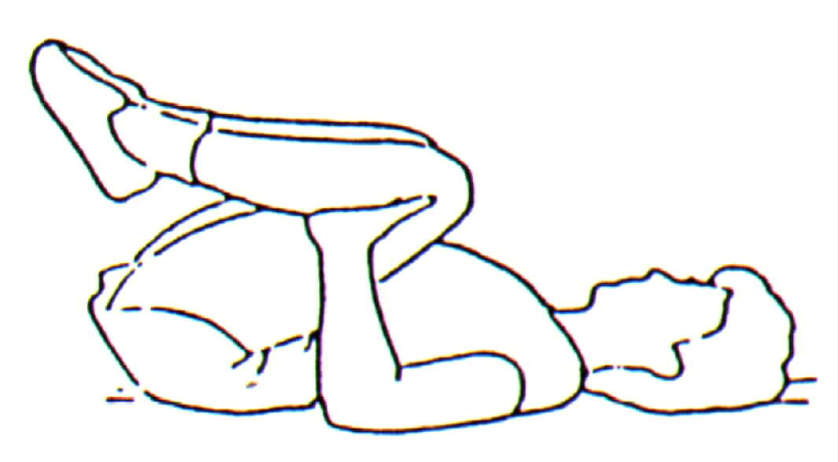
DOUBLE KNEE TO CHEST STRETCH
Lie on back with both knees bent
Engage abdominal muscles when moving legs
Raise one knee at a time to chest
Hold for 20 to 30 sec
Lower one leg at a time to start position
Perform 3 to 5 repetitions
BE GENTLE!!!!
http://www.ipcphysicaltherapy.com/Kneestochest.aspx

Slide 13
HAMSTRING STRETCH
Sit with one leg stretched out to front, other knee bent
While keeping back and front leg straight, bring toes back towards shin
Feel stretch on back of leg behind knee
May need to bend forward at hip to feel stretch
Hold for 20 to 30 sec
Repeat 3 to 5 times
BE GENTLE!!!!
http://blogs.abc.net.au/.a/6a00e0097e4e688833014e8abceb6d970d-popup

Slide 14
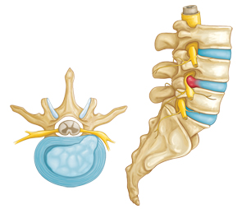
DISC HERNIATIONS
Men age 30 – 50 most likely
Increased pain in AM
Often causes radiating pain down leg(s)
Often increased pain w/sidebending
Many are asymptomatic
http://orthoinfo.aaos.org/topic.cfm?topic=a00534

Slide 15
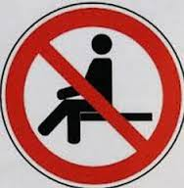
TREATMENT - DISC HERNIATION
Basic principles
Avoid prolonged positions, especially sitting
Avoid aggravating activities and move slowly
McKenzie exercises
Centralization vs. peripheralization
Repeated movements testing
Prone press ups or prone on elbows
Pintrest.com

Slide 16
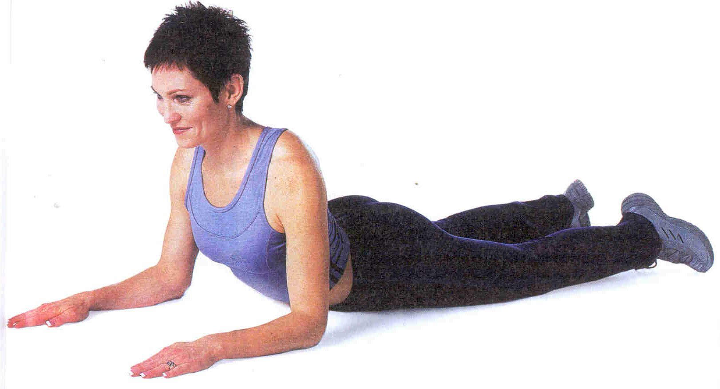
TREATMENT – PRONE PRESS UPS
Lie on stomach with arms bent and elbows under armpits
Engage abdominal muscles
Exhale as you gently press up through hands keeping lower body on floor
Hold 5 seconds
Perform 10 repetitions, 5 times/day
Increased local LBP OK if leg symptoms consistently decrease
http://themindbodymoderate.com/tag/core/

Slide 17
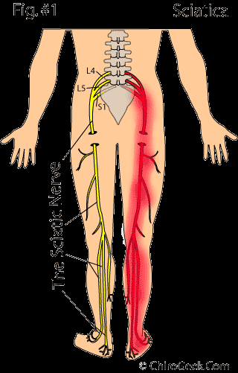
SCIATICA
Possible causes of sciatica include
Lumbar herniated disc
Spondylolisthesis – slipped vertebra
Piriformis syndrome
Sacroiliac joint dysfunction
Degenerative disc disease
Stenosis

Slide 18
SCIATICA TREATMENT
Basic principles
Epidural steroid injections give temporary relief
Treatment depends on cause
Gentle stretching of hamstrings and piriformis muscles usually indicated
McKenzie exercises may be helpful for disc herniation/spondylolisthesis
Myofascial leg pull, muscle energy techniques for SI joint dysfunction
Sciatic nerve glides

Slide 19
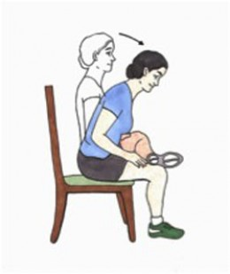
PIRIFORMIS STRETCH
Sit up straight and pull one leg up so the ankle rests on the opposite knee
Keeping back straight, gently bend at hips until a stretch is felt in buttocks
Hold for 20 to 30 seconds
Perform 3 repetitions on each side
BE GENTLE!!!!
http://hubpages.com/health/The-Piriformis-Stretch

Slide 20
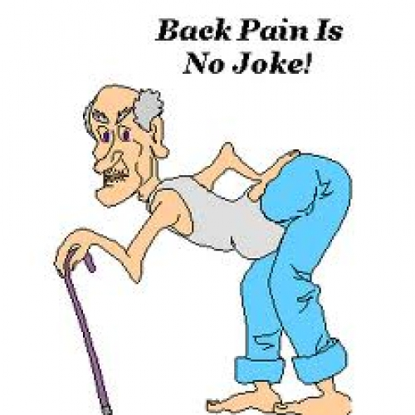
DEGENERATIVE CONDITIONS
Arthritis/spondylosis - loss of cartilage, bone spurs
Stenosis – narrowing of spinal canal puts pressure on spinal cord
Degenerative Disc Disease – decrease in disc height

Slide 21
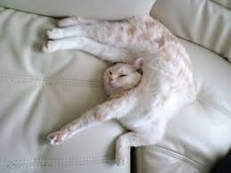
TREATMENT – DEGENERATIVE CONDITIIONS
Stretching and flexibility exercises
Hamstring stretch
Pelvic tilts
Strengthening exercises, especially “core” muscles
Dying bug
Aerobic exercise
Posture and movement education

Slide 22
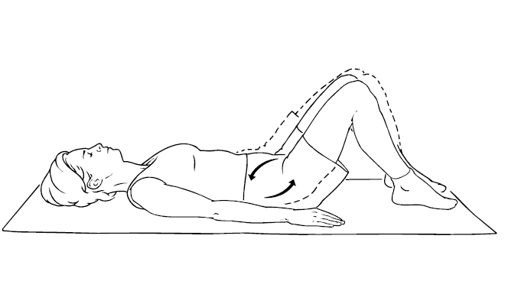
PELVIC TILTS
Lie on your back with your knees bent
Tighten abdominal muscles while pressing low back into floor
Hold 5 seconds
Perform 20 repetitions
www.secretlyhealthy.com

Slide 23
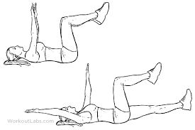
DYING BUG
Lie on back as shown with abdominal muscles tight
Extend opposite arm and leg simultaneously
Return to start position
Alternate sides
Perform 1 to 2 sets of 10 with good form

Slide 24
SUMMARY OF OPTIONS FOR ADDRESSING LBP
Self treatment
Injections
Surgery
Physical therapy
Thorough assessment for muscle imbalances, postural contributions, root cause
Pain relief modalities (Electrical Acupuncture, Hot/Cold packs, Kinesiotape)
Manual therapy (Soft/deep tissue mobilization, stain-counterstrain, joint mobs)
Supervised therapeutic exercise and neuromuscular re-education
Patient education

Slide 25
REFERENCES
National Institute of Neurological Disorders and Stroke, Low Back Pain Fact Sheet: http://www.ninds.nih.gov/disorders/backpain/detail_backpain.htm
American Physical Therapy Association, Move Forward PT, Physical Therapist’s Guide to Low Back Pain: http://www.moveforwardpt.com/symptomsconditionsdetail.aspx?cid=d0456c65-7906-4453-b334-d9780612bdd3#.VpVWwvkrLIU

