Slide 1
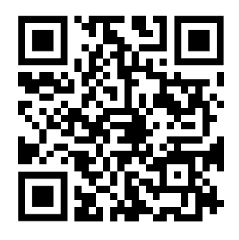
MEASURE!
What does your practice footprint look like?
https://seesustainability.co.uk/carbon-footprint

Slide 2
WASTE

Slide 3
Look at the list of Waste Actions below and tick the box to show which you have:
done already
can do in 2023
or will do next year in 2024
Space for your notes from the webinar…
Done
Doing
Next
Hand dryers
Couch roll -> green bin
E-letters and NHS app / text
Gloves -> hand washing (where appropriate)
Fit notes via AccuRx
Stream waste efficiently*
*not officially in QIMP but related to paper towels + less use of gloves.

Slide 4
Footprint _____ t CO₂e
Map the actions you will take over the next 3 – 12 months
Done
2024
This is your carbon reduction plan to share with the ICB.

