Slide 1
Reducing non-clinical carbon emissions in general practice
Dr Matt Sawyer
ICS Lunch and learn
10th June 2022

Slide 2
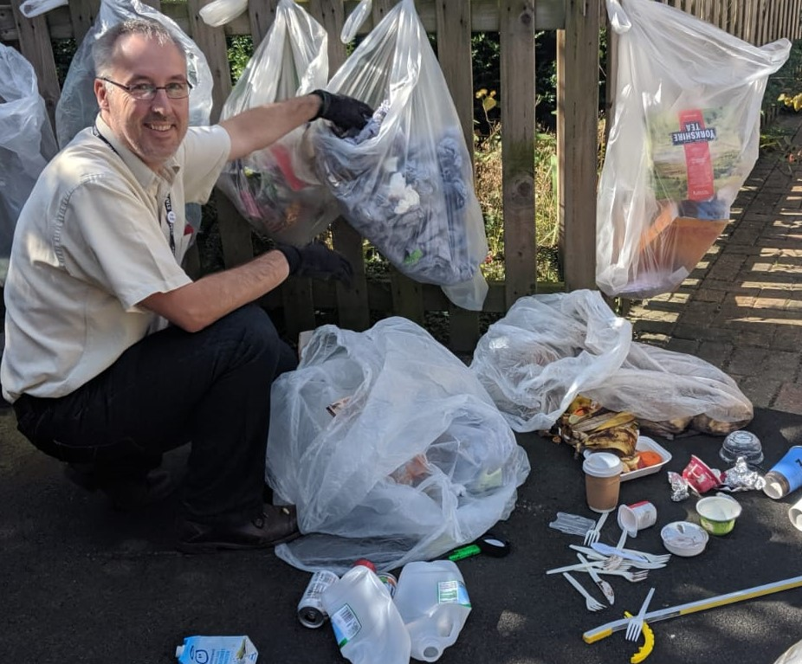
Dr Matt Sawyer
Medical doctor – GP for >15 years
Environmental MSc
Working on how to help primary care reach Net Zero
Runs a sustainability consultancy seesustainability.co.uk
Carbon Literacy trainer
Carbon footprints for practices
Notes:
Intro
Coming live from yorkshire
I have provided carbon literacy training for GPs and practices but also to businesses large and small.
Please put any questions in the chat box. If you add your email address, then any questions we don’t have a chance to answer, I will aim to reply individually

Slide 3
Impact from climate crisis
Recognise the impact on patients and staff
Heat
Air quality
Flooding,
Wildfires,
Extreme weather events,
Droughts….
Notes:
Why do I need to know
Why do I need to reduce our emissions?
We need to recognise the impact on service delivery

Slide 4
What do I and my practice need to know?
Understanding
Low carbon is the only direction of travel
It is better for our patients
It is better for our populations
It is better for our practices
Knowledge
How do I?
How do we?
Notes:
Low carbon is the direction of travel – not up for debate
It is better for our practices
It is better for our patients
It is better for our populations
Knowledge
how do I? – e learning, appraisal, - make it easy, understand Sus QI etc
How do we? – at practice level – see next section
Understanding he impact of flooding on premises?

Slide 5
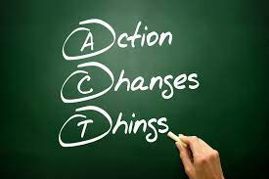
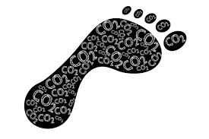
What can I do?
Become aware
Carbon literacy training
2. “Know your number”
Carbon footprint of practice
3. Turn intention into action – Have a plan
4. Declare a climate emergency
Notes:
Knowledge
To me there are 4 things that primary care can do today to work towards net zero for their practice, their group of practices in the local PCN or wider, at CCG level.
Firstly, we need clinicans and managers to become climate aware with carbon literacy training
Secondly, have the carbon footprint of your practice calculated
Thirdly, develop a pathway to net zero for your practice
And finally, make a public declaration of a climate emergency.

Slide 6
What is Carbon Literacy?
“An awareness of the carbon costs and impacts of everyday activities and the ability and motivation to reduce emissions, on an individual, community and organisational basis.”
Notes:
Introduction
Not a science lesson
Creating a low carbon culture > empowered learners to take action and to support action.
Images: See copyrighting document for image licenses
Figure 4: CL logo

Slide 7
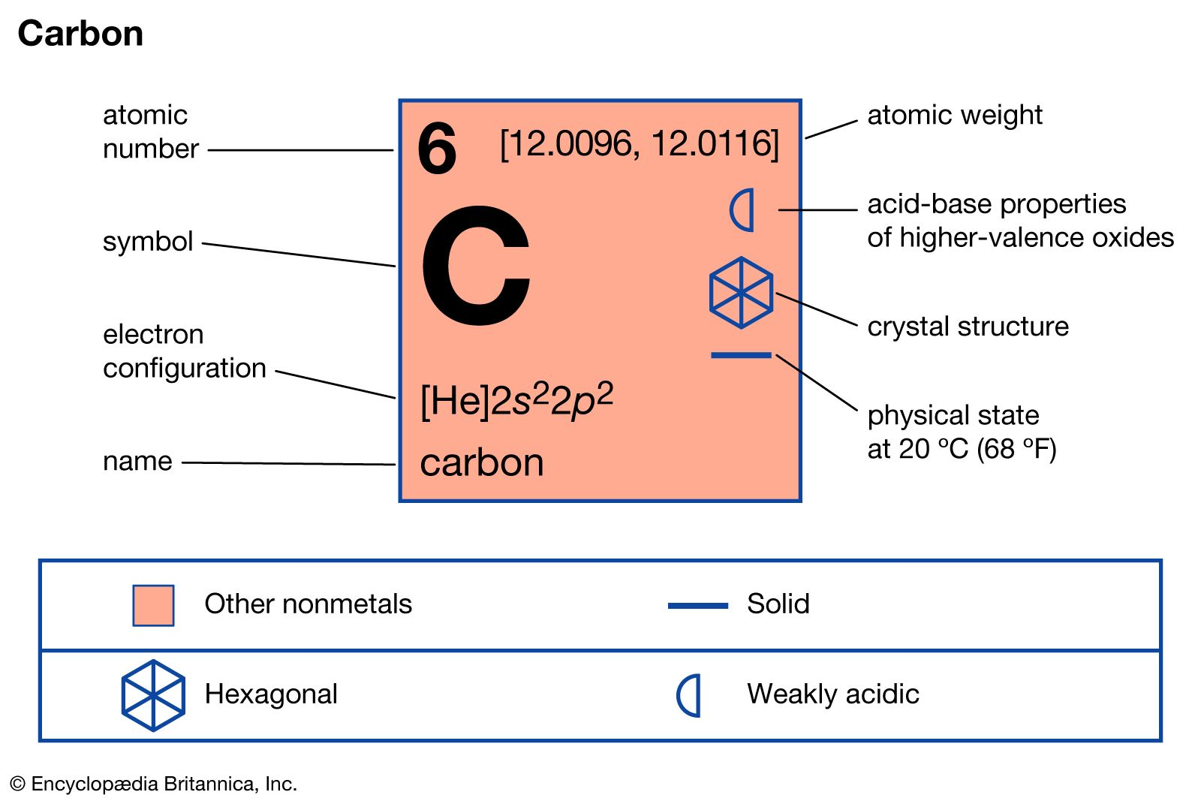
What is carbon?
What is ‘carbon literacy’?
What are ‘carbon emissions’?
What is a ‘carbon footprint’?
What is ‘net zero’?
Notes:
Remembering back to a level chemistry days, carbon is the building block of life on earth, but how harmful or problematical can it really be?
Not just carbon…
Greenhouse gases
Carbon dioxide
Methane
Nitrous Oxide
Fluorinated gases
Carbon footprint = total greenhouse gas emissions measured by carbon dioxide equivalence

Slide 8
Sources of carbon in primary care
Clinical 61% | kilotonnes CO2e | %
Inhalers (MDI) | 767 | 13
Pharmaceuticals and chemicals | 2,750 | 48
Non-clinical – 39%
Energy
Staff travel
Patient travel
Services
Medical supplies
Office supplies
Total emissions
NHS 25 million tonnes CO2e
Primary care 5.75 million tonnes CO2e
www.england.nhs.uk/greenernhs/wp-content/uploads/sites/51/2020/10/ delivering-a-net-zero-national-health-service.pdf
www.thelancet.com/journals/lanplh/article/PIIS2542-5196(20)30271-0/fulltext
Notes:
If we amalgamate all the different sources of carbon for primary care, carbon emissions can be split into clinical and non clinical sources
We will have a look at the non clinical hotspots and one of the components in a moment
We can then think about what needs to be done to reduce the emissions
For today, I am going to focus into one area
(Click) for the NHS To reach overall net zero, all parts need to reach zero

Slide 9
What is the footprint of running a GP practice?
Carbon hotspots in primary care
Notes:
This is for GP practices, we are awaiting confirmation regarding work on pharmacies to measure their footprints. I may come to you and ask for volunteers if it happens
However, <click> one area which will be a source of emissions is staff and patient travel

Slide 10
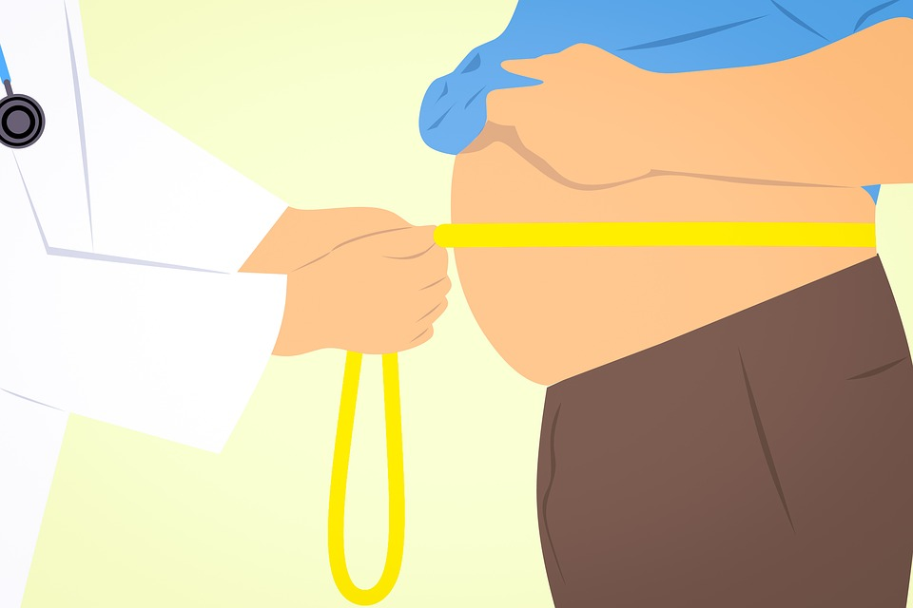
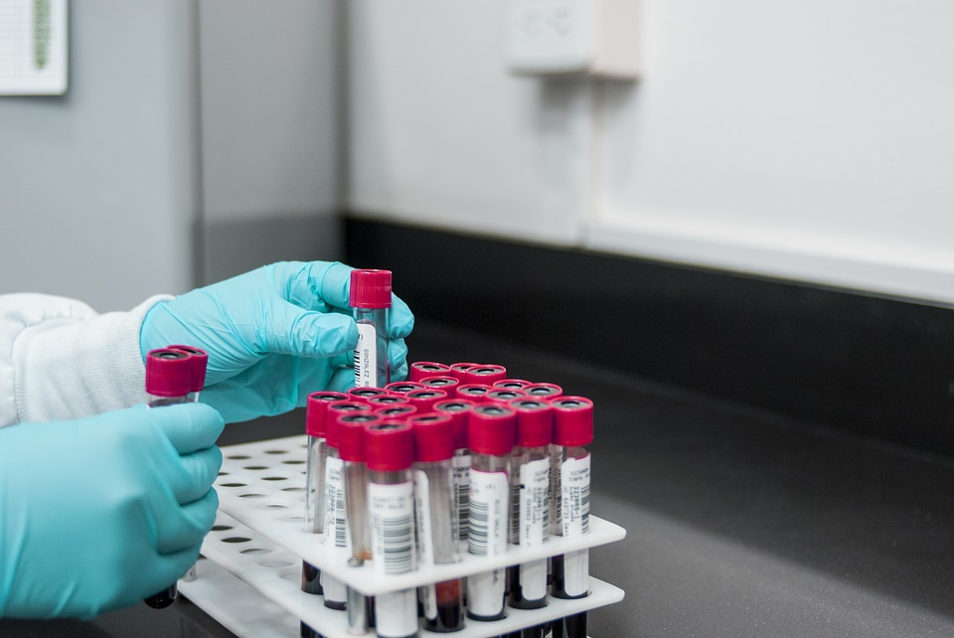
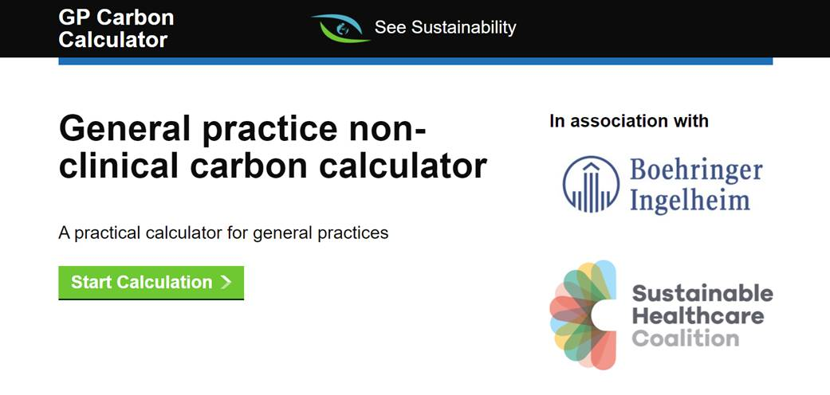
www.gpcarbon.org/#/
If you can’t measure it, you can’t improve it
Notes:
We need to know our number
What do practices need?
How to calculate the carbon footprint of a practice?
We need to know our number
We measure blood pressure… .diabetes…. And now our contribution to greenhouse gas emissions
We measure weight…. Cholesterol
And now our contribution to greenhouse gas emissions from primary care.
If we don’t know our number, we don’t know what to do, what actions we can take or put in place.
This is a toolto help primary care understand and recognise their responsibility and contribution
From here, a blueprint to work towards net zero is possible

Slide 11
Practice Decarbonisation Plan
Including how to educate, engage and empower staff with green communities
 |  | Aim/target
Area | Current footprint | 3 years time |  | 6 years time |  | 9 years time
 |  | % reduction | How | % reduction | How | % reduction | How
Energy – electricity
Gas
Travel – staff
Travel – patient
Business services
Procurement – Medical
Procurement – Office
Total
Notes:
Group action

Slide 12
Example of a low carbon general practice
 |  | Aim/target
Area | Current footprint (kg CO₂e) | 3 years time |  | 6 years time |  | 9 years time
 |  | % reduction | How | % reduction | How | % reduction | How
Energy - Electricity | 46,000 kg CO₂e | 25% in use 100% green | Green team, behaviour change, energy audit. Change to 100% renewable. | 50% | Install on site generation, more efficient equipment. | 75% | Intelligent building management system for heating.
Energy – Gas | 37,000 kg CO₂e | 20% in use | Improved insulation, reduced losses. | 80% | Replace with ASHP/GSHP. | 100% | Gas free premises.
Travel – staff | 46,000 kg CO₂e | 25% | Incentivise those closest to walk or cycle. | 50% | Actively encourage bike to work scheme, e-bikes, install facilities. | 75% | Install EV charge point at surgery, encourage those who travel most to EV.
Travel – patient | 24,000 kg CO₂e | 20% in use | Promote walking scheme, actively push active travel. | 80% | Look at practice boundary, install EV charge point for patients. | 90% | Arrange with local bus service re requirements.
Business services | 30,000 kg CO₂e | 20% in service use 25% fall in carbon | Identify services which are no longer needed. Use lower carbon services in the biggest hotspots. | 50% reduction in carbon | Actively identify further low carbon services; using only services with a decarbonisation plan in place. | At least 75% reduction in carbon | Use only carbon neutral suppliers for all new suppliers. Audit and press current suppliers to achieve carbon neutrality.
Medical procurement | 24,000 kg CO₂e | 25% | Audit and identify medical equipment and consumables. Manage stock better. | 50% | Identify alternative clinical pathways to reduce single use. | 75% | Identify reusable medical equipment; remove single use; 100% at end of life to refurb service.
Office procurement | 20,000 kg CO₂e | 20% in use | Paper free with digital as default for communication. | 50% | Use recycled equipment as default via Warp-it etc. | 100% | Remove all single use materials; only use suppliers with net zero policy.
Total | 227,000 kg CO₂e |  |  |  |  |  | 40,900 kg CO₂e – 82% reduction
Notes:
What could a practice look like in the process of decarbonising their non-clinical emissions?

Slide 13
Declare a climate emergency
Notes:
Use your influence
Tell others

Slide 14
Notes:
Greenhouse gases – GHG – a gas that absorbs part of the suns rays and redistributes them as heat back to the surface of the planet
Carbon equivalent emissions – all the GHGs converted into equivalent amount of carbon dioxide. Expressed as CO2e
Carbon footprint – total of all GHG emissions from a person or organisation in a period of time expressed as CO2e per year
Carbon neutral - When the amount of carbon emissions is balanced by the amount absorbed
Net zero
Combination of avoiding all greenhouse gas emission AND
Offsetting – when you compensate for the amount of carbon emissions through purchasing ‘credits’ for absorbing carbon by (usually) an external organisation.

Slide 15
Resources
SEE Sustainability seesustainability.co.uk
Greener Practice www.greenerpractice.co.uk/
UKHACC www.ukhealthalliance.org/carbon-literacy-guide
Centre for Sustainable Healthcare sustainablehealthcare.org.uk/
The Carbon Literacy Project carbonliteracy.com
Notes:
There are lots of great resources
For carbon literacy in primary care – I deliver the course through speak carbon or see sustainability. More general courses and carbon literacy course for other sectors can be foundat the carbon literacy project
The UKHACC UK Health Alliance on Climate Change has a useful guide to the science and impact of the climate emergency
The centre for sustainable healthcare is running a course of sustainable health care
There are other resources such at the Green impact for health scheme which provides a toolkit for practices to look at improving their enrivonmental impact.
And from Sheffield there is a fabulous called Greener practice which have got a huge amount of resources and webinars, for GPs, practice staff and patients. Well worth checking out.

