Slide 1
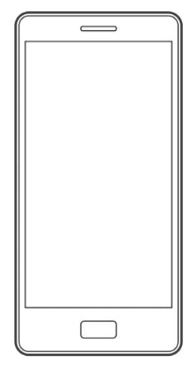
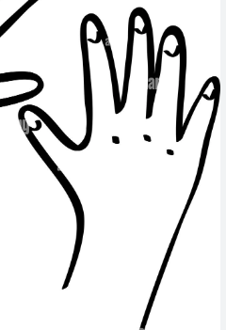
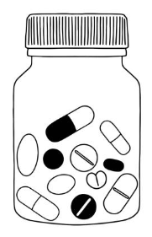
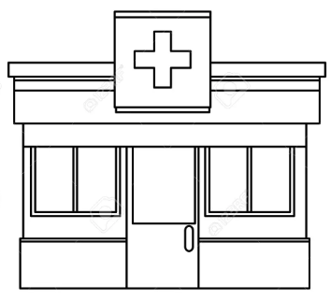
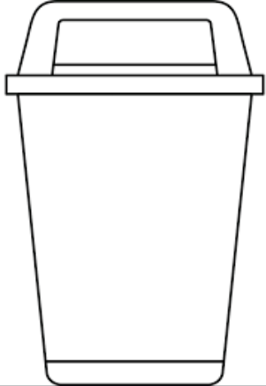
How we will reduce the £300 million pounds of wasted medication every year:
1.
2.
3.
NHS app
4.
Practice website
2 WEEKS TO GO
Then, only re-order the drugs you need.
*N.B. Your medication will still be available to you for future prescriptions.
Try not to reorder medicines until you have less than 2 weeks supply.
Add a note if you need to order early for a holiday.
Remember to finish current packets / containers before opening new ones.
Only take the drugs you need.
7.
X
6.
5.
REDUCE
WASTE
If you no longer use or need a medicine, remember not to reorder it for your next prescription.
Do talk to your GP if you think your medicines aren’t helping your condition.
*N.B. Please don’t just stop taking them and let your doctor or pharmacist know if you stop taking a medicine..
Check your medicines before you leave the pharmacy.
Unwanted medicines can be returned + reissued but if taken home, then they must be destroyed.
Never flush your medicines down the toilet.
It goes straight into the water supply and is very damaging to wildlife.

Slide 2
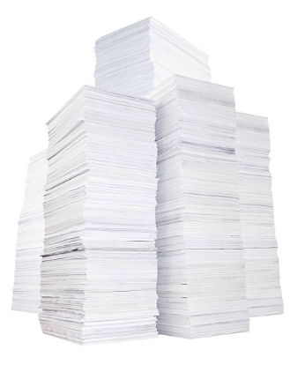
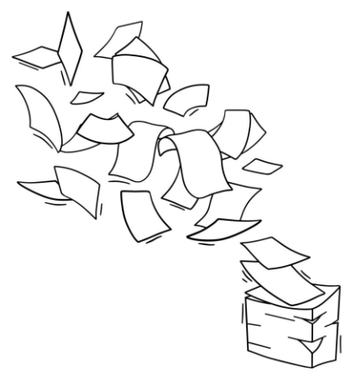
1.
2.
3.
NHS app
4.
Practice website
Only take the drugs you need.
Re-order only the drugs you need.
*N.B. Your medication will still be available to you for future prescriptions.
Finish current containers before ordering new ones.
Check your medicines before you leave the pharmacy.
7.
6.
5.
X
Separate images for paper!
Waste bin at the pharmacy.
Never flush your medicines down the toilet.

