Slide 1
The NHS and Climate Change: Developing solutions to decarbonise the NHS supply chain
VentureFest North East Challenge
1pm 30th March 2022
The Boiler Shop, NEWCASTLE
Dr Matt Sawyer
GP and SEE Sustainability
Notes:
5 mins top

Slide 2
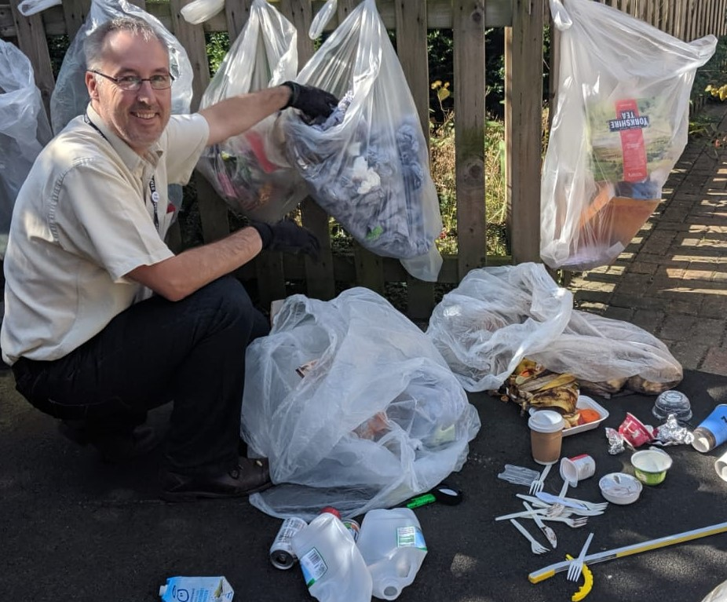
Dr Matt Sawyer
Medical doctor – GP for >15 years
Environmental MSc
Working on how to help primary care reach Net Zero
Runs a sustainability consultancy seesustainability.co.uk
Carbon Literacy trainer
Carbon footprints for practices
Notes:
I have provided carbon literacy training for GPs and practices but also to businesses large and small.
Please put any questions in the chat box. If you add your email address, then any questions we don’t have a chance to answer, I will aim to reply individually
Goal – engaged and enthusiastic and motivated audience members
How to solve a problem like decarbonisation?

Slide 3
How to solve a problem like… decarbonisation?
Our story….
Primary care is responsible for
approximately 23% of the total NHS England emissions footprint
about 5.75 million tonnes per year
amounting to 1% of UK greenhouse gas emissions.
One ICS
Total energy used 30,000 MWh in one ICS
One practice
Staff travel – 500,000 km per year in one practice
Notes:
What decarbonisation goals and issues are on your agenda for the next 2 years?
What do you want to be saying about your progress on decarbonisation a year from now?
How is progress being measured in your decarbonisation mission – and who are the key decision makers who will need to be on board to make it happen in your organisation/sectors?
Developing solutions to decarbonise Primary Care
What is our starting point?
What are the goals?
What are the issues?
How do we measure success?
Who needs to be involved?
Total energy use 30,000 MWh in one ICS
Travel – 500,000 km per year in one practice from staff travel alone.

Slide 4
Our baseline - Clinical vs non clinical carbon
Clinical
Pharmaceuticals, prescribing and inhalers
Non clinical
Energy
Staff travel
Patient travel
Services
Medical supplies
Office supplies
www.england.nhs.uk/greenernhs/wp-content/uploads/sites/51/2020/10/delivering-a-net-zero-national-health-service.pdf
www.thelancet.com/journals/lanplh/article/PIIS2542-5196(20)30271-0/fulltext
Notes:
Building Energy, Travel, Services including Waste, Medical and office goods Procurement – all come under non clinical emissions from primary care

Slide 5
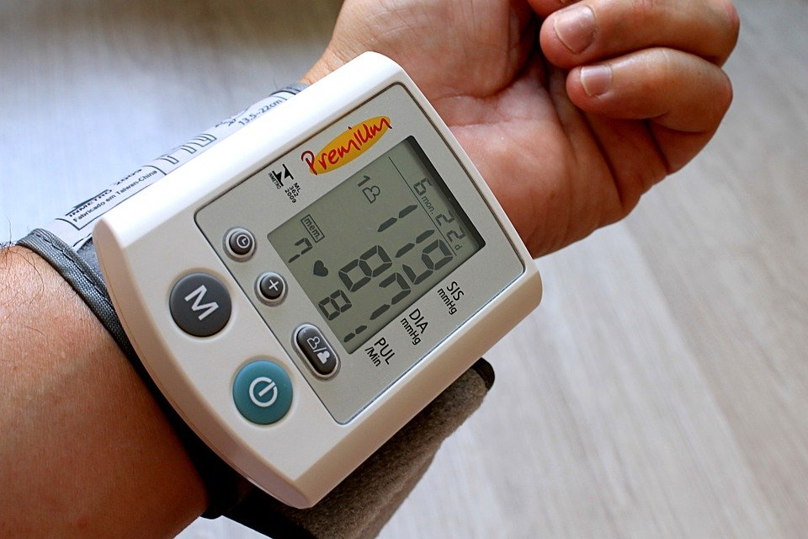
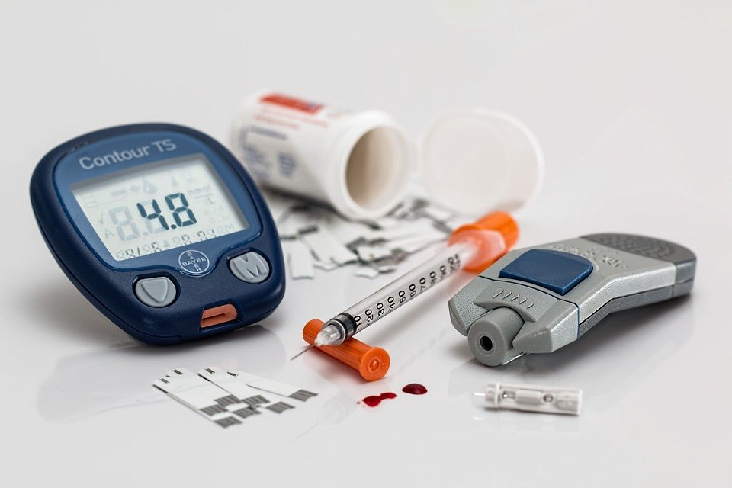
What have we done?
If you can't measure it,
you can't improve it
Notes:
Where are we now
Currently in Early stages, lack of knowledge and awareness
Longer term goal
What is next? What can we do in the next 2 years?
We need to know our number
We measure blood pressure… .diabetes…. And now our contribution to greenhouse gas emissions

Slide 6
Non clinical emissions in primary care
Carbon emission hotspots in primary care
Notes:
Howeverone area which will be a source of emissions is energy. From general practices we have analysed, this is between 20 and 35% of the emissions
What ar ethe barriers and opportunities we face?
as most GP practices are privately owned (ie not part of the NHS estate), how can the funding be made availabe to help them to decarbonise? (ie SALIX funding is only part of the public sector properties)
Non-GP parts of primary care - dentists, opticians, pharmacies - are also overlooked. There are about 30,000 or so premises which also need to decarbonise - what is the NHS estate plan to assist? Will there be access to private or public finance to do the same?
If we are to tackle travel emissions, how can we best situate practices so they are accessible to their patient population without the relience on car travel? (Ie link to active travel, 20 min towns, air quality, public transport etc).
How low can we go? RIBA suggests we may be able to achieve 50kWh/m2/year from the current average energy use of 225kWh/m2/y. We need examples or demonstration models of such good practice and what is in the pipeline? (I dont know of any so far)
Behaviour change can account for around a 40% reduction in energy use (with tech changes e.g. intelligent building management, smart meters, light sensors, better insulation etc making the other 60%), how can we look to improve staff eco-engagement in the workplace?
How can we incentivise best practice when it comes to energy and building management? There can be a law of diminishing returns where to save the last few kWh, takes a lot of additional effort - something in short supply in general practice at the moment (and I suspect the rest of primary care too).

Slide 7
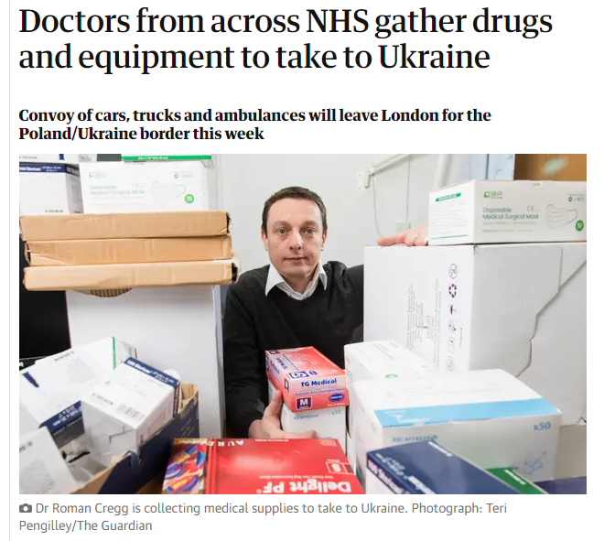
What can we do?
Get involved
Recognise the issues
Reducing waste starts with what is bought
Waste management and reduction
Stock control – digital, automated
Wasted resources
“As with many hospitals’ donations, most are stocks that have expired or are close to expiry”
Notes:
Delivery of primary healthcare which benefits people and planet.
Without negative environmental impact including meeting the NHS ambition of Net Zero emissions
Digital tech, remote healthcare, timely advice, diagnosis and treatment
Low carbon care pathways
Reducing waste starts with what is bought
Waste management and reduction
Stock control – digital, automated
Wasted resources

Slide 8
Issues Measuring success
Priorities
Staff availability
Fatigue
Funding opportunities
Resources
What could be our goal(s)?
Planetary health
Population health
Personal health
Primary care health
Notes:
Need to decarbonise each component to achieve Net Zero ambition
How to balance budgets and emission footprints
Where are we on our decarbonisation journey across primary care? (as a profession/sector)
What can we do together? What is missing? (people/expertise/resources)
How to balance budgets and emission footprints
Digital tech, remote healthcare, timely advice, diagnosis and treatment
Low carbon care pathways
Waste management and reduction table 30mins
Slide on waste reduction in supply chain
Stock control – digital, automated
Wasted resources

