Slide 1

What GOD Expects from YOUNG ADULTS
Summer Series 2025

Slide 2
Agenda
Introduction – “What is ‘Grown’?”
Stewardship vs Management
Health
The Future is Now
Relationships

Slide 3
What GOD Expects from YOUNG ADULTS
What does “I am grown” mean?
vs.
What does “being grown” mean?

Slide 4
What GOD Expects from YOUNG ADULTS
Setting Priorities
Proverbs 3:9-10 (NIV): “(9) Honor the Lord with your wealth, with the firstfruits of all your crops; (10) then your barns will be filled to overflowing, and your vats will brim over with new wine.”
Matthew 6:33 (NIV) “But seek first HIS kingdom and HIS righteousness, and all these things will be given to you as well.”
  Putting GOD first in the beginning for everything that is done determines long term peace and blessings: Time – Talent - Treasure
  Start your day, goals, and priorities with God. Time with Him comes first, not last.
  Last week?….This week, examine your use of:
    Time – . . . surrendered to GOD? -
    Money - . . . give as you prosper?
    Talents – . . . using them to build GOD’s Kingdom?

Slide 5
What GOD Expects from YOUNG ADULTS
Summer Series 2025
Health

Slide 6
What GOD Expects from YOUNG ADULTS
Our Health with GOD
The most important relationship in the Bible is between GOD and humanity. Every other relationship flows from this one.
Matthew 22:37-38 (ESV):
“You shall love the Lord your GOD with all your heart and with all your soul and with all your mind. This is the great and first commandment.”
James 4:8 (NIV):
“Come near to GOD and he will come near to you.”
A restored relationship with GOD through Jesus Christ is the starting point of true love, healing, and peace in all other relationships.

Slide 7
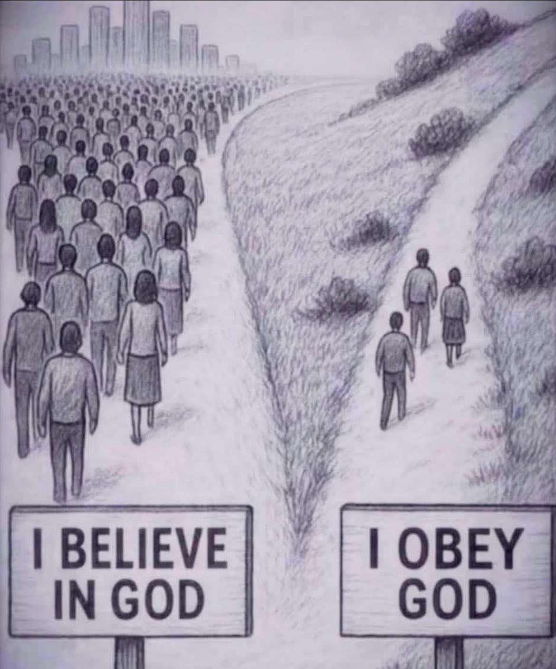

Slide 8
What GOD Expects from YOUNG ADULTS
GOD’s Healthy Wisdom
SPIRITUAL
Emotional
Physical
Social / Community
Financial
Mental
Relational
Moral / Behavioral
Environmental

Slide 9
What GOD Expects from YOUNG ADULTS
Spiritual Health
Definition: A life aligned with God's will, marked by repentance, prayer, obedience, and faith.
Key Scriptures (NIV):
Proverbs 3:7-8 – “Be not wise in your own eyes; fear the Lord and turn away from evil. It will be healing to your flesh and refreshment to your bones.”
3 John 1:2 – “Dear friend, I pray that you may enjoy good health and that all may go well with you, even as your soul is getting along well.”
Psalm 51:10 – “Create in me a pure heart, O God, and renew a steadfast spirit within me.”
Indicators:
Growing faith and godliness | Daily communion with God | Trust in God's promises

Slide 10
What GOD Expects from YOUNG ADULTS
Emotional Health (Heart and feelings)
Definition: Stability and healing of emotions such as grief, fear, anger, joy, and hope.
Key Scriptures (NIV):
Psalm 34:18 – “The Lord is close to the brokenhearted and saves those who are crushed in spirit.”
Ecclesiastes 3:4 – “a time to weep and a time to laugh, a time to mourn and a time to dance,”
Proverbs 15:13 – “A happy heart makes the face cheerful, but heartache crushes the spirit.”
Biblical
Encouragement:
God cares about your emotional pain | Jesus wept (John 11:35) and showed compassion | Healing comes through prayer, community, and worship

Slide 11
What GOD Expects from YOUNG ADULTS
Mental Health (Mind and thoughts)
Definition: Sound thinking, decision-making, and managing anxiety, confusion, or oppression.
Key Scriptures (NIV):
Isaiah 26:3 – “You will keep in perfect peace those whose minds are steadfast, because they trust in you.”
Romans 12:2 – “Do not conform to the pattern of this world, but be transformed by the renewing of your mind. Then you will be able to test and approve what God’s will is—his good, pleasing and perfect will.”
2 Timothy 1:7 – “For the Spirit God gave us does not make us timid, but gives us power, love and self-discipline.”
Biblical
Encouragement:
Replace lies with truth (John 8:32) | Take thoughts captive (2 Corinthians 10:5) | Trust God over circumstances (Proverbs 3:5-6)

Slide 12
What GOD Expects from YOUNG ADULTS
Physical Health
Definition: Honoring God with the body through care, rest, and healthy choices.
Key Scriptures (NIV):
1 Corinthians 6:19-20 – “19 Do you not know that your bodies are temples of the Holy Spirit, who is in you, whom you have received from God? You are not your own; 20 you were bought at a price. Therefore honor God with your bodies.”
Proverbs 17:22 – “A cheerful heart is good medicine, but a crushed spirit dries up the bones.”
Exodus 15:26 – He said, “If you listen carefully to the Lord your God and do what is right in his eyes, if you pay attention to his commands and keep all his decrees, I will not bring on you any of the diseases I brought on the Egyptians, for I am the Lord, who heals you.”
Biblical Habits:
Moderation and rest | Avoiding gluttony, immorality, and defilement | Trusting God for healing and practicing wisdom

Slide 13





What GOD Expects from YOUNG ADULTS
What do I put in my coffee?
1.
2.
3.
Cocaine
Sugar
Flour
Salt
Garlic
Heroin
4.
5.
6.

Slide 14
What GOD Expects from YOUNG ADULTS
Relationship Health (One-on-one relationships)
Definition: Loving, forgiving, and growing in personal relationships (family, friends, marriage, etc.).
Key Scriptures (NIV):
Ephesians 4:32 – “Be kind and compassionate to one another, forgiving each other, just as in Christ God forgave you.”
Colossians 3:13 – “Bear with each other and forgive one another if any of you has a grievance against someone. Forgive as the Lord forgave you.”
1 Peter 3:8-9 – “Finally, all of you, be like-minded, be sympathetic, love one another, be compassionate and humble. 9 Do not repay evil with evil or insult with insult. On the contrary, repay evil with blessing, because to this you were called so that you may inherit a blessing.”
Healthy Signs:
Forgiveness and reconciliation | Communication and respect | God at the center of personal relationships

Slide 15
What GOD Expects from YOUNG ADULTS
Social / Community Health (How we relate to society and groups)
Definition: Living in peace, justice, and kindness in broader community relationships (church, neighbors, culture).
Key Scriptures (NIV):
Romans 12:18 – “If it is possible, as far as it depends on you, live at peace with everyone.”
Micah 6:8 – “He has shown you, O mortal, what is good. And what does the Lord require of you? To act justly and to love mercy and to walk humbly with your God..”
Acts 2:44-47 – “44 All the believers were together and had everything in common. 45 They sold property and possessions to give to anyone who had need. 46 Every day they continued to meet together in the temple courts. They broke bread in their homes and ate together with glad and sincere hearts, 47 praising God and enjoying the favor of all the people. And the Lord added to their number daily those who were being saved.”
Healthy Signs:
Active participation in community | Fairness, humility, hospitality | Avoiding gossip, division, or favoritism

Slide 16
What GOD Expects from YOUNG ADULTS
Intellectual Health (What is The Truth)
Definition: Truth is Spirit-led — the Holy Spirit guides believers into all truth (John 16:13).
Key Scriptures (NIV):
John 14:6 – “Jesus answered, “I am the way and the truth and the life. No one comes to the Father except through me.”
  This means that truth is not just a set of facts or moral principles; it is embodied in Jesus Himself — His nature, His words, His actions, and His sacrifice.
Truth Is Not Always Welcomed. Biblical truth can be uncomfortable or unpopular. Paul warned:
  2 Timothy 4:3–4 – “For the time will come when they will not endure sound doctrine… and they will turn their ears away from the truth,..and be turned aside to fables.”
If you're seeking truth, the Bible doesn’t just define it — it invites you into a relationship with it:
  John 18:37 - “Everyone who is of the truth hears My voice.”
Healthy Signs:
Truth challenges us, calls for repentance, and demands faith.

Slide 17
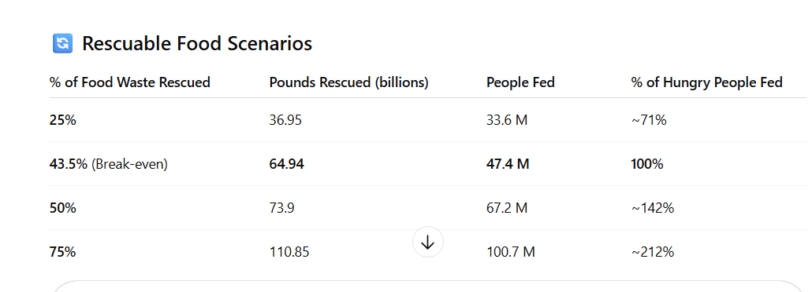
What GOD Expects from YOUNG ADULTS

Slide 18
What GOD Expects from YOUNG ADULTS
Moral/Behavioral Health
Definition: Living in integrity and resisting sin through the power of the Holy Spirit.
Key Scriptures (NIV):
Galatians 5:16 – “So I say, walk by the Spirit, and you will not gratify the desires of the flesh.”
Micah 6:8 – “He has shown you, O mortal, what is good. And what does the Lord require of you? To act justly and to love mercy and to walk humbly with your God.”
Romans 12:2 – “Do not conform to the pattern of this world, but be transformed by the renewing of your mind. Then you will be able to test and approve what God’s will is—his good, pleasing and perfect will.
Healthy Signs:
Obedience to God's commands | Conscience aligned with the Word | Resisting temptation and walking in purity

Slide 19
What GOD Expects from YOUNG ADULTS
Environmental Health
Definition: Caring for the earth and God’s resources with wisdom, justice, and responsibility.
Key Scriptures (NIV):
Genesis 2:15 – “The Lord God took the man and put him in the Garden of Eden to work it and take care of it.”
Psalm 24:1 – “The earth is the Lord’s, and everything in it, the world, and all who live in it;”
Proverbs 12:10 – “The righteous care for the needs of their animals, but the kindest acts of the wicked are cruel.
Healthy Signs:
Stewardship, not exploitation | Sustainable living; Care for animals and land | Responsibility for community needs

Slide 20
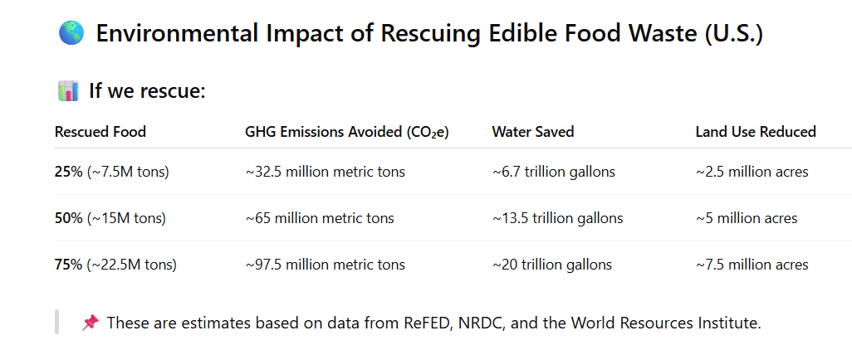
What GOD Expects from YOUNG ADULTS

Slide 21
What GOD Expects from YOUNG ADULTS
Financial Health
Definition: Faithful stewardship of God’s resources, avoiding debt, giving generously, and trusting God for provision.
Key Scriptures (NIV):
1 Timothy 6:10 – “For the love of money is a root of all kinds of evil. Some people, eager for money, have wandered from the faith and pierced themselves with many griefs.
Luke 16:10-11 – “10 Whoever can be trusted with very little can also be trusted with much, and whoever is dishonest with very little will also be dishonest with much. 11 So if you have not been trustworthy in handling worldly wealth, who will trust you with true riches?”
Matthew 6:24 – “No one can serve two masters. Either you will hate the one and love the other, or you will be devoted to the one and despise the other. You cannot serve both God and money.
Healthy Signs:
Avoiding debt and greed (Romans 13:8, Proverbs 22:7) | Contentment and diligence (Philippians 4:11, Proverbs 10:4) | Planning and budgeting (Luke 14:28) | Tithing and generosity (Malachi 3:10)

Slide 22
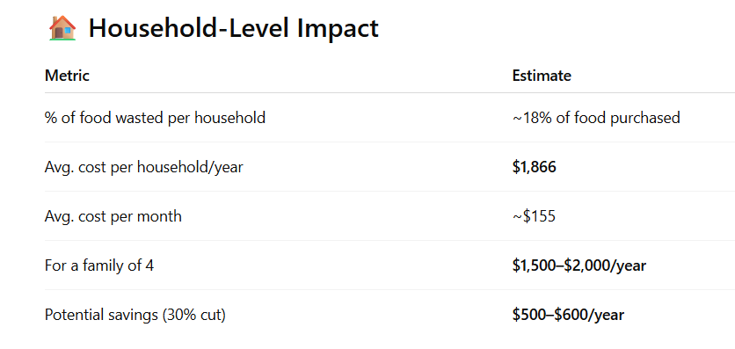
What GOD Expects from YOUNG ADULTS

Slide 23
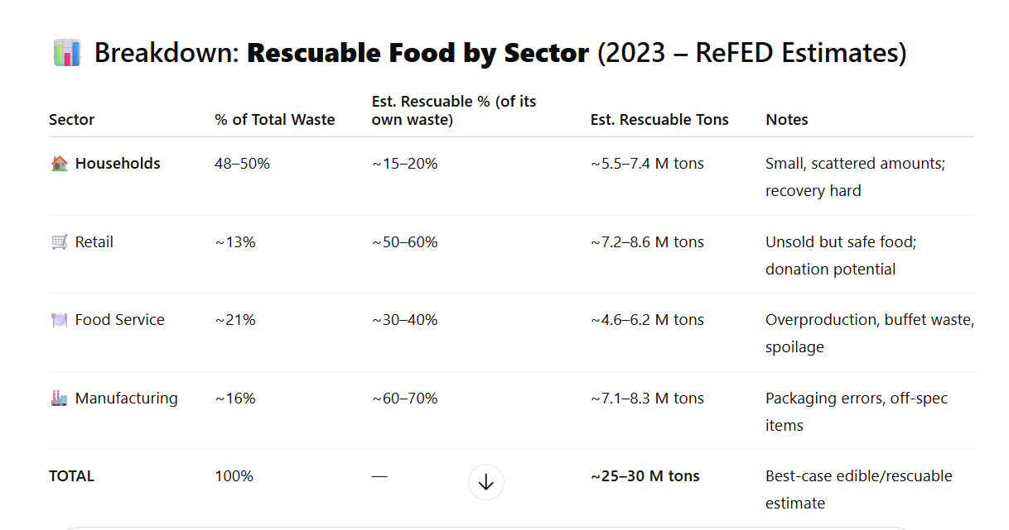
What GOD Expects from YOUNG ADULTS

Slide 24
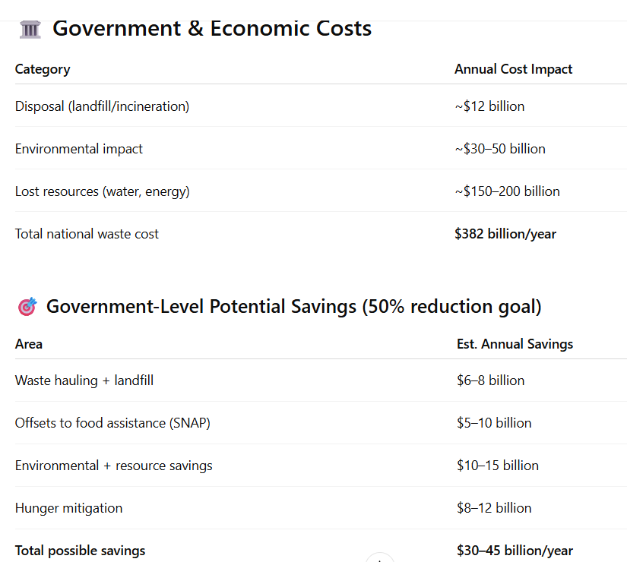
What GOD Expects from YOUNG ADULTS

Slide 25
What GOD Expects from YOUNG ADULTS
Summer Series 2025

