Slide 1

What GOD Expects from YOUNG ADULTS
Summer Series 2025
Stewardship vs Management

Slide 2
Agenda
Introduction – “What is ‘Grown’?”
Stewardship vs Management
Health
The Future is Now
Relationships

Slide 3
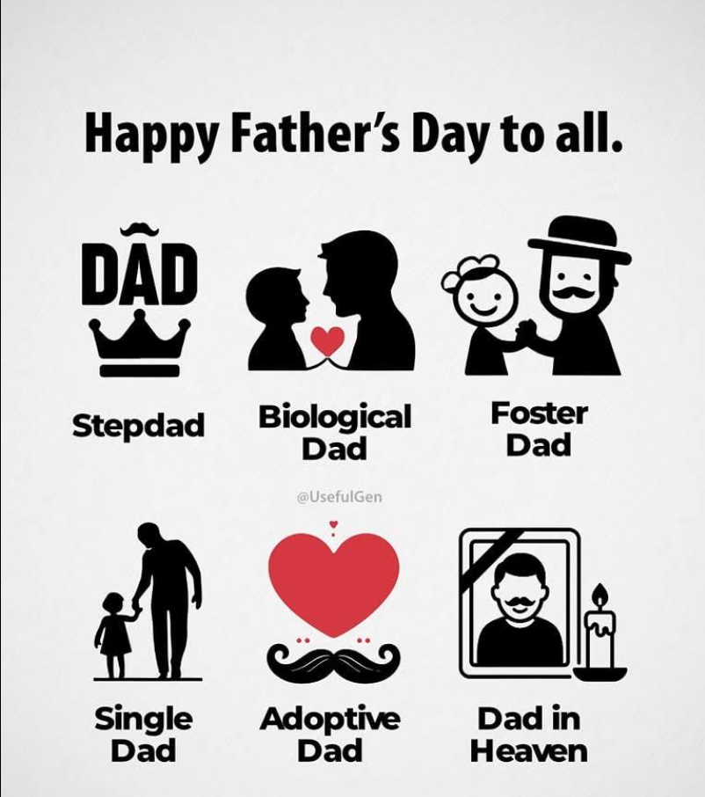

Slide 4
What GOD Expects from YOUNG ADULTS
Father’s Day
Proverbs 22:6 - ⁶ Train up a child in the way he should go; even when he is old he will not depart from it.
Ephesians 6:4 - ⁴ Fathers, do not provoke your children to anger, but bring them up in the discipline and instruction of the Lord.
Proverbs 4:1 - Hear, O sons, a father's instruction, and be attentive, that you may gain insight,
Probverbs 23:24 - The father of a righteous child has great joy; a man who fathers a wise son rejoices in him.

Slide 5
What GOD Expects from YOUNG ADULTS
What does “I am grown” mean?
vs.
What does “being grown” mean?

Slide 6
What GOD Expects from YOUNG ADULTS
Work Ethic
2 Thessalonians 3:12 - ¹⁰ For even when we were with you, we would give you this command: If anyone is not willing to work, let him not eat. ¹¹ For we hear that some among you walk in idleness, not busy at work, but busybodies. ¹² Now such persons we command and encourage in the Lord Jesus Christ to do their work quietly and to earn their own living.

Slide 7
What GOD Expects from YOUNG ADULTS
Parental Priorities
“Adults Are Sharing The Ways Their Parents Accidentally Made Their Lives So, So, So Much Harder”
https://www.buzzfeed.com/jake_farrington/seemingly-harmless-parenting-mistakes
  "My parents unconsciously taught me to value external validation over everything else and it has been the cause of persistent depression in my adult life.“
  12. "Making finances a taboo subject. Financial illiteracy can be devastating once entering adulthood. Want to keep your children from making your own money mistakes? Don’t be too proud to teach them what those mistakes were. And to clarify, I don’t mean robbing your children of their innocence by putting the weight of your debt on them at an early age. But rather, teaching them how to properly budget their money as they earn it, how to build savings, what credit is, and how to responsibly manage it."

Slide 8
What GOD Expects from YOUNG ADULTS
Priorities
1 Timothy 6:10 - ¹⁰ For the love of money is a root of all kinds of evils. It is through this craving that some have wandered away from the faith and pierced themselves with many pangs.
Hebrews 13:5 - ⁵ Keep your life free from love of money, and be content with what you have, for he has said, “I will never leave you nor forsake you.”
Luke 12:!5 - ¹⁵ And he said to them, “Take care, and be on your guard against all covetousness (greed), for one's life does not consist in the abundance of his possessions (things).”
Proverbs 15:27 - ²⁷ Whoever is greedy for unjust gain troubles his own household, but he who hates bribes will live.
Ecclesiastes 5:10-12 - ¹⁰ He who loves money will not be satisfied with money, nor he who loves wealth with his income; this also is vanity. ¹¹ When goods increase, they increase who eat them, and what advantage has their owner but to see them with his eyes? ¹² Sweet is the sleep of a laborer, whether he eats little or much, but the full stomach of the rich will not let him sleep.

Slide 9
What GOD Expects from YOUNG ADULTS
Stewardship vs Management
Understanding Biblical Stewardship
Definition: Managing something that ultimately belongs to GOD.
Biblical Viewpoint: Everything we have—time, talent, treasure, influence—belongs to the Lord.
  Psalm 24:1-2 – “The earth is the Lord’s, and everything in it, the world, and all who live in it; (2) for he founded it on the seas and established it on the waters.”
    Ownership belongs to GOD.
  1 Corinthians 4:1-5 – “(2) Now it is required that those who have been given a trust must prove faithful.”
    Faithfulness is the requirement.
Example: The stewards in the Parable of the Talents (Matthew 25). They were given resources, not for themselves, but to be productive for the Master.
In what areas of your life are you acting like the owner instead of a steward?

Slide 10
What GOD Expects from YOUNG ADULTS
Stewardship vs Management
Understanding Management
Definition: Organizing and executing tasks efficiently to achieve objectives.
Biblical Examples:
  Joseph (30 years old) managed Egypt’s economy (Genesis 41:36).
  Moses appointed leaders to manage groups of people (Exodus 18).
  Proverbs 21:5 – “The thoughts of the diligent tend only to plenteousness; but of every one that is hasty only to want.”
Management is wise and necessary, but it’s not always GOD-centered unless tied to stewardship.
Are your management decisions led by GOD’s purposes or by personal/professional goals?

Slide 11
What GOD Expects from YOUNG ADULTS
1st Sin: Selfishness
Isaiah 14:12-15 (KJV)
¹² How art thou fallen from heaven, O Lucifer, son of the morning! how art thou cut down to the ground, which didst weaken the nations!
¹³ For thou hast said in thine heart, I will ascend into heaven, I will exalt my throne above the stars of God: I will sit also upon the mount of the congregation, in the sides of the north:
¹⁴ I will ascend above the heights of the clouds; I will be like the most High.
¹⁵ Yet thou shalt be brought down to hell, to the sides of the pit.

Slide 12

Cost of Goods & Services
(1985 vs. 2025 Annual Equivalent)
Housing (Rent):
1985: $8,000
2025 Equivalent: $25,000 (3x increase)
Food:
1985: $3,000
2025 Equivalent: $10,500 (3.5x increase)
Gasoline
1985: $1,000
2025 Equivalent: $4,800 (4.8x increase)
Healthcare:
1985: $2,000
2025 Equivalent: $14,000 (7x increase)
Education (College Tuition):
1985: $1,500
2025 Equivalent: $9,750 (6.5x increase)
Transportation (Car, Public Transit, etc.):
1985: $2,500
2025 Equivalent: $10,500 (4.2x increase)
Clothing:
1985: $1,200
2025 Equivalent: $3,000 (2.5x increase)
Energy (Electricity, Utilities, etc.):
1985: $800
2025 Equivalent: $3,040 (3.8x increase)

Slide 13
Income
(1985 vs. 2025 Annual Equivalent)
1985 – Entry-Level Estimate (Houston, Energy)
  National average (graduating programmer): ~$25K–30K
  Houston’s cost of living slightly lower (~10%): ~$27K
  Inflation-adjusted (2025 USD): $$27K × 2.8 ≈ $76K
2025 – Entry-Level in Energy (Houston, TX)
  BP (Software Engineer, Level J):
    Total comp ≈ $118K (Base $105K, Stock ~6.7K, Bonus ~6.1K)
  Schlumberger (Level G9):
    Total comp ≈ $106K (Base $96K + $5.5K stock + $4.5K bonus)
  ExxonMobil (Entry-level CL23):
    Base ≈ $106K, total comp likely ~$108K+

Slide 14
CBS Morning News:
Gen Z on Pay Cycles
Talk of the Table
Getting Paid
Every Two Weeks Doesn’t Work
Ren Adelinaa – 21 Years Old
“Because one week I’m so rich, I’m so rich,
The next week living off genuine scraps.”
Ren Says: She needs to be paid weekly in order to manage her money.
Average Pay Period in 2023
43% | BIWEEKLY
27% | WEEKLY
19.8% | SEMIMONTHLY
10.3% | MONTHLY

Slide 15
CBS Morning News:
Gen Z on Pay Cycles
Americans on Current Pay Cycle 2024
62% Say It Does Not Fit Current Financial Situation
Source: Financial Technology Association
56% Stretch Their Income - Average Worker Runs Out In 12 Days
Source: Financial Technology Association
64% Would Rather Be Paid Weekly
Source: Financial Technology Association

Slide 16
Income
(1985 vs. 2025 Monthly Equivalent)
Category | 1985 $27,000 (A) | 2025 $100,000 (A)
Gross Salary | $2,250 | $8,333
Less: Federal Tax | $338 (15%) | $1,833 (22%)
Less: Social Security (6.2%) | $140 | $517
Less: Medicare (1.45%) | $33 | $121
= Net Income (Take-Home Pay) | $1,740 | $5,863

Slide 17
Expense
(1985 vs. 2025 Monthly Equivalent)
Expense Category | 1985 $27,000 (A) | 2025 $100,000 (A)
Housing (Rent) | $400 | $1,600
Food | $200 | $300
Utilities | $100 | $200
Transportation | $150 | $250
Miscellaneous | $100 | $250
= Net Income (Take-Home Pay) | $950 | $2,800

Slide 18
Net Balance
(1985 vs. 2025 Monthly Equivalent)
 | 1985 $27,000 (A) | 2025 $100,000 (A)
Net Income | $1,740 | $5,863
Less: Total Expenses | $950 | $2,800
= Net Monthly Balance | $790 | $3,063
What’s Missing?
Emergency Fund?
Savings?
GOD?

Slide 19
What GOD Expects from YOUNG ADULTS
Setting Priorities
Proverbs 3:9-10 (NIV)
“(9) Honor the Lord with your wealth, with the firstfruits of all your crops; (10) then your barns will be filled to overflowing, and your vats will brim over with new wine.”
  Putting GOD first in the beginning for everything that is done determines long term peace and blessings: Time – Talent - Treasure

Slide 20
What GOD Expects from YOUNG ADULTS
Setting Priorities
Matthew 6:33 (NIV)
  “But seek first his kingdom and his righteousness, and all these things will be given to you as well.”
    Start your day, goals, and priorities with God. Time with Him comes first, not last.
This week, examine your use of:
Time – Is it surrendered to GOD?
Money – Do you give as you prosper?
Talents – Are you using them to build GOD’s Kingdom?

Slide 21


Slide 22
What GOD Expects from YOUNG ADULTS
Resources
Rocket Money – Financial Education and Analysis
https://www.rocketmoney.com/
Quicken – Personal and Business Financial Tracking
https://www.quicken.com/
Credit Karma – Credit Scores
https://www.creditkarma.com/

Slide 23
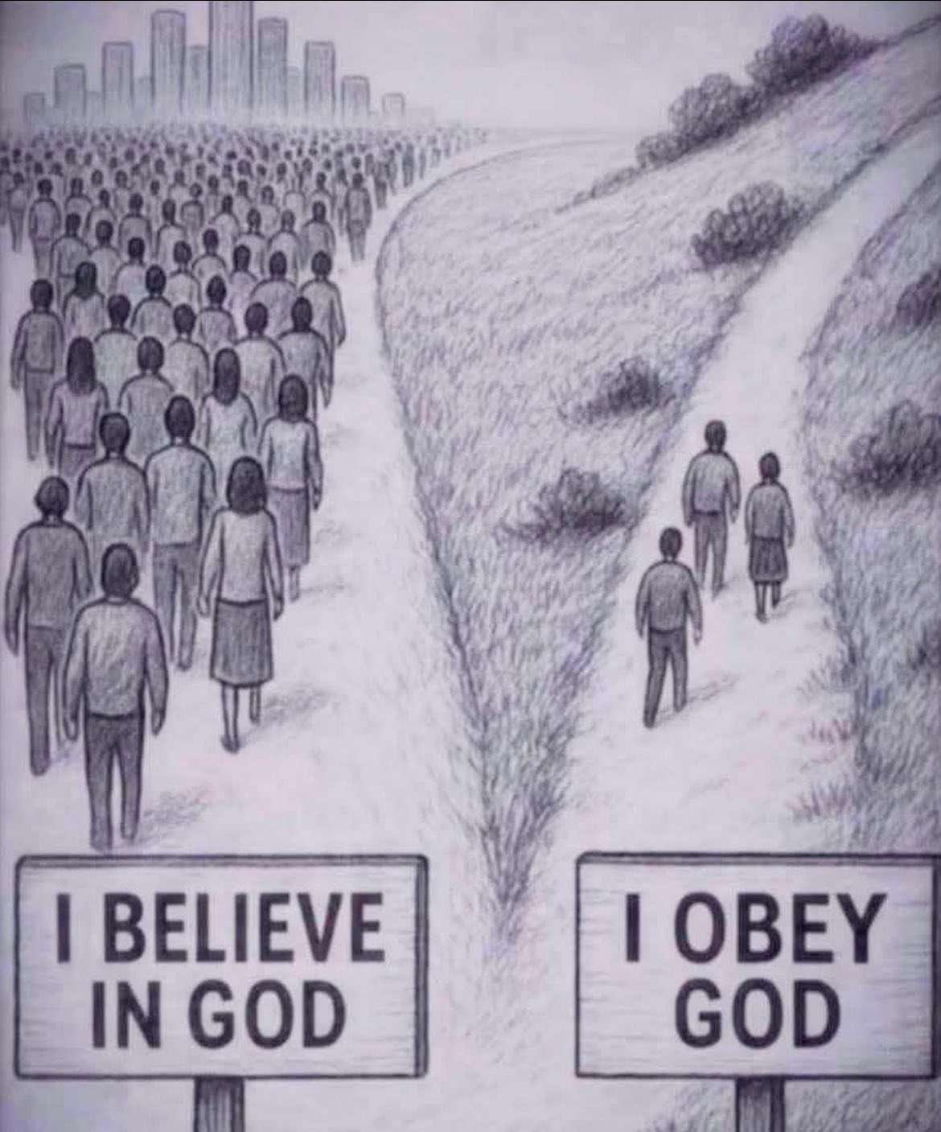

Slide 24
What GOD Expects from YOUNG ADULTS
Summer Series 2025
Relationships

Slide 25
What GOD Expects from YOUNG ADULTS
Romantic / Marriage
Ephesians 5:25 (NLT)
“For husbands, this means love your wives, just as Christ loved the church. He gave up his life for her.”
→ Husbands are called to sacrificial love — not dominance, but servant leadership.
Proverbs 18:22 (ESV)
“He who finds a wife finds a good thing and obtains favor from the Lord.”
→ Marriage is a blessing when entered with God’s guidance.
1 Corinthians 13:4–7 (NIV)
“Love is patient, love is kind… It always protects, always trusts, always hopes, always perseveres.”
→ Biblical love is not about feelings but action, endurance, and commitment.

Slide 26
What GOD Expects from YOUNG ADULTS
Family
Exodus 20:12 (NIV)
“Honor your father and your mother, so that you may live long in the land the Lord your God is giving you.”
→ Respect and honor for parents are foundational to family order.
Colossians 3:21 (NLT)
“Fathers, do not aggravate your children, or they will become discouraged.”
→ Parenting should be nurturing, not provoking.
1 Timothy 5:8 (NIV)
“Anyone who does not provide for their relatives… has denied the faith and is worse than an unbeliever.”
→ Responsibility and care within family is a Christian duty.

Slide 27
What GOD Expects from YOUNG ADULTS
Friendship
Proverbs 17:17 (NIV)
“A friend loves at all times, and a brother is born for a time of adversity.”
→ True friendship is loyal and shines during hardship.
Ecclesiastes 4:9–10 (NIV)
“Two are better than one… If either of them falls down, one can help the other up.”
→ GOD designed friendship for strength and support.
1 Corinthians 15:33 (ESV)
“Do not be deceived: ‘Bad company ruins good morals.’”
→ Choose friends who strengthen your walk with GOD.

Slide 28
What GOD Expects from YOUNG ADULTS
Community / Church
Romans 12:10 (ESV)
“Love one another with brotherly affection. Outdo one another in showing honor.”
→ Mutual respect and service is the heart of Christian fellowship.
Galatians 6:2 (NIV)
“Carry each other’s burdens, and in this way you will fulfill the law of Christ.”
→ We’re called to be there for others spiritually and practically.
James 1:19 (NIV)
“Everyone should be quick to listen, slow to speak and slow to become angry.”
→ Good relationships require emotional maturity and self-control.

Slide 29
What GOD Expects from YOUNG ADULTS
Reflection Questions
How am I showing love through action in my relationships?
Am I a source of peace or conflict in my family and friendships?
Do I build others up with my words, or tear them down?
Am I modeling Christ in how I treat others?
What is my relationship with GOD?
Are my actions the same as a week ago? Month? Year? 10 Years ago?
Do I give the world more than I give GOD? Time? Talent? Treasure?
Is tomorrow promised? The rest of today?

Slide 30
What GOD Expects from YOUNG ADULTS
Summer Series 2025

