Slide 1

What GOD Expects from YOUNG ADULTS
Summer Series 2025

Slide 2
Agenda
Introduction – “What is ‘Grown’?”
Stewardship vs Management
Health
The Future is Now
Relationships

Slide 3
What GOD Expects from YOUNG ADULTS
What does “I am grown” mean?
vs.
What does “being grown” mean?

Slide 4
What GOD Expects from YOUNG ADULTS
Setting Priorities
Proverbs 3:9-10 (NIV): “(9) Honor the Lord with your wealth, with the firstfruits of all your crops; (10) then your barns will be filled to overflowing, and your vats will brim over with new wine.”
Matthew 6:33 (NIV) “But seek first HIS kingdom and HIS righteousness, and all these things will be given to you as well.”
  Putting GOD first in the beginning for everything that is done determines long term peace and blessings: Time – Talent - Treasure
  Start your day, goals, and priorities with God. Time with Him comes first, not last.
  Last week?….This week, examine your use of:
    Time – . . . surrendered to GOD? -
    Money - . . . give as you prosper?
    Talents – . . . using them to build GOD’s Kingdom?

Slide 5
What GOD Expects from YOUNG ADULTS
Summer Series 2025
Relationships

Slide 6
What GOD Expects from YOUNG ADULTS
Our Relationship with God – The Foundation
The most important relationship in the Bible is between God and humanity. Every other relationship flows from this one.
Matthew 22:37-38 (ESV):
“You shall love the Lord your God with all your heart and with all your soul and with all your mind. This is the great and first commandment.”
James 4:8 (NIV):
“Come near to God and he will come near to you.”
A restored relationship with God through Jesus Christ is the starting point of true love, healing, and peace in all other relationships.

Slide 7
What GOD Expects from YOUNG ADULTS
Our Relationship with God – The Foundation
The most important relationship in the Bible is between God and humanity. Every other relationship flows from this one.
  Matthew 17:1-8 (ESV):17 And after six days Jesus took with him Peter and James, and John his brother, and led them up a high mountain by themselves. 2 And he was transfigured before them, and his face shone like the sun, and his clothes became white as light. 3 And behold, there appeared to them Moses and Elijah, talking with him. 4 And Peter said to Jesus, “Lord, it is good that we are here. If you wish, I will make three tents here, one for you and one for Moses and one for Elijah.” 5 He was still speaking when, behold, a bright cloud overshadowed them, and a voice from the cloud said, “This is my beloved Son, with whom I am well pleased; listen to him.”
  Psalms 2:7 (ESV): I will tell of the decree: The Lord said to me, “You are my Son; today I have begotten you.
A restored relationship with God through Jesus Christ is the starting point of true love, healing, and peace in all other relationships.

Slide 8
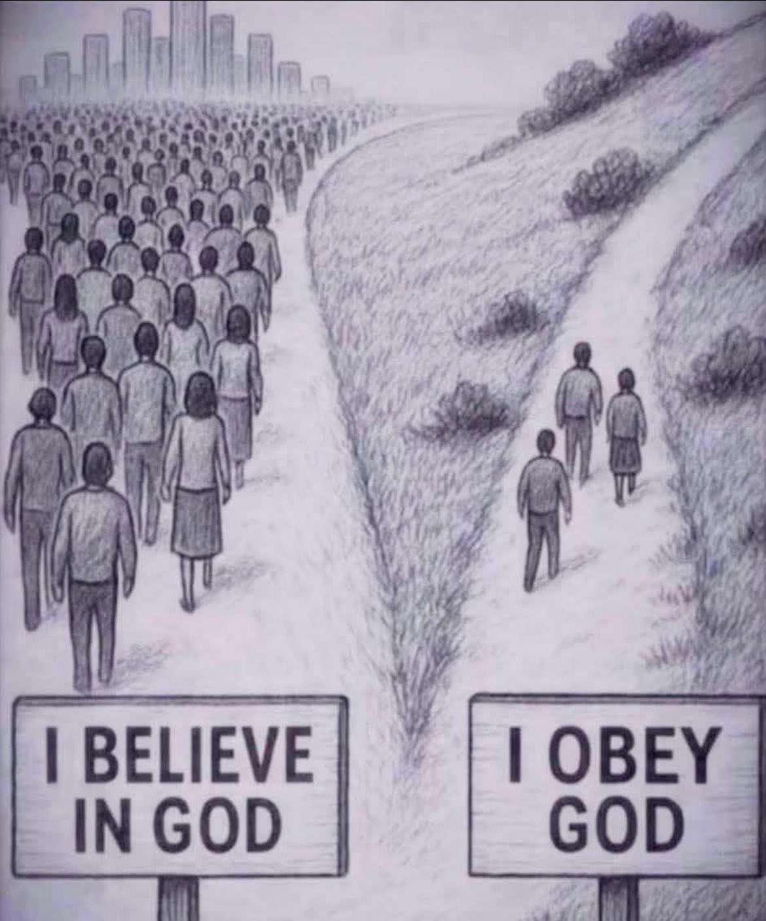

Slide 9
What GOD Expects from YOUNG ADULTS
Relationships with Others – The Second Greatest Command
Matthew 22:39 (ESV):“And a second is like it: You shall love your neighbor as yourself.”
This includes:
Marriage
Family
Friendships
Fellow believers (the Church)
Strangers & enemies
God calls us to treat others with love, truth, humility, and respect — even when it’s difficult.

Slide 10
What GOD Expects from YOUNG ADULTS
Romantic / Marriage
1 Corinthians 13:4–7 (NIV): “Love is patient, love is kind… It always protects, always trusts, always hopes, always perseveres.”
→ Biblical love is not about feelings but action, endurance, and commitment.
Ephesians 5:25 (NLT): “For husbands, this means love your wives, just as Christ loved the church. He gave up his life for her.”
→ Husbands are called to sacrificial love — not dominance, but servant leadership.
Proverbs 31:10–31 —The Virtuous Woman(ESV): “A wife of noble character who can find? She is worth far more than rubies.”
→ This is the most well-known passage describing a godly wife

Slide 11
What GOD Expects from YOUNG ADULTS
Romantic / Marriage
Virtuous Woman (Proverbs 31:10 - 31) She is trustworthy (v.11) She works hard with willing hands (v.13) She provides for her family (v.15) She is wise in business (v.16, 24) She helps the poor and needy (v.20) She is clothed with strength and dignity (v.25) She speaks with wisdom and kindness (v.26) Her children and husband praise her (v.28) She fears the Lord — this is the key (v.30) Honor her for the work brings praise (v.31) | Virtuous Man Fears God and walks humbly (Micah 6:8) Practices integrity and justice (Proverbs 20:7) Leads with wisdom and self-control (Titus 2:6) Shows love, patience, and faith (1 Tim 6:11) Provides and cares for others (Psalm 112) Guards his words and heart (James 1:19) Resists sin and lives righteously (Psalm 1)

Slide 12
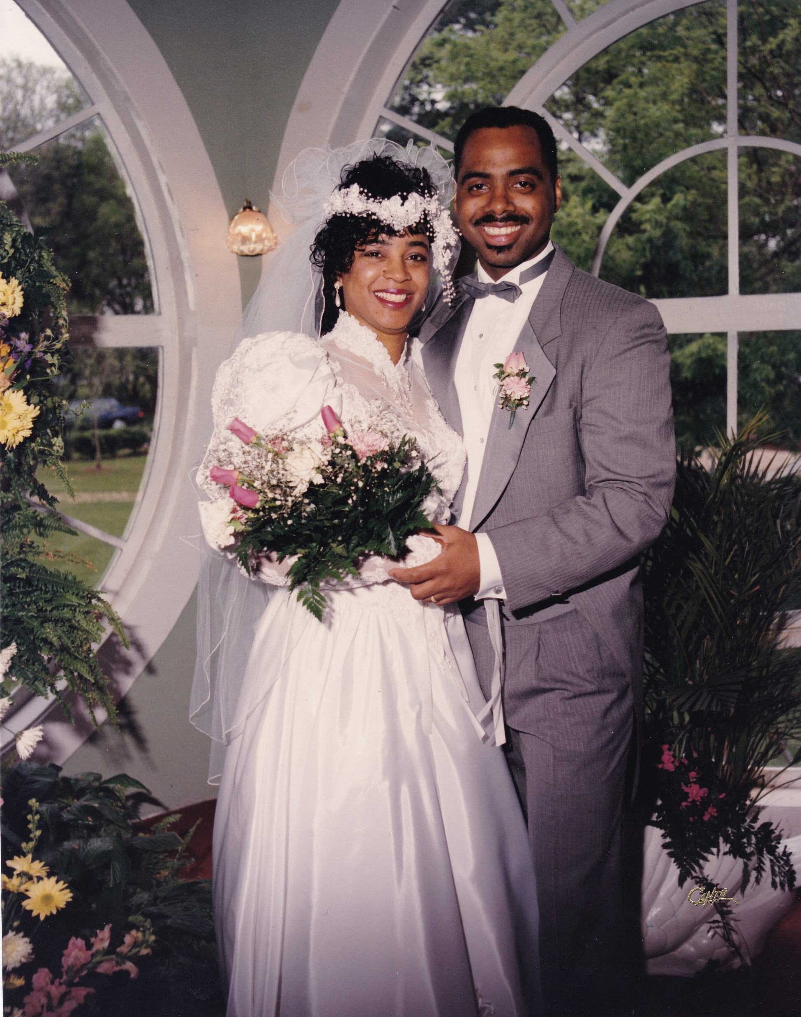
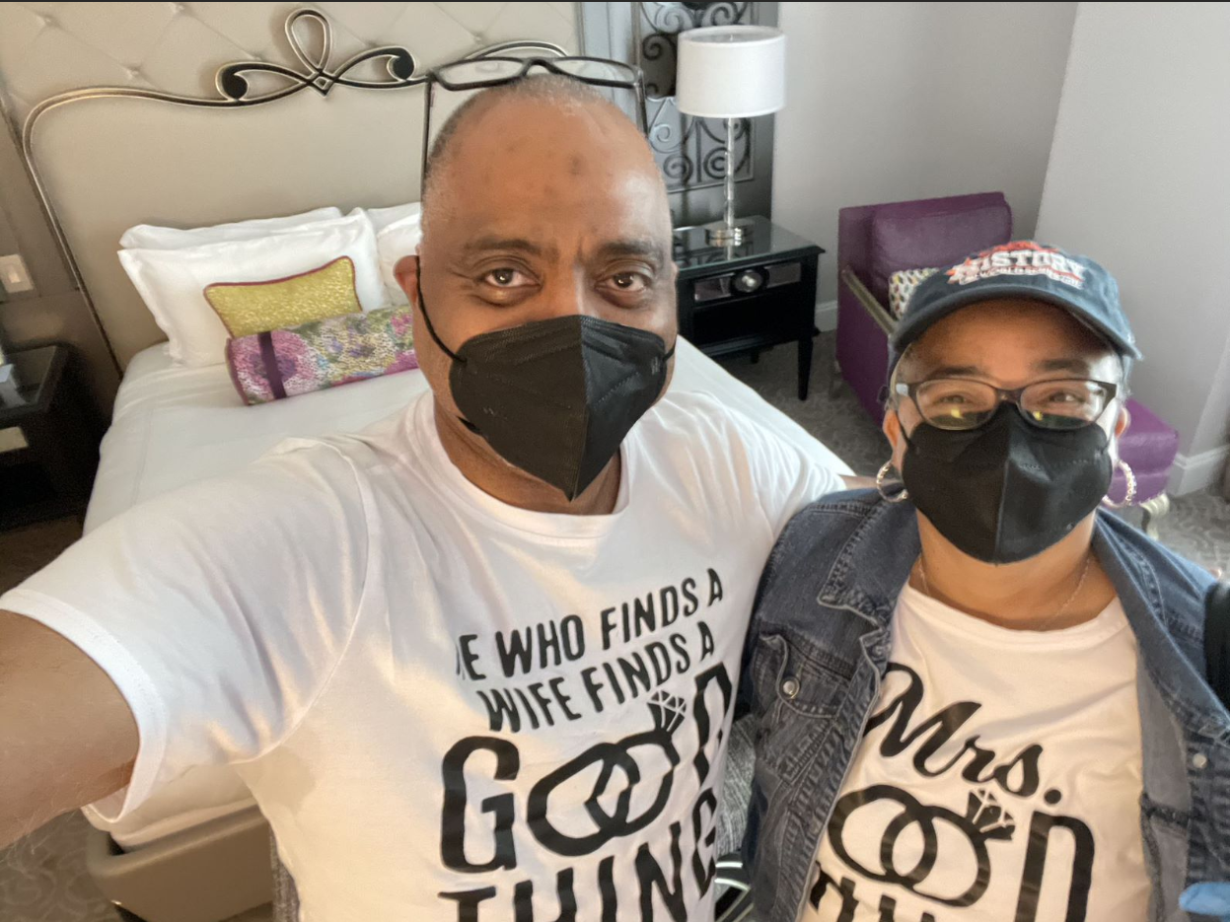
What GOD Expects from YOUNG ADULTS
Romantic / Marriage
Proverbs 18:22 (ESV)
“He who finds a wife finds a good thing and obtains favor from the Lord.”
→ Marriage is a blessing when entered with God’s guidance.

Slide 13
What GOD Expects from YOUNG ADULTS
Family
Exodus 20:12 (NIV): “Honor your father and your mother, so that you may live long in the land the Lord your God is giving you.”
→ Respect and honor for parents are foundational to family order.
Colossians 3:21 (NLT): “Fathers, do not aggravate your children, or they will become discouraged.”
→ Parenting should be nurturing, not provoking.
1 Timothy 5:8 (NIV)
“Anyone who does not provide for their relatives… has denied the faith and is worse than an unbeliever.”
→ Responsibility and care within family is a Christian duty.

Slide 14

What GOD Expects from YOUNG ADULTS

Slide 15
What GOD Expects from YOUNG ADULTS
Friendship
Proverbs 17:17 (NIV): “A friend loves at all times, and a brother is born for a time of adversity.”
→ True friendship is loyal and shines during hardship.
Ecclesiastes 4:9–10 (NIV): “Two are better than one… If either of them falls down, one can help the other up.”
→ GOD designed friendship for strength and support.
1 Corinthians 15:33 (ESV): “Do not be deceived: ‘Bad company ruins good morals.’”
→ Choose friends who strengthen your walk with GOD.

Slide 16

What GOD Expects from YOUNG ADULTS

Slide 17
What GOD Expects from YOUNG ADULTS
Community / Church
Romans 12:10 (ESV): “Love one another with brotherly affection. Outdo one another in showing honor.”
→ Mutual respect and service is the heart of Christian fellowship.
Galatians 6:2 (NIV): “Carry each other’s burdens, and in this way you will fulfill the law of Christ.”
→ We’re called to be there for others spiritually and practically.
James 1:19 (NIV): “Everyone should be quick to listen, slow to speak and slow to become angry.”
→ Good relationships require emotional maturity and self-control.

Slide 18

What GOD Expects from YOUNG ADULTS
14 And when they came to the crowd, a man came up to him and, kneeling before him, 15 said, “Lord, have mercy on my son, for he has seizures and he suffers terribly. For often he falls into the fire, and often into the water. 16 And I brought him to your disciples, and they could not heal him.” 17 And Jesus answered, “O faithless and twisted generation, how long am I to be with you? How long am I to bear with you? Bring him here to me.” 18 And Jesus rebuked the demon, and it came out of him, and the boy was healed instantly. 19 Then the disciples came to Jesus privately and said, “Why could we not cast it out?” 20 He said to them, “Because of your little faith. For truly, I say to you, if you have faith like a grain of mustard seed, you will say to this mountain, ‘Move from here to there,’ and it will move, and nothing will be impossible for you.”

Slide 19
What GOD Expects from YOUNG ADULTS
Biblical Principles for Healthy Relationships
Love
  1 Corinthians 13:4-7 (NIV): “Love is patient, love is kind... it always protects, always trusts, always hopes, always perseveres.”
Forgiveness
  Ephesians 4:32 (NIV): “Be kind and compassionate to one another, forgiving each other, just as in Christ God forgave you.”
Honesty & Integrity
  Proverbs 27:6 (NKJV): “Faithful are the wounds of a friend, but the kisses of an enemy are deceitful.”

Slide 20
What GOD Expects from YOUNG ADULTS
Biblical Principles for Healthy Relationships
Accountability
  Proverbs 27:17 (ESV): “Iron sharpens iron, and one man sharpens another.”
Communication
  James 1:19 (NIV): “Everyone should be quick to listen, slow to speak and slow to become angry.”
  Proverbs 25:11 (NIV): “A word fitly spoken is like apples of gold in a setting of silver.”

Slide 21

What GOD Expects from YOUNG ADULTS

Slide 22
What GOD Expects from YOUNG ADULTS
Reflection Questions
How am I showing love through action in my relationships?
Am I a source of peace or conflict in my family and friendships?
Do I build others up with my words, or tear them down?
Am I modeling Christ in how I treat others?
What is my relationship with GOD?
Are my actions the same as a week ago? Month? Year? 10 Years ago?
Do I give the world more than I give GOD? Time? Talent? Treasure?
Is tomorrow promised? The rest of today?

Slide 23

What GOD Expects from YOUNG ADULTS

Slide 24
What GOD Expects from YOUNG ADULTS
Summer Series 2025

