Slide 1
Market Update June 2022

Slide 2
Residential Snap Shot
January 1st, 2022- May 31st, 2022
Area 01 CdA Active Listings 670 Homes Sold/Closed YTD 450 Avg Days on Market 66 Median Sales Price $590,000 Avg Sales Price $685,000 SP/OLP 99% | Area 02 Post Falls Active Listings 123 Homes Sold/Closed YTD 460 Avg Days on Market 65 Median Sales Price $523,000 Avg Sales Price $574,000 SP/OLP 98% | Area 03 Hayden Active Listings 374 Homes Sold/Closed YTD 220 Avg Days on Market 61 Median Sales Price $620,000 Avg Sales Price $746,000 SP/OLP 98%
Area 04 Rathdrum/Twin Lakes Active Listings 299 Homes Sold/Closed YTD 174 Avg Days on Market 78 Median Sales Price $518,000 Avg Sales Price $605,000 SP/OLP 99% | Area 04a Hauser Lake Active Listings 44 Homes Sold/Closed YTD 25 Avg Days on Market 140 Median Sales Price $835,000 Avg Sales Price $769,000 SP/OLP 102% | Area 05 Athol/Spirit Lake NW Kootenai Co Active Listings 124 Homes Sold/Closed YTD 70 Avg Days on Market 79 Median Sales Price $577,000 Avg Sales Price $606,000 SP/OLP 98%
Area Athol/Bayview 06 NE Kootenai Co Active Listings 75 Homes Sold/Closed YTD 30 Avg Days on Market 69 Median Sales Price $737,000 Avg Sales Price $833,000 SP/OLP 95% | Area 12 Silver Valley Active Listings 156 Homes Sold/Closed YTD 87 Avg Days on Market 69 Median Sales Price $295,000 Avg Sales Price $295,000 SP/OLP 97% | Area All Kootenai Co Active Listings 2,405 Homes Sold/Closed YTD 1,492 Avg Days on Market 68 Median Sales Price $565,000 Avg Sales Price $692,000 SP/OLP 98%
Jennifer Smock® Windermere Coeur d’Alene Realty
Co-Owner /Managing Broker

Slide 3
Residential Snap Shot 2021 vs 2022 YTD Single Family <2 ac
Coeur d’Alene Active Listings -5% Homes Sold -13% Median Sales Price +24% $610,000* | Post Falls Active Listings -9% Homes Sold -15 % Median Sales Price +23% $555,000
Shoshone County Active Listings -28% Homes Sold -34% Median Sales Price +44% $295,000* | Kootenai County Active Listings -8% Homes Sold -18% Median Sales Price +22% $551000* Average Sales Price $643,000
Jennifer Smock® Windermere Coeur d’Alene Realty
Co-Owner /Managing Broker

Slide 4
% Increase in Average Sold Values Kootenai County all Residential

Slide 5
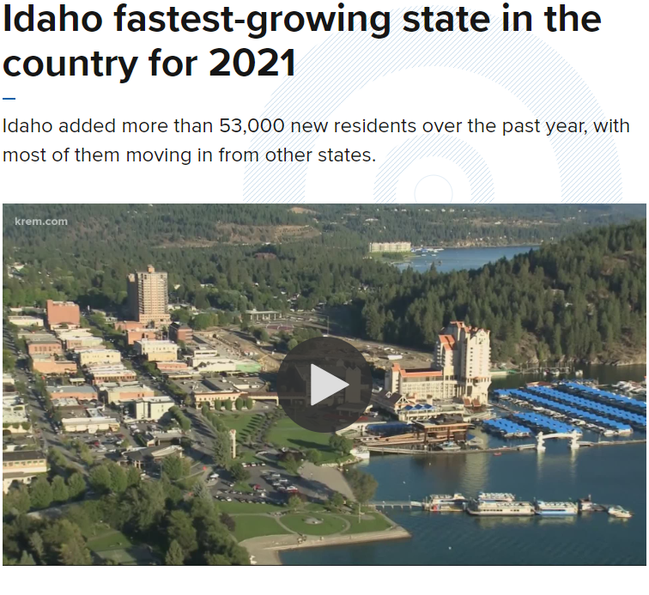
How Did This Happen?
America's top property hotspot is lakeside city Coeur d'Alene in Idaho where average home prices rose nearly 47% in a year to $476,000 thanks to remote workers flooding in

Slide 6
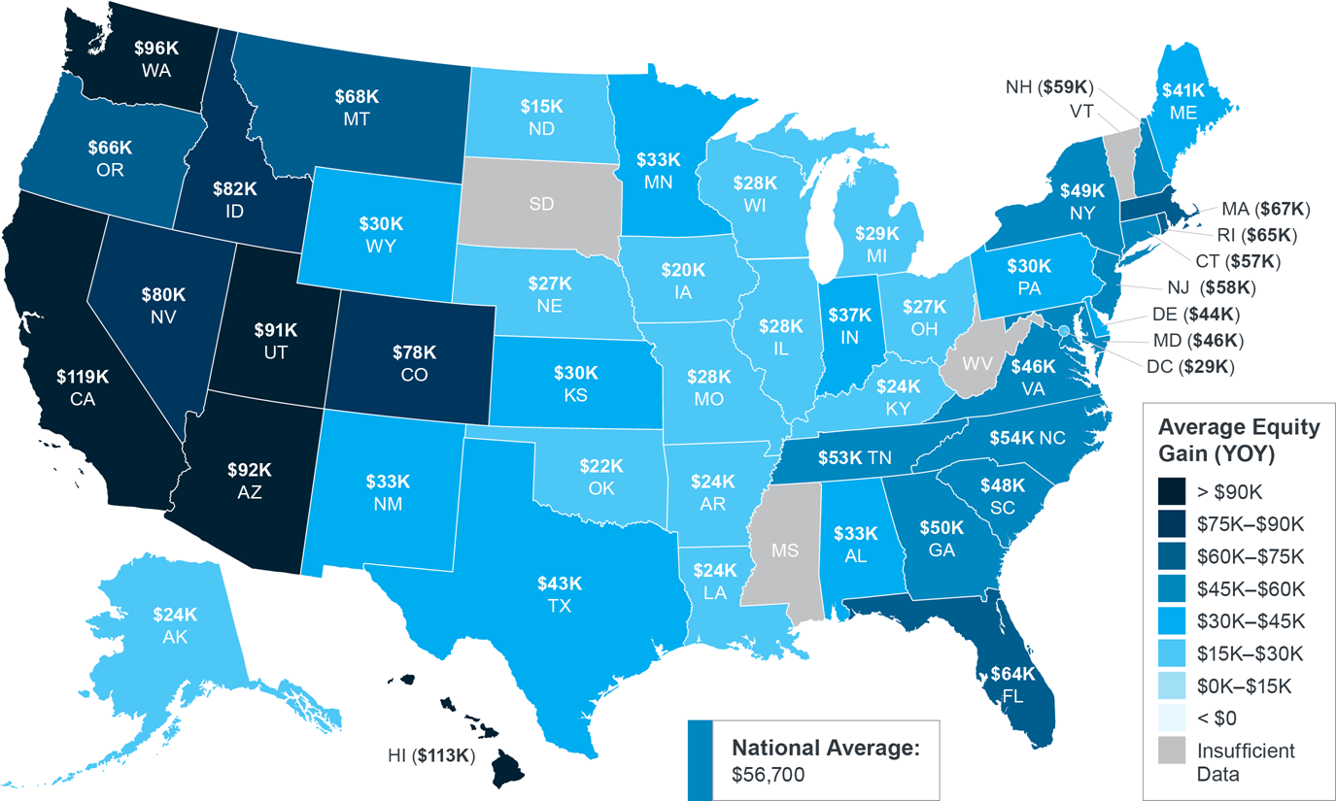
Homeowner Equity Growth Still Surging

Slide 7
Inventory Shortage
The number of new listings on the market monthly is similar to the same amount we had in 2012, 10 years ago.

Slide 8
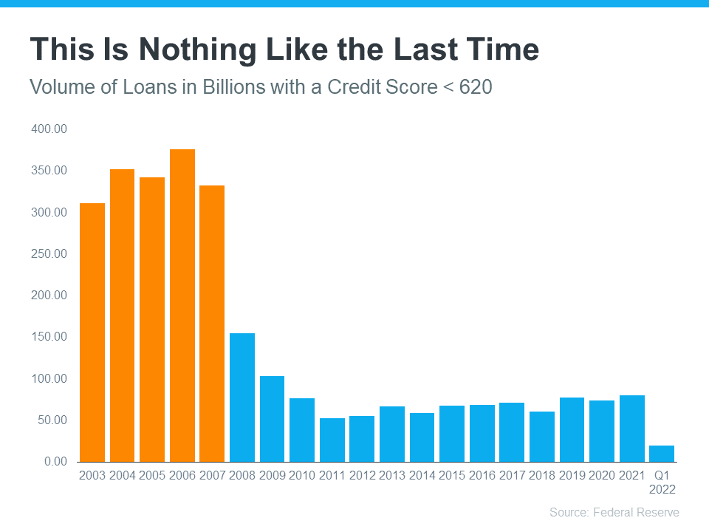

Slide 9
Single Family<2 Acres Kootenai County

Slide 10
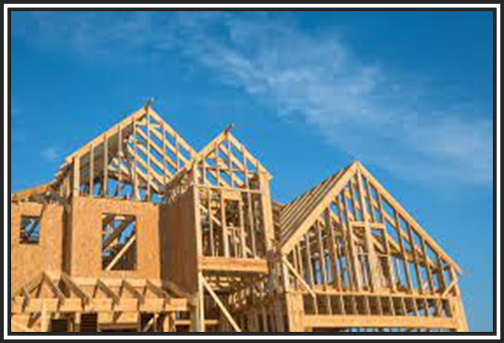
Why not Build It instead of Buy it?
The cost of land in Kootenai County has risen dramatically.
Five years ago, five-to-ten-acre parcels were priced at about $5,000 to $6,000 per acre.
Current pricing now ranges between $40,000 to $60,0000 per acre depending on location and the availability of utilities
A ¼ Acre vacant lot in Woodbridge recently sold for $165,000
Downtown Cd’A .13 acre lot sold recently for $350,000
Regulatory costs associated with New Construction
account for nearly ¼ of the sales price

Slide 11
2022 New Construction vs. Re-sale
Single Family All MLS (Lots & Ac.)
Avg. Sales Price
$664,000
+38%
New Construction was 28% of Single Family Sales YTD 2022
9% higher than this time last year.
Single Family homes all MLS (on Lots and Acres)

Slide 12
$390 Mill
$158 Mill

Slide 13
2021/2022 YoY Average Sales Price Re-Sale All MLS
+17%
+19%
+7%

Slide 14
2021/2022 YoY Average Sales Price Re-Sale All MLS
+168%
5%
61%

Slide 15
Talking Points…
Month over Month Changes (April vs May 2022)
All Residential Property Average closed value is down 4%
Single Family down 4%
Multi Family is up 113%
Mobile/Manufactured is down 10%
Days on Market as of 6/7/2022
Cda/Dalton 48, DTC 37
Post Falls 60, DTC 48
Rathdrum 81, DTC 73
Average MLS 59, DTC 46

Slide 16
Q & A

