Slide 1
Grant Writing + Management for Workforce & Economic Development
AACC Workforce Development Institute 2023

Slide 2
Welcome!
Meet your Presenters:
Tim Aldinger, Executive Director, Workforce Development, Foundation for California Community Colleges, CA
Stacy N. Fitzsimmons, Founder & CEO, SNF Writing Solutions, IN
Nancy Smith, Director, Office of Grants Development, The Community College of Baltimore County, MD
Susan Taylor, Founder and CEO, The Grant Lab, OR
Frank Woodbeck, Executive Director, Grants and Special Projects, College of Southern Nevada, NV
Jen Worth, Senior Vice President, Academic and Workforce Development, AACC, DC

Slide 3
Meet Each Other
Partner up and interview each other. Introduce your partner to the room.

Slide 4
Board 1: “I would like to learn about ______.”
Board 2: “My expertise level in grants is ______.”
Session Compass

Slide 5
Design Thinking that Makes Sense
What do we mean by design thinking?
What sources are guiding your understanding of a given issue?
How can we craft a proposal that reflects that actual needs of our target group?

Slide 6
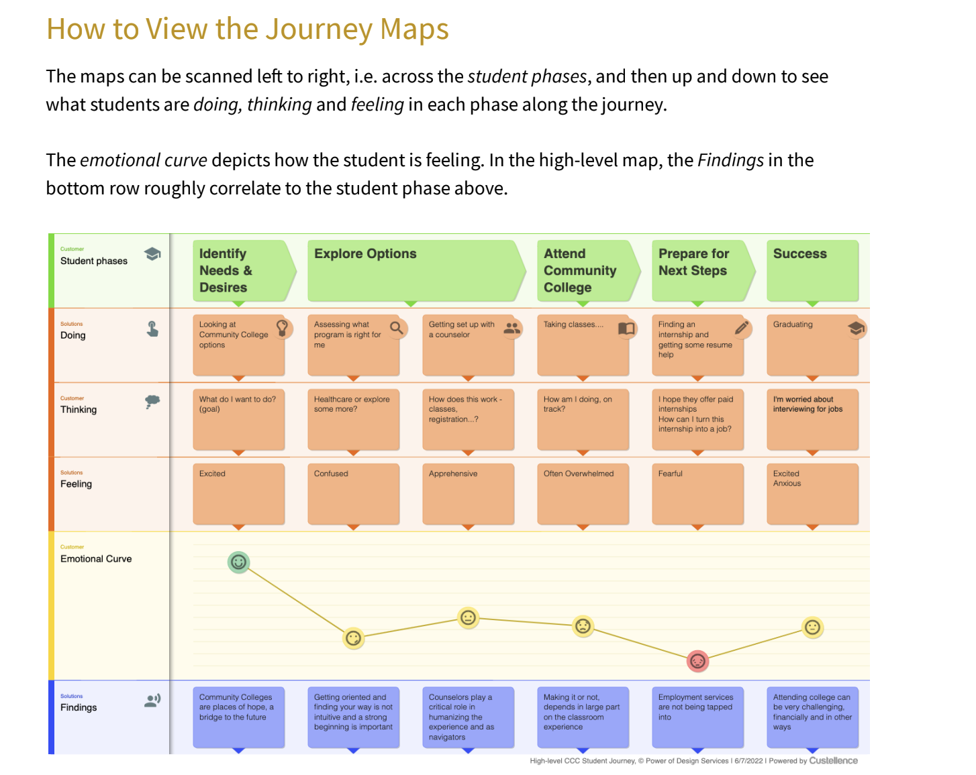

Slide 7
Peer Learning Lunch
Roundtable Discussions by Topic
Facilitator | Topic
Tim Aldinger | Matchmaking and Relationships
Stacy N. Fitzsimmons | Grant Management
Nancy Smith | How to Keep from Chasing the $$
Susan Taylor | What Grant Opportunities Match my Project Idea?
Frank Woodbeck | Matching Goals to Grants

Slide 8
Grant Development Overview
A Briefing

Slide 9
What’s a good grant “project”?
Community-driven
Has a target audience/population that can be quantified and qualified
Provides a solution to a need in the community that can be demonstrated in data
Defined activities that can be scheduled and tracked for progress reporting
Goals that are community-initiated
“SMART” objectives/outcomes crafted with community input
Partnerships demonstrate community support and involvement of supporting se
Organization has the expertise and capacity to implement the project
Matches the funder’s mission and funding purpose
Resources required for the project fit within the parameters of the funding

Slide 10
SNF Writing Solutions Checklist for Program Design
Have we described the intended audience for the program?
Do we know who else is doing similar or compatible work in the community?
Do we know how to reach the target audience for the program?
Have we supported the need for the program with data?
Do we have the expertise to implement the program?
Have we outlined what we will do?
Do we know what and when we need to do in the first year?
Do we have a plan for the timing of program implementation for years 2-5?
Have we assigned each task to a person?
Will we include our target population in program implementation/review/implementation?
Is our program designed with DEI in mind?
Can we qualitatively and quantitatively measure the impact of our program on the target population?

Slide 11
Differences between Public and Private Funding
Public
Private
Purpose set by legislation
Have the most money and more likely to award large grants
More likely to cover indirect costs
Application process and deadlines are public information and very firm
Use prescribed formats for proposals; many use “common” forms
Possibility to renew is known up front
Plenty of staff resources; most projects have specific contact
More likely to focus on emerging issues/new needs
Often willing to pool resources with other funders
Wide range in size of grants
Full length, complex proposals not always necessary
More willing source of start up or experimental funds
Can often provide alternative forms of assistance (technical, in-kind, expertise)
Can generally be much more informal and willing to help with proposal process.

Slide 12
Additional Differences
Public
Private
Are much more bureaucratic
Complex application and lengthy proposal requirements
Often require institutional cost-sharing and matching
Reviewers tend to favor established applicants
Changing political trends affect security of some programs
Research is time consuming and must be cited in proposal
Sometimes difficult to sell new ideas
Short turnaround time to develop projects
Average size of grant is much smaller
Priorities can change quickly
Applicants have limited influence on decision-making
Information on procedures must generally be researched
Less likely to cover all project costs
Limited staff
Not always clear about reasons for rejection

Slide 13
Foundation Grant Primer

Slide 14
How to get started with grants

Slide 15
Grant Development Process
Ideation:
Project & Budget
Seek proper approvals
Find funding sources
Write the grant proposal
Submit proposal

Slide 16
1. Ideation & Project Planning
Questions to answer in ideation meeting:
What do you want to do?
Why?
What problem does this solve?
Does this project or program align with the college mission, vision, and strategic plan?
What partners should be involved?
Do I/we have time to manage this project? If not, who will do it?
Will we need to sustain funding after the grant? If so, how will we do it?

Slide 17
1. Ideation & Project Planning
The best way to get buy-in and get everyone on the same page:
Prepare a one-page internal briefing:
  What is the project?
  What problem does this project seek to solve?
  Who will it serve?
  Who will do the work?
  What impact and/or outcomes will it have?
  How much will it cost?

Slide 18
1. Ideation & Project Planning: Budgeting
Put together one overall inclusive, multi-year project budget. Use this project budget to guide smaller budgets for grant proposals.
How much will it cost make this project a success?
What internal resources will be leveraged to ensure project success?
For which components should we seek external funding?

Slide 19
1. Ideation & Project Planning: Budgeting
Often forgotten project development and implementation costs that may pertain to your project:
  Personnel: % of staff, faculty, admin, finance office, HR, facilities, IT
  Marketing and recruitment of students or participants
  Partnership building
  Wraparound services
  Participant/student resources: supplies, books, transportation etc.
  Space rental for off-site locations
Consider your cost per participant ratio when developing a grant budget.

Slide 20
2. Seek proper approvals
Discuss your project with leadership for approval to pursue grants.
Make your case:
  Why do you need additional funding?
  What specific impact will this have (on students, the institution, and the community)?
  How will you manage it?
Discuss your idea and budget with your grant development office.

Slide 21
3. Find funding sources
Some projects will require multiple funding sources, some only need one.
Where to find grant funding?
  Your grant development office
    Possible access to paid subscriptions and prospect research databases
  Candid: Foundation Center Online
  Philanthropy News Digest
  Grantmakers.io
  AACC
  Local or institutional library
  Google

Slide 22
4. Write the grant proposal
Rule #1: Follow the directions! (Seriously though)
Tell your story – real humans are reading your proposal.
Gather and include data, stories, partner agreements, photos, and/or news articles pertaining to your project.
Provide required documentation.
Prepare an accurate and inclusive budget.

Slide 23
5. Submit
Check with your grants office on the process for submissions – each institution varies.
Double-check all grammar, character counts, attachments, and checkboxes.
Every foundation has a different submission process:
  Online portal
  Email
  Snail mail
Leave yourself at least 50% more time than you think it will take.

Slide 24

Tim’s Top 3 Secrets to Grant Success
1. Match your desired change with what funder cares about
2. Raise the conversation with funders to the parts that matter
3. Subject experts and grant experts are a great team

Slide 25
Frank’s Top 3 Secrets to Grant Success
1. Don’t ”chase” every grant just because your institution
is eligible.
2. Identify the primary or desirable needs/goals of your
institution and seek to pursue grant opportunities that
fit those needs/goals.
3. Always question: “Is this a grant opportunity we can
win?” i.e. How large is the pool of $ available, and
how many grants will be awarded?

Slide 26

Susan’s Top 3 Secrets to Grant Success
1. Track your time while writing each grant. That way you know your ROI and how to plan for grant writing next time. I use Toggl Track for free.
2. Ask for help and feedback!
3. Don’t reinvent the wheel: leverage existing resources to support your grant development work.

Slide 27
Federal Grant Development & Management Clinic

Slide 28
Where do federal grants come from?
Federal grants are funded by Congress through the annual appropriations process.
About 40% of federal spending is "discretionary." This includes areas like defense or education funding, for which the spending is set each year by Congress.
Discretionary spending requires a two-part process. It is created or "authorized" in one bill, and then the actual money is "appropriated" in another bill. Most grant programs are discretionary.
While federal departments administer and distribute grant funds, usually through a grant competition, these programs must adhere to the purposes identified by Congress
Congress expects funds to be used in the fiscal year for which they are appropriated.
The federal fiscal year runs from October 1 to September 30.
The majority of federal grant funds are distributed to the states that then disburse the funds to entities within their borders. Each state may choose a different method to distribute funds.

Slide 29
Brief intro to grants.gov and the Federal Register
Roles & access (E-Biz POC, AOR)
Timeframe for registrations
Software up to date
Portals are different and update frequently
2-step verification
Keep access open – login frequently (at least every 30 days)

Slide 30
Brief intro to grants.gov and the Federal Register
Roles & access (E-Biz POC, AOR)
Timeframe for registrations
Software up to date
Portals are different and update frequently
2-step verification
Keep access open – login frequently (at least every 30 days)

Slide 31
Reading and interpreting the NOFO
Look for: Eligibility – Fit w/ Institution - # funded (level of competition)
- New vs Recurring
Timing of discussions with agency program staff & intelligence gathering
  Congressional delegation & government affairs
Background – Narrative Requirements – Submission Instructions – Review Criteria
  Information that isn't readily available, but can be located
    DOL grant review manual
Research for "hot topics" and what is trending in the community and administration
  Sources to back up your data/ideas
Feasibility of application success given resources (human, time, tangible) available for application and implementation

Slide 32
Grant readiness matrix
Decision tool used to evaluate an organization or opportunity
Criteria determined by the organization (typically stays consistent)
Yes/No or weights for each criteria aid in getting to a Go/No-Go decision
Criteria can be generated from:
  Organizational Priorities, Best Practices, Pet Peeves, Success Benchmarks, Performance Measures,
  Data/Sample items that have been parts of success/barriers
Criteria Examples:
  Number of Awards, Eligibility, Likelihood to Meet Deadline, Key Personnel Availability, Mission Alignment, Competition, Geographic Location/Facilities Support

Slide 33
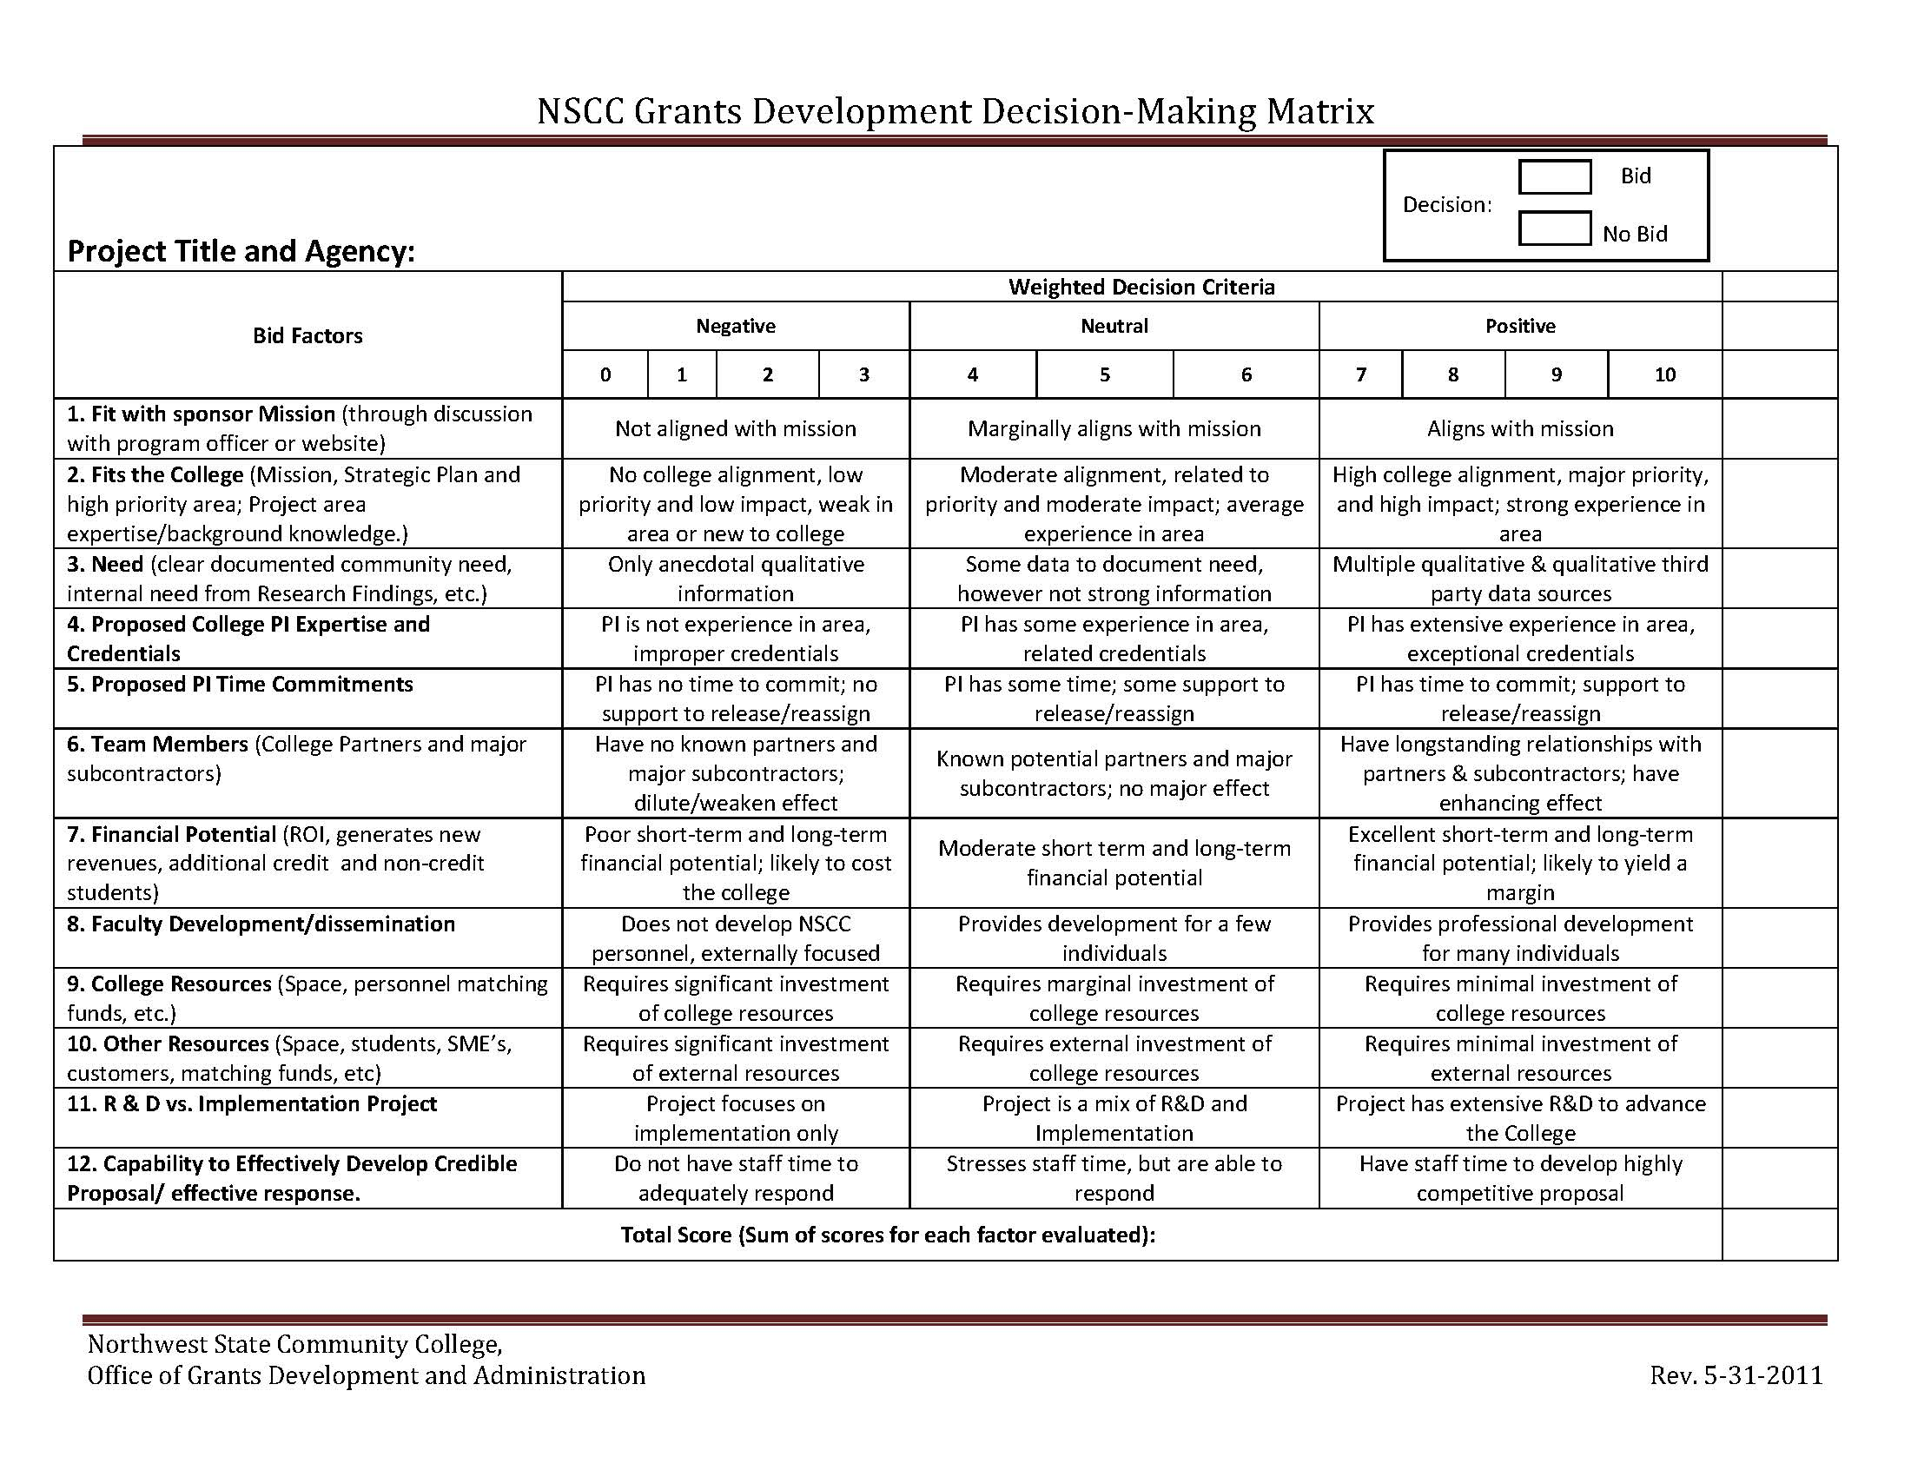

Slide 34
Earmarks
”Earmarks” are Congressionally Directed Spending grants which are a specific amount of discretionary budget authority targeted to a specific entity (i.e. college, university, city, county, etc.) within a Congressional district to underwrite the cost (or portion thereof) of a project or program.
In 2021, the House and Senate brought back an earmark process after 11 years of a moratorium. This Community Project Funding Member Request Process limited the number and scope of potential projects Members could request. Also a more stringent reporting process that included public disclosure of earmark requests, along with the Member’s name is part of the disclosure process.
Only projects with demonstrated community support will be considered, and evidence of that includes:
  Letters of support from elected community leaders (i.e. mayors & other public officials)
  Press articles highlighting the need for the project
  Resolutions passed by the city councils or commissions, etc.
  Projects listed on State intended-use plans

Slide 35
Earmarks – Continued
Important parameters to keep in mind:
  Is the earmark request limited to one-year funding (recommended)?
  How much money is needed from Congress?
  Is the request less than $2 million? (preferred, since a Member’s funding is limited)
  Does the earmark request have broad public support?
Other considerations:
  What federal programs within agencies do your faculty rely on for grant funding, i.e. NSF?
  Are there any programs within a federal agency that fund an existing program or center on campus?
  Are there any current centers or large-scale grants in your college nearing an end, and what federal accounts fund these centers?
Although this is a new (or revived) source of grant funding, it is still a grant, and you will have to account for the funding and the parameters under which the funding was requested and granted. In the future (near or distant) you will have to respond to a federal audit. Be aware!!

Slide 36
Things to contemplate...
Is it worth chasing the money?
Cyber requirements, transparency, and the grant process
Shifting landscape with each administration
Program Requirements being put on the grants – and midstream shifts
  Data
  Proof of progress towards objectives
Maintaining relationships with "people on the inside"
Sense of humor

Slide 37
Grant Management
Begin with the end in mind
Can you do the work?
Do you have qualified staff with time to do the work?
Person in compliance with project management experience that can coach PDs
Can you track the funds? Participants? Outcomes?
Controls in place for reporting and contact with the PO/GMS
Document everything! "Note to File" with a trail and follow-up calls with emails
Database to track and repository for all files

Slide 38
Farewell!
Write down three takeaways from this session that you are going to implement by January 31st.
Share at least one business card with someone in the room and write a word or phrase so they remember you.

