Slide 2

Judgement
First Referee

Slide 3
Consistency
Consistency is the key to being considered a great referee
Coaches and players might not agree with a call, but if the call is consistently made at that level for both teams throughout the match, the coach and the players are more likely to adjust and play on
So, the goal is to be consistent throughout the match
One way to improve consistency is to hold the whistle early in the match on borderline decisions
When a ball handling decision is made early, a standard is set for the match
Evaluate a couple of rallies early in the game to judge the level of ball handling during live play

Slide 4
Ball-Handling-Judge the Play
As much as fans and coaches want to judge the spin of the ball, referees need to focus on the player and the players’ contact of the ball
The spin may provide evidence the contact was not clean, but ball-handling needs to focus on the handling of the ball, not just the ball itself
If the athlete makes a difficult play and the result is a blatant fault, the violation should be called
If the player is in good position, there is no leanancy on the 2nd contact

Slide 5
Ball-Handling Philosophies and Concepts
Enter the match only when necessary
Start where you want to finish…If you are not going to call a marginal contact at 14-14 in the 5th set don’t call the same contact at 4-5 in the 1st set
Call to the level of play-You adjust don’t make the teams adjust
Don’t raise your standards if the teams can’t match it, but it is not a free-for-all where anything goes
Preparation-Observe warm-ups and watch setters’ techniques

Slide 6
Ball-Handling Goals
Consistency- Have a consistent predictable strike zone. Teams will adjust, providing you don’t throw them a curve ball
Consistent from:
  Set to set
  Match to match and team to team
  Within a team-player to player, setter vs non-setter
  Skill to skill- Tight with doubles but loose with power tips or visa-versa
  Referee to referee

Slide 7
Ball-Handling Goals
Avoid “automatic calls
Minimize outside influences-spectators, coach and players reactions. They are biased, referees are not.
Be predictable-don’t surprise teams with a random call

Slide 8
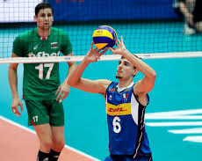
Interesting Point
Sometimes the ball blocks the view of the setter’s hands
The R1’s view is different than coaches

Slide 9
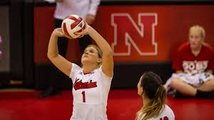

Slide 10
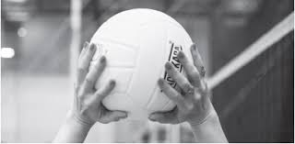

Slide 11
