Slide 1
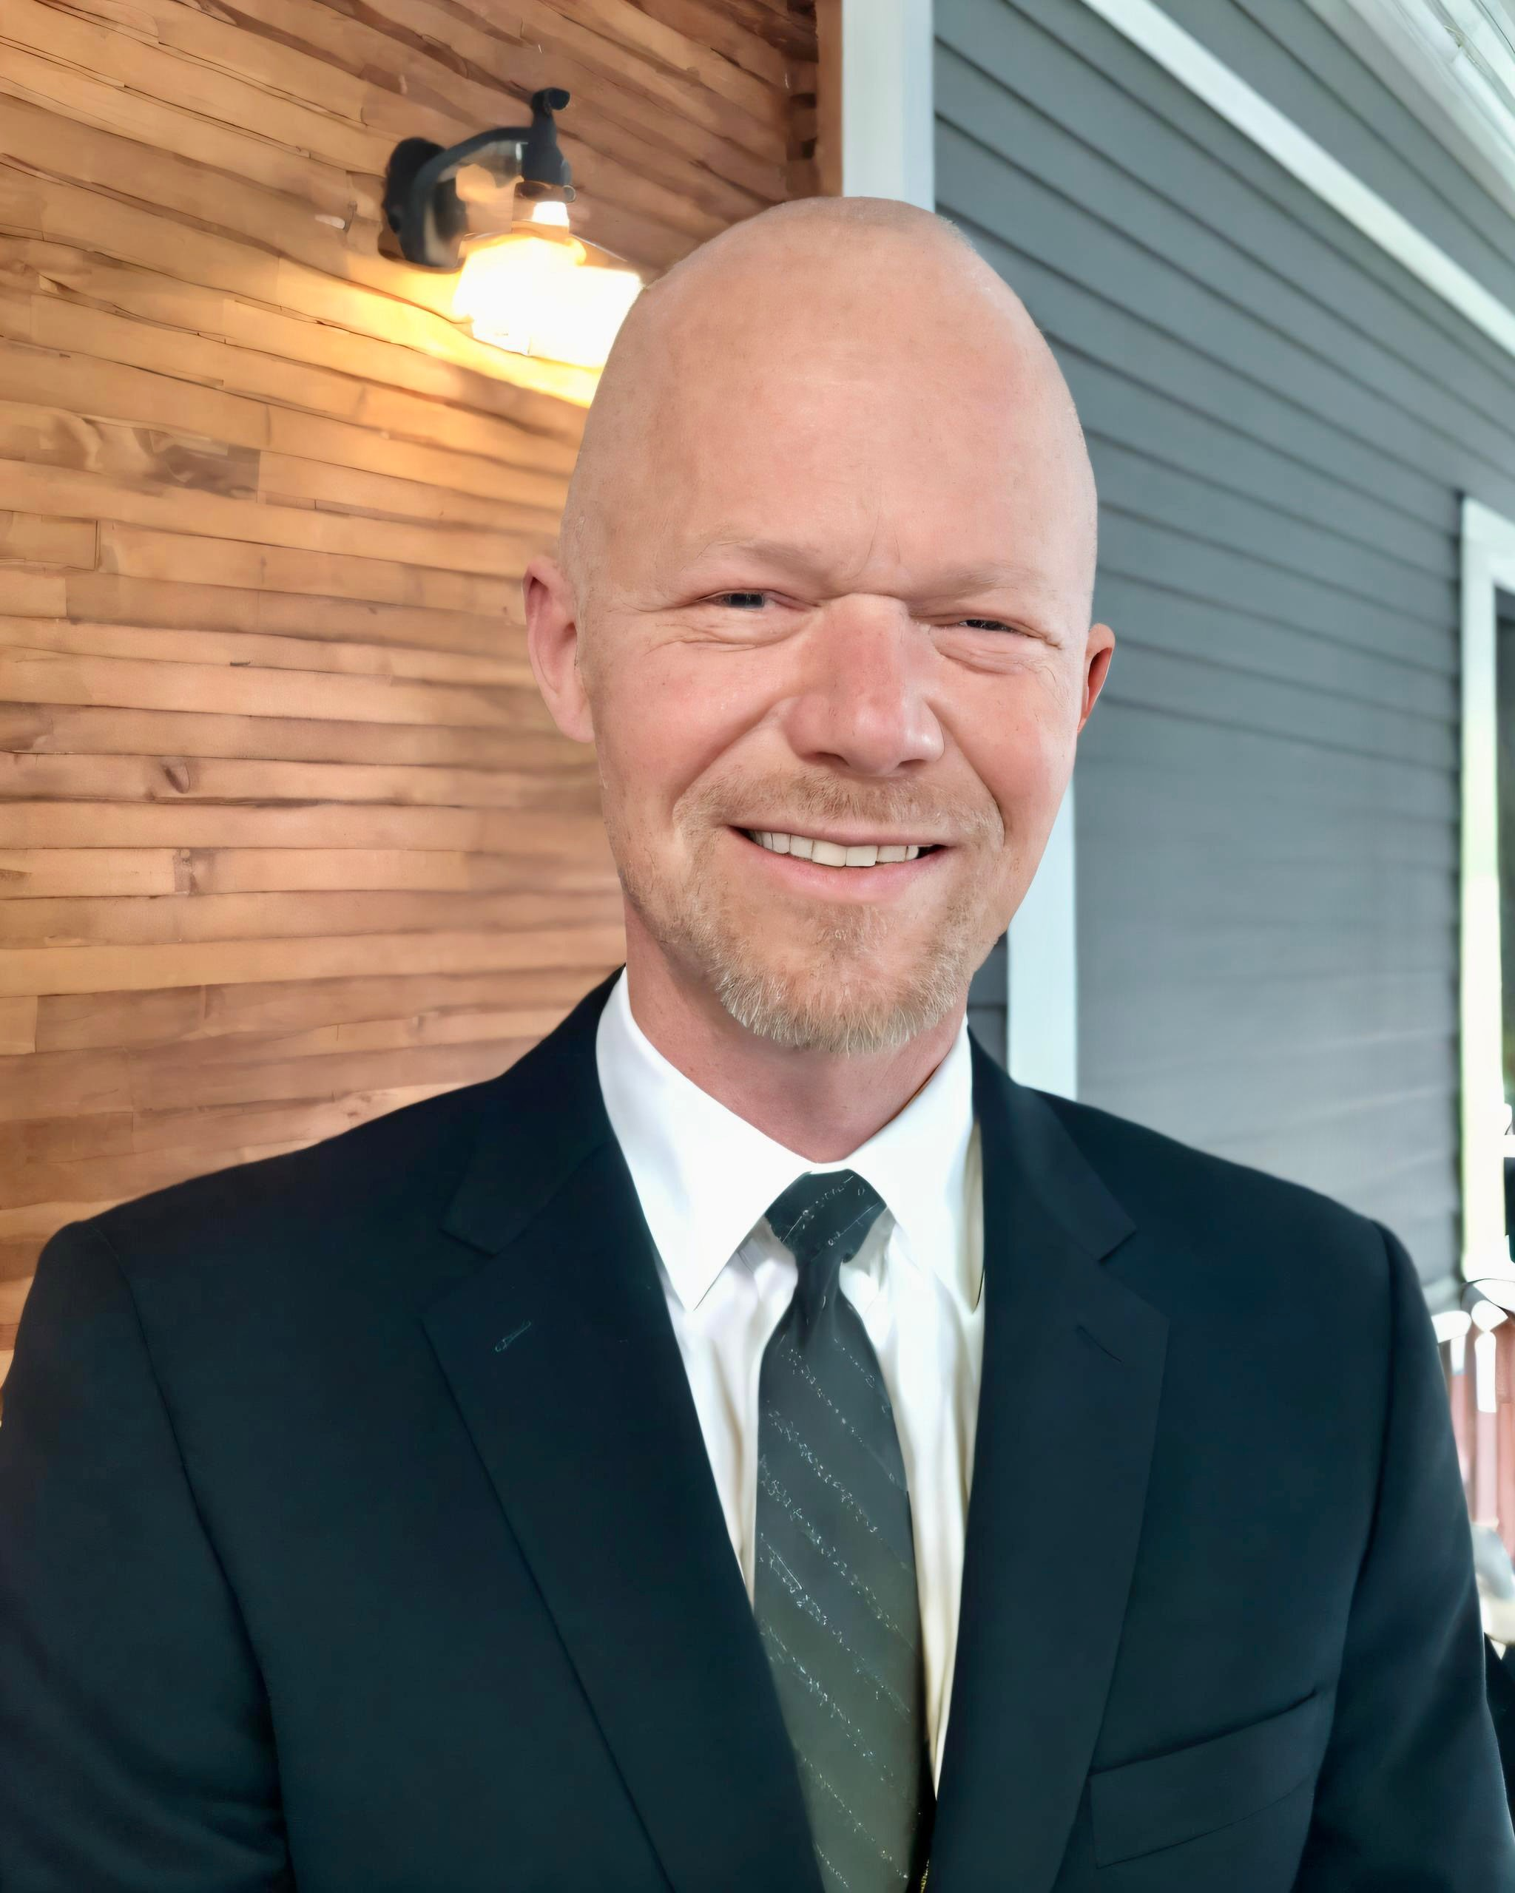



NCNA Conference 2026
Dean Eason-Williams Dean@notaryclt.com
(980) 999-2612
Notary Website Fundamentals
NotaryCLT.com
Skool.com/notarycltapex

Slide 2
01.
Importance of Website and Digital Trust
Clarity and Messaging
Homepage and Trust Signals
Design, Connection, and Organization
Service Pages and Positioning
User Experience and Mobile
Agenda
7. Common Mistakes and Disorganization
8. Improvement and Summary

Slide 3
Importance of Website and Digital Trust
02.

Slide 4


04.
Importance of Website and Digital Trust
Why Your Website Matters
First Impressions Matter
Your website is often the initial touchpoint for potential clients.
A professional online presence sets the tone for trust and confidence.
Digital Trust Drives Decisions
Clients frequently decide on your services before making contact, based on your website.
Clear, organized sites reduce hesitation and build reassurance.
Professionalism Builds Confidence
Strong messaging and trust signals increase client comfort and clarity.
Professional photos, testimonials, and certifications reinforce legitimacy.

Slide 5

05.
Importance of Website and Digital Trust
Digital Trust Psychology
First Impressions Matter
Website appearance shapes professionalism and trust.
Trust Begins Online
Clients assess legitimacy and responsiveness before contact.
Reduce Hesitation
Clear, organized sites boost confidence and comfort.
Build Reassurance
Professional websites minimize confusion and skepticism.

Slide 6

06.
Importance of Website and Digital Trust
Professionalism Drives Confidence
First Impressions Matter
A polished website signals professionalism and builds immediate trust.
Clarity Drives Action
Clear messaging helps visitors quickly understand your services and next steps.
Comfort Reduces Hesitation
A well-organized site reassures clients, making them more likely to reach out.
Trust Signals Boost Confidence
Professional photos, testimonials, and certifications reinforce your credibility.

Slide 7
Clarity and Messaging
07.

Slide 8

07.
Importance of Website and Digital Trust
Reducing Visitor Hesitation
Clear Communication Builds Trust
Visitors quickly understand your services, reducing uncertainty.
Specific messaging reassures clients and sets clear expectations.
Professional Design Reduces Skepticism
Organized layouts and visible contact info increase confidence.
Trust signals like testimonials and certifications minimize hesitation.
Clarity Drives Conversion
Easy navigation and clear next steps encourage visitors to take action.

Slide 9


09.
Clarity and Messaging
Website Clarity Essentials
Instant Service Recognition
Visitors should immediately grasp what services you offer and who you help.
Clear descriptions prevent confusion and encourage engagement.
Location and Contact Transparency
Make your service area and contact methods obvious from the start.
Visible phone numbers and easy scheduling build trust.
Confidence Through Clarity
Strong, specific messaging reassures visitors and reduces hesitation.
Avoid generic or unclear language to foster confidence.

Slide 10
Homepage and Trust Signals
10.

Slide 11

10.
Clarity and Messaging
Strong vs. Weak Messaging
Clear Messaging Builds Trust
Specific language signals professionalism and expertise.
Focused messaging reassures visitors about your services.
Generic Messaging Creates Doubt
Unclear or broad statements lead to confusion and hesitation.
Visitors may feel uncertain about what you offer or who you help.
Confidence Through Clarity
Strong, specialized messaging helps clients understand your value.
Clarity reduces skepticism and increases conversion rates.

Slide 12

12.
Homepage and Trust Signals
Homepage Sets Expectations
Set Professional Tone Instantly
Homepage should convey professionalism and organized presentation.
Clear branding and messaging build immediate trust.
Showcase Specialization
Highlight unique services and expertise to stand out.
Specific language reassures visitors of your focus.
Make Contact Effortless
Visible contact options and easy scheduling reduce hesitation.
Clear next steps guide visitors toward conversion.
Ensure Visitor Clarity
Homepage answers: what you do, who you help, and how to connect.
Reduce confusion to boost confidence and engagement.

Slide 13

13.
Homepage and Trust Signals
Reducing Homepage Confusion
Immediate Clarity Matters
Visitors must instantly grasp your services, location, and contact options.
Reducing Visitor Hesitation
Clear messaging builds confidence and encourages engagement.
Avoiding Abandoned Visits
Confusing layouts and unclear information lead to frustration and lost opportunities.
Setting Professional Expectations
A well-structured homepage signals trustworthiness and specialization.

Slide 14

14.
Homepage and Trust Signals
Trust Signals That Matter
Visual Professionalism
High-quality photos convey credibility and attention to detail.
Client Feedback
Displaying reviews and testimonials builds confidence in your services.
Certifications & Credentials
Showcase certifications to demonstrate expertise and legitimacy.
Consistent Branding
Unified colors, logos, and messaging reassure visitors of your professional identity.

Slide 15
Design, Connection, and Organization
15.

Slide 16

15.
Homepage and Trust Signals
Missing Trust Signals Risks
Skepticism Rises Without Trust
Missing trust signals lead visitors to question your legitimacy.
Clients may hesitate to engage due to lack of visible credibility.
Confidence and Professionalism Drop
Absence of professional photos, reviews, or certifications reduces perceived expertise.
Uncertainty about your services can cause visitors to abandon your site.
Hesitation Impacts Conversion
Visitors are less likely to contact or schedule without clear trust signals.

Slide 17

17.
Design, Connection, and Organization
Organized Websites Feel Strong
First Impressions Matter
A well-organized website projects professionalism and builds immediate trust.
Clarity Drives Confidence
Clear layouts and messaging help visitors quickly understand your services and expertise.
Reduce Visitor Hesitation
Organized design minimizes confusion, making clients more likely to reach out.
Reassurance Through Structure
Consistent branding and visible contact info reassure clients of your legitimacy.

Slide 18

18.
Design, Connection, and Organization
About Page Builds Connection
Build Trust Through Story
Share your journey to convey professionalism and authenticity.
Showcase Human Connection
Highlight your values and approach to create a sense of calm authority.
Establish Specialization
Demonstrate expertise and focus to reassure visitors you understand their needs.
Use Trust-Building Language
Communicate with clarity and warmth to foster confidence.

Slide 19
Service Pages and Positioning
19.

Slide 20

19.
Design, Connection, and Organization
Weak About Pages Lose Trust
Generic Content Erodes Trust
Visitors sense emotional disconnect when About pages lack personality.
Transactional language feels impersonal and reduces confidence.
Strong About Pages Build Connection
Showcase professionalism and calm authority to reassure clients.
Use trust-building language and highlight specialization.
Shape Positive Expectations
A well-crafted About section sets the tone for the client experience.

Slide 21

21.
Service Pages and Positioning
Service Pages and SEO
Clear Service Descriptions
Dedicated pages help visitors quickly understand what you offer and where you operate.
Professional Impression
Focused service pages signal specialization and build client confidence.
SEO Advantages
Google recognizes services, locations, and relevance for better search visibility.
Conversion Boost
Clear, relevant pages increase the likelihood of visitors becoming clients.

Slide 22

22.
Service Pages and Positioning
Google Understands Specialization
Service Pages Signal Expertise
Dedicated pages showcase your specialization and professionalism.
Clear, focused content helps Google understand your unique offerings.
Location & Relevance Matter
Google identifies your service area and matches you with local clients.
Relevant details boost your visibility in search results.
SEO Drives Client Conversion
Strong service pages improve search rankings and attract more inquiries.
Focused messaging increases client confidence and conversion rates.

Slide 23
User Experience and Mobile
23.

Slide 24



23.
Service Pages and Positioning
Estate Signing Positioning
Specialized Messaging Builds Trust
Using ceremony language and calm authority reassures clients.
  Clear, professional communication signals expertise.
Attorney-Facing Positioning
Highlighting specialization and responsiveness appeals to legal
professionals.
Showcase organization and clarity to meet attorney expectations.
Signer Care and Professionalism
Emphasize signer support and attention to detail for estate signings.

Slide 25



25.
User Experience and Mobile
Contact Experience Matters
Clear Contact Methods
Visible phone numbers and easy-to-find contact forms build trust and encourage action.
Simple Scheduling
Streamlined booking tools and clear instructions reduce hesitation and improve conversion rates.
Defined Next Steps
Clients should know exactly what happens after reaching out, increasing confidence and comfort.
Mobile Accessibility
Easy contact and scheduling on mobile devices prevent abandoned visits and frustration.

Slide 26
Common Mistakes and Disorganization
26.

Slide 27

26.
User Experience and Mobile
Mobile Experience Essentials
Mobile-First Impressions
Most clients access your site via smartphones, making mobile usability essential.
Readable Text Matters
Clear, legible fonts ensure visitors can quickly absorb information without frustration.
Simple Navigation Drives Engagement
Easy-to-find buttons and menus help users locate services and contact options efficiently.
Fast Access Reduces Hesitation
Quick-loading pages and visible calls-to-action boost confidence and conversion.

Slide 28

28.
Common Mistakes and Disorganization
Common Website Mistakes
Cluttered Layouts
Overcrowded pages lead to visitor confusion and frustration.
Disorganized design reduces perceived professionalism.
Weak Messaging
Generic or unclear wording fails to communicate your services and value.
Unfocused content leaves visitors uncertain about what you offer.
Hidden Contact Information
Difficult-to-find phone numbers or emails decrease trust and responsiveness.
Unclear Services
Ambiguous service descriptions create hesitation and reduce conversion.

Slide 29
Improvement and Summary
29.

Slide 30



29.
Common Mistakes and Disorganization
Disorganization Creates Uncertainty
Cluttered Layouts Undermine Trust
Disorganized websites create confusion and reduce visitor confidence.
Clients may abandon visits when faced with unclear navigation or messy design.
Hidden Information Causes Frustration
Missing or hard-to-find contact details lead to hesitation and lost opportunities.
Professional Hesitation Leads to Lost Clients
Uncertainty about services or expertise drives potential clients elsewhere.

Slide 31

31.
Improvement and Summary
Immediate Improvement Areas
Enhance Homepage Clarity
Clearly state services, location, and contact details to build visitor confidence.
Reduce confusion by using focused messaging and organized layouts.
Use Professional Photos
High-quality images convey trustworthiness and reinforce your brand.
Strengthen About Page
Showcase human connection and calm authority to foster client trust.
Display Trust Signals
Include testimonials, certifications, and consistent branding to reassure visitors.

Slide 32



32.
Improvement and Summary
Long-Term Growth Strategies
Expand Service Pages
Create dedicated pages for each notary service to boost clarity and
professionalism.
  Highlight specialized offerings to attract targeted client groups.
Enhance SEO Performance
Optimize content for relevant keywords, services, and locations to
improve Google visibility.
Use focused, clear language to increase search relevance and conversion rates.
Position for Attorney Audiences
Emphasize professionalism, organization, and responsiveness to
appeal to legal professionals.
Integrate trust-building signals and specialized messaging for estate
signing and attorney-facing services.

Slide 33


33.
Improvement and Summary
Your Website’s Bigger Purpose
First Impressions Matter
Your website is often the initial trust-building moment for potential clients.
Trust Begins Online
Professional design and clear messaging foster confidence and reassurance.
Small Changes, Big Impact
Incremental improvements
—like clearer contact info or stronger About pages—can significantly boost client trust.
Reduce Hesitation
A well-organized site minimizes uncertainty and encourages visitors to take action.

Slide 34

34.
Improvement and Summary
Key Takeaways for Notaries
Build Trust with Professionalism
A polished website increases confidence and reassures visitors.
Showcase certifications, reviews, and professional photos to reduce hesitation.
Clarity Drives Conversion
Clear messaging helps visitors quickly understand your services and expertise.
Avoid generic or confusing language—specificity builds trust.
Easy Contact and Responsiveness
Visible phone numbers and simple scheduling boost visitor confidence.
Make next steps obvious to encourage action and reduce uncertainty.
Continuous Website Improvement
Regularly update service pages and trust signals for long-term growth.
Expand specialization and attorney-focused content to strengthen your position.

Slide 35
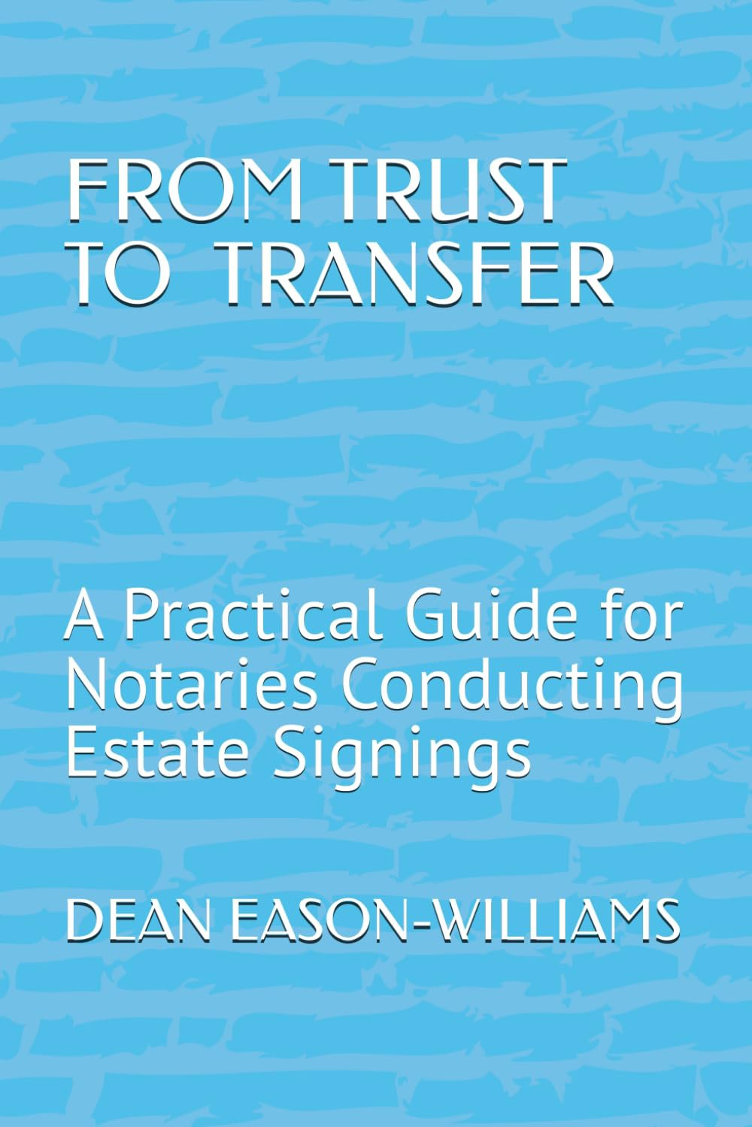


35.
Q & A
Thank you for attending today's session.
Dean Eason-Williams Dean@notaryclt.com
(980) 999-2612
NotaryCLT.com Skool.com/notarycltapex

