Slide 1
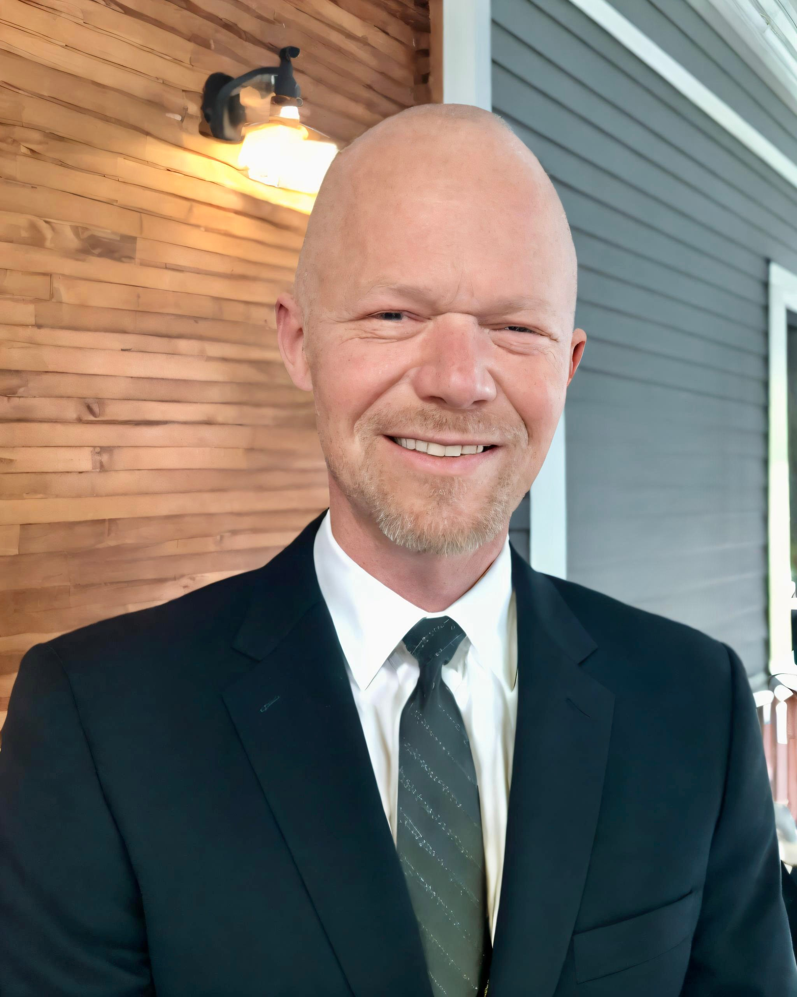



Dean Eason-Williams Dean@notaryclt.com (980) 999-2612
NCNA Conference 2026
Optimizing Notary Profiles for Trust

Slide 2
02.
Importance of Profile Optimization
Building Visual and Headline Credibility
Optimizing Bio and Services
Establishing Trust and Professionalism
Improving and Reviewing Profiles
Summary and Takeaways
Agenda

Slide 3
Importance of Profile Optimization
03.

Slide 4

04.
Importance of Profile Optimization
Why Profile Optimization Matters
Your Profile Is Your Digital Storefront
Clients form opinions about your professionalism and credibility before reaching out.
Visibility Drives Trust and Opportunity
A strong profile increases discoverability and opens doors to new business.
First Impressions Are Made Online
Your online presence often determines whether clients choose to contact you.

Slide 5

05.
Importance of Profile Optimization
Digital Notary Advantage
Digital Presence Defines Professionalism
Clients assess your credibility and responsiveness through your online profile.
A polished digital presence signals preparedness and trustworthiness.
Enhanced Discoverability
Strong profiles make it easier for clients to find and refer your services.
Visibility online increases opportunities for new business.
Building Trust Through Online Credibility
Consistent branding and professional information reinforce trust.
Clients are more likely to contact notaries with complete, professional profiles.

Slide 6





06.
Importance of Profile Optimization
Evaluating Online Trust
Online Presence Shapes Trust
Clients form opinions based on your digital profile before reaching out.
Consistency Signals Professionalism
Uniform branding, clear messaging, and
up-to-date information reinforce credibility.
Responsiveness Builds Confidence
Quick replies and visible contact options make clients feel valued and secure.
Professionalism Prevents Hesitation
Incomplete or unprofessional profiles can cause clients to question your reliability.

Slide 7
Building Visual and Headline Credibility
07.

Slide 8

08.
Building Visual and Headline Credibility
Visual Credibility Essentials
Professional Headshots Establish Trust
A clear, confident headshot signals credibility and approachability.
Avoid blurry selfies or distracting backgrounds to reinforce professionalism.
Lighting, Background, and Attire Matter
Well-lit photos with clean backgrounds create a strong first impression.
Dress in attire that matches your business image for visual consistency.
Consistent Branding Builds Recognition
Use similar colors, logos, and style across your profile for branding consistency.

Slide 9

09.
Building Visual and Headline Credibility
Profile Photo Best Practices
Professional Headshot Essentials
Use a clear, high-quality photo with good lighting and a clean background.
Dress in attire that matches your business image for a trustworthy impression.
Expression & Approachability
Choose a confident, approachable facial expression to build instant trust.
AI Headshot Guidelines
Ensure AI-generated photos look realistic and accurately reﬂect your appearance.
Maintain consistency with your branding and professional image.

Slide 10

10.
Building Visual and Headline Credibility
Headline Impact
Craft Headlines That Stand Out
Include your service type, location, and specialization for instant clarity.
Specificity Builds Trust
Avoid generic titles; use precise language to highlight your expertise.
Attract Your Ideal Clients
Tailor headlines to the audience you most want to serve, such as attorneys or estate clients.
First Impressions Matter
A strong headline sets the tone for professionalism and credibility.

Slide 11








11.
Building Visual and Headline Credibility
Crafting Strong Headlines
Define Your Services Clearly
Specify your notary service type to set expectations.
Highlight specializations such as trust & estate signings or mobile notarizations.
Showcase Your Location
Include your city or region to attract local clients.
Target Your Ideal Audience
Tailor your headline for specific groups: attorneys, estate clients, businesses, or hospitals.
Avoid Generic Labels
Replace vague titles like 'Notary Public' with descriptive headlines.
Strong Headline Example
"Mobile Notary & Trust Estate Signing Professional Serving Charlotte, NC" builds instant credibility.

Slide 12
Optimizing Bio and Services
12.

Slide 13

13.
Optimizing Bio and Services
About Section Optimization
Craft a Human-Centered Bio
Use conversational language to foster approachability.
Share your motivation for becoming a notary.
Showcase Professionalism & Experience
Highlight relevant certifications and years of service.
Mention specialized expertise, such as trust & estate signings.
Connect with Your Audience
Address client needs and demonstrate emotional intelligence.
Emphasize calm authority and presence during sensitive signings.

Slide 14


14.
Optimizing Bio and Services
Bio Tone and Connection
Humanize Your Bio
Use authentic, conversational language to connect with clients.
Avoid generic phrases—share your unique approach and values.
Demonstrate Calm Authority
Show confidence and professionalism, especially for sensitive signings.
Highlight your experience handling trust and estate ceremonies with composure.
Set Clear Expectations
Describe your process and what clients can expect from your services.
Establish trust by outlining your commitment to professionalism and care.

Slide 15

15.
Optimizing Bio and Services
Showcasing Services
Highlight Your Key Services
Showcase offerings like Trust & Estate Signings, Apostille Facilitation, Loan Signings, and Mobile Notary Services.
Emphasize Specialization
Position yourself as a specialist—such as a professional mobile notary for estate signing ceremonies—to build credibility.
Avoid Generic Messaging
General profiles create vague impressions; specificity helps clients trust your expertise.

Slide 16
16.
Optimizing Bio and Services
Specialization Planning
Identify Your Core Services
List the notary services you most want to be recognized for, such as trust & estate signings, loan signings, or apostille facilitation.
Showcase Specialized Expertise
Highlight your proficiency in areas like hospital notarizations, jail notarizations, or I-9 verifications to stand out from generalists.
Attract Targeted Opportunities
Specificity in your profile draws clients seeking specialized notary services, increasing trust and referrals.

Slide 17
Establishing Trust and Professionalism
17.

Slide 18





18.
Establishing Trust and Professionalism
Trust Signals That Matter
Certifications & Credentials
Showcase relevant certifications to signal professional expertise.
Highlight training, memberships, and specialized credentials.
Client Reviews & Testimonials
Feature positive reviews to build social proof and credibility.
Encourage satisfied clients to leave feedback on your profile.
Consistent Branding & Visuals
Use a professional headshot, clear logo, and cohesive branding elements.
Maintain uniform colors, fonts, and tone across your profile.
Professional Wording & Experience
Craft clear, confident language that reﬂects your specialization.
Include years of experience and areas of expertise for added trust.

Slide 19

19.
Establishing Trust and Professionalism
Professionalism Online and Offline
Digital Presence Shapes Perception
Clients often judge your professionalism based on your online profile before reaching out.
A polished profile signals credibility and preparedness.
Complete Profiles Build Trust
Include clear contact info, certifications, and service details to reinforce trust.
Consistent branding and professional headshots enhance your reputation.
Regular Trust Signal Audits
Review your profile for missing information, weak bios, or outdated visuals.
Update trust signals like reviews, certifications, and specialization to stay relevant.

Slide 20




20.
Establishing Trust and Professionalism
Common Profile Mistakes
Visual Presentation Pitfalls
Blurry or unprofessional photos instantly reduce perceived trust.
Distracting backgrounds and poor lighting weaken your credibility.
Weak Profile Messaging
Generic bios fail to showcase expertise or build connection.
Vague wording leaves clients unsure about your services and specialization.
Incomplete Information Risks
Missing details or contact info create hesitation and lost opportunities.
Lack of clear specialization makes your profile blend in with competitors.

Slide 21
Improving and Reviewing Profiles
21.

Slide 22


22.
Improving and Reviewing Profiles
Fixing Profile Weaknesses
Pinpoint Your Weakest Link
Audit your profile for blurry photos, vague bios, or incomplete information.
Prioritize fixing the most trust-damaging issue first.
Shift to Specific Messaging
Replace generic statements with clear, specialized service descriptions.
Highlight your expertise, location, and target audience for stronger impact.
Enhance Trust Signals
Use a professional headshot, consistent branding, and display certifications.
Ensure your contact info and services are clearly listed.

Slide 23





23.
Improving and Reviewing Profiles
Interactive Profile Review
Assess Professionalism & Trust
Review profile for complete information, clear branding, and professional tone.
Check for certifications, reviews, and consistent visual presentation.
Clarify Specialization & Services
Ensure your services and specialization are clearly stated and audience-focused.
Highlight unique offerings, such as trust & estate signings or mobile notary expertise.
Identify Trust Builders & Hesitations
Pinpoint elements that build trust, like professional headshots and strong bios.
Spot areas of hesitation: incomplete info, vague messaging, or weak visual credibility.
Evaluate Contact Options & Audience Focus
Verify contact details are easy to find and audience targeting is clear.

Slide 24
24.
Improving and Reviewing Profiles
Immediate Improvement Plan
Identify Quick Wins
Spot areas needing immediate attention, such as weak headlines or blurry photos.
Update incomplete information to ensure your profile feels complete and professional.
Clarify Specialization
Highlight your main services and target audience, e.g., trust & estate signings or mobile notary work.
Use specific language to reinforce your expertise and attract your ideal clients.
Strengthen Trust Signals
Showcase certifications, professional headshots, and consistent branding.
Ensure contact information and service details are clear and accessible.
Address Biggest Weakness
Pinpoint the most critical gap—such as vague bios or missing trust signals—and prioritize fixing it first.

Slide 25

25.
Improving and Reviewing Profiles
Final Action Checklist
Upgrade Your Headline
Craft a headline that clearly states your services, location, and specialization.
Move beyond generic titles—be specific to build instant credibility.
Enhance Your Bio & Visuals
Write a bio that feels professional, human, and trustworthy.
Use a high-quality, professional headshot with consistent branding.
Strengthen Trust Signals
Display certifications, reviews, and clear contact information.
Ensure your profile feels complete and professional to reinforce trust.
Clarify Specialization & Audience
Highlight your most desired services and areas of expertise.
Position your profile to attract your ideal clients—be it estate professionals, attorneys, or the general public.

Slide 26
Summary and
Takeaways
26.

Slide 27
27.
Summary and Takeaways
Profile as a Credibility Tool
Profile as Your Digital Storefront
Your profile is often the first impression clients receive.
A strong profile signals credibility and professionalism instantly.
Visibility Drives Opportunity
Optimized profiles improve discoverability and attract more clients.
Clear, professional presentation increases trust and referral potential.
Trust is Built Before Contact
Clients decide whether to trust you based on your online presence.
Consistent branding and complete information reinforce confidence.

Slide 28



28.
Summary and Takeaways
Takeaways for Notary Profiles
First Impressions Set the Tone
Your profile is often the first thing clients see—make it count.
A professional headshot, clear headline, and complete information build
immediate trust.
Specificity Drives Credibility
Clearly state your services, location, and specialization to stand out.
Avoid generic phrases; use targeted language like "Mobile Notary & Trust
Estate Signing Professional."
Consistency Creates Opportunity
Maintain branding, professionalism, and completeness across your profile.
Trust signals—certifications, reviews, and clear contact info—reinforce your
credibility.

Slide 29
Dean Eason-Williams Dean@notaryclt.com (980) 999-2612
NCNA Conference 2026
Q & A
Thank you for attending today's session.

