Slide 1
Sports Council
Go for Gold

Slide 2
Our role
Our role as the Sports Council is -
*to encourage more pupils in the school to be active in sports
*to promote and support competitions and sporting events like the Sport’s Festival, Cross Country etc.
*to promote and encourage links between the school and established sporting clubs & groups (like we are doing this evening)
*to assist in the formation of afterschool clubs
*to celebrate sporting participation and achievement in the school

Slide 3
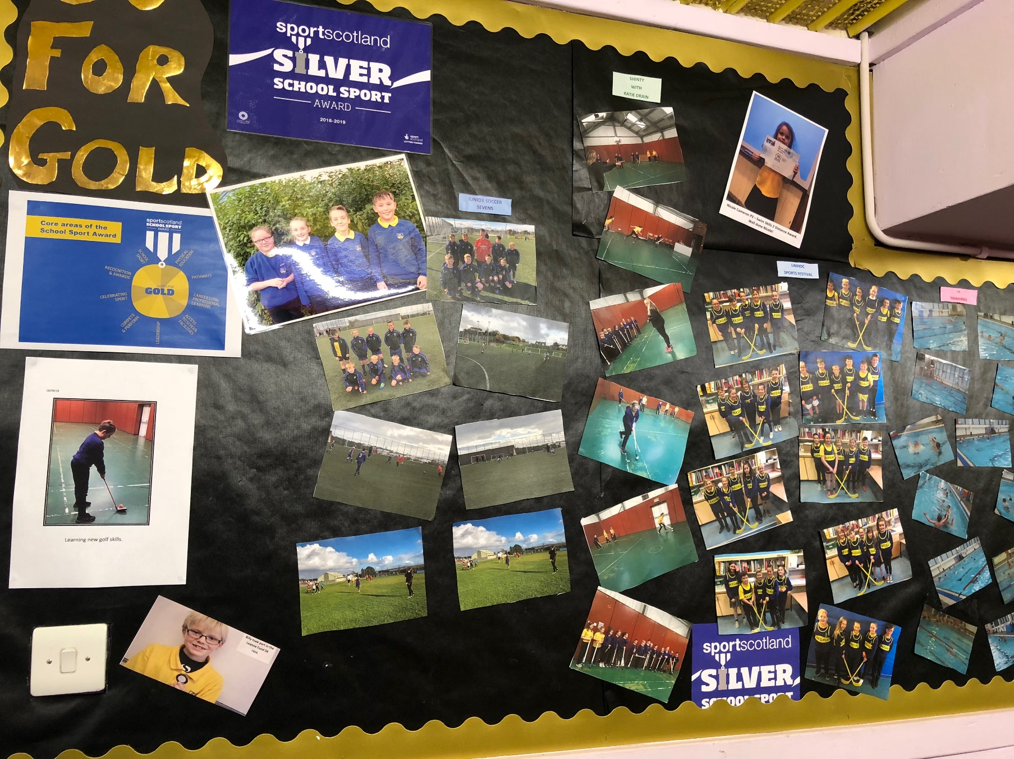

Slide 4
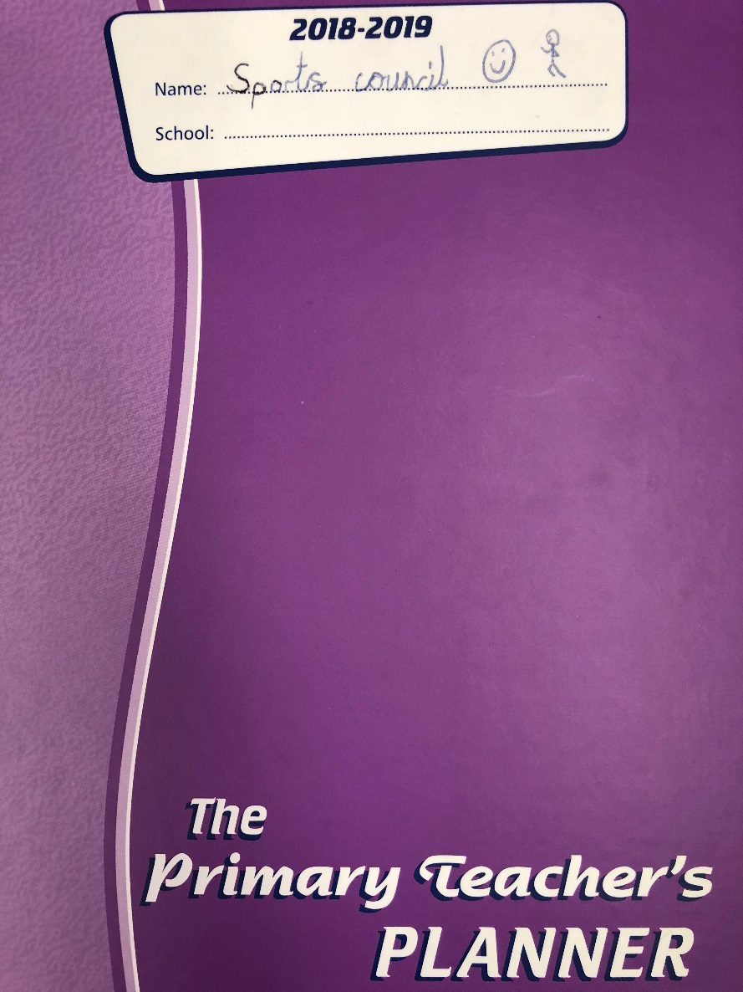
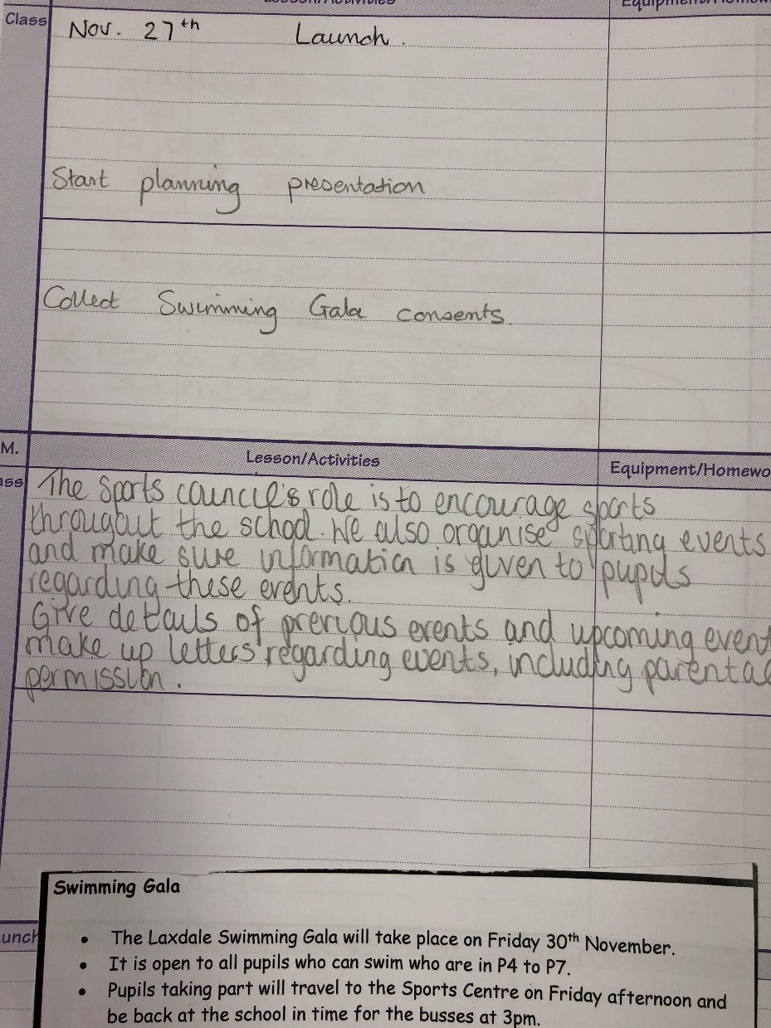

Slide 5
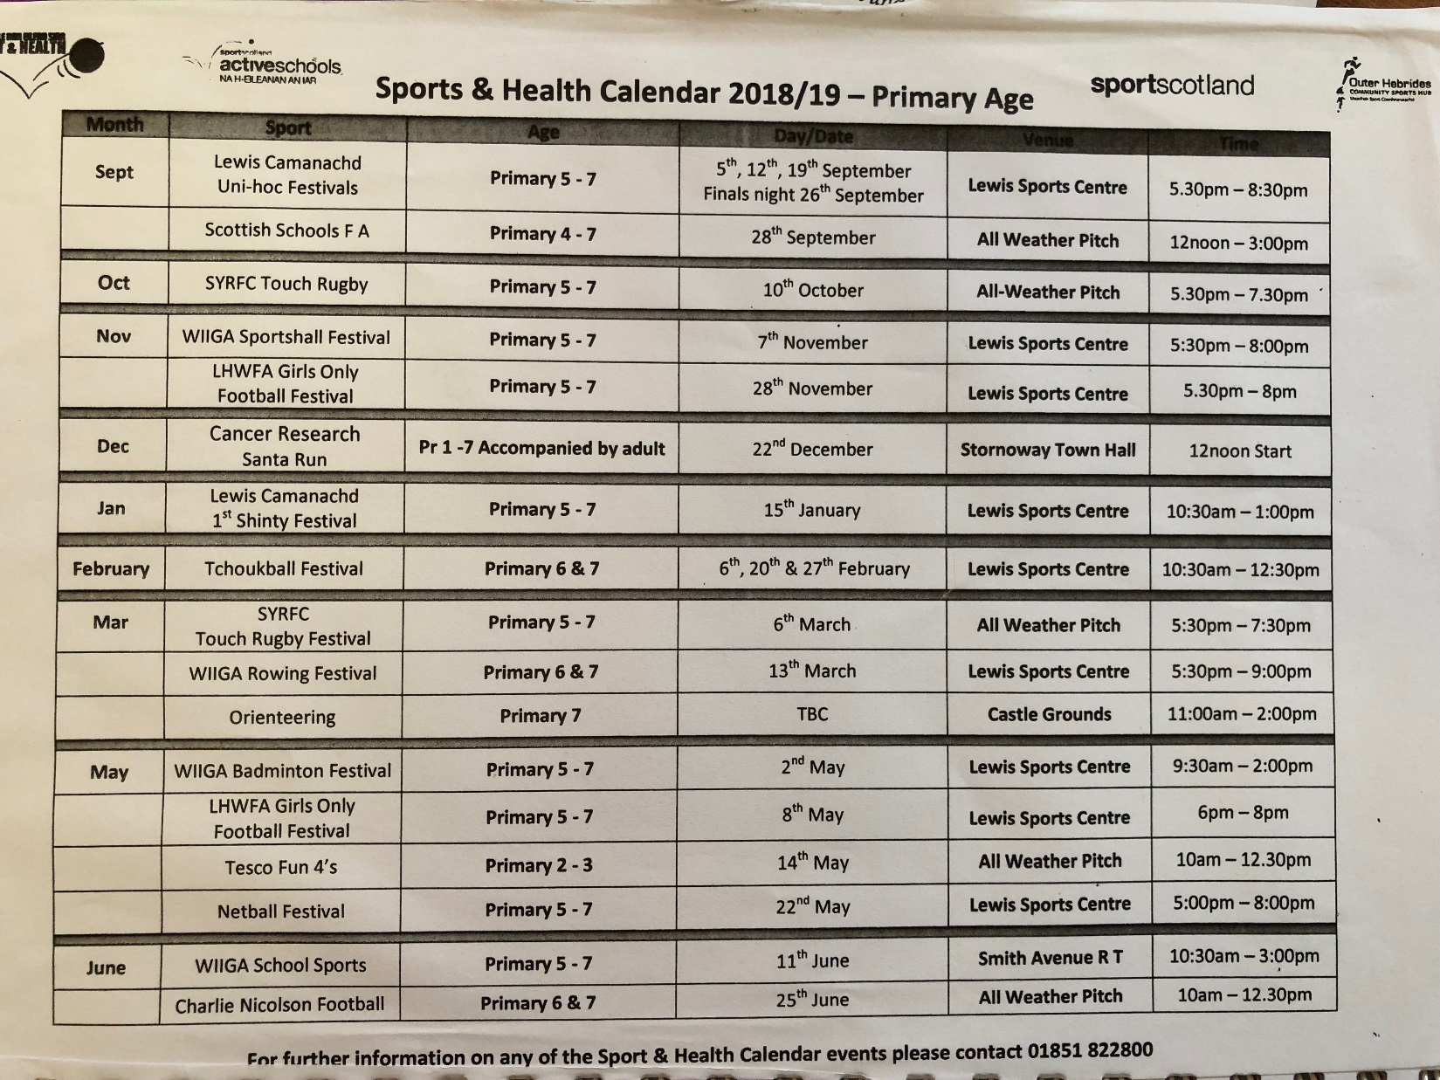

Slide 6
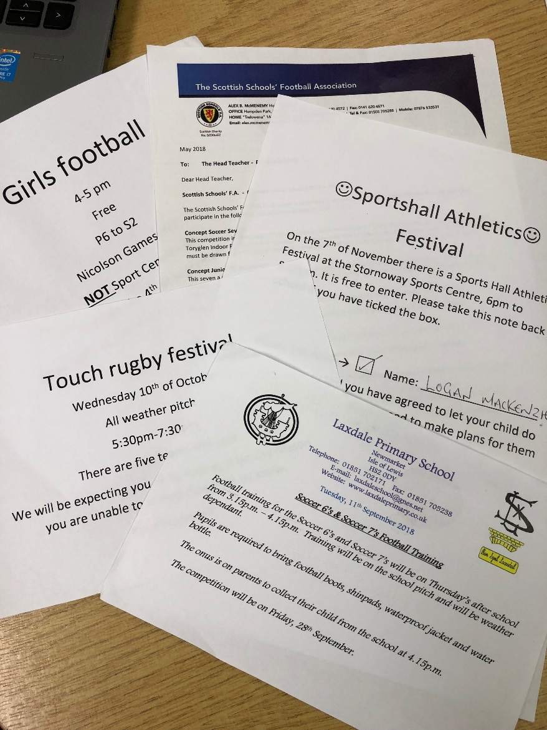
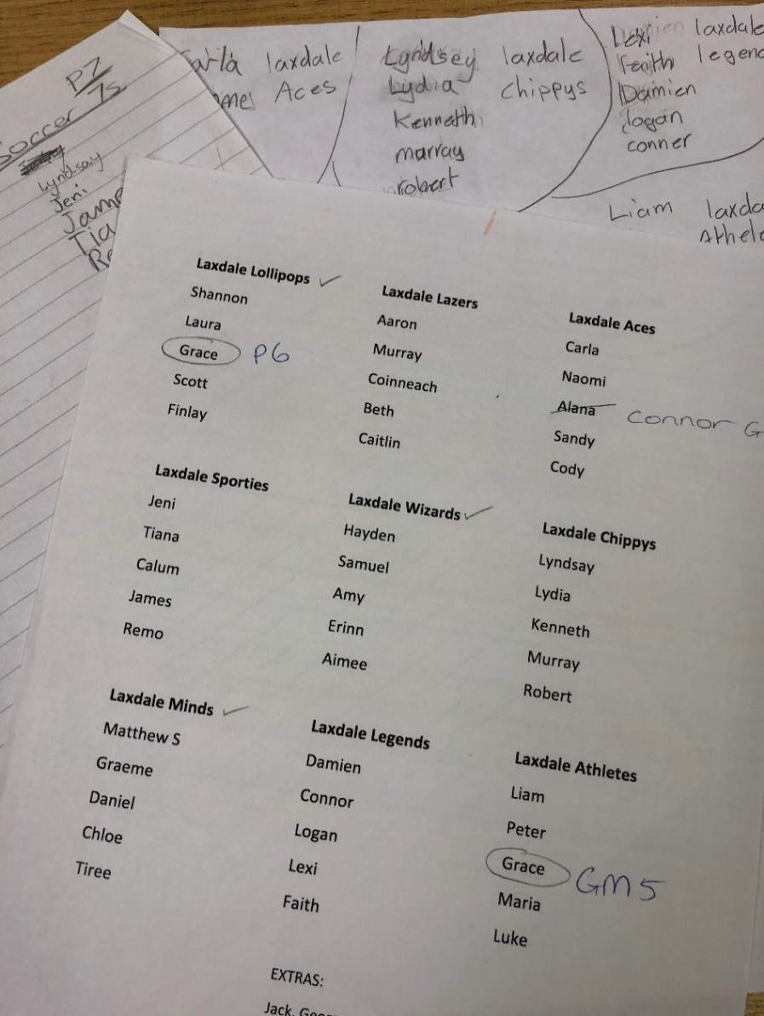
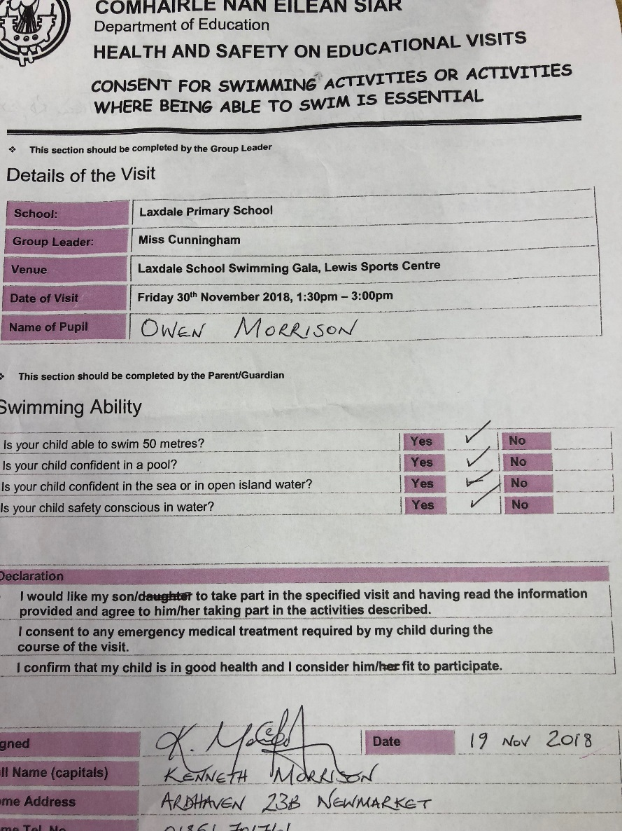

Slide 7
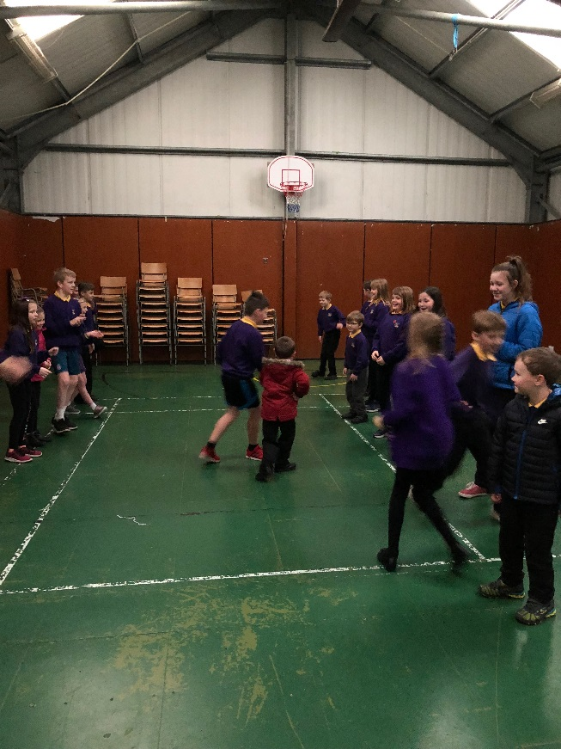
Dance – older pupils teaching younger classes
Notes:
P6 & 7 teaching P2 the Military Two Step and Strip the Willow

Slide 8
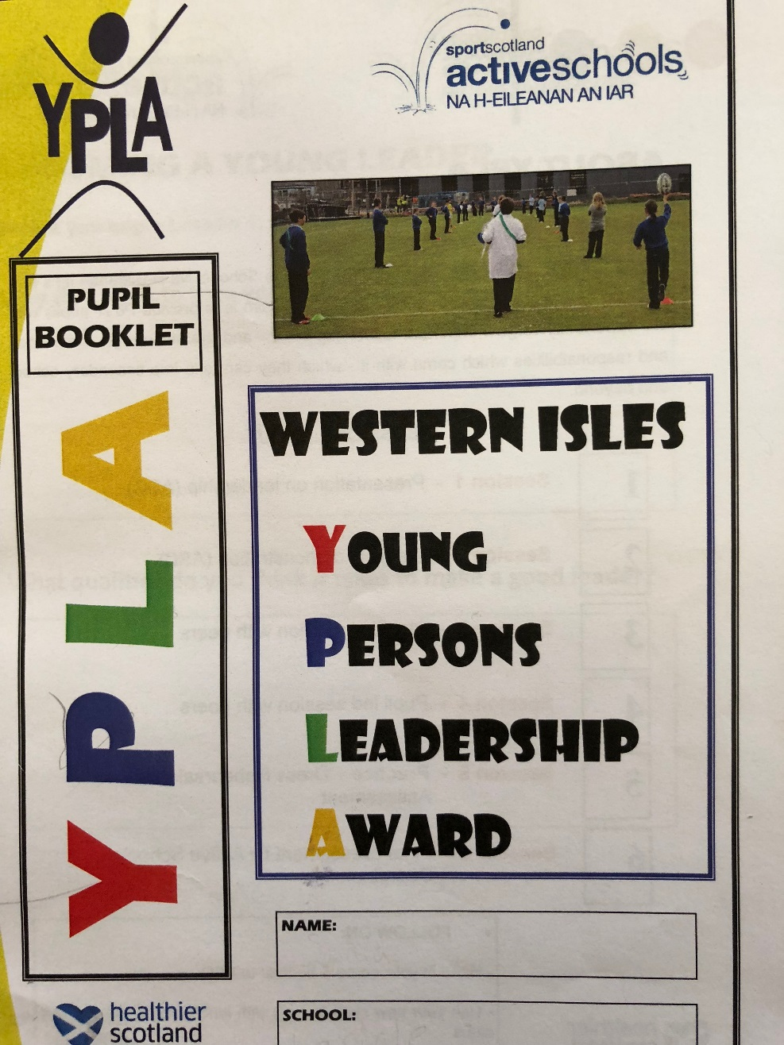
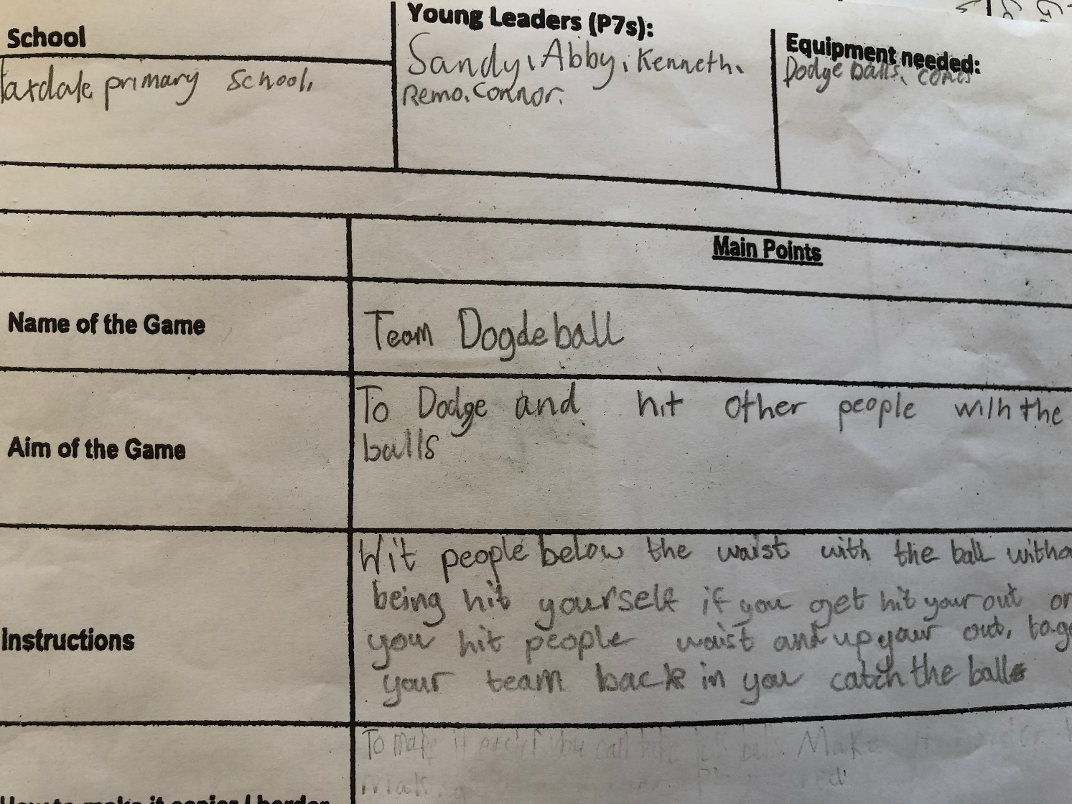
Young Leaders

Slide 9
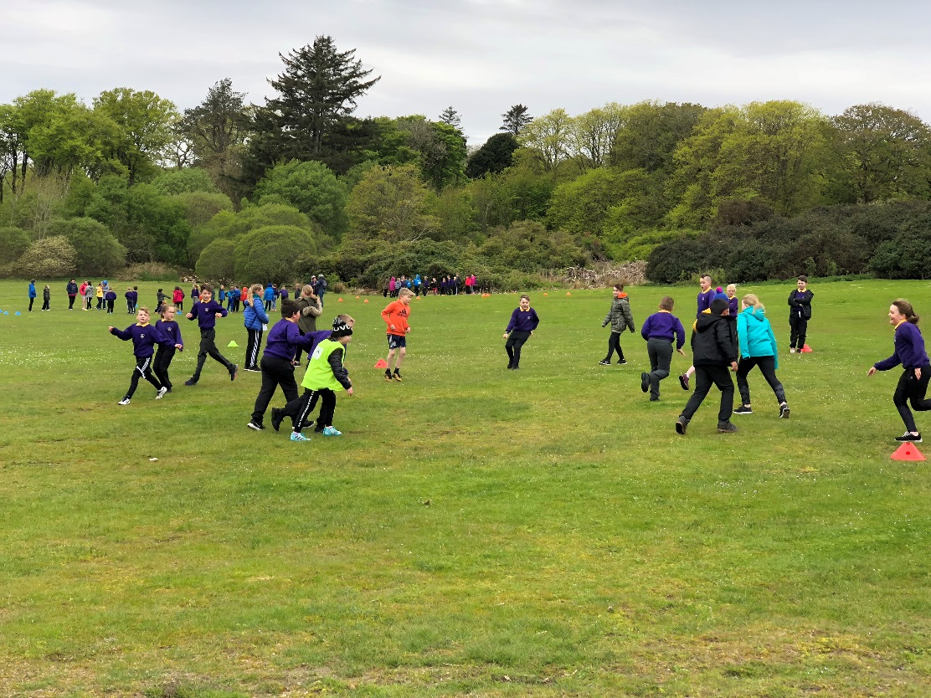
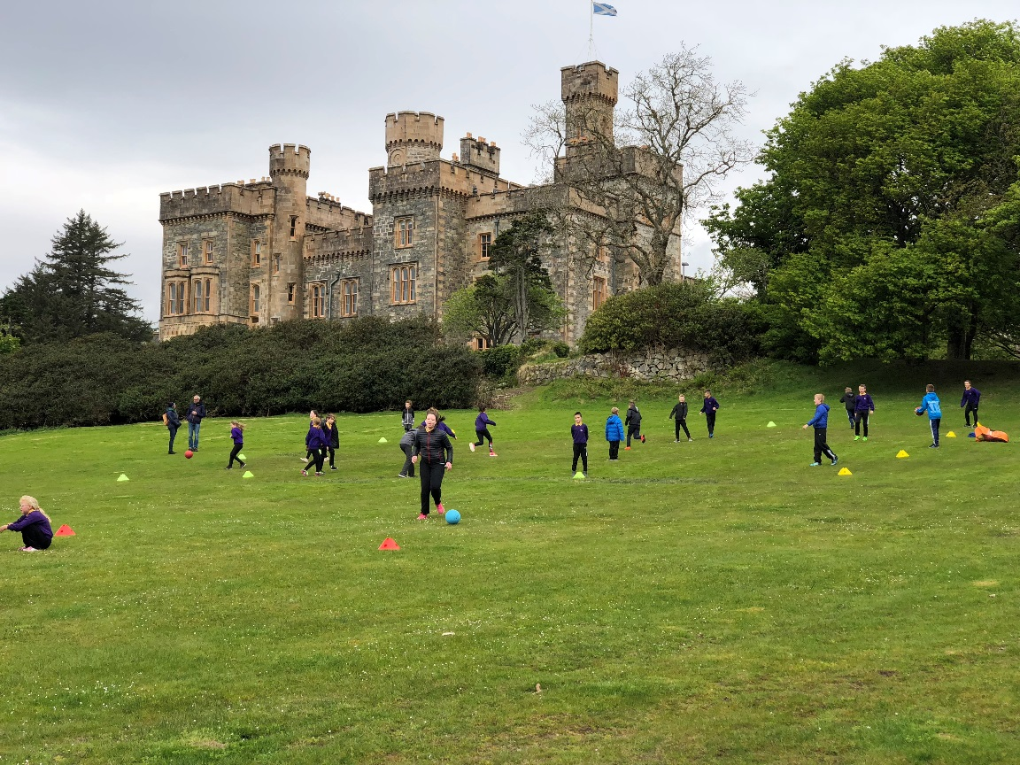
Young Leaders will organise WIIGA sports day

Slide 10
Laxdale’s Own Events

Slide 11
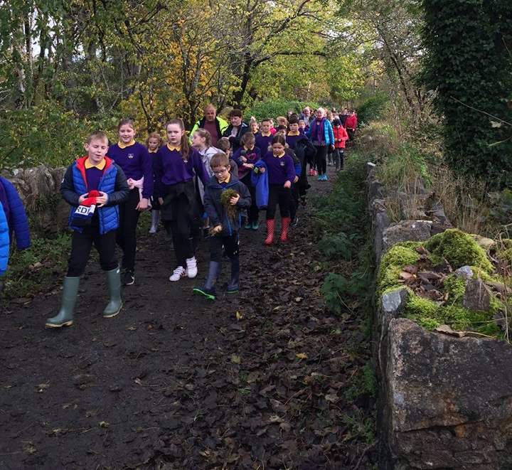
Sponsored Walk

Slide 12
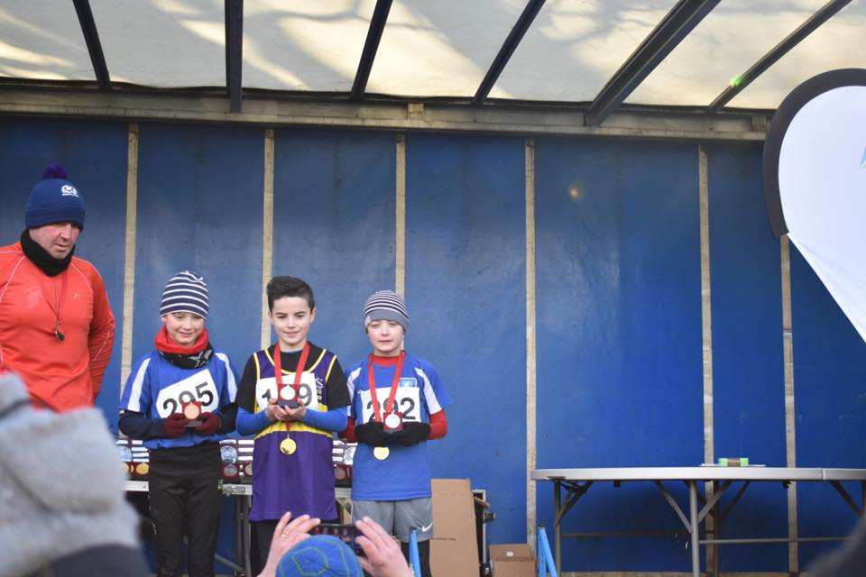
Cross Country

Slide 13
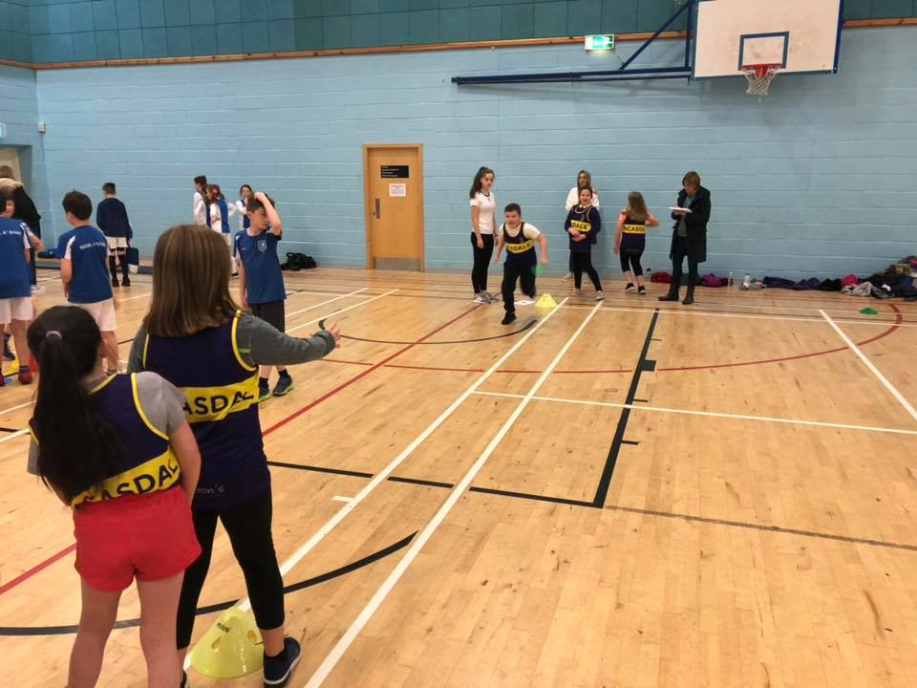
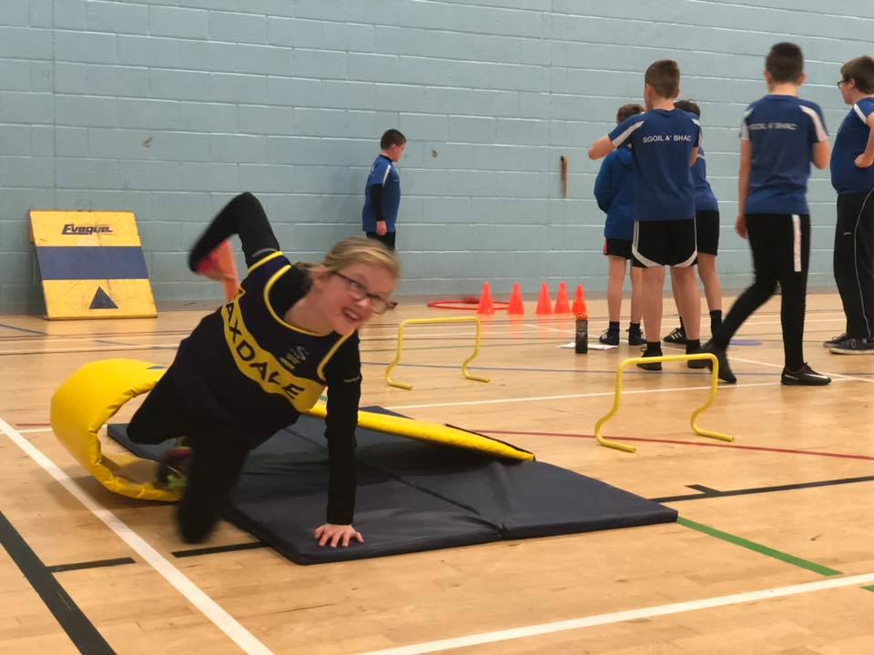
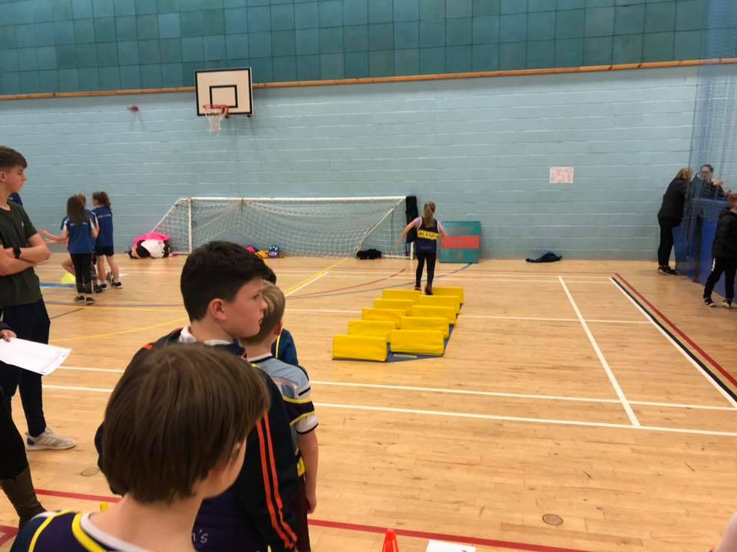
Sports Hall Athletics

Slide 14
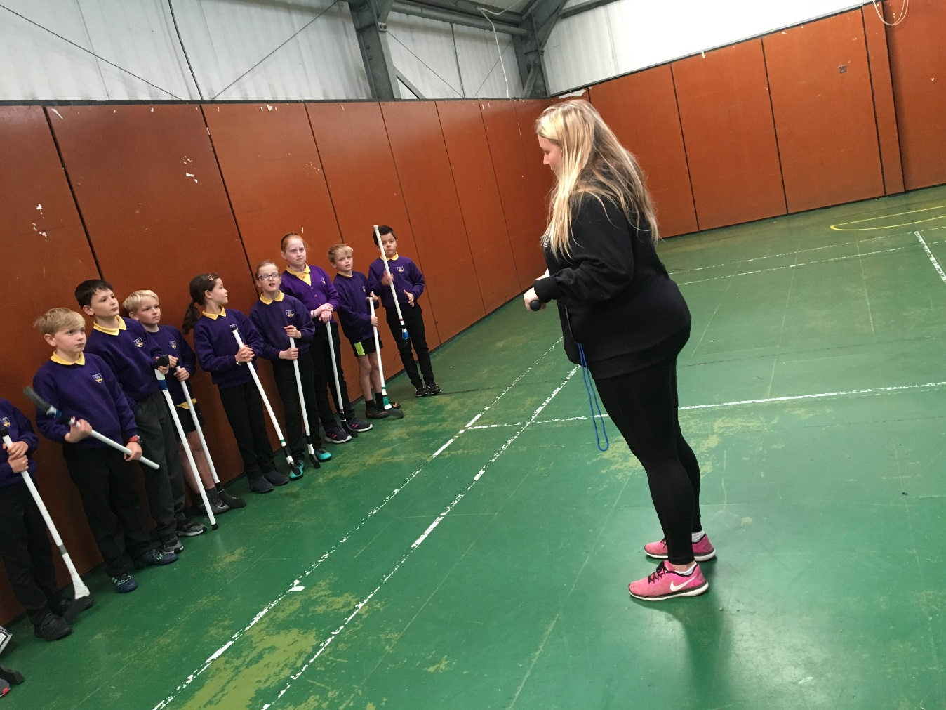
Trying Out New Sports
Shinty with Katy Drain

Slide 15
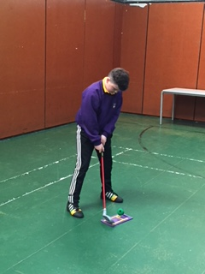
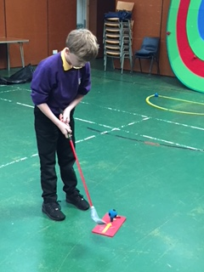
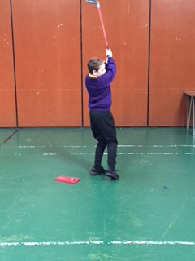
Golf

Slide 16
Fun Football Fridays! Another upcoming event
Lots of Primary 1s were wanting to play football with the Primary 7s, so the sports council decided that we would let them play football with us on Fridays. We can teach them our skills and maybe they could become pros. ☺

Slide 17
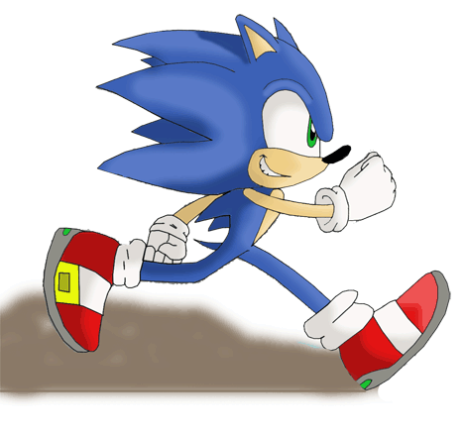
Here today we have representatives

Slide 18
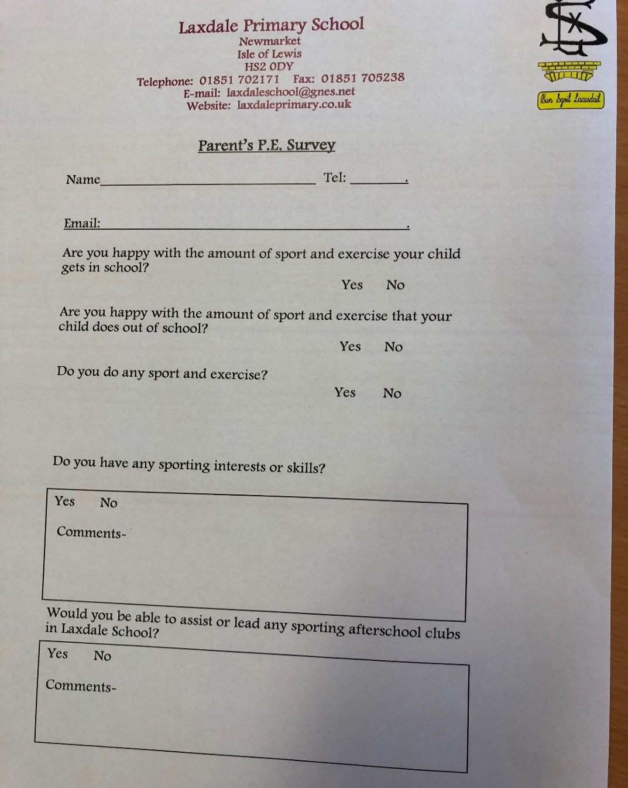
Please sign up to help

