Slide 1
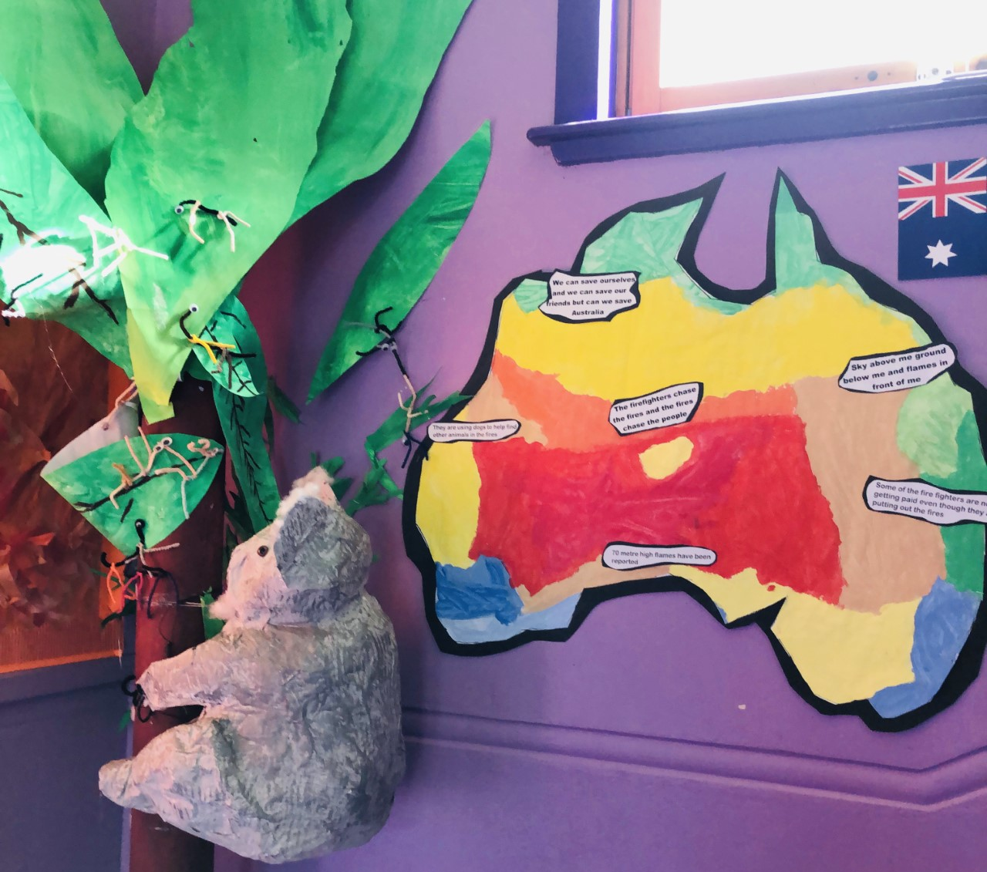
Laxdale is an Eco School
Australian Bush Fires

Slide 2
You can see the flag on the wall half way up the stairs.
The Green Flag Award is the highest award you can earn from Eco Schools.
You must work towards renewing the award every two years.
So 2020 will be the fifth time we have achieved this high standard.

Slide 3
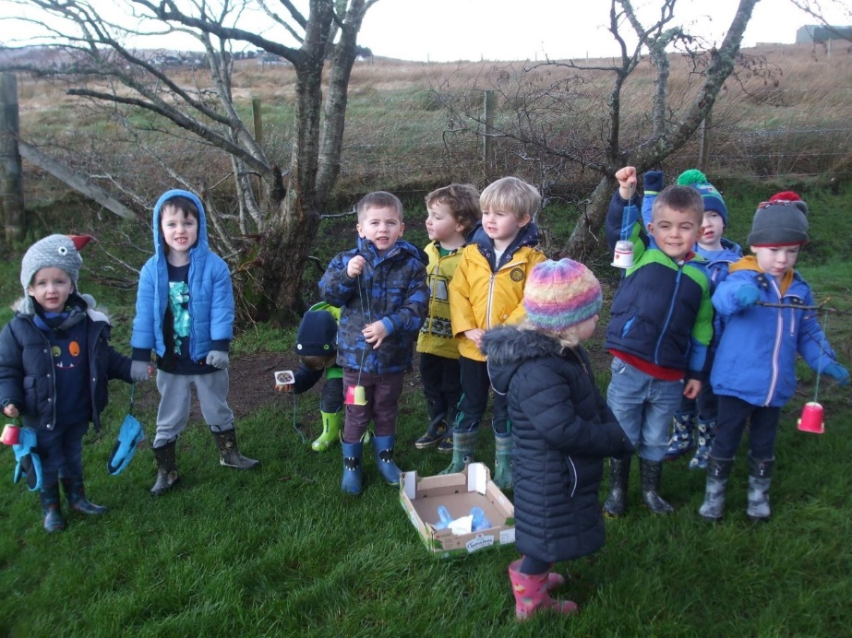
What does it mean to be an Eco School?
We care for our school and wider environment
We don’t drop litter and keep the school grounds looking good.

Slide 4
We are very lucky to have a poly tunnel which is being well used.

Slide 5
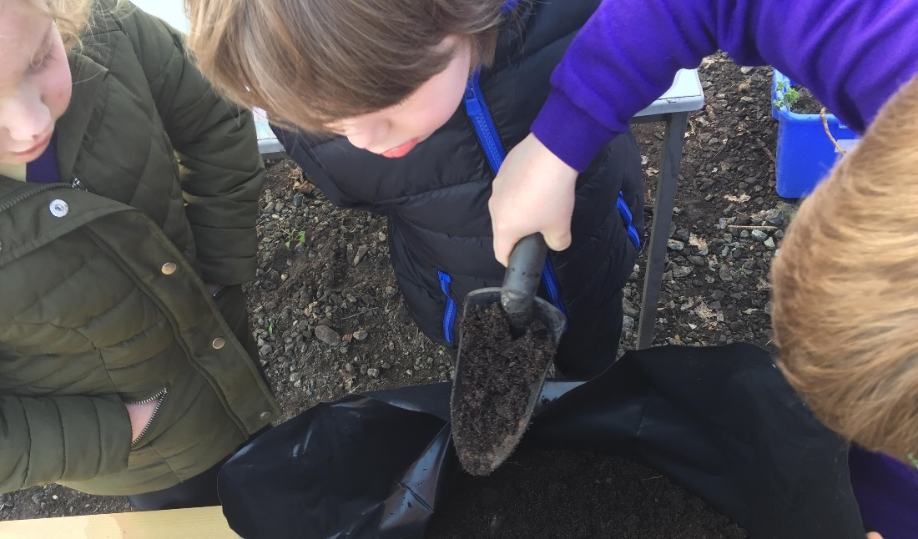

Slide 6
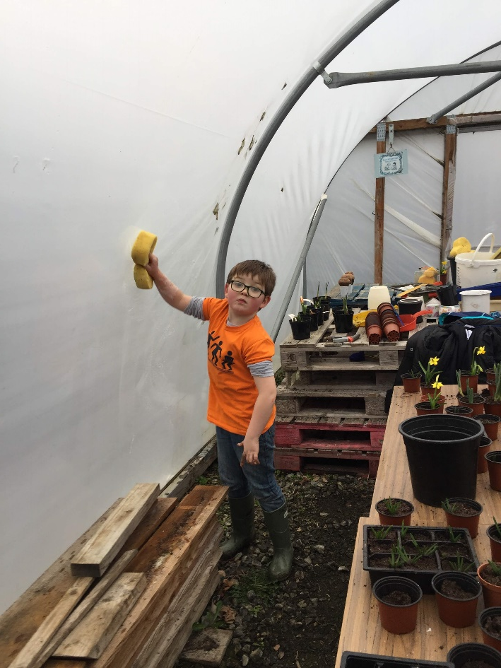
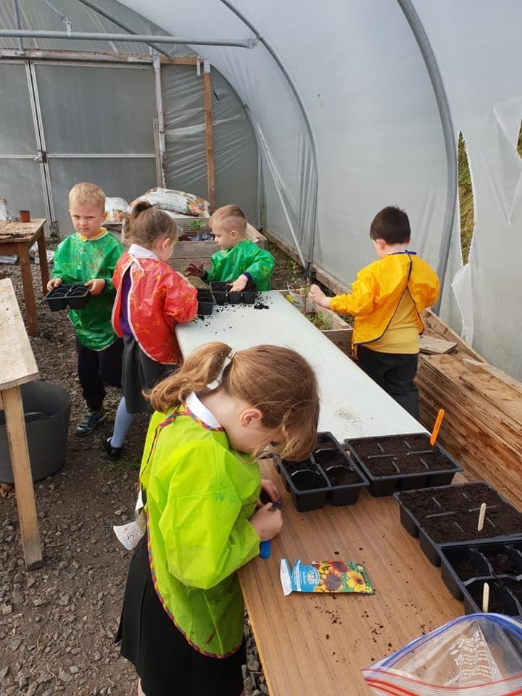

Slide 7
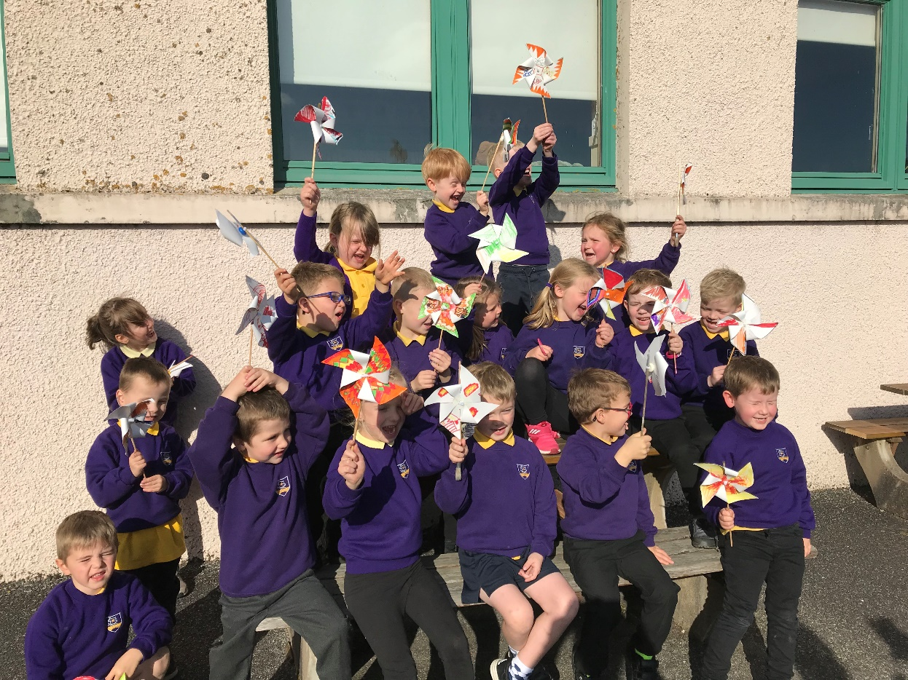
You choose 2 main topics to focus on:
We chose Cleaner Energy

Slide 8
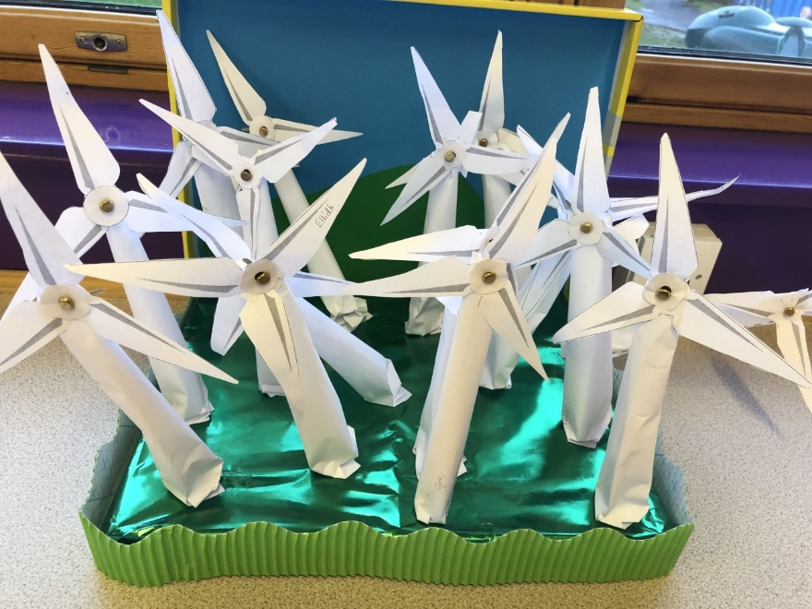
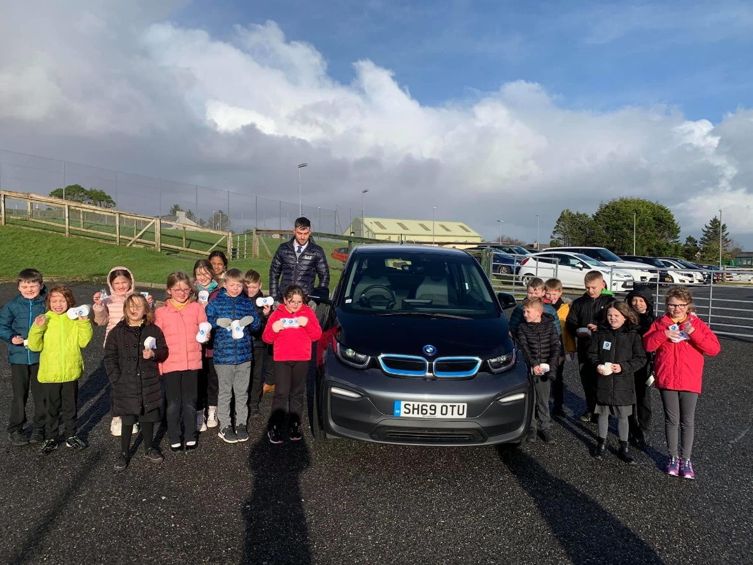
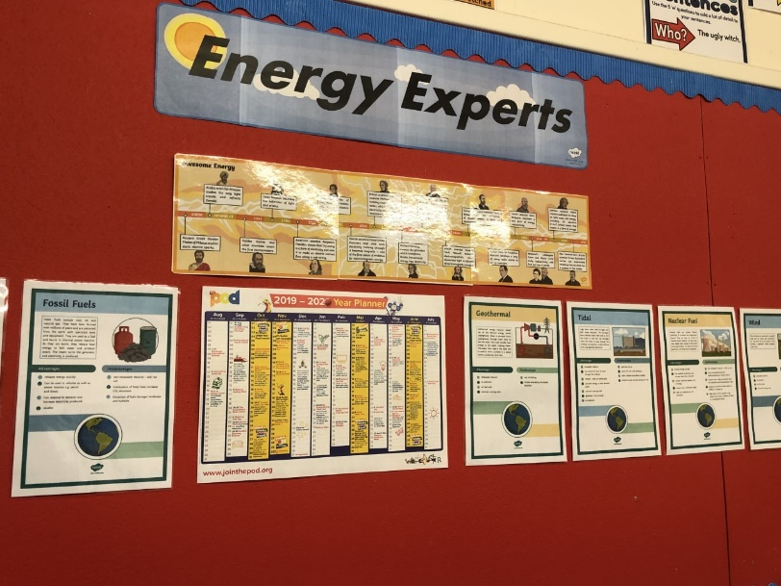
Electric car
P4/5 know all about Wind Energy

Slide 9
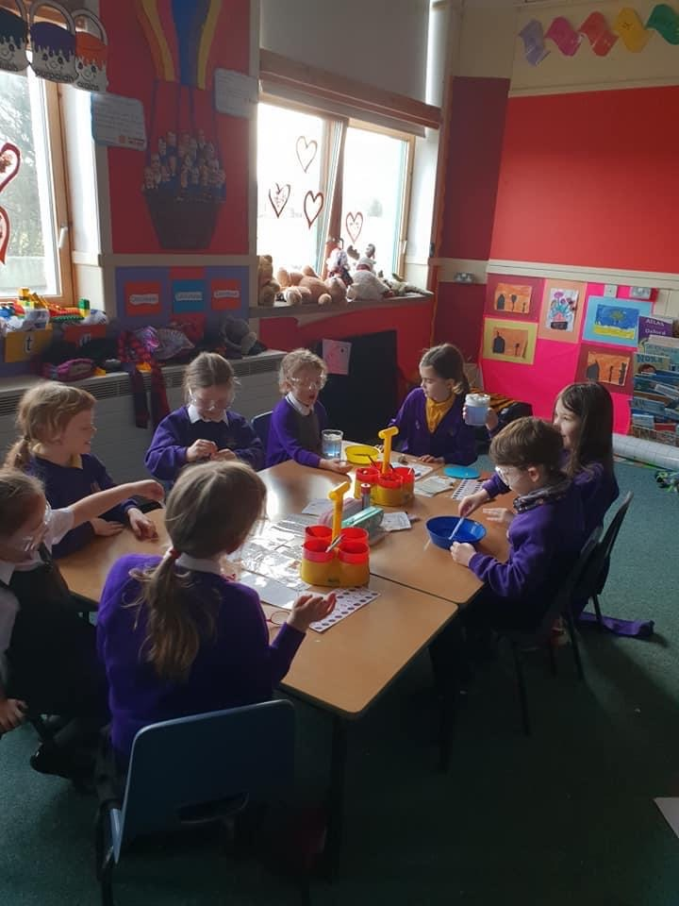
Cloud experiment in GM 1/2

Slide 10
And extreme weather study with coastguard Richard Cooke in GM5/7

Slide 11
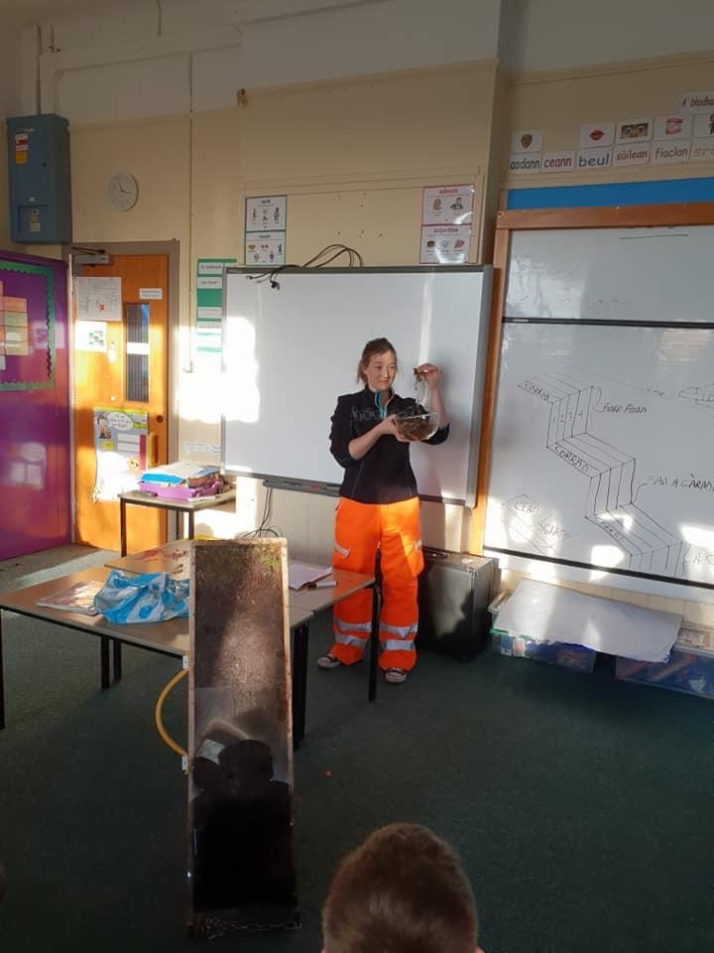
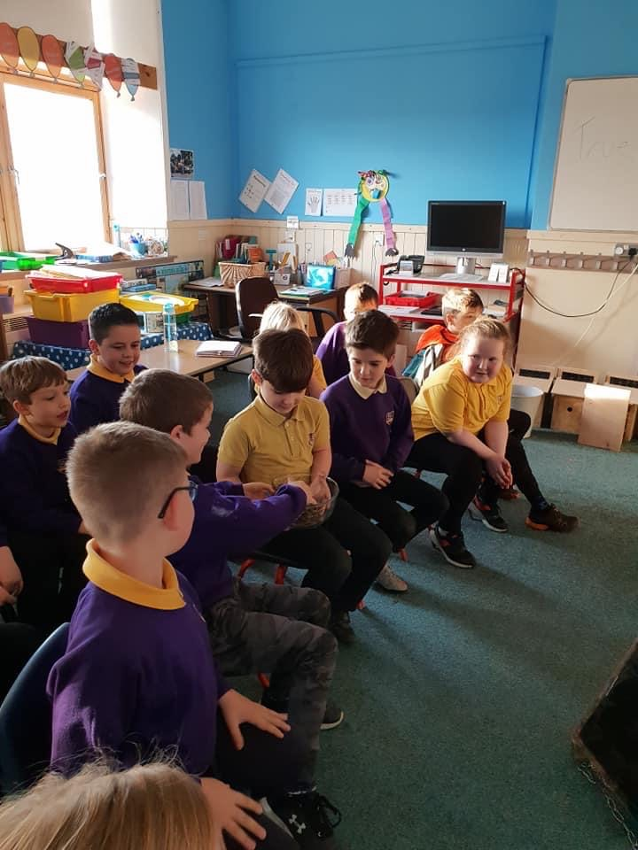
Emma is an Ecologist

Slide 12
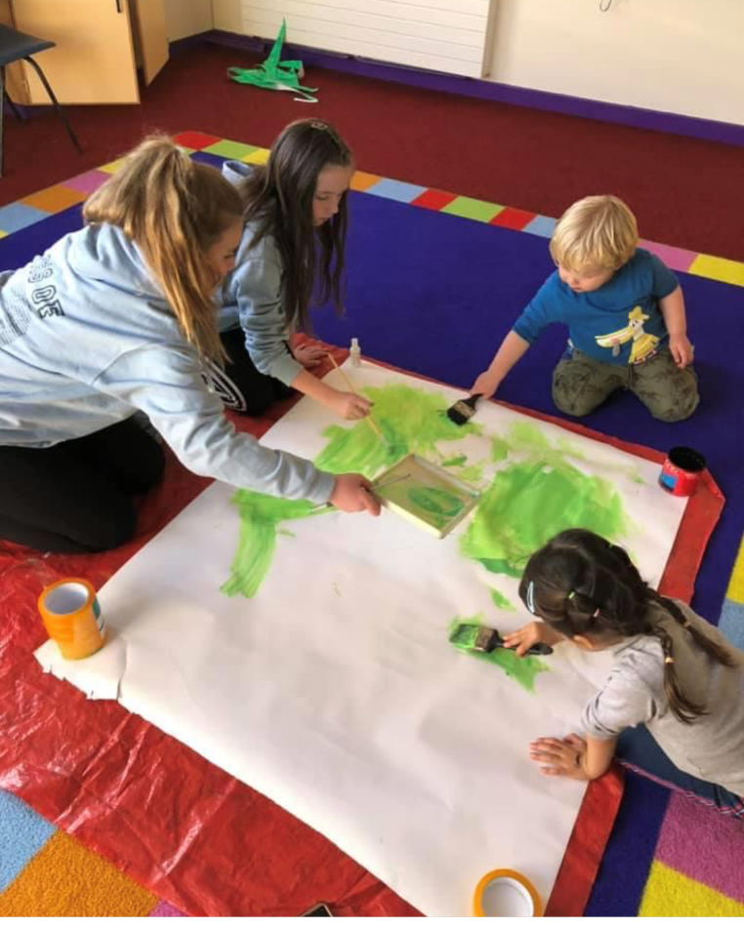
Our second topic was Climate Change
Our oldest and our youngest pupils working together on the Climate Change display

Slide 13
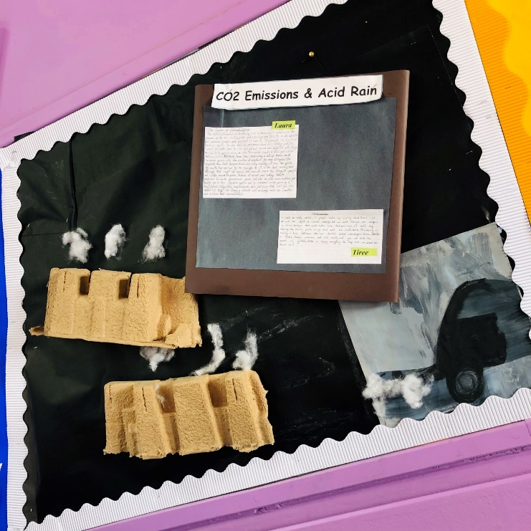
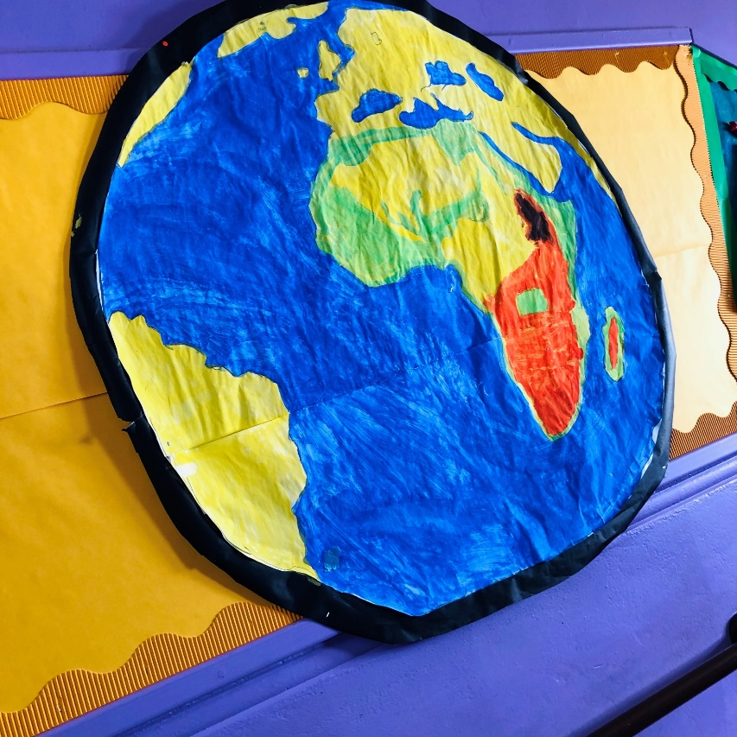
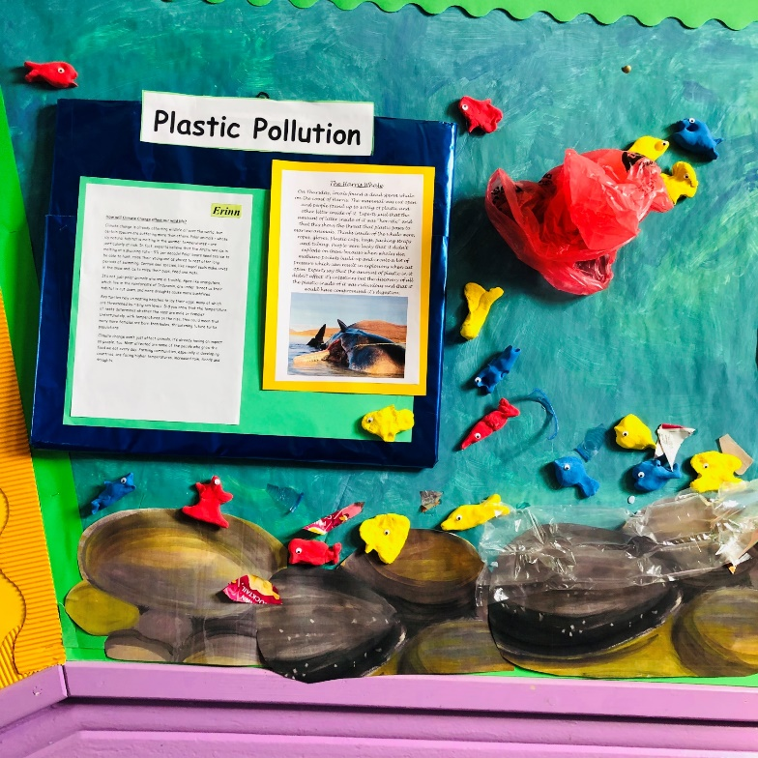
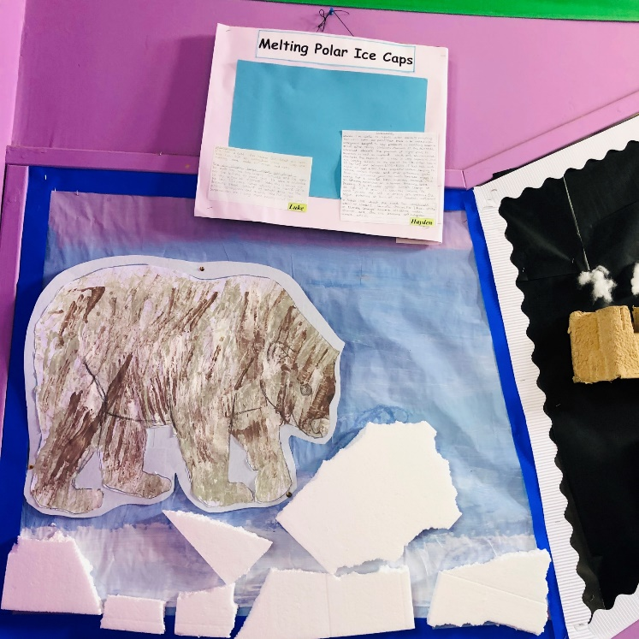
Global Warming and Climate Change

Slide 14
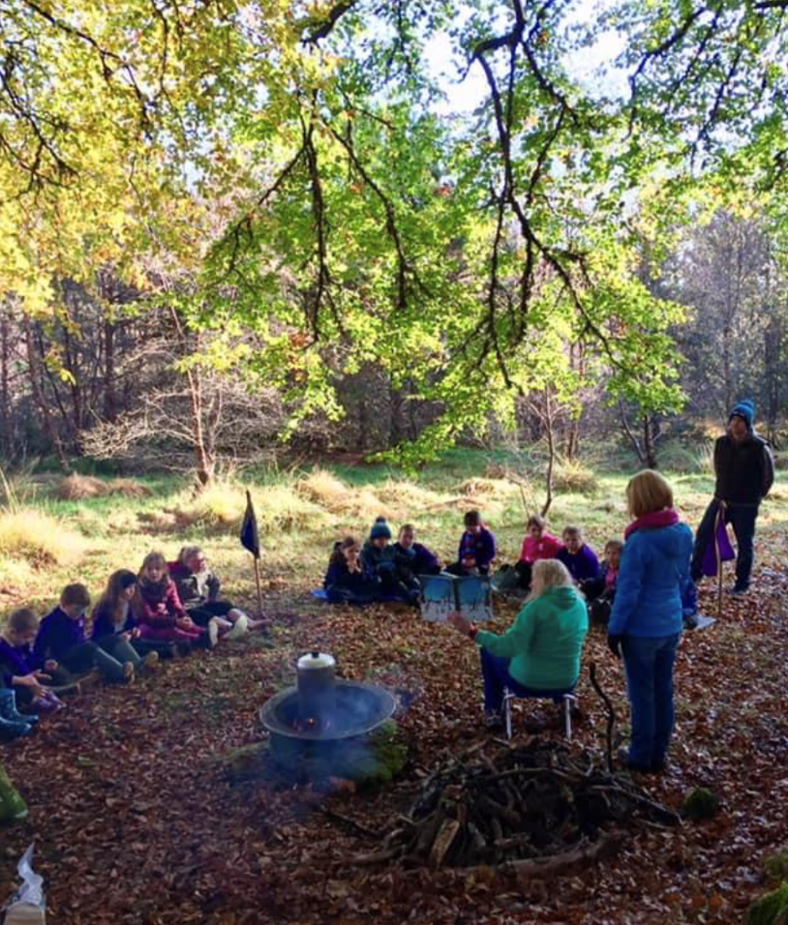
Some more examples of Eco work were:
Treasure Hunt on Latha na Gaidhlig
Scouting in the Grounds
Painting Bird Boxes

Slide 15
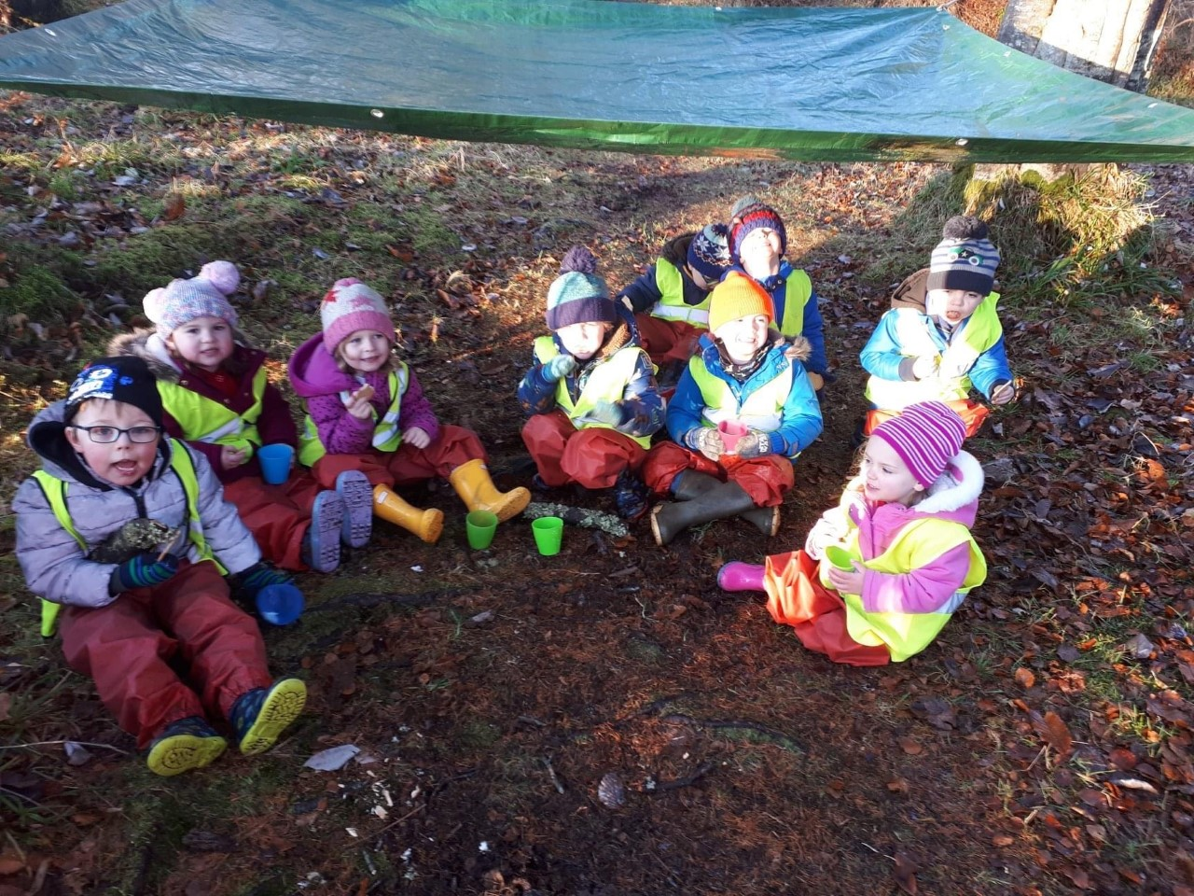
Nusery
Clean up
Shelter Building

Slide 16
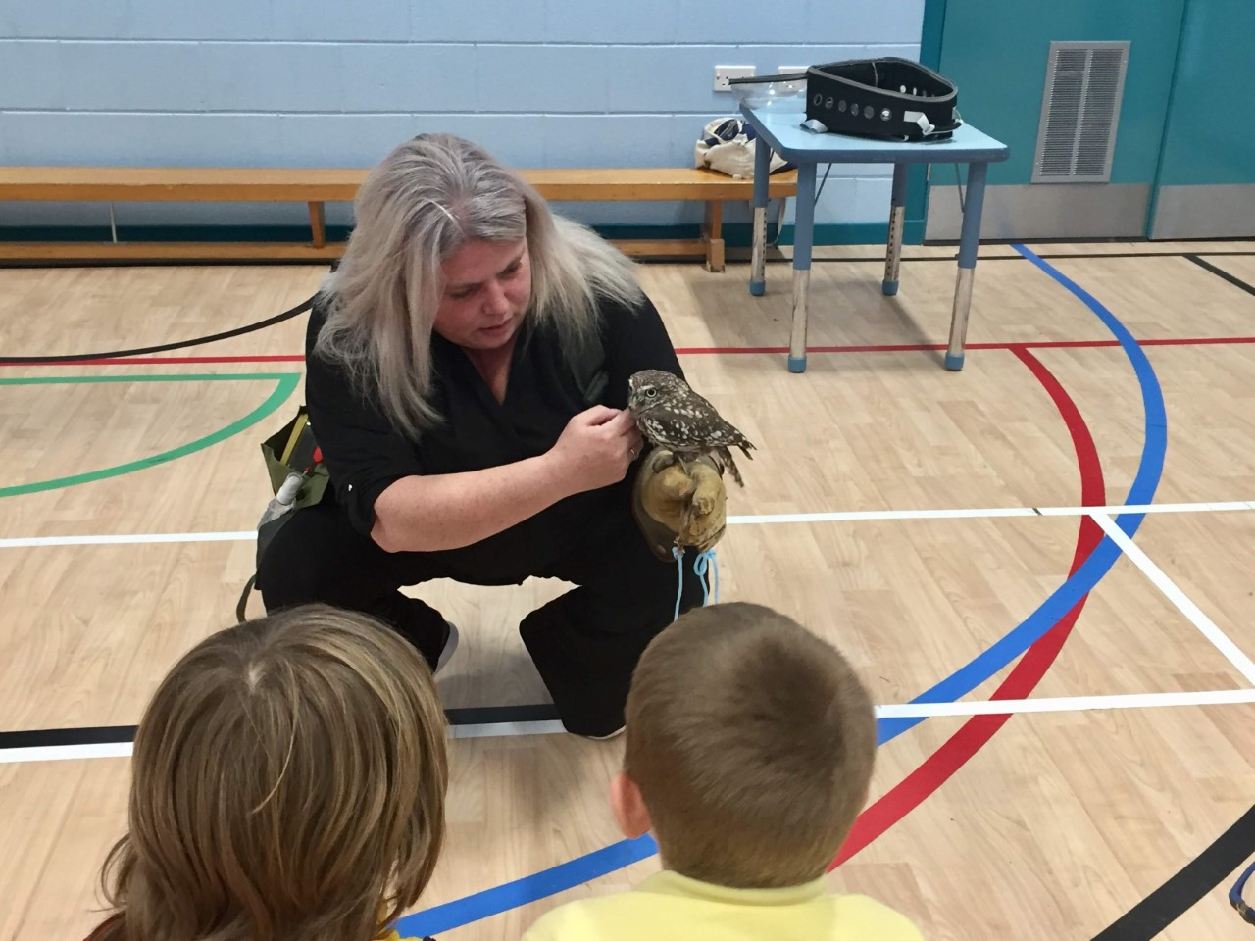
The day the owl came to school

Slide 17
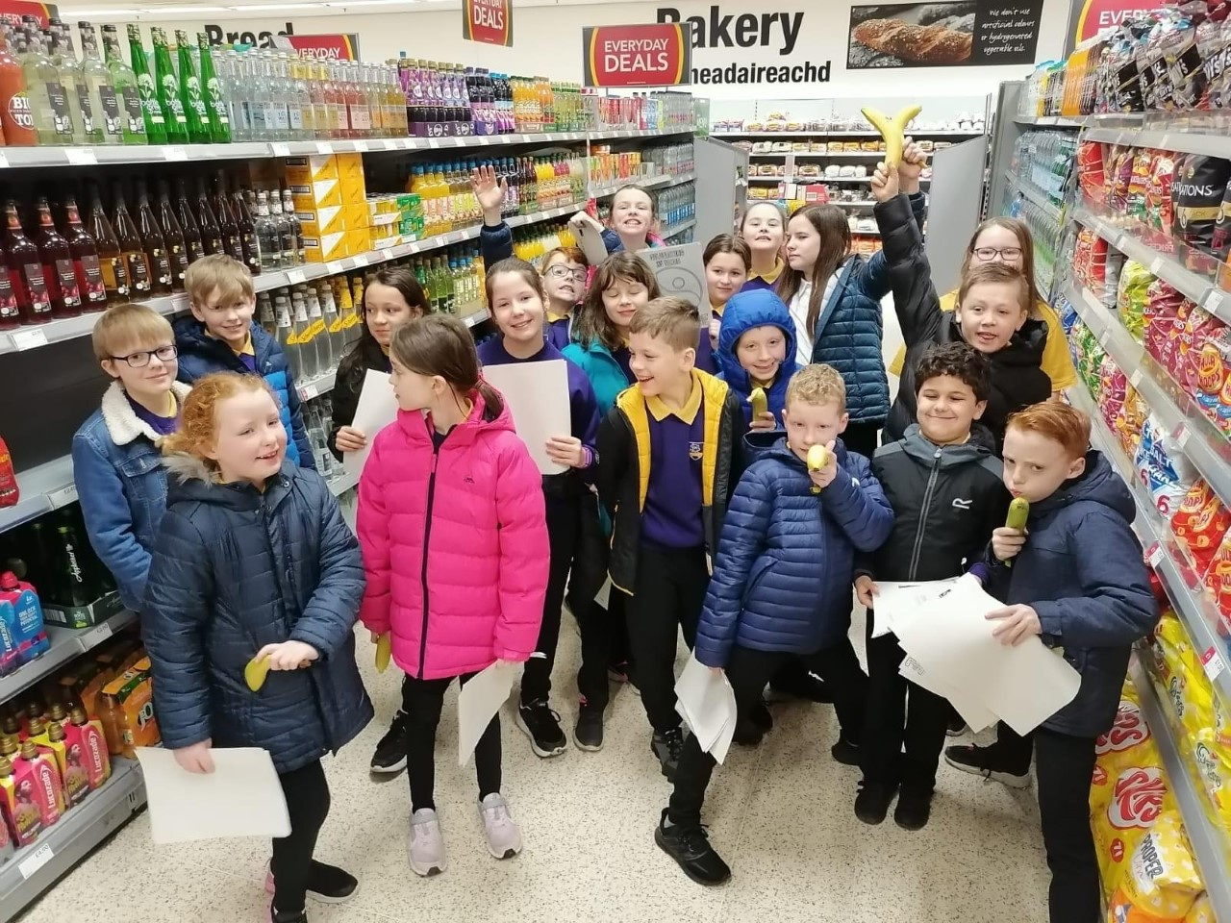
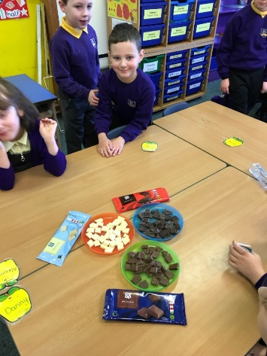
Fairtrade P5/6 visit to the co-op

Slide 18
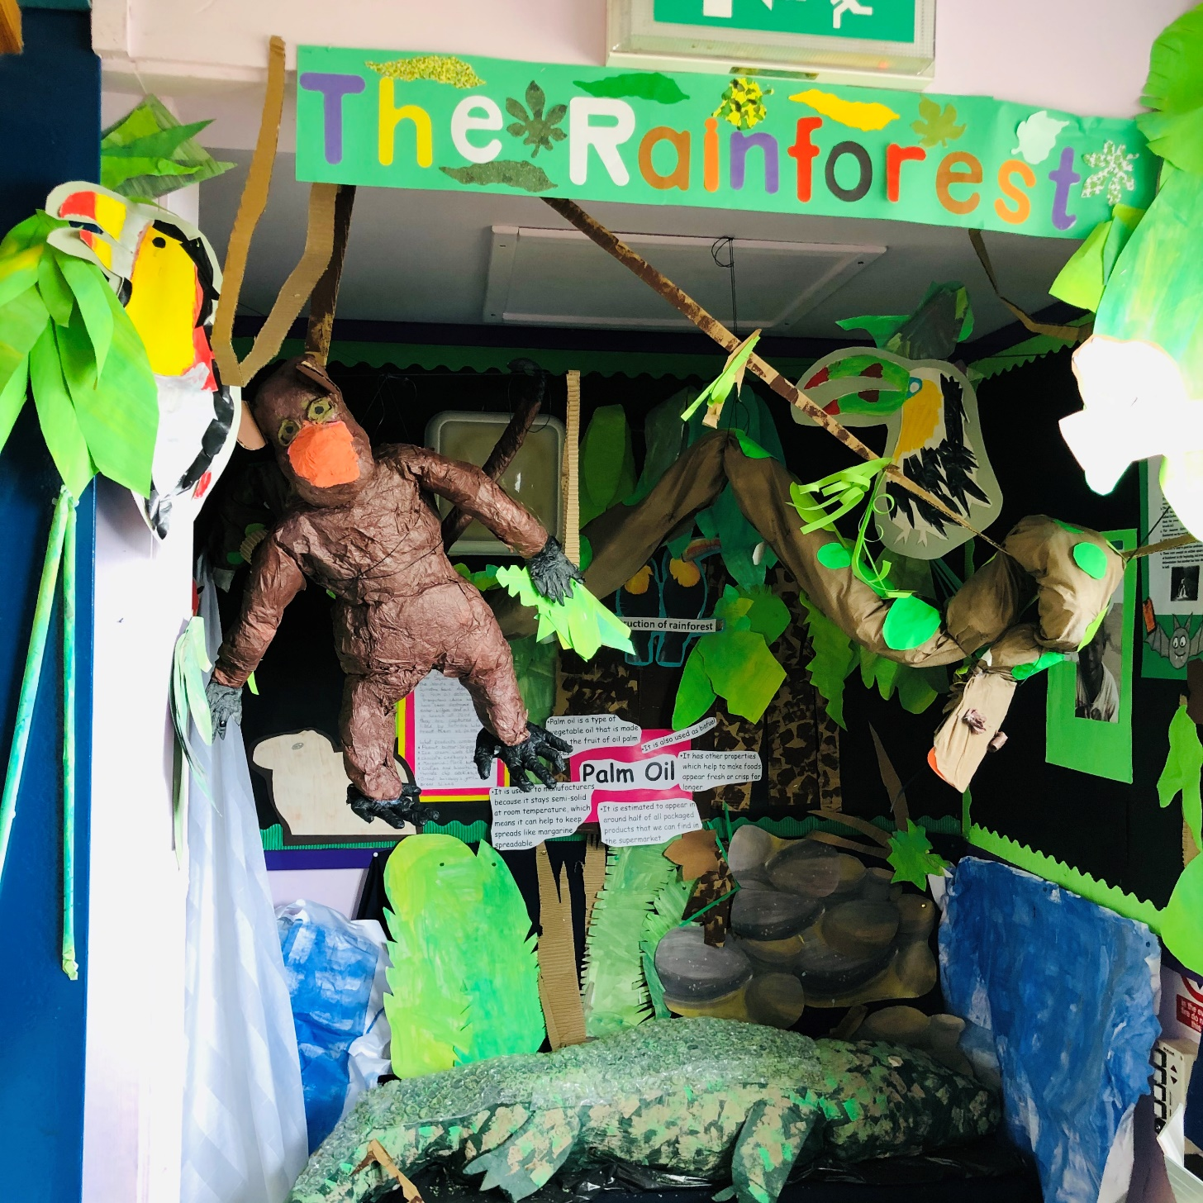
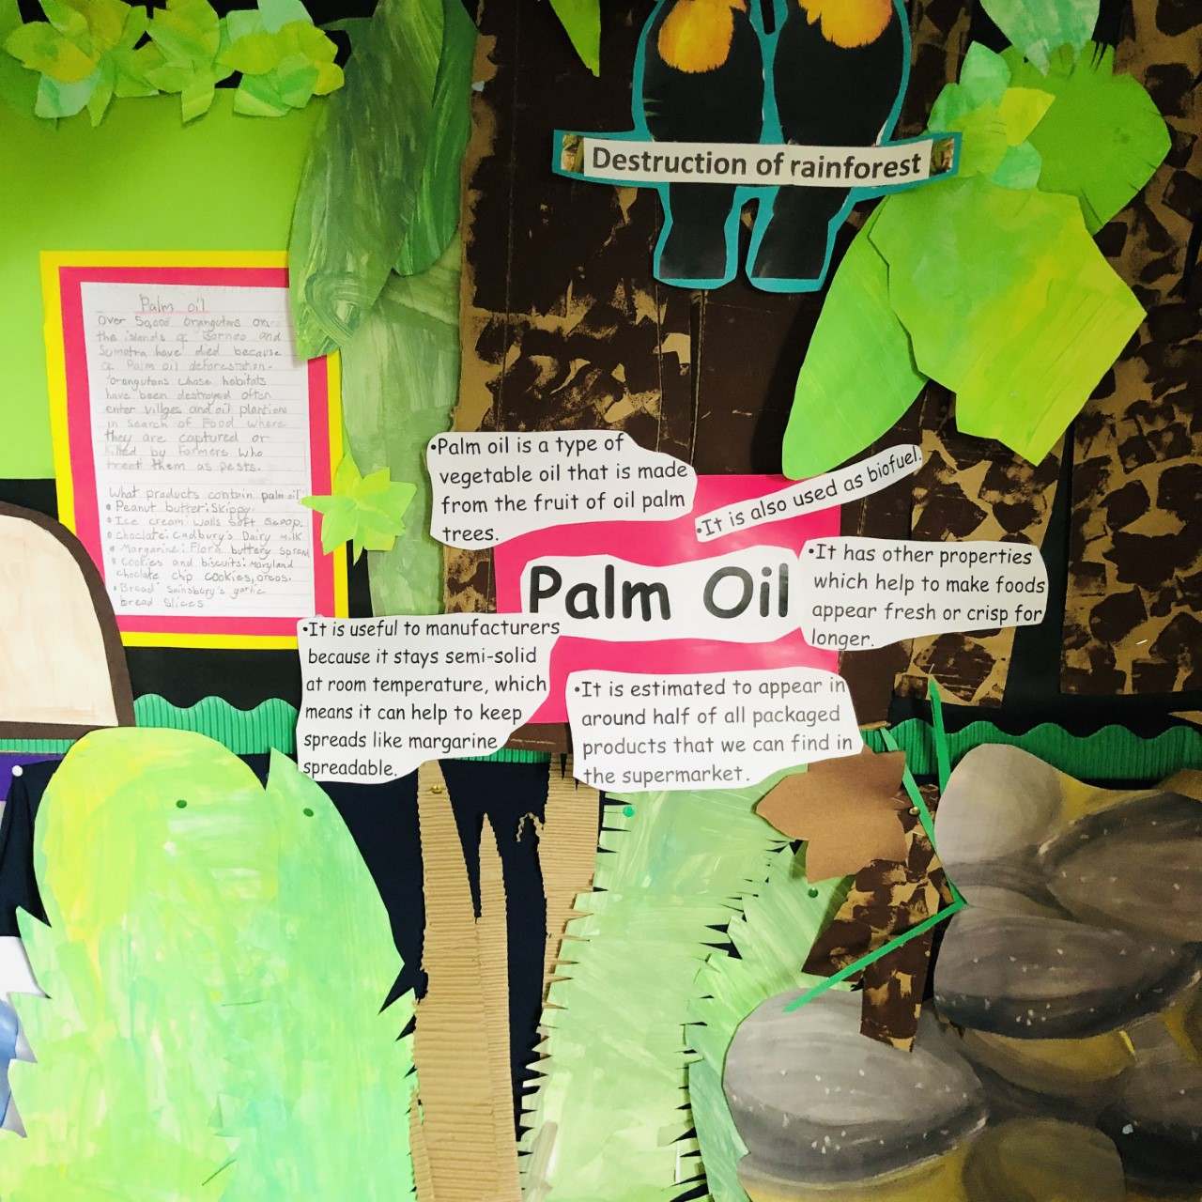

Slide 19
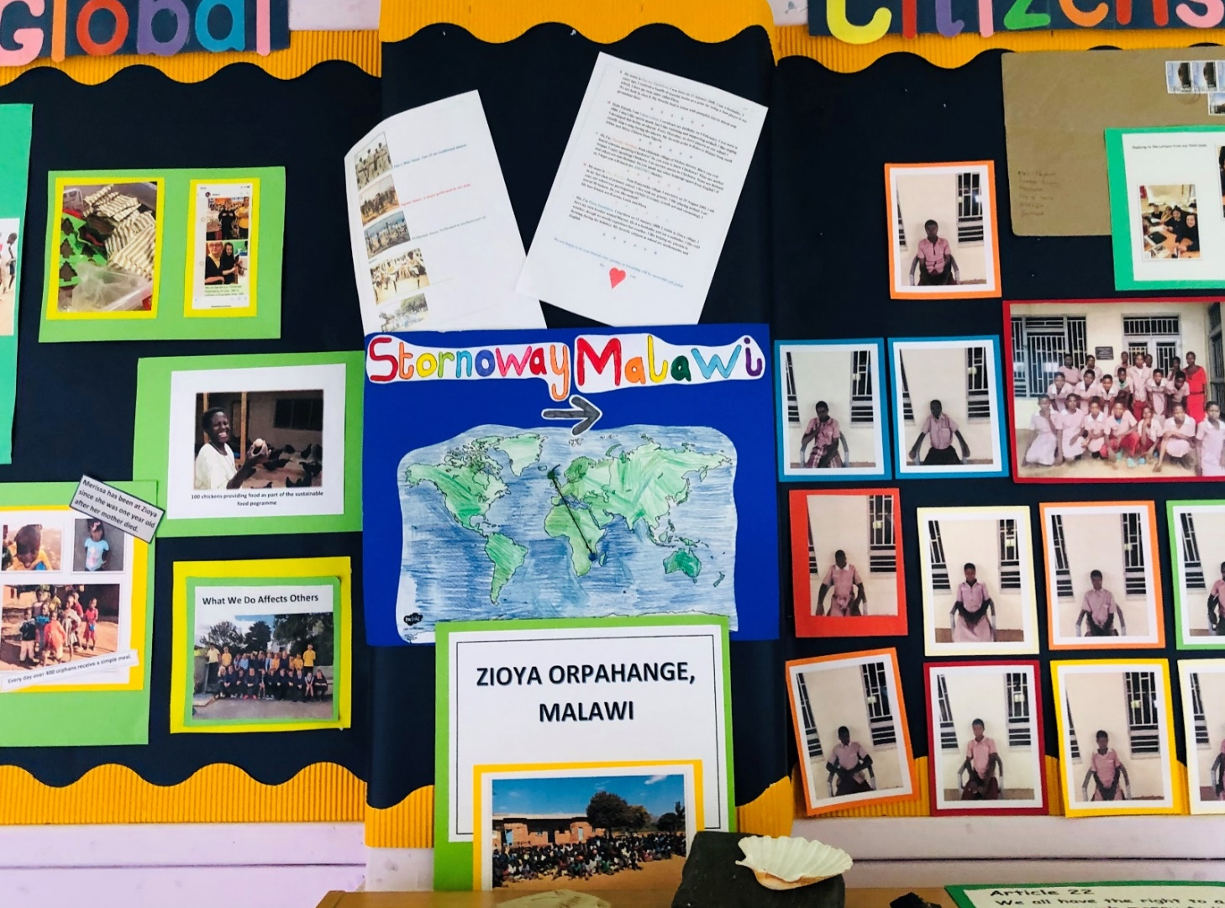
Malawi

Slide 20
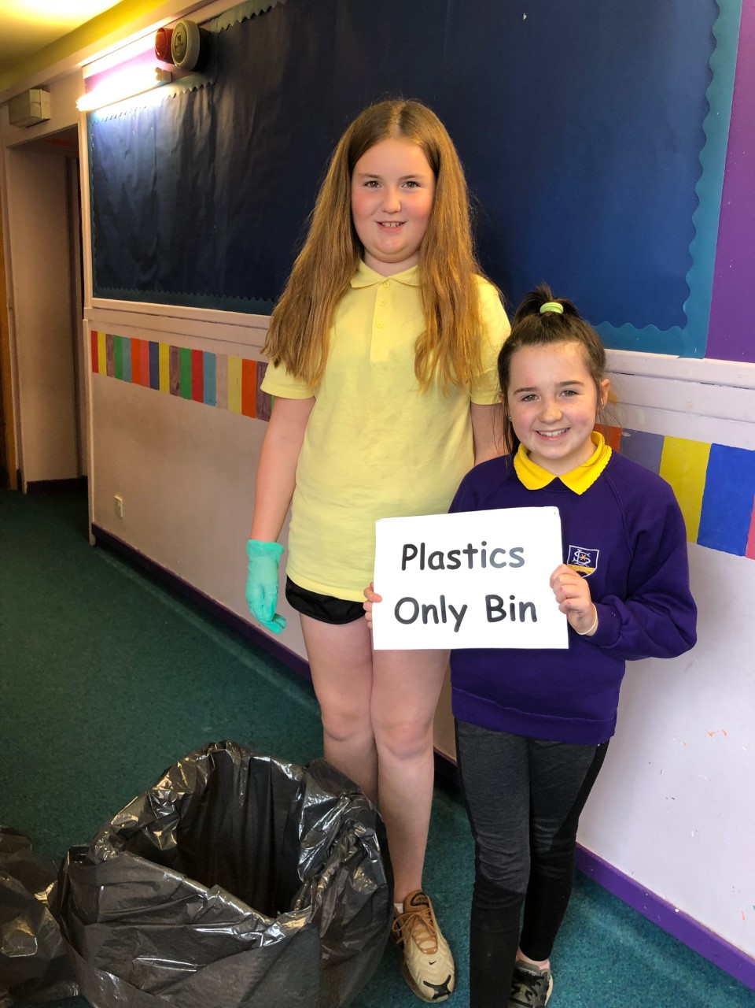
The Eco Committee has been busy all year

Slide 21
And are still busy working via vscene

Slide 22
We have had our Green Flag since 2011
lots of you weren’t even born!
Our present award runs out on 27th July this year.

Slide 23
So we need to make sure we get it renewed.

