Slide 1
Prediabetes and Elevated Blood Sugars
Kelly Dwyer, MNT &
Jeannette Guerrasio, MD

Slide 2
Goals
What is prediabetes?
Common symptoms
Why you want to prevent diabetes
Prevention Strategies
Notes:
Metabolic syndrome
Genetics
Exercise
nutrition

Slide 3
Normal Physiology
Stomach – absorbs carbohydrates
⇢ stimulating the release of Incretins (GLP1/2, DPP4)
Pancreas – makes insulin to bind to sugar/glucose
⇢Incretins stimulate the release of insulin
Insulin – Carries glucose into cells
www.CK-12.org
Notes:
Pancreas makes insulin binds to sugar and moves it into cells

Slide 4
Normal Physiology
Muscles – Turn glucose into energy and glycogen
Liver – Turns glucose into glycogen
Fat – Takes in glucose to make fatty acids
Notes:
Pancreas makes insulin binds to sugar and moves it into cells

Slide 5
Abnormal Physiology
Stomach – absorbs carbohydrates
⇢ stimulating the release of Incretins (GLP1/2, DPP4) BUT THEY DON’T WORK
Pancreas – makes LESS insulin to bind to sugar/glucose
LESS Insulin – Carries LESS glucose into cells
⇢ Leaving more glucose in the blood stream
www.CK-12.org
Notes:
Pancreas makes insulin binds to sugar and moves it into cells

Slide 6
Abnormal Physiology
CAN’T ABSORB AS MUCH GLUCOSE FROM THE BLOOD and BECOME INSULIN RESISTANT…
Muscles – TURN LESS glucose into energy and glycogen
Liver – CAN’T TURN glucose into glycogen, MAKES MORE GLUCOSE
Fat – CAN’T take in glucose to make fatty acids
Kidneys – REABSORB MORE GLUCOSE
Notes:
Pancreas makes insulin binds to sugar and moves it into cells

Slide 7
Appetite – GOES UP!!!
Young JB, The Orlando Weekly; 2018:1 (18)

Slide 8
Symptoms of rising blood glucose
Nothing
Increased urination
Feeling very thirsty
Hunger
Fatigue
Blurry vision
Wounds that won’t heal
Darkening of the skin
Fungal rashes
Pain or tingling in your feet

Slide 9
Normal Prediabetes Diabetes < 110 110-125 126+ < 5.7% 5.7-6.4% 6.5+%
Fasting glucose:
(mg/dL)
HbA1c:
Notes:
Lee Mendel

Slide 10
Why do you want to prevent diabetes?
Retinopathy → Blindness
Kidney Failure → Dialysis
Neuropathy → Pain, tingling, numbness in your feet
Vascular Disease →
Strokes
Heart attacks
Loss of toes &
limbs
Rupture of the
aorta
Notes:
Want to feel better overall!

Slide 11
Can you really prevent diabetes?
http://mccarthy.well.ox.ac.uk/2018/10/gwas-gift-keeps-giving/

Slide 12
You have the power!
→
→
Lifestyle Factors
DM
Genes
Transition from JG’s slides to KD’s slides
Notes:
David F.
Exercise increases insulin sensitivity and you muscles ability to use glucose for energy with less insulin
2.5 hours/week of moderate to vigorous activity – brisk walk, water aerobics, swimming, jogging etc.
2-3 sessions of resistance training/week (lifting weights)
No more than 24 hours rest
Stretching
Exercise increases insulin sensitivity and you muscles ability to use glucose for energy with less insulin

Slide 13
Prevention strategies: lifestyle change
Nutrition
Stress management
Sleep
Exercise
= Lower blood sugar, health risks & feel better
Notes:
All of these factors are interrelated. Think about where you can make the most improvements?
Diet is high on the list.

Slide 14
Nutrition: Blood sugar balance
Less: sweets and processed foods
More: proteins, fat and fiber (a balanced, whole foods diet)

Slide 15
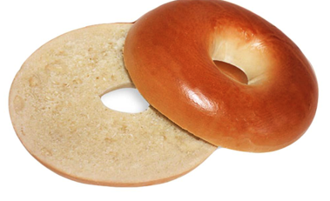
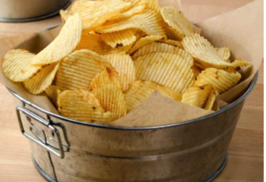
Blood sugar imbalance
Highs: Energized, happy or anxious, stressed out
Lows: “Starving,” irritable, lightheaded, foggy, tired, anxious
Too much sugar = Body stores it as fat
Notes:
Cookie: blood sugar, endorphins and serotonin (feel good hormone) go up
Insulin comes in to clear sugar from blood….. blood sugar drops = fatigue, brain fog, sugar cravings
= weight gain, hormonal imbalance, eventually insulin resistance

Slide 16
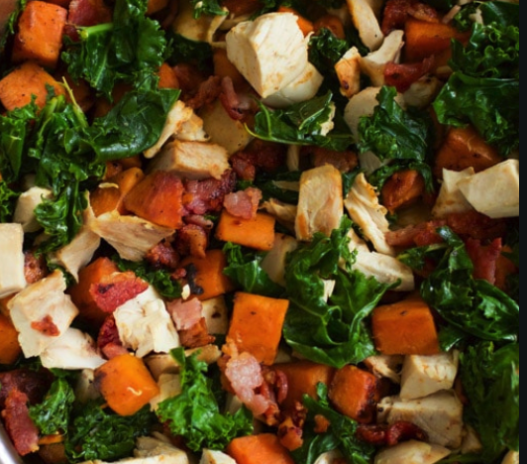
Blood sugar balance
Protein, healthy fats and fiber
Regular meals and snacks if needed
= improved mood, sleep & energy

Slide 17
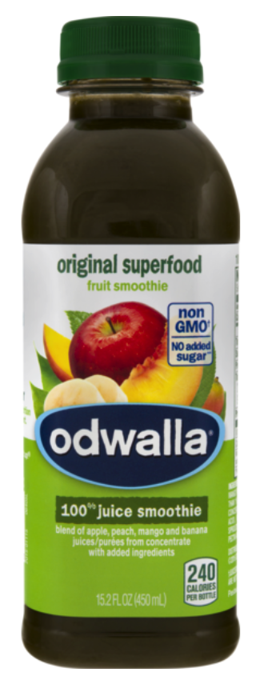
Sugar by the numbers
6 tsp. (AHA max. for “added” sugars) =
3 T Kraft BBQ sauce (10.5 g) +
1 Chips Ahoy cookie (6 g) +
1 med. whole wheat hamburger bun (1.9 g) +
2 T Marie’s raspberry vinaigrette (5.3 g)
6 tsp. of sugar = <1/4 cup Craisins (29 g)
6 tsp. of sugar = ½ bottle Odwalla ----->
Notes:
Let’s see what 6 teaspoons is …
Apple juice, mango, peach and banana purees, spirulina, wheat grass and more etc. …..
1-2 servings fruit (berries if you’re lowering)

Slide 18
Sugar: Where it is …
Obvious
Cookies, ice cream, doughnuts, soda, candy, coffee creamers
Beer, wine, alcohol
Sneaky (sugars and “quick” carbs = turn to sugar quickly)
BBQ sauce, salad dressings, ketchup, granola & energy bars, energy drinks, fruit-filled yogurt, juice, dried fruit
Bread, pasta, cereal, instant oats, crackers, chips, pastries, pretzels, bagels, muffins, tortillas, canned soups, prepared meals

Slide 19
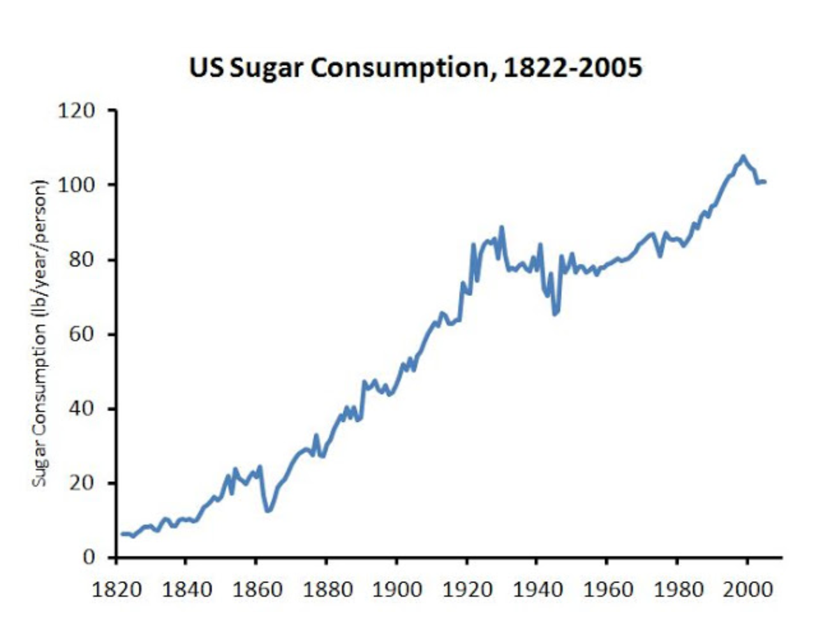
Sugar through history…
Consumption
per person, per year:
1822: 6.3 lbs.
1999: 107.7 lbs.
😳
Notes:
“In 1822, we ate the amount of added sugar in one 12 ounce can of soda every five days, while today we eat that much sugar every seven hours.” Stephen Guyenet and Jeremy Landen WholeHealthSource.blogspot.com

Slide 20
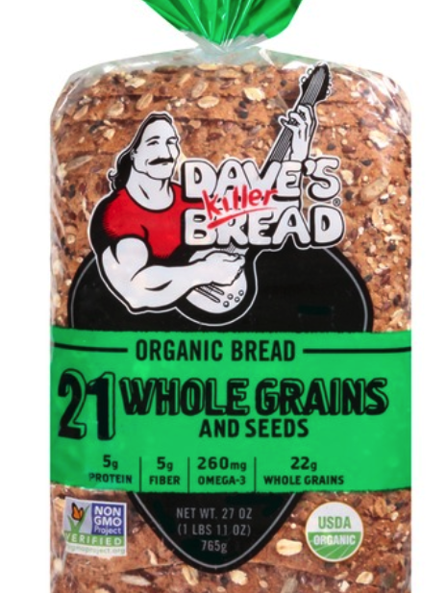
Starches = sugar Food makers try to sell you on the front label … “Whole Grains” “Fiber” “Protein” “USDA Organic”

Slide 21
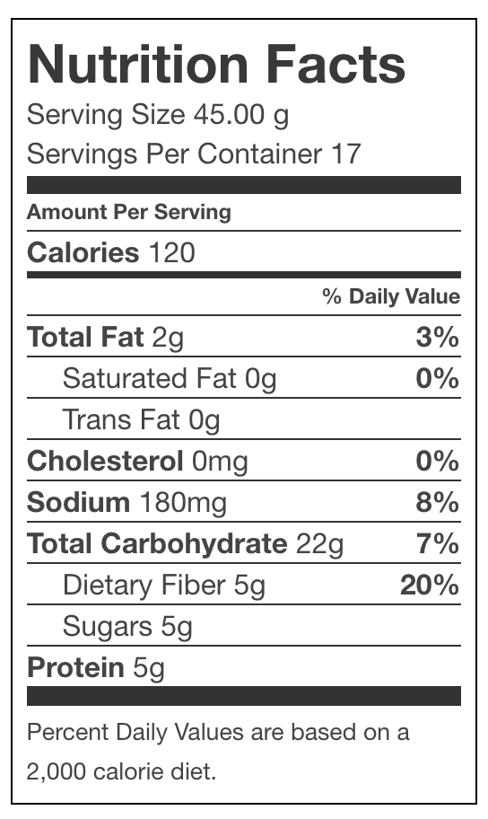
Starches = sugar
1 slice Dave’s 21 Whole Grains bread
Starches = strings of sugar molecules
Starches are not listed on labels
Fiber + Sugar + Starches =
Total Carbohydrates
Notes:
This is the label for 1 slice of Dave’s bread

Slide 22
Don’t get overwhelmed …
Image: https://therapeuticmeals.com/blogs/news/tagged/minced-diet
Notes:
Don’t get overwhelmed with the counting …..
This is not about making you crazy – WE DON’T WANT TO TAKE THE JOY OUT OF EATING
TAKEAWAY
Reducing sugars and quick carbs not only lowers blood sugar, over time restore IS
Work on small changes

Slide 23
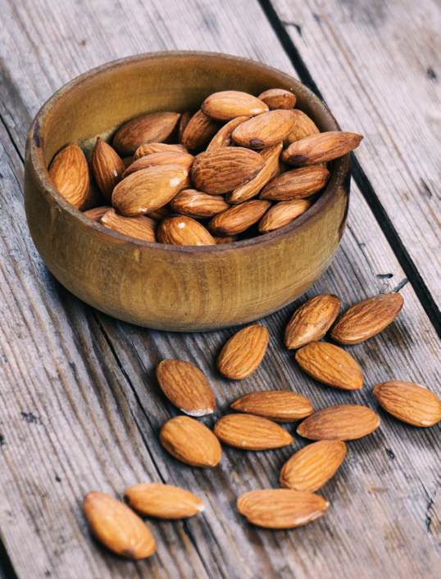
Balanced eating strategies
Read labels (educate yourself, but don’t obsess)
Eat mostly whole foods (you’re 80% there!)
Cut out “low-hanging fruit” (sugars you don’t care about)
Choose healthy swaps
Handful of nuts vs. pretzels
Carrots & hummus vs. chips & dip
Half vs. whole sandwich
Piece of fruit vs. glass of juice
1 cookie vs. 2 cookies
Photo: Tetiana Bykovets, Unsplash
Notes:
WHOLE – dig, pick, hunt, fish, milk
Look at carbs and sugars – buy ketchup w/ lowest sugar count
Don’t care about cake? Don’t eat cake!
This is where the changes add up.
I don’t like cake so stopped eating cake! (Now if you melt ice cream in it …)

Slide 24
Food specifics
Fiber, fat and protein
Balanced meals – especially breakfast
Snacks when needed
Notes:
among diabetics, protein and EFA deficiencies are common

Slide 25
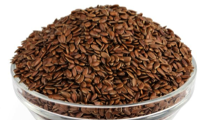
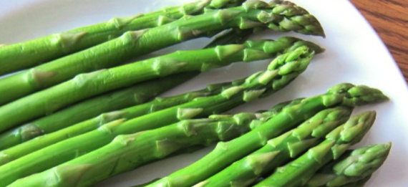
Fiber: Slows absorption of glucose
Favorites fiber sources
greens, colorful vegetables, root vegetables, berries,
nuts & seeds (esp. flax seeds)
Higher fiber sources
fruit, beans, lentils, whole grains (not whole grain flours)
Fiber vital for healthy gut bacteria (prebiotics)
jicama, Jerusalem artichoke, asparagus, cocoa,
avocado, root veggies, apples & other
fruits, flax seeds, beans
Notes:
Also helps with digestive health; fiber essential for gut health –
Soluble fiber feeds healthy gut bacteria (talk more ….): broccoli, sweet potatoes and other root veggies, avocado, apples and other fruits, beans
Sugar feeds overgrowth of certain microbes = bad actors
Healthy gut microbiome changes signaling throughout body = better

Slide 26
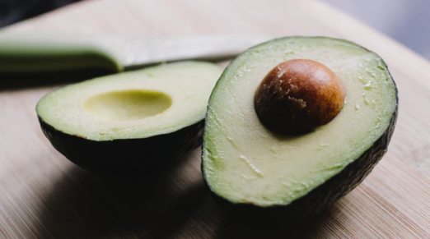
Fat: slow burn
Fat is fuel (slow burning log)
Reduce sugars & carbs = increase healthy fats in diet
Healthy fat sources: avocado; olive, avocado & coconut oils; nuts & seeds; high quality animal foods: ghee, butter, whole whole dairy, poultry, fish, meats
Photo: Marko Horvat, Unsplash
Photo Kelly Sikkema, Unsplash
Notes:
Fat and Glucose are our two main fuel sources.
Sugar = twig that starts the fire
Fat is the big log burns more slowly. Also satiety…

Slide 27
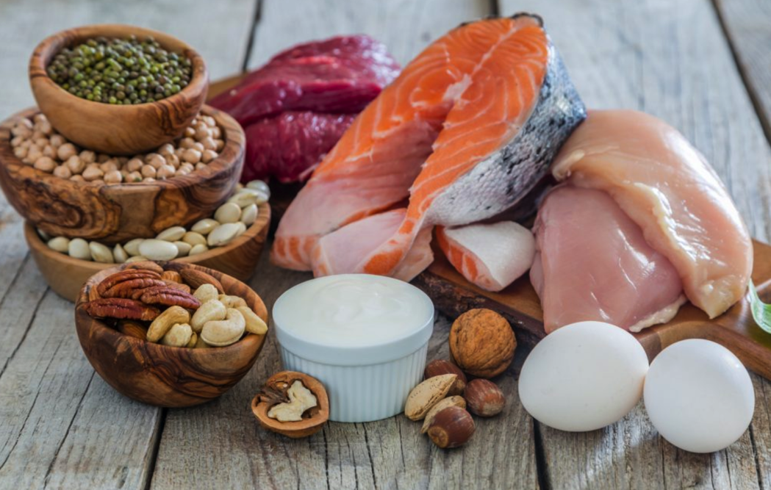
Protein
Digests more slowly than carbs
Significant sources: high quality dairy, eggs, meats, poultry & fish
Smaller sources: nuts & seeds, legumes, quinoa, spirulina, peas, dark leafy greens, broccoli, Brussels sprouts,
Protein = satiety
Don’t overdo it – palm-sized
Photo: Blog.csiro.au
Notes:
Most people don’t unless they’re trying to eat lots or really limit carbs or fat
Gluconeogenesis

Slide 28
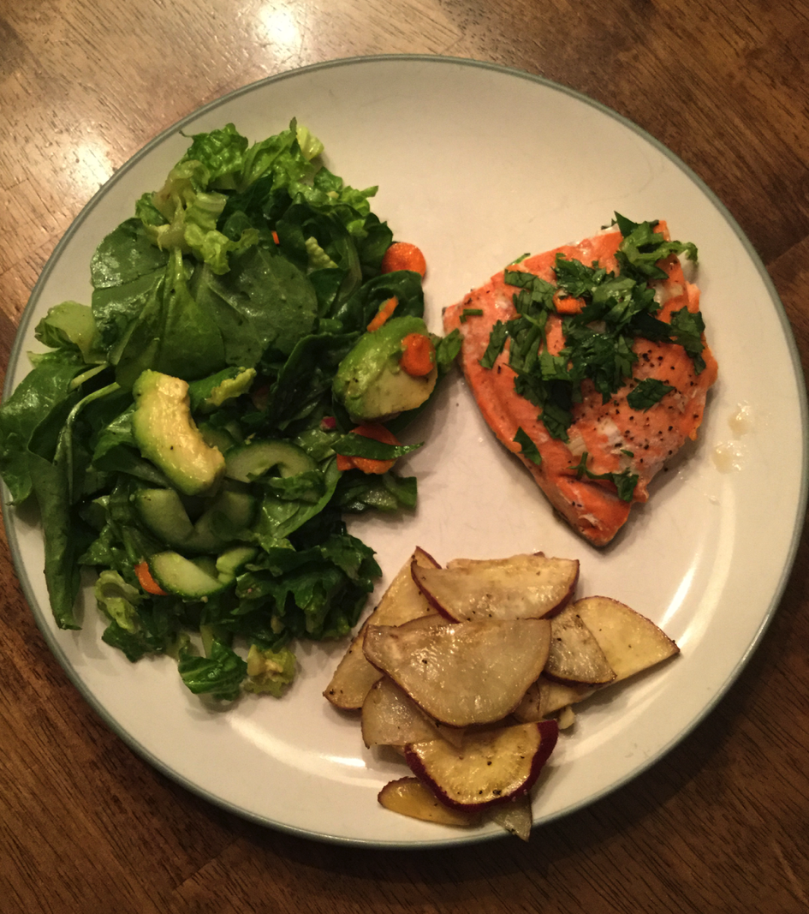
Balanced meals
Half your plate or more colorful veggies (fiber)
Moderate protein
Health fats throughout
Avoid white foods
pasta, bread, crackers, white potato, rice etc.
Limit sweets
Eat slowly
Stay hydrated (drink mostly between meals)
Photo: Kelly Dwyer
Notes:
dehydration = higher blood sugar concentration
don’t drink too much during meals – dilutes digestive juices

Slide 29
Key nutrients for insulin sensitivity
Vanadium (trace mineral): Mushrooms, shellfish, black pepper, parsley, dill weed
Chromium (trace mineral): Broccoli, barley, oats
Zinc: Beef, lamb, sesame & pumpkin seeds, lentils, garbanzo beans, cashews, quinoa, shrimp
Omega-3 fatty acids: Wild Alaskan salmon, sardines, pasture-raised eggs & beef; flax seeds, walnuts
Magnesium: Pumpkin, sesame & sunflower seeds, Brussels sprouts, quinoa, black beans, cashews
Ceylon cinnamon
Notes:
Insulin sensitivity is good! This is the other direction from insulin resistance

Slide 30
How & when we eat impacts blood sugar
Don’t skip meals
Avoid eating late at night
Mindful eating (stress response)
Intermittent fasting (discuss with us first)
Listen to your body!
Dizzy, lightheaded, brain fog, hunger pangs = eat!
Not hungry = don’t eat (or go light)
Photo: Malvestida Magazine, Unsplash
Notes:
intermittent fasting – 12-14 hours
don’t eat right when you wake up. Eat in 10-12 hour period
diabetics, hypoglycemic etc. discuss with us first
Don’t eat if not hungry. Sounds simple, but ask yourself, are you paying attention?
Our hunger levels fluctuate

Slide 31
Lifestyle factors
Stress hormones raise blood sugar
Caffeine → stress hormones → raise blood sugar
Sleep affects glucose tolerance (ability to break down glucose)
Exercise & movement improves insulin sensitivity
Some medications affect blood sugar balance
Notes:
Stress hormones tell the liver to send glucose into blood
Glucose tolerance is your body’s ability to break down glucose
Steroids, Diuretics, beta blockers, ACE inhibitors, angiotensin receptor blockers

Slide 32
Stress management
Sleep
Balanced meals
Chamomile & ashwaganda teas
Deep breathing
Meditation
Time outdoors
Time out from work
Time with friends & family
Laughter
Photo: 123rf.com
Notes:
Stress hormones tell the liver to send glucose into blood
Glucose tolerance is your body’s ability to break down glucose
Steroids, Diuretics, beta blockers, ACE inhibitors, angiotensin receptor blockers

Slide 33
Sleep
Research study #1. One group studied.
Nights 1-4, 8.5 hours in bed
Nights 5-8, 4.5 hours in bed
= 300-1,000 more kcal/day (& more sweets!)
Research study #2. Two groups studied.
Dieters who got more sleep lost more fat
Sleep affects hunger signals (leptin & ghrelin hormones)
Notes:
1st study – same access to foods, environment etc. all nights
2nd study – Kcal resticted diet -- 2 groups slept different # of hours; both groups lost weight, butt those with less sleep = losing lean muscle mass

Slide 34
Sleep
Reduce caffeine & alcohol
Hydrate more earlier in the day (to reduce waking)
Balanced diet (fat & protein at dinner); avoid food 2-3 hours before bed
Get sun early in the morning (no sunglasses)
Exercise daily
Meditation & deep breathing
Photo: Matthew T Rader, Unsplash
Quit screens 2-3 hours before bed
Sleep in a cooler room (~ 68° F)
Eye mask & ear plugs
Address sleep apnea (if applicable)
Investigate other options with the docs
Notes:
1st study – same access to foods, environment etc. all nights
2nd study – Kcal resticted diet -- 2 groups slept different # of hours; both groups lost weight, butt those with less sleep = losing lean muscle mass

Slide 35
Exercise & movement
Exercise improves insulin sensitivity
2.5 hrs./week moderate to vigorous activity
Brisk walk, water aerobics, swimming, jogging
2-3 sessions strength/resistance training/week
< 24 hours “rest”
Stretching
Keep moving
Cooking, gardening, shopping, stairs, walking meetings, standing desk, walk or ride vs. drive
Photo: Tobias Mrzyk, Unsplash
Notes:
Injured? Focus on what you can do

Slide 36
Summary
Excess glucose → insulin resistance → prediabetes → diabetes & other health complications
Genes play a role, but we steer outcomes largely through our lifestyle choices
Nutrition, stress management, sleep, exercise
Diet plays a huge role
Less sugar & quick carbs
Balanced meals: Fiber, fat and protein
Make small, consistent changes. They add up!
Notes:
Injured? Focus on what you can do
Much of this is about habit change … you may know what to eat – come see me I can help

Slide 37
Sources
• American Diabetes Association
• Centers for Disease Control and Prevention website
• Diabetes Teaching Center, University of California San Francisco
• Walker, Matthew, Why We Sleep: Unlocking the Power of Sleep and Dreams, 2017
• Journal of Clinical Diabetes 2018 Apr; 36(2): 202-202

