Slide 1
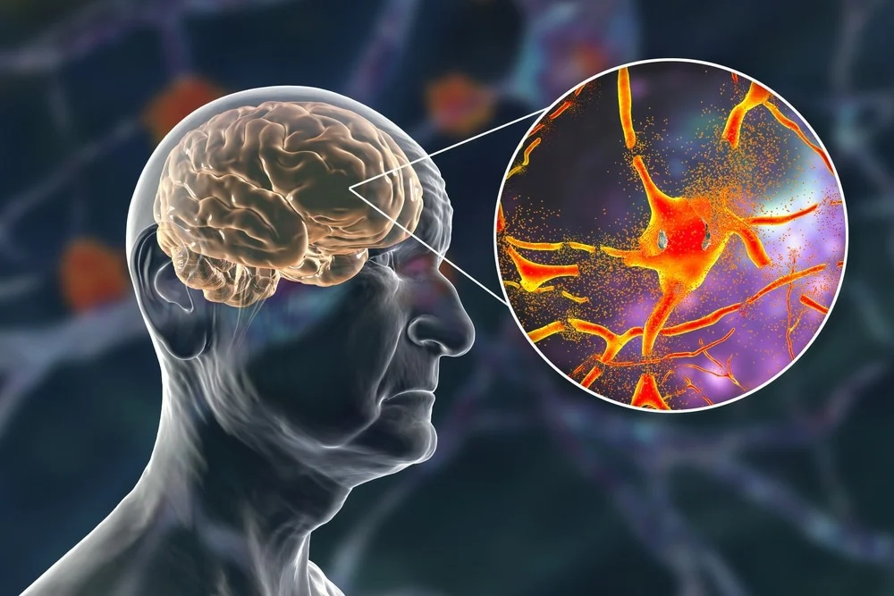
Aging Brain

Slide 2
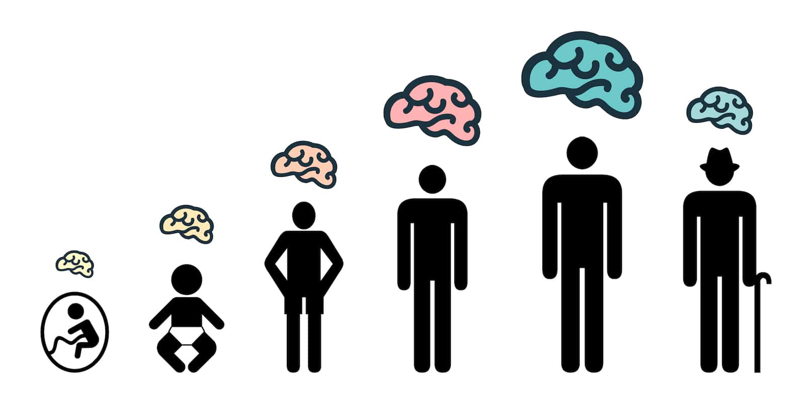
Physical Brain Changes with Aging
Brain size changes over one’s lifetime: Reduction in brain weight and volume (5% per decade after 40), particularly in the frontal lobe and hippocampus, leading to cortical thinning and enlarged ventricles.

Slide 3
Key Physical Changes
Brain Atrophy: Significant shrinkage occurs, especially in the prefrontal cortex (responsible for executive function) and hippocampus (crucial for memory).
Reduced Volume/Weight: Brain mass decreases, with accelerated shrinkage after age 60.
Cortical Thinning & Ventricular Enlargement: The cerebral cortex thins, while the fluid-filled ventricles increase in size.
White Matter Changes: Myelin (protective insulation) deteriorates, reducing communication efficiency between brain regions.
Microscopic Changes: Accumulation of lipofuscin, senile plaques, and neurofibrillary tangles often occur, along with reduced neuron density and fewer synaptic connections.
Reduced Neurogenesis: The brain's ability to create new neurons decreases.

Slide 4
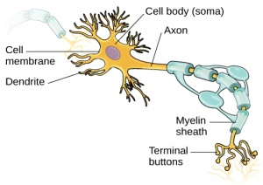
Age-Related Changes in Neurons
  Number of neurons declines
  Number and size of dendrites on the neuron decreases
  Tangles develop in axon fibers of the neuron
  Increases in deposits of proteins
  Number of synapses decreases (area between the neurons basically)
  Declining health of brain’s white matter
  These changes occur in greater numbers in diseases such as Alzheimer’s disease

Slide 5
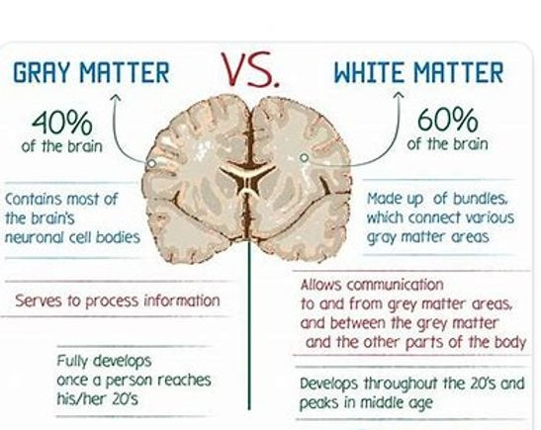

Slide 6

Feature | Grey Matter ("Grey Cells") | White Matter
Main Component | Neuron cell bodies, dendrites | Myelinated axons
Function | Information processing, cognition, memory | Signal transmission, connectivity
Appearance | Greyish | Whitish (due to myelin)
Location (Brain) | Outer cortex | Deep tissues
Metabolic Demand | High | Lower

Slide 7
White Matter/Hyperintensities
  White matter refers to the insulating sheath (myelin) covering neurons
  White matter hyperintensities (WMH), spotty patches on MRI images, indicate brain pathologies
  Indicates myelin loss (coating protection around nerves such as cranial nerves) or neural atrophy
  WMH are clearly associated with progressive cognitive impairment, 2x increased risk of dementia, 3x increased risk of stroke
  WMH also associated with increased risk of falling

Slide 8
Age-Related Changes in Neurotransmitters
Dopamine – a neurotransmitter associated with higher-level cognitive functioning
  High dopamine levels are linked to cognitive processes that are deliberate but not processes that are automatic
  The neurons that use dopamine are call the dopaminergic system. Declines in the dopamingergic system are related to memory decline
Serotonin – involved in many brain processes, such as memory, mood, appetite, and sleep. Abnormal processing of serotonin shown in normative aging and in dementia.
Acetylcholine has a role in general cognitive processes (arousal, sensory perception, attention, higher order thinking) Studies suggest that mitigating the loss of cholinergic neurons and receptors is vital for maintaining cognitive health in the aging population

Slide 9
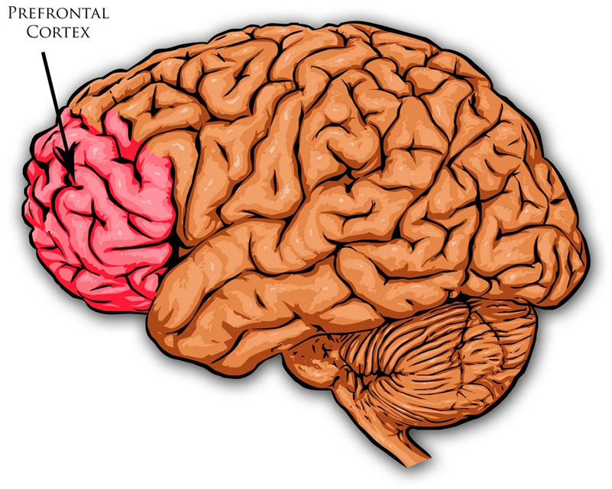
Prefrontal Cortex (PFC)
The PFC is highly vulnerable to aging, showing structural shrinkage, reduced grey matter, and decreased white matter integrity starting in midlife.
This leads to declines in executive functions, including working memory, multitasking, focus, and inhibitory control.
However, some older adults may exhibit increased PFC activity, potentially acting as a compensatory mechanism.
The PFC one of the slowest parts of the brain to develop, reaching full maturity in the mid-twenties. Children and teenagers are more prone to risk-taking behavior, while adults are generally better at planning ahead and reasoning.

Slide 10
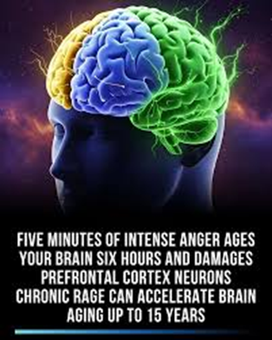
Factors Affecting PFC
Lifestyle: Regular exercise, healthy diet, and cognitive engagement can help mitigate the rate of structural decline.
Physical Health: Changes in cardiovascular health and hormonal changes, such as reduced estrogen during menopause, can impact brain function, contributing to "brain fog".

Slide 11
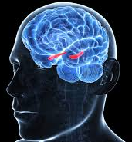
The Hippocampus
The hippocampus—the brain region critical for memory and learning—typically experiences atrophy at a rate of 1-2%/year in adults over 55.
This normal aging process is accompanied by reduced creation of new neurons and synaptic loss, contributing to age-related memory decline
Accelerated atrophy in disease: While normal aging shows 1–2% shrinkage, Alzheimer's disease can cause 3–5% yearly.

Slide 12
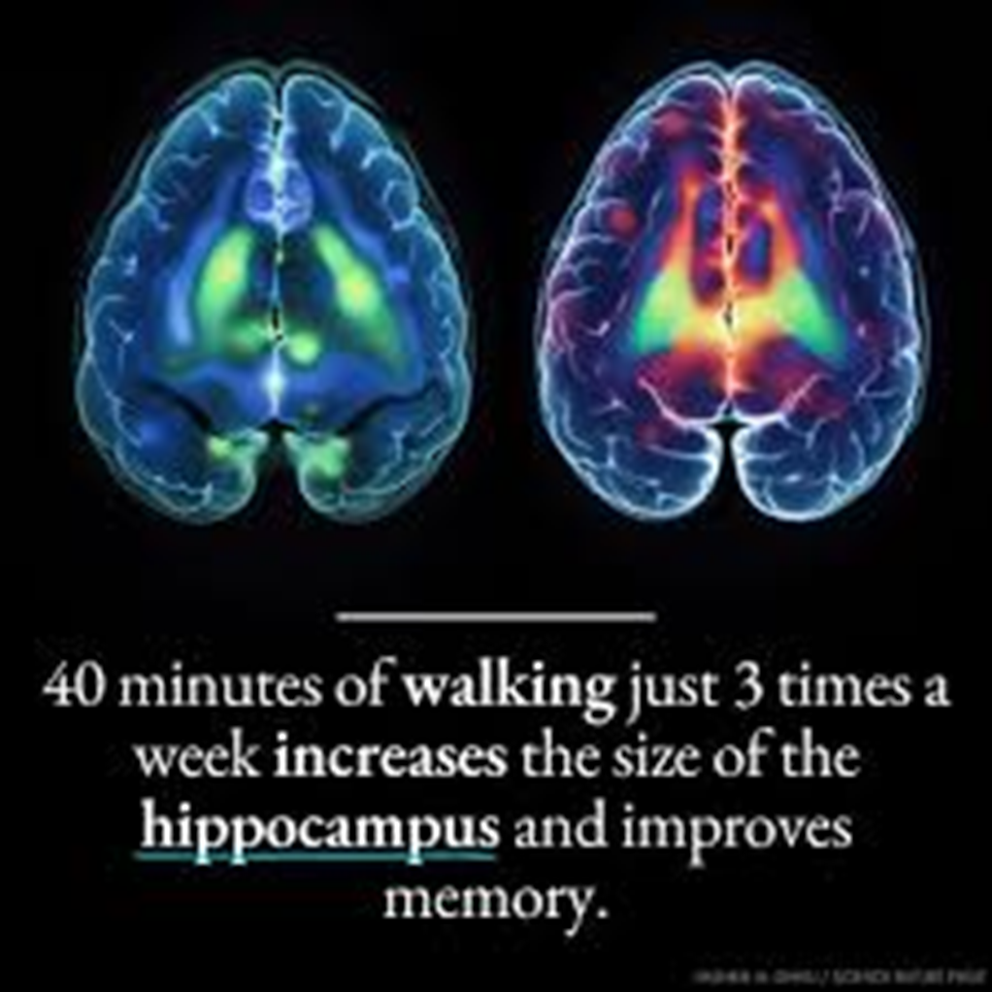
Preserving Function
Mitigating Factors:
Exercise: Regular physical activity can help counteract shrinkage of the hippocampus and support neurogenesis.
Lifestyle: A healthy diet and stress reduction can help maintain hippocampal volume.

Slide 13
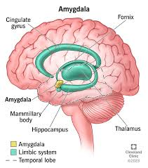

Slide 14
The Amygdala
With aging, the amygdala generally experiences a reduction in volume and decreased reactivity to negative emotional stimuli, contributing to a "positivity effect" where older adults often focus more on positive emotions.
While its physical structure may undergo slight decline, its functional connectivity with the prefrontal cortex often changes, aiding in better emotional regulation.
Impact of Neurodegeneration: In cases of dementia, the amygdala undergoes significant degeneration, whereas, in healthy aging, changes are relatively minor.

Slide 15
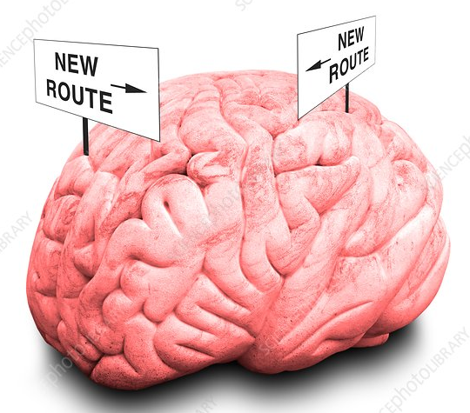
Plasticity
The brain’s ability to reorganize its structure, functions, and neural connections in response to learning, experience, or injury
What may appear to be decline in some skills may in part represent a lack of practice in using them
Older adults activate new or additional areas in the brain to compensate for decline in other areas.
Example: After a stroke or traumatic brain injury, the brain can rewire itself, allowing healthy areas to take over functions previously managed by damaged areas.

Slide 16
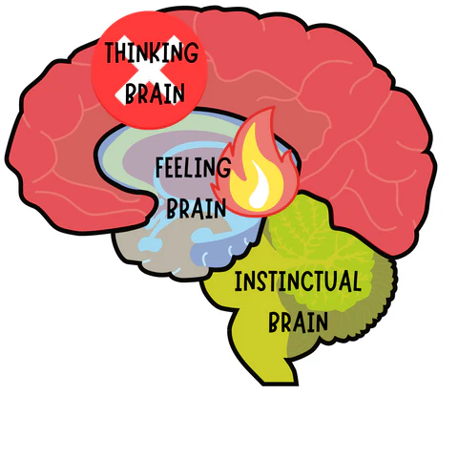
Structural Changes linked to Behavior
  It is the link between brain structures and functions and our behavior that matter
  Brain structures involved in automatic processing (amygdala) have less age-related deterioration compared to structures involved in more reflective processing (prefrontal cortex), which has more deterioration.
  An intriguing research finding is that brain pathways involved in memory tend to deteriorate with age, whereas key pathways involved in emotions do not.
  How these structures change and how individuals compensate for changes are highly individualized.

Slide 17
Working Memory
Working memory—the ability to temporarily hold and manipulate information—generally declines with age due to reduced processing speed and prefrontal cortex changes.
While daily, functional memory remains stable for most, age-related declines often manifest as difficulties with multitasking, focusing attention, and recalling new information.
Regular exercise, social engagement, and cognitive training can help mitigate these effects.

Slide 18
False Memories
Older adults are more susceptible to false memories than younger adults, often remembering the "gist" of an event while forgetting specific details.
This occurs due to declines in the prefrontal cortex and hippocampus, resulting in reduced recollection, lower inhibitory control, and increased reliance on semantic memory.
Confidence in Errors: Older adults often exhibit high confidence in their false memories, sometimes making them difficult to correct.
Impact on Daily Life: Increased vulnerability to scams, issues with medication management, and challenges with eyewitness testimony.

Slide 19
Prospective Memory
  Remembering to perform a planned action in the future
Equally important to remembering to do something is remembering that it was indeed done.
Prospective memory often declines with age due to prefrontal cortex changes.
  Best example is taking meds – people forget to take them and also forget that they have taken them, leading to both extra and missed doses
  Supporting Prospective Memory
Use External Aids: Depend on lists, pill dispensers, and smartphone alarms.
Focus on Cues: Associate tasks with specific, recurring, and noticeable events.
Reduce Cognitive Load: Simplify routines to minimize the need to "remember to remember".

Slide 20
Semantic Memory
  Learning and remembering the meaning of words and concepts that are not tied to specific occurrences of events in time -- Language comprehension, structure of knowledge, general knowledge
    Semantic memory (recall-meaning) is relatively spared in normal aging
  Changes can happen if it becomes
    hard to access if the knowledge is not used
    Hard to retrieve --momentary failure – “feeling of knowing” but not quite remembering
  Older adults tend to experience more FOK’s

Slide 21
Implicit versus Explicit Memory
Implicit memory—unconscious, automatic, or procedural memory like riding a bike—is generally well-preserved in healthy aging
Explicit memory (declarative): Intentional and conscious remembering of information that is learned at a specific point in time
Performance on explicit memory tasks declines with age.

Slide 22
Memory Monitoring
Memory monitoring involves knowing what you are doing with your memory.
The ability to monitor one’s memory does not appear to decline with age.
OA who are better at monitoring are more likely to use effective strategies, even if they have mild cognitive impairment.
Building memory strategy interventions on skills that change little with age can improve performance, and by extension, quality of life.
Memory self-efficacy: Memory successes tend to bolster self-efficacy, and failures reduce one’s belief of memory competence.

Slide 23
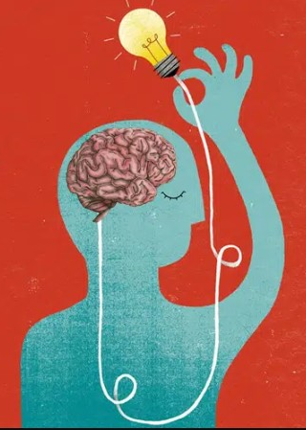
Decision Making and Everyday Cognition
There are age-related declines in basic cognitive and sensory mechanisms.
There are age-related increases in experience that build semantic memory and crystallized intelligence.
Functionally – do older adults have sufficient skills and knowledge for tasks in their daily lives? Are they “competent”?

Slide 24
Decision Making
  Older adults do not perform well when decision making needs to be quick -- involving a high degree of working memory capacity
  With extra time, older adults can use means to support working memory (keep notes)
  Older adults search for less information to arrive at a decision, tend to avoid risk in decision making, and rely most on easily accessible information
  Emotions play a role. Older adults are motivated to reduce the experience of negativity and enhance the experience of positivity. They prefer options that increase quality of life and the ability to continue being with loved ones.

Slide 25
Evidence of Compensation
  Studies show that, when presented with similar tasks, younger adults exhibit focal, unilateral activity in left prefrontal region, and older adults exhibit bilateral activity (both left and right prefrontal areas).
    Older adults may be compensating, but creative and intellectual reasoning need both left and ride side of our brains.
    Bilateral activation in older adults plays a supportive role in older adults’ cognitive function.

Slide 26
Control-related Strategies
    Primary control helps change the environment to match one’s goals. It involves bringing the environment into line with one’s desires and goals.
      Maybe start an exercise routine at home instead of going to the gym.
    Secondary control reappraises the environment in light of one’s decline in functioning and then adapts to current situations. The individual turns inward and makes a behavior change to deal with a situation that cannot be changed.
        Stop a given activity (like bike riding) involves changing your behavior to deal with safety issues

Slide 27
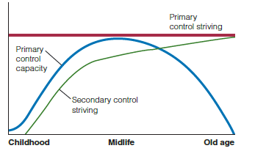
Trajectories for Control Strategies
Older adults turn to groups or secondary control as they age
Notes:
Figure 8.2 Hypothetical life-span trajectories for primary control potential and primary and secondary control striving.

Slide 28

Two C’s

Slide 29
Everyday Competence
  No single environment meets everyone’s needs.
Everyday competence is a person’s potential ability to perform activities considered essential for independent living.
    Physical health
    Sensory-perceptual skills
    Motor skills
    Cognitive skills
    Ego strength
    Primary outcomes of everyday competence are psychological and physical well-being, both major components of successful aging. Balancing environment press and competence, individuals can maintain their independence.

Slide 30
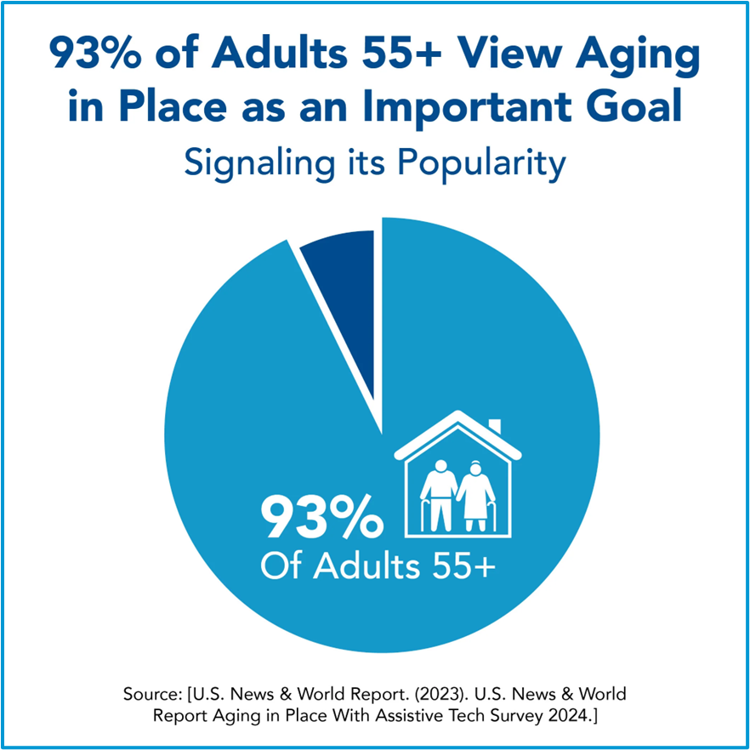
Person-Environment Fit
When a home become too costly to manage or an older person is physically unable to maintain it, the demands of the environment may be too stressful
.
An older adult’s decision to move often is prompted by needs for greater physical, psychological, or social help.
To adapt successfully to a new, more structured living environment older adults need to seek a level of autonomy appropriate to their resources and competencies

Slide 31
2nd C = Compensation
Some older adults may exhibit increased PFC activity, potentially acting as a compensatory mechanism.
Bilateral activation in older adults plays a supportive role in older adults’ cognitive function.
Older adults activate new or additional areas in the brain to compensate for decline in other areas.
As episodic memory (specific events) declines, older adults rely more on semantic knowledge to guide decisions and understand new information.
Support prospective memory with use of memory aids, strategies.

Slide 32
Building Cognitive Resources
Solving Puzzles & Riddles: Solving Rubik's cubes, Sudoku, or, brain teasers,
Adapting to New Technology: Learning to use a new app or device without instructions.
Rapid Problem-Solving: Fixing a broken object with makeshift tools (e.g., using a coin as a screwdriver)
Navigating New Environments: Finding your way through a new city's complex, unfamiliar bus system
Abstract Reasoning & Logic: Recognizing patterns in visual data
Creative Thinking: Finding a way to make coffee while camping using available materials like a pot and cheesecloth
.

Slide 33
Lifelong Learning
Lifelong learning is an excellent way to approach the need for keeping active cognitively.
Individuals preferred means of learning may change as they age
Lifelong learning is central to developing expertise
Lifelong learning can help address sociocultural issues in aging.
Transculturalism represents a new way of being and learning where individuals interact with each other in a culturally dynamic environment.

Slide 34

Flossing & Dementia
A study, published in Neurology, found that gum disease and tooth loss were associated with shrinking in the hippocampus, a part of the brain critical for memory and learning and one of the first areas to be damaged by Alzheimer’s
disease. The study was small, involving 172 older men and women who were living in Japan. But the findings build on earlier evidence that gum disease is tied to an increased risk for Alzheimer’s disease and other forms of dementia.

Slide 35
Dental Care & Dementia
.
Poor oral health, specifically gum disease (periodontitis) and tooth loss, is strongly linked to a higher risk of developing Alzheimer's disease and other forms of dementia
Bacteria from gum disease can travel to the brain, causing inflammation and the buildup of Alzheimer’s-related plaque
Bidirectional Relationship: While poor dental care can lead to dementia, the onset of dementia often causes individuals to neglect oral hygiene, worsening the situation in a "vicious cycle".

Slide 36
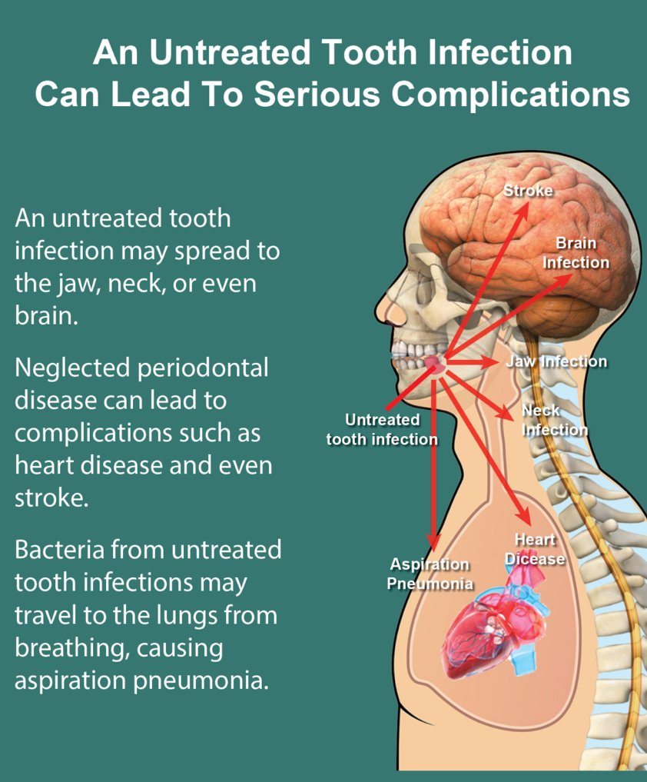
Dental Duh
Prevention: Regular dental cleanings and good oral hygiene are associated with a lower prevalence of subjective cognitive decline and may help mitigate the risk of dementia. Important for other health issues too.

Slide 37
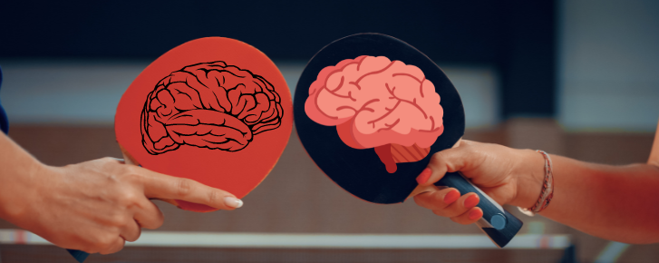
Ping Pong Anyone?
Coordinative challenging exercises in changing environments referred to as open-skill exercises seem to be beneficial on cognitive function.
Good example: table tennis

Slide 38
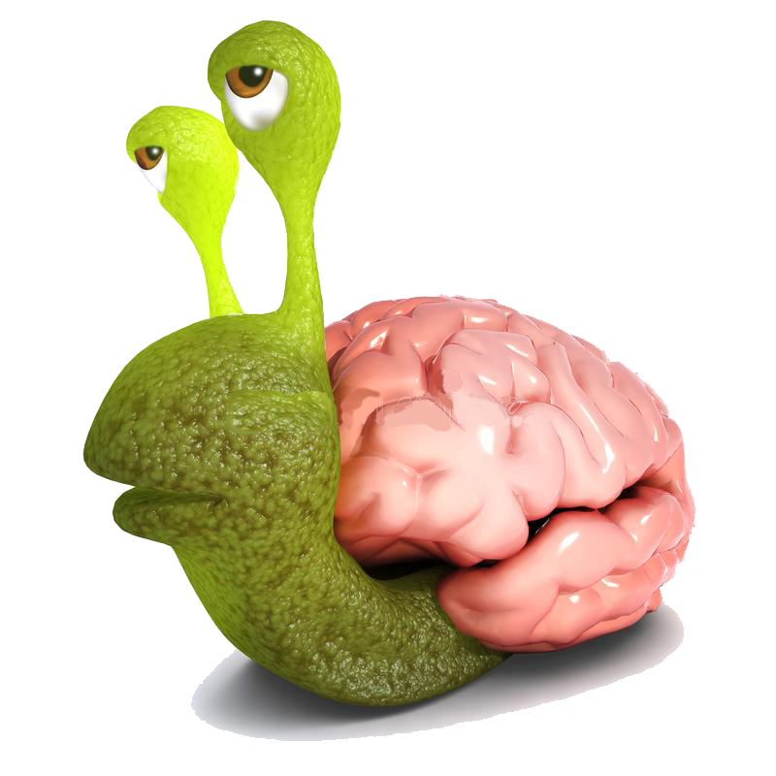
Summarizing Aging Brain Issues
Brain does undergo changes but these can be forestalled by lifestyle habits – exercise, nutrition, mental stimulation, socialization
Speed of processing slows, recall is harder & storage capacity declines, prospective memory can decline.
Learning new things is harder (working memory), and older adults are susceptible to false memories.
Maximizing competency can help OA maintain their independence
Activities OA chose contribute to their ability to compensate for mental/memory issues

Slide 39
Key Take Away Points
Are you participating in mind-stimulating activities? -- KEEP IT UP!
  Trying new things
  Puzzles/games
  Lifelong learning
Are your lifestyle habits conducive to maximizing your competency? -- KEEP IT UP! OR START!
Are you maximizing health options -- physical, mental, emotional, social
Memory monitoring – are you optimizing strategies to help compensate for any deficits?

Slide 40
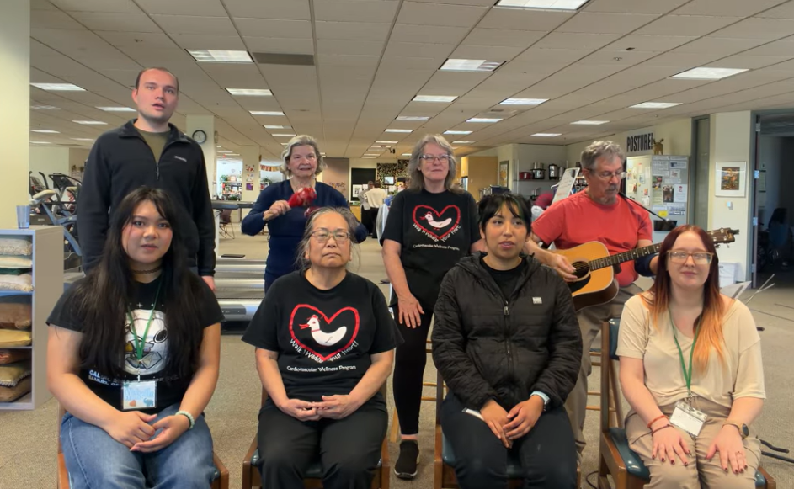
https://www.youtube.com/watch?v=oQ077JWWrd4

Slide 41
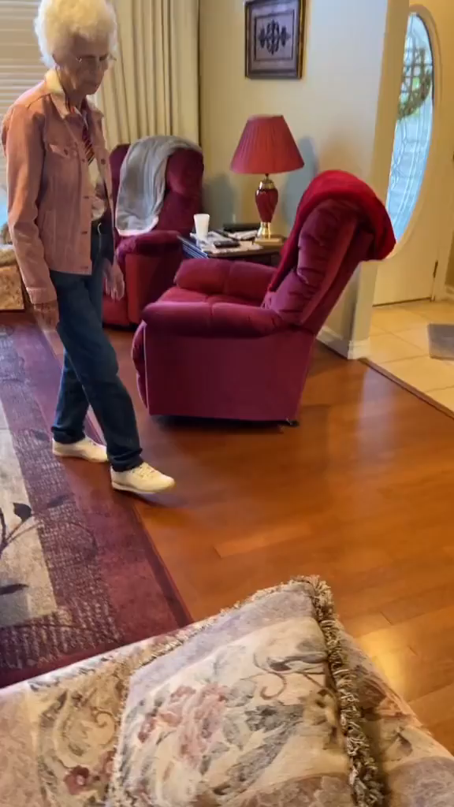

Slide 42
