Slide 1
Proper Medication Use in Older Adults
By: Navneet Sandhu and Kayla Amato

Slide 2
Did you know?
15.9% of adults use medications inappropriately

Slide 3
Why is this important for you?
Aging adults have a higher probability of adverse reactions
Polypharmacy can increase the likelihood of medication interactions
Not being on proper medication can decrease quality of life
The goal of medications should be to improve:
Your physical health
Your psychological health
Manage your diseases and prevent them from progressing

Slide 4
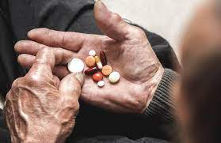
Polypharmacy
Multiple medications by a person who has more than 1 health problem
Older adults (65+) ~2-10 medications
Some drugs are prescribed to counteract the effects of another drug
Can result in ADEs
See one pharmacist who knows your history and has all current prescriptions on file

Slide 5
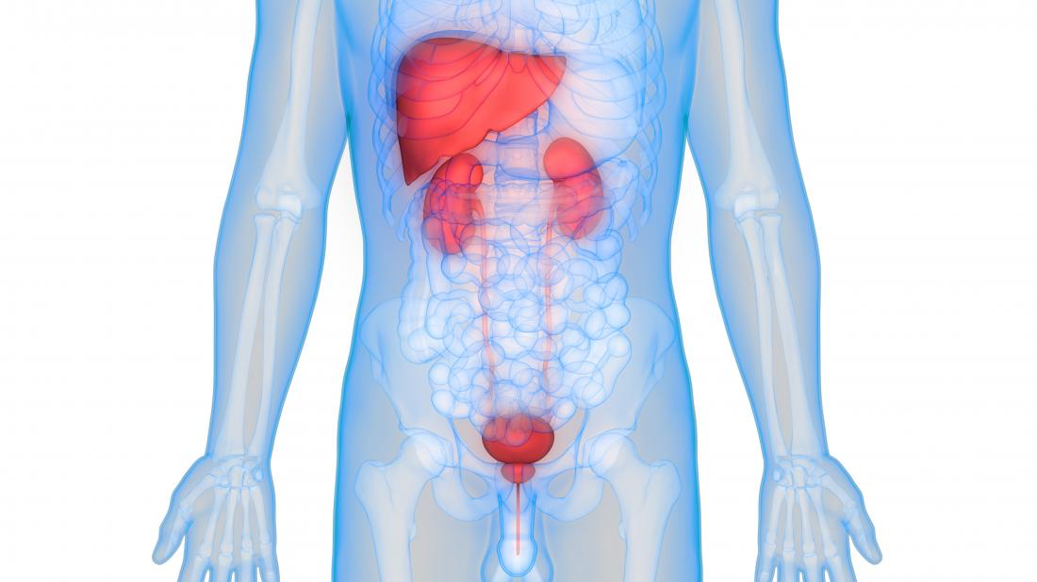
Aging and the Impact on Your Body
Liver and Kidneys
Decrease in nephrons
Decrease in GFR
Decrease in excretion of meds
Increase in toxicity
Overall metabolize drugs much slower

Slide 6
High Risk Medications
Caution
Benzodiazepines (Ativan)
Anticholinergic (Benedryl)
Opioids (morphine)
Anti-hypertensives
Diuretics (Lasix)
NSAIDS
Anticoagulants (Coumadin)
Cardiac Antiarrhythmics (Digoxin)

Slide 7
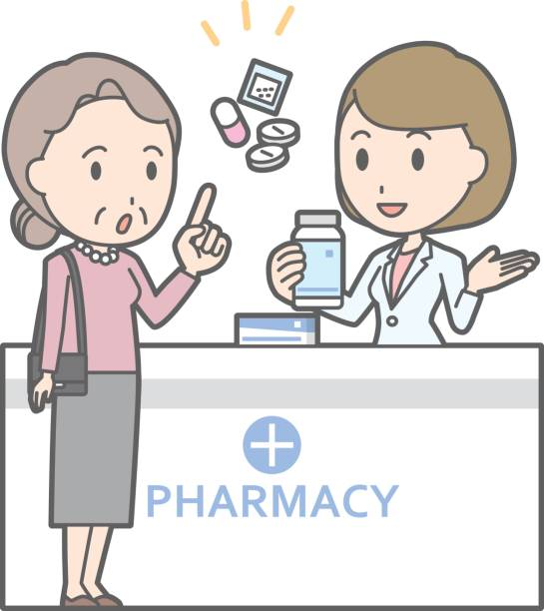
BEERS List

Slide 8
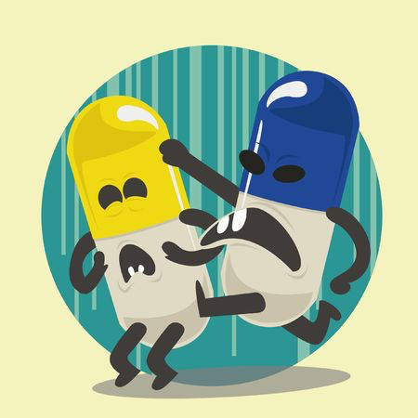
Common Interactions
Interactions can be drug and disease
Drug and disease interactions include:
NSAIDs and Aspirin can cause gastric problems or GI bleeds
Opiates can cause constipation

Slide 9
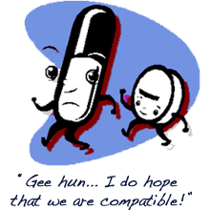
Common Interactions
Drug interactions include:
Warfarin with NSAID, Aspirin, or Acetaminophen
Antidepressants (SSRIs) should not be taken with other Tetralynic Antidepressants
Digoxin with other Antiarrhythmics like Amiodarone

Slide 10
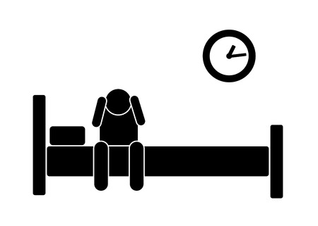
When to call your doctor
Any of the following:
Confusion
Fatigue
Unsteadiness/ Falls
Incontinence
Drowsiness
Depression
Bleeding
Not working as intended
Incorrect medication
ANYTIME YOU FEEL LIKE SOMETHING IS NOT RIGHT!

Slide 11
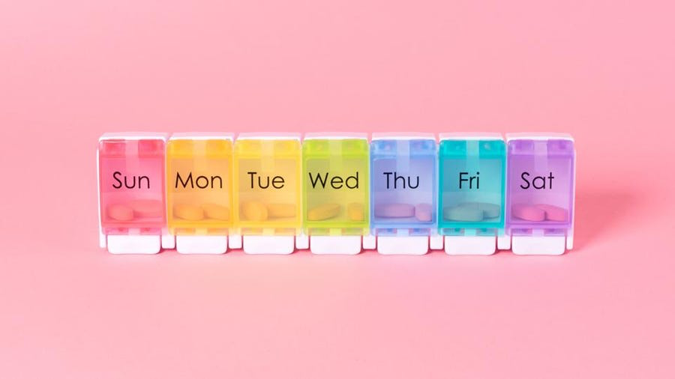

Slide 12
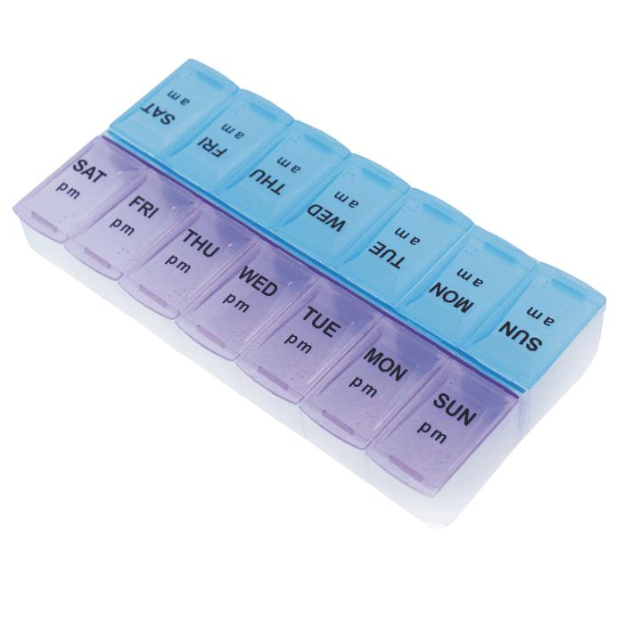
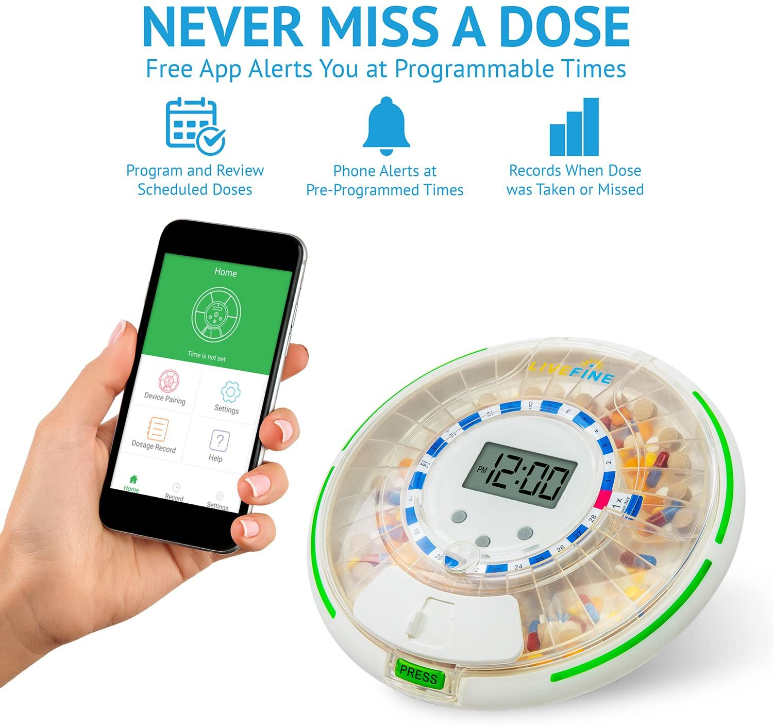
Medication Management
Use a pill box
Separate one for morning and night pills
Keep original pill containers even if you are using a box
See only one pharmacist/ physician
review all current meds (including vitamins and over the counter)
Do not share or take other peoples medications
Do not stop taking medications abruptly
When in doubt, call your doctor

Slide 13
QUESTIONS OR TIPS?

Slide 14
Resources
Ament, P. W., Bertolino, J. G., & Liszewski, J. L. (2000, March 15). Clinically significant drug interactions. American Family
Physician. Retrieved October 8, 2021, from https://www.aafp.org/afp/2000/0315/p1745.html.
Andrew J. McLachlan, Lisa G. Pont, Drug Metabolism in Older People—A Key Consideration in Achieving Optimal Outcomes With Medicines,
The Journals of Gerontology: Series A, Volume 67A, Issue 2, February 2012, Pages 175–180, https://doi.org/10.1093/gerona/glr118
Lavan, A. H., & Gallagher, P. (2016). Predicting risk of adverse drug reactions in older adults. Therapeutic advances in drug
safety, 7(1), 11–22. https://doi.org/10.1177/2042098615615472
Lewis, S.L., Bucher, L., Heitkemper, M.M., & Harding, M.M. (2017). Medical-surgical nursing: Assessment and management of clinical problems (10th ed.). St. Louis, MO: Elsevier.

