Slide 1
ATRIAL FIBRILLATION
Radhika Nandur Bukkapatnam MD MAS FACC
6/27/24

Slide 2
2023 ACC/AHA/ACCP/HRS Guideline for the Diagnosis and Management of Atrial Fibrillation

Slide 3
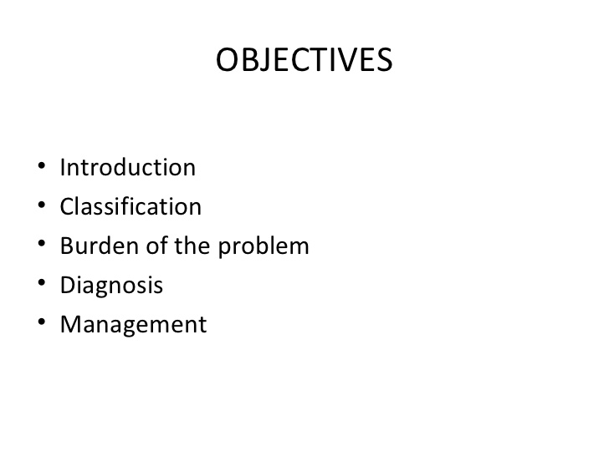

Slide 4

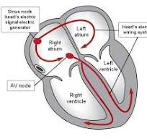
Electrical System of the Heart

Slide 5
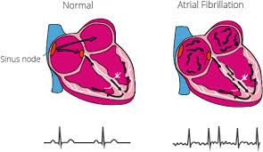
DEFINITION
Irregular, chaotic heart rhythm that comes from the left atrium or the pulmonary veins.
Paroxysmal
Persistent
Chronic

Slide 6


Slide 7
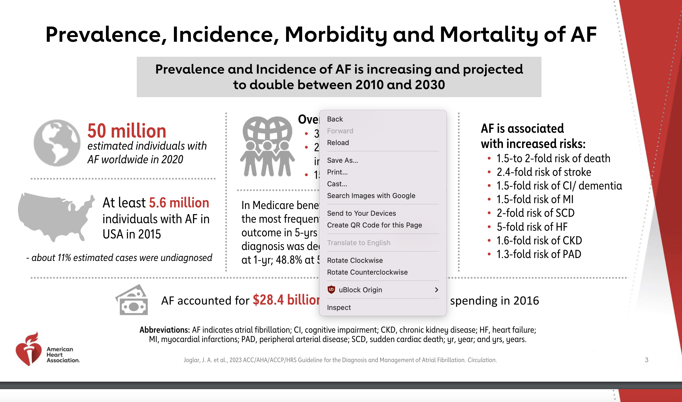

Slide 8
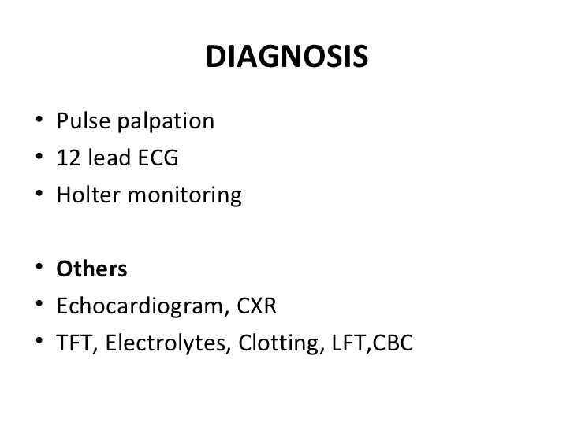

Slide 9
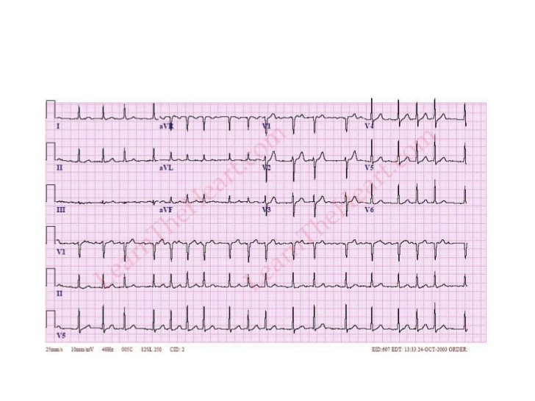
Atrial Fibrillation

Slide 10
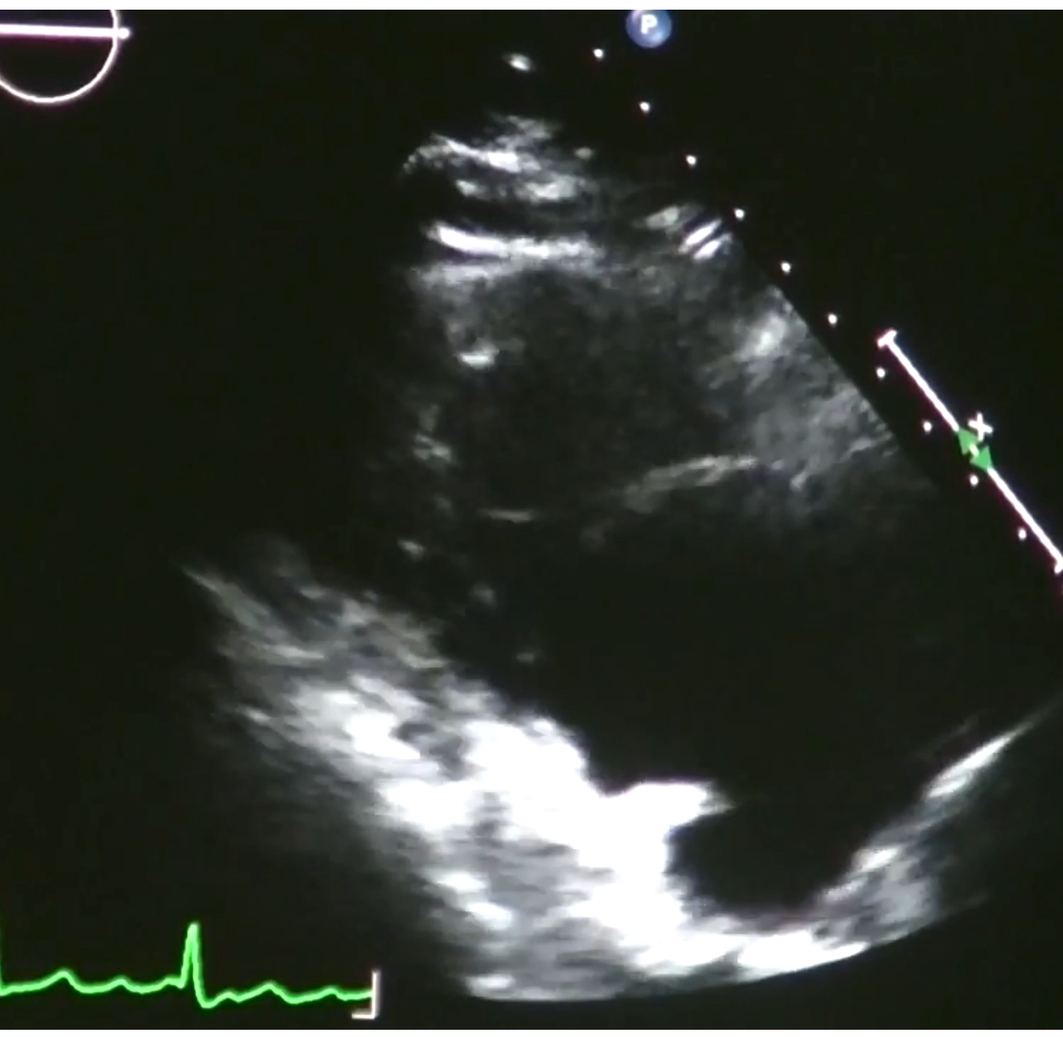

Slide 11

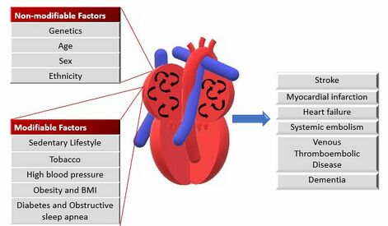

Slide 12
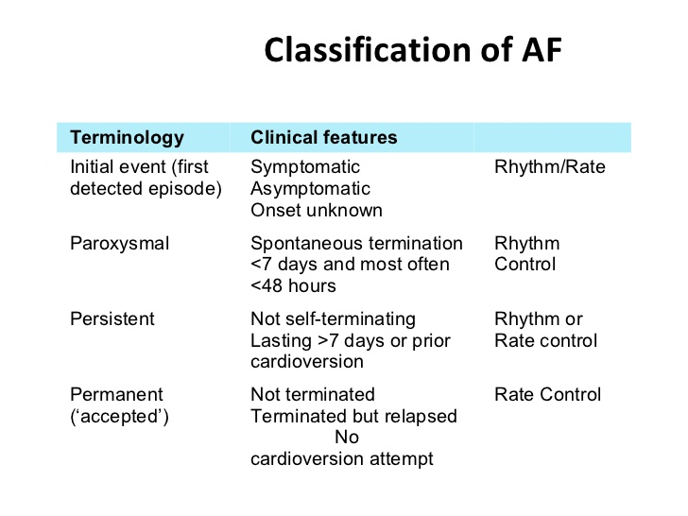

Slide 13
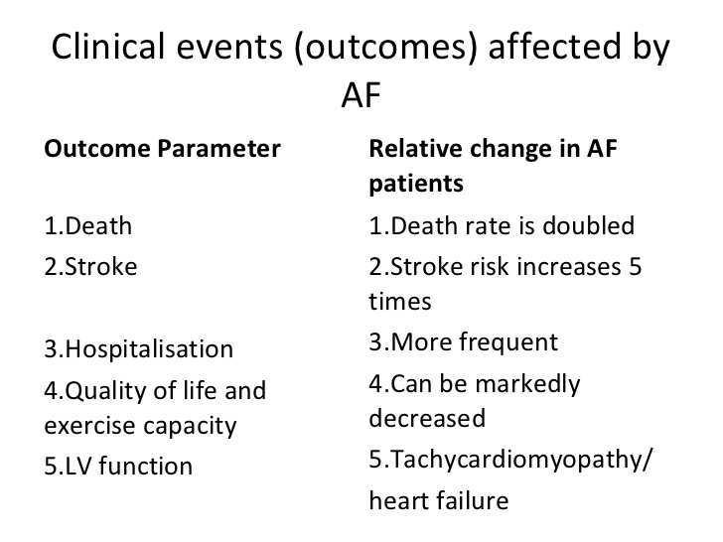

Slide 14
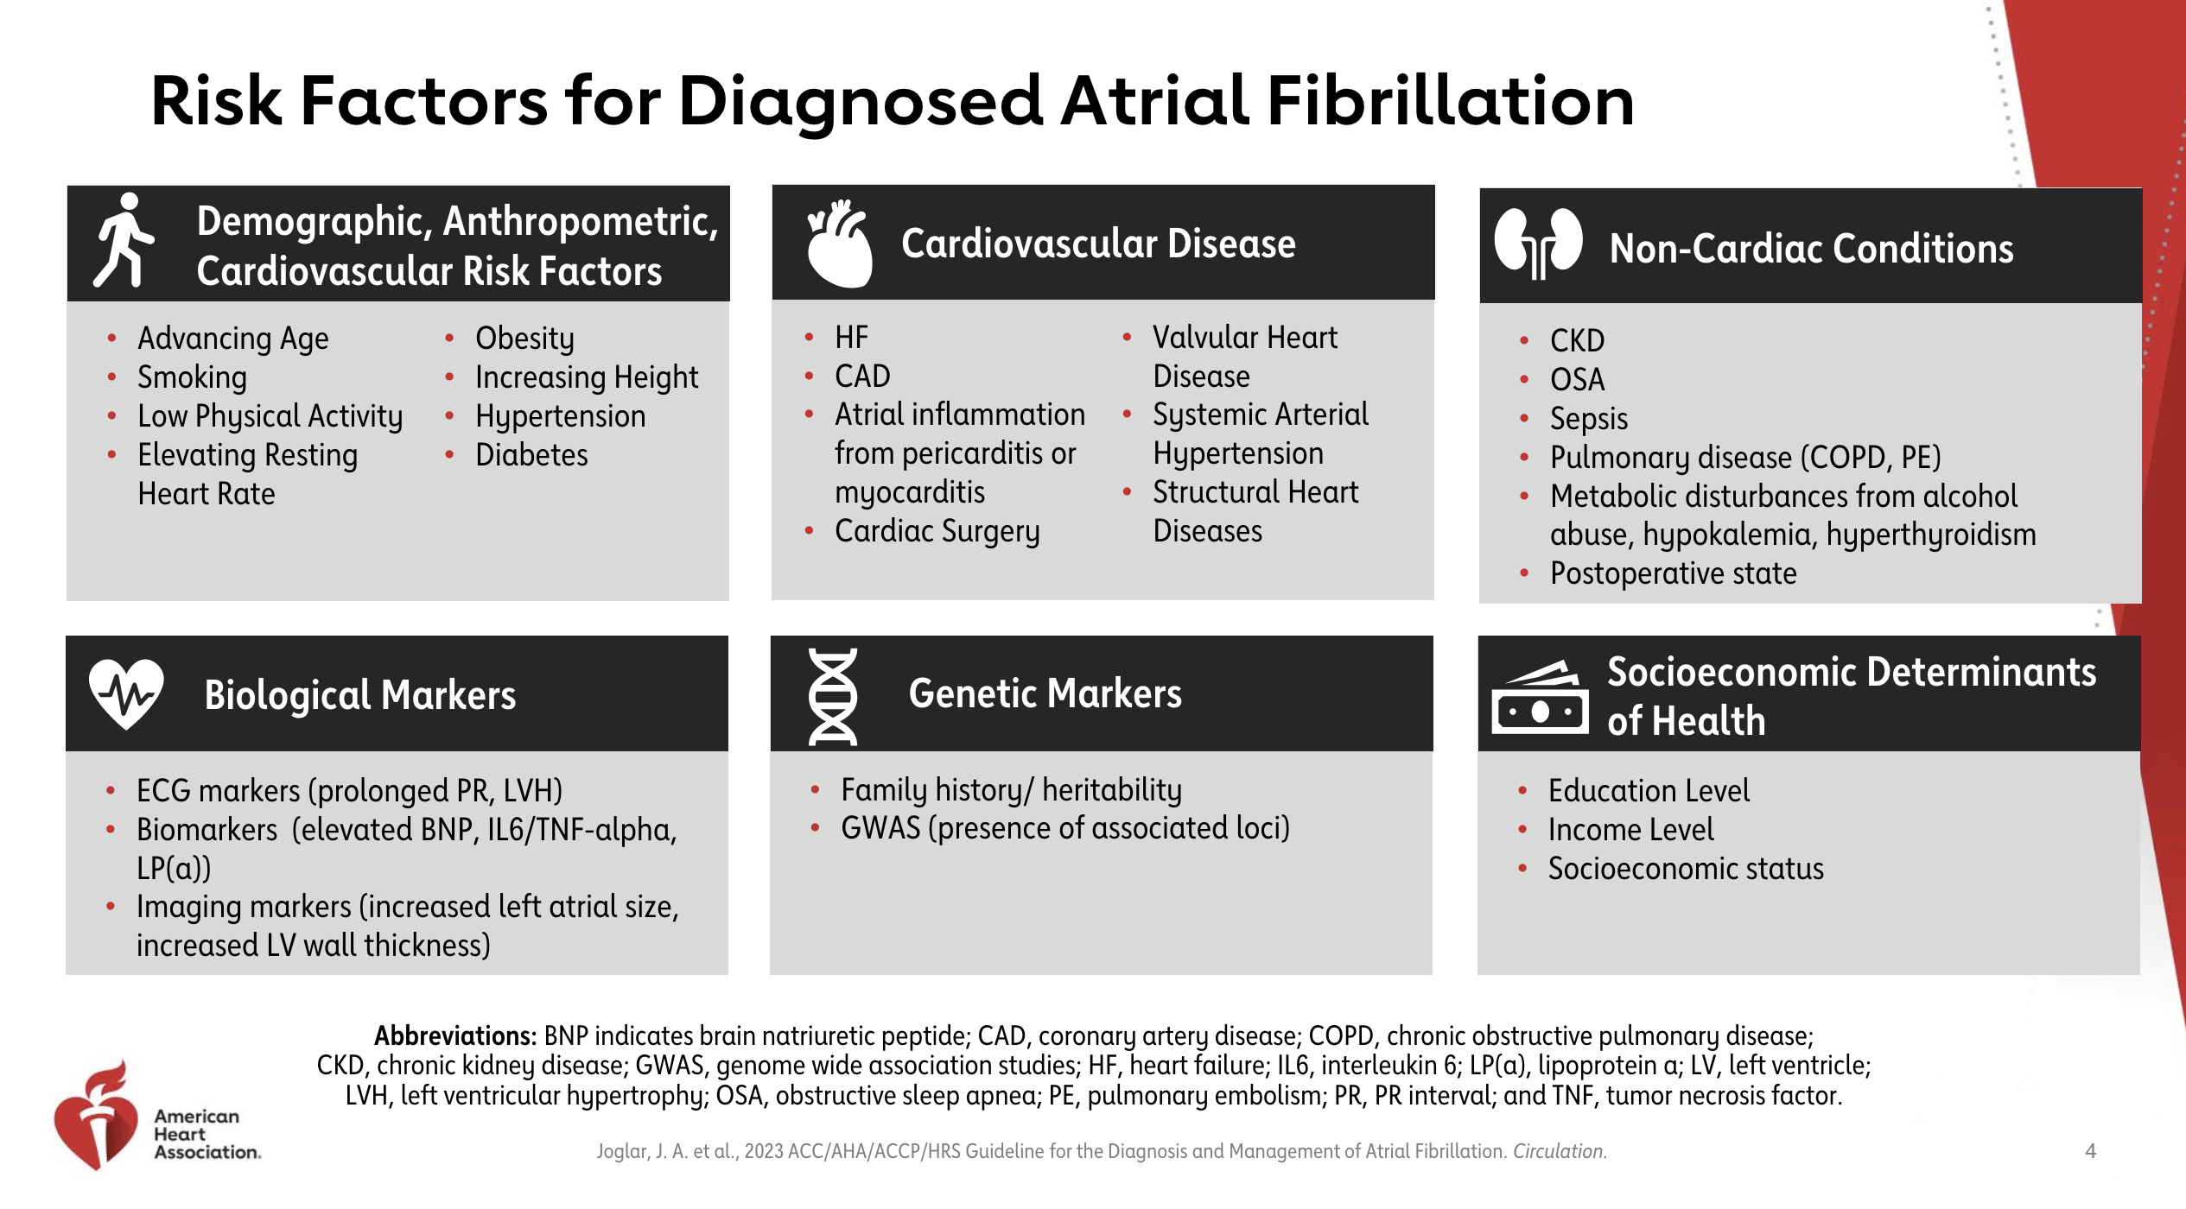

Slide 15
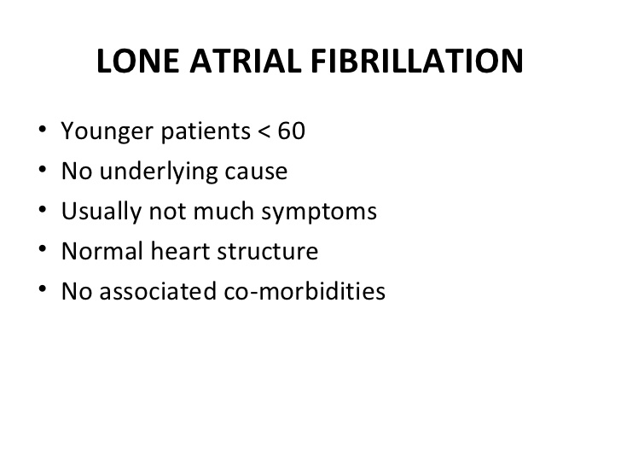

Slide 16
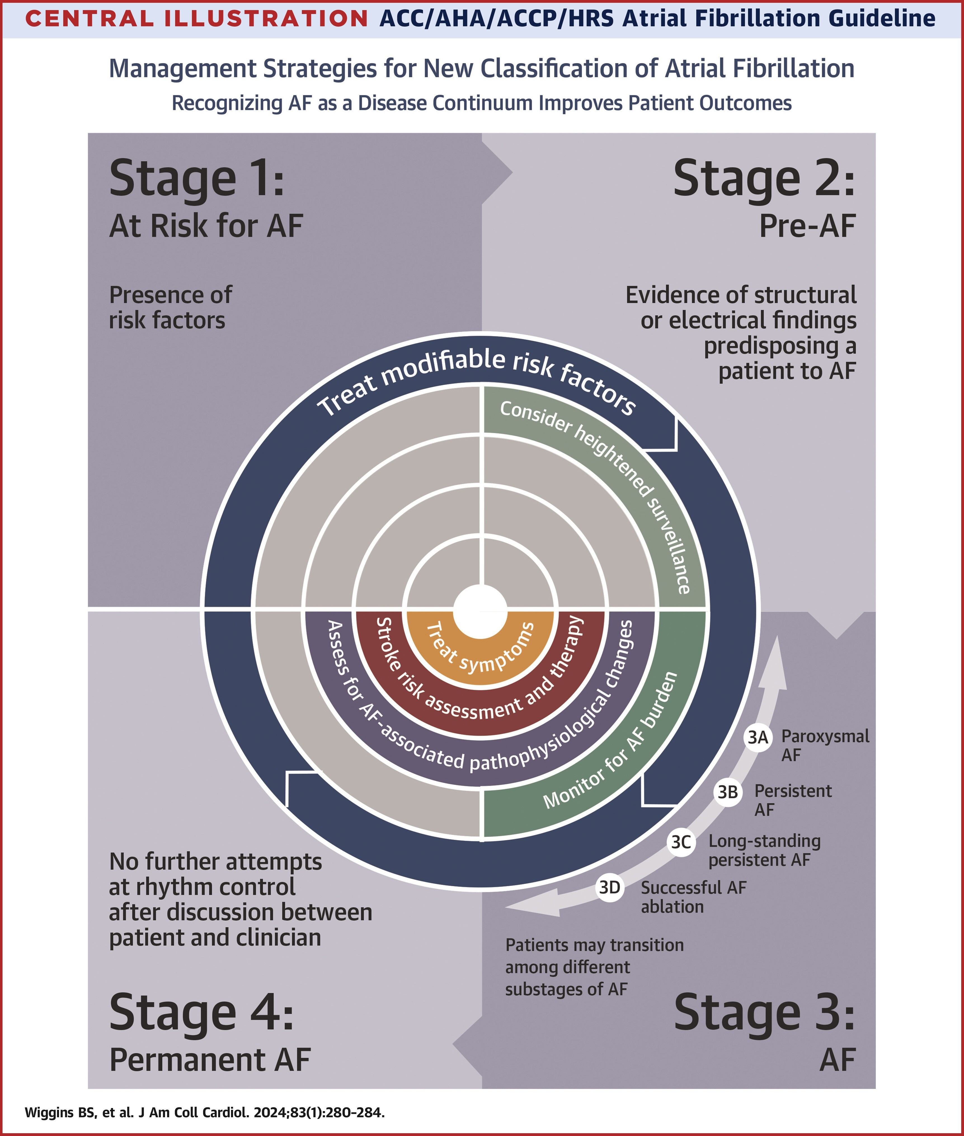
STAGES of ATRIAL FIBRILLATION

Slide 17
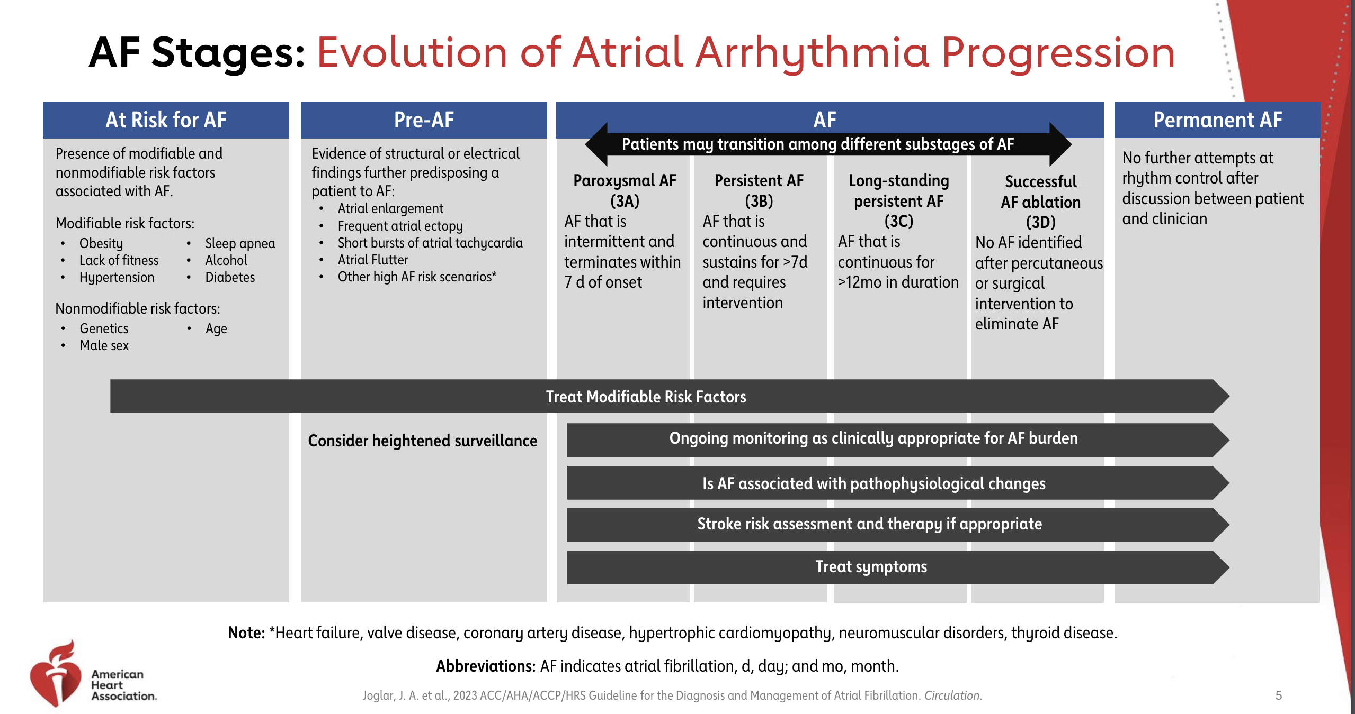

Slide 18
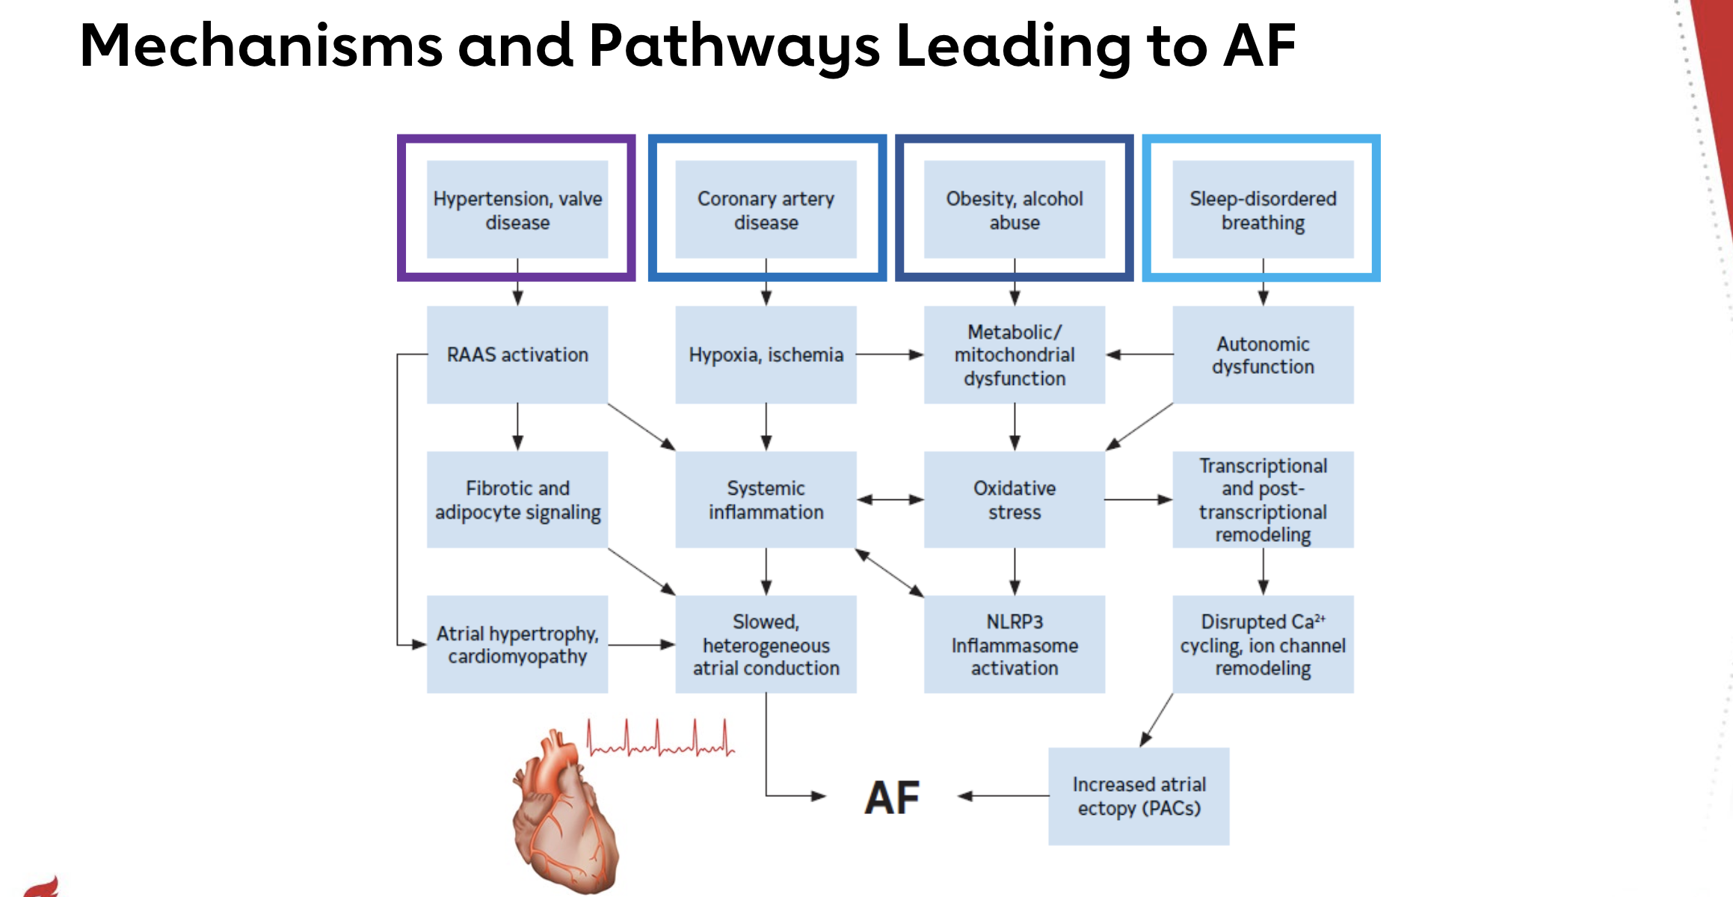

Slide 19
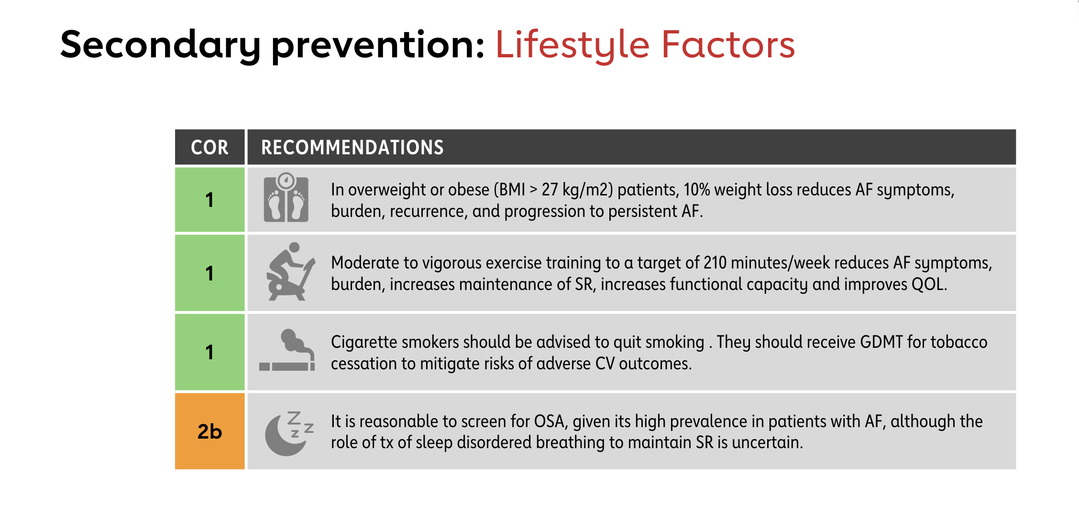

Slide 20
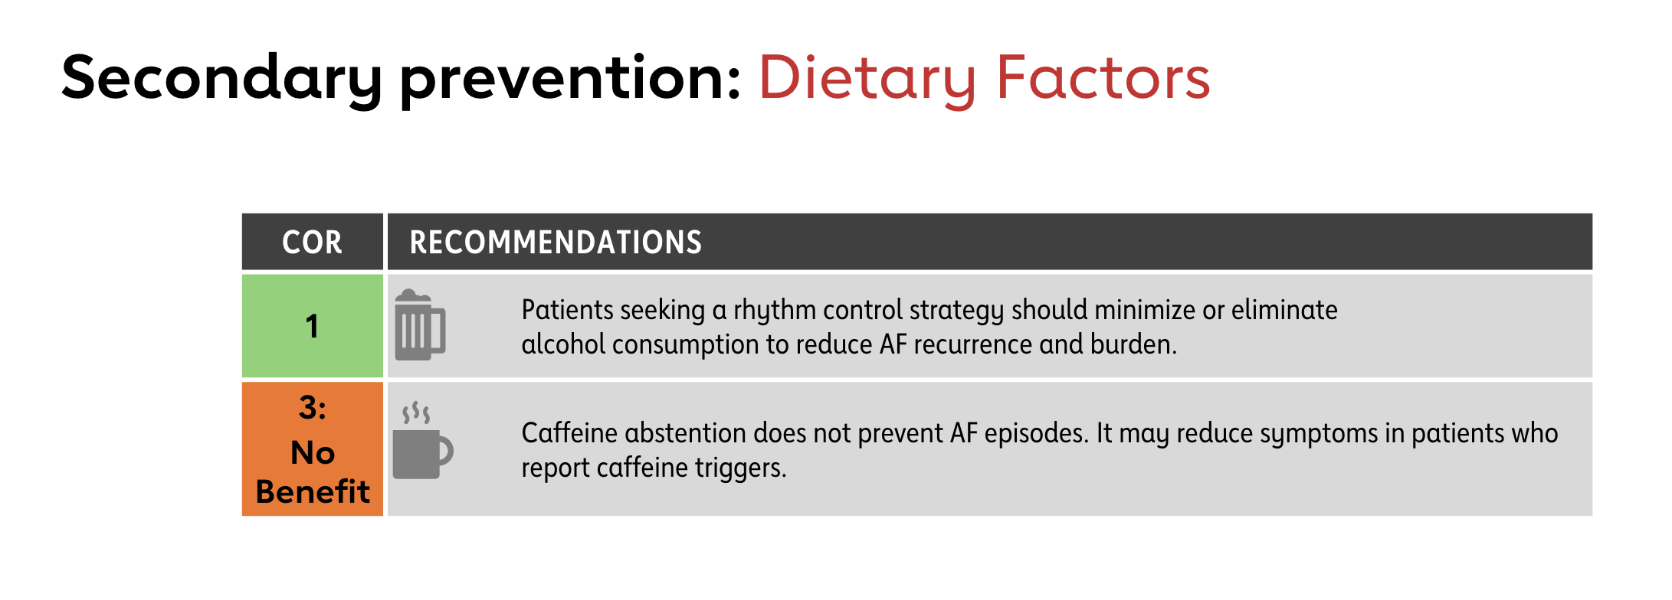

Slide 21
MANAGEMENT OF A FIB
Acute Management
Stroke Prevention
Rate control: For symptoms and to prevent decompensation
Rhythm control: To prevent stroke, dementia, CHF
Prevention

Slide 22
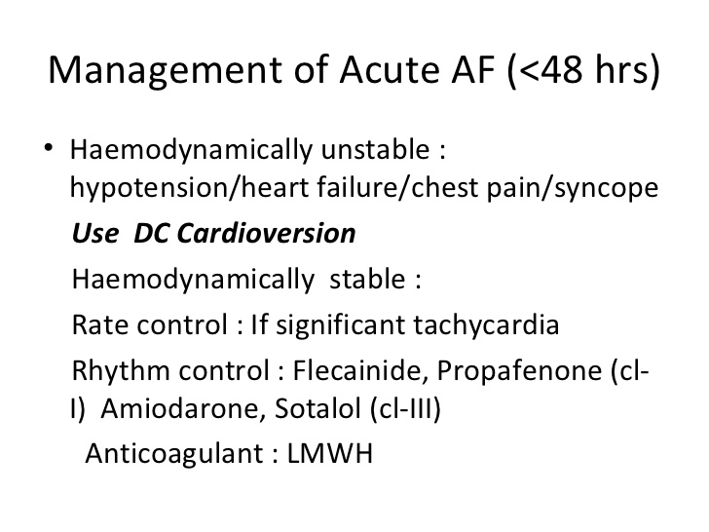
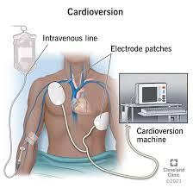

Slide 23
STROKE PREVENTION

Slide 24
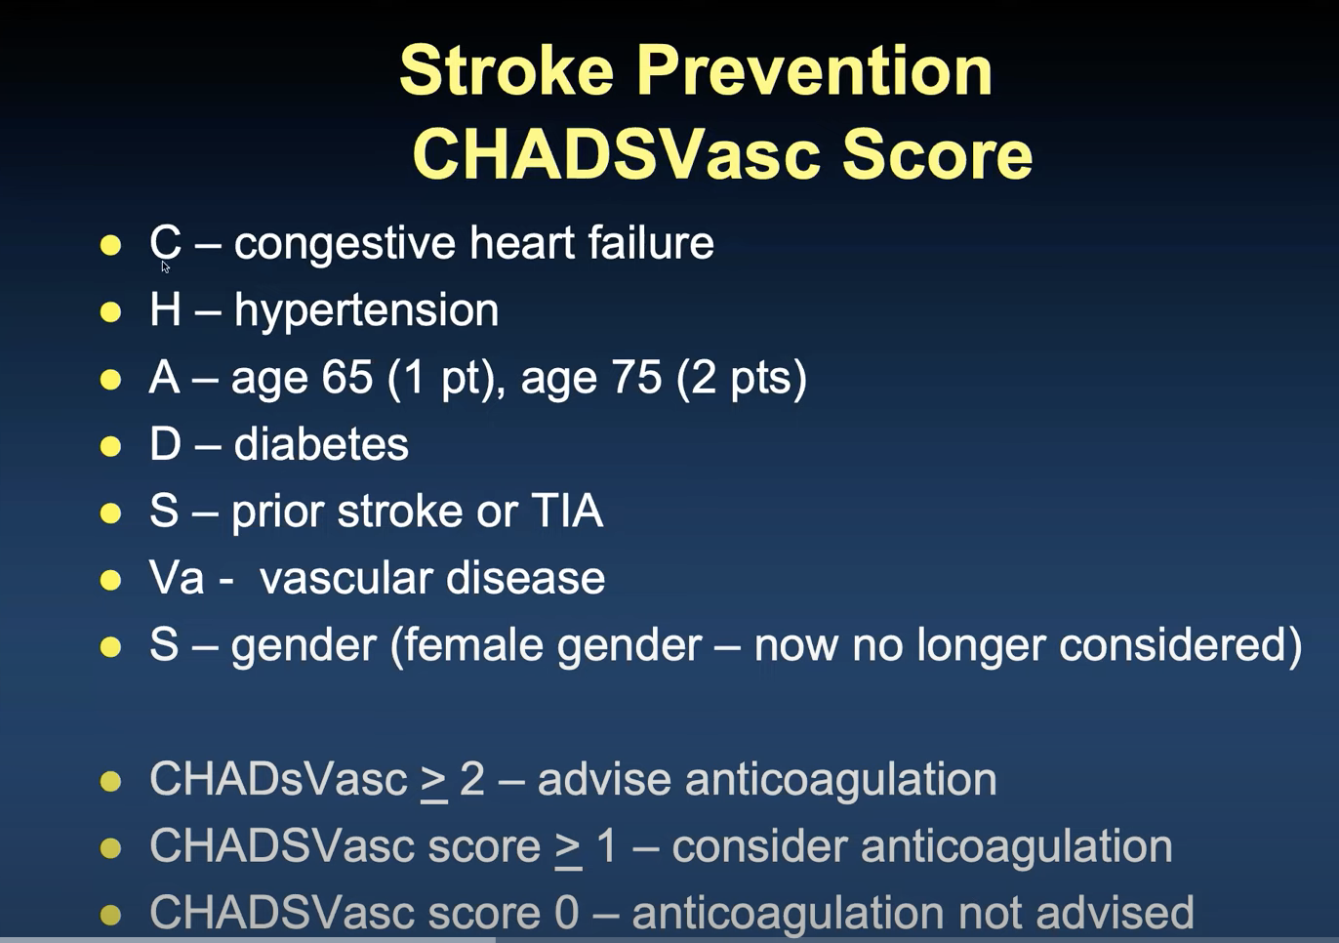

Slide 25
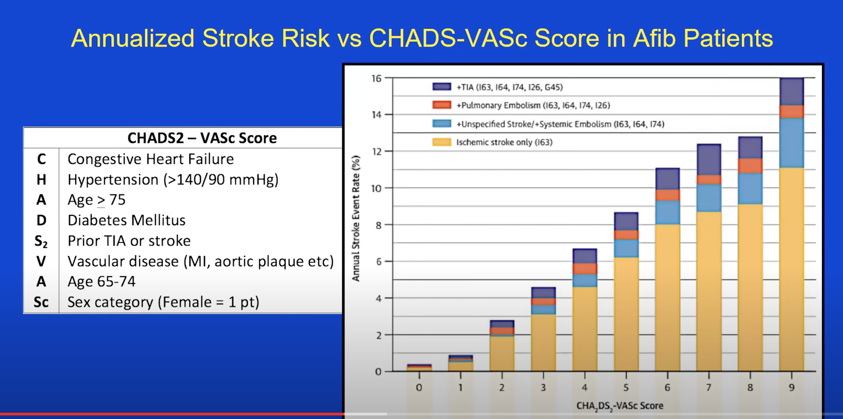

Slide 26
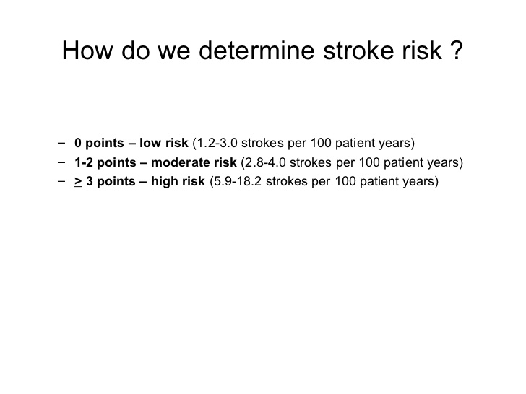

Slide 27

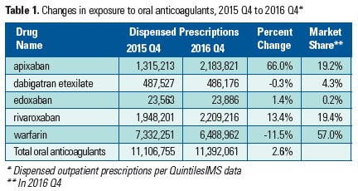
Types of Blood Thinners
z

Slide 28
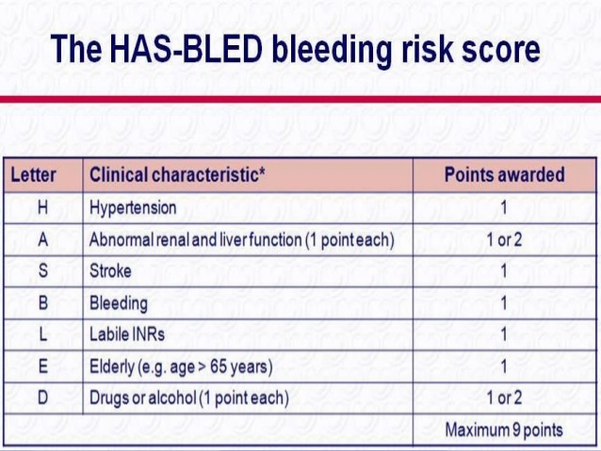

Slide 29
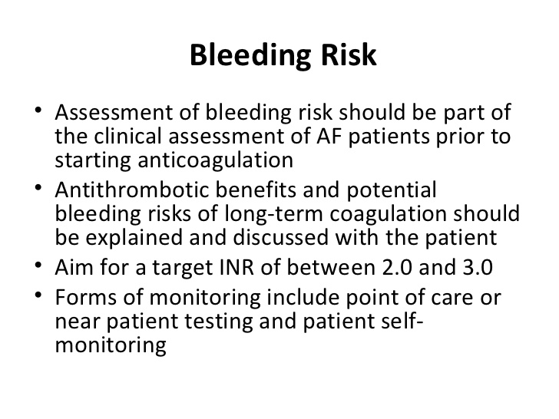

Slide 30
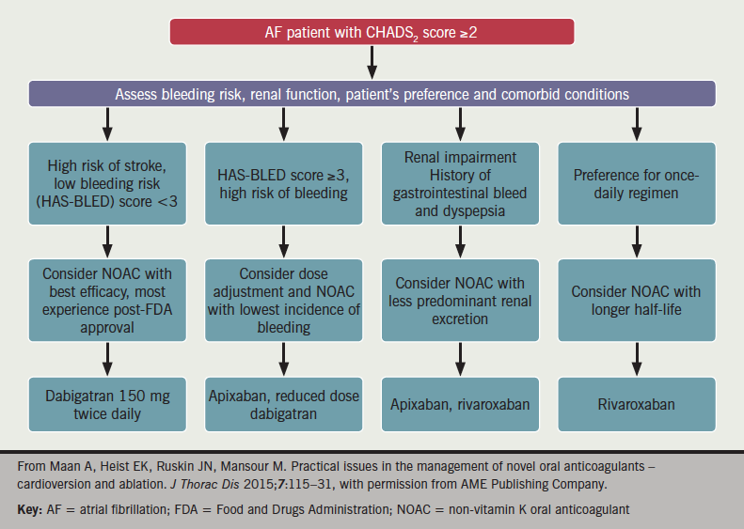
How do we choose blood thinners

Slide 31
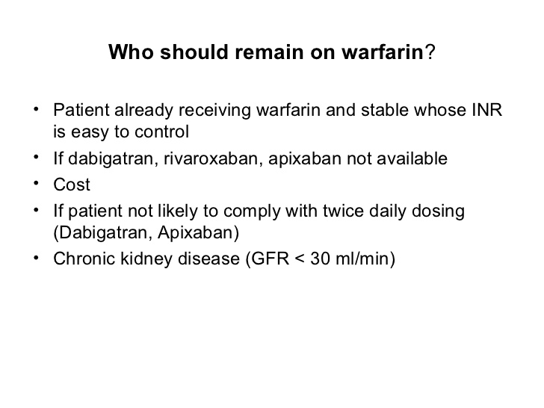

Slide 32
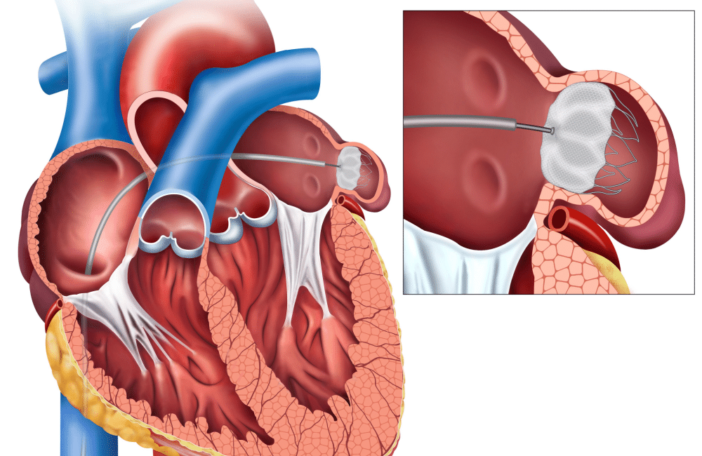
WATCHMAN DEVICE: CLOSURE OF LEFT ATRIAL APPENDAGE

Slide 33
RATE and RHYTHM CONTROL

Slide 34
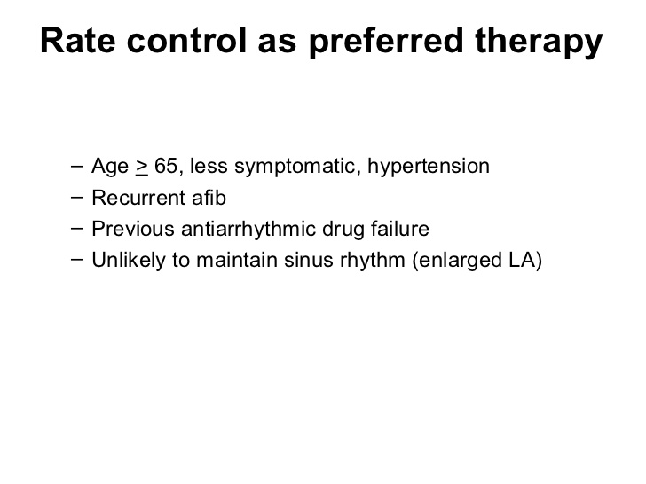

Slide 35
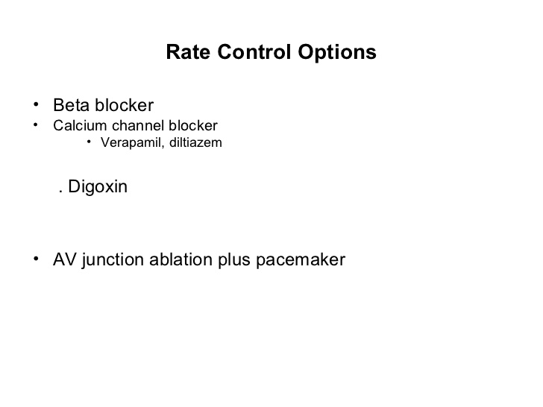

Slide 36
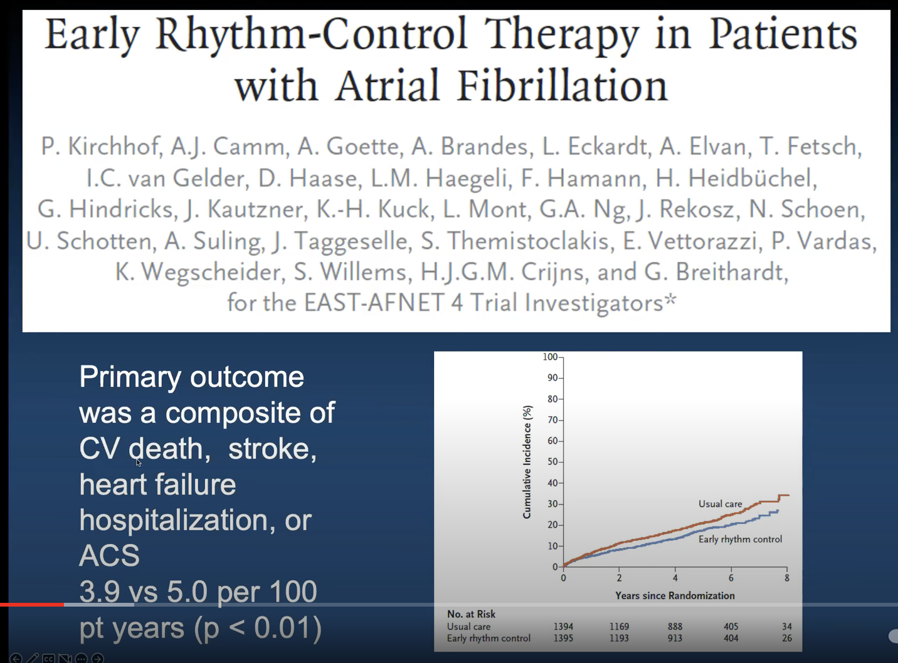

Slide 37
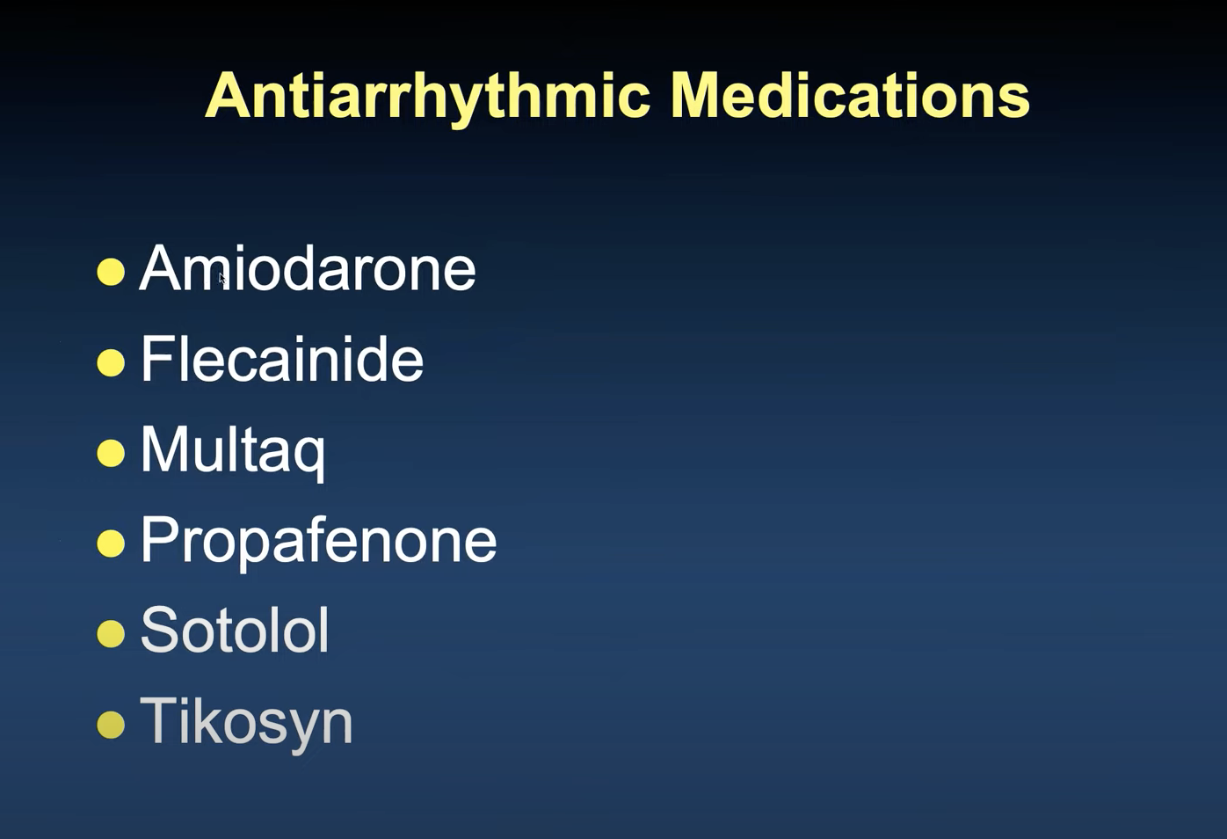

Slide 38
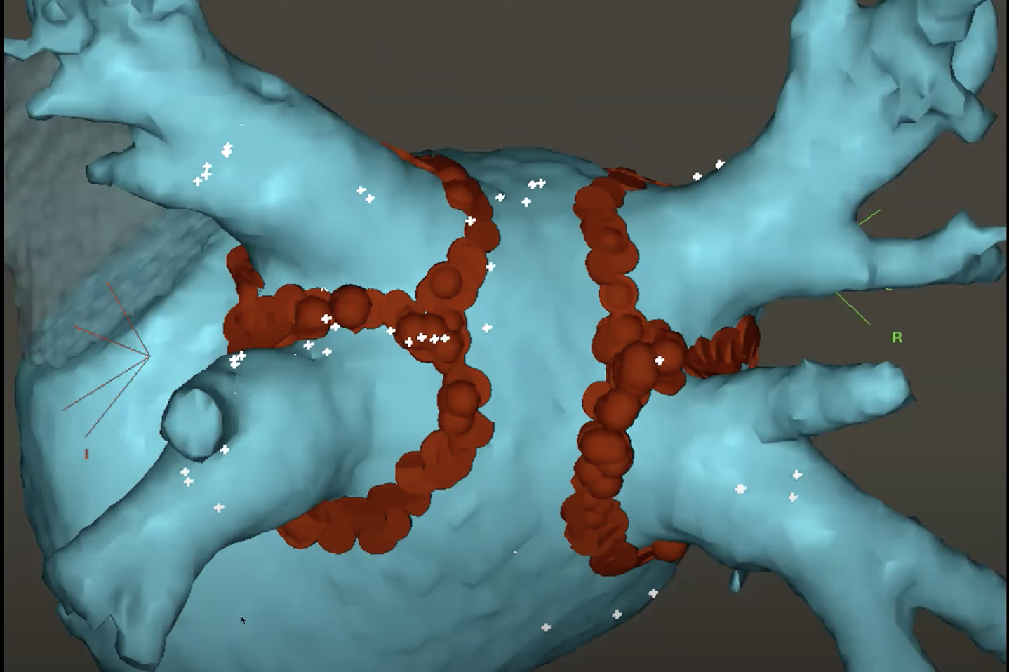

Slide 39
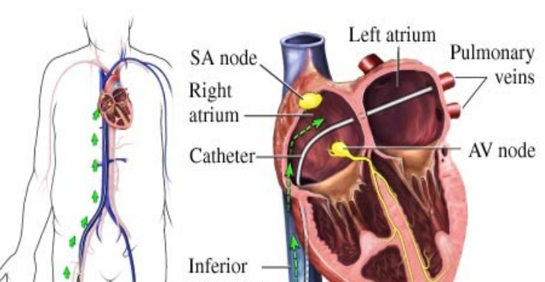
A fib Ablation
z

Slide 40
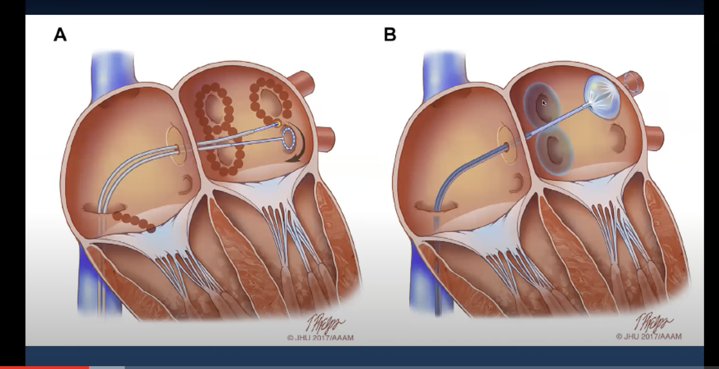
ABLATION

Slide 41
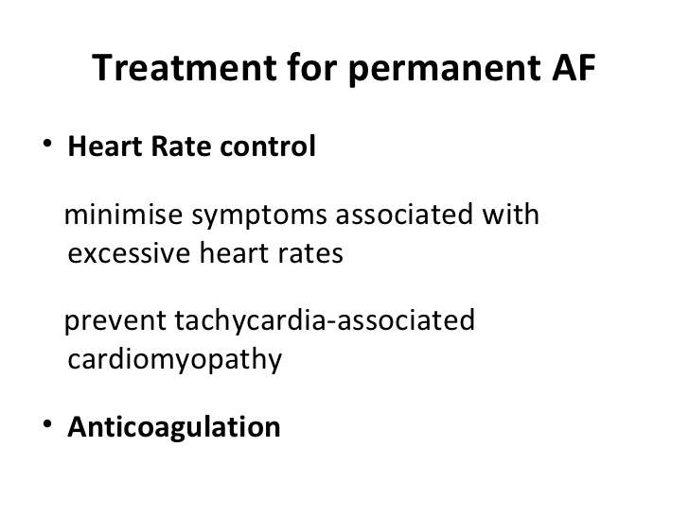

Slide 42
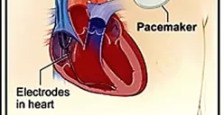
Pacemaker with AV nodal Ablation
z

Slide 43
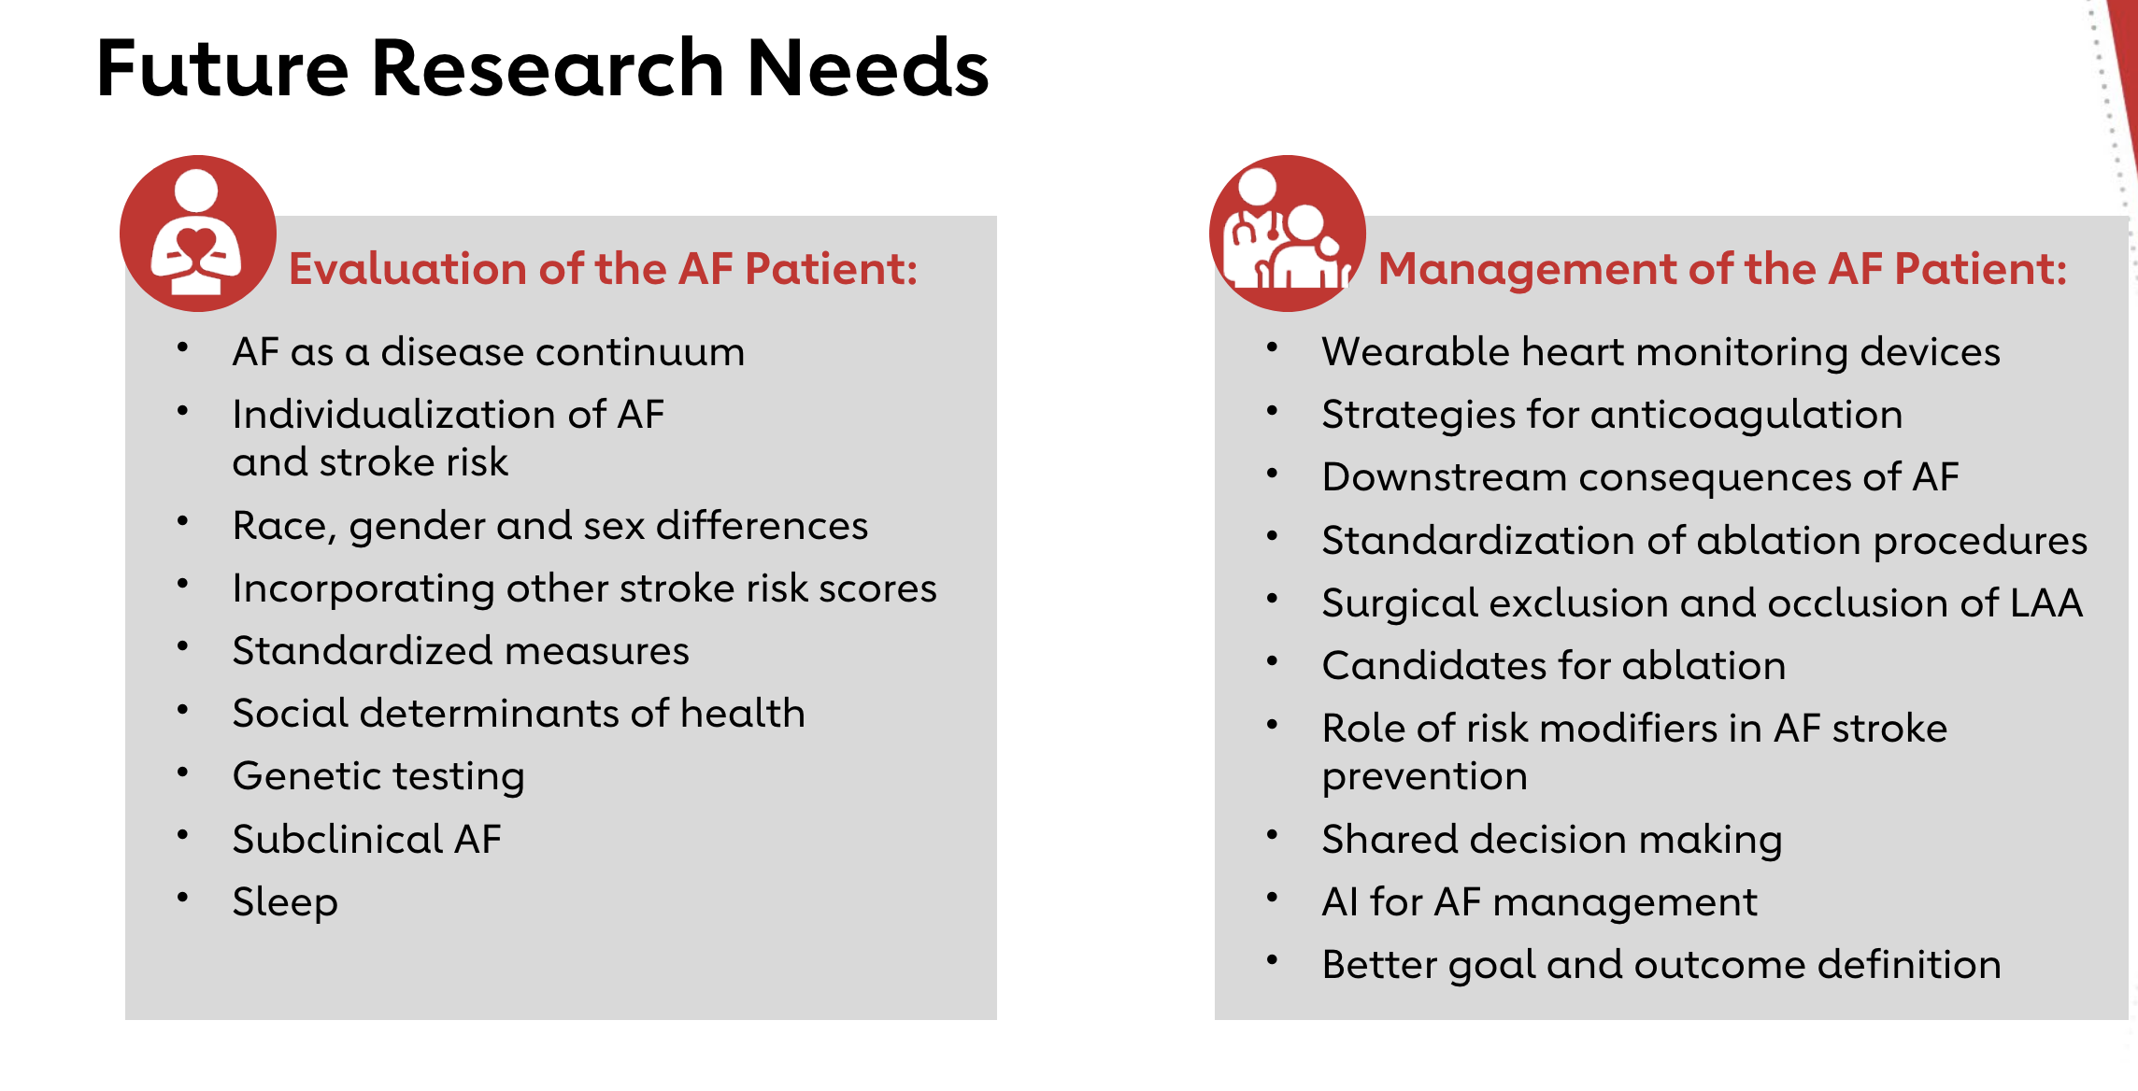

Slide 44
Thank You

