Slide 1
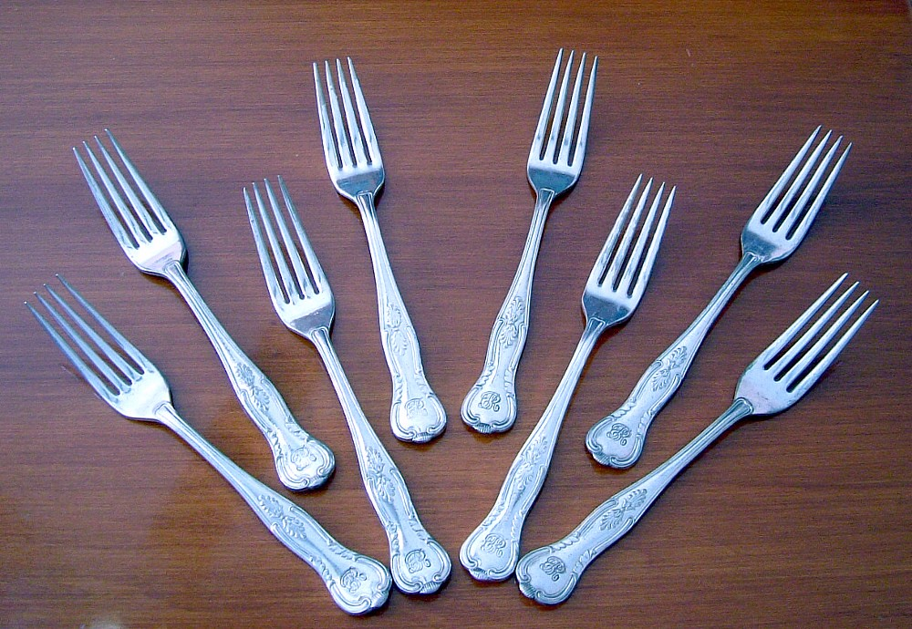
Let’s lower cholesterol with our forks
Debbie Lucus, MS, RD, CDCES
10.06.26
dlucusrd@gmail.com
Notes:
On the next few slides we’ll look at a few common varieties of beans and discuss their shape, size, and flavor.

Slide 2
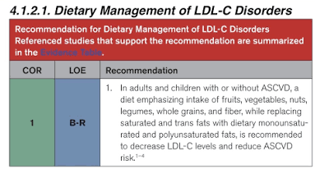

Slide 3
And more info….
Further LDL lowering with vegetarian diet
Especially if it has added:
  Fiber
  Soy protein
  Nuts
Important factor to lower LDL is avoiding saturated fat, trans fat and cholesterol
Reducing refined carbs, sugary drinks and sugar helps triglycerides, weight, glucose

Slide 4
2026 AHA updated guidelines
Start checking for labs as young as 30 yo
The longer LDL stays elevated, the greater the impact
Clear LDL targets are back: under 100 for most, under 70 for higher risk, under 55 for those with existing disease
ApoB is being used more often to better understand risk
Lipoprotein(a) is now recommended to be tested at least once, since it can significantly increase risk
Coronary artery calcium scoring is playing a larger role in guiding treatment decisions
Notes:
Treat dyslipidemia earlier to reduce lifelong risk of prolonged exposure to atherogenic lipoproteins. Health behavior counseling to support lifestyle optimization should start in youth, with early consideration of pharmacotherapy in youth with familial hypercholesterolemia (FH) and in young adulthood in individuals with low-density lipoprotein cholesterol (LDL-C) ≥160 mg/dL or a strong family history of premature atherosclerotic cardiovascular disease (ASCVD).
2.
Use the more contemporary American Heart Association Predicting Risk of cardiovascular disease EVENTs (PREVENT™) equations instead of the older Pooled Cohort Equations (PCE) for 10- and 30-year risk assessment to guide lipid-lowering therapy (LLT) in primary prevention in adults aged 30 to 79 years. Use the “CPR” Model: A) Calculate 10-year ASCVD risk; B) Personalize the estimated risk to the specific patient by considering factors not included in PREVENT-ASCVD equations; and C) possibly Reclassify with selective use of coronary artery calcium (CAC) and Reassess treatment recommendations.
3.
Low-density lipoprotein (LDL)–lowering therapy can be considered in adults for primary prevention of ASCVD with a 10-year PREVENT-ASCVD risk estimate of 3% to <5% (borderline risk) and should be considered for those at 5% to <10% (intermediate risk) 10-year risk after a clinician–patient discussion.
4.
LDL-C and non–high-density lipoprotein cholesterol (HDL-C) treatment goals are back to guide LLT. Percentage reduction in LDL-C remains a priority for all individuals as well, with goal for % reduction depending on the level of ASCVD risk.
5.
Apolipoprotein B (ApoB) testing can be useful to improve risk assessment and guide therapy once LDL-C and non–HDL-C goals are met, particularly in those with elevated triglycerides (TG) (≥150 mg/dL), diabetes, or low achieved LDL-C (<70 mg/dL). ApoB measurement helps identify adults with residual elevated lipoprotein-related risk that may be underestimated by the standard lipid profile alone and may be useful in the diagnosis of specific lipid and lipoprotein disorders.
6.
Lipoprotein(a) [Lp(a)] should be measured at least once to identify those individuals at higher risk of ASCVD. It is considered as a risk-enhancing factor at levels ≥125 nmol/L (50 mg/dL), which is associated with about a 1.4-fold increased ASCVD risk, and values ≥250 nmol/L (100 mg/dL) are associated with ≥2-fold higher estimated risk. The presence of elevated Lp(a) should be an indication for more intensified LDL-C lowering and management of other risk factors.
7.
CAC scoring in men at least 40 years of age and women at least 45 years of age can improve risk assessment and guide LDL-C and non–HDL-C goals. Both the absolute amount of CAC and the corresponding standardized percentile (currently based on age, sex, and race) have prognostic importance and help to reclassify risk in adults.
8.
LDL-lowering therapy is recommended for primary prevention in adults aged 40 to 75 years with diabetes, chronic kidney disease stage 3 or 4, or human immunodeficiency virus, regardless of LDL-C level. After age 75 years, LDL-C–lowering pharmacotherapy can be considered in conjunction with lifestyle interventions to reduce ASCVD risk.
9.
In secondary prevention, a goal of LDL-C <55 mg/dL (1.4 mmol/L) and non–HDL-C <85 mg/dL (2.2 mmol/L) is recommended for those at very high risk of ASCVD events. Although a smaller number of patients with ASCVD not at very high risk have an LDL-C goal of at least <70 mg/dL, the majority of those with a history of ASCVD events will likely qualify for an LDL-C goal of <55 mg/dL.
10.
In patients with persistently elevated TG, statin therapy remains the foundation of pharmacotherapy as an adjunct to lifestyle intervention to reduce ASCVD risk. Treatment for prevention of pancreatitis may also include TG-lowering therapies, especially in individuals with TG levels ≥1000 mg/dL (11.3 mmol/L).

Slide 5
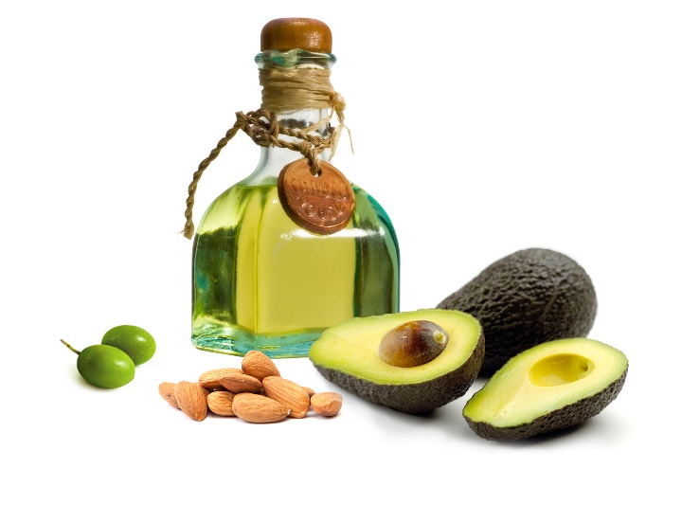
Sources of dietary fats
Animal sources: meat, cheese, dairy
Plant sources: vegetable oils, nuts, avocados, seeds
“Hidden” dietary fat: French fries, pizza, pasta dishes, baked goods, salad dressings

Slide 6
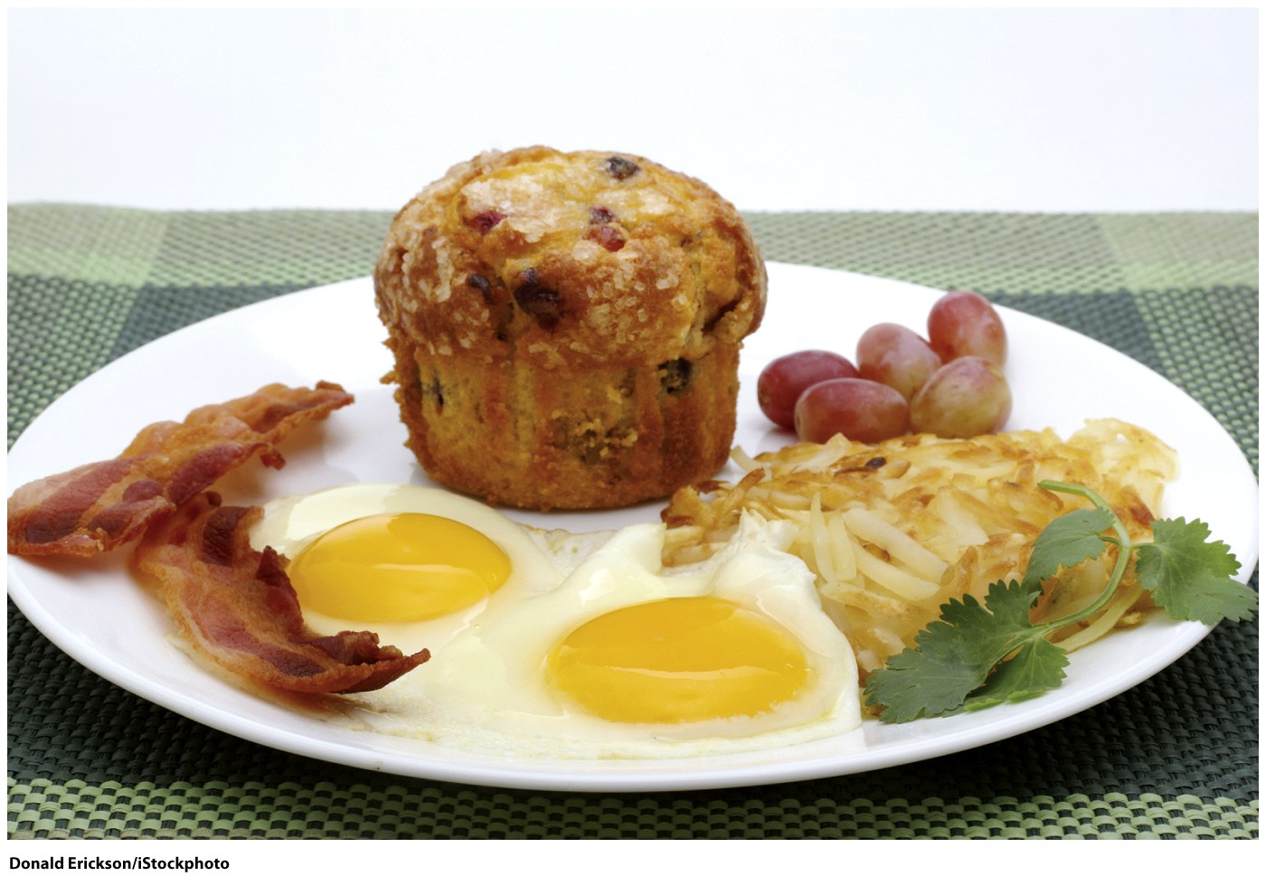
Visible and hidden fats
Which food on this plate has the most fat?
Bacon?
Eggs?
Hashed Browns?
Muffin?
Bacon = 7 g
Eggs = 14 g
Hashed Browns = 15 g
Muffin = 32 g (600 kcal)

Slide 7
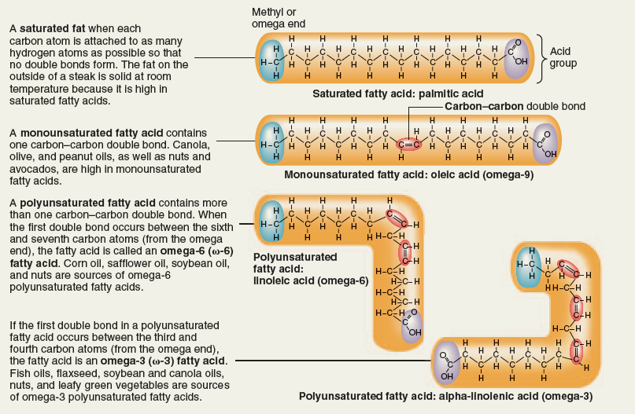
Triglycerides and fatty acids

Slide 9
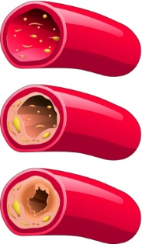
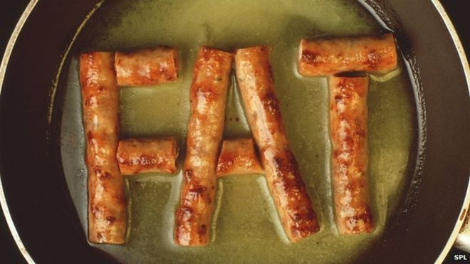
Saturated Fats
  Solid at room temperature (lard, butter)
  Mostly in animal foods: meat, dairy
  Tropical oils (coconut, palm kernel)
  Long-chain saturated fats:
    Increase LDL
    Associated with heart disease

Slide 10
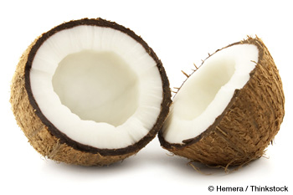
Saturated Fats - Coconut
Medium-chain saturated fats:
  May not have all negative effects
    Shorter chain
    Quickly digested and absorbed into the blood stream
    Bypass peripheral fat tissue
    Less likely to be stored as fat
    This doesn’t make it a health food

Slide 11
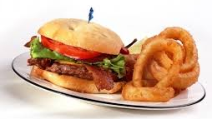
Common sources of Saturated Fat
Butter
Ground meat / sausage / fried meat / steaks
High-fat milk, cheese, yogurt, cottage cheese
Egg yolks
Fried foods
Sour cream
Chips / Crackers
Pizza
Ice cream / Desserts / Candy

Slide 12
How to reduce saturated fats
Switch to plant-based milks (or use non-fat dairy)
Limit animal foods – substitute beans/lentils, meat alternatives, nuts, soy
Don’t add fat to recipes
Swap eggs with plant foods: scrambled tofu, flax in place of eggs in recipes
If having fat – choose whole foods that have healthy fat

Slide 13
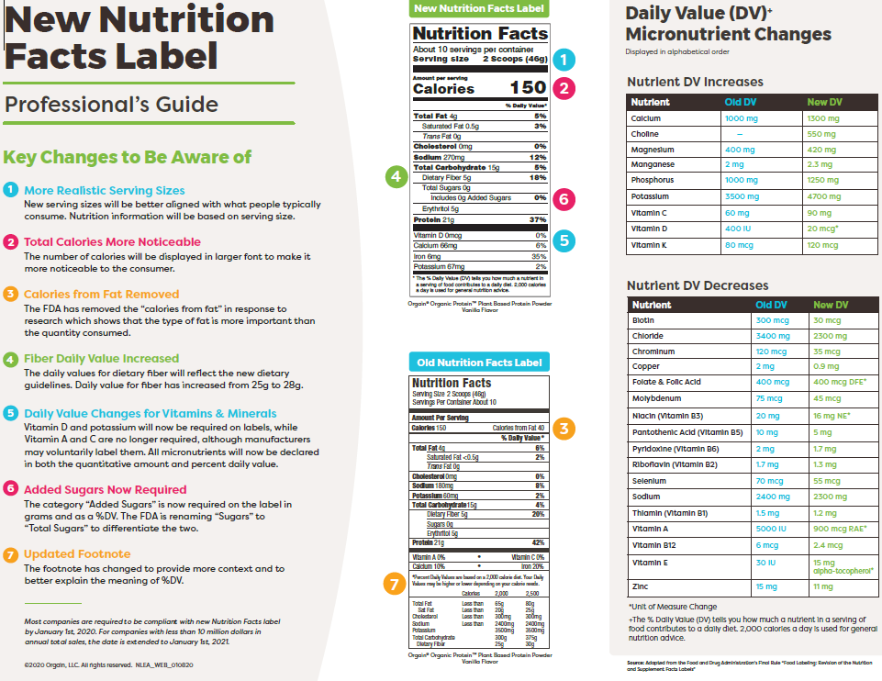

Slide 14
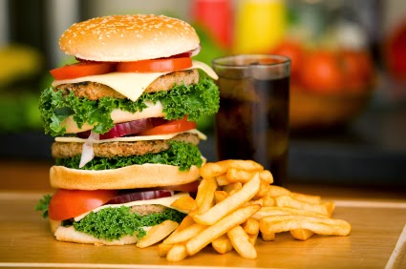
Dietary Cholesterol
The less you eat the better
Get rid of:
  Meat
  Dairy
  Eggs
Only found in animal products

Slide 15
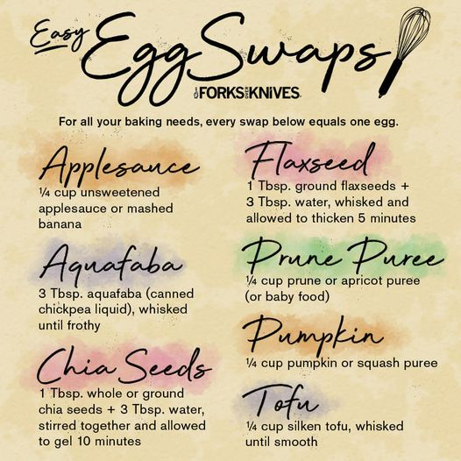
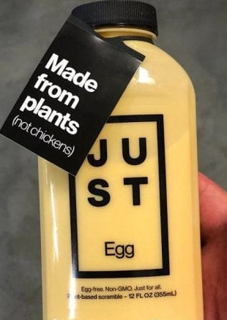
Easy Egg Swaps
Each item swaps for one egg when baking
Applesauce -- ¼ cup unsweetened applesauce or mashed banana
Aquafaba – 3 Tbsp canned chickpea liquid, whisked until frothy
Chia Seeds – 1 Tbsp whole or ground chia seeds + 3 Tbsp water, stirred together and allowed to gel ~10 minutes
Flaxseed – 1 tbsp ground flaxseed + 3 tbsp water, whisked and allowed to thicken, ~ 5 minutes
Prune Puree – ¼ cup prune or apricot puree
(could be baby food)
Pumpkin – ¼ cup pumpkin or squash puree
Tofu – ¼ cup silkin tofu, whisked until smooth

Slide 16
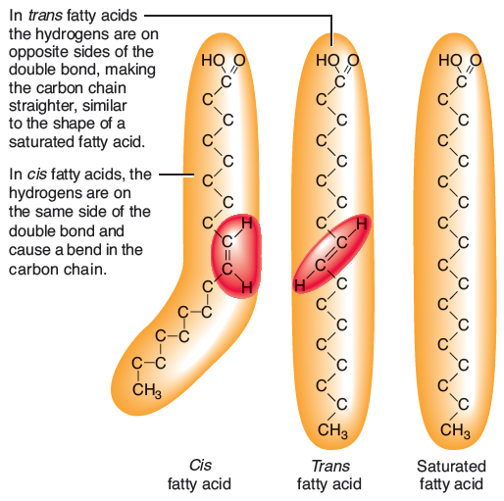
Trans fatty acids
a. The orientation of hydrogen atoms around the double bond distinguishes cis fatty acids from trans fatty acids. Most unsaturated fatty acids found in nature have double bonds in the cis configuration.

Slide 17

Trans Fats
Sources:
  Processed baked products
    Crackers, cookies, pastries, doughnuts, cupcakes, pie crusts, cake frosting, baking mixes, biscuits and dough
  Hard margarines, shortening
  Fried foods
    French fries, Fried chicken,
  Check ingredient lists for hydrogenated or partially hydrogenated oil - put it back!
Notes:
17
--impact lipid profile negatively. Hydrogenation is a process of heating and compressing an oil to make it more saturated.
-portion sizes of the foods that will contain trans fatty acids (or any fats for that matter) should be small anyway! So intake will be low.
Unsaturated oils that have become hardened to make it more stable, saturated, and solid at room temperature.
Partially hydrogenated means the oils are only partly hardened.
Manufacturers use hydrogenated fat to extend shelf life.
Contain high levels of trans fatty acids, which are linked to heart disease.
Can be found naturally in animal fats, such as dairy products and some meats
Raise blood cholesterol similarly to saturated fat
Can raise LDL and lower HDL levels
Not included in the less than 7 percent of calories you can have from saturated fat
Bring an example food label to next class

Slide 18
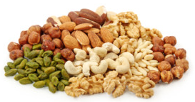
Unsaturated Fat
Nuts and Seeds
Very healthy
Eat 1 serving daily
1 serving = 2-4 Tablespoons
Good source of plant stanols and sterols
Caution: high in calories!
Notes:
18
--impact lipid profile negatively. Hydrogenation is a process of heating and compressing an oil to make it more saturated.
-portion sizes of the foods that will contain trans fatty acids (or any fats for that matter) should be small anyway! So intake will be low.

Slide 19
Unsaturated Fat
Polyunsaturated
  Safflower oil
  Sunflower oil
  Corn oil
  Soybean oil
  Nuts
  Seeds
Monounsaturated
  Olive oil
  Peanut oil
  Canola oil
  Nuts
  Seeds
  Avocados
Notes:
19
--impact lipid profile negatively. Hydrogenation is a process of heating and compressing an oil to make it more saturated.
-portion sizes of the foods that will contain trans fatty acids (or any fats for that matter) should be small anyway! So intake will be low.

Slide 20
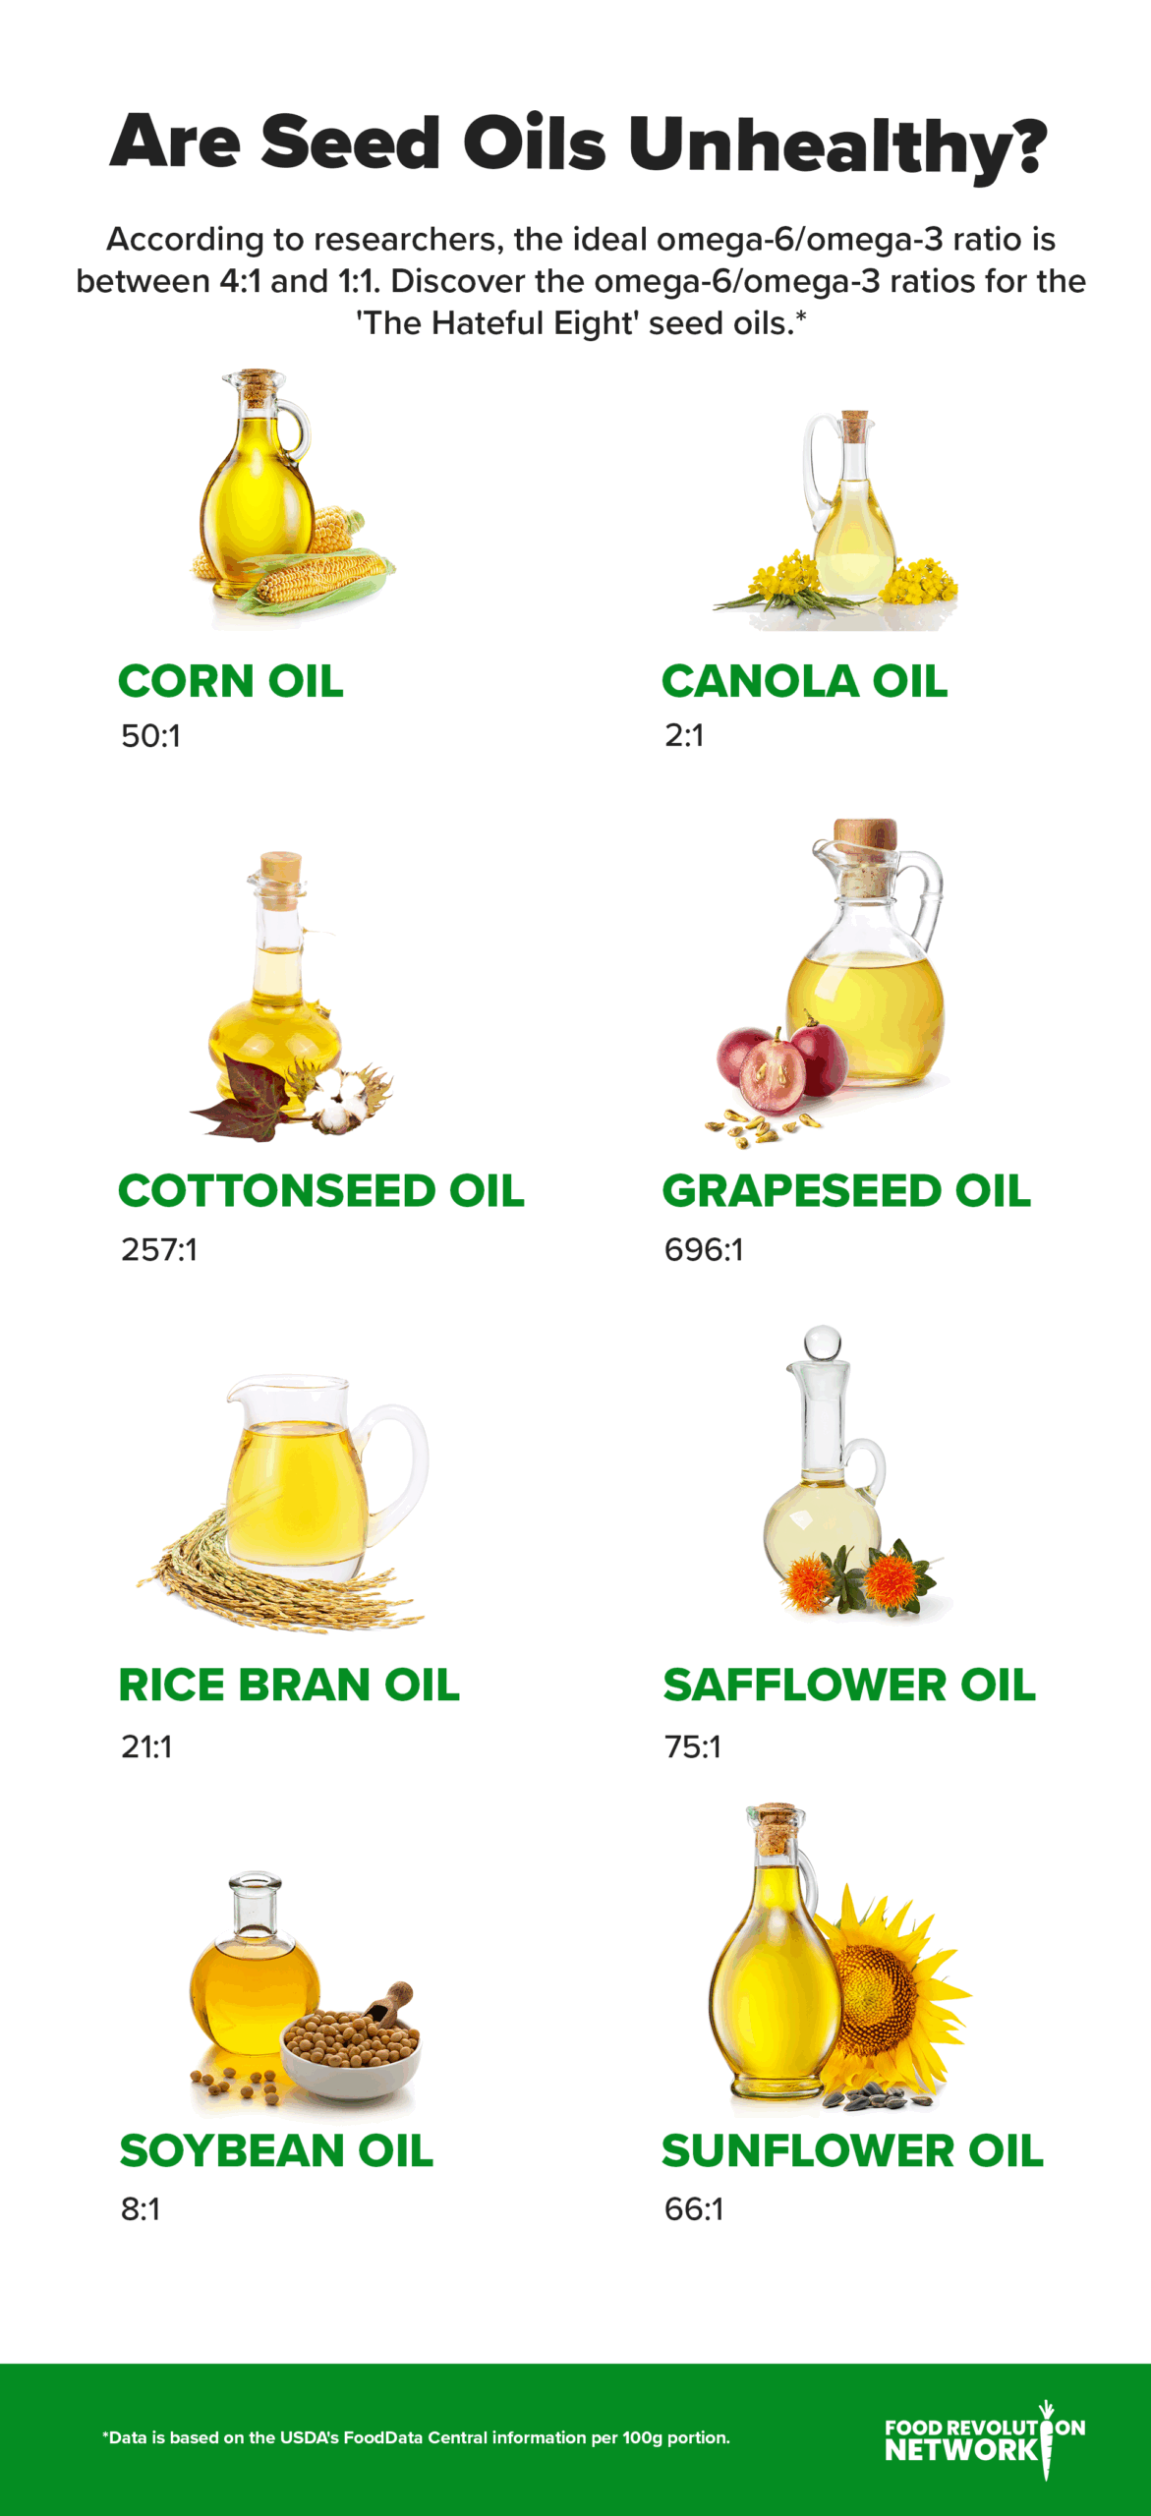
Omega 6 to Omega 3 ratio
  Soy & Canola are okay
  Most in ultraprocessed foods
  Hempseed oil = 3:1
  Flaxseed oil = 1:5
Chemicals in processing
  True
  Small batches & cold pressed don’t have this issue
Linked to CVD
  No – especially if compared to saturated and trans fats
  Replace animal fats with these and lowers risks

Slide 21
Omega-3 Fatty Acids
May help prevent heart disease
Reduce triglyceride levels
Help brain health
Rec: 250 mg/day yeast or algae-derived EPA/DHA
Fish sources
  Salmon
  Lake trout
  Mackerel
  Tuna
  Sardines
Plant sources
  Walnuts
  Canola oil
  Ground Flaxseed
  Flaxseed oil
  Chia & hemp seeds
Notes:
21
May help prevent blood clots from forming and inflammation from affecting artery walls
Give handout for sources and amount of omega-3 fatty acids.

Slide 22
Omega-3 seeds
Flax:
  Reduce inflammation, high blood pressure, blood sugars, improve survival of breast and prostate cancer
Chia:
  Good source of protein, fiber, magnesium, iron
  Powerful antioxidant
Hemp:
  Protein, fiber, nutrients
  Anti-inflammatory

Slide 23
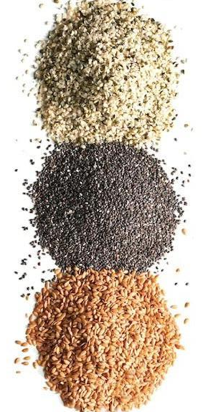
What to do with Flax/Hemp/Chia?
Put on oatmeal
Shake onto salads
Add to smoothies
Use as a binder in recipes
Make crackers
Add to breakfast bites
Sprinkle on soups or grain dishes
Use as thickener

Slide 24
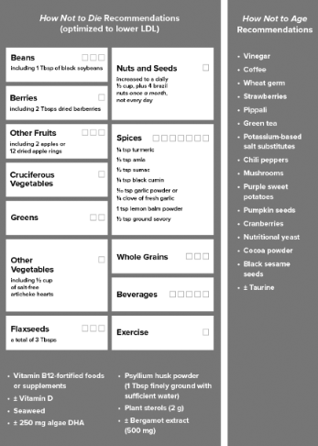
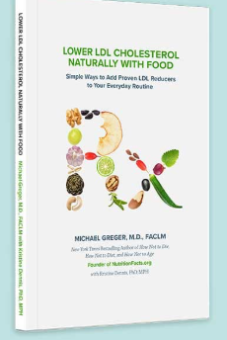
Foods to lower cholesterol

Slide 25
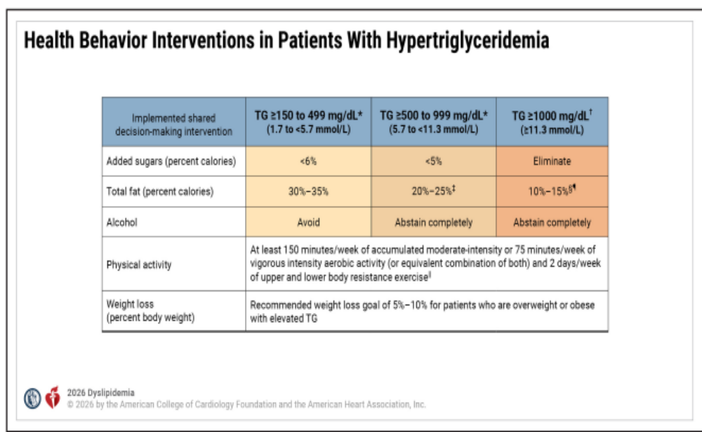
Health Behavior Interventions in patients with hypertriglyceridemia

Slide 26
How can you lower saturated & trans fats?
Less or no meat
No or non-fat dairy
Limit high fat condiments - ie. secret sauce, mayo
Bake, broil, grill instead of fry
Cut added fats in recipes
Swap high fat toppings for low fat or plant sources(sour cream, cream cheese, butter/margarine)
Limit ultraprocessed foods
Other ideas?

Slide 27
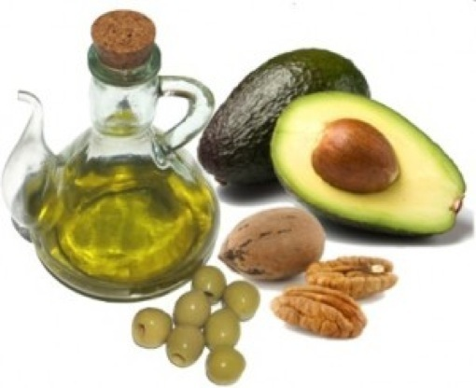
Bottom line
Choose healthy fats
Limit saturated and trans fats
  Animal foods
  Processed foods
  Fast foods
Avoid refined sugars and carbs, sugary drinks
Add cholesterol-lowering foods

Slide 28
What will you do?
What do you eat right now that you could eat less of or substitute with a healthier choice?
How will you use healthy fats?
  Sprinkle nuts and seeds on cereal, salads, bowls?
  Cashew cream instead of cream to thicken soup?
What sugary foods could you change
What foods can you add to lower LDL?
Make a goal today of one change to your intake ☺

Slide 29
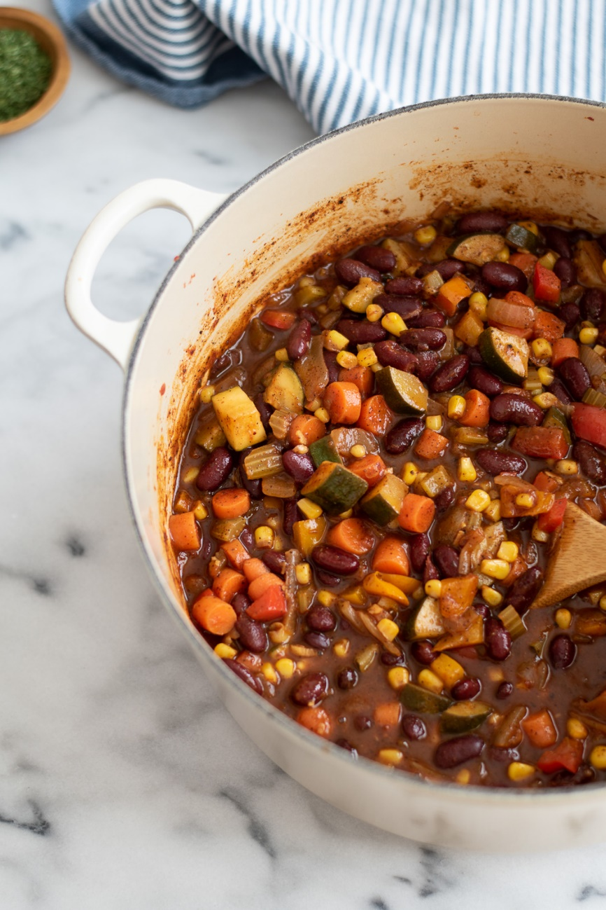
Our dish today: No Chop Chili
Plant-based meat of your choice
2 cans beans of choice, rinsed and drained
1 can no salt added corn kernels (or frozen)
1 can low sodium diced tomatoes
1 small can green chiles
1 cup salsa
2 cups water
2 Tablespoons Chili powder
1 Tablespoon Cumin
1 tsp. oregano
Other seasonings that you like

Slide 30


Slide 31

Thank you!

