Slide 1
Ageing and Heart Disease
Radhika Nandur Bukkapatnam MD MAS
7/25/24

Slide 2
Definition
The World Health Organization (WHO) developed a definition of healthy ageing. It is the process of developing and maintaining the functional ability that enables wellbeing in older age.
Functional ability:
To meet their basic needs
To learn, grow and make decisions
Mobility
Social interaction and contribution to society
Frailty is theoretically defined as a clinically recognizable state of increased vulnerability resulting from aging-associated decline in reserve and function:
low energy, slowed waking speed, low physical activity, and/or unintentional weight loss

Slide 3
Ageing
No one knows how and why people change as they get older
Some theories claim that aging is caused by injuries from ultraviolet light over time, wear and tear on the body, or byproducts of metabolism.
Genetics
Aging is a complex process that varies as to how it affects different people and even different organs.
Interaction of many lifelong influences, including heredity, environment, culture, diet, exercise and leisure, past illnesses, and many other factors.

Slide 4
Decade of Healthy Ageing
The UN declared 2021–30 as the Decade of Healthy Ageing with an aim to improve the health and wellbeing of older people
WHO's work on the UN Decade of Healthy Ageing (2021–2030)
Abuse of older people.
Assistive technology.
Dementia.
Disability.
Falls.
Older people and COVID-19.
Palliative care.
Physical activity.

Slide 5
Ten Determinants for Healthy Ageing
Physical activity
Diet
Self-awareness
Outlook/attitude
Life-long learning
Faith
Social support
Financial security
Community engagement, and
Independence.

Slide 6
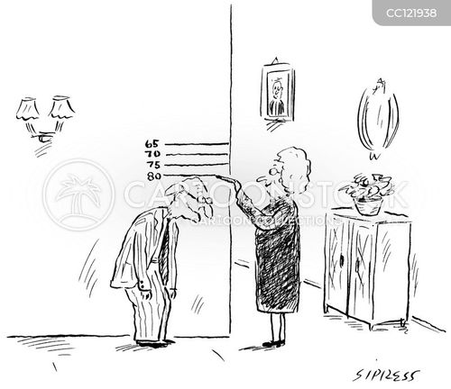

Slide 7
Unlike the changes of adolescence, which are predictable to within a few years, each person ages at a unique rate. Some systems begin aging as early as age 30. Other aging processes are not common until much later in life.
Although some changes always occur with aging, they occur at different rates and to different extents. There is no way to predict exactly how you will age

Slide 8
Genetic components of aging, disease and lifestyle, which presently remain largely unknown, likely complicate the picture further.
During the past two decades, a sustained effort has been applied to characterize effects of aging on health in multiple aspects of cardiovascular structure and function in a single study population, the Baltimore Longitudinal Study on Aging (BLSA).

Slide 9
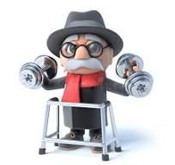
Organs affected by Ageing
Nervous system
Senses: Eyes, ears, taste
Musculoskeletal
Lungs
Heart

Slide 10
Effects of Ageing on the Nervous System
As you age, your brain and nervous system go through natural changes.
Lose nerve cells and weight (atrophy).
Nerve cells may begin to pass messages more slowly than in the past.
Waste products or other chemicals such as beta amyloid can collect in the brain tissue as nerve cells break down. This can cause abnormal changes in the brain called plaques and tangles to form. A fatty brown pigment (Lipofuscin) can also build up in nerve tissue.
Breakdown of nerves can affect your senses ( Hearing, sight, smell, taste).
You might have reduced or lost reflexes or sensation.
This leads to problems with movement and safety and makes it more likely to suffer falls.

Slide 11
Mind
Slowing of thought, memory, and thinking is a normal part of aging. These changes are not the same in everyone. Some people have many changes in their nerves and brain tissue. Others have few changes. These changes are not always related to the effects on your ability to think.
Sleep disorders
Loneliness and Depression
Medications

Slide 12
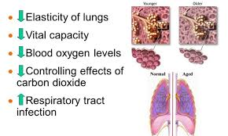
Lungs

Slide 13
Skeletal Muscle Ageing
A substantial loss of muscle mass and strength (sarcopenia)
Decreased regenerative capacity
Compromised physical performance
Healthy lifestyle and regular exercise delay muscle ageing

Slide 14
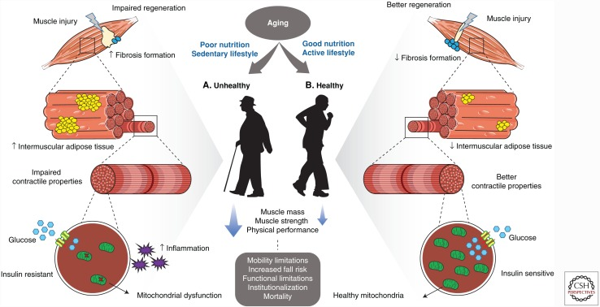

Slide 15
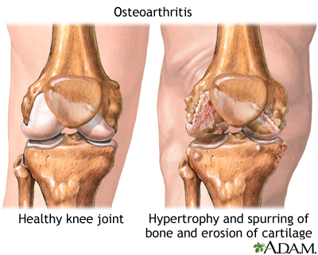
Ageing and Joint Health
People lose bone mass or density as they age, especially women after menopause. The bones lose calcium and other minerals.
Spinal discs lose fluid, so curved and brittle
The joints become stiffer and less flexible. Fluid in the joints may decrease.
The cartilage may begin to rub together and wear away. Minerals may deposit in and around some joints (calcification).

Slide 16
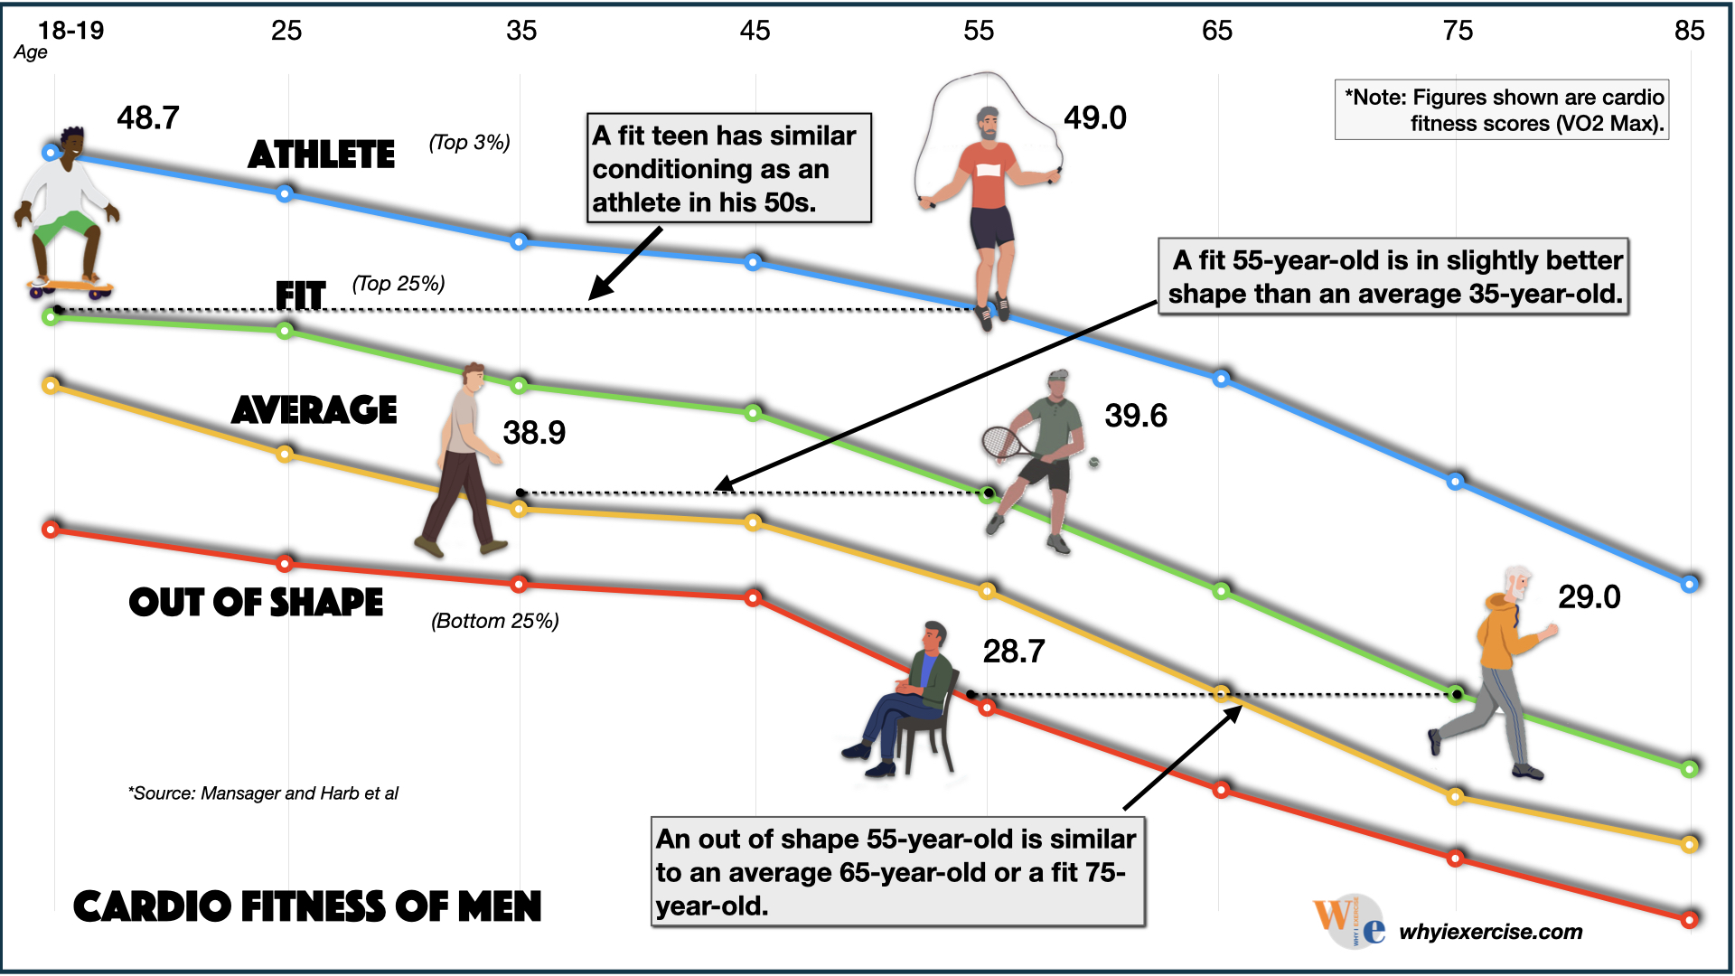

Slide 17
Chronological Age and Changes in the Heart
Chronological age is identified as the major risk factor for cardiovascular morbidity and mortality
The cardiovascular system undergoes structural and functional changes with age that compromise cardiac reserve.
These age-associated cardiovascular changes lower the threshold for the three major cardiac pathophysiological conditions such as Left ventricular hypertrophy, chronic heart failure and atrial fibrillation, all seen with increasing age
The prevalence of CVD has also been shown to increase with age, in both men and women, including the prevalence of atherosclerosis, stroke and myocardial infarction. The American Heart Association (AHA) reports that the incidence of CVD in US men and women is ~40% from 40–59 years, ~75% from 60–79 years, and ~86% in those above the age of 80

Slide 18
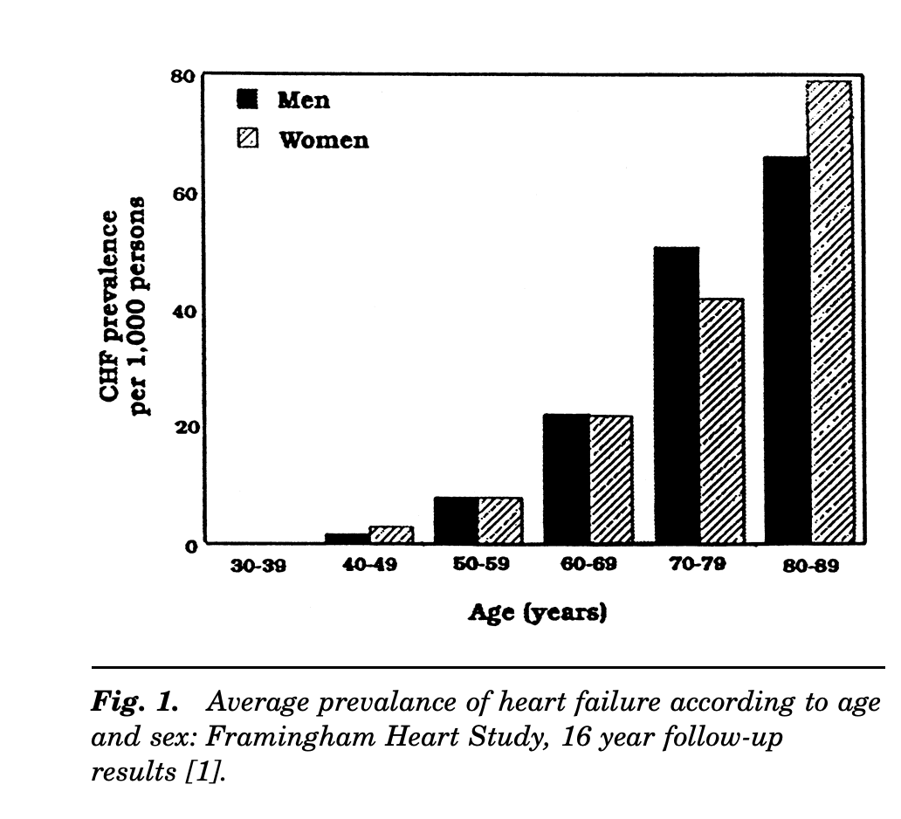

Slide 19
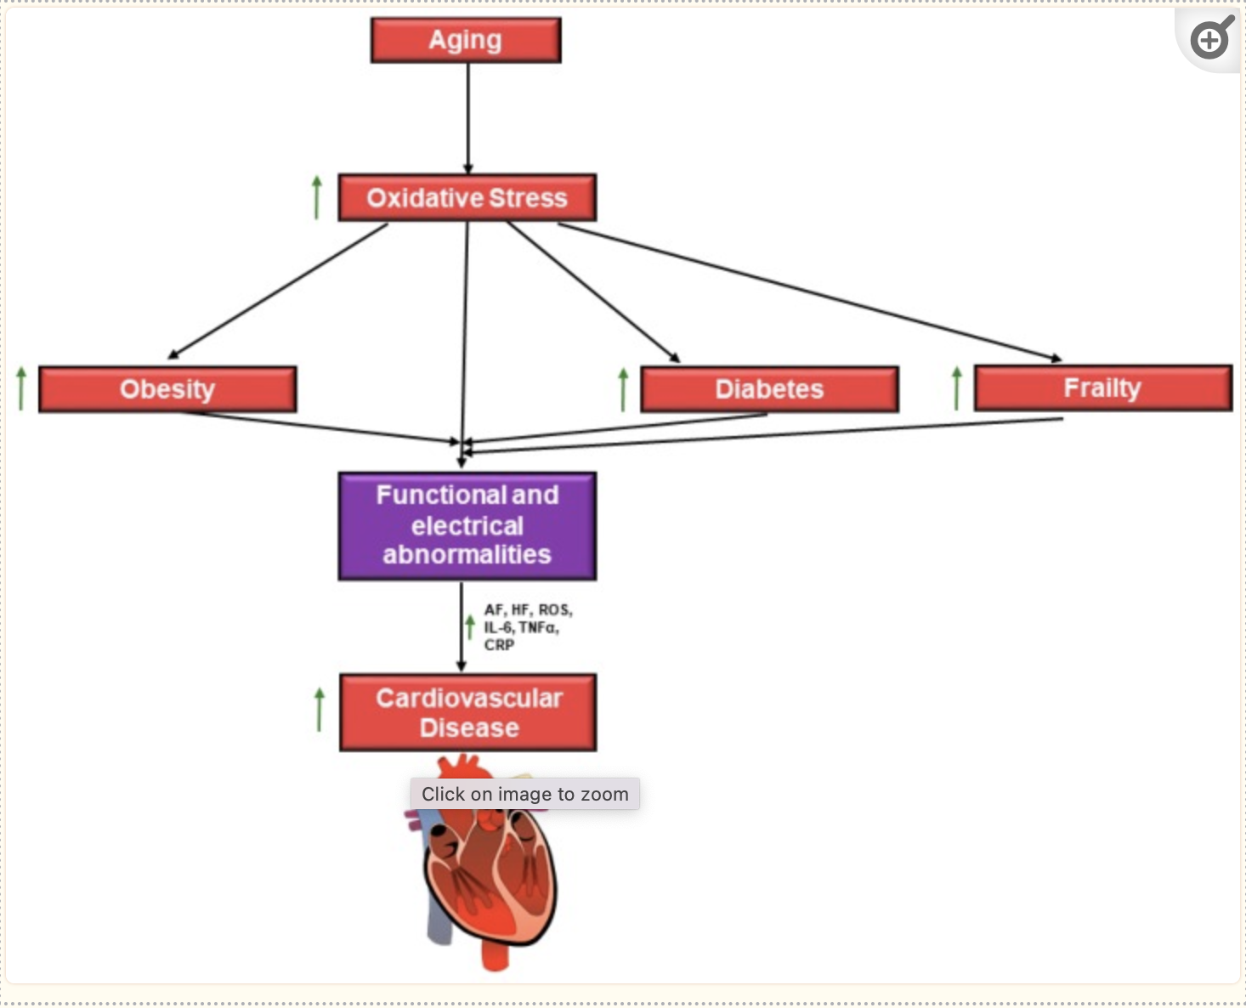

Slide 20
The LV wall thickness increases with age and this is due largely to an increase in the size of cardiac myocytes accompanied by focal increase in collagen.
Decrease in the efficacy of b-adrenergic modulation of both the heart and vasculature occurs with aging
Reduction in the heart rate at rest in the sitting position, during routine activities of daily living and during exertion.
The left atrial size also increases with aging in otherwise healthy persons

Slide 21
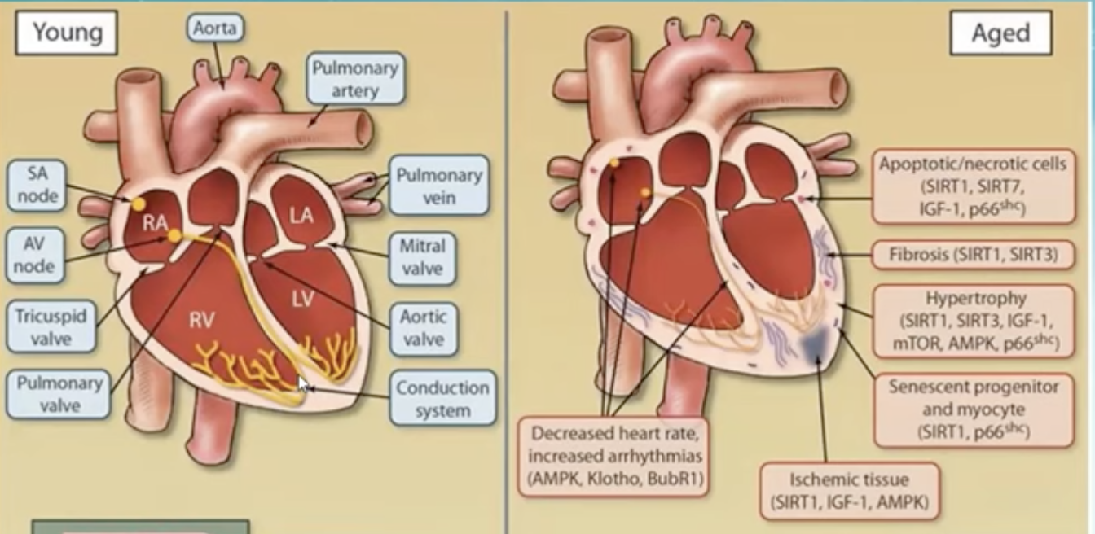

Slide 22
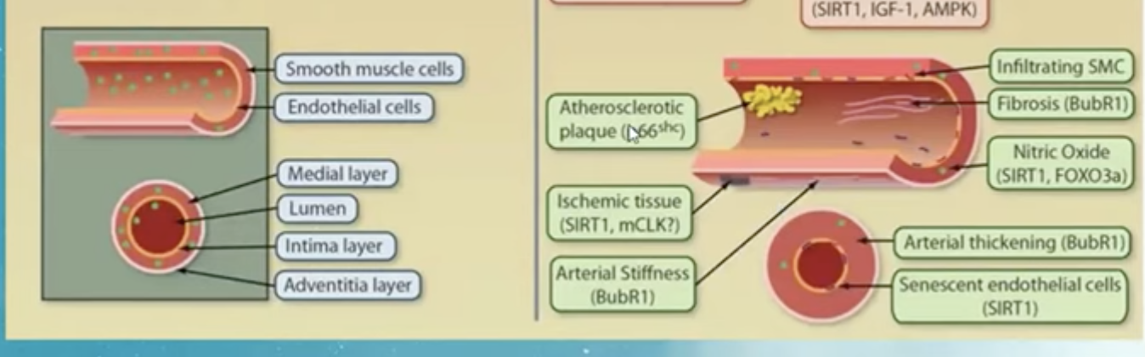
Changes in the Vessel Wall

Slide 23
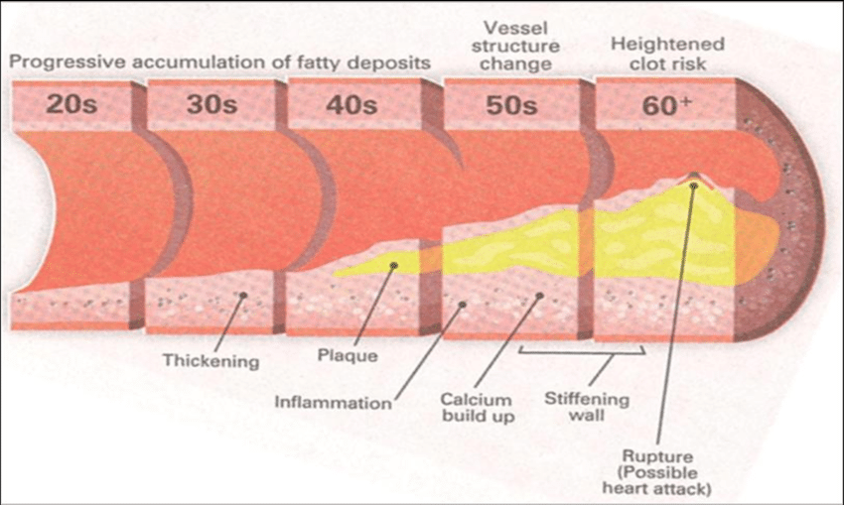
Vascular Changes
With advancing age, large arteries dilate , their walls, particularly the intima, become thickened and the media exhibits an increased collagen content and frayed elastin.

Slide 24
Anatomic to Physiological Effects
Loss of cells from SA node
Decrease in myocardial Cells
Decreased distensibility
Stiffness
Decrease in max HR
Reduced Cardiac output
Age-associated reductions in muscle mass
Inefficient redistribution of blood and oxygen uptake by peripheral muscles
Decreased HR
Decreased distensibility
Increased load on LV
Increase in BP
Decreased exercise capacity

Slide 25
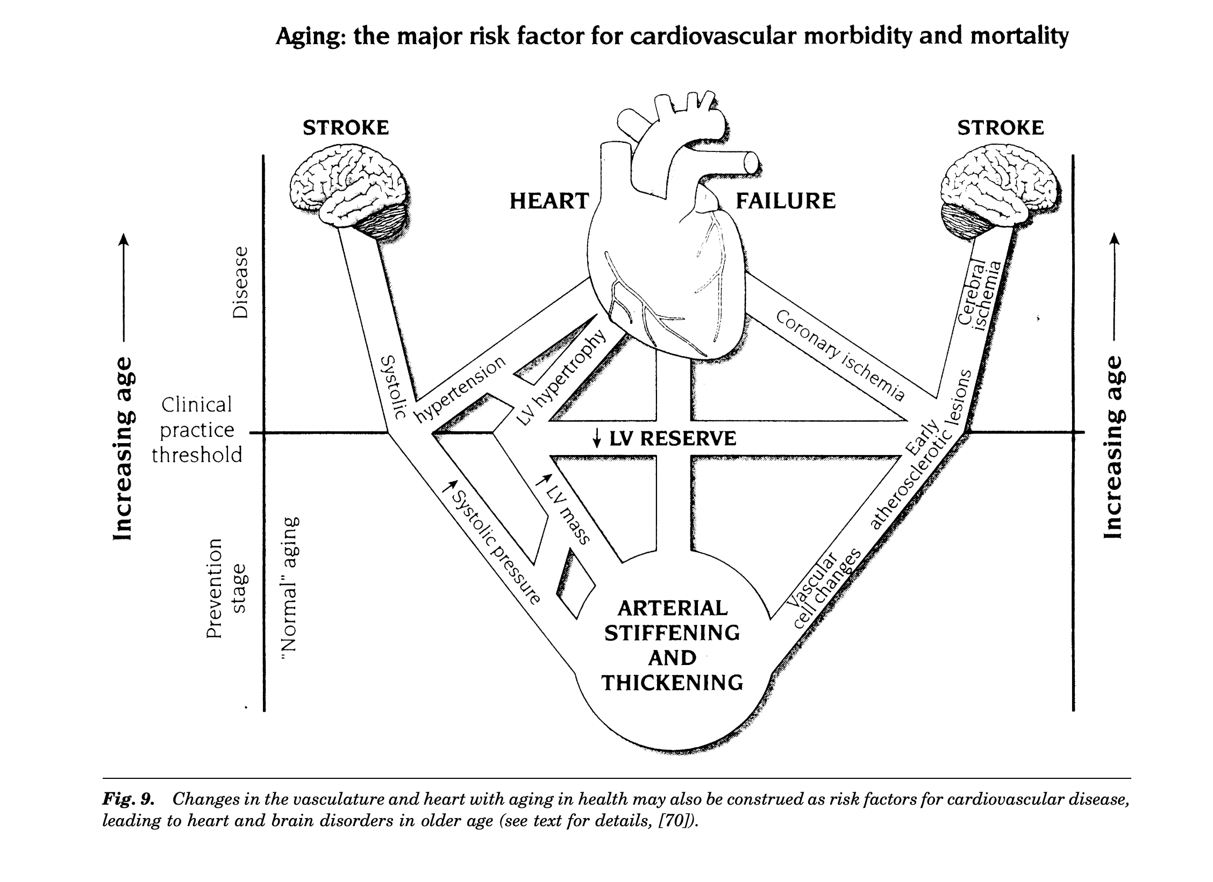

Slide 26
Age is an independent risk factor for cardiovascular disease (CVD) in adults, but these risks are compounded by additional factors, including frailty, obesity, and diabetes and multiple comorbidities.
These factors are known to complicate and enhance cardiac risk factors that are associated with the onset of advanced age.
Sex is another potential risk factor in aging adults, given that older females are reported to be at a greater risk for CVD than age-matched men.

Slide 27
Impact of Estrogen on CVD
Estrogen has been shown to exert a cardioprotective effect in males as well.
One study reported that males are likely to develop heart disease 10–15 years earlier than women due to the gradual decline in estrogen levels after puberty.
Accumulation of visceral fat in women after menopause has been linked to hormonal changes, such as decreased estrogen, which result in an increased risk of metabolic syndrome and cardiovascular complications in obese postmenopausal women
It has been reported that the risk for CVD increases dramatically in women at the onset of menopause, by as much as 2–4 times
In addition to increased risk for CVD, women at menopause are also at a greater risk for high LDL cholesterol levels, hypertension, diabetes, and obesity, which further elevates cardiovascular risk factors in both perimenopausal and postmenopausal women

Slide 28
Impact of Testosterone on Ageing Men
Low testosterone was also shown to be independently associated with a high risk for acute MI in type 2 diabetic males, and a high incidence of coronary artery disease (CAD) in men.
In older men, low testosterone levels have been linked to a higher risk for stroke.
Despite the potential benefits of hormone replacement therapy in older men, the US Endocrine Society does not currently recommend testosterone therapy in asymptomatic older men (>65 years), particularly as an “anti-aging” treatment, due to the lack of complete evidence

Slide 29
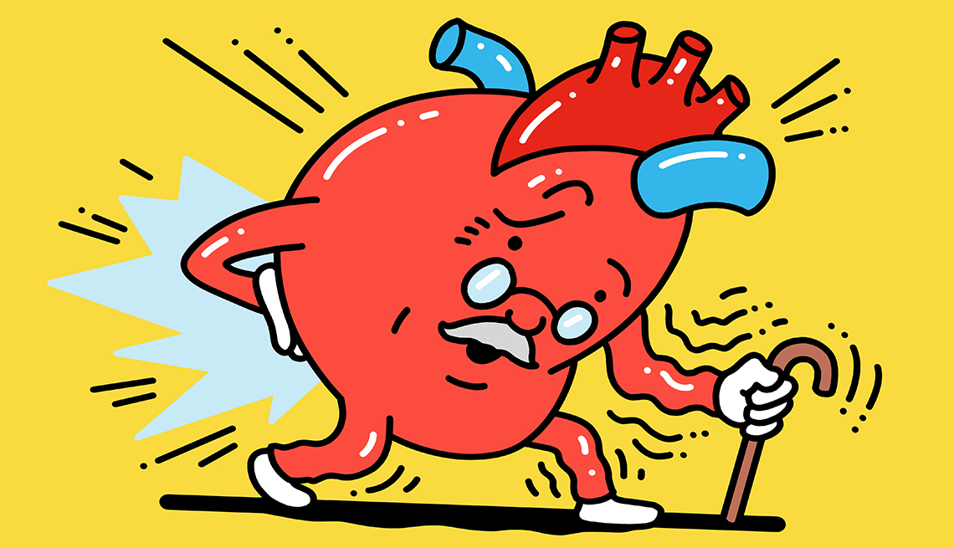

Slide 30
Frailty and Heart Disease
Another important risk factor associated with the development and manifestation of CVD among the elderly, is the onset of frailty
Among men and women aged 65 years and over, the presence of significant frailty has been shown to accurately predict incident CVD
Frailty is known to be a direct consequence of weakened physiological reserve, which results in a heightened vulnerability towards either acute or chronic illness
Decreased walking speed, exhaustion, inactivity, muscle wasting and weakness

Slide 31
Management of Heart Disease in Elderly
While age is shown to be independently associated with inflammation and a risk for CVD, health behaviors may also complicate these factors.
lifestyle modifications are a key to promoting better health in aging adults, and are a fundamental approach to reducing cardiovascular risk in adults
Examples of lifestyle changes that have been directly linked to decreased risk of CVD include maintenance of a healthy weight, avoidance of tobacco products, and regular exercise

Slide 32
Summary: Decline in Functional Status
Sensory aids
Neuromuscular coordination
Musculoskeletal weakness
Cardiac output and relaxation
Comorbidities
Medications and previous surgeries

Slide 33
Management
Regular moderate exercise
Avoiding extreme temperatures
Hydrate
Postural changes and balance
Avoid falls and injuries
Pace yourself

Slide 34
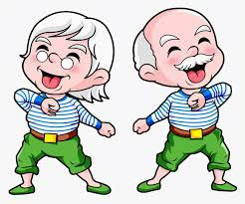

Slide 35

Thank you

Slide 36
References
Abud T, Kounidas G, Martin KR, Werth M, Cooper K, Myint PK. Determinants of healthy ageing: a systematic review of contemporary literature. Aging Clin Exp Res. 2022 Jun;34(6):1215-1223. doi: 10.1007/s40520-021-02049-w. Epub 2022 Feb 8. PMID: 35132578; PMCID: PMC8821855
Rudnicka E, Napierała P, Podfigurna A, Męczekalski B, Smolarczyk R, Grymowicz M. The World Health Organization (WHO) approach to healthy ageing. Maturitas. 2020 Sep;139:6-11. doi: 10.1016/j.maturitas.2020.05.018. Epub 2020 May 26. PMID: 32747042; PMCID: PMC7250103..
Xue QL. The frailty syndrome: definition and natural history. Clin Geriatr Med. 2011 Feb;27(1):1-15. doi: 10.1016/j.cger.2010.08.009. PMID: 21093718; PMCID: PMC3028599.
Lakatta, E.G. Age-associated Cardiovascular Changes in Health: Impact on Cardiovascular Disease in Older Persons. Heart Fail Rev 7, 29–49 (2002). https://doi.org/10.1023/A:1013797722156
Rodgers JL, Jones J, Bolleddu SI, Vanthenapalli S, Rodgers LE, Shah K, Karia K, Panguluri SK. Cardiovascular Risks Associated with Gender and Aging. J Cardiovasc Dev Dis. 2019 Apr 27;6(2):19. doi: 10.3390/jcdd6020019. PMID: 31035613; PMCID: PMC6616540
https://www.mountsinai.org/health-library/special-topic/aging-changes-in-the-bones-muscles-joints

