Slide 1


Staying Resilient in Troubled Times
Sharon Myers RN
Tissa Kappagoda MD
Notes:
This is a program designed to help people who are at risk of developing diseases of the heart and circulation such as strokes and heart attacks. This includes people who have conditions such as significant weight problems, diabetes and high blood pressure.

Slide 2
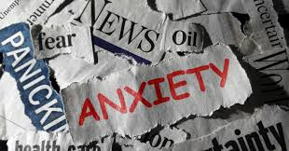
There is a Lot Going On...
Aging Issues
Loss
Social Media
Gas Prices
Political Divide
War
AI
Violence
Tech Changes
Price of Groceries
Climate Change

Slide 3

Negative Events in Life Are Inevitable

Slide 4
Antonovsky’s Sense of Coherence
A theoretical tool used to explain why some people thrive and maintain health under difficult circumstances and others become weaker and less healthy

Slide 5
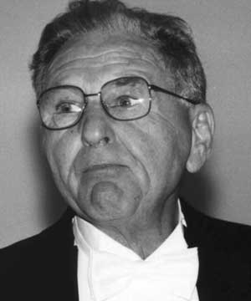
Aaron Antonovsky
Concept of Sense Of Coherence (SOC) was put forward by Aaron Antonovsky in 1979
Explains why some people become ill under stress and others stay healthy
Why do some people maintain a positive attitude and good health despite having hardships and stress in their lives, while others do not

Slide 6

Sense of Coherence
The idea that one has a feeling of confidence that things will work out as well as can be expected.
Sense of coherence (SOC) is a orientation that allows individuals to be more resilient to stressors in daily life, stay well and improve their health.
Combination of people’s ability to assess and understand the situation they were in, to find a meaning to move in a health promoting direction and to believe they have the capacity to do so(Linstrom, Eriksson, 2005)
Antonovsky A. The structure and properties of the sense of coherence scale. Soc Sci Med. 1993 Mar;36(6):725-33.

Slide 7
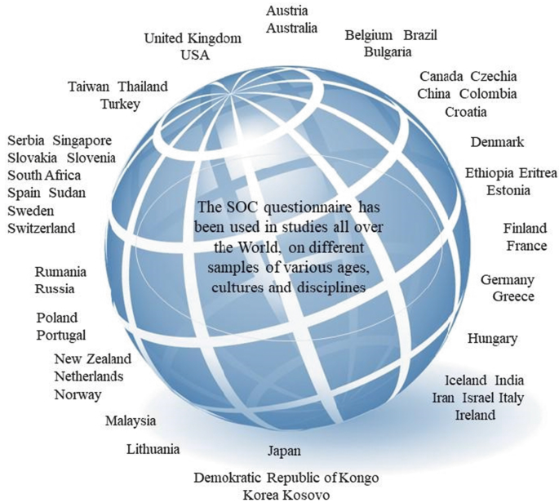
Sense of Coherence and Influence on Health - Studied Worldwide
The SOC gained widespread attention and has since been linked to health outcomes in many studies throughout the world

Slide 8
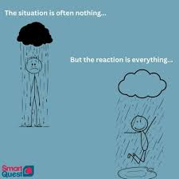
Stress Management
Two people confronted by the same stressor:
One meets the challenge and the other doesn’t

Slide 9

Sense of Coherence Origins
Antonovsky was originally curious about women survivors of the holocaust who were healthy and doing well
Developed a Salutogenic model of health

Slide 10
Antonovsky Observed Women Holocaust Survivors
Aaron Antonovsky's Sense of Coherence (SOC) theory was directly inspired by his 1970 study of Israeli women who had survived Nazi concentration camps
Among the group who had survived concentration camps, only 29% were found to be in good mental and physical health.
Instead of focusing on the 71% who were struggling, Antonovsky focused on the 29% who were well-adapted. He asked, "How could these women maintain reasonable health after such unimaginable horror?
All had a good Sense of Coherence
https://www.ncbi.nlm.nih.gov/books/NBK435812/ doi: 10.1007/978-3-319-04600-6_11

Slide 11
Salutogenic Model of Health
sa·​lut·​o·​gen·​e·​sis sə-ˌlü-tō-ˈje-nə-səs
: an approach to human health that examines the factors contributing to the promotion and maintenance of physical and mental well-being rather than disease with particular emphasis on the coping mechanisms of individuals which help preserve health despite stressful conditions
https://www.merriam-webster.com/dictionary/salutogenesis

Slide 12
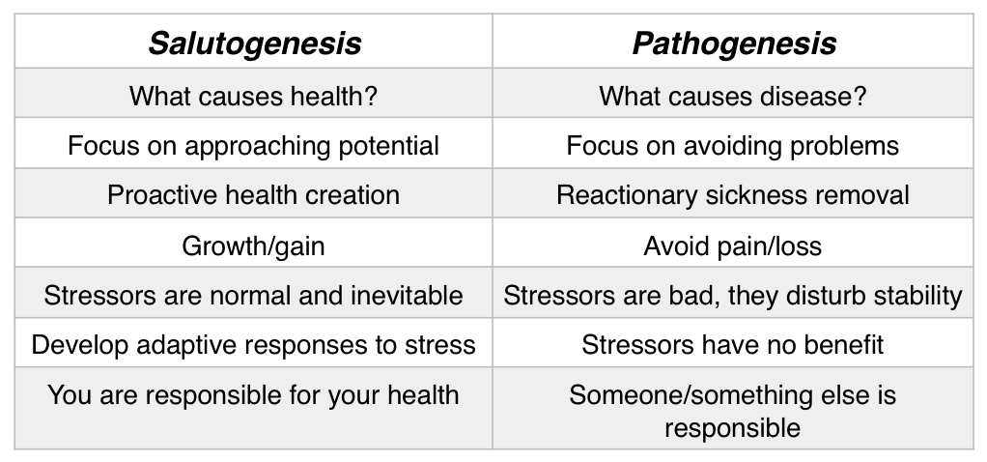
Salutogenesis vs Pathogenesis
Arose from the salutogenic approach, that is, the search for the origins of health rather than the causes of disease

Slide 13
A Salutogenic Approach to Life
A realistic view of life
It does not assume a smooth, linear life trajectory as the status quo
It assumes we will make mistakes, experience things as difficult, experience diversity and hardships
We can look for factors and processes that actively counteract our mental and/or physical decline by purposely striving for the things by which health (‘saluto-‘) is being created (‘genesis’)
The challenge, Antonovsky said, lies in learning to deal as well as possible with what life brings and make sure we can weather the storm

Slide 14
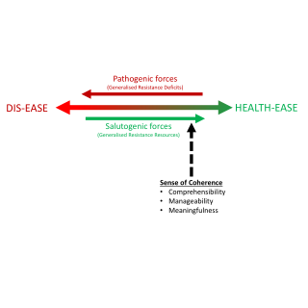

Moving Toward Health
A strong Sense of Coherence helps the individual mobilize resources to cope with stressors successfully and move toward the Health-ease side of the continuum

Slide 15


Sense of Coherence
Sense of Coherence (SOC) involves three components:
Comprehensibility
Meaningfulness
Manageability

Slide 16
Comprehensibility
What affects comprehensibility?
Certain parts and pieces need to be present in a certain way for us to be able to understand things…
Structure
Predictability
Explainability
Enables one to find logic in the stimuli encountered
A prerequisite to being able to cope with a stressful situation is that one can understand it. What one comprehends is easier to manage.

Slide 17

Meaningfulness
Extent to which an individual believes that life makes sense emotionally and that one possesses the desire and motivation to cope with the issues which are likely to confront him/her – “Is it all worthwhile to me”?

Slide 18

Manageability
Self Efficacy
Extent to which an individual perceives that the resources needed to cope with challenges are available to them
Internal (within yourself)
External (in the outside environment)

Slide 19
An Example…
Let’s say you have a health goal to “reduce the amount of cholesterol you eat” …
The degree to which you will be successful may be dependent on your overall Sense of Coherence and the three components of this…
Comprehensibility
Meaningfulness
Manageability

Slide 20
Comprehensibility Structure, predictability, explainability
What effect does cholesterol in the foods we eat have on our heart and blood vessels?
Will eating less cholesterol cause my cholesterol to go down?
How many mg of cholesterol is OK per day?
What foods that I am eating are high in cholesterol ?
How do I do this ? What do I eat? It’s too hard? I don’t understand?
What kind of knowledge and understanding might YOU need in order to make this change of reducing the amount of cholesterol you
eat ?

Slide 21
Meaningfulness Are the demands/issues worthy of your investment?
What makes something of value to you ?
Behavior doesn’t happen in isolation from our thoughts
What is meaningful or of value can change depending on what is going on in your life

Slide 22

Meaningfulness Think about yourself …
Is lowering the amount of cholesterol you eat of value to you right now?
Why or Why not ?
Is there anything that would make this health goal more meaningful?

Slide 23

Manageability Extent to which resources are available
The environment is a source of both stressors and resistance resources
People with a strong Sense of Coherence have a greater variety of general resistance resources

Slide 24
Resistance Resources
Internal Resistance Resources
Effective management of emotions- not harboring negative emotional states
Coping strategies in your tool box such as sleep, exercise, meditation, breathing, hobbies, laughter etc… can help you strengthen your internal state of coping or management of emotions
Valuative/attitudinal coping strategies( rationality, flexibility, and foresight)
Having physical stamina

Slide 25
Resistance Resources cont.
External Resistance Resources
Material items such as housing, living conditions, money, car, clothing, nutrition
Social Support
Relationship stability
Cultural
Life skills/Self efficacy
Information-classes, reading materials
Religion/philosophy
Rituals- repeating familiar activities

Slide 26
What types of resistance resources might help if you if you were trying to reduce the amount of cholesterol you eat?
What types of resistance resources might help you successfully deal with all the current stressors in the world and your life?

Slide 27
The Impact of Generalized Resistance Deficits (GRD)
According to researchers from NIH, when GRDs outweigh resources, coping mechanisms are more likely to fail. This imbalance can lead to:
Pathogenic Outcomes: Physical illness, burnout, or chronic disease.
Psychological Distress: Increased anxiety, depression, and a sense of hopelessness.
Weakened Sense of Coherence: A diminished ability to perceive life as structured, manageable, and meaningful.
Flensborg-Madsen T, Ventegodt S, Merrick J. Sense of coherence and physical health. The emotional sense of coherence (SOC-E) was found to be the best-known predictor of physical health. ScientificWorldJournal. 2006 Jun 22;6:2147-57. doi: 10.1100/tsw.2006.344. PMID: 17370010; PMCID: PMC5917406.

Slide 28
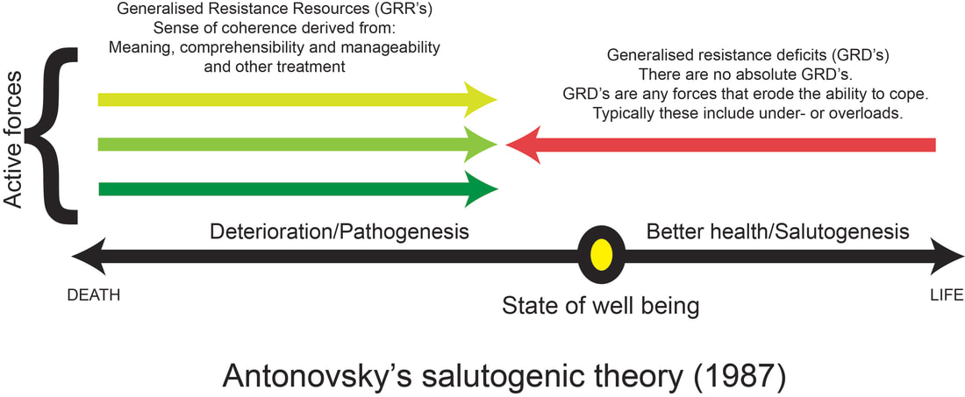
The Really Good News…
SOC is a dispositional orientation and not a personality trait
(Disposition means the positive or negative way a person views the world and you can change this)
Personality is more permanent and harder to change
SOC is measured on a continuum and you move along this continuum to the higher end
SOC increases with age in both men and women

Slide 29
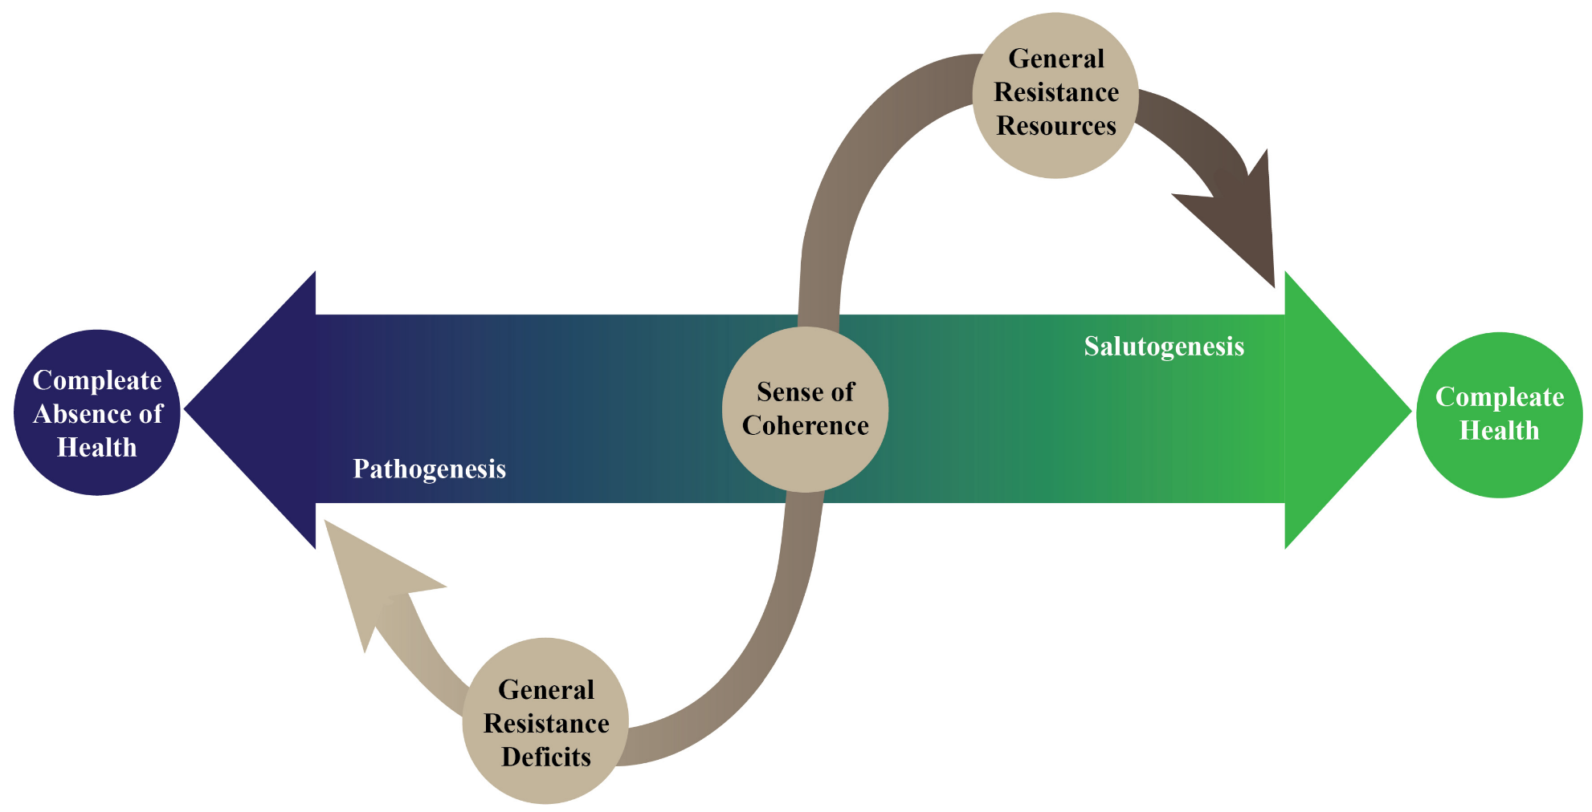
Summary of the Salutogenesis Model of Health

Slide 30

How to Strengthen Your Sense of Coherence?
Be aware it’s a life long process
Reframe your stressors
Create meaning from life’s challenges
Strengthen your resistance resources. And develop new ones
Participate in a supportive social network
Surround yourself with people who model what you need to learn
Seek out knowledge and understanding. Continue to learn
Explore what is of value to you
Participate in an exercise program
Participate in a mindfulness or stress management program
Do things that increase your ability to believe you can do hard things

Slide 31
Strengthening sense of coherence: Evidence from a physical activity intervention targeting vulnerable adults
Looked at whether a health intervention could strengthen SOC
268 participants, age 55 or higher, socially vulnerable adults with low SOC scores
Participated in physical activity program-Communities on the Move
Sense of coherence (SOC) was stronger after a physical activity intervention.
Adults’ SOC may be strengthened, particularly when SOC is initially low.
SOC may be an alternative success indicator for physical activity interventions.
Thompson K, Herens M, van Ophem J, Wagemakers A. Strengthening sense of coherence: Evidence from a physical activity intervention targeting vulnerable adults. Prev Med Rep. 2021 Sep 8;24:

Slide 32
Exercise Associated with Higher Sense of Coherence
3403 participants (1856 women and 1547 men) completed a Finnish cardiovascular risk factor survey
They also completed the Beck Depression Inventory, the State-Trait Anger Scale, the Cynical Distrust Scale, and the Sense of Coherence inventory
Individuals who exercised at least two to three times a week experienced significantly less depression, anger, cynical distrust, and stress than those exercising less frequently or not at all.
Those who exercised at least twice a week reported higher levels of sense of coherence and a stronger feeling of social integration than their less frequently exercising counterparts.
Hassmén P, Koivula N, Uutela A. Physical exercise and psychological well-being: a population study in Finland. Prev Med. 2000 Jan;30(1):17-25

Slide 33
Sense of Coherence (SOC)- Orientation to Life Questionnaire
Two versions- 13 or 29 questions
Measures the three different areas:
Comprehensibility
Manageability
Meaningfulness
Score is linked to perceived health, positive health outcomes and QOL
Scores on SOC test have high reliability and validity scores and are cross culturally applicable(National Institute of Health)

Slide 34
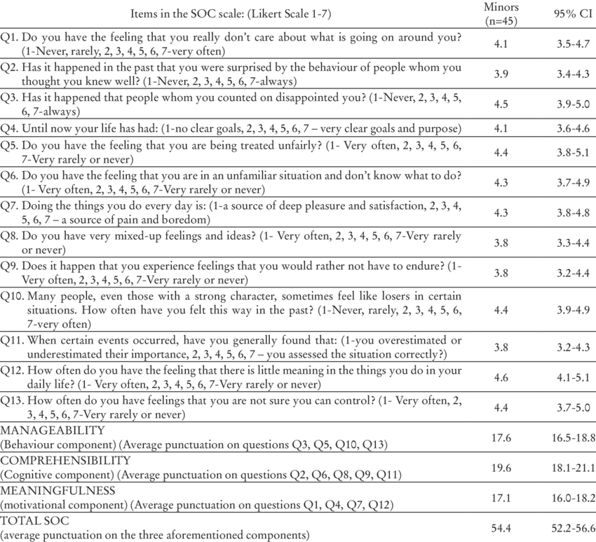
Example of the SOC Scale- 13 item
*Scores range from 13-91. A higher total score indicates a stronger sense of coherence

Slide 35
Thank-you !
Questions or Comments?

