Slide 1
Cardiac Devices
Radhika Nandur Bukkapatnam MD MAS FACC
4/10/25

Slide 2
Cardiac Devices
Monitors
Pacemakers
Automatic Implantable Cardioverter Defibrillator ( AICD/ ICD)
Cardiac Resynchronization therapy
Ventricular Assist Devices
Cardiomems
Valves
TAVR ( Aortic valve)
Mitraclip
Tricuspid
PV
WATCHMAN/ Amulet

Slide 3
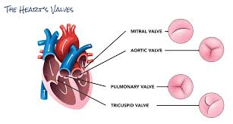
Structure of the Heart

Slide 4
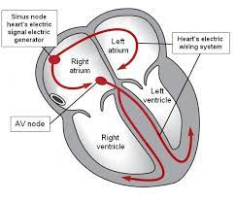
Electrical System of the Heart

Slide 5
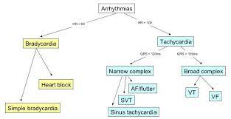
Types of Arrhythmias

Slide 6
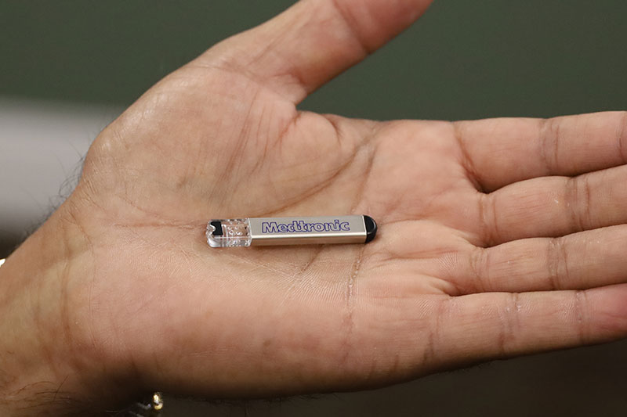
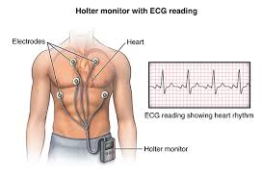
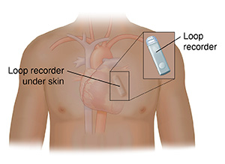
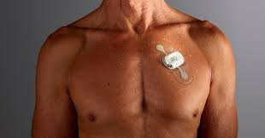
Monitoring for Arrhythmias

Slide 7
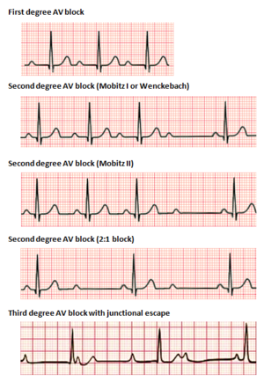
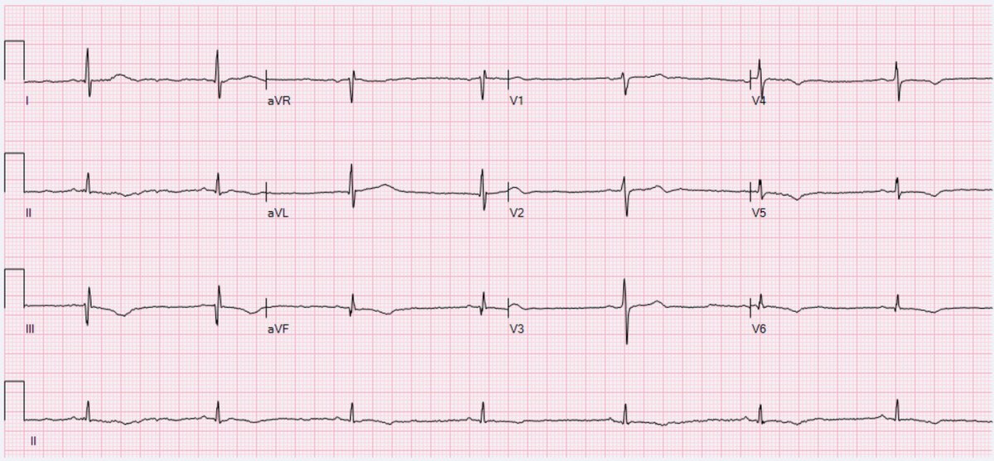
Pacemakers
Slow Rhythms: Bradycardia
Slow Rhythms: Bradycardia

Slide 8
Pacemakers
These are devices that detect the rhythm of the heart and stimulate it to contract at a faster rate
These were first developed in 1952
First transvenous pacemakers were implanted in 1960s

Slide 9
Indications for a Pacemaker
Symptomatic Heart Block
Symptomatic Sinus Bradycardia
Atrial Fibrillation with:
Symptomatic bradycardia
Adjunct to AV nodal ablation
Aid in treatment of fast rhythms
Pause > 3 seconds or <40 bpm awake in normal sinus rhythm
Pause >5 seconds awake in pts with atrial fibrillation
Chronic slow arrhythmias with LV dysfunction
Neuromuscular disease with AV block

Slide 10
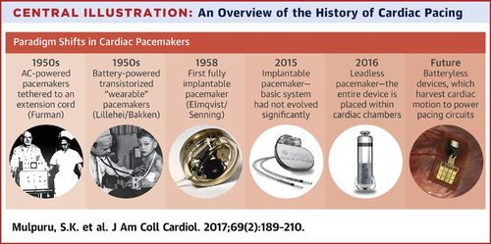

Slide 11
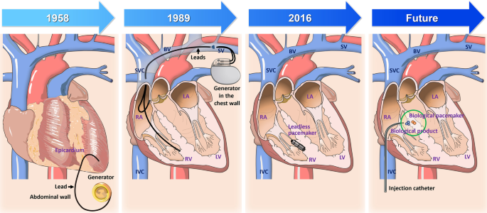

Slide 12
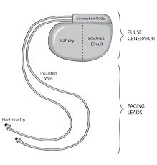
Components of a Pacemaker
Pulse generator (houses the battery
Electronic circuitry
Lead system
Nearly all pacemakers are lithium powered and last from 6-14 years

Slide 13
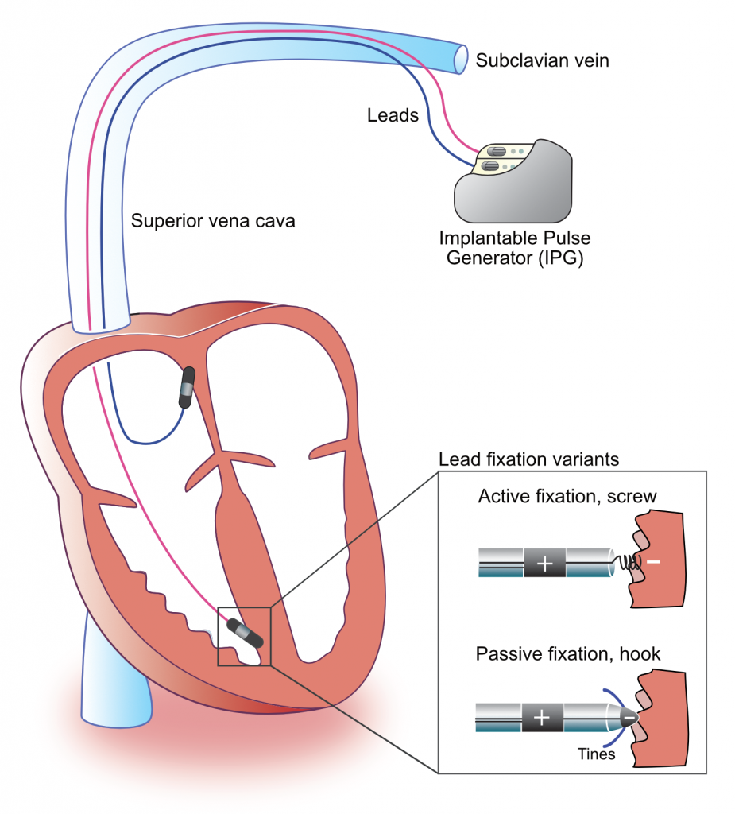
Pacemaker Placement

Slide 14
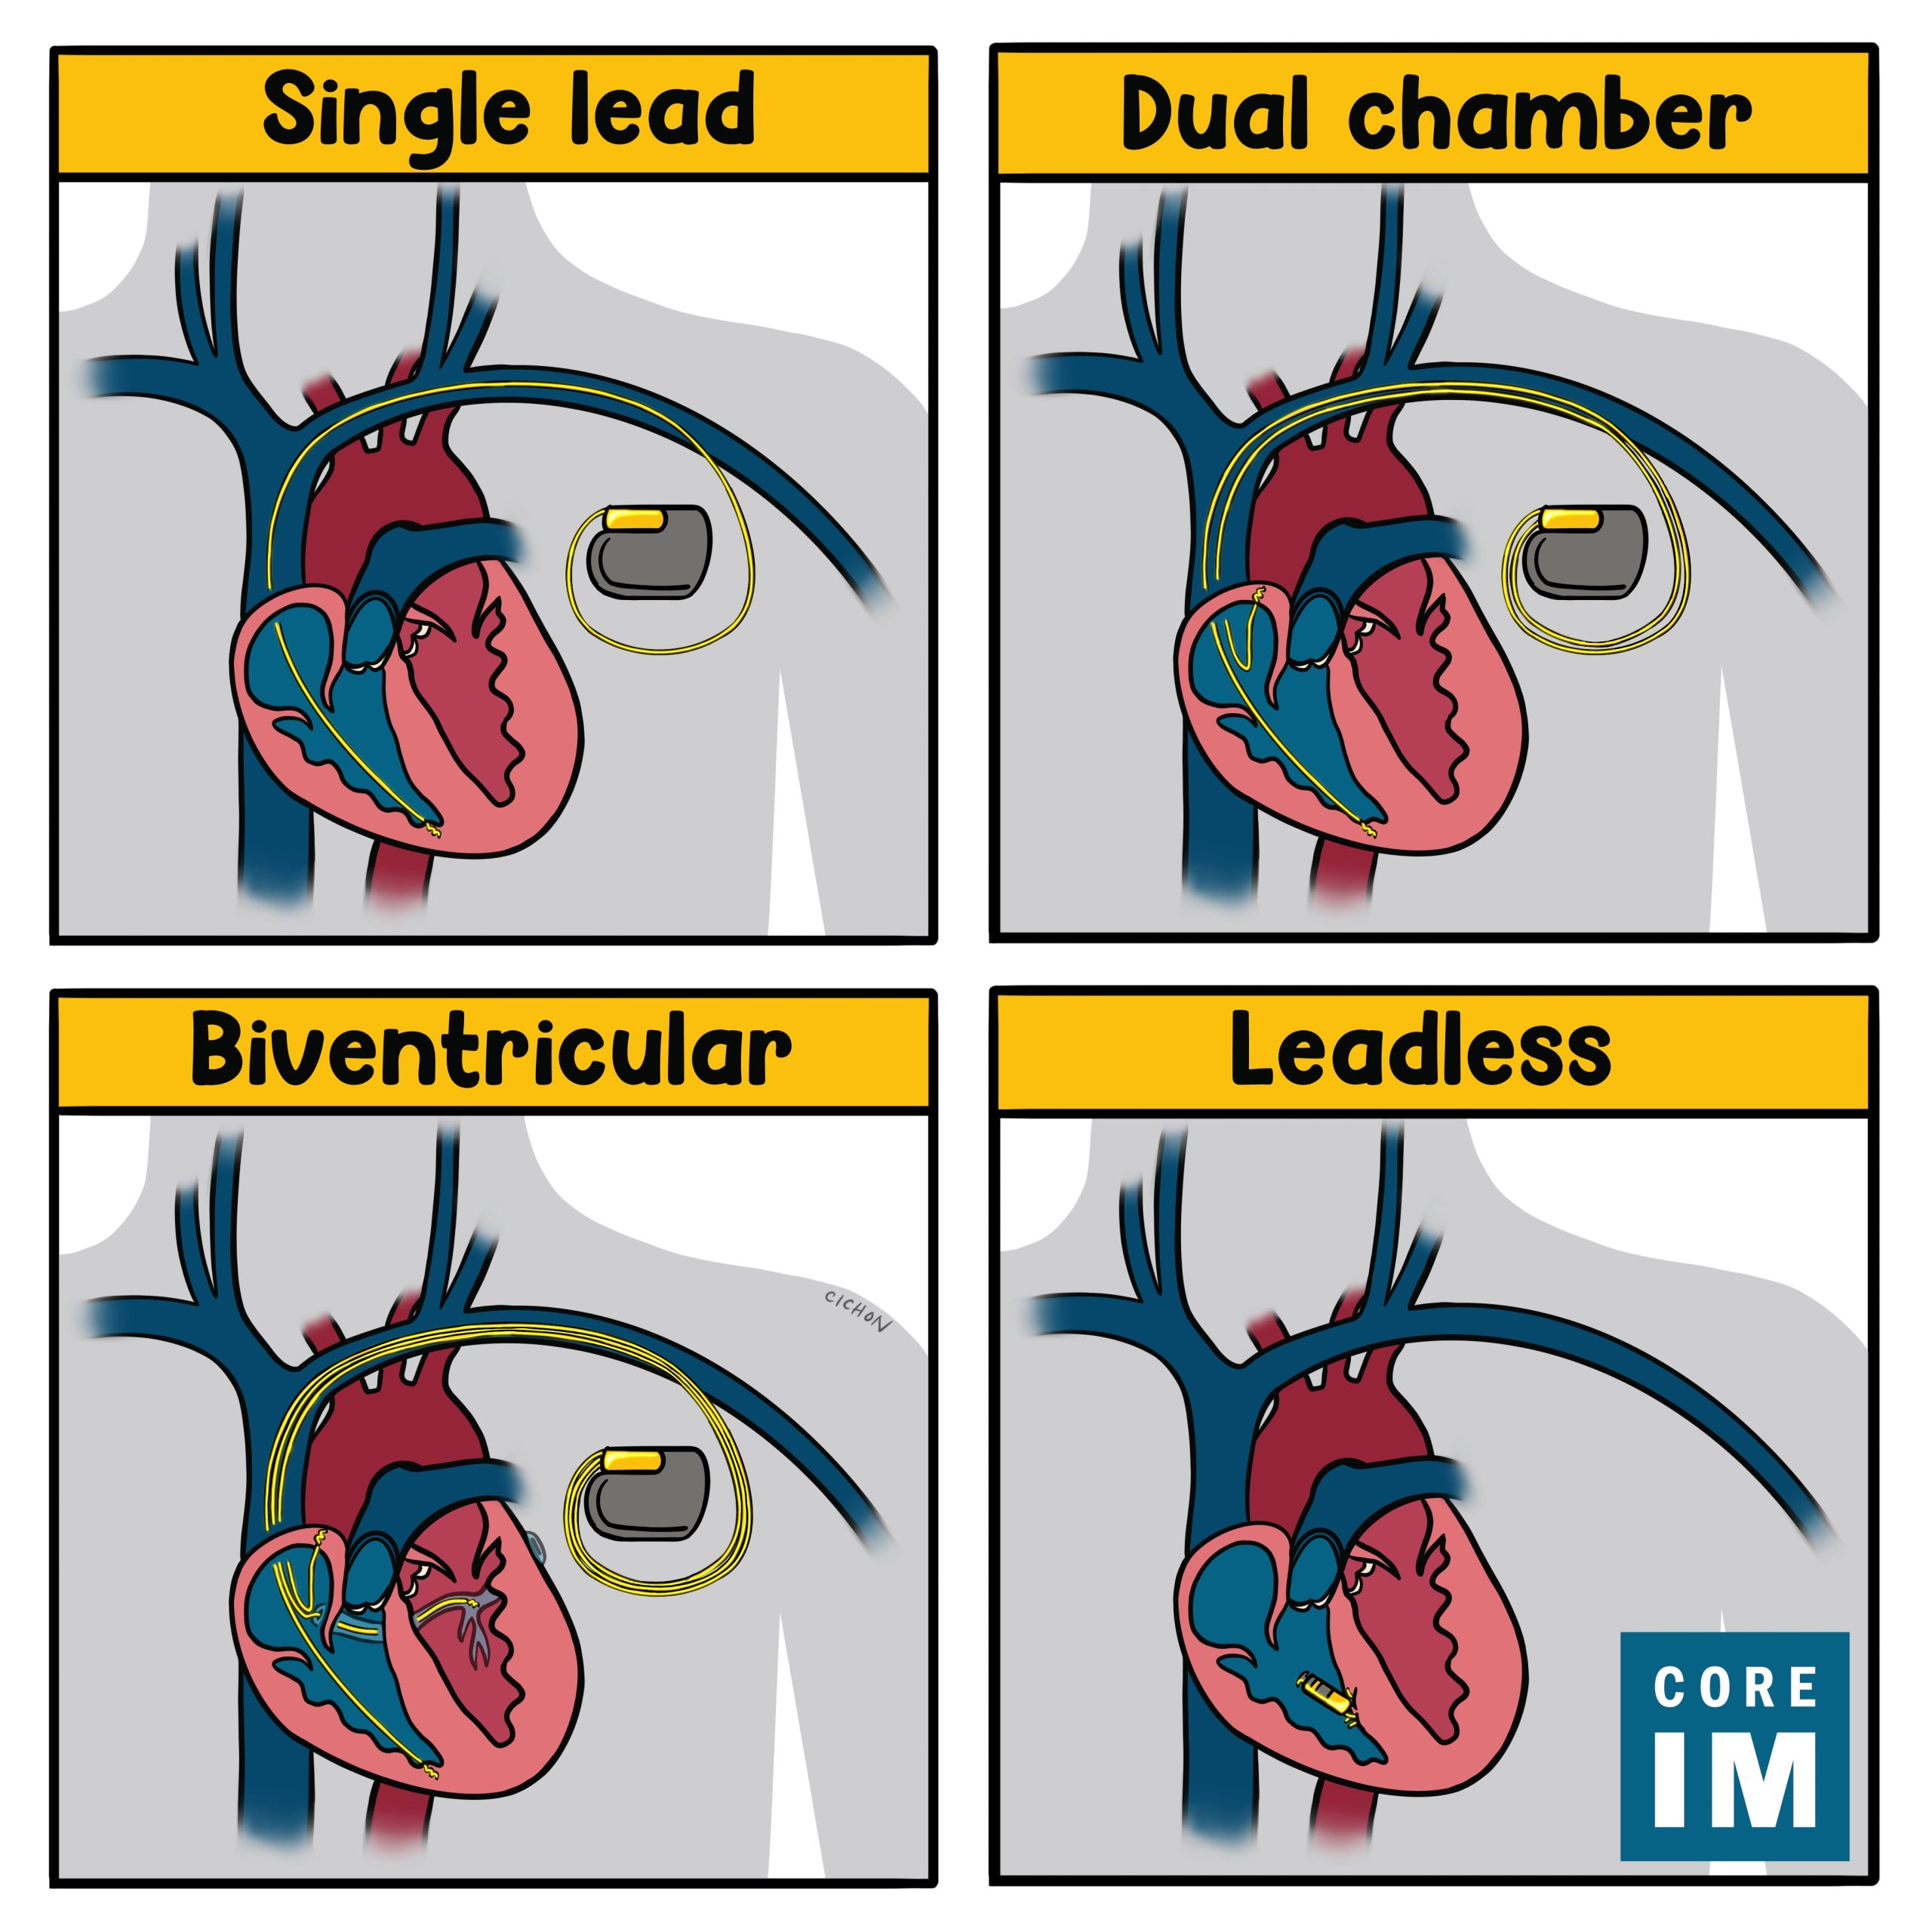
Types of Pacemakers

Slide 15
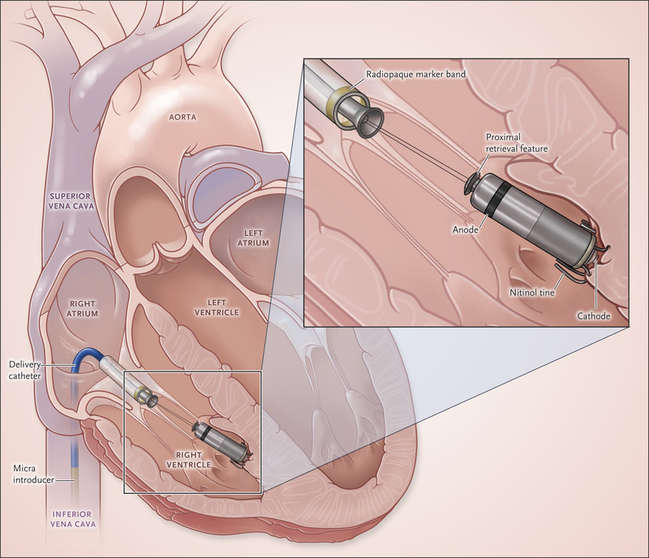
Leadless Pacemakers
Reduce hardware, lead failure
Reduce risk of infection
Reduce valve injury
Do not have much information about arrhythmias/pacemaker syndrome
Morbid obesity
Other cardiac devices

Slide 16
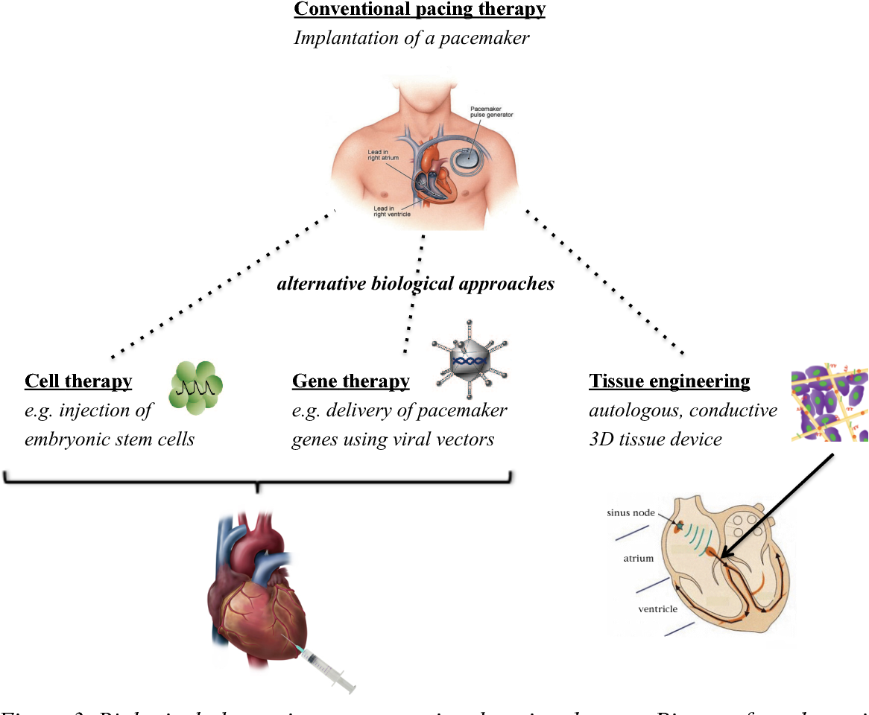
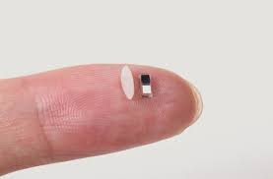
Biological Pacemakers

Slide 17
Automatic Implantable Cardioverter Defibrillators

Slide 18
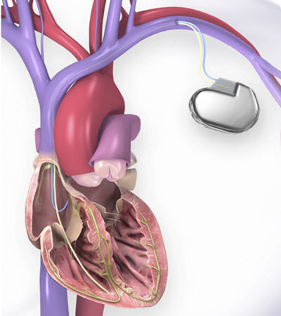
AICD/ ICD
An ICD is a battery-powered device placed under the skin that keeps track of your heart rate. If an abnormal heart rhythm is detected the device will deliver an electric shock to restore a normal heartbeat if your heart is beating chaotically and much too fast.
ICDs prevent sustained ventricular tachycardia or fibrillation in survivors.
Prevent cardiac arrest in high-risk patients who haven't had, but are at risk for, life-threatening ventricular arrhythmias

Slide 19
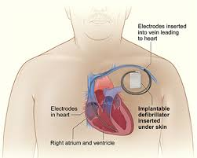
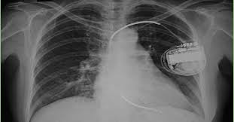
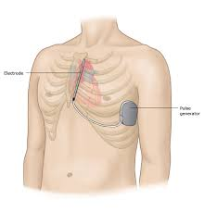
Components of an AICD

Slide 20
Indications for AICD
Cardiac arrest due to Ventricular tachycardia (VT) or fibrillation (VF)
Spontaneous VT
Syncope with inducible VT, when drug therapy is ineffective
NSVT with low LVEF or CAD
Long QT syndrome, Brugada syndrome
Congenital heart Disease

Slide 21
Basics of AICD
Earliest devices implanted in surviving victims of SCD in 1980
Drug therapy ( Metoprolol/ Carvedilol, Amiodarone) and other CHF therapy is still essential to suppress ventricular arrhythmias, to minimize the frequency of ICD discharges
All ICDs have inbuilt pacemakers
Common complaint of ICD patients is occurrence of frequent shocks
Shocks may occur with hypokalemia, hypomagnesemia, medications, ischemia
Other malfunction

Slide 22
Cardiac Resynchronization Therapy (CRT)

Slide 23
In heart failure patients CRT, or biventricular pacing, is used to help improve the heart’s rhythm and the symptoms associated with the arrhythmia.
The procedure involves implanting a half-dollar sized pacemaker, usually just below the collarbone. Three wires (leads) connected to the device monitor the heart rate to detect heart rate irregularities and emit tiny pulses of electricity to correct them. In effect, it is "resynchronizing" the heart.

Slide 24
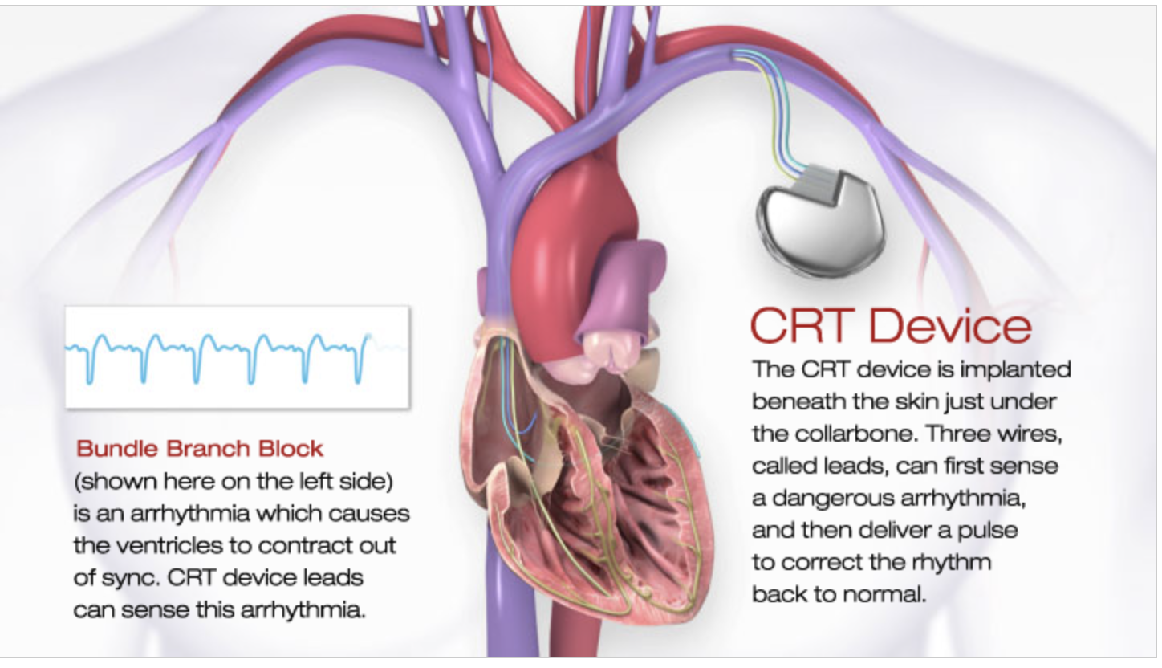

Slide 25
Indications for Biventricular AICD
Moderate to severe heart failure (NYHA Class III-IV) with EF ≤ 35% and QRS duration ≥ 120 ms
Left bundle branch block (LBBB) with QRS duration ≥ 130 ms, EF ≤ 30%, and mild (NYHA Class II)
Ischemic or nonischemic heart failure or asymptomatic (NYHA Class I) ischemic heart failure

Slide 26
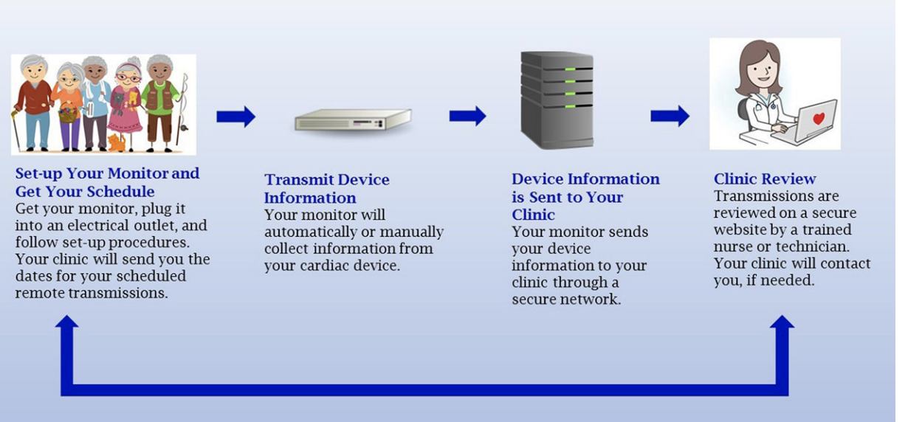
Remote Monitoring

Slide 27
Lifecycle of a Pacemaker/ Defibrillators
Implantation and Postop
Adjusting the pacemaker
Remote monitoring
Identify arrhythmias
ERI: Recommended Replacement time (RRT)
End of life and battery replacement
Treat ad readjust pacemaker
Pacemaker Malfunction

Slide 28
Care of Pacemaker/ ICDs
Household appliances — No special precautions when using normally functioning common household appliances such as microwave ovens, televisions, radios, toasters, and electric blankets.
Cellular phones — People with a pacemaker or a defibrillator should know that items with strong magnetic fields (eg, cellular phones with magnets for wireless charging [iPhone 12], magnetic accessories such as certain “smart watches”) can affect the function of the device if they are very close (less than six inches) to their device. MP3 players, such as an iPod®, don’t pose a risk to ICDs or pacemakers. However, the headphones used with MP3 players can interfere with both devices.
If you have a pacemaker or a defibrillator, the safest strategy is to use your cell phone at the ear on the side opposite the cardiac device. When you are carrying your phone, keep it in a pocket or bag below your waist.
Be physically active. Try to do what you enjoy – or what you feel up to – each day. Take a short walk, or simply move your arms and legs to aid blood circulation.
Feel free to take baths and showers. Your pacemaker is completely protected against contact with water.
Car, train or airplane trips should pose no danger.
People with pacemakers can continue their usual sexual activity.

Slide 29
Metal Detectors
Anti-theft systems — Electromagnetic anti-theft security systems are often found in or near the workplace, at airports, in stores, at courthouses, or in other high-security areas. Experts advise that patients with pacemakers should:
●Be aware of the location of anti-theft systems and move through them at a normal pace
●Avoid leaning on or standing close to an anti-theft system
Metal detectors at airports — Similar to antitheft systems, metal detectors at airports can potentially interfere with pacemakers, although this is unlikely. Such exposure has been shown to cause interference in some cases and may be related to the duration of exposure and/or distance between the security system and the pacemaker. Metal detectors will likely be triggered by the presence of a pacemaker and therefore at places such as airports, it will be important for individuals with pacemakers to carry an identification card for their pacemaker, and airport personnel will likely prefer to do a manual search

Slide 30
Medical Procedures and MRIs
Diagnostic or therapeutic procedures — Certain types of surgery and procedures may interfere with pacemakers. Such procedures include:
●Magnetic resonance imaging (MRI), which uses a strong magnetic field that is pulsed on and off at a rapid rate. Even patients with a standard pacemaker (ie, not designated "MRI safe") can often undergo MRI scans with careful monitoring and other appropriate precautions.
● Transcutaneous electrical nerve/muscle stimulators (TENS), a method of pain control.
●Diathermy, which heats body tissues with high-frequency electromagnetic radiation or microwaves.
● Extracorporeal shock wave lithotripsy, the use of sound waves to break up gallstones and kidney stones.
● Therapeutic radiation for cancer or tumors, which can cause permanent pacemaker damage.
●Any surgery in which electrocautery is being used. The risks are greatest when the electrocautery is being performed close to the pulse generator.
Thus, doctors, dentists, and other health care providers should be informed about a person's pacemaker. If a procedure associated with pacemaker interference is contemplated, the possible benefits, risks, and alternatives should be considered and discussed, as appropriate. People with pacemakers should carry a medical identification card for emergencies.

Slide 31
Arc Welding
External electrical equipment — External electrical fields do not seem to cause a problem for most people with a pacemaker. However, in workplaces that contain welding equipment or strong motor-generator systems, because interference can inhibit pacing, it is recommended that a person with an implanted cardiac device remain at least two feet from external electrical equipment, verify that the equipment is properly grounded, and leave the immediate locale if lightheadedness or other symptoms develop.

Slide 32
Garage door openers
Hedge trimmers
Weed trimmers
Leaf blowers
Electric lawn mowers
Electric drills (including cordless drills)
Power saws, routers and sanders
Laser levels
Stud finder
Keyless entry car remotes
Battery-powered flashlights
Metal detectors for recreational use
GPS devices
Radio-controlled toys and devices
Computers
Printers and scanners
Photocopiers
Security badge scanners
Salon-style hair dryers
Tanning beds
Hot tubs
Casino slot machines
Massage chairs and massage pads
Low voltage power lines (often found in residential areas)
Household appliances and electronics
Electric shavers
Electric blankets
Heating pads
E-readers
Electronic tablets
Microwave ovens
Kitchen appliances, such as mixers, blenders, toasters and coffeemakers
Ionized air filters
Computers
AM/FM radios
CD/DVD/VHS players and recorders
TV transmitters and remotes
Home wireless devices, such as modems, routers and headsets
Video game wireless controllers
TV and stereo speakers
Bluetooth® wireless technology, including headsets
Hair dryers
Irons
Hand-held back massagers
Electronic weight scales

Slide 33
Know the Make of Pacemaker/ Defibrillator
Boston Scientific
Medtronic
Biotronik
St Jude/ Abbott
Micra/ Avier
MRI compatible or not

Slide 34
Advanced Heart Failure
Cardiac Resynchronization therapy
Cardiomems
VAD

Slide 35
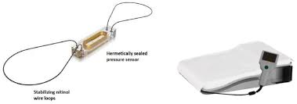
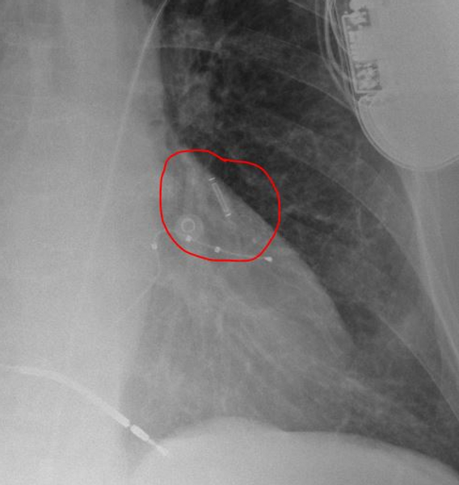
Cardiomems
Device to monitor the amount of fluid in the lungs
Device in the lungs
Monitored by sleeping on a special pillow

Slide 36
Ventricular Assist Device
A ventricular assist device (VAD) — also known as a mechanical circulatory support device — is a device that helps pump blood from the lower chambers of your heart (ventricles) to the rest of your body.
VAD may be placed as a bridge to transplant or permanent therapy in advanced heart failure
Continuous flow

Slide 37
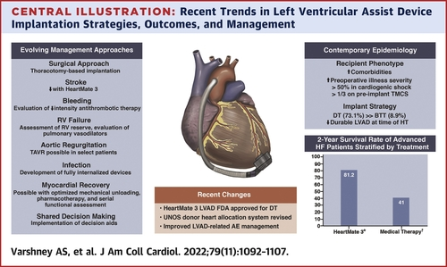

Slide 38
Valvular Heart Disease

Slide 39
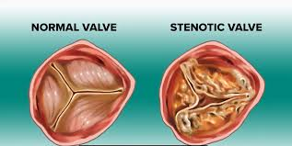
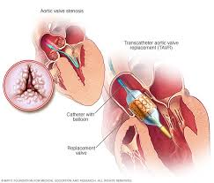
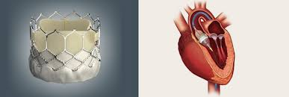
Aortic Stenosis: TAVR

Slide 40
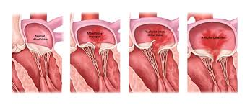
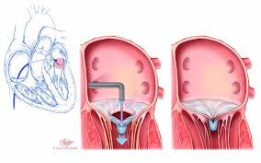
Mitral Regurgitation: Clip

Slide 41
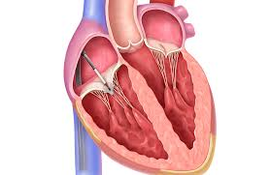
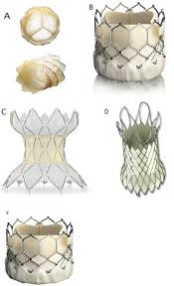
Tricuspid and Pulmonic Valve Regurgitation
Pulmonary valve

Slide 42
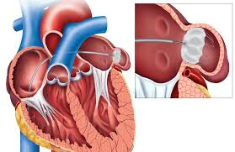
Atrial Fibrillation
Stroke Prevention
Coumadin, Eliquis, Xarelto, Pradaxa
Falls/ bleeding……..Alternative
WATCHMAN device
Amulet device

Slide 43
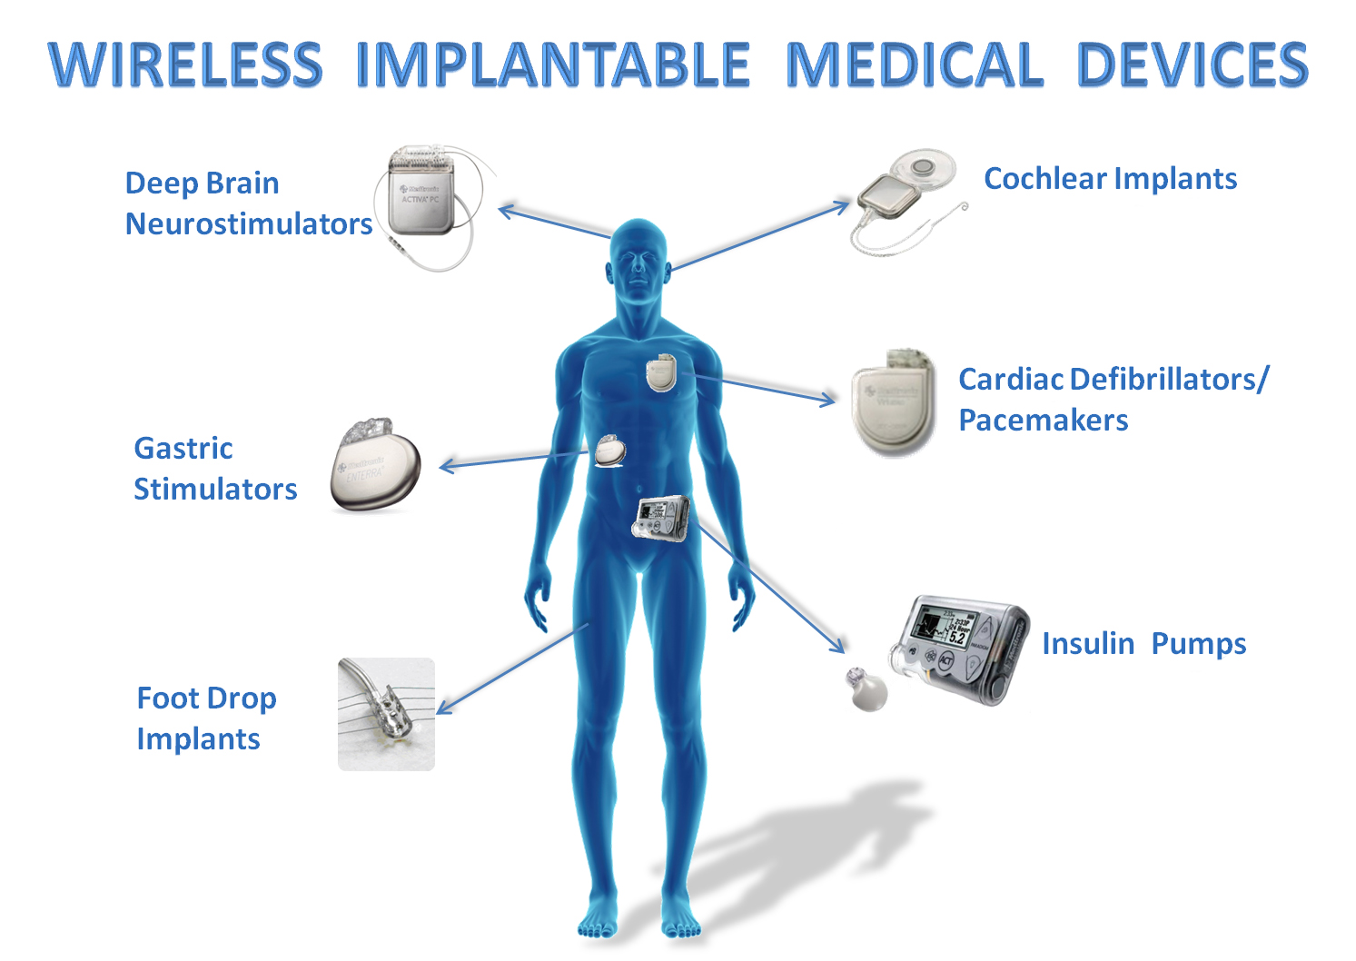

Slide 44
Thank you

