Slide 1

Tips on The Window of Tolerance
CSUS Cardiovascular Program Psychosocial Wellness Series
Linda Goode LCSW

Slide 2
What is the window of tolerance?
The concept of the window of tolerance was developed by psychiatrist Dr. Dan Siegel to describe the range of emotional intensity a person can experience while still functioning effectively in daily life.
The window of tolerance is the optimal zone of emotional and physiological arousal in which a person can effectively manage stress, think clearly, and respond adaptively without becoming overwhelmed or shutting down.

Slide 3

Why is the window of tolerance relevant?
When someone is within their window, they can process emotions, make decisions, and maintain relationships without being hijacked by stress or trauma.
Emotions are present with challenges, but manageable, so our brain to can help us think clearly to cope and problem solve.
If we are outside our window of tolerance we may either jump into action- hyperarousal or retreat into hypoarousal as our brains try to respond to a perceived threat and keep us safe.

Slide 4

To illustrate how this works….here is a short video
https://www.youtube.com/watch?v=BbIhNVEYYno&t=6s

Slide 5
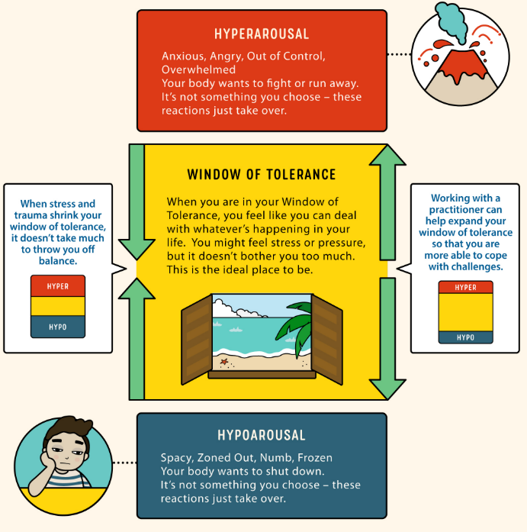
How our window of tolerance may look…

Slide 6

What shapes our window?
Our window of tolerance is not just shaped by our individual personalities’
It is also shaped by the people we encounter, our life experiences and the environments we live in.
Traumatic life events can make our window smaller.
Chronic stressors like poverty, discrimination, and social marginalization can act as persistent threats that cab narrowing the window.

Slide 7

What else shapes our window?
Nurturing environments
Healthy food, safe water and clean air
Positive social interactions
Safe spaces can widen the window.
Can all make our window larger

Slide 8

What can we do when we are outside our window of tolerance?
Hyperarousal involves heightened stress responses such as anxiety, panic, irritability, anger, overwhelm which make it harder to think. It also may lead people to do or say things they otherwise wouldn’t under calmer conditions.
During this time if people can learn to notice this before leaping into action, name what is happening, and nudge themselves to pause, count to 10, go for a walk ask for help and do calming activities before taking action.

Slide 9
When outside the lower window…
When an individual is outside their lower window in Hypoarousal, they may feel trapped, frozen, shut down, withdrawn, depressed, disconnected, and spacy. Individuals may retreat when it is not in their best interest.
If they notice this, and name it, they can nudge themselves to try:
Breathing and mindfulness to return to the present moment
Practice grounding and anchoring exercises (feeling feet on the ground, hands on the desk)
Use all 5 senses exercises.
Try washing hands and or face in warm or cold water.
Talk to someone supportive.

Slide 10
Key Take Aways to help return to your window:
Notice feeling outside the window
Name the feeling if you can
And Nudge yourself to do something about it:
Movement
Breathing
Connect
Rest

Slide 11
When to seek additional help….
When someone has a history of trauma, it can be especially difficult for them to stay in the window of tolerance because reminders of the past events maybe more vivid and intrusive.
The stress of a traumatic memory or trigger may cause them to be pushed out of their window of tolerance.
individuals may not be able to notice or name when they are out of their window, so they may not realize they are getting pushed into to states of hyperarousal or hypoarousal.
Behavioral health professionals such as Psychiatry, therapy and skill based support groups can help individuals practice additional ways to notice, name and nudge into new coping strategies.

Slide 12
Hope for building a Larger Window….
Research on neuroplasticity has shown that the brain has the ability to change and adapt throughout our lives.
This means that we can expand our window of tolerance in time
Over time, with our own practices, or consistent therapeutic work and safe relational experiences with others, we can build on our window.
Having a larger window can make it easier to stay present, problem solve, and stay emotionally regulated in our changing times.
Don’t forget to look out the window regularly and enjoy the view as the more you practice the easier it will get!

Slide 13
References and resources
Thank you and enjoy the view
psychiatrymagazine.com
nicabm.com
scienceinsights.org.
Window of Tolerance
https://anniewright.com/
Dr. Tracey Marks https://www.youtube.com/watch?v=VD8hhboXYTI&t=1s

