Slide 1
Thriving Together:
An Interprofessional Student-led Community Clinic for Healthy Aging
Konrad J. Dias, PT, DPT, PhD
Professor,
Department of Physical Therapy
Sarah Brown Blake, PhD, RN, PHN
Associate Professor,
School of Nursing

Slide 2

Introduction
In 2023, 343,903 residents in Sacramento County were aged 60 and older - 22% of the county’s population.
By 2030, 25% of the population in Sacramento County will be aged 60 and older.
Sacramento County Age and Disability Friendly Action Plan 2025-2030. https://www.agefriendlysaccounty.org/
Notes:
A significant demographic shift is occurring across the county, the state, and the country. By 2030, 25% of the county’s population will be aged 60 and older; by 2060, it will be 30% (or 620,000 people).
The age and disability-friendly movement represents an opportunity to revisit how we design our communities. If we adapt our surroundings to better meet needs as we age, we will create communities that will be more supportive and accessible for all. We believe that planning ahead leads to better outcomes.

Slide 3

Background
Human aging, a global challenge, presents with profound social, health, and economic implications.
Aging-related functional decline commonly manifest as frailty and/or disability.
However, evidence suggests that the rate of decline can be significantly delayed through person-centered, routine interdisciplinary preventive care.

Slide 4
Overview
This presentation outlines key elements of a unique and novel interdisciplinary initiative that utilizes Geriatric 5M Framework, a holistic approach to promoting health in older adults.
Program benefits:
  Students through experiential learning and interprofessional collaborating.
  Community by providing assessments to track wellness in older adults.
  University by supporting the goal of serving as an Anchor university.

Slide 5
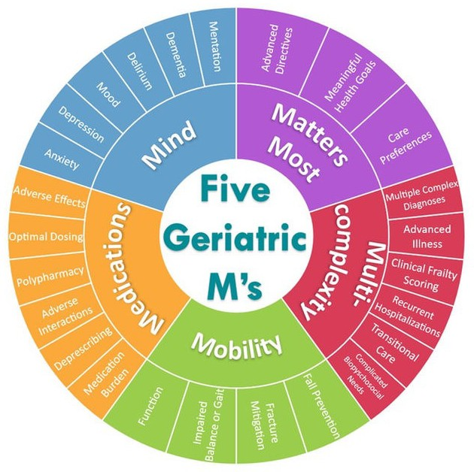
5M Framework in Geriatric Care
American Geriatric Society advocates for the use of an Age Friendly Health System when working with older adults.
This initiative promotes the use of the 5M Framework in geriatric practice.
Five evidence base pillars that shift care based on the unique needs of older adults.
Molnar F, Frank CC. Optimizing geriatric care with the GERIATRIC 5Ms. Can Fam Physician. 2019 Jan;65(1):39

Slide 6
PURPOSE
This endeavor proposes the development, assessment, and efficacy of a student-run wellness clinic for older adults at Sacramento State.
HYPOTHESIS
We hypothesize that a comprehensive, interdisciplinary, community-based program developed at Sacramento State will be effective in supporting the “Healthy Aging” initiative advocated by the American Geriatrics Society.

Slide 7

Thriving Together Clinic
Housed on the third floor of Folsom Hall in the Cardiovascular Wellness Center.
Clinic run every Friday for 2 hours during the spring and fall semesters.
Each participant will sign up for a one-hour session.
Participants will receive biannual assessments.
Student volunteers from PT and RN will assist with assessment.
One faculty member will be present to assist students with assessments.
Notes:
Participants will receive biannual assessments using validated tools aligned with the evidence-based Geriatric 4M framework: Mind, Mobility, Medications, and Multicomplexity. Students in nursing, physical therapy, and audiology will collaboratively conduct standardized assessments of hearing, cognition, strength, balance, frailty, and medication management.

Slide 8
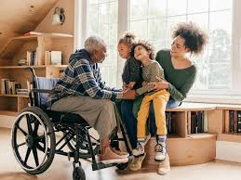
Friday Dates
October 2nd, 9th, 16th, and 30th
November 6th, 13th, and 20th

Slide 9
Assessments Stations
Participants will move through four stations of assessment and education.
MULTI-COMPLEXITY (PT)
Frailty
Sarcopenia
MEDICATIONS (RN)
Polypharmacy
Medication Reconciliation
MATTERS MOST AND MIND (RN)
Delirium
Dementia
Depression
MOBILIITY (PT)
Balance
Strength
Endurance
Notes:
These assessments and educational interventions will be delivered through coordinated interdisciplinary practice within the College, fostering experiential learning while providing meaningful community benefit.

Slide 10
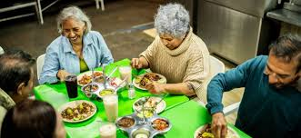
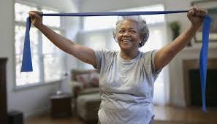
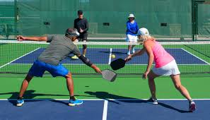
MATTERS MOST
Goals, preferences, and individual priorities in the context of health and wellbeing
Basic vital signs (blood pressure, heart rate, height/weight)
Advanced directive planning

Slide 11
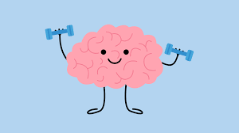

MIND
Quick Screen for Depression
  Patient Health Questionnaire (PHQ-9)
Cognition and Dementia
  Mini-Cog Test

Slide 12

MEDICATIONS
Gather information about current prescriptions, use of over-the-counter medications and supplements, adherence, safety
Discuss concerns
  side-effects
  answer questions

Slide 13
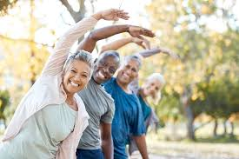
MOBILITY
Assessment of Strength
  30 second Chair Rise Test
Assessment of Endurance
  6-minute Walk Test
Assessment of Balance and Fall Risk
  Timed Up and Go Test

Slide 14
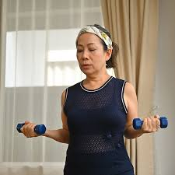
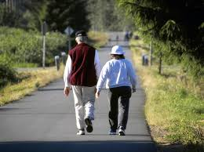
MULTICOMPLEXITY
Sarcopenia
  Handgrip Strength Testing
Frailty
  Walking Speed (4 meter Gait speed Test)

Slide 15
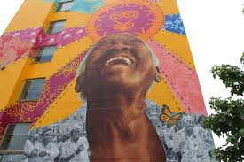
Biannual Visits
Follow-up every six months:
  Updates to health conditions and hospitalizations
  Changes in medications
  Changes in health history since last visit

