Slide 1
Sleep and Cardiovascular disease
Radhika Nandur Bukkapatnam
10/17/2024

Slide 2
Risk Factors for Cardiovascular Disease
Cardiovascular disease (CVD) remains a highly prevalent cause of morbidity and mortality, both in the United States and worldwide.
There has been an increased focus on modification of cardiovascular risk factors for both primary and secondary prevention.
Adults with sleep disorders not only have an increased risk of developing comorbid CVD but also have worse outcomes related to CVD.
Important risk factors for OSA include obesity, craniofacial or oropharyngeal anatomic abnormalities, male sex, and smoking

Slide 3
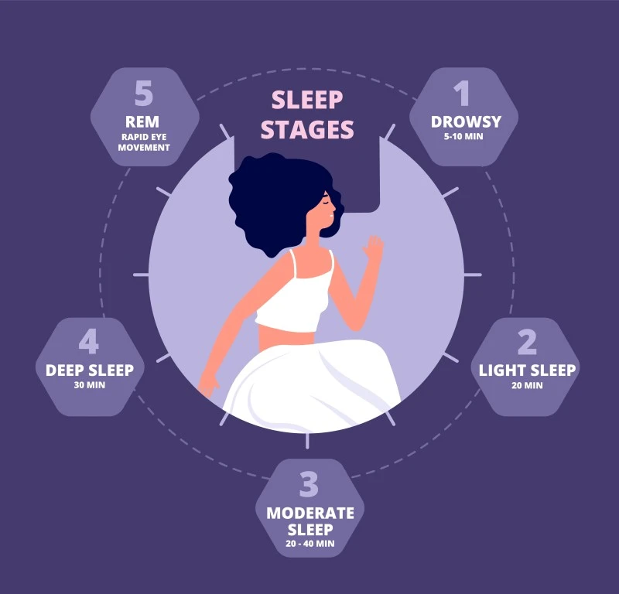

Slide 4
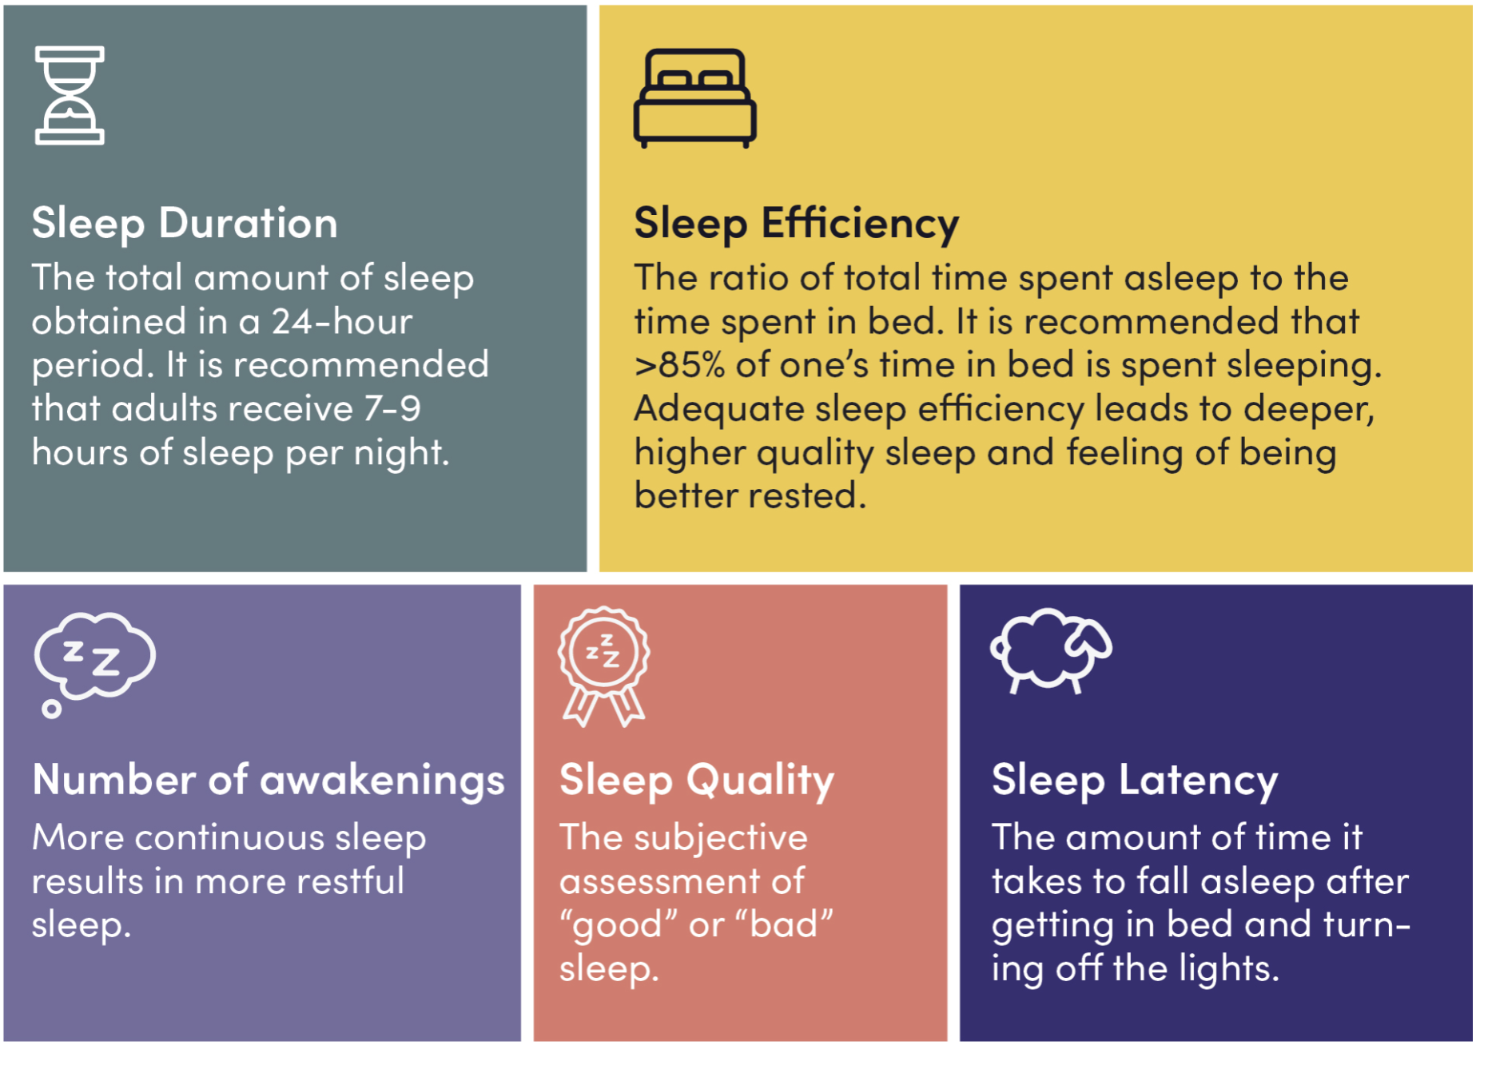

Slide 5
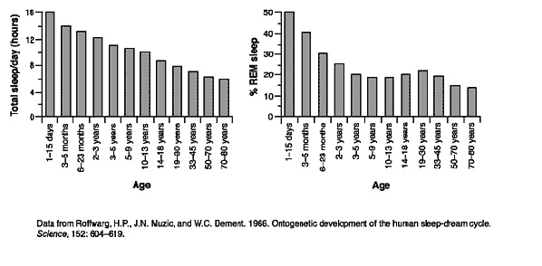
Sleep and Age

Slide 6
Sleep and Ageing
Less total nighttime sleep
Multiple nighttime arousals and awakening
Increased daytime sleepiness
Fragmented sleep-wake cycle
Changes in circadian rhythm
Early morning awakening
Night owl pattern

Slide 7
Sleep Disorders
More than 80 different sleep disorders
Most common disorders
Insomnia/ sleep deprivation
Restless leg syndrome
Narcolepsy
Sleep apnea
1 in 3 adults report not getting adequate sleep
50-70 million Americans have chronic sleep problems

Slide 8
Medical Conditions Affecting Sleep
Primary sleep disorders such as
Obstructive sleep apnea
Periodic limb movement disorder
Restless leg syndrome
Other causes such as
Pain from any source
Neurological conditions such as Parkinson's disease, Alzheimer's
Cardiovascular conditions: CHF, A.fib

Slide 9
Definition of Sleep Apnea
Sleep apnea is characterized by repetitive episodes of apnea occurring during sleep. An apnea is defined as a cessation of inspiratory airflow lasting 10 seconds or more, while the term hypopnea refers to a reduction in inspiratory airflow (by at least 30%) lasting 10 seconds or more with an associated drop in oxygen saturation or arousal from sleep
OSA is prevalent in over a billion people worldwide, estimated to affect 34% of men and 17% of women in the general population² and 40% to 60% of patients with CVD.³ Furthermore, the prevalence is increasing, with these figures representing a 30% increase over the previous 2 decades,² likely related to the obesity epidemic as well as an aging population.

Slide 10
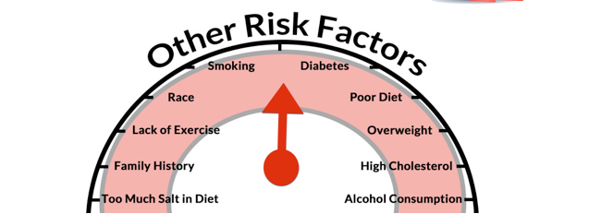
Sleep Apnea as a Risk Factor

Slide 11
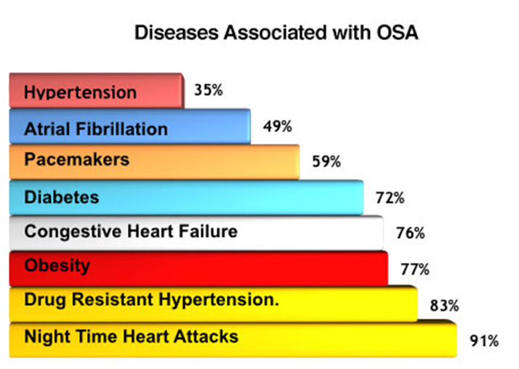

Slide 12
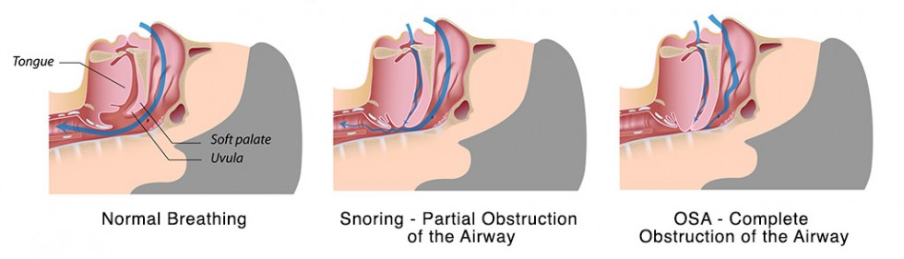
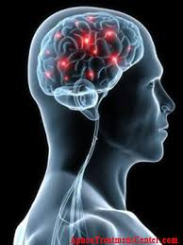
The Mechanism for Apneas or Hypopneas
Obstructive
Central

Slide 13
Signs and Symptoms of Sleep Apnea
Snoring
Witnessed apnea by partner
Gasping
Insomnia with repeated awakenings
Daytime sleepiness
Nonrefreshing sleep
Morning headaches
Memory impairment
Mood changes/ irritability
Nocturia

Slide 14
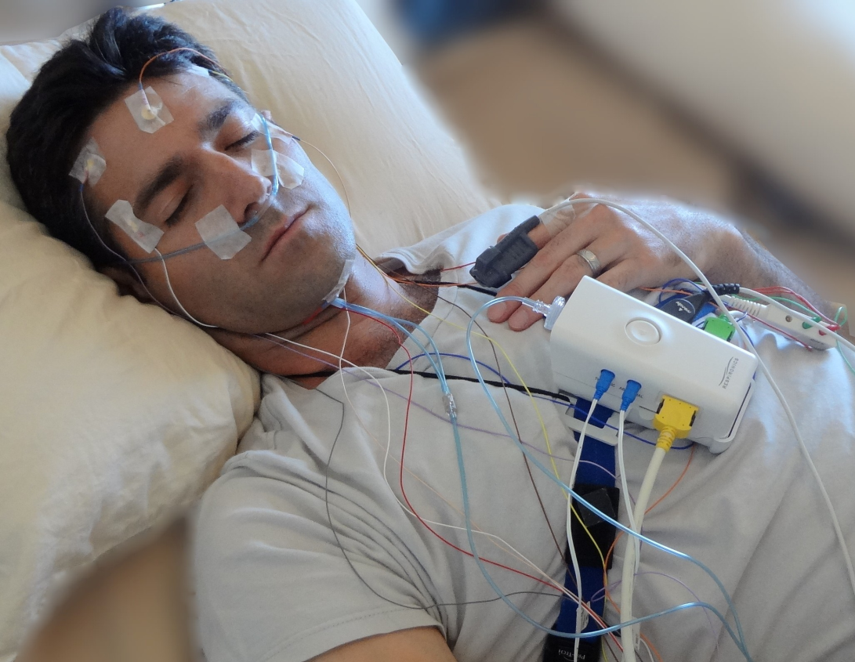
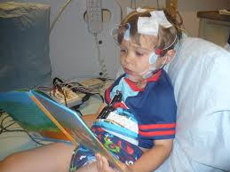
Sleep Study

Slide 15
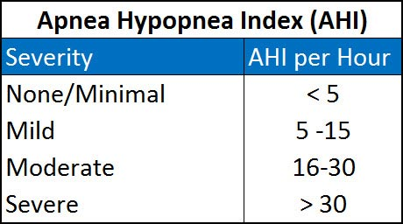
Severity of Sleep Apnea

Slide 16
Treatment
3 Behavioral Therapies for Obstructive Sleep Apnea
Treatment | Patient Selection
Weight loss | All overweight or obese patients should be encouraged to lose weight, as adjunct to primary therapy
Positional therapy | Can be used as either a secondary or adjunctive therapy in patients with significant reduction in nonsupine position as compared with supine Can be considered as primary therapy in select cases when normalization of AHI in a nonsupine position has been demonstrated by polysomnography and adherence can be assured
Avoidance of alcohol or other substances | Patients should be encouraged to minimize alcohol intake Physicians should monitor for and avoid prescribing medications with potential to exacerbate sleep apnea, such as benzodiazepines, opiates, or other central nervous system depressants

Slide 17
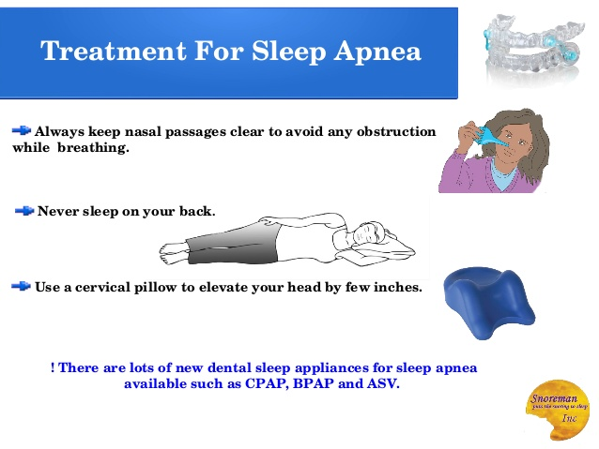

Slide 18
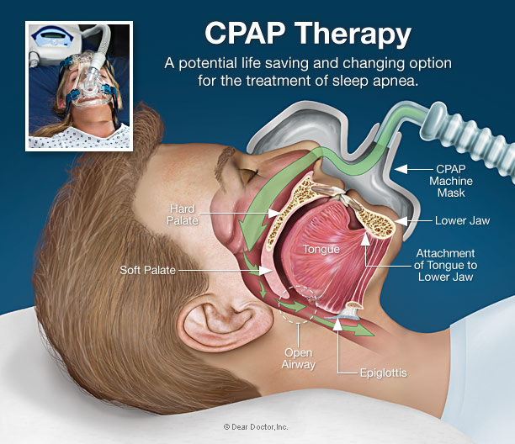

Slide 19
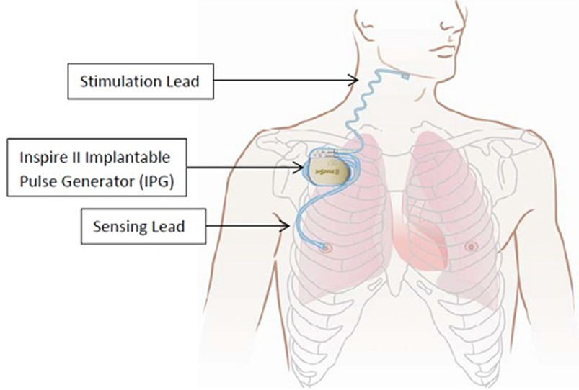
Surgical Options for Treatment
Nasal Surgery
Uvula, pharyngeal surgery
Inspire system

Slide 20
Insomnia/Sleep deprivation
Ability to fall asleep, stay asleep or quality of sleep
Daytime sleepiness, low energy, irritability, difficulty concentrating, focus, depression, anxiety
1 in 2 acute insomnia, 6-10% chronic insomnia (3 nights/w x3 months)
45% increased risk of CVD
Cortisol: increased diabetes, BP and inflammation
54% increased risk of stroke

Slide 21
Narcolepsy
Excessive daytime sleepiness and an inability to regulate sleep-wake cycles normally
Sleep attacks and hallucinations
No cure, but treatment for daytime sleepiness
130-200000 people in US
HBP, stroke, heart attack, heart failure
Diabetes, obesity, depression, OSA

Slide 22
Restless leg syndrome
Neurological disorder that causes your legs to feel uncomfortable or unsettled. It can feel like there’s a “creeping” sensation in your legs, and you may feel an irresistible urge to move them.
7-10% Americans
Increased BP causes CHF, stroke

Slide 23
Sleep disorders and A fib
1 in 4 women between the ages of 50-79 developed AFib, and there was a correlation between sleep disturbances and stress in affected women
Young veterans with insomnia were 32% more likely to develop AFib than those without insomnia.
sleep disturbances, including traumatic brain injury, post-traumatic stress disorder, anxiety and depression and chronic pain

Slide 24
Factors that Disrupt sleep
Depression and anxiety
Medications and other substances:
diuretics, steroids, antidepressants, antihistamines, caffeine, alcohol, nicotine, sugary foods
Poor sleep habits
Shift work syndrome

Slide 25
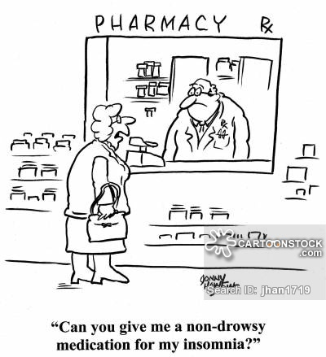

Slide 26
Treatment
Improve sleep habits
Establish regular sleep-wake cycles
Exercise 30 mts/day
Avoid caffeine, alcohol, smoking
Avoid using electronics half hr before bedtime
Establish bedtime routine
Avoid excessive time in bed
Eliminate loud noises, bright lights, maintain comfortable room temperature

Slide 27
Treatment
Non-medication treatments include
behavioral modification
relaxation techniques
sleep restriction
light therapy
cognitive-behavioral therapies including tai chi, yoga, meditation, acupuncture, and acupressure

Slide 28
Non Prescription Sleep Aids
OTC Melatonin
Benadryl, Zzzqyl
Unisom
Valerian root
Homeopathic medication
Please check with your doctor before taking any
of these medications and ensure there is no interaction with other medications.

Slide 29
Treatment
Prescription medications for insomnia
Should not be used for more than 2 weeks at a time
Hangover effect
Most are habit forming, cause dependence
Long term use can affect memory, concentration
Potential for withdrawal after stopping the medication

Slide 30
2009 Adult Obstructive Sleep Apnea Task Force of the American Academy of Sleep Medicine regarding treatment of OSA:
Clinical correlation is necessary to determine whether CPAP‐intolerant patients should be referred for upper airway surgery or oral appliance therapy. A multidisciplinary approach to the management of OSA should be used as appropriate for each individual patient, including involvement of physicians trained in sleep medicine, otolaryngology–head and neck surgery, cardiology, maxillofacial surgery, and dentists trained in sleep dentistry.
All patients with diagnosed OSA should be offered treatment.
Follow‐up sleep testing should be performed to assess efficacy of non‐PAP therapies as part of a routine follow‐up plan in addition to assessment of symptoms and other clinical parameters.
For patients with difficulty tolerating CPAP, attempts at modifying the treatment should be made to improve compliance.

Slide 31
Thank You

