Slide 1
Lipids in Atherosclerosis
Radhika Nandur Bukkapatnam MD MAS

Slide 2
Atherosclerosis
Common cause of cardiovascular disease leading to 7.2 m deaths each year.
Risk factors: Dyslipidemia, hypertension, obesity, smoking, diabetes, abnormal glucose tolerance, age, gender, and family history.
Dyslipidemia is a common condition characterized by high plasma levels of cholesterol, triglycerides, or both

Slide 3
Functions of Lipids
Triglycerides are a key source of calories (energy) throughout the body and also stores excess heat.
Cholesterol is an essential structural constituent of cell membranes and is an essential constituent of some hormones (e.g., steroid hormones).
In healthy people, when levels of glycerides/cholesterol increase within the blood, cells such as hepatocytes secrete lipoproteins that play an essential role in lipid transport, metabolism, and storage.
Binding of lipids to the lipoproteins facilitates a rebalance of lipid metabolism and returns circulating levels of unbound glycerides/cholesterol to more normal levels

Slide 4
Classification of Lipoproteins
Based on their size and density
Very-low-density lipoprotein (VLDLs)
Low-density lipoproteins (LDLs)
Intermediate-density lipoproteins (IDLs)
High-density lipoproteins (HDLs)
Chylomicrons (CM)
The various lipoproteins bind different proportions of triglycerides and cholesterol and are associated with different types of apolipoproteins

Slide 5
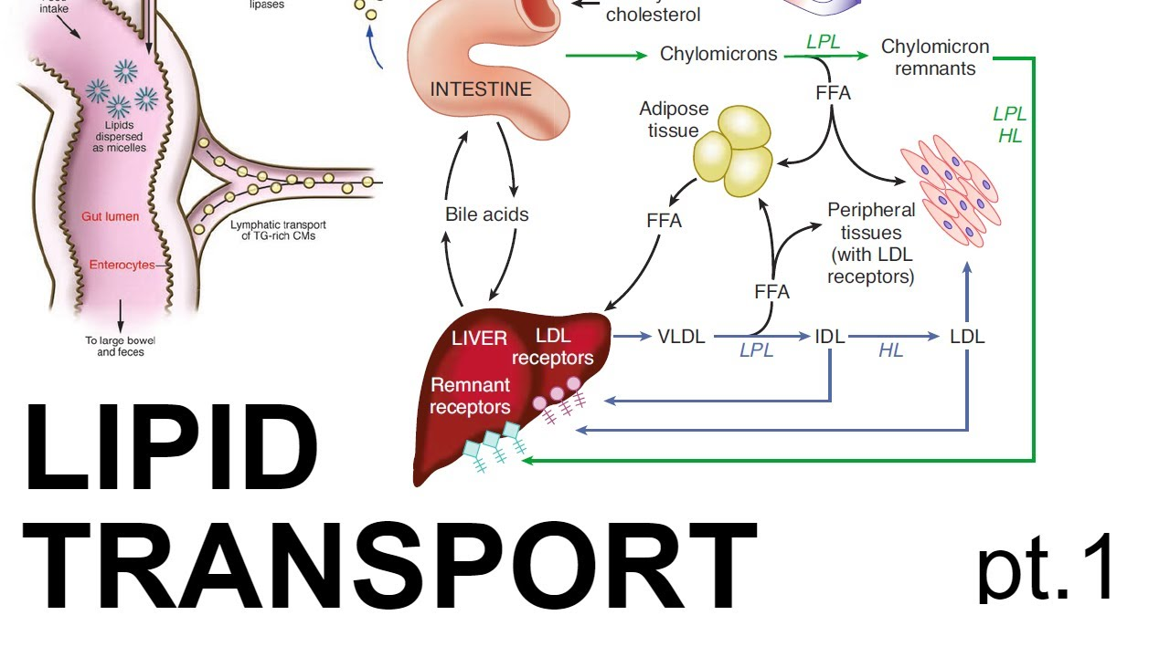

Slide 6
The various lipoproteins work together cohesively to maintain healthy vasculature, including the coronary arteries.
However, with prolonged dyslipidemia, the lipoproteins fail to maintain healthy lipid metabolism, resulting in sustained high levels of cholesterol and triglycerides and accelerated accumulation of lipids in atherosclerotic plaque, thereby exacerbating atherosclerosis.

Slide 7
Pathogenesis of Atherosclerosis
Lipid infiltration, endothelial damage, inflammatory response, platelet aggregation, and thrombosis
Infiltration of lipoproteins, particularly LDL, contributes to the development of atherosclerosis.
LDL often enters and accumulates in subendothelium of the vascular wall
LDL then undergoes oxidative modification
Modified LDLs are captured by the macrophage scavenger receptor system, and ox-LDL production is not controlled by a feedback mechanism, thus resulting in an unlimited uptake
Progresses to intimal thickening and narrowing of the vascular lumen, eventually resulting in vessel occlusion with thrombus formation with resultant clinical symptoms and adverse outcomes.

Slide 8
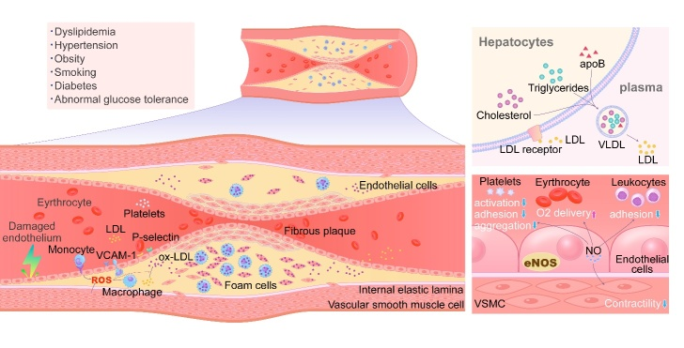

Slide 9
LDL
LDL particles are the main compartment storing serum composed of free triacylglycerols, cholesterol, phospholipids, cholesteryl esters, and apoB and act as the main transporters of cholesterol in human blood
During normal metabolism, LDLs are removed from circulation via LDL receptors on the surface of hepatocytes
Excessive secretion of lipoproteins by the liver and/or ineffective clearance of plasma LDL occurs, circulating levels of LDL rise.
Raised plasma LDL levels results in the initiation and development of atherosclerotic plaques.

Slide 10
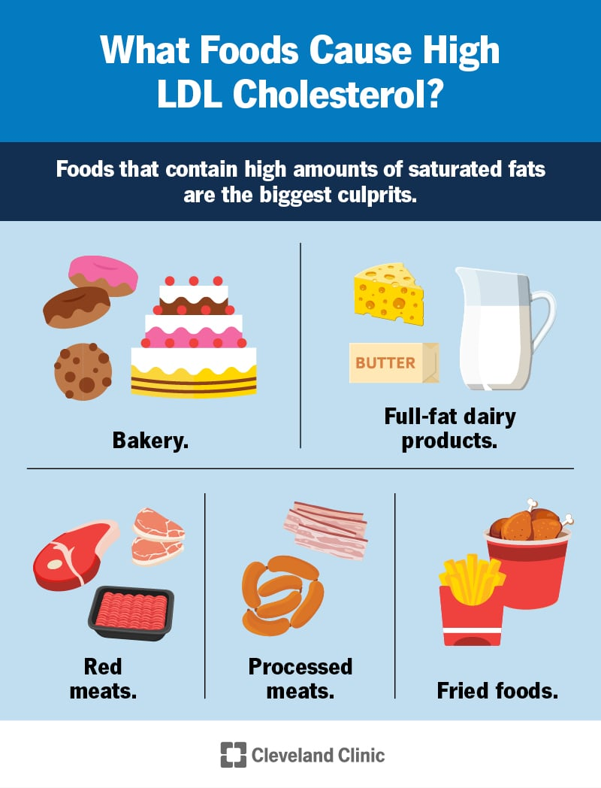

Slide 11
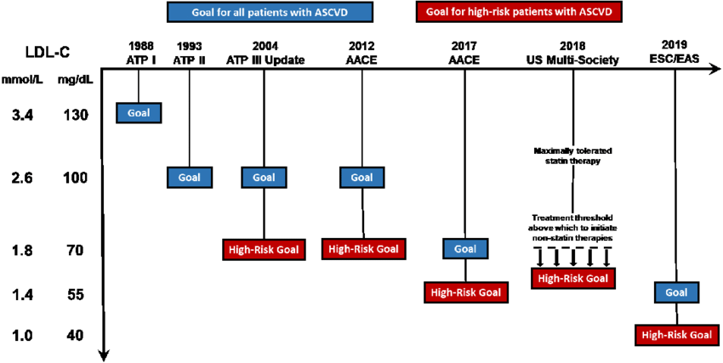

Slide 12
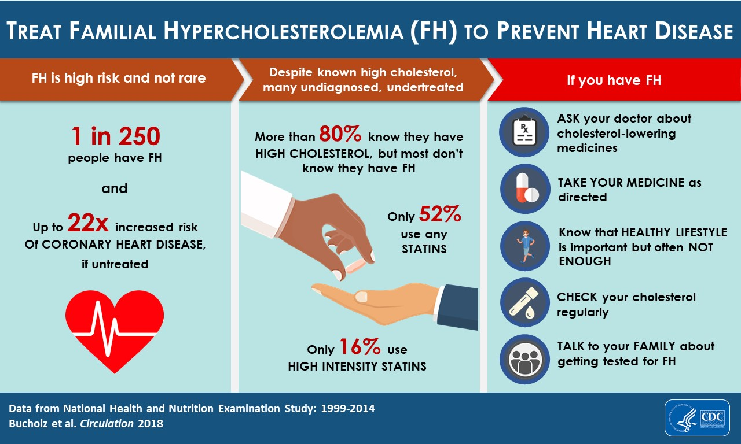

Slide 13
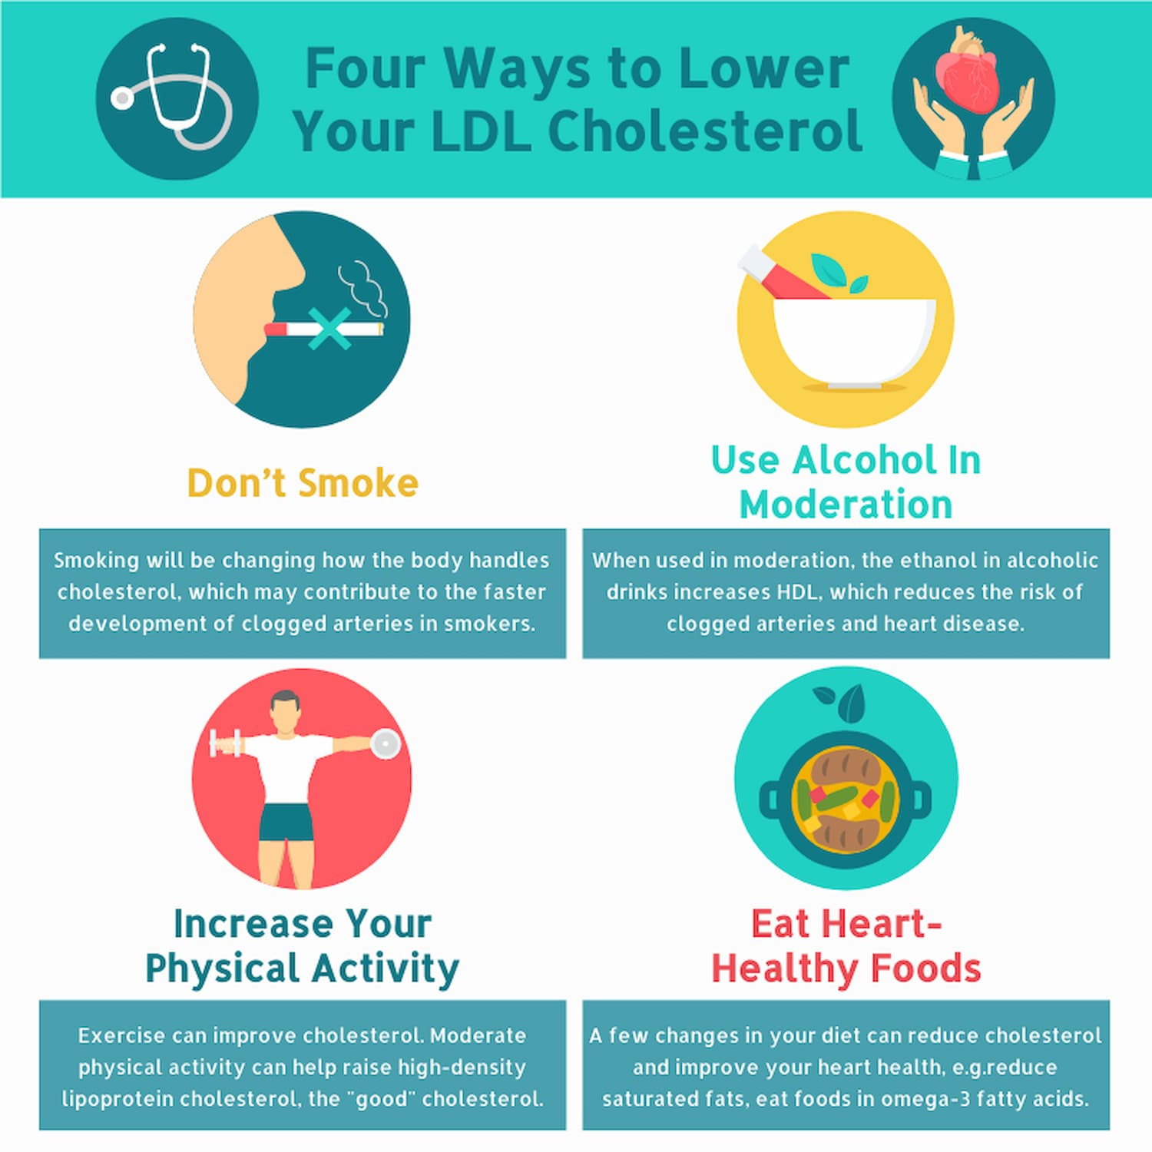
Reduction of LDL

Slide 14
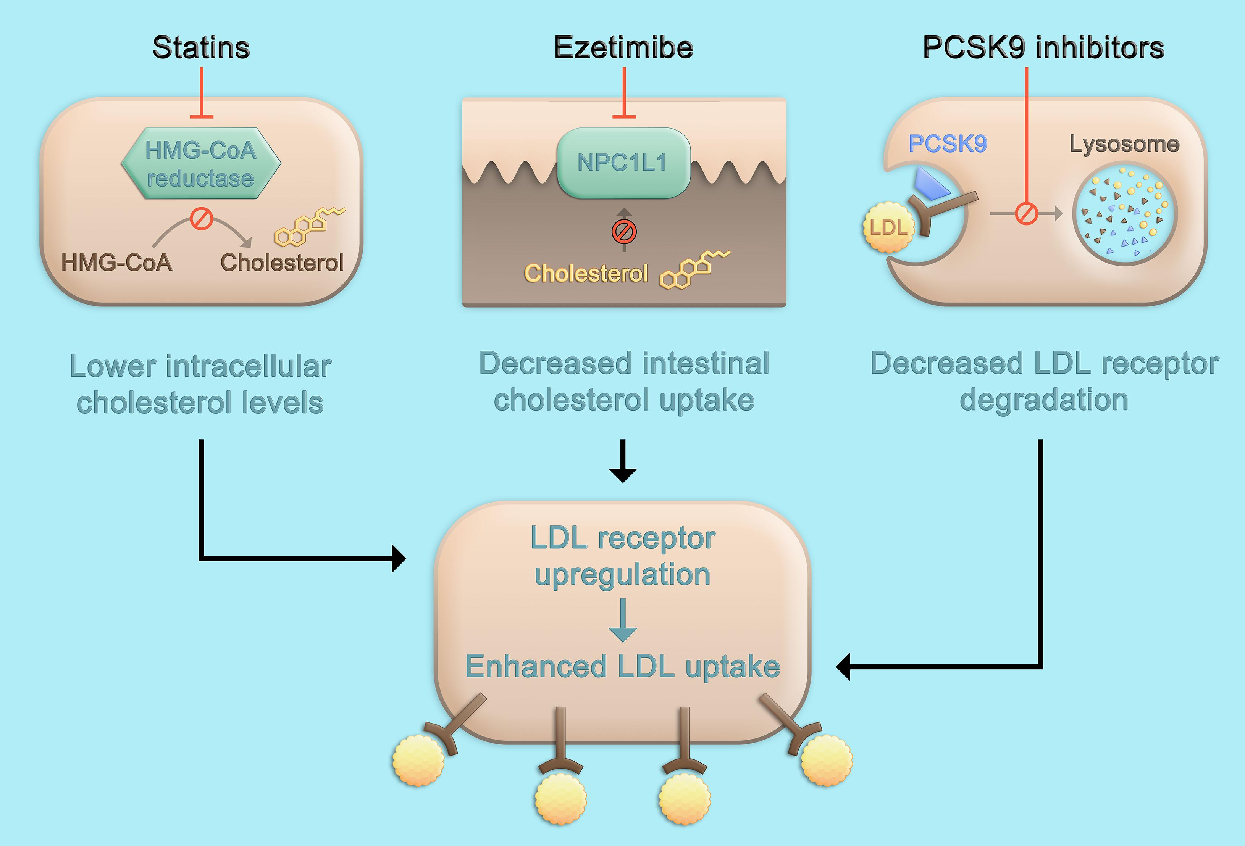

Slide 15
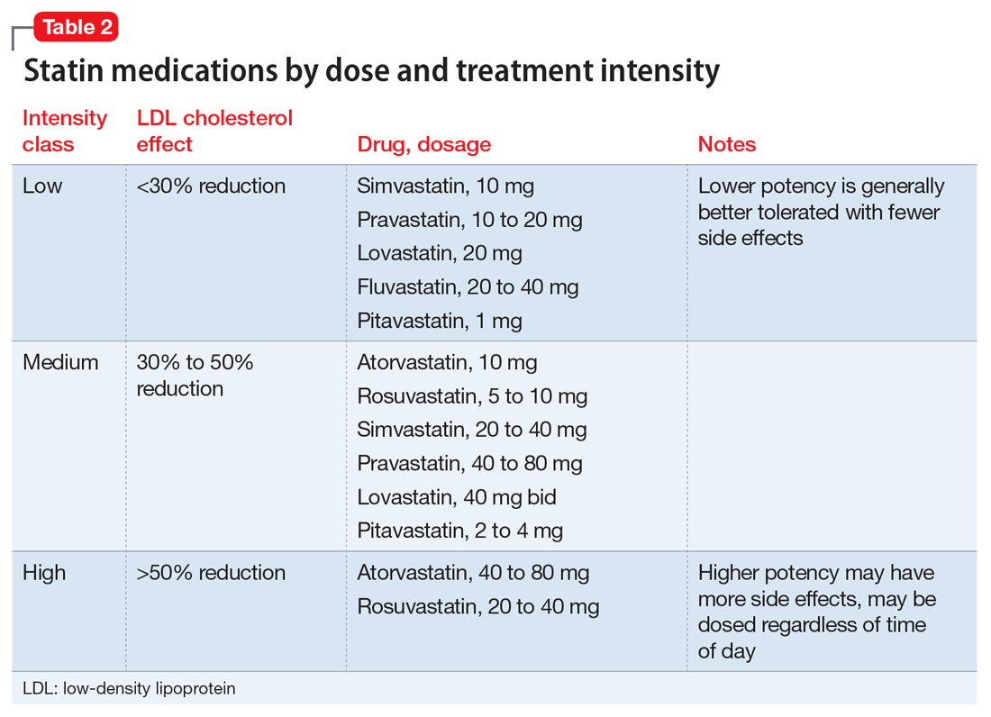

Slide 16
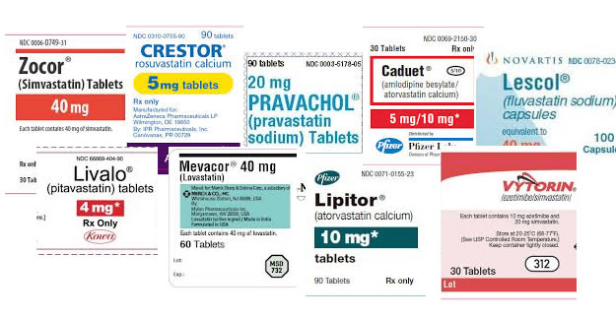

Slide 17
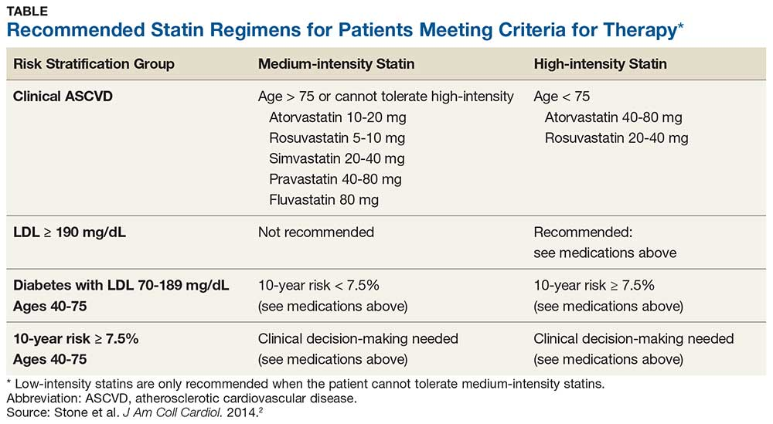

Slide 18
Triglycerides
TGs are transported in plasma by VLDLs, chylomicrons and their remnants created during metabolism
Oxidized free fatty acids can increase expression of inflammatory cytokines and interleukins leading to endothelial inflammation
TRLs may be more atherogenic than LDL, and TRL cholesterol, rather than TGs, may directly promote atherosclerosis development

Slide 19
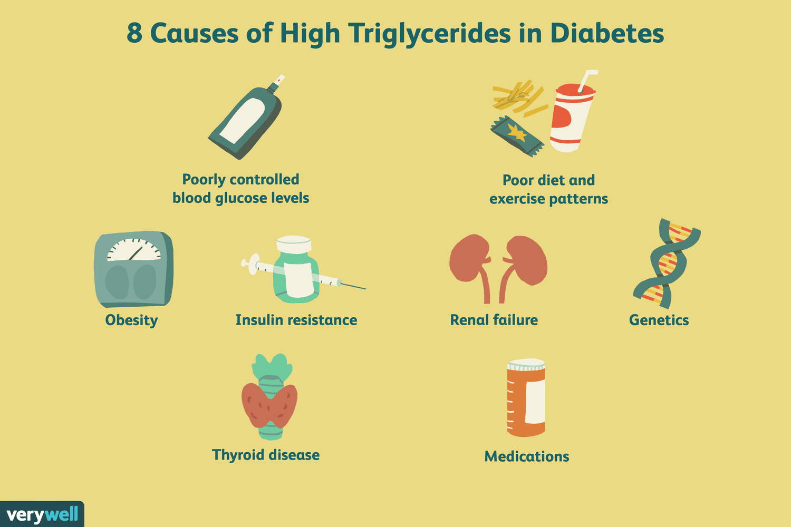
Causes of Triglycerides

Slide 20
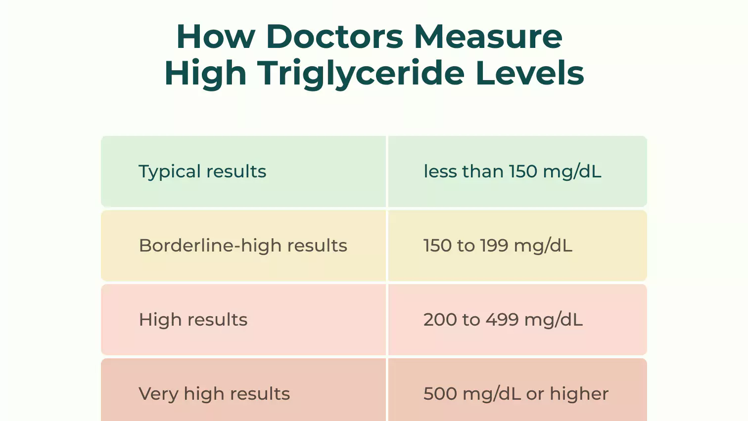

Slide 21
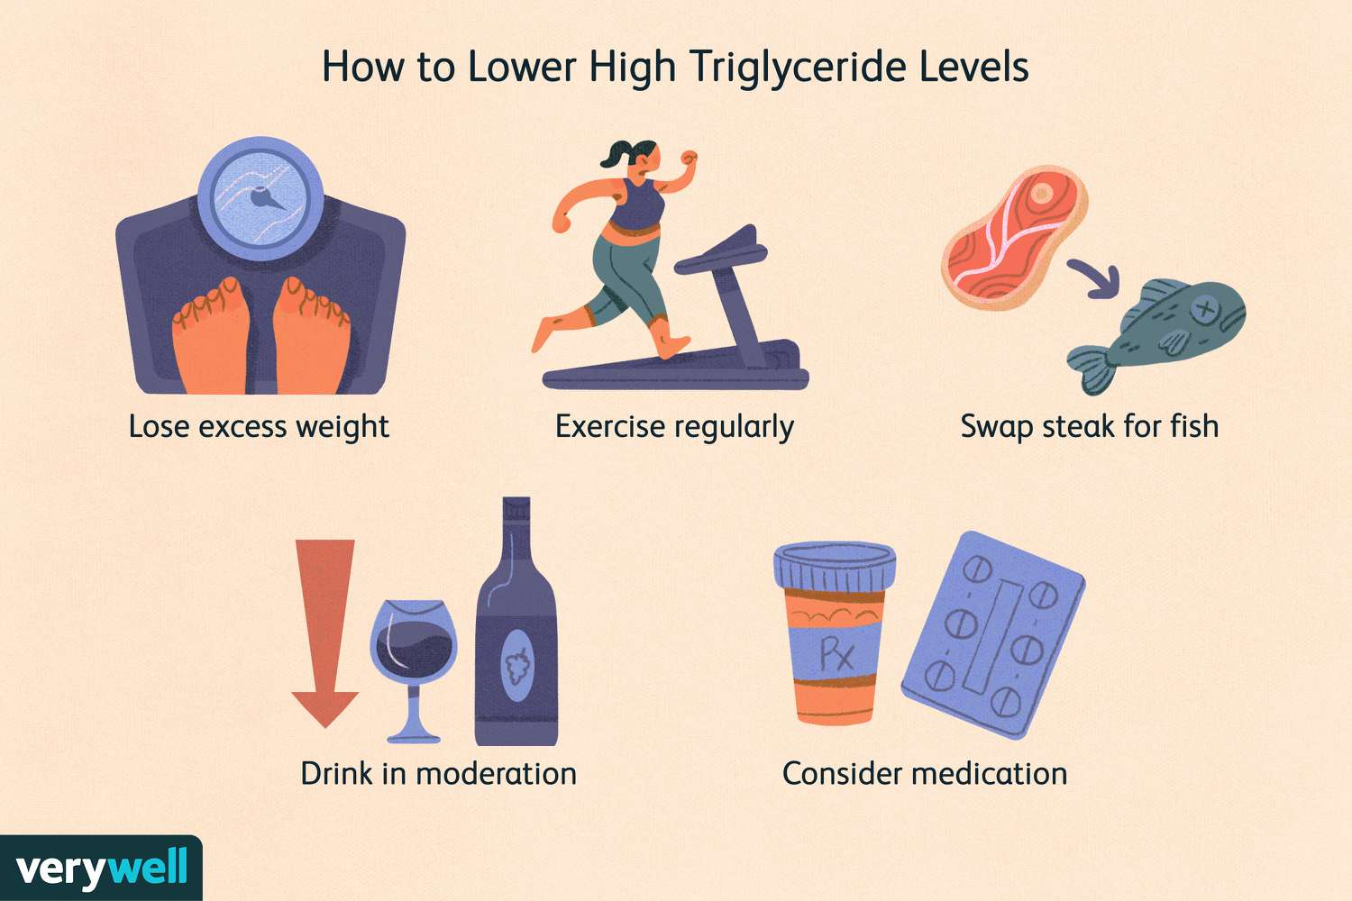
Reduction of Triglycerides

Slide 22
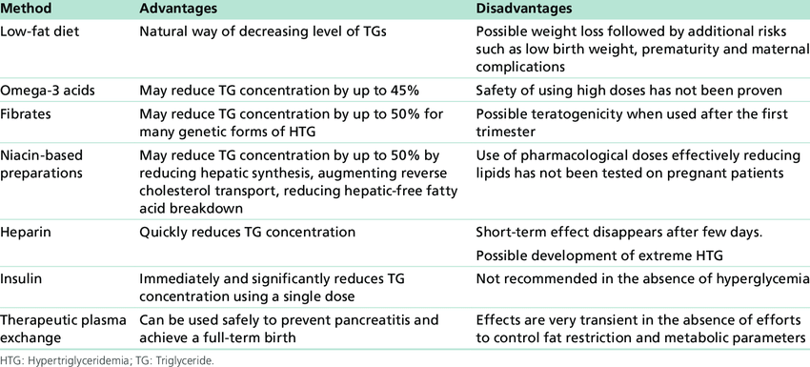

Slide 23
HDL in Atherosclerosis: A double edged sword
Anti-atherogenic properties of HDL particles are mainly facilitated by reverse cholesterol transport (RCT), a catabolic mechanism transferring cholesterol from peripheral tissues to the liver for excretion
HDL level < 40 mg/dL are a risk for heart attack and stroke [51], whilst a healthy level for HDL is >60mg/dL, highlighting the positive role HDL plays in protection from atherosclerosis.
Raising HDL levels can increase the risk of developing atherosclerosis.

Slide 24
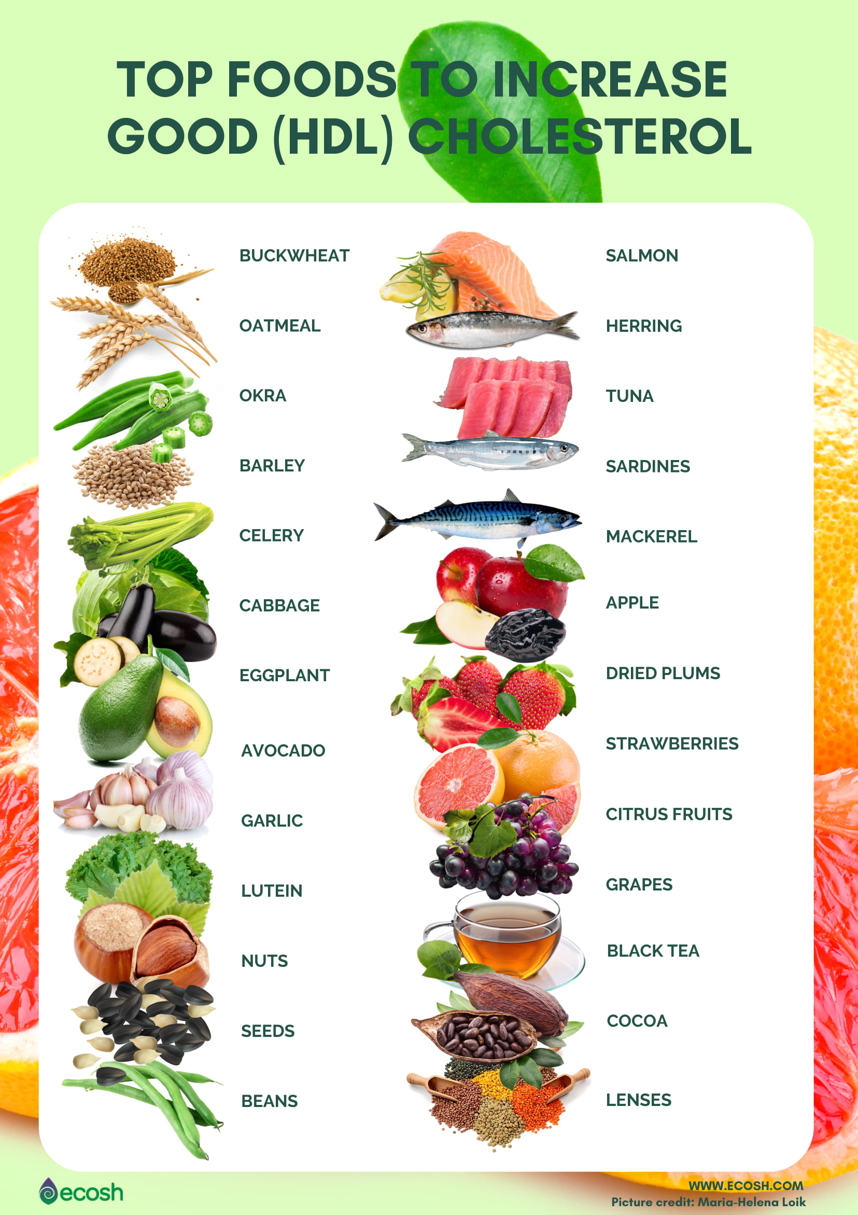

Slide 25
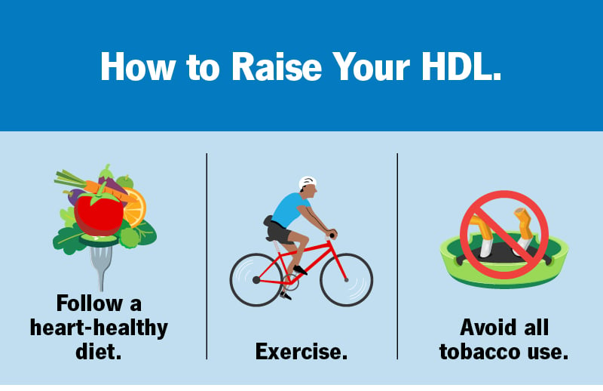

Slide 26
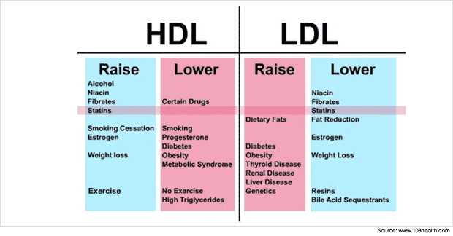

Slide 27
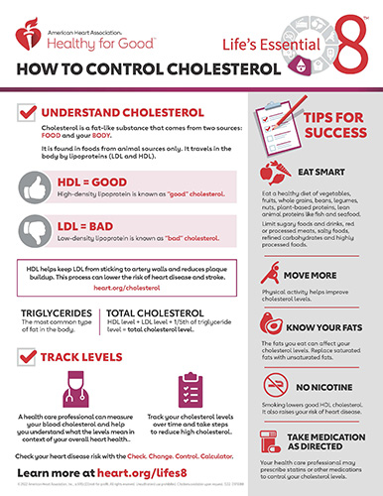

Slide 28
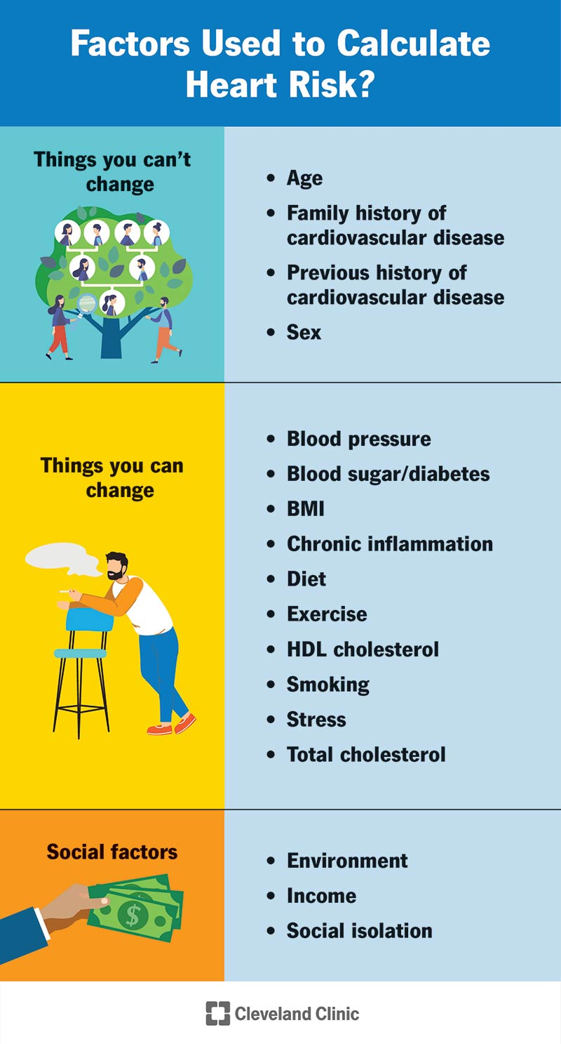

Slide 29
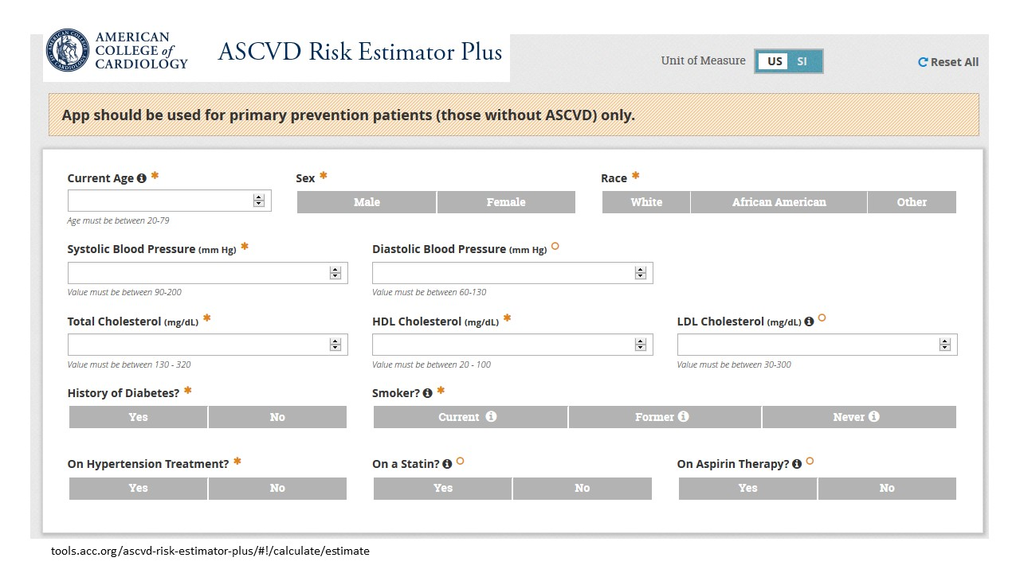

Slide 30
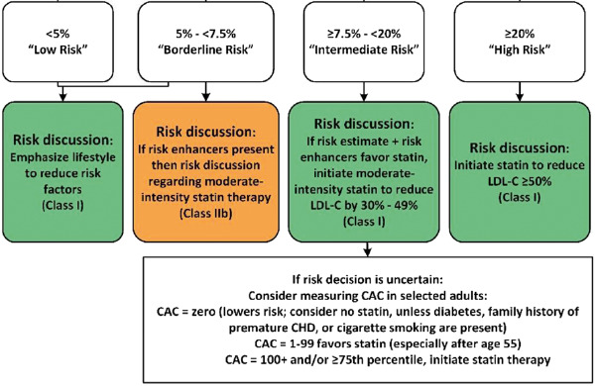

Slide 31
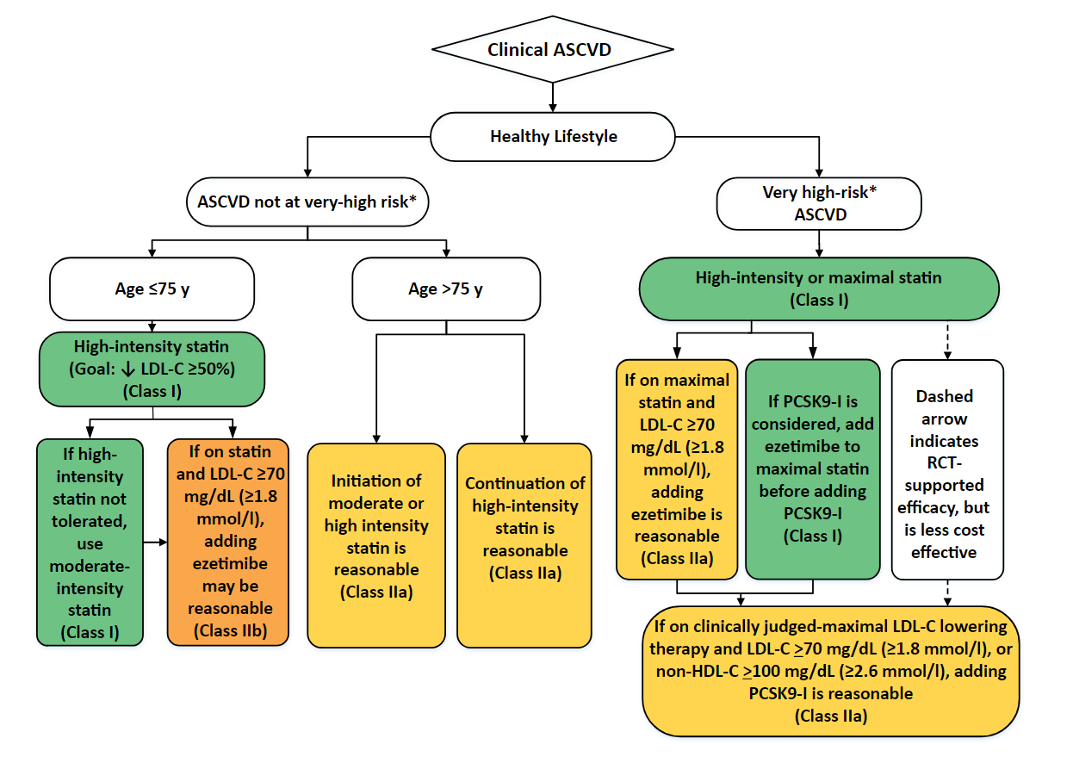

Slide 32
Thank you

Slide 33
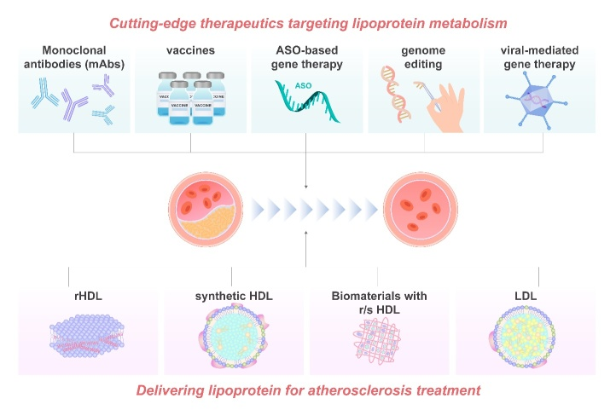

Slide 34
Thank you

