Slide 1

Resolution Re-Boot Making Things Happen
Sharon Myers RN, MA

Slide 2

What ?
What is something you would like to do, but haven’t been able to do yet?

Slide 3
Types of Things You May Want Have Happen...
A single action you’d like to take
Stop a harmful behavior or habit
Start a new helpful/healthful behavior
Change an unhelpful pattern you have e.g. eating snacks on long driving trips, scrolling your phone
Change unhelpful or negative thinking
Judgmental thinking
Self-critical thoughts
Ruminating or worrying thoughts that get you no where
Notes:
Things to think about

Slide 4
Let’s Start by Looking Back...
When in the past have you been successful at making a change or in doing something that was hard for you ?
Did you stop a bad or unhealthy habit?
Did you start a healthy habit ?
Learn to do something new that was hard for you?
Did you resolve an issue that was weighing on you?
Made a needed apology
Made amends

Slide 5
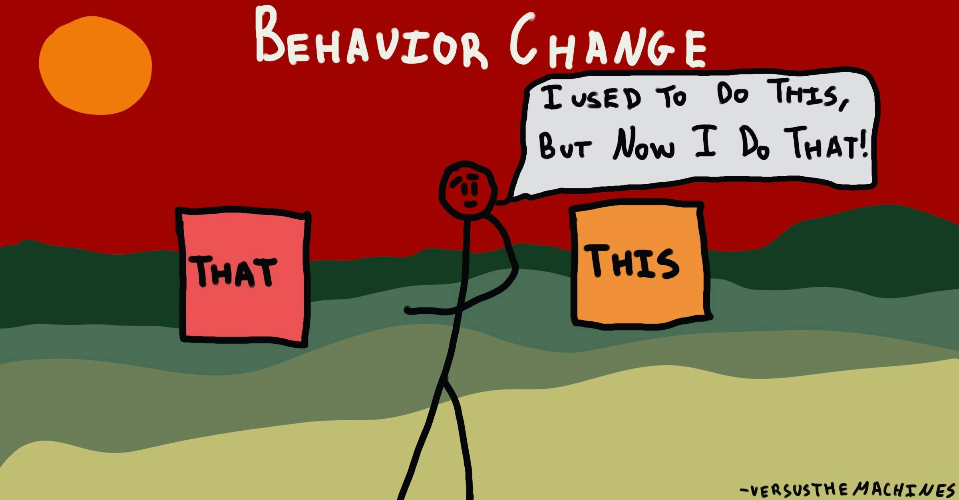
How Did You Do It?
What were the things you did to make the change you made or to move forward in the way you did?
Let’s name some things...
Notes:
You all started and continue to come to the CWP. How were you able to do that? How do you keep yourself coming?

Slide 6

What is Getting in the Way?
Saying “I’m just lazy” is a way to avoid having to do anything
Take some time to figure out why you truly aren’t doing the thing you say you want to do:
Maybe you don’t really want to do it. It isn’t of value to you
Get more information
Maybe you don’t believe the benefit of making the change is worth giving up your old behavior or habit
Mortality example from study
Fear of change, fear of communicating your needs. Fear of shining or being happy
Not feeling like you have the ability to do the new behavior
Poor self –efficacy
Learn some new skills
Get help/support
Depression- Lack of hope
Lack of resources
Money, transportation, physical limitations, know-how etc.
Life-overwhelm

Slide 7
Things That Help Us to Change Our Behavior
Get information-be inspired
e.g. Dr Bukkapatnam’s lecture- BP
Get Support
Tell someone
Do it with someone
Join a support group or form one
Learn the skills you need
Make it easy to do. Something you can do right now with your current resources
Make it hard to do your old behavior
Start with a small step TODAY!
Have a mantra for when negative thoughts appear
Have a substitute to take the place of the negative behavior
Remind yourself frequently of the “why” you want to do it. Make post-it notes
Notice the positives you receive when you do the new behavior or stop the old behavior
Stacking technique-Uses the formula (After..., I will...).Tying the new behavior with something you already have a pathway for
Mindfulness Practice
Association technique-pairing a stimulus (cue) with a behavior

Slide 8
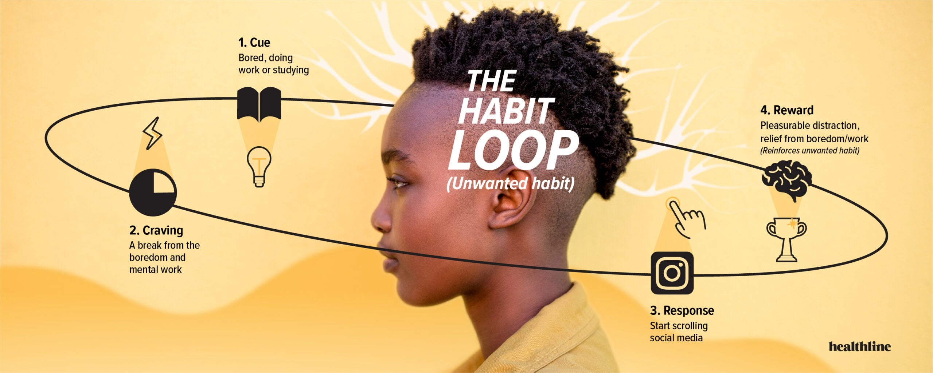
Association Technique How We Create Unwanted Habits
Dopamine
Dopamine
/urge
https://www.healthline.com/health/the-science-of-habit#1

Slide 9
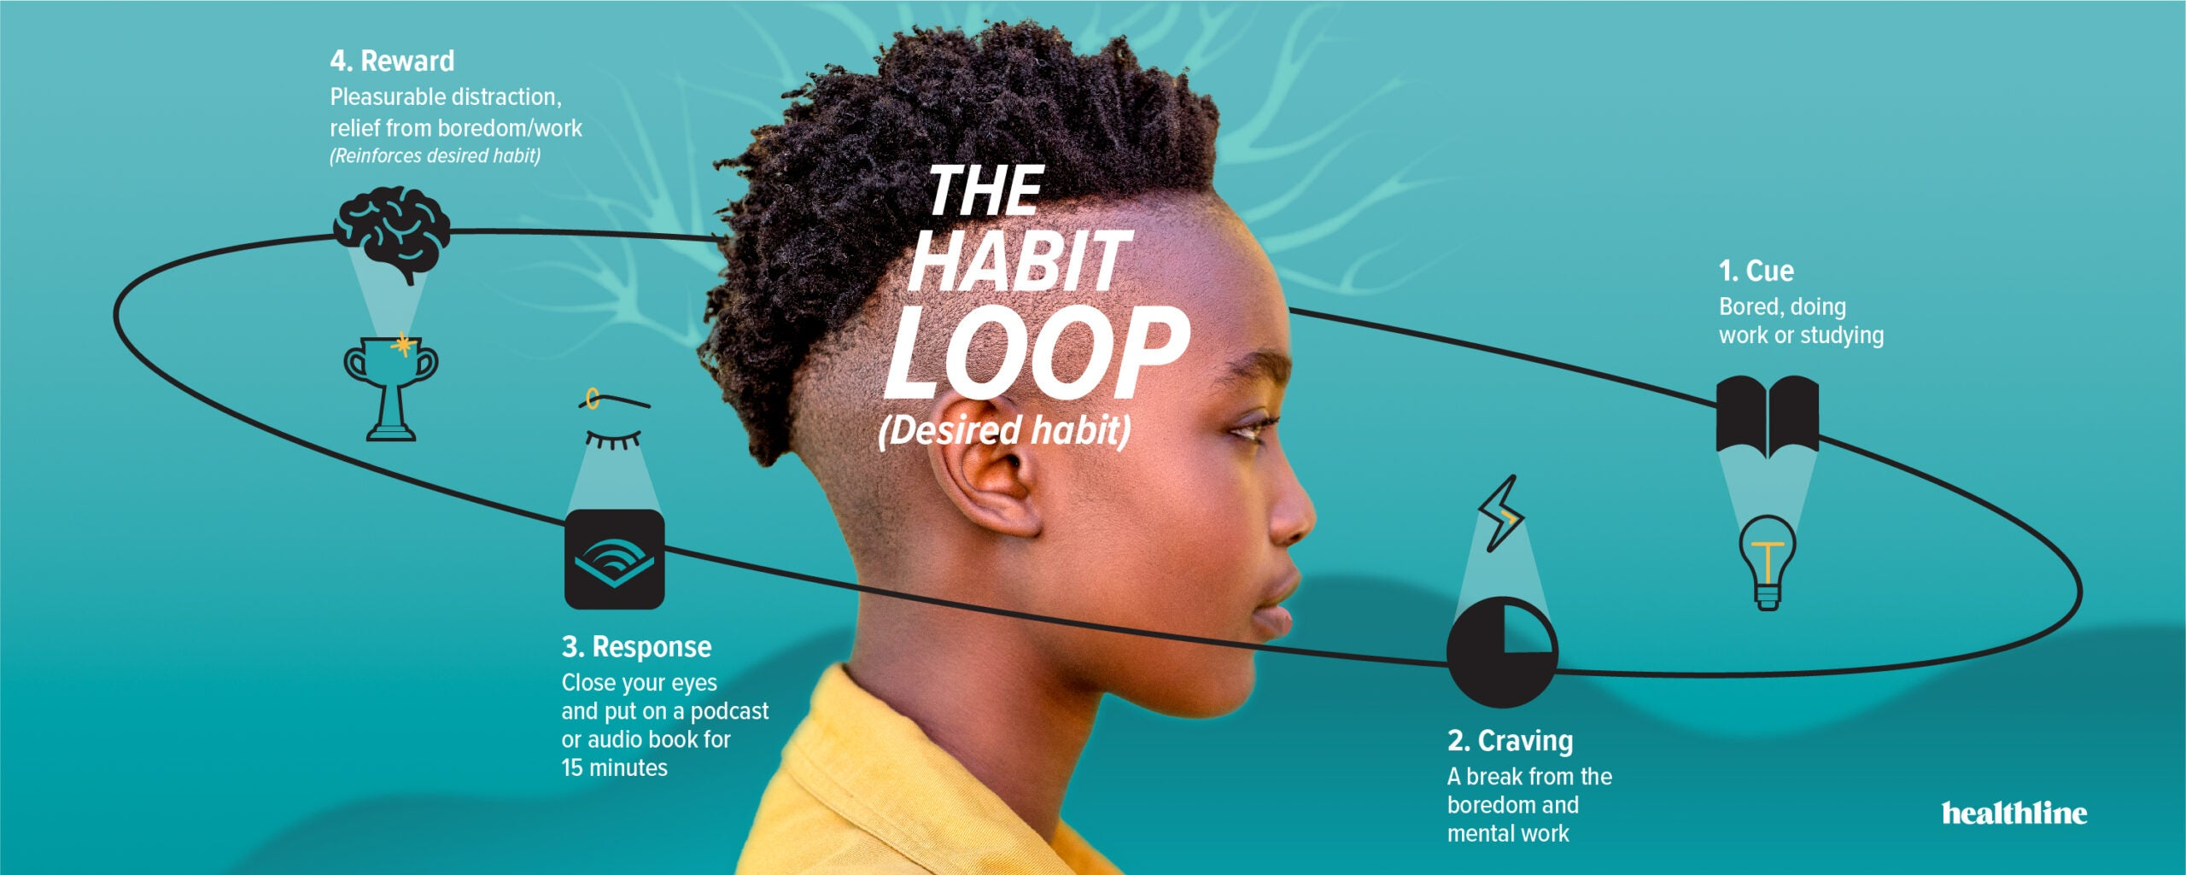
Association Technique How We Create Good habits
Dopamine
/urge
https://www.healthline.com/health/the-science-of-habit#1

Slide 10
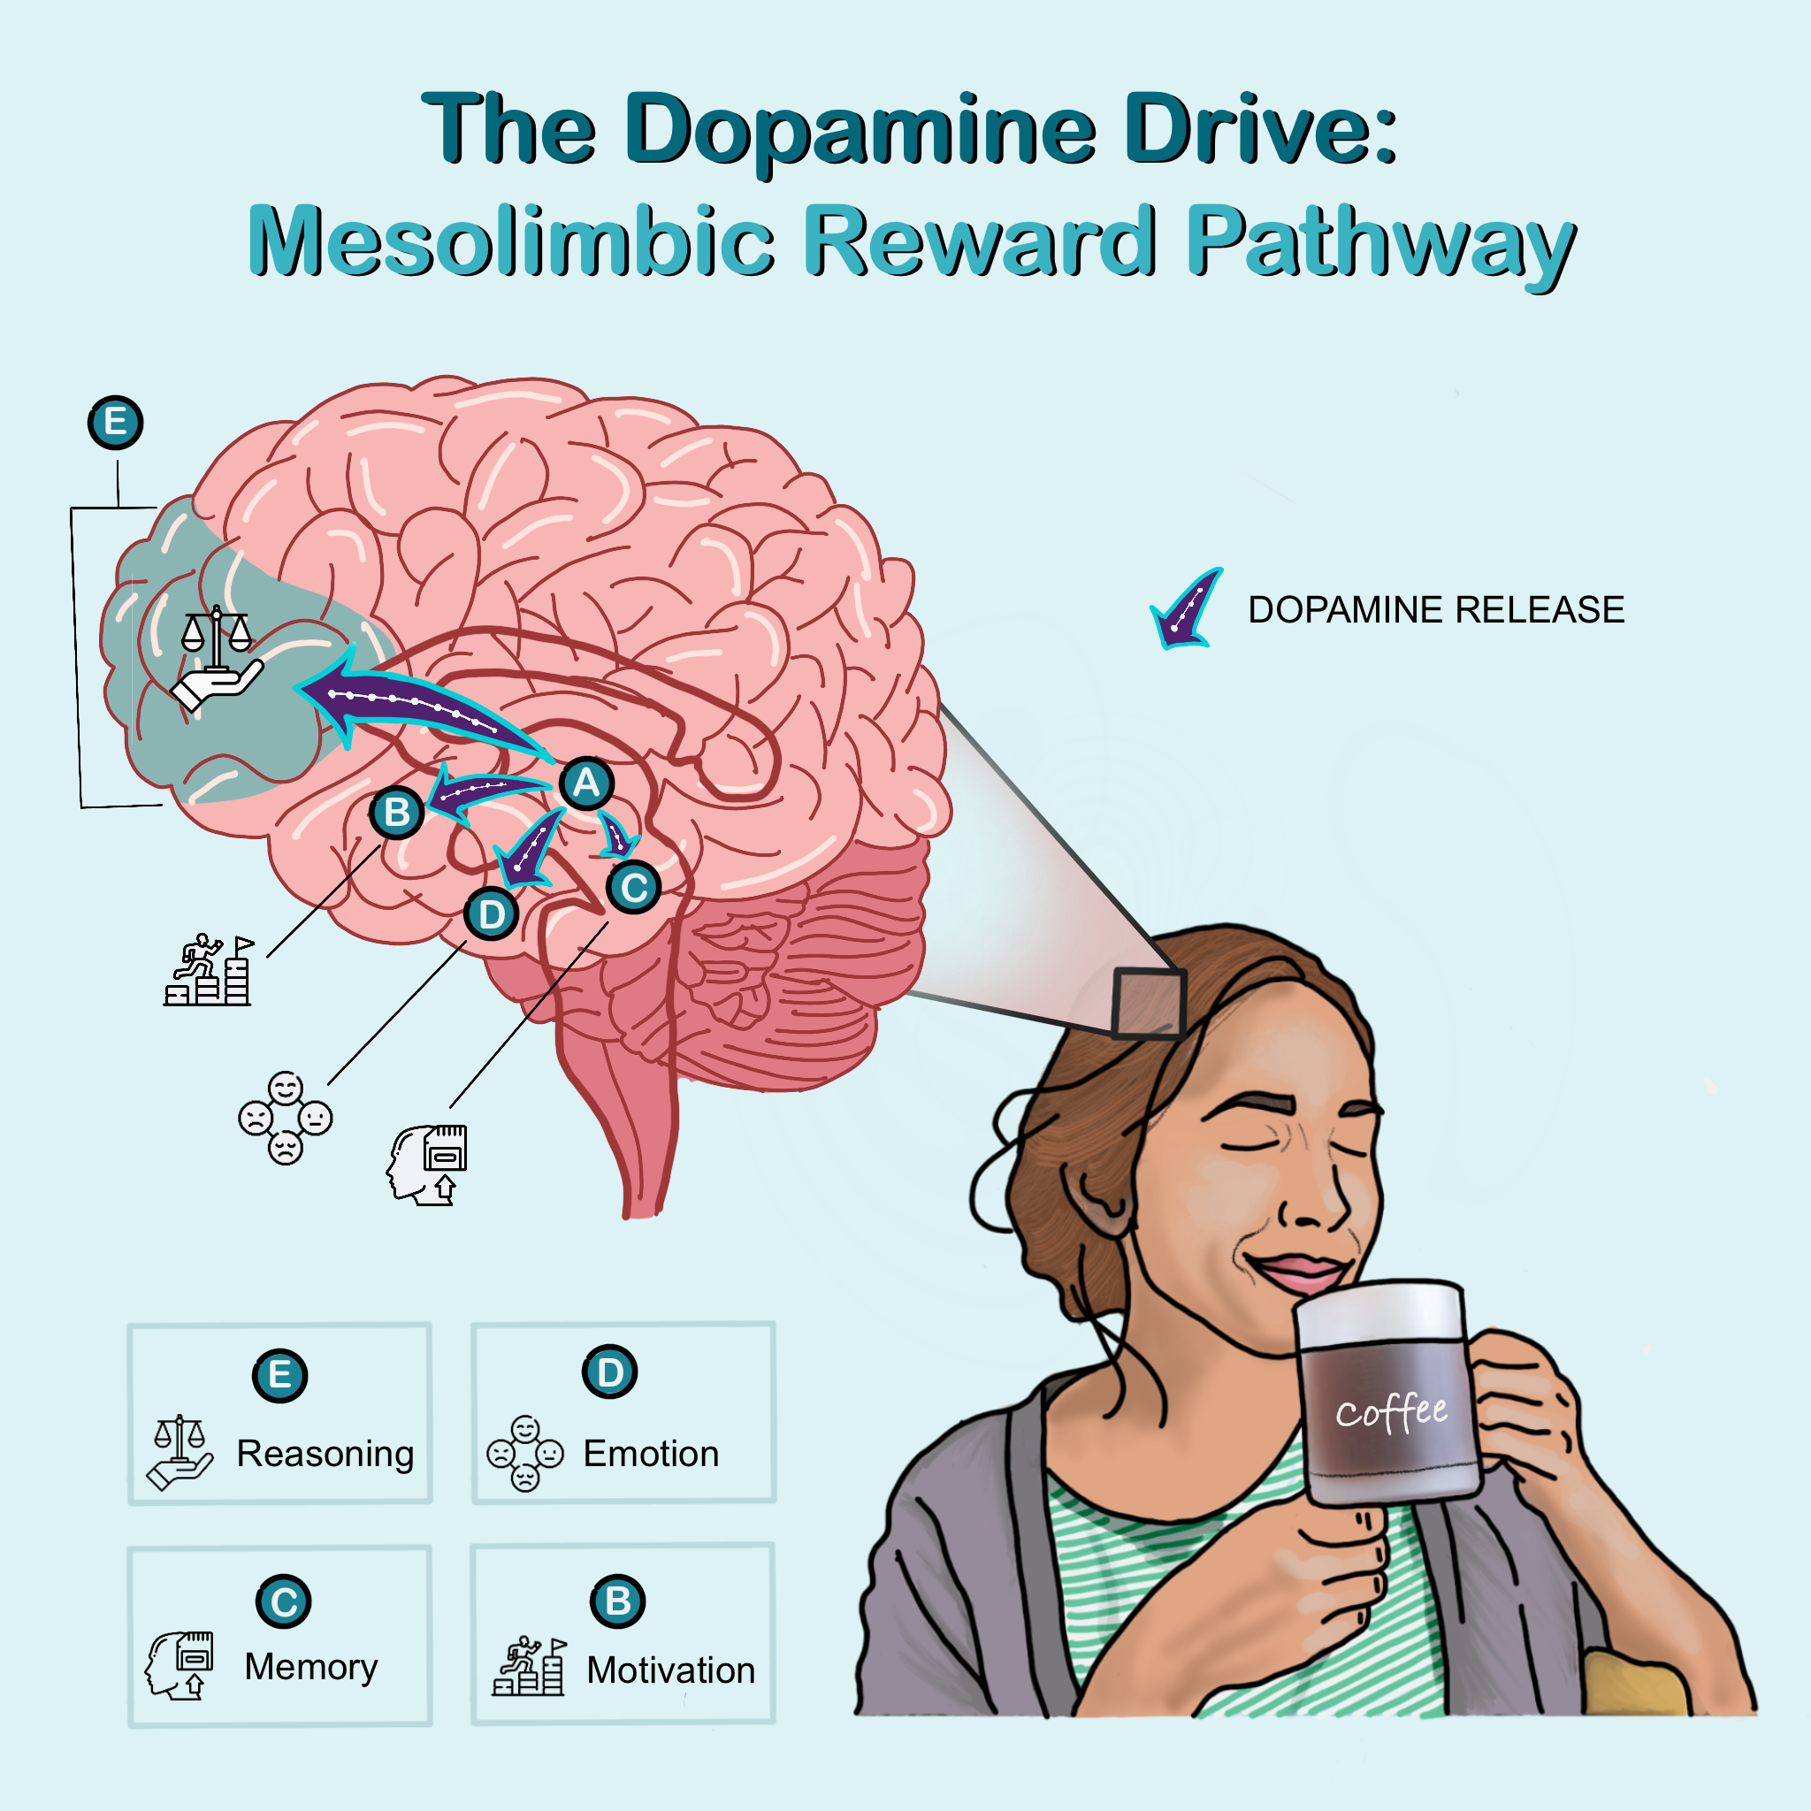
Dopamine Is Important in Habit Formation
We’re wired to avoid pain and to survive.
Your sensory nervous system is always monitoring for actions that keep us safe and avoid pain.
We also get a release of dopamine which is the positive reward for making a connection between a cue and urge ( such as perceived danger, or an uncomfortable feeling) and taking an action that relieves that urge.
Dopamine gives us an intense feeling of reward
Dopamine helps us learn, focus, and affects our mood.

Slide 11
Other Things to Keep in Mind
It will not be easy
Change is uncomfortable
Your brain believes you are putting yourself in danger when you break out of old patterns
Every time you do a new behavior you are training your brain and making those new pathways stronger
Be happy you are having urges telling you to do your old unhealthy habit, because that just gives you an opportunity to practice not acting on them. And an opportunity to build a new pathway for your new better habit.

Slide 12
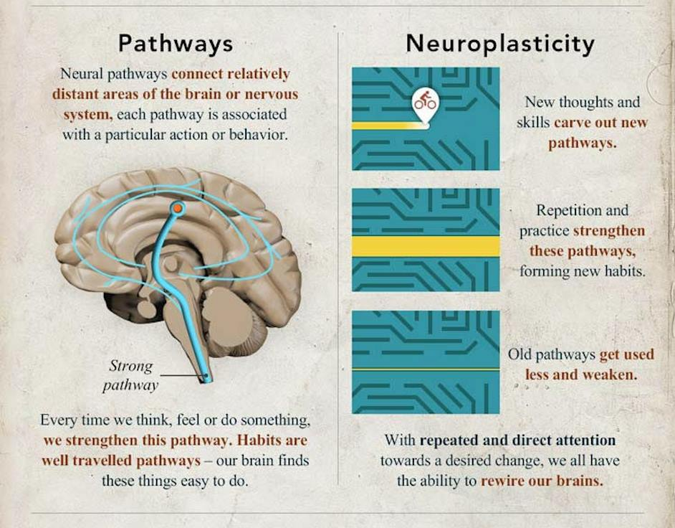
The Habit Loop Creates a Pathway in the Brain
Neuroplasticity and habits are closely intertwined.
When you intentionally introduce new behaviors or habits, you are forging new neural pathways in your brain.
As you repeat behaviors, good or bad, the corresponding neural connections grow stronger. The habit grows stronger.
You can rewire your brain by consciously choosing to perform new good or health- oriented habits that are of value to you.

Slide 13

The Steps To Change Your Behavior and Rewire Your Brain
Focus on the “Why”
The change you want to make must be important or meaningful to YOU
What is it that I value about creating this new habit or stopping the old habit?
Do some reflection on why the behavior change you are wanting to make is important to you
Visualize the you and what your life will look like once the old habit is not longer present, and what it will look like with the new healthy habit?

Slide 14
The Steps To Change Your Behavior and Rewire Your Brain cont.
Set up your environment to support your success
Hang out with like minded people who are doing what you are trying to do
Make it easy to do your new behavior
Make it hard to do your old behavior
Have a substitute for your old bad behavior.
Must be something quick & easy
Must give you a little dopamine hit
Association technique
Stacking technique
Mindfulness Practice- meditation, deep breathing, Qigong
Get Support

Slide 15
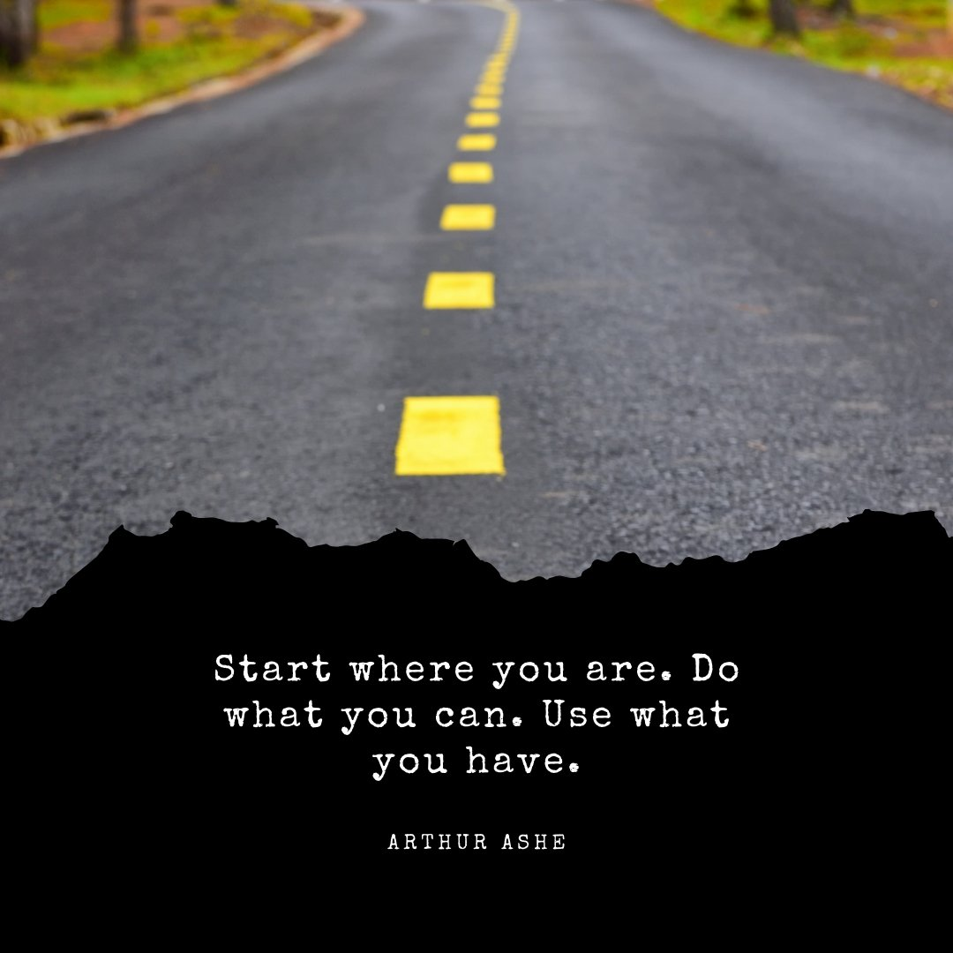
What You Wanted to Know... How to Avoid Procrastination
The 5 minute Rule –Set an alarm and do the task for just a 5 minutes
Set a short/easy deadline for yourself
Tell yourself you will just go walk for 5 minutes- (you do you)
Finish cleaning one drawer
Do the hard and important tasks first. ...
Manage your environment
Make it easier to do
Reminder with a box to check off
Tell someone you are going to do the a particular action
Ask someone to come over and sit with you for 30 minutes to start

Slide 16
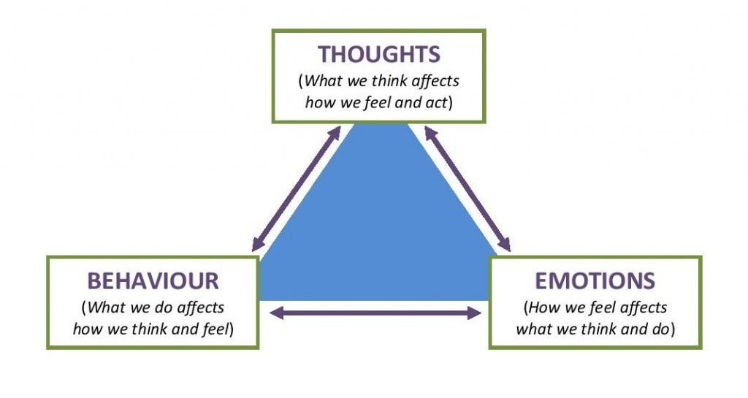
How to Avoid Procrastination cont.
Start before you are ready
Don’t prepare
Don’t wait until you feel like doing it
Start with the behavior

Slide 17
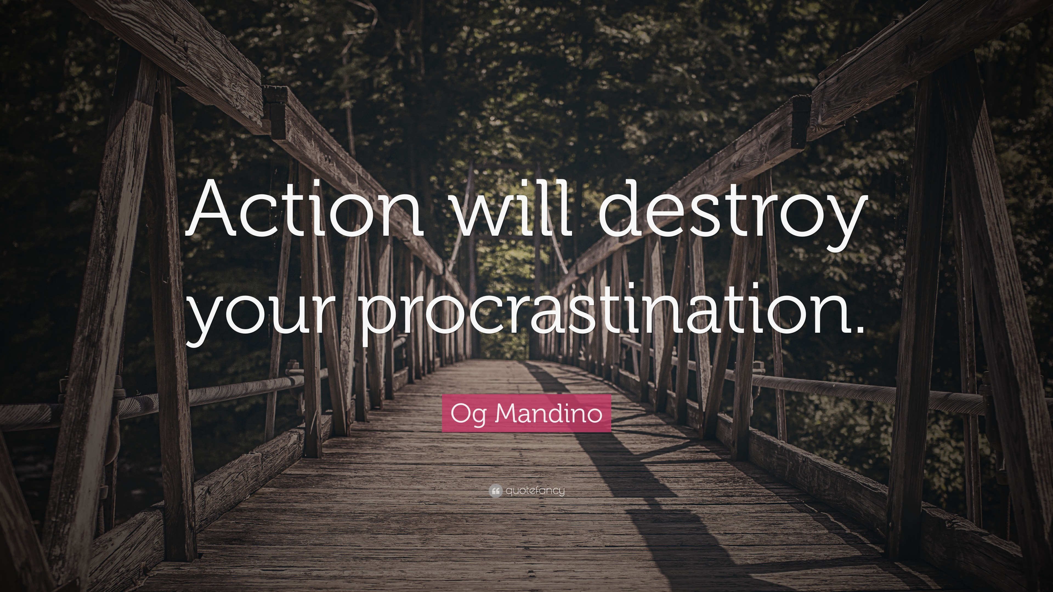

Slide 18
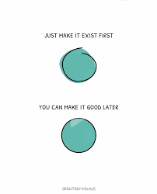
Avoid Doing Things Perfectly

Slide 19
What You Wanted to Know... How to Get Motivated
Things that sap your motivation:
Fear of Failure/Success: Prevents trying or completing goals due to anxiety about outcomes. Feeling like you’re not good enough
Negative Thinking: A negative outlook drains energy. Notice what you are thinking…
Feeling Overwhelmed: Having too much to do or goals that seem too big.
Lack of Identity/Purpose: Not knowing your why.
Lack of Goal Clarity- Does it align with your values and desires?
Perfection hinders motivation

Slide 20
How to Get Motivated- How to Fight Back…
Start Small: Take tiny steps to build momentum. One success leads to another
Notice any positive feelings in mind or body when you do the new behavior or avoid the behavior you are trying to stop
Keep your “Why” front and center in your mind. Have reminders of your why
Does your goal align with your values and/or desires?
Work on the things in your life that may be making you feel overwhelmed
Manage Environment:
Have things in your environment that support what you want to do
Get rid of the things in your environment that support your unhealthy behavior
Make a reminder to remember to do the new behavior
Get support in some way
Make your new behavior exist in some small way

Slide 21

What Can You Do Today or Right This Moment to
Go in the Direction of Doing the Thing You Want to Do?

Slide 22
References
Books:
Atomic Habits- James Clear
Brain Over Binge- Katheryn Hansen
Rational Recovery –Jack Timpey
The Little Book of Big Change- Amy Johnson
Journal Article:
Wyatt, Zoe, Neuroscience of Habit Formation, Neurology and Neuroscience(2024)

Slide 23

Questions or Comments

