Slide 1

Older Adults and Mental Health!

Slide 2
Older Adults & Mental Health
CWp 2021-2024

Slide 3

Comparison between Mental Health and Sleep Habits in Older Adults in 2021, 2022 & 2023
M age by year
  2021 (n = 55) M = 68.32,
  2022 (n = 45) M = 74.9
  2023 (n = 53) M = 72.77.

Slide 4
Geriatric Depression scale
The GDS –is a screening tool used to identify depressive symptoms in older adults
Normal 0-9
Moderate 10-19
Severe 20-30

Slide 5
Questions
Do you feel happy most of the time?
Do you often feel helpless?
Do you feel worthless the way you are now?
Have you dropped many of your activities and interests?
Do you prefer to stay at home rather than going out and doing new things?

Slide 6
GDS
.

Slide 7
Epiworth Sleepiness Inventory
Typical situations include:
Sitting and reading
Watching TV
Sitting inactive in a public place (e.g., theater, meeting)
Riding as a passenger in a car for an hour
Lying down to rest in the afternoon
Sitting and talking to someone

Slide 8
Scores
0-9 | 10-12 | 13-15 | 16-24
Normal | Mild | Moderate | Severe

Slide 9
EPS

Slide 10

Pittsburgh Sleep Quality Index
Many questions about sleep duration & Quality
High scores 5 & above poor sleepers
Score 5 or less Good sleepers

Slide 11
PSQI

Slide 12
Good vs Poor Sleepers
Does it Affect their Your mood?

Slide 13
Epworth’s Sleepiness Inventory & Sleep Type

Slide 14
Beck’s Norms
1-10____________________These ups and downs are considered normal 11-16___________________ Mild mood disturbance 17-20___________________Borderline clinical depression 21-30___________________Moderate depression 31-40___________________Severe depression over 40__________________Extreme depression

Slide 15
Beck’s and Sleep Habits

Slide 16
New Research
Is Gaming Beneficial to older adults ?

Slide 17
New Research Indicates
Older adults-Benefit from games, crossword puzzles & computer games
  Helps memory
  Attention improves
There is ample evidence that computer games improve cognition in adults Jaffe et al., (2022).
A Systematic Review on Serious Games in Attention Rehabilitation and Their Effects see Shahmoradi et al., 2022.
In 2009, researchers used brain Imaging and showed that playing Tetris leads to an increase in brain stimulation (Jung et al., 2009).

Slide 18
What Games do Older adults play?

Slide 19
What Devices are used for gaming?

Slide 20
How many Days of week played & hours per day

Slide 21
Does Gaming have effect on mental health?
Notes:
71 N size

Slide 22
Gamers Vs Non Gamers

Slide 23
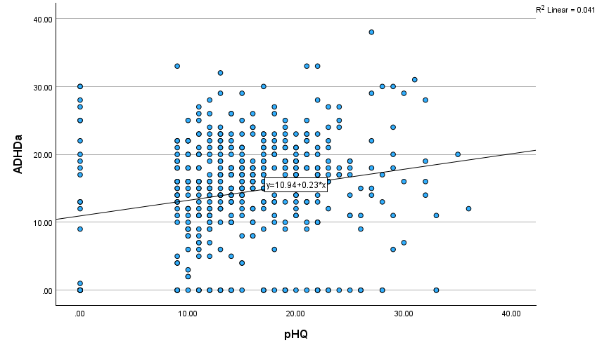
Correlations- Scores higher on ADHD inattentive tendencies then increase depression PhQ

Slide 24
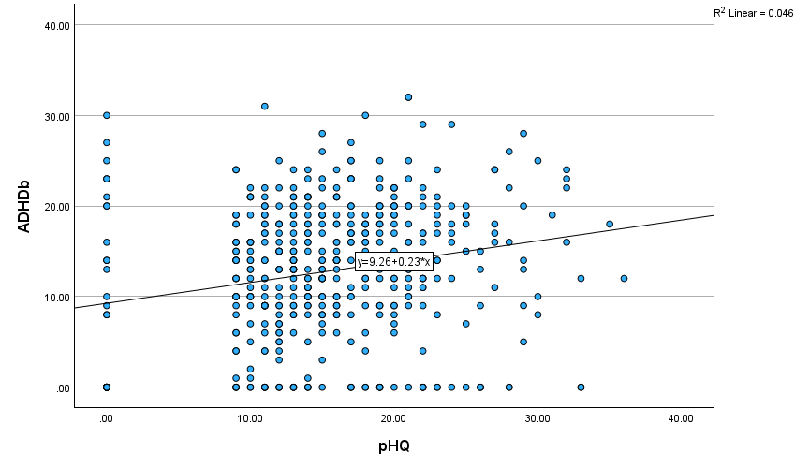
Correlation between ADHD score on Hyper tendency & Depression

Slide 25
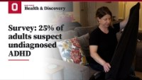
ADHD in Adults- 25% undiagnosed

Slide 26
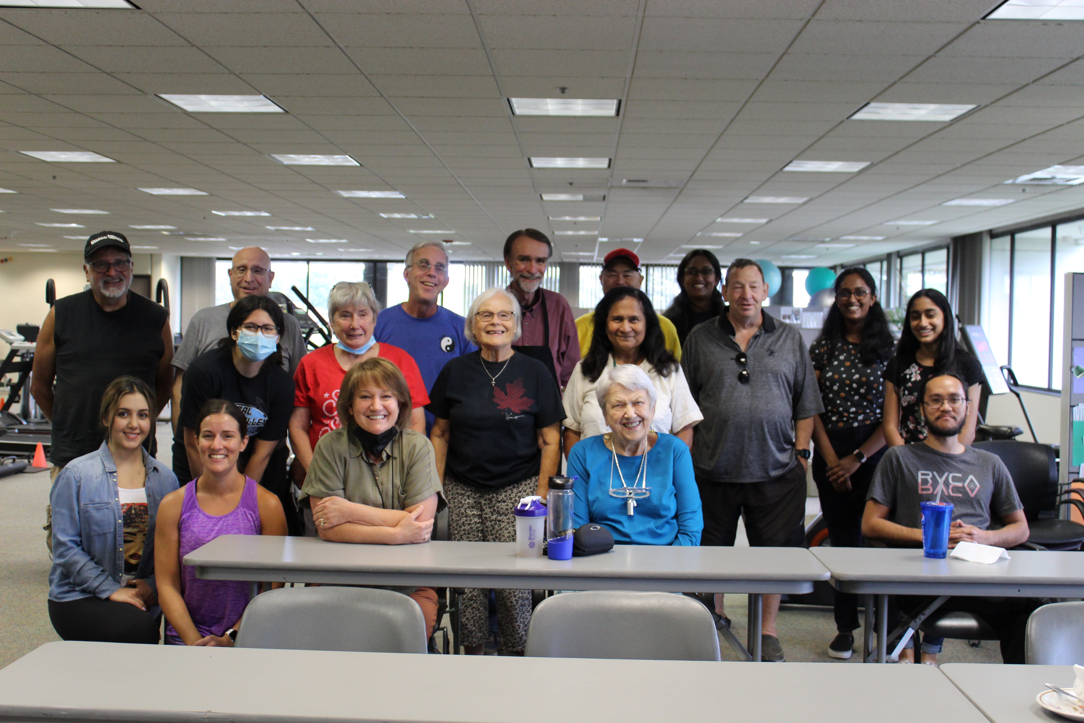
Questions
Is ADHD underdiagnosed in Older Adults?
Does Gaming help improve symptoms of ADHD?
More research needs to be done
☺
Thank you for your attention & participation!

Slide 27
Index card: What do you think the symptoms are for someone with ADHD? How many symptoms below do you have?
Inattention (most prominent)
  Difficulty sustaining attention during conversations, reading, or meetings
  Frequently misplacing items (keys, glasses, phone)
  Forgetting appointments, deadlines, or medications
  Trouble organizing tasks, finances, or paperwork
Hyperactivity
  Inner restlessness rather than physical hyperactivity
  Difficulty relaxing or “shutting off” the mind
  Excessive talking or interrupting (may persist)
  Feeling driven or chronically busy

Slide 28
Are data Older adults Vs Young adults

Slide 29
Scores
Total Score Interpretation
Unlikely ADHD 0–23
Possible ADHD 24–35
Likely ADHD 36+

Slide 30
New research
ADHD in older adults – a scoping review Fischer & Nilsen (2024) Health, 28:9, 1189-1196,
DOI: 10.1080/13607863.2024.2339994
ABSTRACT Objectives: This scoping review presents an overview of the available research on symptoms, comorbidities, and associated challenges among older adults with ADHD. Method:
The review included 17 articles. Symptoms of ADHD persist throughout life. Older adults with ADHD experience similar core symptoms as younger individuals, but their manifestation and intensity may differ. The most common comorbidity found was mental illness, for example Conclusion: Older adults with ADHD face various symptoms, comorbidities, and challenges that affect their quality of life. Age-related changes can amplify ADHD symptoms and increase the perceived burden of illness. More research is needed to understand the complex relationship between these factors and enable tailored interventions to improve their quality of life and well-being.

