Slide 1
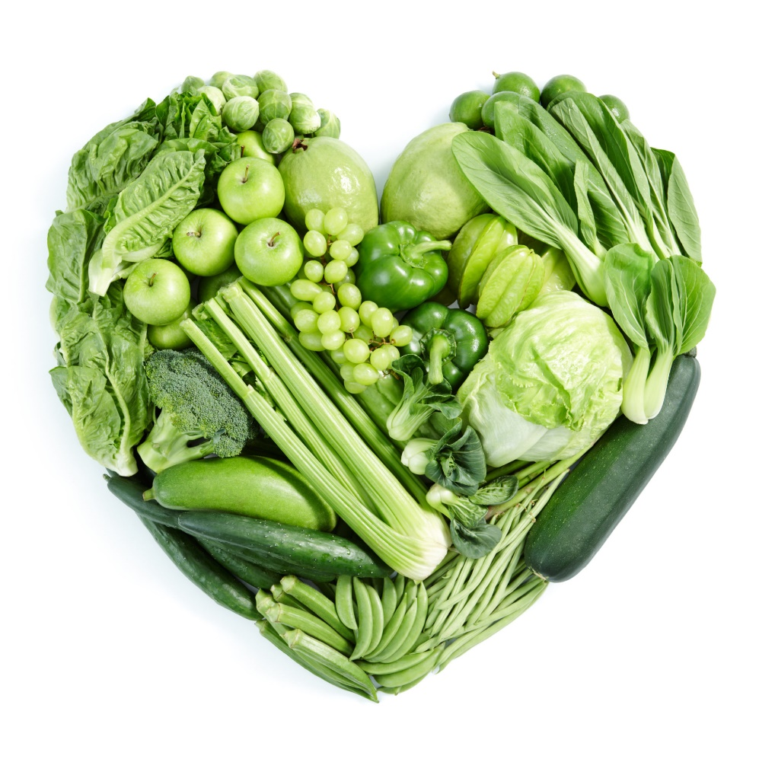
Go green!
https://www.youtube.com/watch?v=akgQusdcuVw
Debbie Lucus, MS, RD, CDE
08.04.20
dlucusrd@gmail.com
Notes:
On the next few slides we’ll look at a few common varieties of beans and discuss their shape, size, and flavor.

Slide 2
How many shades of green are there?
Numerous leafy greens
Green foods
Saving ‘green’ $$$
Going green for the environment
Being green – new, inexperienced

Slide 3
Name that Green
Kohlrabi
Bok choy
Spinach
Broccoli Raab
Chard
Collards
Mustard greens
Beet greens
Kale (curly & Tuscan)
Sorrel

Slide 4
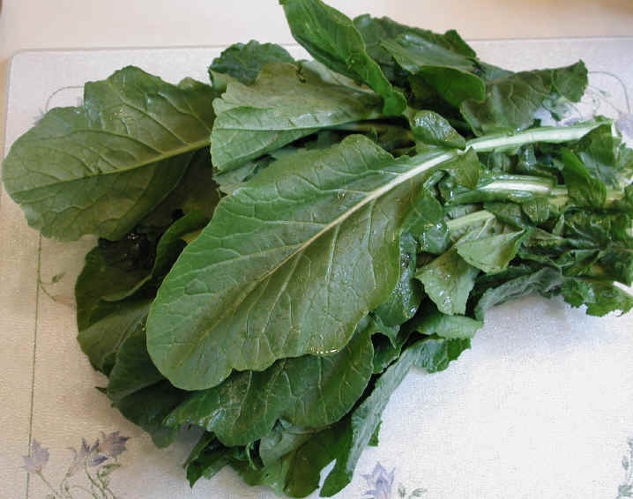
Go with Greens
Rich in antioxidants – beta carotene, lutein, anthocyanins
Excellent source of folate, iron, Vitamins A & C, Vitamin K
Associated with strongest protection against chronic diseases
20% reduction for heart attacks and strokes for every add’l serving/day
Reduced risk of cancer

Slide 5
More reasons to go green….
May help with weight loss by increasing feeling of fullness and curbing desire for junk foods
Reduce risk of macular degeneration & glaucoma
Good source of nitrates – turn to nitric oxide which is associated with lower CVD risk and lower BP
Low in calorie density, high in nutrient density
Mix with healthy fat to increase nutrient absorptions
Nuts & seeds, avocado, olives

Slide 6
And if that wasn’t enough…Calcium!
Dark greens are excellent source of calcium
High oxalates – which may block the absorption of calcium and increase risk of kidney stones
Beet greens
Chard
Spinach
Rhubarb
Choose variety of greens

Slide 7
Other plant-based calcium foods
Broccoli
Tofu – if set with calcium
Tempeh
Tahini
Almonds
Black beans
Oranges
Seeds
Blackstrap molasses

Slide 8
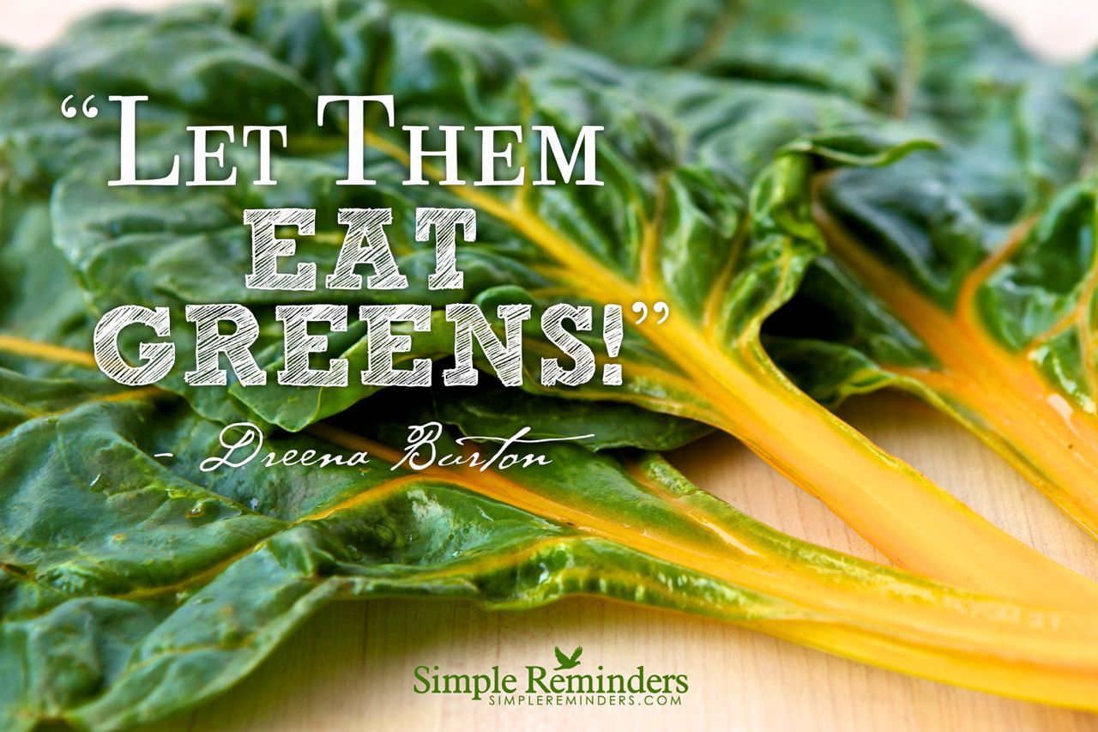
How many?
2-5+ servings daily
This is in addition to your cruciferous veggies and other veggies
Serving size:
1 cup raw
½ cup cooked

Slide 9
Caution with Coumadin
Greens are source of Vitamin K – helps with clotting
If on Coumadin, trying to avoid clots
Doesn’t mean you can’t eat greens – just need to be consistent with them
Protimes will indicate how to adjust Coumadin level
Don’t use it as an excuse not to eat greens

Slide 10
10 ways to eat more greens
Make a green smoothie. Add a couple of handfuls of baby greens to your favorite fruit smoothie recipe.
Saute: In a hot pan, add several handfuls of greens. Leave it be until the greens wilt. With a pair of tongs, turn over. Stir in some minced fresh garlic. Sprinkle with fresh lemon juice or a bit of vinegar. Season with salt and pepper.
3. Add it to Quesadillas: Finely chop greens. Add half a cup to white bean spread and put on each quesadilla before cooking.

Slide 11
More greens….
4. Add it to Soup: Greens are a great way to up the nutritional value of canned soup. Just put a couple of handfuls in the bowl or pan before adding soup and heating on stovetop or in microwave.
5. Hide it in Spaghetti sauce: roughly chop and stir into warmed sauce.
6. Mix it into Chili: roughly chop and stir in right before serving.
7. Make Pesto: With ﬁve minutes and a food processor, you can whip up a quick fresh, green pesto (nutritional yeast instead of cheese, tofu instead of oil)

Slide 12
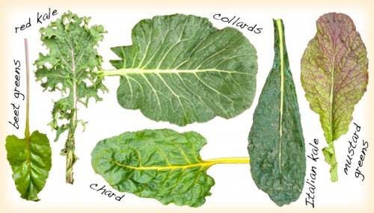
And more…
8. Use collard green as wrap
9. Scramble it in tofu.
10. Use it as your salad base: Top with mandarin oranges, red onions, toasted pecans and a balsamic vinaigrette.

Slide 13
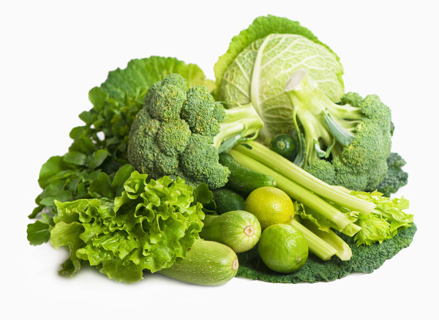
Other green foods…..
Eat your colors
The more color, the more antioxidants & nutrients
Broccoli, cabbage, Brussels
Cruciferous veggies
Help reduce risk of cancer
Split peas, peas, soy beans
High in fiber
Green peppers, hot peppers, chilies
Great source of Vitamin C
Asparagus, celery, green beans, zucchini
Herbs: parsley, basil, oregano, etc.
Avocado
M&Ms ☺

Slide 14
Saving ‘Green’
Eating plant-based can help your budget
Buy in bulk
Big box stores often have best deals
Planned-overs
Cook extra and freeze or re-purpose
Cook more from scratch
Farmers’ Markets and CSAs
Limit convenience foods (you do the cooking instead)
Eat at home more
Start a garden
Try www.plantbasedonabudget.com

Slide 15
Go green for the planet

Slide 16
Meatless Monday

Slide 17
What if you are ‘green’?
Purchase the basics – grains, beans, produce
Look up recipes:
ForksoverKnives.com
Cardiac Wellness Program
PCRM.org
UCDIntegrativeMedicine.com
Try a 21 day Kickstart
Hang out with Cardiac Wellness Program a lot!!

Slide 18
Greens Pesto
Typical pesto: basil, pine nuts, garlic, parmesan cheese, olive oil
Use any green (basil, parsley, carrot tops, kale, etc)
Can use any nut (walnuts, almonds, cashews)
Try silken tofu for the creaminess
Use Nutritional yeast for the ‘cheesiness’
Use on pasta, pasta salad, sandwich spread, spoonful in soups (freeze extras)

Slide 19
Go Green!!
Whether you are trying to:
Get healthy
Stay healthy
Feel better
Look better
Save the planet
Save money
Plant-based eating can help you achieve your goals!

