Slide 1
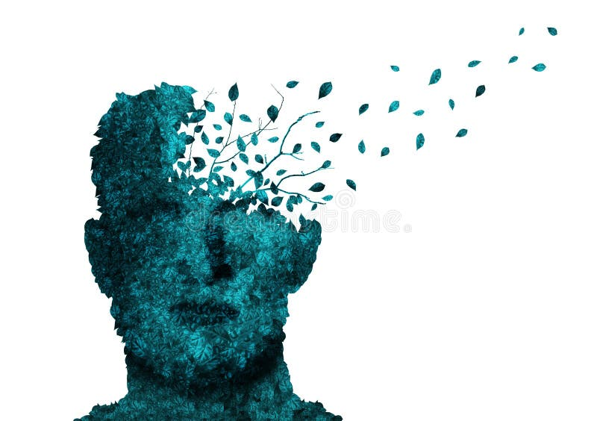
Pseudodementia
Sharon Myers RN, MA
CSUS Cardiovascular Wellness Program

Slide 2
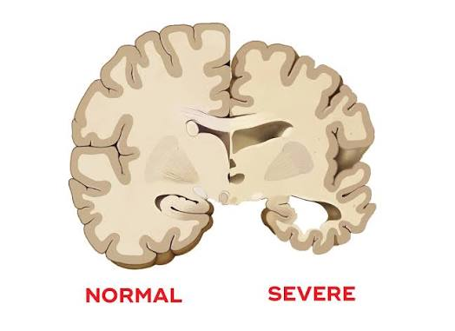
What is Dementia ?
An umbrella term used to describe a range of neuro-cognitive conditions caused from physical damage to brain cells and neural pathways
Dementia involves physical, irreversible damage and destruction of nerve cells in the brain, causing brain atrophy, cell death, reduced blood flow, leading to decreased ability across the brain to communicate

Slide 3
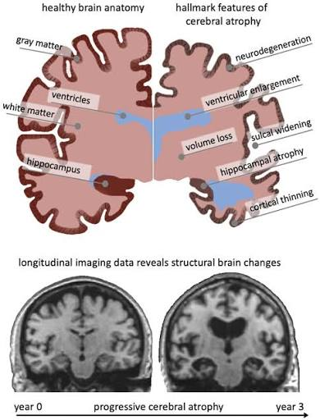
Dementia
While different types of dementia start in different ways and target different areas of the brain, they all ultimately end on the same final path: brain atrophy and poor cellular communication.¹
¹https://memory.ucsf.edu/what-dementia

Slide 4
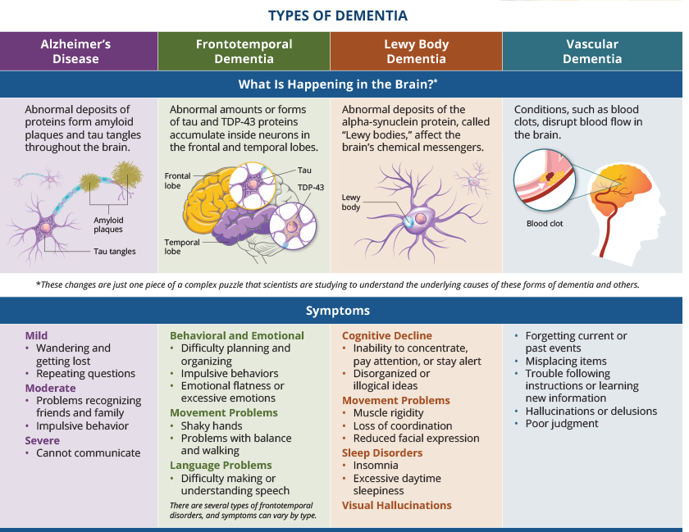

Slide 5

What is Pseudodementia ?
Pseudo
Means fake, false or pretended
Comes from the Greek word “to lie” or “false” (Dictionary .com)
Something that attempts to look like the real thing or look official, but is actually fake or artificial
Pseudodementia can look like real dementia in that you may have many of the symptoms of real dementia, but you don’t actually have the brain changes seen in real dementia.

Slide 6
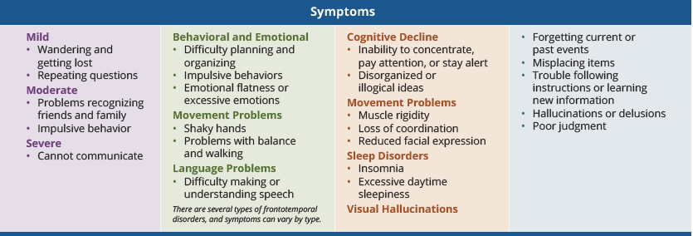







Lets Look Closely at the Symptoms of Dementia
Withdrawal from work or social activities

Slide 7
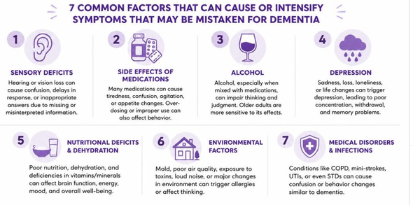
What Are Some Other Things Besides Dementia That Can Cause These Types of Symptoms?
Depression- Depression is the most common cause of pseudodementia in the elderly
Anxiety- Severe anxiety overwhelms the brain's ability to focus, leading to memory issues.
Bipolar Disorder- Depressive or manic episodes in bipolar disorder can cause temporary decline in cognitive function.
Schizophrenia and Psychosis- Disorganized thinking can mimic true dementia
Life Stressors
Medications
Excess alcohol intake
Sensory deficits- such as hearing loss, vision issues
Medical conditions & infections
Nutritional deficits & dehydration

Slide 8

Depressive Pseudodementia is the most common type of pseudodementia and the most studied

Slide 9
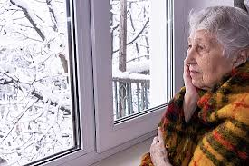
Typical Symptoms of Depressive Pseudodementia or “false dementia”
Depressive Pseudodementia is the most common type of pseudodementia:
Sad or depressed mood
Difficulty concentrating
Lack of interest in usual activities
Restlessness or slowed movement
Fatigue and lack of productivity
Memory loss
Problems with planning/organizing
Trouble regulating emotions

Slide 10
Why Does Depression Cause Cognitive Problems?
Neurotransmitter imbalance: Chemical messengers like serotonin, dopamine, and norepinephrine fall out of balance, impairing how brain cells communicate.¹
Inflammation: Higher levels of chronic inflammation in the body and brain interfere with normal neural health and cognitive performance.
Negative cognitive bias: Depression forces the brain to filter information through a negative lens, consuming mental energy and disrupting concentration.
Chronic depression and chronic stress can injure the hippocampus²
The hippocampus is important for memory and learning
¹https://doi.org/10.1016/j.bbr.2024.115218
²Sapolsky, R. M. (1996). "Why stress is bad for your brain." Science, 273(5276), 749-750.

Slide 11
Pseudodementia –Depression | Dementia
More abrupt onset(days or weeks) | Subtle onset
Rapid symptom progression | Progression is slow and gradual
Family aware of onset of symptoms | Family initially unaware
Depressed mood | Superficial or changeable or exaggerated mood
Has +history of mental health issue such as depression | May have no history of mental health issues
Poor collaboration- little effort to perform well | Good collaboration: frustrated/reacts catastrophically to error
Psychological symptoms such as sadness, anxiety, body complaints | Predominance of neurological symptoms: may have difficulty swallowing, difficulty with motor planning, balance, gross and fine motor activities
Unlikely to have Aphasia(speech and language problem), Apraxia( muscle planning and movement issues), Agnosia(failure to recognize common objects) | May have Aphasia, Apraxia or Agnosia
Disturbed by memory lapses, but does well on cognitive tests. Greater impairment of personality characteristics such as confidence, motivation, interests, attention | Denies, hides, minimizes difficulties. Poor performance on cognitive tests. Impairment in memory and temporal orientation
CT, EEG, Spect - Normal | CT , EEG, Spect- show atrophy, and slow brain activity
Treatable: Responds to treatments such as antidepressants, ECT, TMS, ketamine, talk therapy, exercise | Incurable. Treatment aimed to control symptoms and slow progression only
Mouta S, Fonseca Vaz I, Pires M, Ramos S, Figueiredo D. What do we know about pseudodementia? Gen Psychiatr. 2023 Aug 22;36(4):e100939.

Slide 12
How Anxiety Causes Pseudodementia Symptoms
High Cortisol: Constant stress floods the brain with stress hormones that harm the hippocampus, the area responsible for memory.
Poor Focus: Severe anxiety overwhelms attention span, making it hard to concentrate, finish tasks, or remember recent events.
Sleep Loss: Chronic worry ruins sleep patterns, which further damages short-term memory and mental processing speed.
*Damage to hippocampus and pseudodementia symptoms can be reversed.

Slide 13
Diagnosing Dementia vs Pseudodementia
Brain Scans:
  CT Scan (computed tomography)
  EEG (electroencephalogram )
  Spect (single-photon emission computed tomography )
Cognitive tests:
  Mini-Mental State Examination (MMSE)
  Montreal Cognitive Assessment (MoCA)
  PHQ-9 (depression)
  GAD-7 ( anxiety)
Physical Exam and History
Blood tests- FDA-approved blood tests that help detect specific biomarkers for Alzheimer's disease, but not other types of dementia

Slide 14
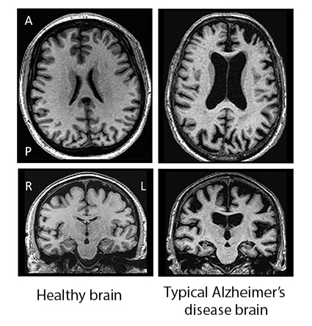
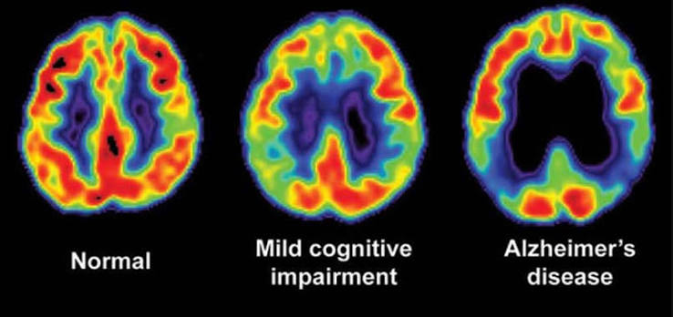
Brain Study Scans-
Pseudodementia vs Dementia
Spect Scan- single-photon emission computed tomography Blue/black is low blood flow
CT Scan- Computed tomography
Rules out treatable, non-dementia conditions
Identifies patterns of tissue loss or blood vessel damage that point to a specific type of dementia

Slide 15
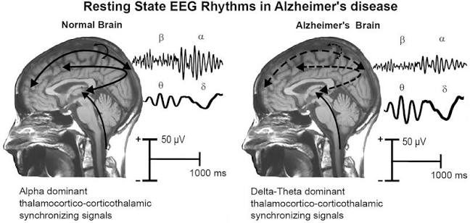
Brain Study Tests cont.
Electroencephalogram (EEG):
Not used as a routine independent tool to diagnose dementia
Plays a crucial role in ruling out alternative conditions, & distinguishing between different types of dementia

Slide 16

Treatment for Pseudodementia or “false dementia”
Treat the underlying cause:
Depression
Anxiety
Medication side effects/interactions
Sleep
Excessive Alcohol
Hearing or visual issues
Other medical issues/infections-UTI, Pneumonia, Thyroid
Nutritional deficits-vit B12, thiamine, sodium, dehydration
Stress- can affect the neurotransmitters
Bipolar disorder
Schizophrenia

Slide 17
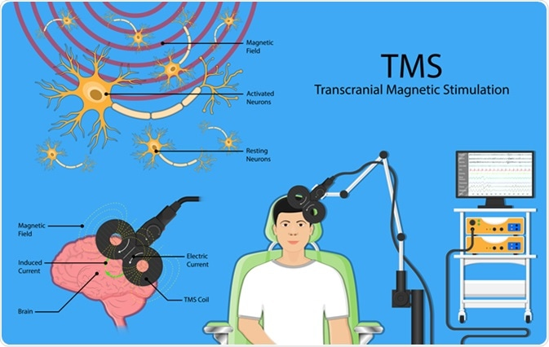
Treatment for Depressive Pseudodementia
Medical Treatments:
Antidepressants (Selective Serotonin Reuptake Inhibitors SSRIs):
  Sertraline(Zoloft) or citalopram( Celexa) are a first choice because they are safer and less likely to cause cognitive side effects.
Serotonin-Norepinephrine Reuptake Inhibitors (SNRIs):
  Vortioxetine (Trintellix) may be used to target both mood and cognitive symptoms.
Advanced Options: Doctors may consider brain stimulation therapies:
  Electroconvulsive therapy (ECT) for severe cases
  Transcranial Magnetic Stimulation (TMS)

Slide 18

Treatment for Depressive Pseudodementia cont.
Psychotherapy and Counseling
Talk Therapy: Cognitive behavioral therapy, and other types of counseling may help process emotional distress and change negative thought patterns
Supportive Care: Family, friends and community social interactions. Why??
Mindfulness and stress reduction training

Slide 19

Treatment for Depressive Pseudodementia cont.
Lifestyle and Daily Habits:
Structured Routines: Following a predictable daily schedule reduces mental fatigue and confusion
Gentle Mental Activities: Engaging in low-stress hobbies, puzzles, reading, learning new things, helps reawaken neural pathways without causing frustration
Strong social connections support overall brain recovery

Slide 20
Treatment for Depressive Pseudodementia cont.
Physical Exercise
Cardiovascular exercise and strength training effective in reducing depression symptoms:
Meta analysis studies have found that moderate-to-vigorous exercise (like brisk walking, running, strength training, or yoga, mixed aerobic exercises and Tai chi) is individually as effective as medication or therapy for mild-to-moderate depression¹
A combined protocol of aerobic exercise and resistance training is more effective than doing aerobic work alone²
Starting small—even going from a completely sedentary lifestyle to a daily walk is associated with immediate mental health gains²
¹Noetel, M., Sanders, T., Gallardo-GÃ³mez, D., Taylor, P., del Pozo Cruz, B., van den Hoek, D., Smith, J. J., Mahoney, J., Spathis, J., Moresi, M., Pagano, R., Pagano, L., Vasconcellos, R., Arnott, H., Varley, B., Parker, P., Biddle, S., & Lonsdale, C. (2024). Effect of exercise for depression: systematic review and network meta-analysis of randomised controlled trials BMJ, 384:e075847. https://doi.org/10.1136/bmj-2023-075847
²Harris E. Meta-Analysis: Exercise as Effective as Therapy for Treating Depression. JAMA. 2024;331(11):908. doi:10.1001/jama.2024.1121

Slide 21

Final Piece...
Pseudodementia or “fake dementia” does not cause neurodegenerative damage to the brain nerves or tissues and the cognitive symptoms are reversible when the underlying cause is treated
However, if you have pseudodementia, you may be at greater risk for developing “real” dementia (irreversible, neurodegenerative dementia later in life)¹
Successfully treating the underlying cause of pseudodementia (most commonly depression) significantly lowers your risk of developing irreversible dementia compared to leaving it untreated²
¹Connors MH, Quinto L, Brodaty H. Longitudinal outcomes of patients with pseudodementia: a systematic review. Psychological Medicine. 2019;49(5):727-737. doi:10.1017/S0033291718002829
²https://www.biologicalpsychiatryjournal.com/pb/assets/raw/Health%20Advance/journals/bps/BPS_221017_PR_Yang_et_al_FINAL-1666034440127.pdf

Slide 22
How Common is Depressive Pseudodementia ?
Between 2% and 32% of older adults with cognitive problems actually have pseudodementia depending on type of facility where it is being diagnosed and the criteria being used for diagnosis
In a primary- care or community screening setting of adults aged 65 or older, depressive pseudodementia is found in only about 0.6%
In specialized psychiatric service centers or presenile dementia clinics, the rates range from 18% to 41% of referred individuals
Brodaty H, Connors MH. Pseudodementia, pseudo-pseudodementia, and pseudodepression. Alzheimer's Dement. 2020; 12:e12027. https://doi.org/10.1002/dad2.12027

Slide 23

Take Home Message...
If you are noticing some decline in your thinking or processing abilities let your primary care doctor know
There are many treatable reasons you may be having cognitive issues that are not related to dementia
Getting these underlying issues treated can help your current ability to think and process information, and can help prevent you getting irreversible neurodegenerative dementia in the future

Slide 24
Review of Things That Can Cause Pseudodementia
Depression
Anxiety
Medication side effects/interactions
Sleep Apnea or other sleep disorders
Excessive Alcohol
Hearing or visual issues
Other medical issues/infections/thyroid
Nutritional deficits-Vit B12, thiamine, sodium, dehydration
Stress
Bipolar disorder
Schizophrenia

Slide 25

Questions ? Comments?

