Slide 1
WINTER AND CARDIOVASCULAR DISEASE
Radhika Nandur Bukkapatnam MD MAS FACC
Dec 18, 2025

Slide 2
Incidence of Cardiovascular Disease in Winter
Cardiovascular disease (CVD) accounts for approximately 25% of the mortality in the United States and 30% globally.
Highest levels occurring during the colder winter months, which have been described in many countries. This phenomenon is referred to as excess winter mortality. CVD-related deaths account for the majority of excess winter deaths (up to 70% in some countries), while about half of the remaining are due to increases in respiratory illnesses.

Slide 3
'Winter peaks' in CVD-related hospitalizations and mortality; event rates in winter are typically 10–20% greater than during 'summer troughs'
CVD seasonality is probably caused by a complex interaction between the susceptibility of individuals and a range of environmental factors (including ambient temperature)
CVD seasonality is most pronounced in individuals living in milder climates, who are least prepared for extreme weather variations
A lag effect, potentially modulated by air pollution levels and concurrent influenza, has been documented after 'cold snaps'

Slide 4
How does the Body lose Heat
Radiation
Breathing in cold air
Working hard: shoveling, working outside evaporation
Long-term exposure to the cold – especially if the body's core temperature falls below 95 degrees Fahrenheit – can lead to hypothermia, frostbite and other problems.

Slide 5
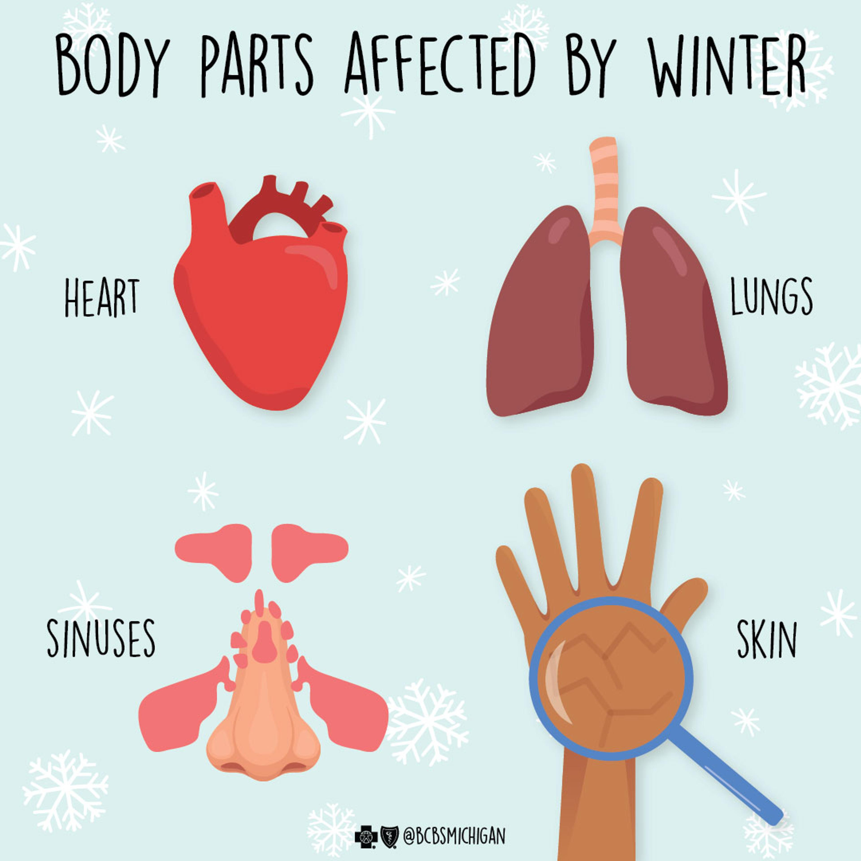

Slide 6
Hypothermia
Hypothermia means the body temperature has fallen below 35 degrees Celsius or about 95 degrees Fahrenheit. It occurs when your body can't produce enough energy to keep the internal body temperature warm enough. It can kill you. Symptoms include lack of coordination, mental confusion, slowed reactions, shivering and sleepiness.
Besides cold temperatures, high winds, snow and rain also can steal body heat. Wind is especially dangerous because it removes the layer of heated air from around your body. At 30 degrees Fahrenheit in a 30-mile-per-hour wind, the cooling effect is equal to 15 degrees Fahrenheit. Similarly, dampness causes the body to lose heat faster than it would at the same temperature in drier conditions.

Slide 7
Effects on the Cardiovascular System
When air temperatures drop, blood vessels constrict to prevent heat loss and to keep more blood around the body's core.
Our body's mission is to preserve vital organs, so warm blood circulates internally.
This increases blood pressure, and high blood pressure can lead to a heart attack or stroke, especially in people who already face higher cardiovascular risks. Extreme cold also may cause blood to thicken and become more prone to clotting, which likewise raises the risk of heart attack and stroke.
There is increased heart rate, which increases the workload of the heart

Slide 8
Lowering of skin temperature during cold exposure elicits a reflex activation of sympathetically mediated vasoconstriction. As a result of the higher peripheral resistance systolic (SBP) and diastolic (DBP) blood pressure increase.
Extreme cold raises the risk of cardiovascular death, with one study finding 37% more heart failure deaths on very cold days.

Slide 9
Effects on the Respiratory System
People with asthma, chronic lung disease, or other respiratory conditions or illnesses are at higher risk when temperatures drop because cold, dry air irritates the airways causing bronchospasm
More susceptible to respiratory illnesses

Slide 10
Coagulation Factors
several hypotheses have been proposed to explain the rise of plasma fibrinogen levels in winter.
Fibrinogen may contribute to atherothrombogenesis by several mechanisms: Involvement in early atherosclerotic plaque, increased platelet aggregability by interaction with glycoprotein IIb/IIIa receptors on the platelet surface, increased RBC aggregation, and finally, contribution to Plasma viscosity.
An increase in these factors generates a “hypercoagulable state,” which may lead to a rise in cardiovascular morbidity and mortality.

Slide 11
Hormones and other Risk Factors
cholesterol, Hormones and vasoactive substance including vasopressin (AVP), norepinephrine (NE), epinephrine (E) and angiotensin II, aldosterone
Children and the elderly are at special risk because they may have limited ability to communicate or impaired mobility. Elderly people may also have lower subcutaneous fat and a diminished ability to sense temperature so they can suffer hypothermia without knowing they're in danger.

Slide 12
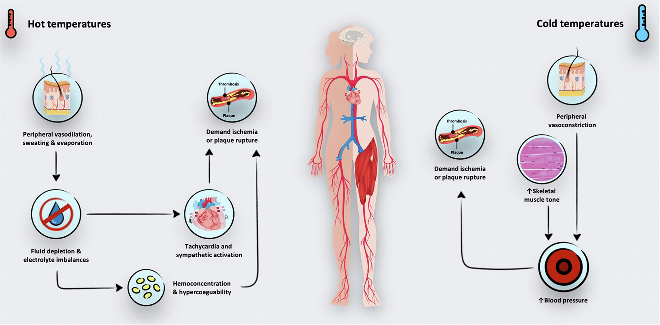
Effects of extreme temperatures on CVD

Slide 13
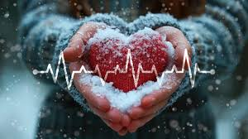

Slide 14
DVT and PE
Most studies have reported a higher occurrence of DVT during the winter months. Only a few studies have failed to find such seasonal variation in the incidence of DVT. Interestingly, a preference for winter in the occurrence of DVT has been linked with meteorological influences, such as temperature, low atmospheric pressure, high wind speed and high rainfall.
Reduced physical activity during the winter months, reduce blood flow in the lower limbs and decreased fibrinolytic activity have been suggested to be associated with the increase incidence of DVT in winter.
Significant peak observed in winter and in particular in the month of January. In wintertime, there is an absolute increase in the risk of VTE of 14% as compared to the other seasons, and the absolute increase in the risk of VTE observed in January is 20% as compared to the other month

Slide 15
Aortic dissection
A relatively high positive correlation was found between the incidence of acute aortic dissection and the mean atmospheric pressure in some of the studies. Winter is also characterized by pro-thrombotic state.
Fibrinogen levels demonstrate wide seasonal variation, increasing up to 23% during the colder months.
Mild surface cooling can increase platelet and red cell count and consequently blood viscosity, thereby favoring spontaneous thrombosis.
Activation of the sympathetic nervous system and secretion of catecholamine are increased in response to cold temperatures, increasing blood pressure through increased heart rate and peripheral vascular resistance. This enhances the forces that act to produce wall deformation, and increase friction and shear stress on the internal surface. The consequent vascular damage may progress, culminating in arterial dissection and rupture of the aorta.

Slide 16
Stroke
10% of all strokes and two thirds of hemorrhagic strokes.
Elevated blood pressure during the winter may play an important role as a trigger for intracerebral hemorrhage

Slide 17
Hypertension
The seasonal variation in hypertension is likely to reflect seasonal variations in one or more risk factors. The risk factors proposed by investigators have included: Outdoor temperature, physical activity, seasonality of vitamin D, seasonal variation in serum cholesterol level, noradrenalin, catecholamine, and vasopressin.

Slide 18
Heart Failure
Several studies on seasonal variation in heart failure (HF) hospitalization carried out in France, Spain, Japan, Scotland, Australia, Brazil, Argentina, Italy, Turkey, Nigeria, Canada, and USA[131–144] have shown an increase in admission during the winter season and a decline in summer season.
Increases peripheral vasoconstriction, which may lead to pulmonary oedema as a consequence of left ventricular failure and may also cause abnormal clotting.
In patients with symptomatic CHF, cold exposure decreases exercise capacity and increases the already raised systemic adrenergic activation. As increased plasma norepinephrine concentrations are associated with increased risk of death from progressive heart failure this may, in part, explain the increased mortality in winter.
Increased blood pressure, lack of vitamin D; physical activity, influenza, and air pollution in winter have also been postulated as responsible factors for the higher number of cases during colder months

Slide 19
Other factors that precipitate heart failure include
Foods: soups, holiday eating
Seasonal blues: overeating, more alcohol, holiday heart syndrome
Upper respiratory illnesses
Obesity, smoking, homeless status
Electricity cuts

Slide 20
Acute Myocardial Infarction
A seasonal pattern dominated by one peak (December) and one trough (August) was found in the > or = 80-year-old category.
High BP, vasocostriction, plasma cortisol and catecholamines, platelet aggregability and numerous hematologic variables have all been shown to display a seasonal rhythm.
Potential environmental and lifestyle factors associated with precipitation of AMI include physical exertion and outdoor temperature.

Slide 21
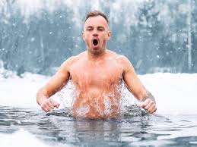
A fib
Hypertension
Increased alcohol use/ dietary changes
Infections
Heart failure
Medications
Extreme activities

Slide 22
Holiday Heart Syndrome
Between Christmas and New Year's, more people die from heart-related complications than at any other time of the year.
Low outdoor temperatures, increased alcohol intake and holiday stress have, for decades, been leading factors of what medical experts call "holiday heart syndrome.”
"Holiday heart syndrome" is an umbrella term for several cardiac-related complications that occur during the winter holiday season. These complications may include atrial fibrillation, or AFib, which is when the heart is beating irregularly, often rapidly.

Slide 23
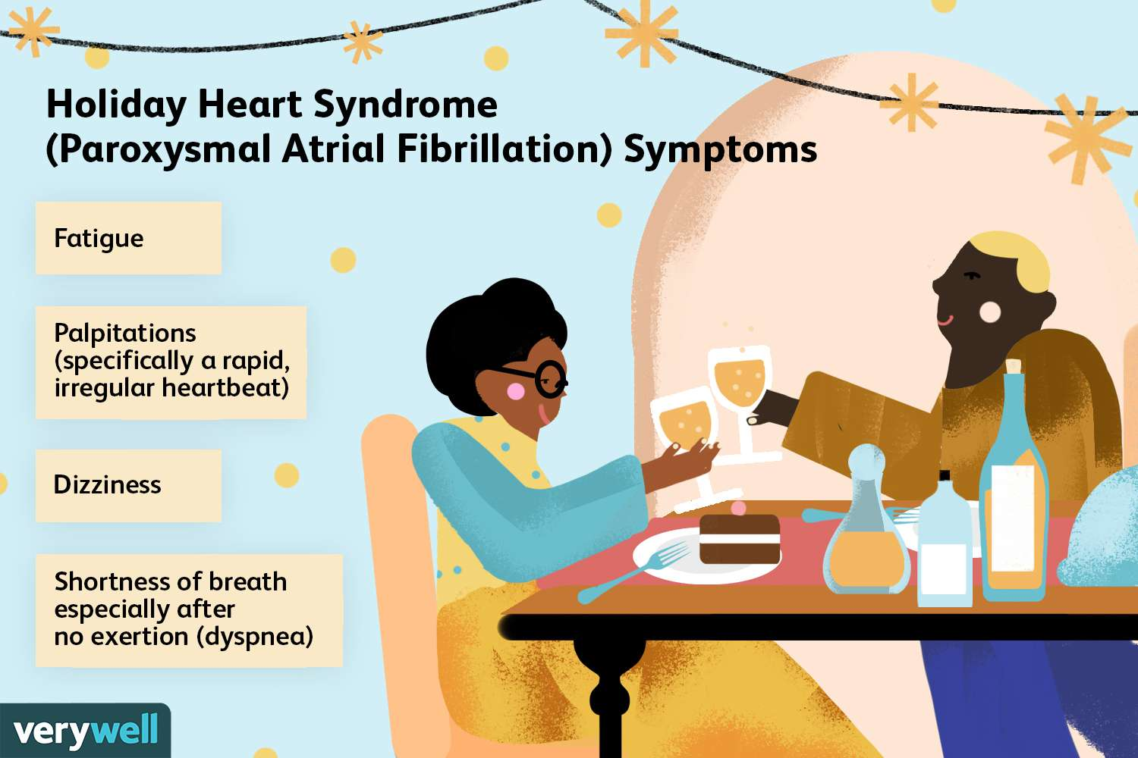

Slide 24
Preventing Holiday Heart Syndrome
Check your medication supplies
Keep hydrated
Avoid mod/ excessive alcohol
Call for help

Slide 25
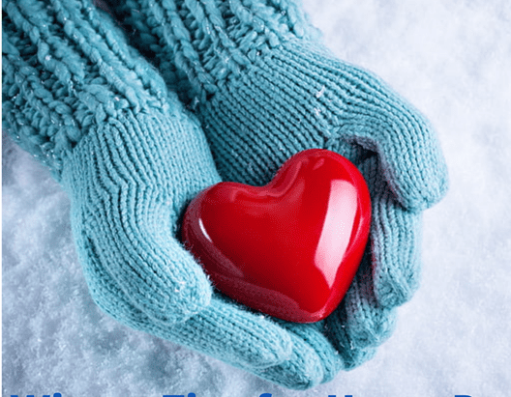

Slide 26
Vitamin D
Significant seasonal vitamin D level variations were observed in several communities, which reveal a variation of values for 25-(OH) D, increased during summer and spring, while gradually decreasing in autumn and winter.
Vitamin D deficiency has been to be associated with CVD risk factors such as hypertension and diabetes mellitus, with markers of subclinical atherosclerosis such as intima-media thickness and coronary calcification as well as with cardiovascular events such as myocardial infarction, stroke and congestive heart failure.
The association between vitamin D levels and CHD has been shown to be independent of smoking, body mass index, treatment for hypertension, vigorous leisure activity, total serum cholesterol and a previous history of angina or MI

Slide 27
Exercise
One of the primary mechanisms through which physical activity is thought to affect CVDs is through improves endothelial function. The endothelium acts to maintain normal vasomotor tone, enhance the fluidity of blood. Abnormalities in these functions contribute many disease processes, including myocardial infarction, coronary vasospasm and hypertension.
Another mechanism proposed that the physical activity may also reduce the elevated sympathetic nerve activity that is common in essential hypertension.

Slide 28
Air Pollution
Air pollution is a heterogeneous, complex mixture of gases, liquids, and particulate matter. Epidemiological studies have demonstrated a consistent increased risk for cardiovascular events in relation to both short- and long-term exposure to present-day concentrations of ambient particulate matter (PM)
Use of fuel during winter-time for heating purposes and stagnant air masses formed because of low temperature and low wind speed
Exposure to pollutants increases heart rate and blood pressure, fibrinogen, and blood coagulation factors, arterial vasoconstriction, inflammatory mediators (e.g., C-reactive protein [CRP]), and endothelial injury/dysfunction. Consequences of these effects may include myocardial ischemia and arrhythmias

Slide 29
Infections in winter
Respiratory infections may increase the risk of developing or dying from CHD through an increase in plasma fibrinogen and endotoxin inhibition of fibrinolysis.
Tachycardia and increased cardiac output that accompany many acute infections and febrile illnesses could increase the wall stress experienced by an atheromatous plaque. This could trigger coronary events by promoting disruption of vulnerable plaques
Influenza vaccines are effective at reducing the risk of cardiac events in those patients with established cardiovascular disease

Slide 30
Age and certain medical conditions (eg, chronic heart, lung, or immune diseases) are known risk factors for influenza-related complications. Vaccination is the primary strategy for preventing influenza-related deaths and can reduce the severity of infection and subsequent complications

Slide 31
Flu and Heart disease
Among adults hospitalized with flu during recent flu seasons, heart disease was one of the most common chronic (long-term) conditions—about half of adults hospitalized with flu have heart disease. Studies have shown that flu illness is associated with an increase in heart attacks and stroke
A 2018 study found that the risk of having a heart attack was 6 times higher within a week of a confirmed flu infection.
Additionally, a 2020 study that looked at more than 80,000 U.S. adults hospitalized with flu over eight flu seasons (2010-11 through 2017-18) found that sudden, serious heart complications occurred in one out of every eight patients (~12% of patients).

Slide 32
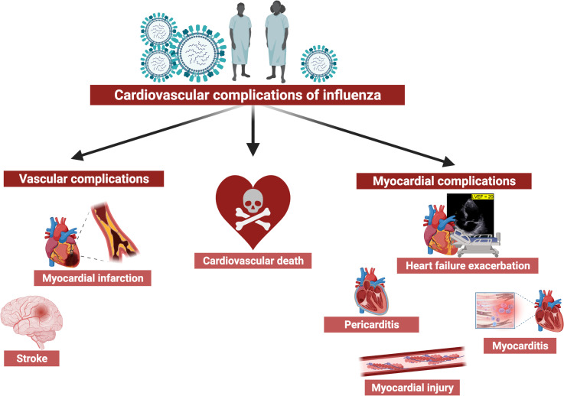

Slide 33
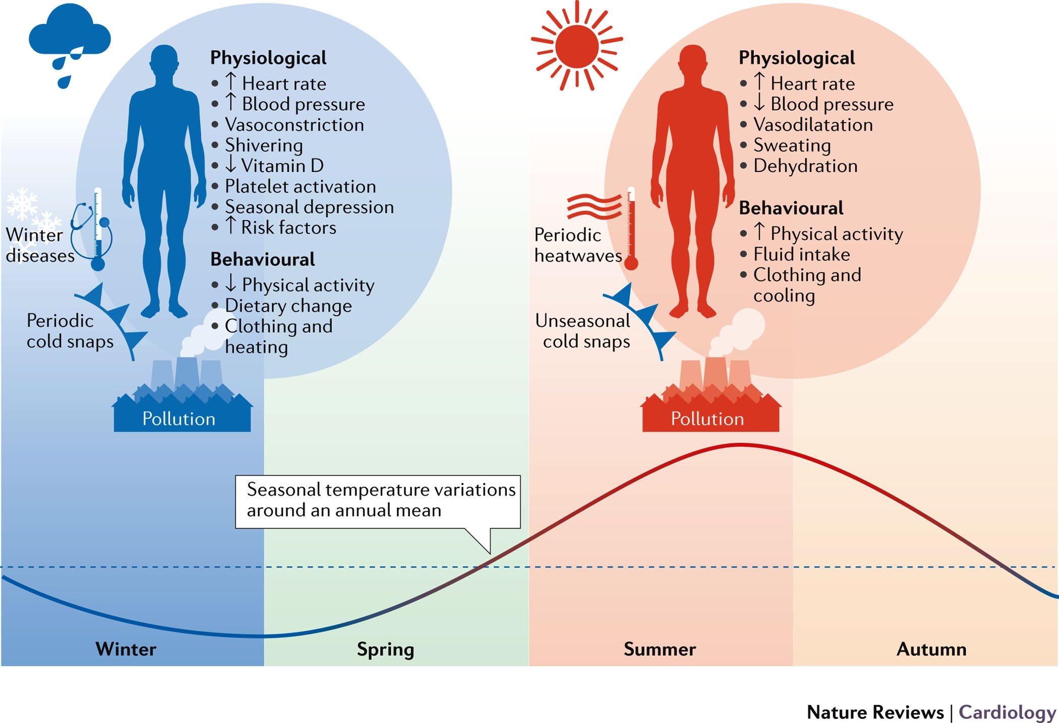

Slide 34
How to prevent Cold related CV Illness
Going outdoors in cold weather can even prevent seasonal depression
Follow safety guidelines for winter work outs/ or work inside
Check the weather forecast and wear proper insulated clothing to prevent hypothermia and other conditions.
Stay dry with weatherproof gear—you lose body heat even faster if you get wet.
Keep your head, hands, and feet warm with gloves, hats, and waterproof footwear.
Sustain your energy levels with regular meals and light snacks.
Stay hydrated by drinking enough fluids.
Vaccinate

Slide 35

Thank you

