Slide 1
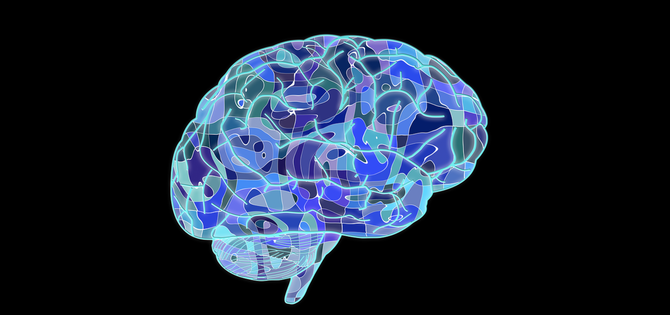
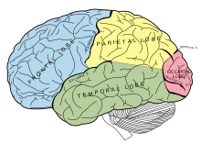
Neuroscience:
Study of the Brain & Behavior

Slide 2
Brain is our 3 pound universe
Composed of billions of Neurons (computer chips): That communicate with each other at an awesome rate
However, we will discuss the Brain then the neuron….

Slide 3
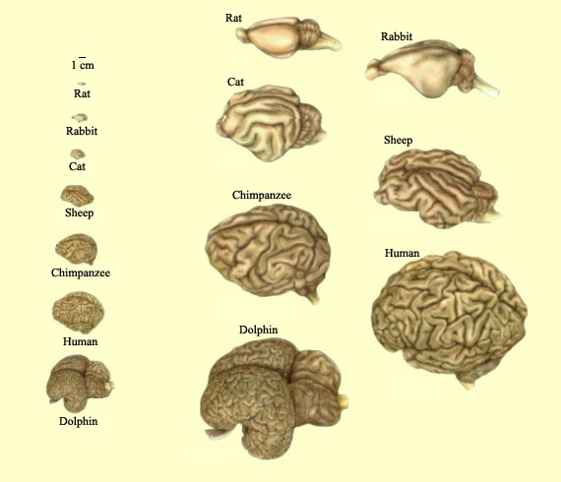
Evolution of the brain

Slide 4
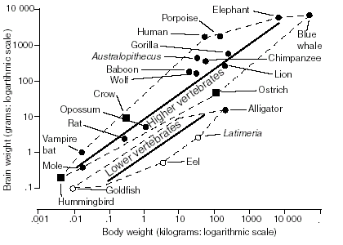
Brain size: relative
Heavier animals have heavier brains
Animals above line have more brain for their size than average animal
Cephalization index K is brain size after taking account of body size

Slide 5
Brain size: relative
Simple mammals K ~ 0.1
Other mammals K ~ 0.2
Primates/whales K ~ 0.3
Dolphins K ~ 0.64
Human K ~ 0.89

Slide 6
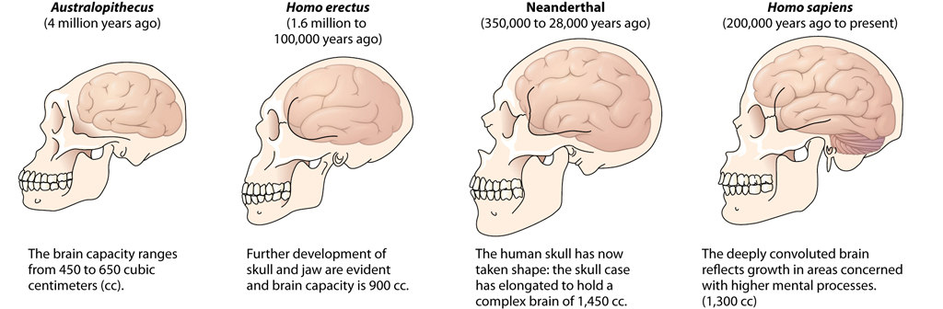
The Brain
This Photo by Unknown Author is licensed under CC BY
https://www.youtube.com/watch?v=pRFXSjkpKWA
Notes:
Phenias gage

Slide 7
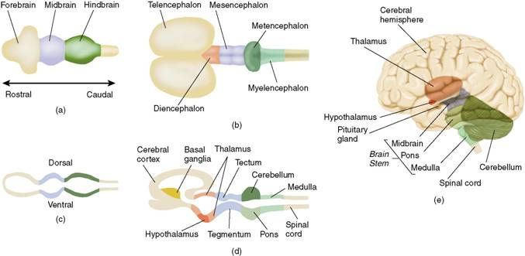
Central Nervous system
Copyright © 2004 Allyn and Bacon

Slide 8

Overview of the Brain

Slide 9
Human Brain
Gray matter: composed of unmyelinated neurons
White matter: Composed of myelinated (white) axons
Neural networks are how we think, remember and share emotions

Slide 10
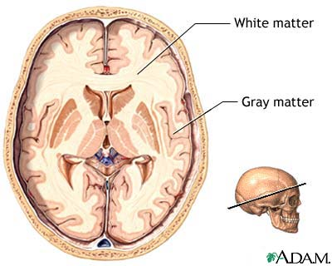
Images

Slide 11
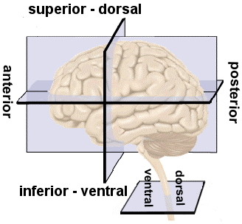
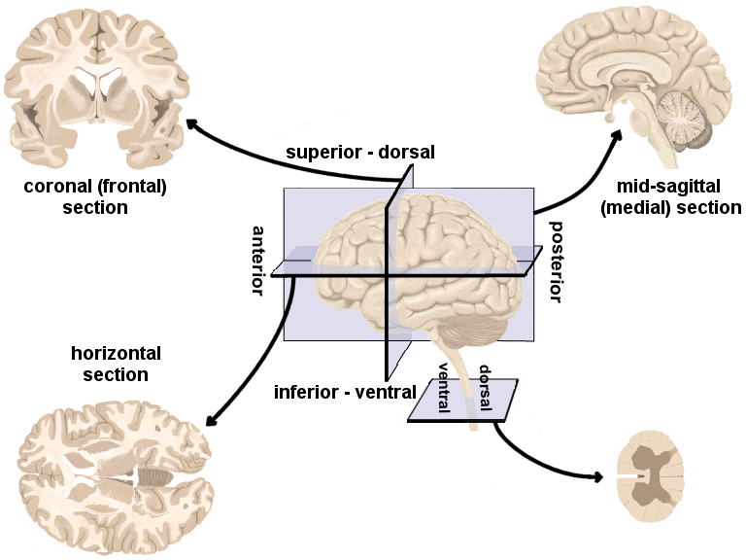
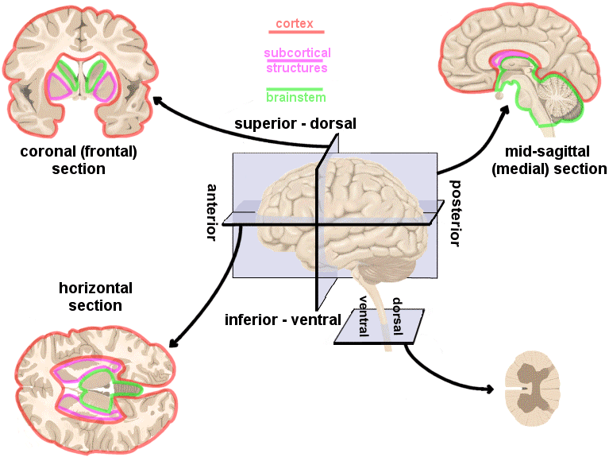
Human Brain: Directions, cross-sections and divisions
Based on Carlson Fig. 3.2, p. 66.
Fig. 1: Left lateral view of the brain and spinal cord. Anterior to posterior: Front to back Superior or dorsal: Top Inferior or ventral: Bottom
Fig. 2: Typical cross-sections through the brain and spinal cord.
Fig. 3: Typical cross-sections with directions labeled.
Fig. 4: Typical cross-sections with the three divisions (as discussed in lecture) labeled.

Slide 12
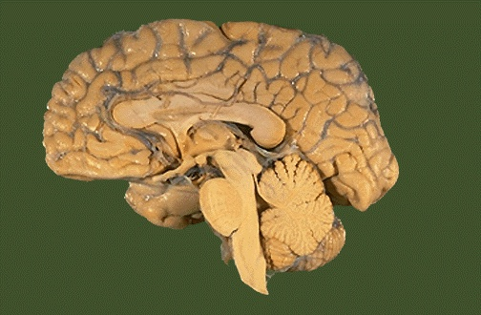
Nomenclature Sagittal Section

Slide 13
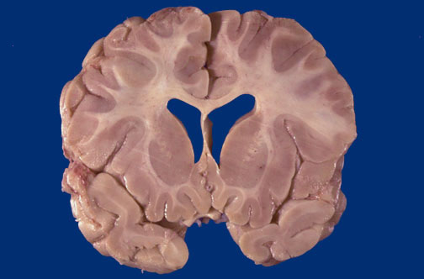
Coronal Section

Slide 14
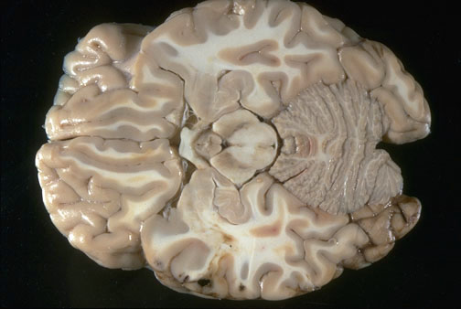
Horizontal Section

Slide 15
Human Brain: Directions, cross-sections and divisions
Based on Carlson Fig. 3.2, p. 66.
Fig. 1: Left lateral view of the brain and spinal cord. Anterior to posterior: Front to back Superior or dorsal: Top Inferior or ventral: Bottom
Fig. 2: Typical cross-sections through the brain and spinal cord.
Fig. 3: Typical cross-sections with directions labeled.
Fig. 4: Typical cross-sections with the three divisions (as discussed in lecture) labeled.

Slide 16
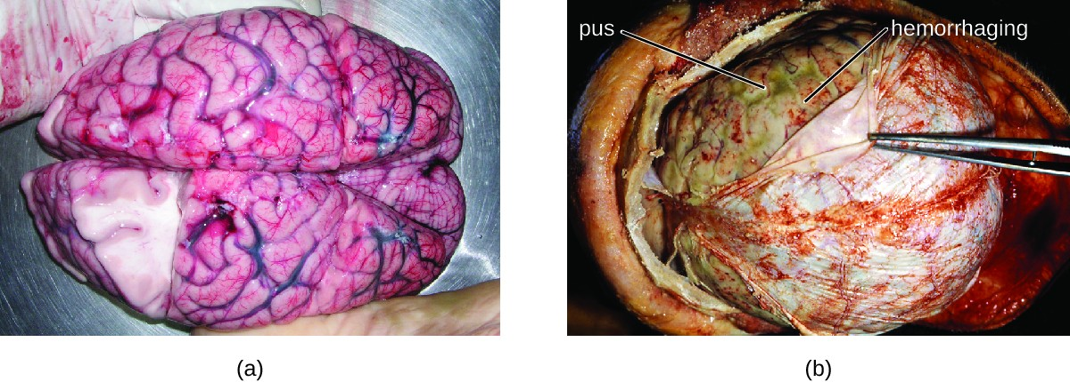
The Meninges
Dura mater
Arachnoid
Pia mater
This Photo by Unknown Author is licensed under CC BY

Slide 17
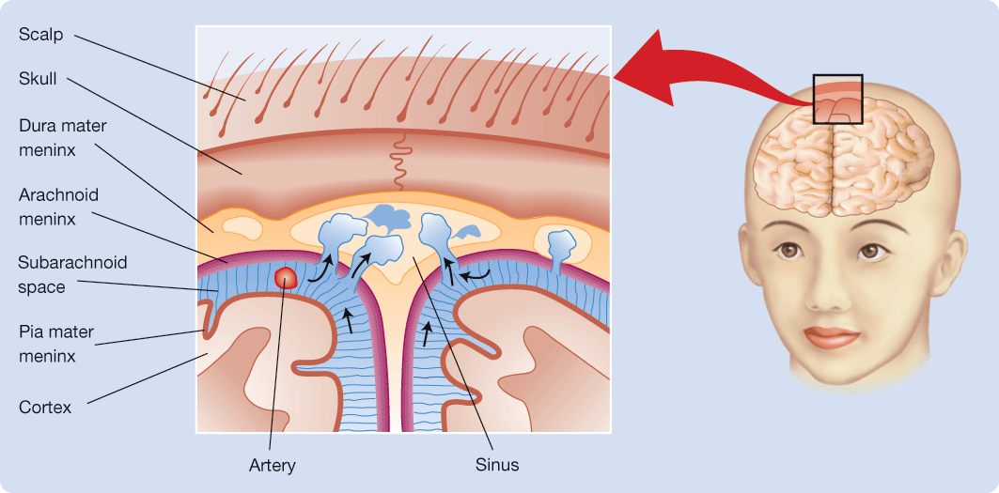
The Meninges
Figure 3.4 The absorption of cerebrospinal fluid (CSF) from the subarachnoid space (blue) into a major sinus. Note the three meninges.
Notes:
LO 3.1 List and describe the major divisions of the nervous system.
The Meninges

Slide 18
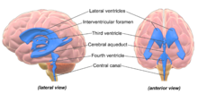
Ventricles and Cerebrospinal Fluid
Ventricles
Lateral
3rd
4th
Central canal
Cerebrospinal Fluid
Hydrocephalus- build up of CSF
This Photo by Unknown Author is licensed under CC BY-SA
Notes:
LO 3.3 Explain where cerebrospinal fluid is produced and where it flows.
General Layout of the Nervous System
Cerebrospinal fluid (CSF) is manufactured by the choroid plexuses—capillary networks that protrude into the ventricles. CSF circulates through the ventricular system of the brain, the central canal of the spinal cord, and the subarachnoid space, and is absorbed into large channels called sinuses in the dura mater and then into the blood stream (see Figure 3.4 in Biopsychology).
When the flow of CSF is blocked, hydrocephalus results.

Slide 19
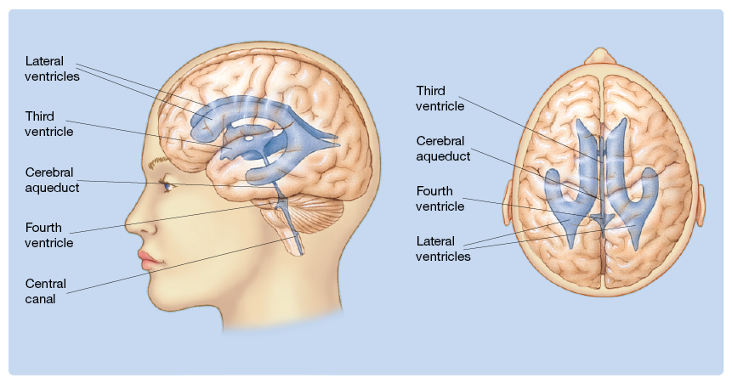
Figure 3.3 Ventricles and Central Canal
Figure 3.3 The cerebral ventricles and central canal.
Notes:
LO 3.3 Explain where cerebrospinal fluid is produced and where it flows.
Ventricles and Cerebrospinal Fluid

Slide 20
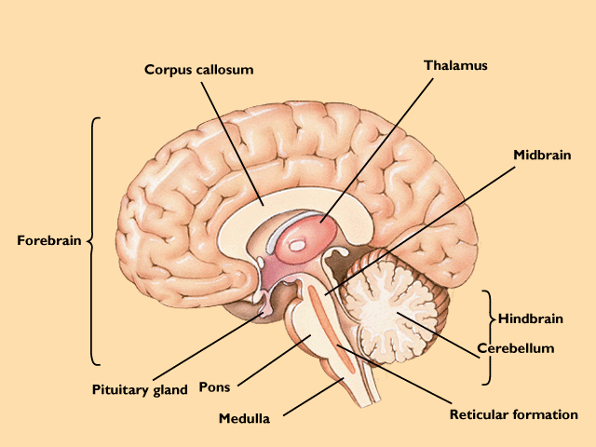
Major Structures of the Brain

Slide 21
Copyright © 2004 Allyn and Bacon

Slide 22
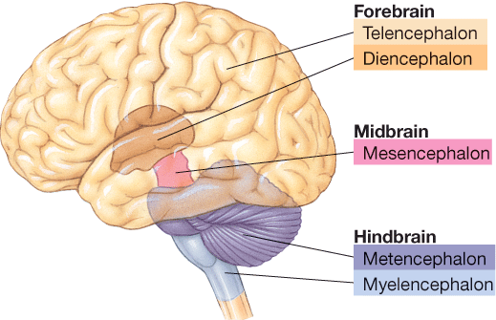
Figure 3.18 The Five Divisions of the Brain
Figure 3.18 The five divisions of the adult human brain.
Notes:
LO 3.10 List and discuss the five major-divisions of the human brain.
The Five Major Divisions of the Nervous System.

Slide 23
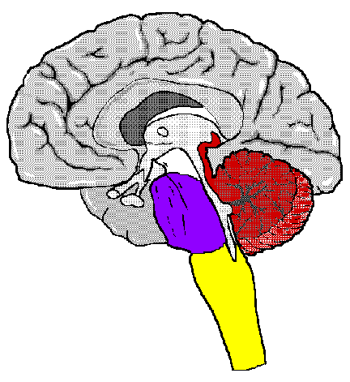
Hindbrain
Myelencephalon
Medulla (Breathing & heart rate)
Reticular Formation (goes through Pons & Medulla)
Regulating a wakeful state, mediating attention, and processing sensory information.

Slide 24
The Hindbrain
Metencephalon
Pons: Links to cerebellum, affects arousal, dreaming
Cerebellum: Balance, coordination, movement
Reticular Formation (deep inside): Controls arousal, waking, sleeping

Slide 25
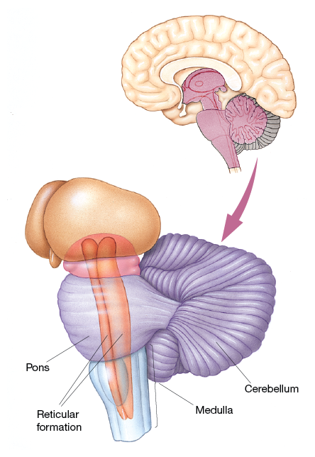
Myelencephalon/Metencephalon
Figure 3.19 Structure of the human myelencephalon (medulla) and metencephalon.
Notes:
3.11 List and describe the components of the myelencephalon.
3.12 List and describe the components of the metencephalon
Myelencephalon
Metencephalon

Slide 26
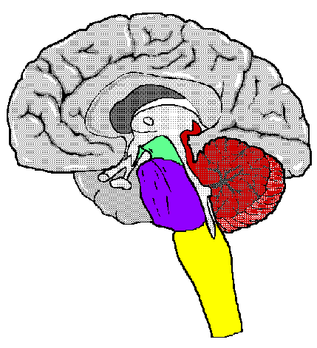
The Midbrain
In mammals, little more than a relay station
Coordinates signals between hindbrain & forebrain.

Slide 27
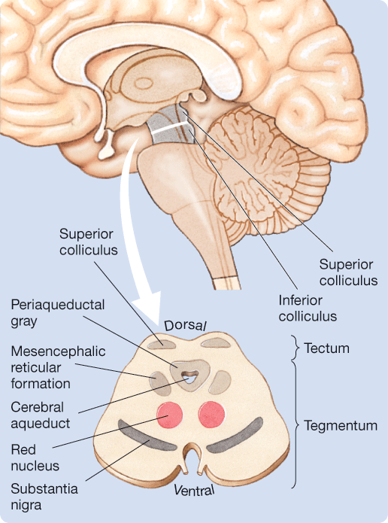
Mesencephalon
The human mesencephalon (midbrain).
Notes:
3.13 List and describe the components of the mesencephalon.
Mesencephalon

Slide 28
Midbrain or Mesencephalon
Tectum (roof)
Superior Colliculi- Vision
Inferior Colliculi- Audition
Tegmentum (floor)
Cerebral Aqueduct
Substantia Nigra (sensorimotor)
Red Nucleus (Sensorimotor)
Periaqueductal Gray (pain)

Slide 29
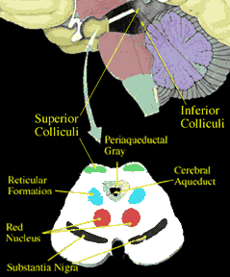
This document was last modified on 11/21/2000 11:46:21

Slide 30
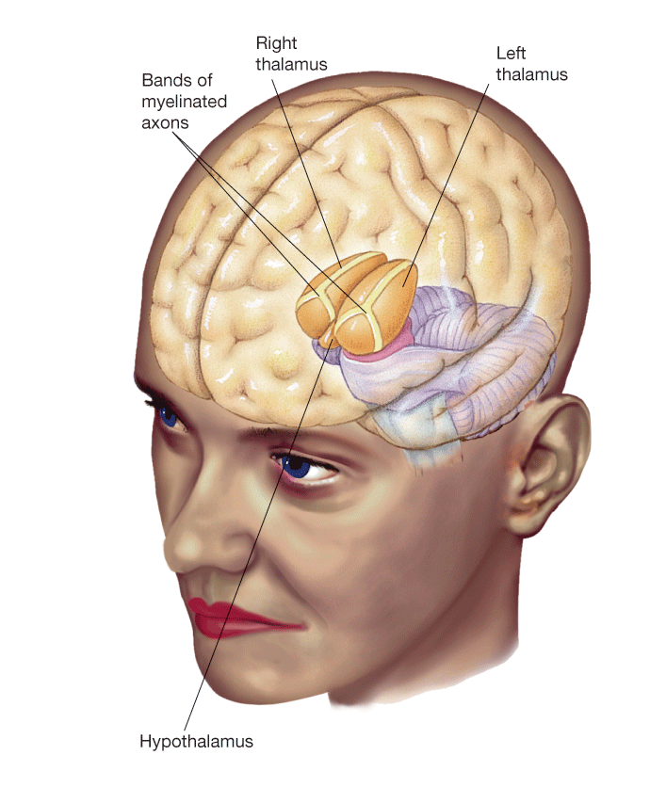
Diencephalon
Figure 3.21 The human diencephalon.
Notes:
LO 3.14 List and describe the components of the diencephalon.
Diencephalon

Slide 31
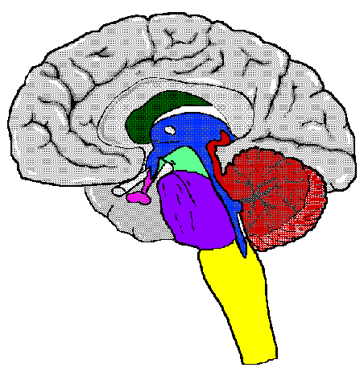
Diencephalon
Thalamus: A critical relay station to the higher brain centers
Hypothalamus: Controls appetites and homeostasis
Pituitary gland: Part of the endocrine system-- connects to the hypothalamus, releases critical hormones.

Slide 32
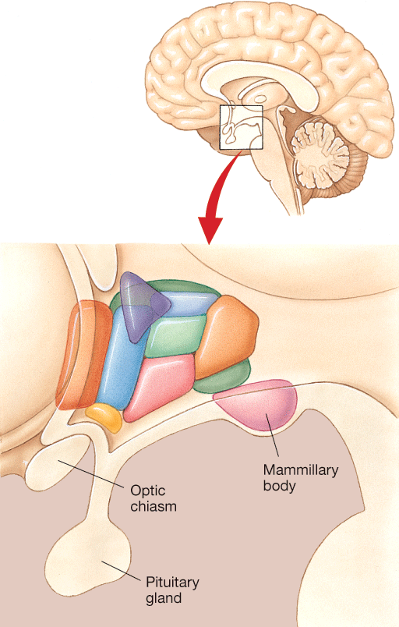
Hypothalamus
Notes:
LO 3.14 List and describe the components of the diencephalon.
Diencephalon

Slide 33
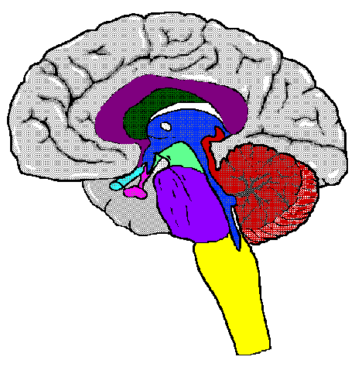
Forebrain regions (Telencephalon)
Optic Nerve: Extends the brain into the retina in each eye. (Diencehphalon)
Corpus Callosum: Connects
Telencephalon
hemispheres of the cortex.
Limbic System:
The hippocampus (memory)
The amygdala (emotional expression)

Slide 34
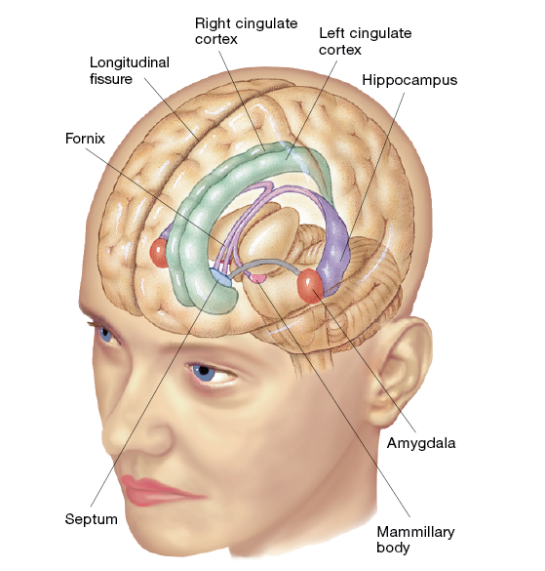
Limbic System
Notes:
LO 3.16 List and describe the components of the limbic system and of the basal ganglia.
Limbic System and the Basal Ganglia

Slide 35
Review limbic system- Papez Circuit

Slide 36
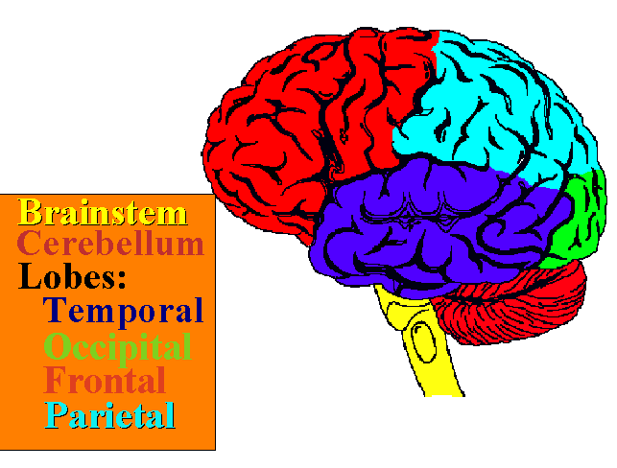
External View of the Brain

Slide 37
Lobes and their function
https://youtu.be/LQ4DlE1Xyd4

Slide 38
Lobes of the Brain (telencephalon)
Temporal Lobes: Contain the auditory cortex, Wernicke's area, associations related to auditory stimuli
Occipital Lobes: Contain the visual cortex, associations related to visual stimuli
Parietal Lobes: Contain the somatosensory cortex, associations related to spatial orientation
Frontal Lobes: Contain controls for speech production, thinking, planning, reasoning, impulse control, motivation

Slide 39
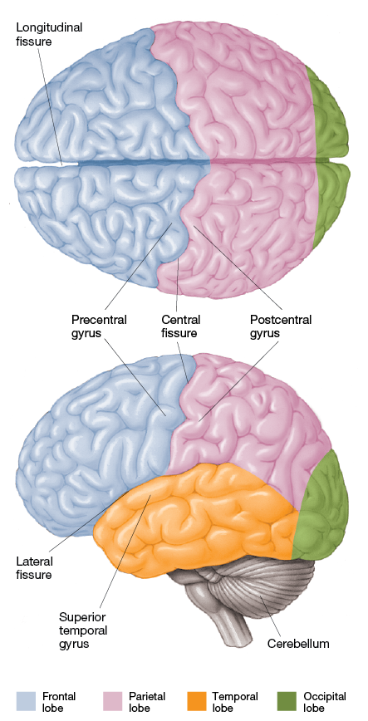
The Lobes of the Cerebral Hemispheres
3.24 The lobes of the cerebral hemispheres.
Notes:
LO 3.15 List and describe the components of the telencephalon.
Telencephalon

Slide 40
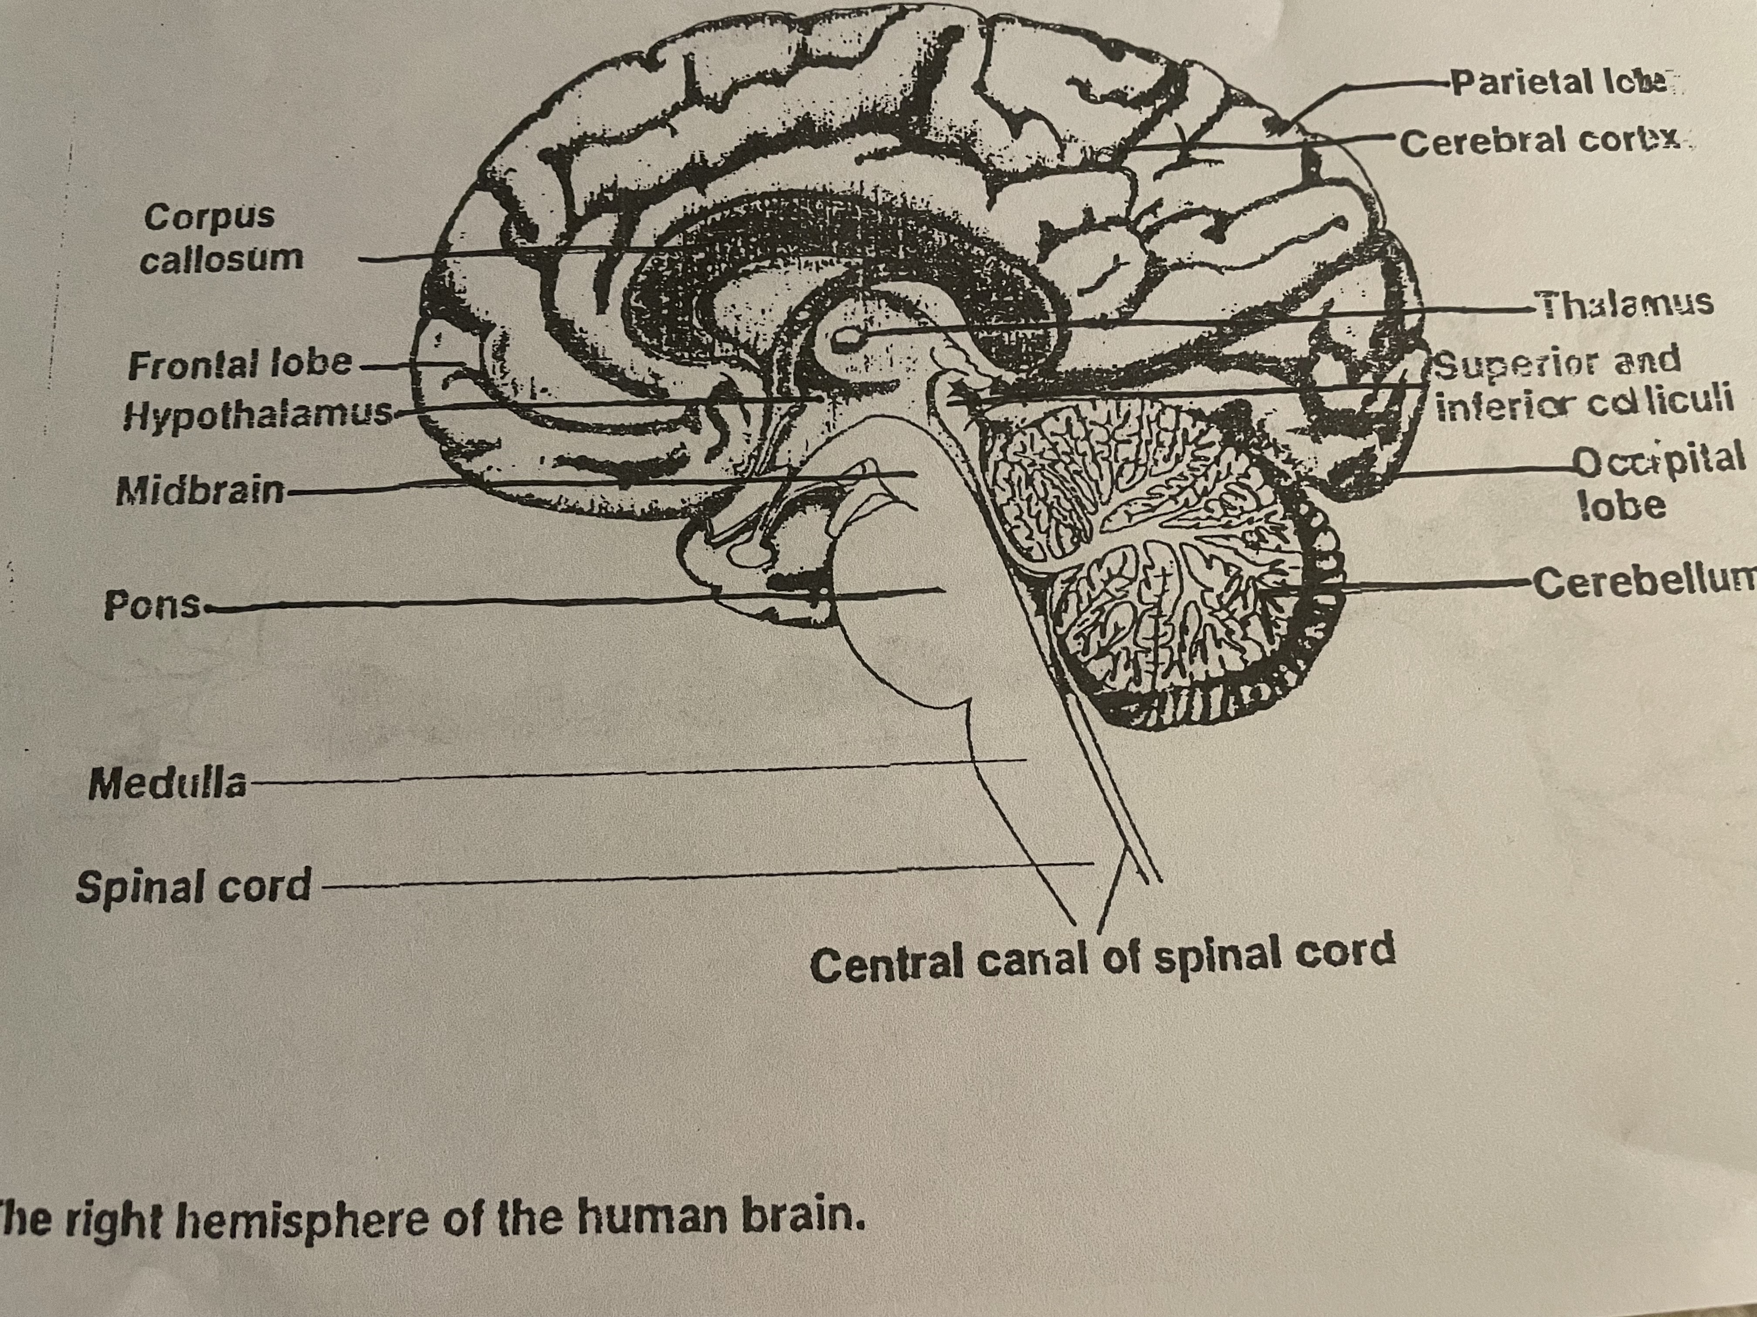

Slide 41
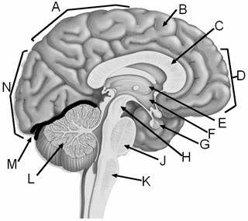
Quiz yourself

Slide 42
Answers
Parietal lobe
Medial frontal gyrus
C. Corpus Callosum
N. Occipital Lobe
D.Frontal lobe
E. Thalamus
F. Hypothalamus
M. Cerebelli sulci
G. Pituitary gland
L. Cerebellum
H . Cerebral Peduncle
k. Medulla
J. Pons

Slide 43
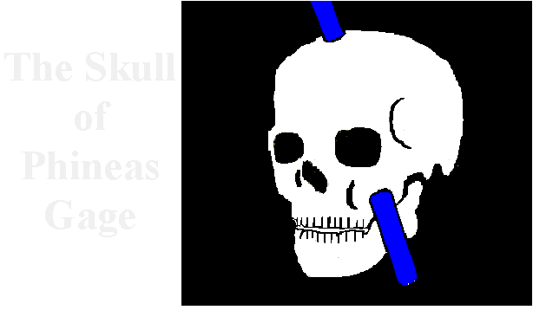
Frontal Lobes
Example: After Phineas Gage's frontal lobes were destroyed in a blasting accident, his ability to plan, limit impulses, and reason were destroyed.

Slide 44
Summary
Understanding the brain is important! It helps us understand behavior & when something may be wrong with our brain.
With advances in MRI & PET scans we can study the brain in real time & predict the occurrence of diseases such as Alzheimer’s!
To understand behavior you should know how the brain functions & its anatomy
What happens when our brain malfunctions?
Can the brain recover from injury?

Slide 45
Woman with Alzheimer’s responses to Music

Slide 46
Case Studies
JR has been walking with difficulty lately. He says “his balance is off”. What brain area may be involved?
KR can recall the past but form no new memories. Doctors think the ____has been damaged.
This brain area is part of the midbrain is important relaying visual information to the occipital lobe.
The brain area important in planning, personality & injured in Phineas Gage?

Slide 47
Answers
JR has been walking with difficulty lately. He says “his balance is off”. What brain area may be involved? Cerebellum
KR can recall the past but form no new memories. Doctors think the ____has been damaged. Hippocampus
This brain area is part of the midbrain is important relaying visual information to the occipital lobe. Superior Collicus
The brain area important in planning, personality & injured in Phineas Gage? Frontal Lobe

Slide 48
Review of Brain MRI

Slide 49
Brain Plasticity
https://youtu.be/IT_tW3EVDK8

