Slide 1
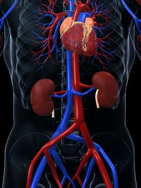
Cardio-Renal Axis
Radhika Nandur Bukkapatnam MD MAS
Aug 7, 2025

Slide 2
Why should we learn about heart disease if you have kidney disease?
If you have kidney disease, you are more likely to get heart disease.
Heart disease is the most common cause of death among people who have kidney disease

Slide 3
What is kidney disease?
Kidney disease means that the kidneys are damaged and can’t filter blood as they should.
This damage can cause wastes to build up in the body. For most people, kidney damage occurs slowly over many years. This gradual loss of kidney function is called chronic kidney disease (CKD).
Most patients with CKD have no symptoms until kidney damage is advanced.
After many years, you may start to feel sick or tired all the time.
Kidney failure is when you need a kidney transplant or a blood filtering treatment called dialysis
Before you reach that stage, other health problems may develop. One of these problems is heart disease.

Slide 4
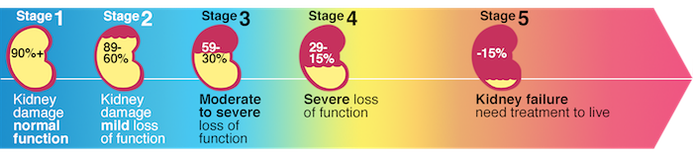
Stages of Kidney Disease (10%)

Slide 5
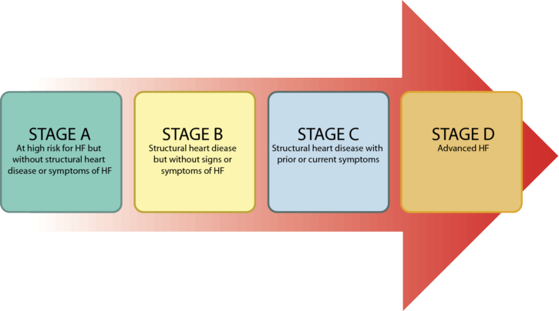
Stages of Congestive Heart Failure

Slide 6
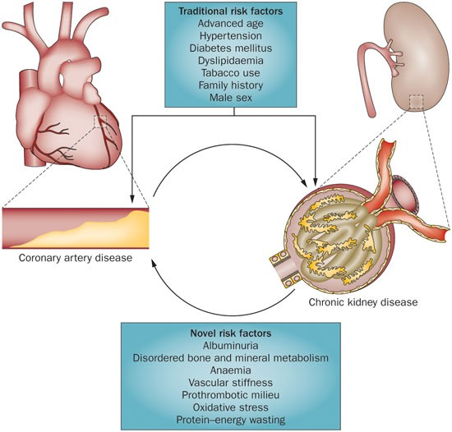

Slide 7
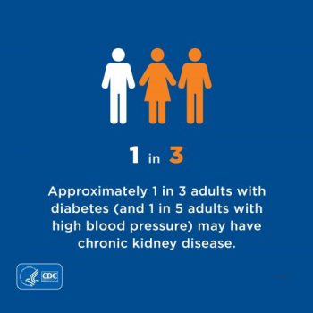
Risk factors
Heart disease
Kidney disease
HTN
Diabetes Mellitus
Smoking
Kidney disease
FH of heart disease
High cholesterol
Smoking
Inflammatory disease
HTN
Diabetes Mellitus
Heart disease
FH of heart disease
NSAIDs
Inflammatory disease

Slide 8
Heart Failure and Kidney Disease
Heart failure (HF) interacts with kidney disease via numerous pathophysiological pathways in both the acute and chronic setting
Mounting data indicate that the complex interplay between the heart and the kidneys involves hemodynamic, (neuro)hormonal and cardiovascular disease-associated mechanisms
Acceleration of HF or kidney dysfunction is driven by impairment of either the heart or kidneys via mechanisms including induction of inflammation, activation of the cellular immune system, metabolic disorders, anemia and mineral and bone disorder

Slide 9
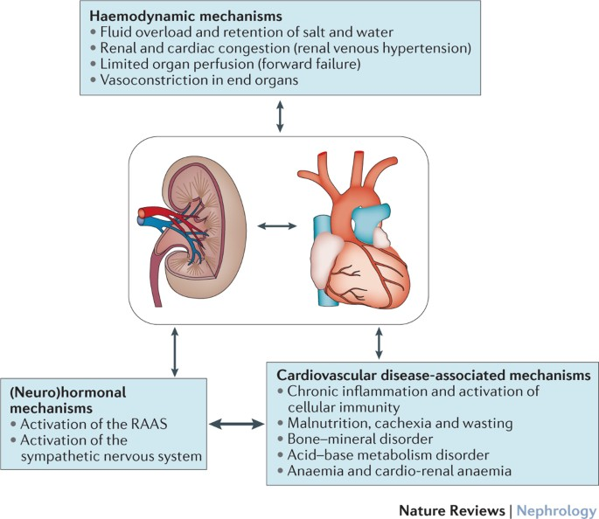

Slide 10
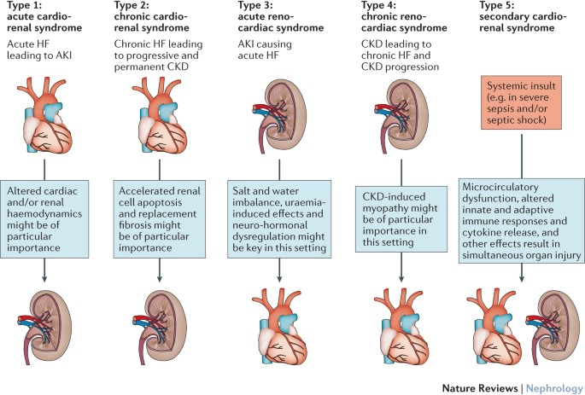

Slide 11
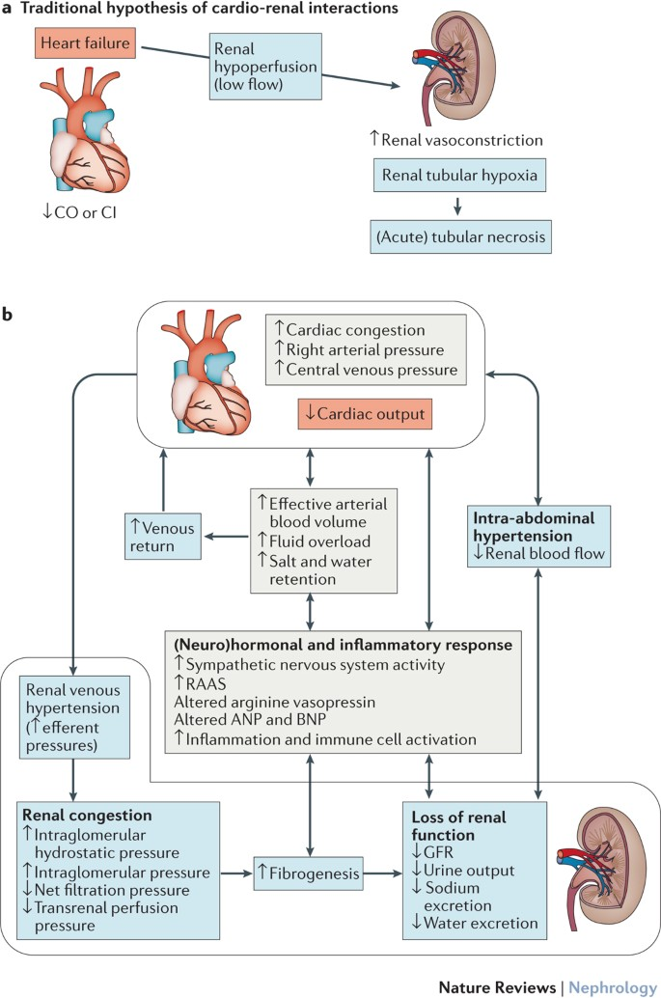

Slide 12
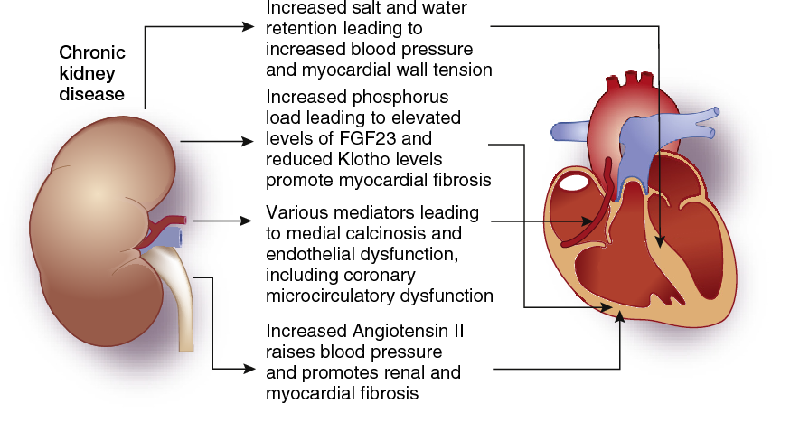

Slide 13
Causes of Kidney Disease

Slide 14
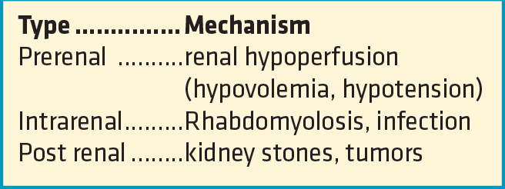

Slide 15
Clinical Features
Edema
Difficulty breathing
Decreased urine output
Anemia
Elevated Cystatin C
Elevated BUN/ Creatinine
Elevated BNP

Slide 16
Drugs affecting kidney disease

Slide 17
Noncardiac drugs affecting the kidneys
Contrast dye
Metformin
Antibiotics
NSAIDS
Chemotherapy
Antirejection
Colchicine

Slide 18
Cardiac Medications affecting kidneys
Contrast dye
Diuretics: Lasix, Bumex, Torsemide, HCTX, Aldactone
Atenolol
ACEI/ ARBs
Antibiotics
Anti-inflammatory drugs
Anti arrhythmic: Dose adjustment and elimination if low kidney function: Digoxin, Flecainide, Sotalol, Amiodarone, Doefetilide
Blood thinners: Dose adjustment

Slide 19
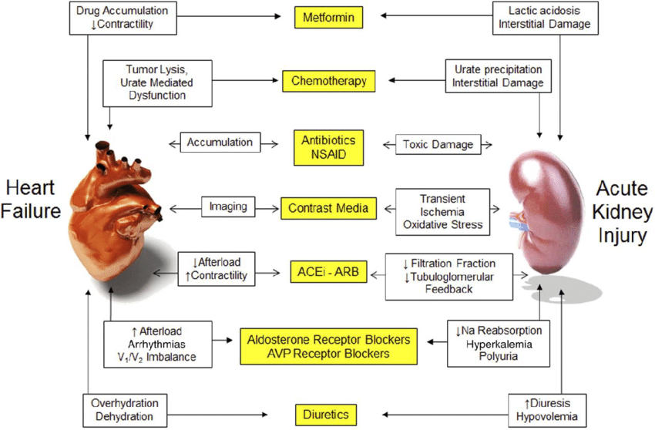

Slide 20
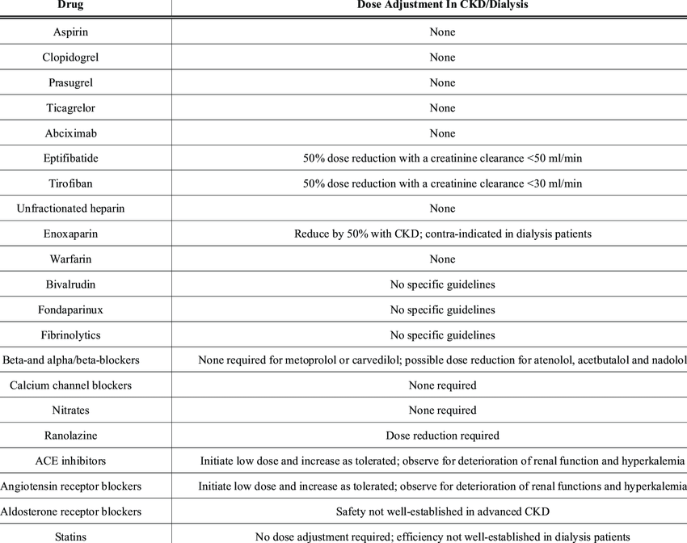
Dose adjustment in kidney disease

Slide 21
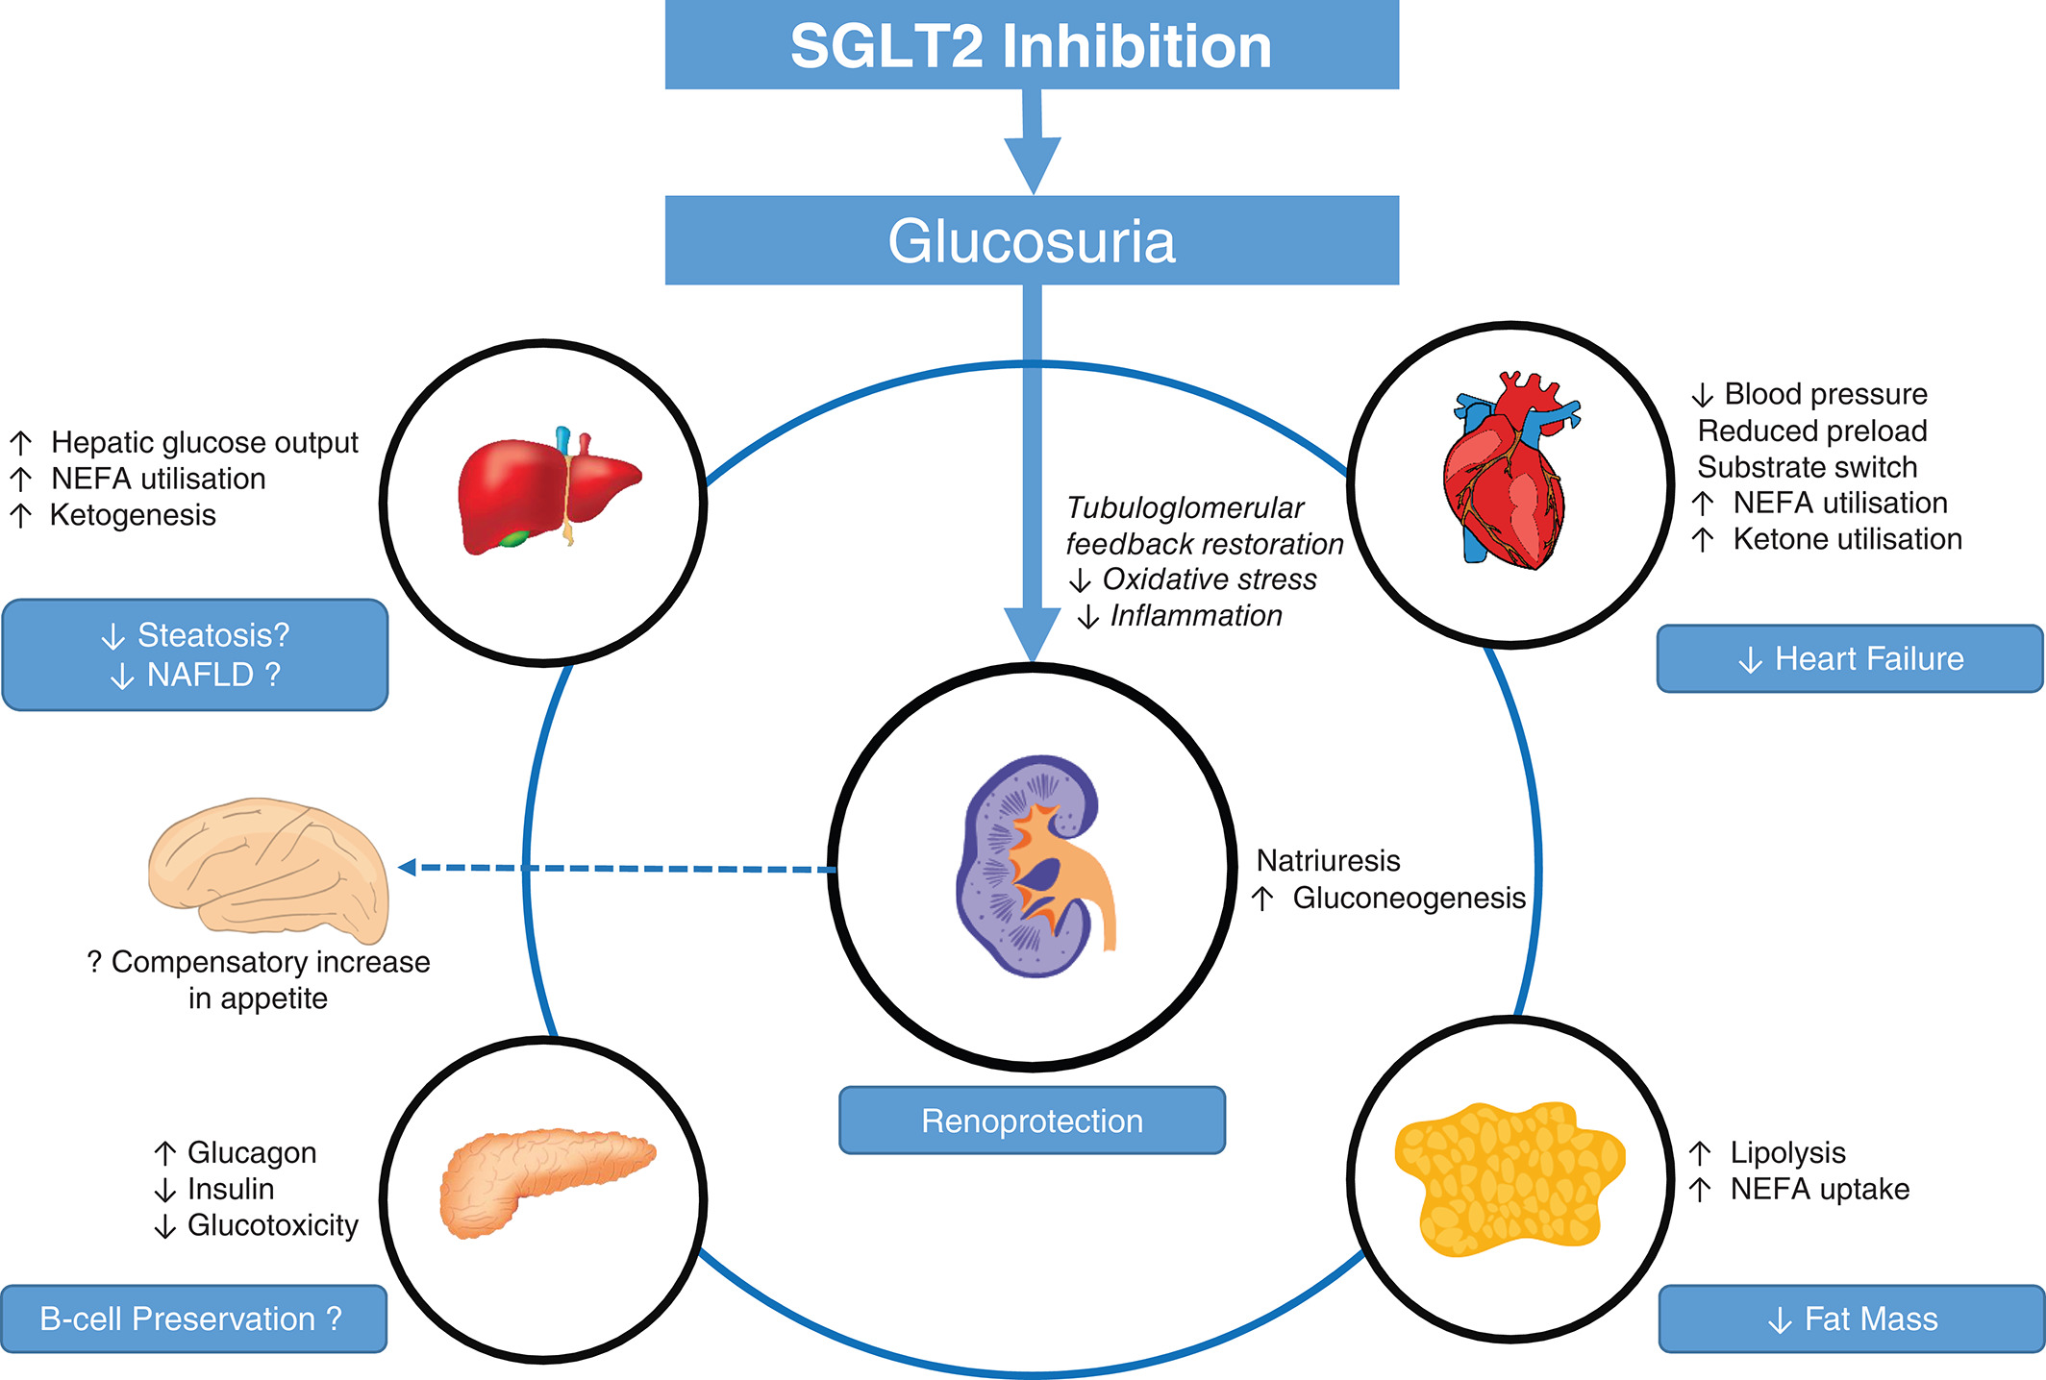

Slide 22
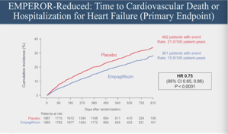

Slide 23
Prevention of Heart disease and Kidney disease

Slide 24
Prevention of Heart disease and Kidney disease
Keep your blood pressure below 140/90.
Control your blood glucose
Have your blood and urine checked as your provider instructs.
Try to keep your cholesterol numbers in a healthy range.
Control your weight. Be physically active 30 minutes a day most days of the week.
Avoid smoking, alcohol, drugs

Slide 25
People with advanced chronic kidney disease may need to adjust their diet to avoid high potassium.
If you have advanced kidney disease, you may need to limit foods such as bananas, oranges, potatoes, and tomatoes and eat apples, berries, grapes, and peaches instead.

Slide 26
Diet
fruits and vegetables
whole-grain breads and cereals
low-fat milk and milk products such as yogurt and cheese
lean meats or meat substitutes such as tofu
fish
unsaturated fats such as olive oil or corn oil
low-sodium foods

Slide 27
Thank you

