Slide 1
Mind Over BODY
Radhika Nandur Bukkapatnam MD MAS FACC

Slide 2
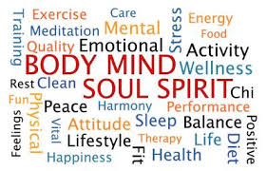

Slide 3
acknowledgemts
My teachers:
Dr Nandur (my father)
Dr Low: Be available, be amicable, be answerable
Dr Whitcomb: There are many ways of treating patients
My patients
Sharon Myers: Anatomy of Hope
All of you

Slide 4
Historical aspects
Although the understanding that emotions affect physical health dates as far back as the second-century physician Galen and the medieval physician and philosopher Moses Maimonides, modern medicine has largely continued to treat the mind and body as two separate entities.
In the past 30 years, research into the link between health and emotions, behavior, social and economic status and personality has moved both research and treatment from the fringe of biomedical science into the mainstream.
In the late 1960s, Herbert Benson, now Clinical Professor of Medicine at Harvard University, coined the phrase ‘relaxation response' to describe physiological changes that occur with meditation. A practicing cardiologist, he observed that many of his patients had high blood pressure at office visits

Slide 5
Health not disease
In 1948, the World Health Organization defined health as the presence of well-being—physical, mental, and social—not as the absence of disease.
In the past, effect of psychological health or interventions was measured in terms of economic benefits or its benefits on substance abuse or criminal behavior
Biopsychosocial model is considered invaluable
This new approach to health says loudly and clearly that the causes, development, and outcomes of an illness are determined by the interaction of psychological, social, and cultural factors with biochemistry and physiology

Slide 6
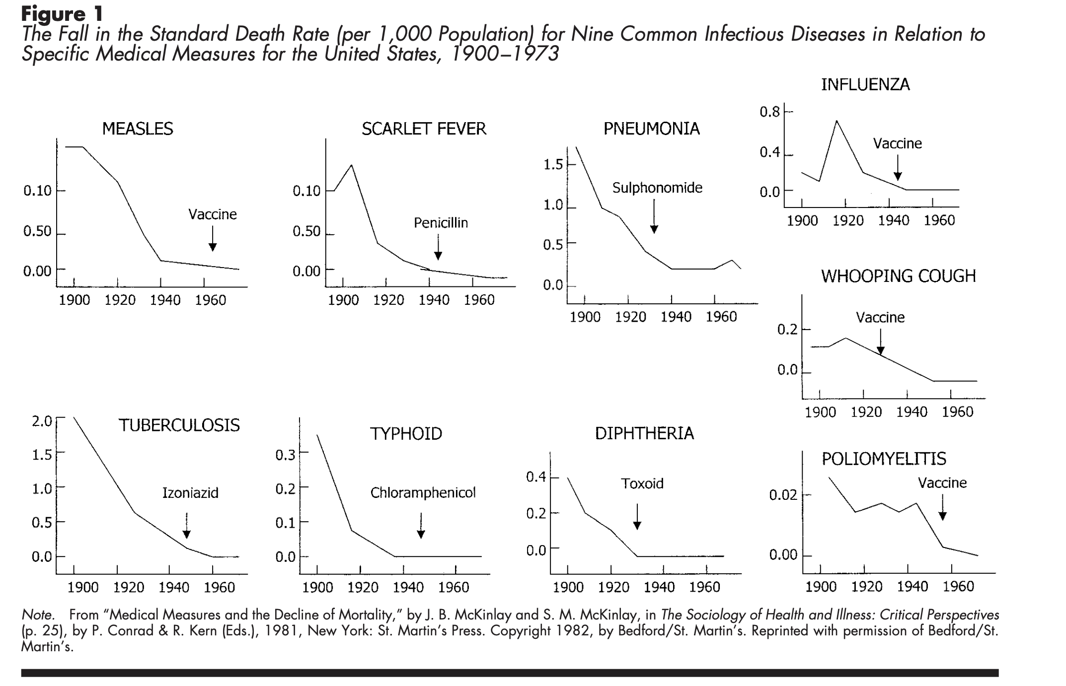
Effect of healthy lifestyle on disease
The history of rapid health gains in the United States is not unique; the rate at which death rates have fallen is even more rapid in more recently modernizing countries. The usual explanations for this dramatic improvement—better medical care, nutrition, or clean water—provide only partial answers. More important in explaining the decline in death worldwide is the rise of hope and the decline in despair and hopelessness. (Sagan, 1987, p. 184)

Slide 7
Determinants of health
Mind
Endocrine system
Nervous system
Immune System
Maier, Watkins, & Fleshner, 1994

Slide 8
Research into mind–body interventions—such as group therapy, stress-reduction techniques and cognitive-behavioral therapy (CBT)—and whether they can affect survival and pain in
Cancer
AIDS: CBT reduces viral load with medications
Bone-marrow transplant patients
Cardiovascular disease
Asthma,
Inflammatory diseases
Autoimmune diseases
Researchers attributed the improvement to changes in depressed mood (Antoni et al, 2006). Depression itself is under study for possible links to a range of inflammatory diseases; several studies show it to be an emerging risk factor for heart disease

Slide 9
Effects on white blood cells
Stressful emotions alter white blood cell function.
Stress diminishes white blood cell response to viral infected cells and to cancer cells.
Vaccination is less effective in those who are stressed
Wounds heal less readily in those who are stressed.
Some types of autoimmune disease, which involve particular subsets of white blood cells, are exacerbated by stress.
The literature documents the efficacy of talk-therapy interventions in altering immune system parameters and enhancing the body's ability to combat disease.

Slide 10
large-scale epidemiological and medical studies among civil servants in the UK
Workers in low-level jobs, in which they have high stress and little autonomy, have more than twice the risk of developing metabolic syndrome—a precursor of heart disease and diabetes—compared with employees in higher-level jobs
People from this group are also more inclined to die prematurely than colleagues who do less menial, higher-level work. In these studies, stress is defined as a high level of demand, a low level of control and little support from co-workers or supervisors.
By measuring heart rate, and cortisol and adrenaline levels, researchers also found that stress affects the autonomic nervous system and neuroendocrine function.

Slide 11
Atherosclerosis…
Acute and chronic psychological stress, related to low socio-economic status, can increase the risk of heart attack by increasing circulating levels of platelet–leukocyte aggregates.
Hardening of the arteries is more frequent in wives when they and their husbands express hostility during marital disagreements, and more common in husbands when they or their wives act in a controlling way

Slide 12
Determinants of illness
Coping skills
Environment
Knowledge
Inner resources
Social support
Spiritual beliefs

Slide 13
Hope vs despair
A prospective study of coronary heart disease (CHD) and paper-and-pencil measured optimism found that “a more optimistic explanatory style, or viewing the glass as half full, lowers the risk of CHD in older men” (Kubzansky, Sparrow, Vokonas, & Kawachi, 2001, pp. 913–914) and discussed other research showing a link “between pessimism, hopelessness, and risk of heart disease” (Kubzansky et al., 2001, p. 910). A 30-year study reported that “a pessimistic explanatory style . . . is significantly associated with mortality” (Maruta, Colligan, Malinchoc, & Offord, 2000, p. 140).

Slide 14
Can hope actually change the course of the malady?
Hope is the elevating feeling we experience when we see a path to a better future.
Hope acknowledges the significant obstacles and deep pitfalls along that path.
Hope has no room for delusion
Hope gives us the courage to confront our circumstances and the capacity to surmount them
Fear makes bad decisions
Doubt leads to complications

Slide 15
Psychoneuroimmunology
The mind is one activity of the brain, and this activity of the brain is the body’s first line of defense against illness, against aging, against death, and key to health and well-being
In 1998, Eric Kandel, a Nobel Laureate in Physiology or Medicine in 2000, provided the general mechanism whereby beliefs do become biology. That is, he explained the process used in the body to convert the electrical activity in the brain, which represents thoughts, into longer lasting changes in the body

Slide 16
Spirituality and social interactions
One study looked at the variables that influenced mortality in men over 55 who had elective cardiac surgery (Oxman, Freeman, & Manheimer, 1995). Two of the top five predictors of six-month mortality are variables of interest—social support and religious support. Those who professed no strength or comfort from religion were three times as likely to die in this six-month period as those who said they drew strength and comfort from religion.
No one is sure why or how increased social interaction decreases mortality: more friends helps an individual to deal better with the stresses and anxieties of life. or increases our health-producing behaviors.
Mortality of the surviving spouse during the first year of bereavement has been found to be 2 to 12 times that of married people the same age”

Slide 17
Will to live
These studies suggest that the will to live is an important part of staying alive. More than that, these studies show that our minds are powerful in determining life and death, health and well-being. All the evidence points to the same conclusion: When an event that is important to an individual is coming up in the near future, it seems possible for some people to delay death until after the significant date has occurred.
PH: Sent for surgery, fought till he saw all his family

Slide 18
Scientific evidence
“Too much stress makes you sick”
By measuring heart rate, and cortisol and adrenaline levels, researchers also found that stress affects the autonomic nervous system and neuroendocrine function (Chandola et al, 2006; Bjorntorp, 1991; Brunner et al, 2002).
Other recent research showed that acute and chronic psychological stress, related to low socio-economic status, can increase the risk of heart attack by increasing circulating levels of platelet–leukocyte aggregates (Brydon et al, 2006).
A study from the University of Utah (Salt Lake City, UT, USA), first presented at the American Psychosomatic Society meeting in March 2006, showed that hardening of the arteries is more frequent in wives when they and their husbands express hostility during marital disagreements, and more common in husbands when they or their wives act in a controlling way

Slide 19
I think, therefore I am descartes
Biopsychosocial model: provides the concepts and the components to change the way we view much of the world. The components are the neurotransmitters, hormones, and cytokines that act as messenger molecules carrying information between the nervous, endocrine, and immune systems. The concepts include two very basic ones: (a) The thought processes are the functioning of the brain, and (b) as we change our minds (our thoughts), we change our brains and therefore our bodies.
NIH has stated that “we know that at least half of all deaths in the United States have behavioral and social factors as significant causes” (Raynard S. Kington, as quoted in Carpenter, 2001, p. 78).

Slide 20
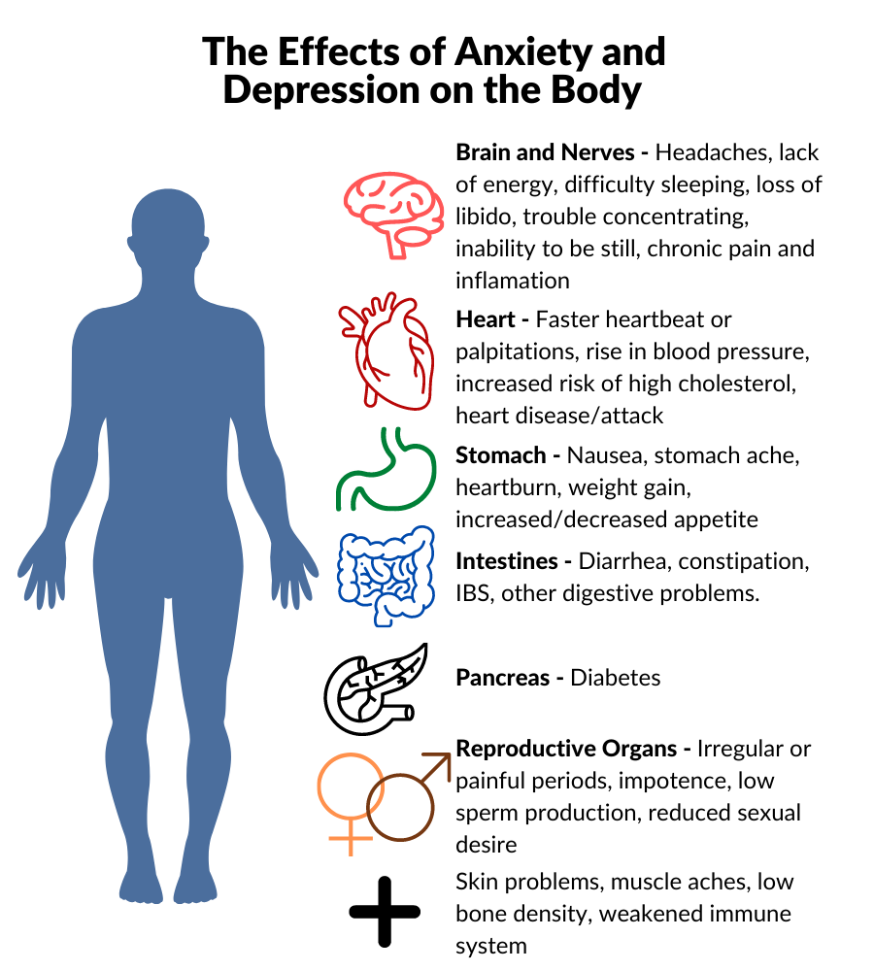

Slide 21
Health Maintenance

Slide 22
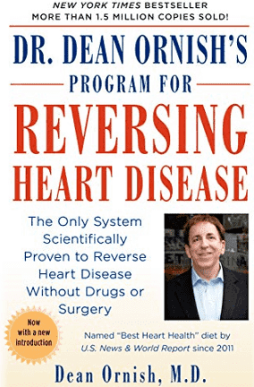
Mind over body
An example of how far mind–body medicine has come over the past three decades is the success story of Dean Ornish, Clinical Professor of Medicine at the University of California, San Francisco (CA, USA), and founder, President, and Director of the Preventive Medicine Research Institute (Sausalito, CA, USA). When he claimed in the early 1980s that heart disease could be prevented and even reversed with ‘lifestyle changes” (Ornish et al, 1983; Gould et al, 1992; Ornish, 1998).

Slide 23
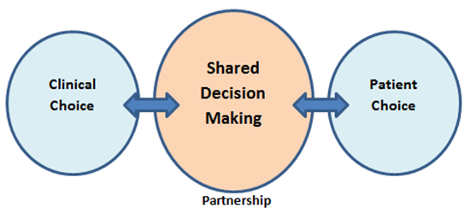
Shared decision making
One report commented that “ ‘patient-centered care’ is emerging as a key concept in modern medicine” and mentioned that patients who exerted “more control” and had “more expression of emotion” (Frishman, 1996, p. 1) during their visit to the doctor’s office showed improved health and felt better. In other words, an active approach to our health increases our chances of getting better. Chiong (2001) concluded that “the modes

Slide 24
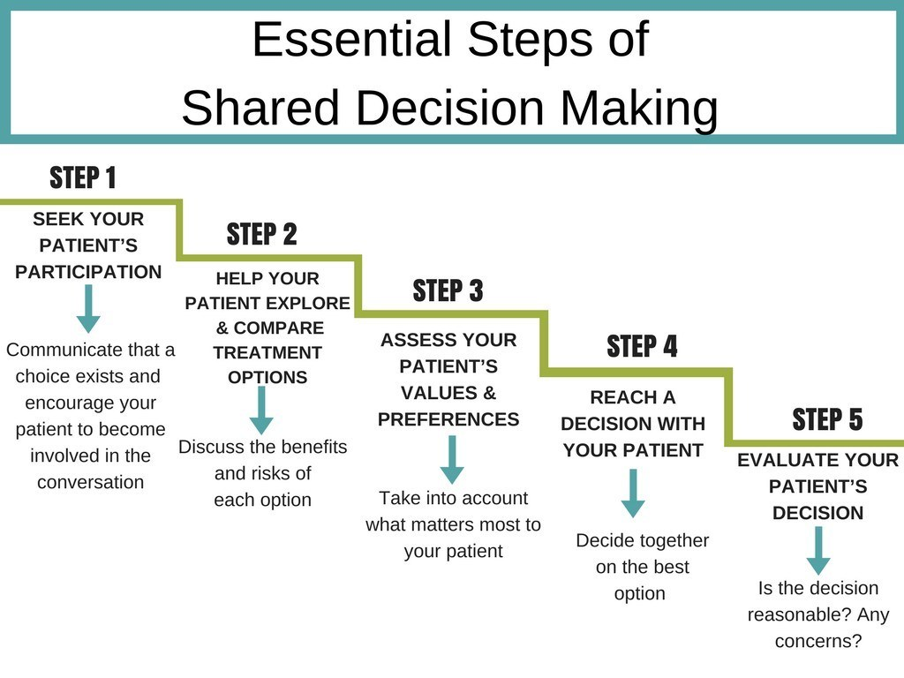

Slide 25
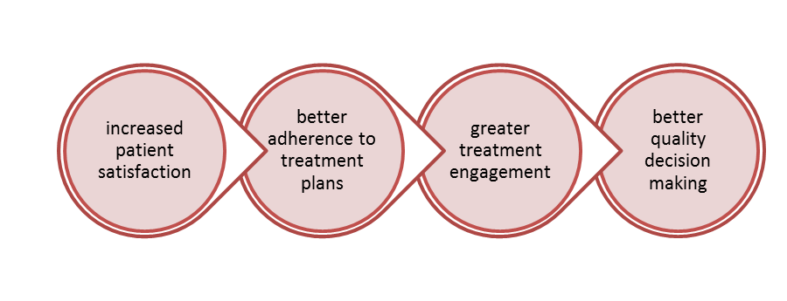
Outcomes of partnership

Slide 26
Application in alternative medicine
Group therapy, stress-reduction techniques and cognitive-behavioral therapy (CBT)
An increasing number of US medical schools and centers now have departments devoted to mind–body research and some also to mind–body treatment, including Harvard University (Cambridge, MA), Columbia University (New York, NY), University of California, Los Angeles, and the University of Pittsburgh (PA)

Slide 27
Durango (Doubt)
Jazz musician
Developed CHF from his lifestyle
Never trusted doctors
Lifetime achievement award
Lived life to the fullest

Slide 28
ABC ( Fear)
Young man who nearly died of west Nile virus
Found to have bad valve disease
Recommended open heart surgery
FEAR………..bad decisions
Parking lot
10 years later……………..

Slide 29
BCD (hope)
91year old with heart disease
Works as a chaplain
Makes and sells jewelry
Overcame fear with prayer, writings and supporting others

Slide 30
CDE (positive attitude)
92 year old with bad valvular disease
Did not have time to be sick because she is in bowling leagues
Had TAVR and reported it improved her game
Worked with CHF team till the end

Slide 31
EFG ( Faith)
Very religious
Had open heart surgery, prayed for her doctors
Had complications, and still prayed for her doctors
Had another surgery, more complications
Miracle that her heart is holding up

Slide 32
Age is only a number
101 year old with pacemaker and valve disease
Wanted to go to NY for his 102 birthday
AVA 0.8 cm2
I was having palpitations
Had valve surgery after he returned

Slide 33
IJK ( American Spirit)
66 year old
Lymphoma in her 30s
Heart attack in her 40s
Oxygen in her 50s.
Girl scout and goes by RV
Summer inspiration

Slide 34
SB
89 year old with wife and daughter
End stage heart disease, heart pumps at 20%
Meds messed up his kidneys
Arrhythmias
Multiple hospitalizations with end of life talks
Celebrated birthday and still doing well

Slide 35
MM
Elderly Hispanic with hip fracture
Avid photographer
Fell and fractured hip
Failure to thrive
Home with help

Slide 36
Mind-Body medicine: Dr Michelle DOSSETT
Western medicine has produced revolutionary health benefits through advances in pharmacotherapies and procedures. It now faces enormous challenges in battling stress-related noncommunicable diseases.
More Americans than ever are taking prescription medications for chronic health conditions, many of which have a lifestyle component. Chronic pain, often perpetuated by psychosocial stress, has become an epidemic that our pharmaceutical arsenal is poorly equipped to handle, and medical costs continue to soar.
Mind-body therapies can be a helpful adjunct in managing chronic pain and other stress-related noncommunicable diseases by fostering resilience through self-care.

Slide 37
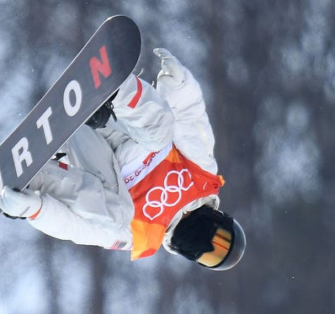
Shaun White is the epitome of what it means to be an Olympian. His strength, perseverance, and heart-- a surgically-repaired heart-- has earned him a place at four consecutive Winter Olympics.
As a baby, White was diagnosed with Tetralogy of Fallot (TOF), a rare heart condition comprised of four congenital cardiac defects. On Jimmy Kimmel Live! in May 2017, White told Kimmel, whose son also has TOF, that he’s undergone three operations to repair his heart.

Slide 38
Healing touch
Be knowledgeable
Be available
Show you care
Don’t judge

Slide 39
Communication
Communicate clearly
Extra note/ phone call/ text
Social media

Slide 40
Patient Perspective
Be positive
Build a relationship
Be your advocate ( be assertive not aggressive)
Give hope and happiness

Slide 41
Thank you

