Slide 1
Blood Pressure
What is it?
What is high?
What is low?
What causes it?.....and more

Slide 2


What is blood pressure. Let’s talk about it
Blood pressure is the force of blood pushing against the walls of your arteries as your heart pumps it around your body.

Slide 3
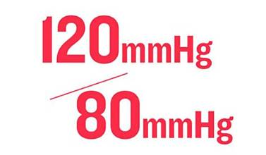
How Readings Work
Blood pressure is measured in millimeters of mercury (mmHg) and uses two numbers written as a fraction
Systolic pressure (Top number): The force when your heart beats and pushes blood out. Force of the contraction of the heart
Diastolic pressure (Bottom number): The force when your heart rests between beats.

Slide 4
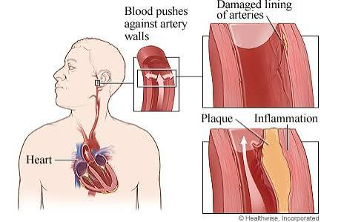
Let’s put it all together
https://youtu.be/pr29CWlkg8Y?si=9K6MGBULqN8mq4J-

Slide 5
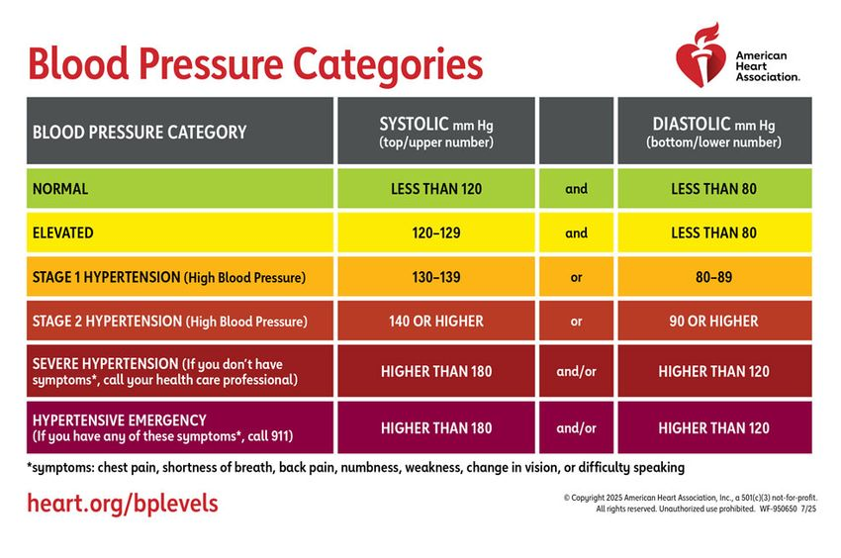

Slide 6
Key Updates and Recommendations:
This is what your doc is thinking about if your pressure is high:
Brain Health Focus: Early treatment targets a systolic pressure under 130 mm Hg to protect cognitive function and lower the risk of dementia.
Risk Assessment: Providers use the PREVENT tool to evaluate a patient's 10-year cardiovascular risk.
Medication Thresholds: Medication is recommended alongside lifestyle changes for average readings of 140/90 mm Hg or higher, or for readings of 130/80 mm Hg and higher in patients with diabetes, chronic kidney disease, cardiovascular disease, or a high PREVENT risk score.
Lifestyle Interventions: The DASH/plant based diet, regular aerobic and isometric exercise, maintaining a healthy weight, reducing sodium, increasing dietary potassium, and minimizing alcohol are strongly advised.

Slide 7
Statistics in the US. What we know
Nearly half of U.S. adults have high blood pressure.
High blood pressure increases risk for heart disease and stroke.
Many adults with high blood pressure do not have it under control.

Slide 8

Having high blood pressure puts you at risk for heart disease and stroke, which are leading causes of death in the United States.
In 2024, high blood pressure was a primary or contributing cause of 680,179 deaths in the United States.
Nearly half of adults have high blood pressure (48.1%, 119.9 million). This is defined as a systolic blood pressure greater than 130 mm Hg or a diastolic blood pressure greater than 80 mm Hg or are taking medication for high blood pressure.
About 1 in 4 adults with high blood pressure has their blood pressure under control (22.5%, 27.0 million)
Heart attack
Stroke
Death

Slide 9

We can do better
About 34 million adults who may need blood pressure medicine according to the hypertension guidelines are not currently taking it. Nearly two out of three of these adults (19 million) have a blood pressure of 140/90 mm Hg or higher.
Annual costs associated with high blood pressure were an estimated $219 billion in the United States in 2019.

Slide 10
What causes high blood pressure?
Primary (Essential) Hypertension
This type develops slowly over many years and has no single, clear cause. Instead, it results from a mix of:
Aging: Blood vessels naturally become stiffer over time.
Genetics: Family history and inherited traits play a large role.
Lifestyle factors: Poor diet (like high sodium and low potassium), lack of exercise, being overweight, and heavy alcohol use

Slide 11
Secondary Hypertension
This type appears suddenly and is caused by an underlying medical issue or external factor. Common causes include:
Kidney disease: Narrowed arteries leading to the kidneys or other renal problems.
Obstructive sleep apnea: Breathing pauses during sleep that raise blood pressure.
Medications: Over-the-counter cold medicines, birth control pills, steroids, and Mayo Clinic non-steroidal anti-inflammatory drugs (NSAIDs).
Substances: Alcohol, nicotine, or illicit drugs like cocaine.

Slide 12
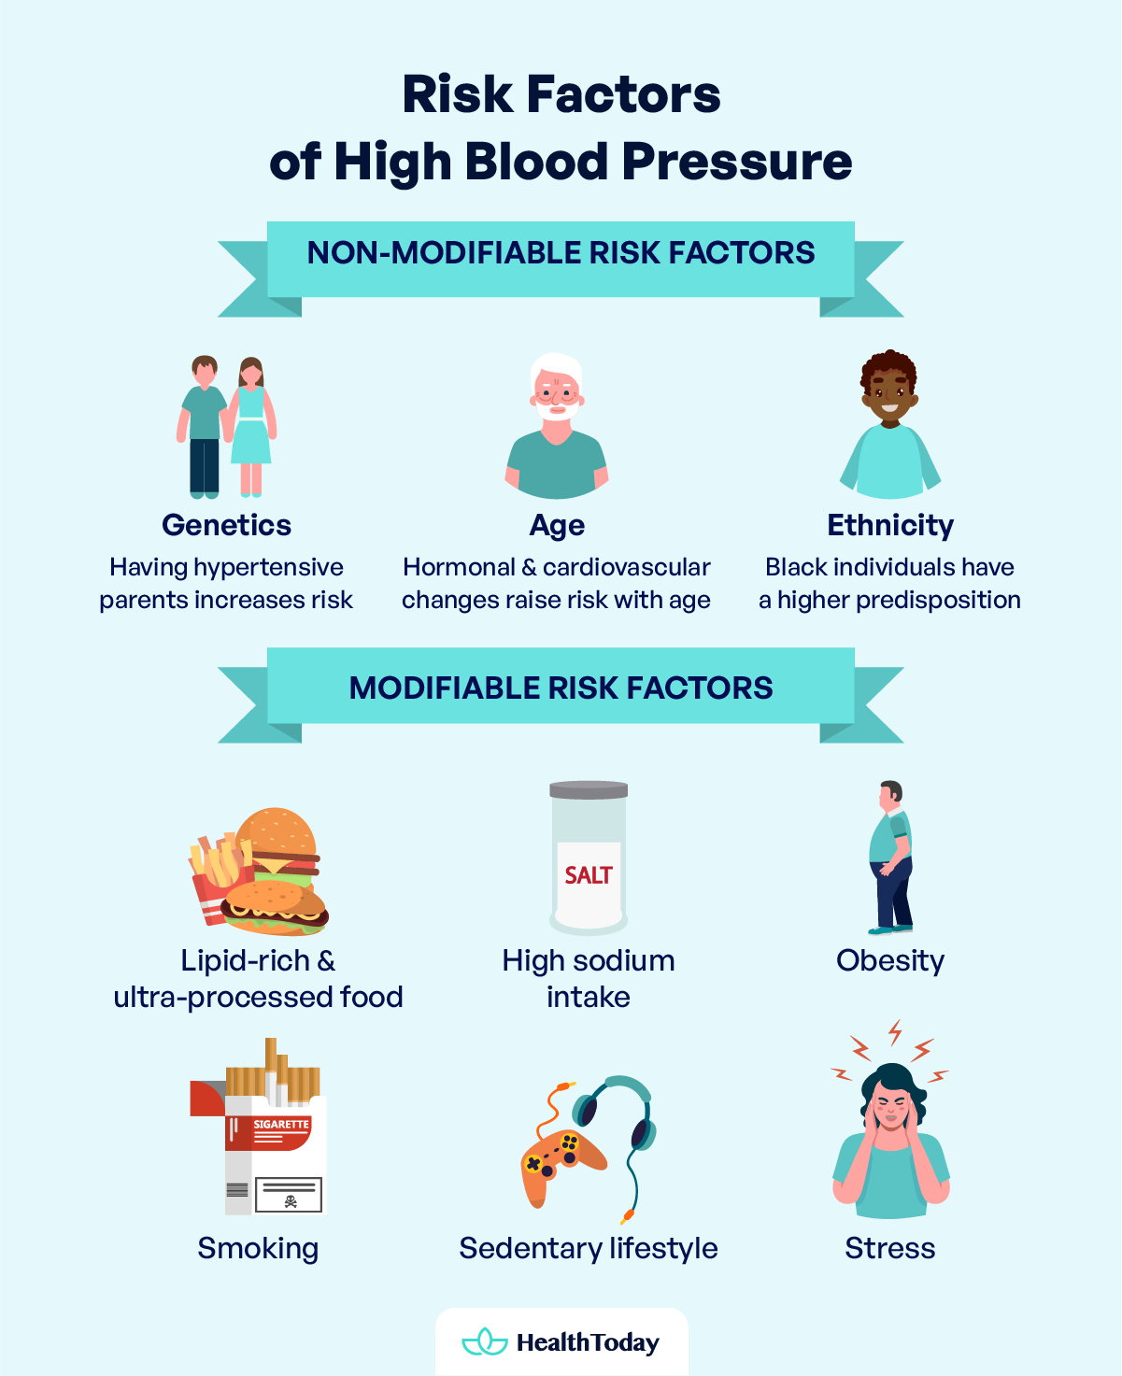
Risk Factors for High Blood Pressure

Slide 13
What about low blood pressure
Low blood pressure, or hypotension, is generally defined as a reading lower than 90/60 mm Hg, but it only requires treatment or concern if it causes symptoms or indicates an underlying medical issue.
So, what are the symptoms?

Slide 14
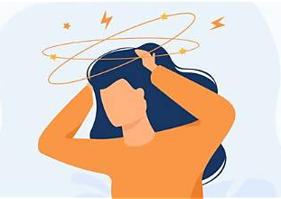
Symptoms of low blood pressure
Dizziness or lightheadedness
Fainting or passing out
Blurred vision
Fatigue or general weakness
Confusion or trouble concentrating

Slide 15
Causes of low blood pressure
Dehydration: Lacking enough fluid from fever, vomiting, or not drinking enough reduces blood volume.
Medications: Drugs for high blood pressure, heart disease, or depression can lower readings.
Heart Conditions: Heart failure, slow heart rates, or heart attacks reduce pumping capacity.
Endocrine Issues: Conditions like Addison's disease or low blood sugar affect hormone regulation.
Severe Infections or Allergic Reactions: Septic shock or anaphylaxis can cause a sudden, life-threatening drop.

Slide 16
Conclusion of part 1 of hypertension
What questions do you have for me?
Sharon is up next to discuss treatment!

