Slide 1

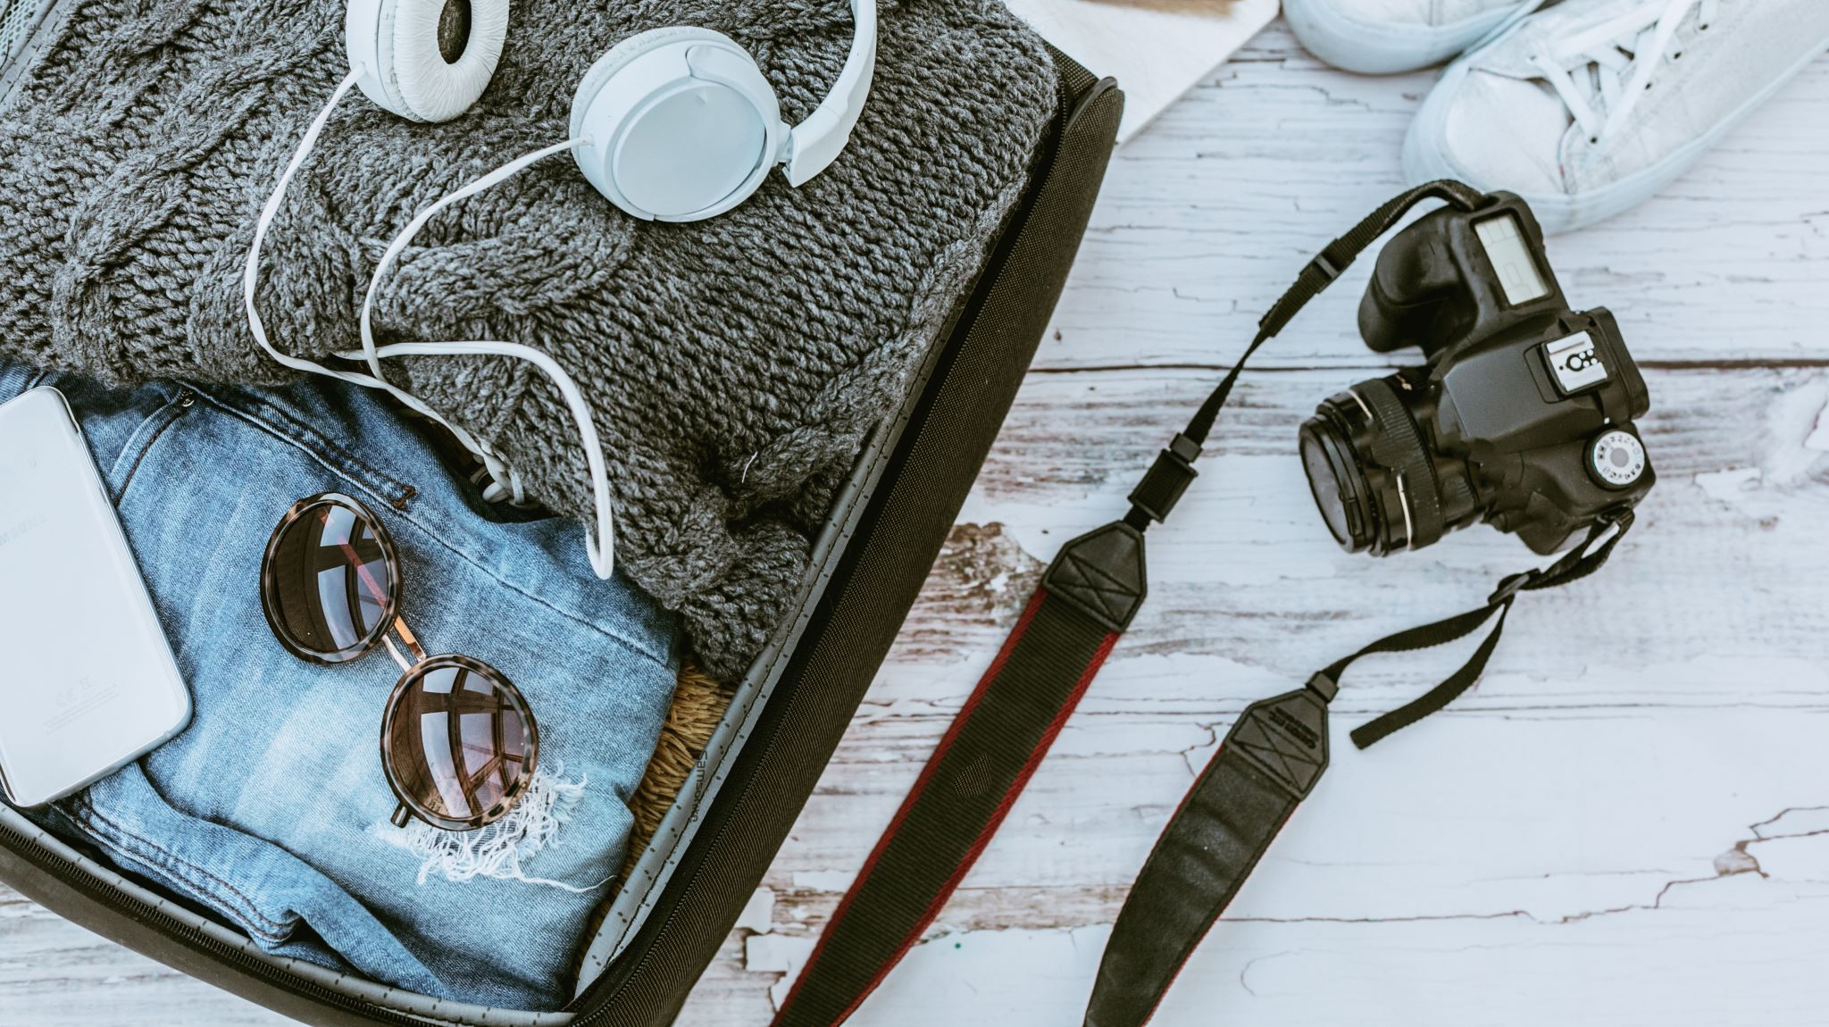
Adventures close to home or abroad: Tips for Positive Mental Health
LindA Goode LCSW
CSuS Cardiovascular Psychosocial Wellness Series

Slide 2
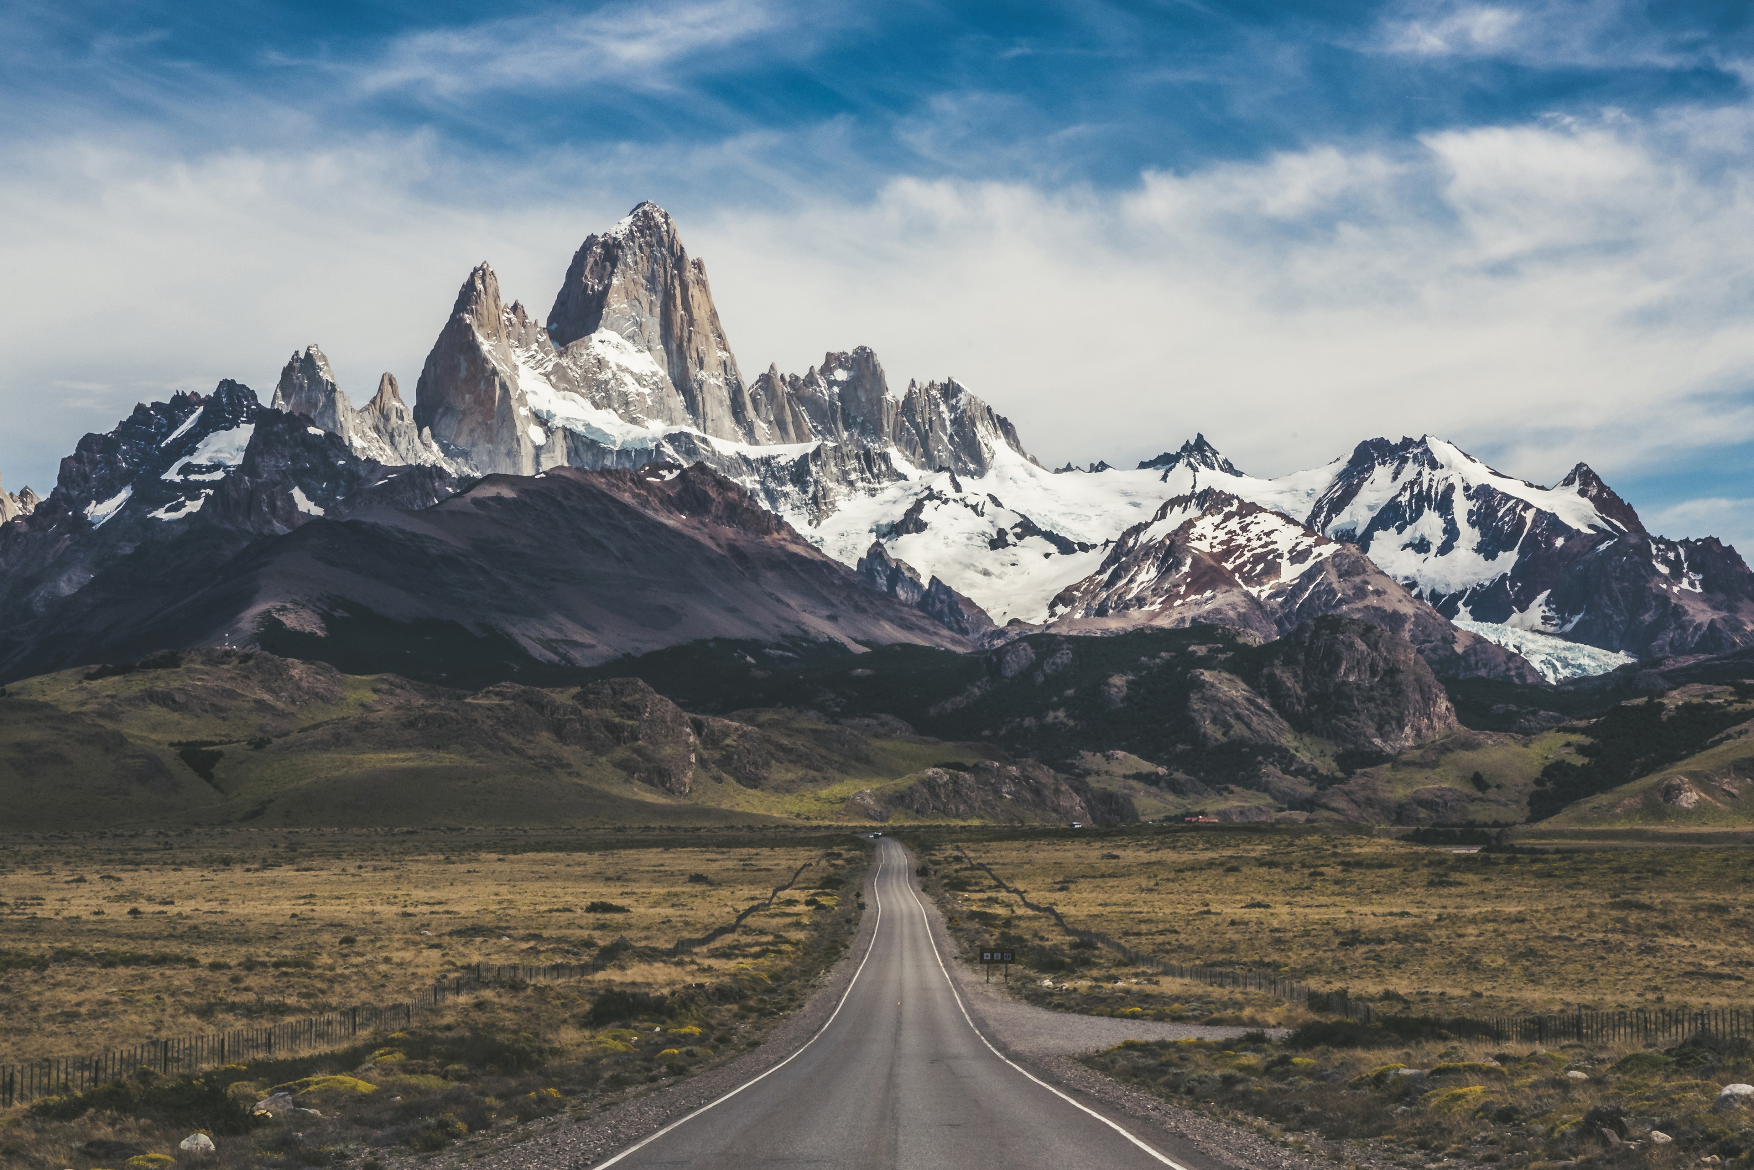
“Blessed are the curious for they shall have adventures.”
– Lovelle Drachman

Slide 3
Traveling has many benefits…
Learning, exploring, and trying new things can create positive emotions, stimulate intellectual growth and support mental health.
When you make a plan, it can create happiness and excitement. Preparing and looking forward to outings are beneficial to your mental health.
Traveling can start out your front door and reach as far as the imagination.
“The real voyage of discovery consists not in seeking new landscapes, but in having new eyes.” – Marcel Proust

Slide 4
Planning to get away…
‌You can make your travel plans big or small. They don’t have to be expensive to get benefits from them. Even talking to someone from a different culture, reading and watching travel shows can offer a different perspective and be beneficial.
Going to new places and talking to different people opens your mind. This might feel counterproductive, but getting out of your comfort zone can be good for your mental health.
Empathy can increase when you learn things about other people and cultures that you've never experienced before.
….“Remember that happiness is a way of travel – not a destination.” – Roy M. Goodman

Slide 5
Travel may also be stressful
According to the World Health Organization: Stress can be defined as a state of worry or mental tension caused by a difficult situation. Stress is a natural human response that prompts us to address challenges and threats in our lives. Everyone experiences stress to some degree. The way we respond to stress, however, makes a big difference to our overall well-being
.
Stressful situations can also cause or exacerbate mental health conditions, most commonly anxiety and depression
Having a daily schedule can help us use our time efficiently and feel more in control. Set time for regular meals, time with family members, exercise, daily chores and other recreational activities. Sleep repairs, relaxes and rejuvenates our body and can help reverse the effect of stress.

Slide 6
Too much stress impacts mental or behavioral health
Traveling often requires leaving our regular routines behind, and trying new ones, therefore mental health symptoms may arise.
There are somethings you can do to enhance your experience and reduce stress during a trip.
You can take actions to prioritize your physical and mental health.
You can learn to manage challenges before they become a crisis.
You can plan so that you reduce the overall stress of your trip.
“Travel isn’t always pretty. It isn’t always comfortable. Sometimes it hurts, it even breaks your heart. But that’s okay. The journey changes you; it should change you.” – Anthony Bourdain

Slide 7
Tips for any trip big or small…
Plan ahead, get plenty of rest before leaving. Make sure you have directions, tickets, reservations and planned breaks for your trip.
Music is great for reducing anxiety when travel becomes stressful. Take earphones and listen to favorite songs to help your mood.
Exercise can help reduce nervous energy and increase blood flow before sitting for a long period in a plane, train or car. Also make time to stretch along the way.
Stay hydrated Dehydration can affect mood, energy and ability to mentally process. Alcoholic beverages can also increase dehydration. Remember to pack drinks or a reusable water bottle.

Slide 8
Tips for any trip big or small, continued
Pack healthy snacks According to the Mental Health Foundation, “A balanced mood and feelings of wellbeing can be protected by ensuring that our diet provides adequate amounts of complex carbohydrates, essential fats, amino acids, vitamins and minerals and water.
Practice mindfulness: Being mindful reduces stress, and increases awareness. If your mind keeps wandering, try to remind yourself to come back to the present.

Slide 9
Tips for reducing stress for larger trips
Be prepared/plan ahead: Check the state department website for any travel advisories for the arears you are going. Have the proper paperwork, visa, vaccinations and any other necessity in advance.
Be sure your passport is current. Also, if the passport is close to expiring, double check that your destination doesn’t reject passports within six months of expiration (some places do this).
Know at least a little about the place you are visiting, especially if you might experience major cultural and linguistic differences.
Book your hotel before you arrive and keep a copy of your confirmation with you.

Slide 10
Tips for larger trips continued
Check in to your flight online the day before the flight and leave extra time at the airport to get through security.
Plan time in your itinerary to rest and recuperate. This can prevent you from feeling too tired and overwhelmed. Also, many major airlines offer day passes to their lounges for a fee. Lounges provide a much quieter, more relaxing experience.
Focus on essentials for carry-on: Medications, chargers/adapters, and important documents should be kept in a carry on. This reduces anxiety about lost luggage, ensuring you have what you need.

Slide 11
Tips for larger trips further continued
Check with your doctor to make sure you have needed vaccinations. Bring enough medication for the entire trip. It is easy to lose track of time when traveling, especially when entering a new time zone. Having your medication on you at all times helps reduce chances of missing a dose.
Use technology to your advantage: Download your airline app, destination maps, and any travel health information before you leave. This can reduce stress when you arrive and help you navigate unfamiliar places

Slide 12
International Travel Healthcare
The US state dept does not pay medical bills and Medicare and Medicaid usually do not cover care abroad. Review your plan details.
Consider buying travel insurance. Medical care and air lift coverage can be a separate plan or part of travel insurance that covers trip cancellation or interruption. Review policies carefully before purchasing to understand what they do and do not cover
Feeling prepared in the event of an emergency, will reduce stress should something arise, and decrease a chance of a crisis while away.
Wherever you are make sure you take time to enjoy the view:
“Surely, of all the wonders of the world, the horizon is the greatest.”
– Freya Stark

Slide 13
Local Outings
Consider smaller local outings
places in the area, and
best times to fit into your routine
reducing stress

Slide 14
Local places to consider:
California State Capitol Museum: Explore the historic halls of the state legislature, admire stunning architecture, gardens and monuments.
Old Sacramento Waterfront: explore historic buildings, unique shops, art galleries, and river cruises.
Crocker Art Museum: California and European art, rotating exhibits, art classes, and family-friendly activities
California State Railroad Museum: History of the railroads with locomotives and interactive exhibits.
Leland Stanford Mansion State Historic Park: Beautifully restored mansion and learn about California’s political history.
Sutter’s Fort State Historic Park: Early Sacramento culture and history
American River Parkway: Bike or walk along scenic trails that stretch for miles
Capitol Park: Trees from around the world; memorials to state events
Murals and Street Art: Walk through neighborhoods featuring over 800 murals.

Slide 15
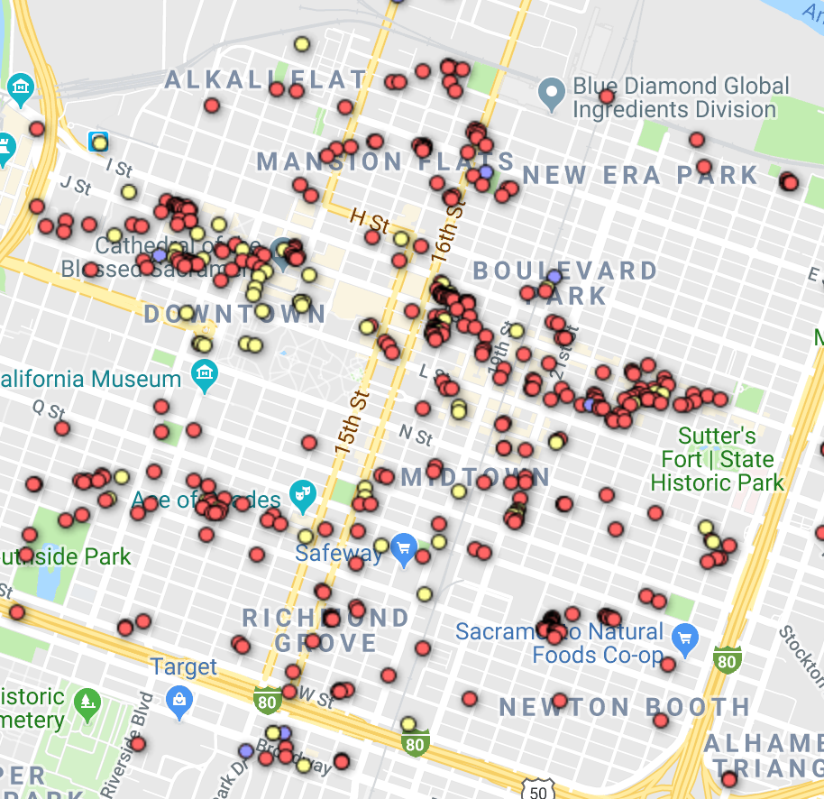
Map of Murals in Sacramento
https://findmasa.com/city/sacramento

Slide 16
Other ideas to explore
Read Books and listen to audiobooks on travel and different parts of the world
Try recipes from different locations, countries and cultures
Watch movies and documentaries that travel to different destinations.
Share stories with students and fellow attendees about travels and learn about others’ adventures.
Explore online travel sites, and see or learn about other places.
Take a Virtual Vacation at cyark.org or virtual vacations:
virtualvacation.us - Explore The World From Home

Slide 17
References
Tips to Stay Mentally Healthy While Traveling | NAMI: National Alliance on Mental Illness
https://www.aaa.com/tripcanvas/article/how-to-keep-your-mental-health-strong-while-traveling-CM772
https://www.globalsupport.harvard.edu/
https://travel.state.gov/en/international-travel.html

